Slide 1
nTIDE Lunch & Learn
Webinar Series
Kessler Foundation, AUCD,
University of New Hampshire Institute on Disability
Season 11, Episode 8
Date: August 7, 2026

Slide 2

nTIDE Lunch & Learn
Webinar Series
Kessler Foundation, AUCD,
University of New Hampshire Institute on Disability
Season 11, Episode 8
Date: August 7, 2026

Slide 3
Up Front Matters
This webinar is being recorded. We will post an archive of along side the Monthly nTIDE broadcast on our webinar, each month, on our website at www.ResearchOnDisability.org/nTIDE. This site will also provide copies of the presentations, the speakers’ bios, full transcripts, and other valuable resources.
As an attendee of this webinar, you are a viewer. To ask questions of the speakers, click on the Q & A box on your webinar screen and type your questions into the box. Speakers will review these questions and provide answers during the last section of the webinar. Some questions may be answered directly in the Q & A box.

Slide 4
Up Front Matters – Contact Info
If you have any questions following this recording, please contact us at Disability.Statistics@unh.edu, or toll free at 866-538-9521 for more information. Thanks for joining us. Enjoy today's webinar!

Slide 5
Welcome to the nTIDE Lunch & Learn
  Occurs at noon Eastern-time on the first Friday day of each month, with the release of the nTIDE Report.
  A joint effort of the University of New Hampshire, Kessler Foundation, and the Association of University Centers on Disabilities (AUCD).

Slide 6
Today’s Session: Reshaping Academia, Expanding Opportunity:
Disability Studies as a Pathway to Employment and Social Change
Part 1: nTIDE Report … “The Numbers”
  Andrew Houtenville, University of New Hampshire
  John O’Neill, Kessler Foundation
Part 2: nTIDE News
  Lillie Heigl, Association of University Centers on Disabilities (AUCD)
Part 3: Guest Speakers
  Javier Robles, Rutgers University – New Brunswick
  Jeff Friedman, Rutgers University – New Brunswick
  Part 4: Q&A

Slide 7
Part 1: The nTIDE Report
John O’Neill
Kessler Foundation

Slide 8
The Monthly nTIDE Report
The monthly nTIDE Report is a press release and infographic, looking at the latest employment statistics.
Uses data from the “jobs report” released by the U.S. Bureau of Labor Statistics, on the 1st Friday of each month.

Slide 9
Source of the Data
U.S. BLS, Current Population Survey (CPS).
  Source of the “official” unemployment rate.
Civilians, ages 16-64, not living in institutions.
Available September 2008 onward.
Not yet seasonally adjusted …
  Which is why the nTIDE Report also compares the same month last year.
  Since COVID, we started focusing on the month-to-month change.

Slide 10
The Numbers
Andrew Houtenville
University of New Hampshire

Slide 11
Employment- to-Population
Ratio:
Notes:
Blank page other than the title.

Slide 12
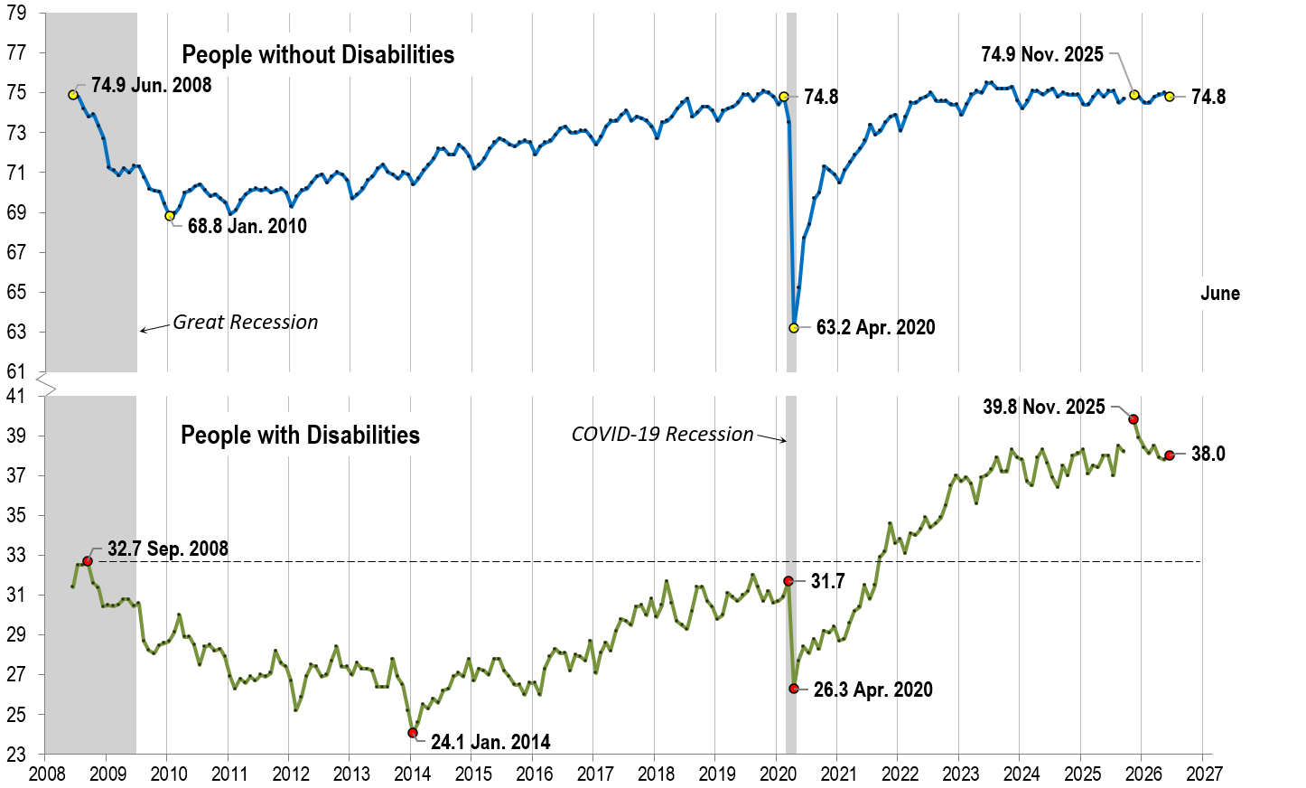
Employment- to-Population
Ratio:
June
Notes:
Chart Details:
The data series starts in June 2008 during the Great Recession which lasted until Mid-2009. The COVID-19 Recession started in April 2020 and last for two months.
Visible Data points (highlights start of the series, the lowest point pre-covid, the points right before and after the Covid-19 recession hit, and the current Employment-to-Population Ratio
People without Disabilities:
June 2008 74.9
January 2010 (lowest point pre-covid) 68.8
February 2020 74.8
April 2020 (Covid-19 Recession hits) 63.2 (lowest point)
November 2025 74.9
June 2026 74.8
People with Disabilities:
September 2008 32.7
January 2014 (lowest point pre-covid) 24.1 (lowest point)
March 2020 31.7
April 2020 (Covid-19 Recession hits) 26.3
November 2025 (all time high) 39.8
June 2026 38 .0

Slide 13

Employment- to-Population
Ratio:
July
Notes:
Chart Details:
This is the same trend line as before with the two trendlines extended one month
People without Disabilities go from:
June 2026 74.8
July 2026 75.0
People with Disabilities go from:
June 2026 38.0
July 2026 38.3

Slide 14
Labor Force
Participation
Rate:
Notes:
Blank page other than the title.

Slide 15
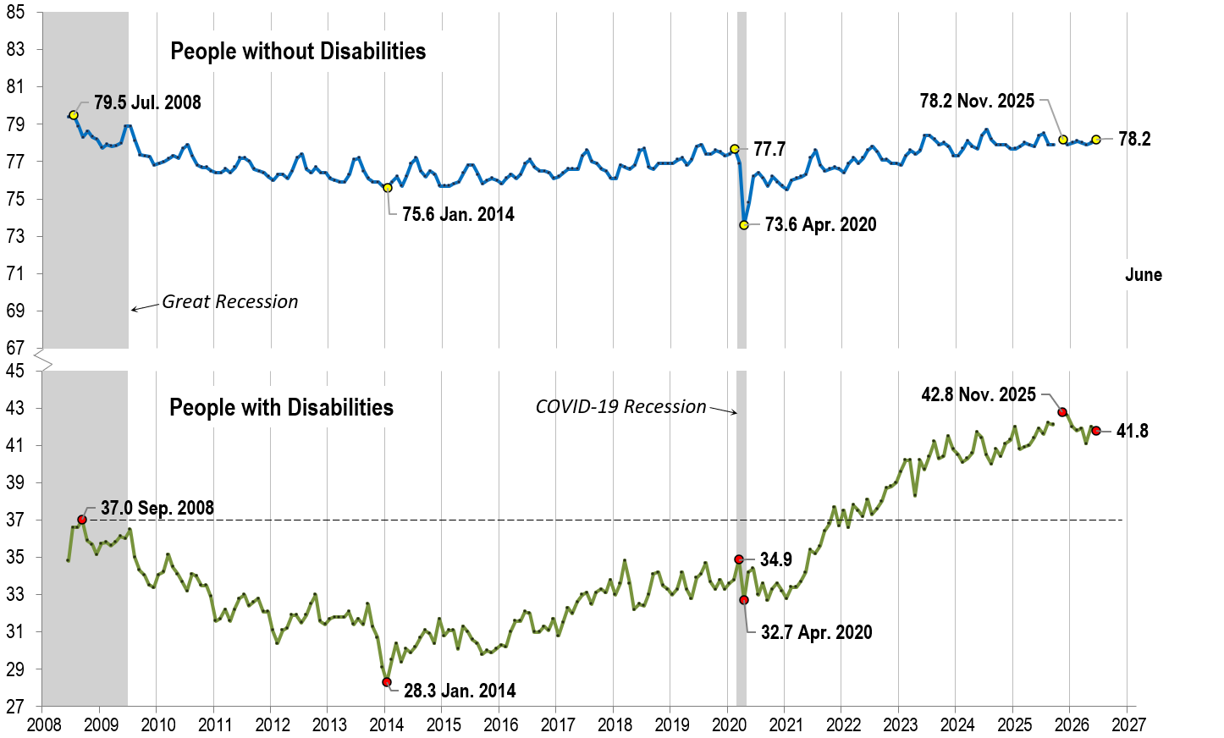
Labor Force
Participation
Rate:
June
Notes:
Chart Details:
The data series starts in June 2008 during the Great Recession which lasted until Mid-2009. The COVID-19 Recession started in April 2020 and last for two months.
Visible Data points (highlights start of the series, the lowest point pre-covid, the points right before and after the COVID-19 recession hit, and the current labor force participation rate.
People without Disabilities:
July 2008 79.5
January 2014 (lowest point pre-covid) 75.6
February 2020 77.7
April 2020 (Covid-19 Recession hits) 73.6 (lowest point)
November 2025 78.2
June 2026 78.2
People with Disabilities:
September 2008 37.0
January 2014 28.3 (lowest point)
March 2020 34.9
April 2020 (Covid-19 Recession hits) 32.7
November 2025 (all time high) 42.8
June 2026 41.8

Slide 16
Labor Force
Participation
Rate:
July
Notes:
Chart Details:
This is the same trend line as before with the two trendlines extended one month
People without Disabilities go from:
June 2026 78.2
July 2026 78.2
People with Disabilities go from:
June 2026 41.8
July 2026 42.4

Slide 17
Part 2 nTIDE News
Lillie Heigl
Association of University Centers on Disabilities (AUCD)

Slide 18
FY27 Appropriations
House passed "clean" Continuing Resolution (CR): The House approved a largely bare-bones CR to keep the government funded past September 30 with few additional provisions, leaving FY27 appropriations negotiations unfinished.
Senate advanced bipartisan CR through December 11: Senate Appropriations Chair Susan Collins and Vice Chair Patty Murray negotiated a bipartisan CR that would fund the government through December 11, includes targeted funding anomalies and extensions, and delay final FY27 appropriations until after the midterm elections.

Slide 19
FY27 Appropriations Cont.
Senate CR temporarily blocks OMB grant rule: Unlike the House bill, the Senate proposal includes language preventing the Administration from implementing its proposed OMB Uniform Guidance rule during the life of the CR. The proposed rule would give political appointees greater authority over federal grant awards; disability and higher education advocates have warned it could politicize grantmaking and affect research, education, and disability programs.
Appropriations work largely on hold: Senate appropriators have shifted their focus to passing the CR before the August recess, delaying anticipated action on individual FY27 appropriations bills until Congress returns in September.

Slide 20
Department of Education
Sec. McMahon Defended Ed-HHS Reorganization at OSEP’s national conference
HELP Committee markup on S.5046 which explicitly prohibits the Administration from transferring four ED offices, the Office of Indian Education, the Office of Special Education and Rehabilitative Services (OSERS), the Office of Elementary and Secondary Education (OESE), and the Office of Postsecondary Education (OPE), out of the U.S. Department of Education (ED)
Notes:
Secretary McMahon defends ED-HHS reorganization: At OSEP's national conference, Secretary Linda McMahon reaffirmed the Administration's commitment to IDEA while promoting the June interagency agreement transferring many OSERS functions to HHS, arguing it will improve coordination without changing students' legal rights. Opposition to the restructuring continues: Disability, civil rights, and education organizations—and some members of Congress—continue to argue that moving OSERS functions to HHS could create confusion, weaken accountability, and undermine IDEA implementation. Senate HELP Committee advances legislation to keep OSERS at ED: This month, the Senate HELP Committee approved bipartisan legislation that would require the Office of Special Education and Rehabilitative Services (OSERS), including the Rehabilitation Services Administration (RSA), to remain within the Department of Education. The bill now awaits consideration by the full Senate. OSEP outlines future priorities: Acting Assistant Secretary Kelly Rogers acknowledged ongoing challenges, including IDEA noncompliance, achievement gaps, and graduation disparities, while emphasizing a focus on modernizing oversight, improving data use, and sharing state-led best practices to improve outcomes for students with disabilities.

Slide 21
HeadStart
The Trump administration announced yesterday that it’s loosening rules for the roughly 1,600 Head Start programs throughout the country that get federal cash to provide free education, health and nutrition services to low-income children. By allowing more “flexibility,” administration officials say, the program will serve as many as 236,000 more kids and save $2.2 billion. But top Democrats are voicing big concerns.
Washington Sen. Patty Murray, the Senate’s top Democratic appropriator, warns that the Trump administration “wants to quietly gut Head Start by eliminating the basic health and safety standards our kids rely on” and allowing providers to “slam the door shut on any kid with a disability.”
Notes:
After months of speculation, today the Trump administration released a new proposed rule, “Reducing Federal Burdens for Head Start Programs.” If enacted, the rule would fundamentally transform the Head Start program by rescinding its entire regulatory foundation and replacing it with a dramatically scaled-back set of requirements. A 60-day public comment period should open tomorrow, meaning comments are due in early October.
The administration frames the proposed changes as reducing bureaucratic burden and expanding access. Critics will recognize it for what it is: a sweeping rollback of the federal standards that have defined Head Start’s quality and scope for decades.
Health Services
Head Start has long served as a critical health care touchpoint for children who have no other access to services. The proposed rule removes federal requirements for health screenings, dental exams, vision and hearing assessments, monthly mental health consultation, health determinations, and assistance navigating health insurance. The statutory requirement for screenings technically remains in the Head Start Act, but the specific timelines, processes, and accountability mechanisms that ensure they actually happen are gone. For many children enrolled in Head Start, these screenings are the only way developmental delays, vision problems, and other treatable conditions get identified early.

Slide 22
DOJ and Olmstead
  June: DOJ's Office of Legal Counsel issued an opinion arguing that Olmstead does not create a broad federal "integration mandate" requiring states to provide community-based services in many circumstances, signaling a much narrower interpretation of the ADA.
  July: DOJ announced it will no longer rely on its 2011 Olmstead guidance when enforcing Title II of the ADA and plans to revise the guidance in light of the Supreme Court's Loper Bright decision.
  Why it matters: Disability advocates warn these actions could weaken federal enforcement of community integration, potentially affecting access to the community-based supports that enable people with disabilities to live, work, and participate in their communities. Olmstead, the ADA, and Section 504 remain in effect.
Notes:
ustice Department Memo Raises Concerns About Community Integration
In June, the Department of Justice issued a memo that disability advocates believe could weaken federal support for community integration rights established under the ADA and the Supreme Court's Olmstead decision.
The memo says that states may not be legally required to provide certain community-based services that allow people with disabilities to live in their homes and communities rather than institutions. Disability organizations across the country have expressed concern that this position could undermine decades of progress toward community living and self-determination.
Update: In mid-July 2026, the United States Department of Justice (DOJ) published a notice about long-standing federal guidance on disability rights. Many states and courts have relied on this guidance for more than a decade, but the DOJ now says it is not enforceable.
The notice focuses on the DOJ’s 2011 Statement of the Department of Justice on Enforcement of the Integration Mandate of Title II of the Americans with Disabilities Act and Olmstead v. L.C. The statement was later updated and is commonly called the “Olmstead guidance.” The DOJ said it will no longer rely on this guidance when enforcing Title II of the Americans with Disabilities Act (ADA).
To be clear, the Olmstead decision itself has not been overturned. Neither the ADA nor Section 504 of the Rehabilitation Act has been repealed.
What has changed is narrower, but still significant. Guidance documents, by their nature, are not laws. Rather, they explain how an agency interprets and plans to enforce existing law.
DOJ’s new notice clarifies that its Olmstead guidance was always just that: nonbinding guidance, not a legal requirement. The department says it plans to revisit the guidance in light of the recent Loper Bright Supreme Court case and in the meantime will not use the guidance as a basis for enforcement action.
This follows an earlier, more sweeping move. In June 2026, DOJ’s Office of Legal Counsel issued an opinion arguing that Olmstead never established a broad “integration mandate” in the first place. It stated that current federal regulations requiring community-based services may go beyond what the law actually requires.

Slide 23
Community Transition Trainers: Living Independently With Disabilities
  Thursday, August 13, 2026, 1:00 PM - 2:00 PM ET
  The Community Transition Trainers (CTT) program by the Michigan Developmental Disabilities Institute offers free virtual presentations and workshops to help people with disabilities, families, and support agencies learn about independent living, housing options, and community participation
Notes:
Community Transition Trainers: Living Independently With Disabilities
Thursday, August 13, 2026, 1:00 PM - 2:00 PM ET
The Community Transition Trainers (CTT) program by the Michigan Developmental Disabilities Institute offers free virtual presentations and workshops to help people with disabilities, families, and support agencies learn about independent living, housing options, and community participation

Slide 24
CEDC Access for All: Building Digital and Document Accessibility Skills
  CEDC Access for All: Building Digital and Document Accessibility Skills – Social Media Accessibility: Creating Inclusive Online Content
  Thursday, August 20, 2026, 12:00 PM - 1:00 PM ET
    The CEDC's Access for All: Building Digital and Document Accessibility Skills series continues with the first session in a three-part series on Social Media Accessibility: Creating Inclusive Online Content. Participants will learn best practices for creating accessible social media posts and communications. The training will be led by Dr. Hillary Goldthwait-Fowles, ATP, an Instructional Design Specialist at Kennedy Krieger Institute. All are welcome to attend the full CEDC Quarterly Meeting or join for the training session.
Notes:
CEDC Access for All: Building Digital and Document Accessibility Skills – Social Media Accessibility: Creating Inclusive Online Content
Thursday, August 20, 2026, 12:00 PM - 1:00 PM ET
The CEDC's Access for All: Building Digital and Document Accessibility Skills series continues with the first session in a three-part series on Social Media Accessibility: Creating Inclusive Online Content. Participants will learn best practices for creating accessible social media posts and communications. The training will be led by Dr. Hillary Goldthwait-Fowles, ATP, an Instructional Design Specialist at Kennedy Krieger Institute. All are welcome to attend the full CEDC Quarterly Meeting or join for the training session.

Slide 25
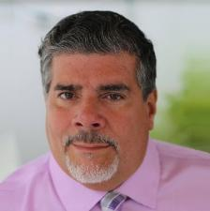
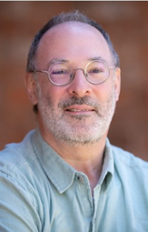
Part 3: Guest Speakers
Javier Robles, JD
Rutgers University-New Brunswick
Jeff Friedman, PhD
Rutgers University-New Brunswick

Slide 26
Rutgers University-New Brunswick
Disability-related
Academic Programs
A New Disability Studies Minor Program
and
The Mason Gross School of the Arts
Integrated Dance Collaboratory

Slide 27
Who we are:
Javier Robles JD is Assistant Teaching Professor / Special Populations at the Kinesiology and Health Department, School of Arts and Sciences (SAS-Rutgers University-New Brunswick)
Jeff Friedman PhD is Professor of Dance Studies at the Dance Department, Mason Gross School of the Arts (Rutgers University-New Brunswick)
We have been collaborating on a wide range of disability-related projects for the past 10 years

Slide 28
The Disability Studies Minor (2015-present)
Javier and I developed the Disability Studies Working Group in 2015 to explore the development of academic programs related to disability
  We encouraged the participation of multiple academics, staff, and students
  We developed a plan to:
    Research existing models
    Develop an academic curricular plan
    Implement the administrative work necessary to move the Disability Studies Minor through multiple channels of approval

Slide 29
Models for Disability Studies academic programs
Members of the Working Group researched a variety of models
  Three existing Disability Studies Minors already implemented in New Jersey
      William Paterson University, organized through a coalition of Departments of Special Education, Professional Counseling and Disability Studies
      Stockton University, organized through the School of General Studies
      Rutgers University-Newark was currently developing a Critical Disability Studies Minor at the same time
  We also interviewed the coordinator for the University of Delaware’s new Disability Studies Minor for information on:
    Feasibility for administering the new Minor
    Growth projections for student enrollment
    Challenges regarding counseling interested students

Slide 30
Analysis and Development of Curriculum
Friedman surveyed each academic program at Rutgers-New Brunswick for existing courses with disability content
  There were surprisingly many courses across a broad range of academic departments that included disability-related content
    We were concerned that some existing disability-related contents were linked to the Medical Model of Disability
Based on existing requirements, the Working Group analyzed various curricular models
  Rutgers-New Brunswick Minors ranged from 18-21 credits
  Some minor programs included:
    Coordinated Internships/Fieldwork opportunities
    A Capstone project

Slide 31
Curriculum Template development
The Working Group settled on six 3-credit course requirements, totaling 18 credits
  We decided to reserve the additional Capstone course for a forthcoming Disability Studies Major, currently in development
  We retained a Fieldwork course to ensure enrolled students came into contact with people with disabilities during their studies
The Working Group developed a set of required core courses, including:
  Introduction to Disability Studies (through Labor Studies)
  Disability Policy and Law (through Bloustein School of Planning and Public Policy)
  Field Experience for Special Populations (through Kinesiology and Health-SAS)
  Notably, all three courses are taught by instructors with lived experience of disability

Slide 32
Link to Rutgers-New Brunswick Disability Studies Minor web page
https://bloustein.rutgers.edu/undergraduate/disabilitystudies/

Slide 33
Curriculum Template development (cont’d.)
Enrolled students select from the 50 (and growing) existing elective courses available at Rutgers-New Brunswick
  Reciprocal transferability of elective courses between Rutgers-New Brunswick and Rutgers-Newark Disability Studies Minor coursework was approved
  Students majoring in subject areas could enroll in elective courses in their own major area, up to 3 elective courses required for completion of the Minor
    The list of elective courses reveals that selected academic departments, such as Psychology, among others, already had 3 elective courses available
      Alternatively, other Departments began developing new disability-related courses

Slide 34
Administrative approval process
Rutgers-New Brunswick operates under the Responsibility-Centered Management (RCM) system
  The RCM system devolves all tuition-related revenues to Centers
  The RCM system devolves many previously-held Central Administration expenses to the Centers
  The effect has challenged any future intra-Center collaborations, especially where interdisciplinary programs and instruction are involved
Since Disability Studies is innately interdisciplinary, this problematized the administrative approval process
  Luckily, Rutgers was re-evaluating RCM operations for such challenges

Slide 35
Administrative approval process (cont’d.)
The implementation of the Disability Studies Minor had:
  Strong support from Chancellor, Vice-Chancellor, and Deans-level administration
  A strong proposal, based on:
    Research on multiple models towards our stated preferences for the existing curriculum template
      NOTE: Minors are required for completion by SAS students who are the largest school enrollment at Rutgers-New Brunswick (23,000 total, out of approximately 60,000)
    A positive projection of student enrollment based on research, including interviews with existing external Disability Studies Minor administrators
    A strong list of ROI, including:
      Based on projected enrollments, projected tuitions would cover projected instructional costs
      Long list of potential future employment opportunities in multiple public and private sectors for graduates with and without disabilities

Slide 36
Approval achieved
The administrative approval was achieved in time for enrollment of students in the new Disability Studies Minor for Fall 2023
  The approved hosting school was a selection between offers from the School of Labor Studies and Bloustein School of Planning and Public Policy
  Bloustein School selected based on a strong proposal including:
    Strong existing disability-related content, including adaptive building and landscape design courses and courses in both Health Disparities and Public Policy majors
    Existing counseling staff willing to provide counseling on proposed enrollment and continued counseling on Minor completion
    Strong support and leadership from Dean Julia Sass Rubin

Slide 37
Current enrollment projections
Enrollment projections have been achieved
  Over the past three years, enrollment has increased:
    First-year in place (AY 24): 26 students
    Second-year in place (AY 25): 63 students
    Third-year in place (AY 26): 89 enrolled Disability Minor students
  Required course sections shifted from 1 annual section to 2
    A first group of 2 Minors graduated in AY 25
    An additional group of 2 Minors graduated in AY 26
    Up to 29 additional graduates anticipated in AY 27

Slide 38
Addenda #1: List of Working Group members
Bryan Adams
  Assistant Director, Office of Veteran and Military Programs and Services
Gary Altman, MS, CRC, HTR
  Associate Director, Horticulture Therapy Program, SEBS
Mason Ameri PhD
  Assistant Professor of Professional Practice/Director of Special Projects, Business School
Lyn Baier MA
  Associate Director for First Year Engagement and Director, First-year Interest Group Seminars, Career Exploration and Success
William Field PhD
  Associate Teaching Professor & Undergraduate Director, Political Science
Douglas Kruse PhD
  Distinguished Professor and Co-director of Program for Disability Research, Department of Human Resource Management
Kathy Loder Murphy
  Assistant Director, Disability Services
Sara Orsak, PhD/ABD
  Women’s, Gender and Sexuality Studies
Lisa Schur, JD/PhD
  Professor and Co-director of Program for Disability Research, Department of Labor Studies and Employment Relations
Jennifer Senick, PhD
  Associate Professor and Director of Development, Bloustein School; Executive Director, Rutgers Center for Green Building, Bloustein School
Andrea Spaeth PhD
  Assistant Professor and Undergraduate Director, Department of Kinesiology and Health, Division of Life Sciences, School of Arts and Sciences
Lorren Whitaker
  Coordinator, Disability Studies Services
Ellen Williams MS
  Associate Professor, Expressive Arts 4-H Agent, SEBS, Rutgers Cooperative Extension
Sonia Yaco MA
  Associate Director, Rutgers Special Collections
Gianna Glatz
  Aresty Fellow for the Disability Studies Working Group (2020-2021)

Slide 39
Addenda 2: Prospective Job opportunities
ADA Specialist
Architect/Landscape Architect
Audiologist
Behavior Analyst
Case Manager
Child Life Specialist
Classroom Paraprofessional
Community Health Worker
Community Services Coordinator
Computer Systems Analyst
Dance Artist/Educator
Drama Therapist
Dance/Movement Therapist
Disability Lawyer
Disability Specialist
Educational Counselor
Engineer
Epidemiologist
Expressive Art/Creative Arts Therapist
Graphic Designer
Group Home Counselor
Healthcare Coordinator Health Educator
Home Health Aide
Human Resource Generalist/Employment Specialist
Human Services Assistant
Interpreter/Translator/ASL specialist
Law enforcement
Learning Specialist
Medical Doctor
Mental Health Counselor
Music Artist/Educator
Music Therapist
Nurse
Occupational Therapist
Adaptive Optician
Adaptive Physical Therapist
Policy Analyst
Psychiatrist
Psychologist
Public Health Adviser
Recreation Therapist
Rehabilitation Counselor
Rehabilitation Specialist
Researcher
Residential Counselor
Residential Manager
Social Services Assistant
Social Worker
Sociologist
Adaptive Software Developer
Special Education Teacher
Speech Therapist
Theatre Artist/Educator
Vocational Counselor/Trainer

Slide 40
Mason Gross Integrated Dance Collaboratory
Friedman has been engaged with disability-related arts projects since 1988
  During the HIV-AIDS epidemic, Friedman developed an oral history program targeting San Francisco Bay Area arts communities highly-impacted by HIV-AIDS (a disabling condition qualified by the ADA in 1998)
  LEGACY Oral History Program (1988-2013) recorded 75 life histories of dance, music, and theater artists, educators, administrators, designers and technicians challenged by HIV-AIDS
    The program’s selection criteria changed over 25 years to include additional factors such as any risk for losing access to each individuals’ unique life experiences and expertise

Slide 41
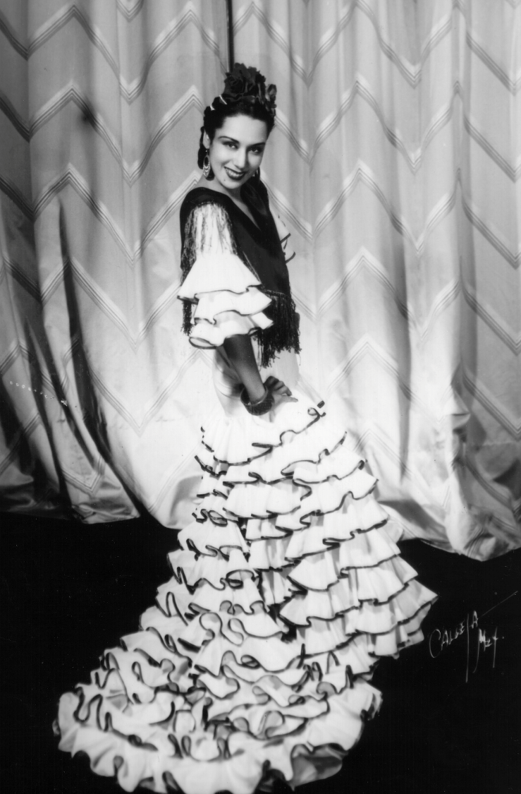
LEGACY Oral History Program samples
Dance artist and educator Malclovia Ruiz
  Trained with classical ballet choreographer George Balanchine, and performed as the dance avatar for an opera singer’s performance of the role of “Carmen” for the Metropolitan Opera
  Toured internationally with a flamenco dance company
  Performed for several films in the 1930s as a Spanish folkloric dance artist
  Malclovia qualified as an 84-year old elder in the Bay Area dance community

Slide 42
Rutgers-based Arts and Disability Programs
Friedman is the founder of the Rutgers Dance for Parkinson’s disease program in 2015
  The program serves anyone challenging Parkinson’s disease and other neurological conditions, such as TBI and Lewy Body syndrome, among others
  Instruction by Dr. Natalie Schultz-Kahwaty, a doctoral researcher in dance and neuroscience, certified in Dance for PD ™ through Mark Morris Dance Cen-ter in NYC
    Instruction offers a hybrid dance class that includes both in-person as well as online access
  The program has been funded by the Parkinson’s Foundation’s Community Grant program, as well as the New Jersey Health Foundation, among others

Slide 43
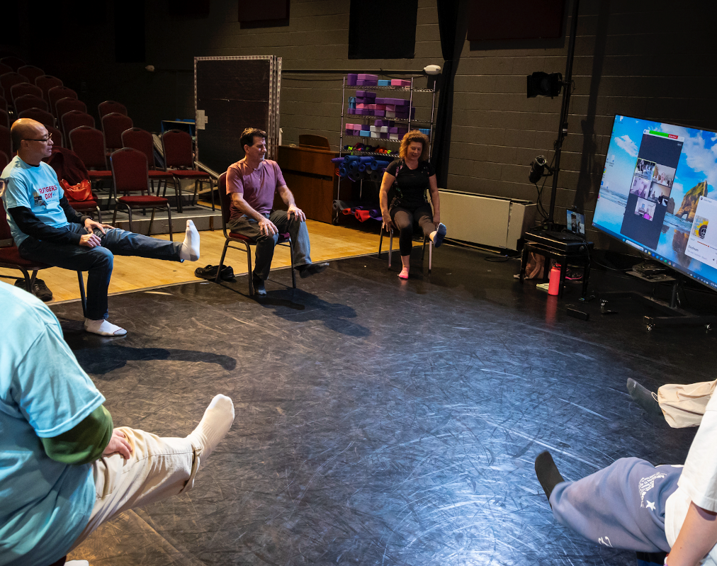
Dance for Parkinson’s disease program
(2015-present)
Hybrid instruction of Dance for Parkinson’s instruction
For Rutgers Day 2025, IDC offers a public Dance for Parkinson’s class
Use of chair-based move-ment supporting PwP with balance issues, providing sequences that improve brain plasticity

Slide 44
Integrated Dance Collaboratory (2021-present)
The Rutgers-New Brunswick Chancellor’s Special Initiatives Fund program supported a 3-year $280,000 grant to develop dance and disability-related programs through the new Integrated Dance Collaboratory
  Funds supported the following 5 programming areas
    Community dance classes for a variety of disabled populations, based on the Dance for Parkinson’s Program, also including dance for neurodivergent populations, and forthcoming “MOVING FOR LIFE” program for people with cancer, affiliated with Rutgers’ Cancer Institute
    Dance artists and scholars short-term residencies for Rutgers students’ enrichment
    CHOREO LAB, a 4-week free residency for disabled choreographers
    Academic course and program development on dance and disability
    Scientific research studies on dance and disability

Slide 45
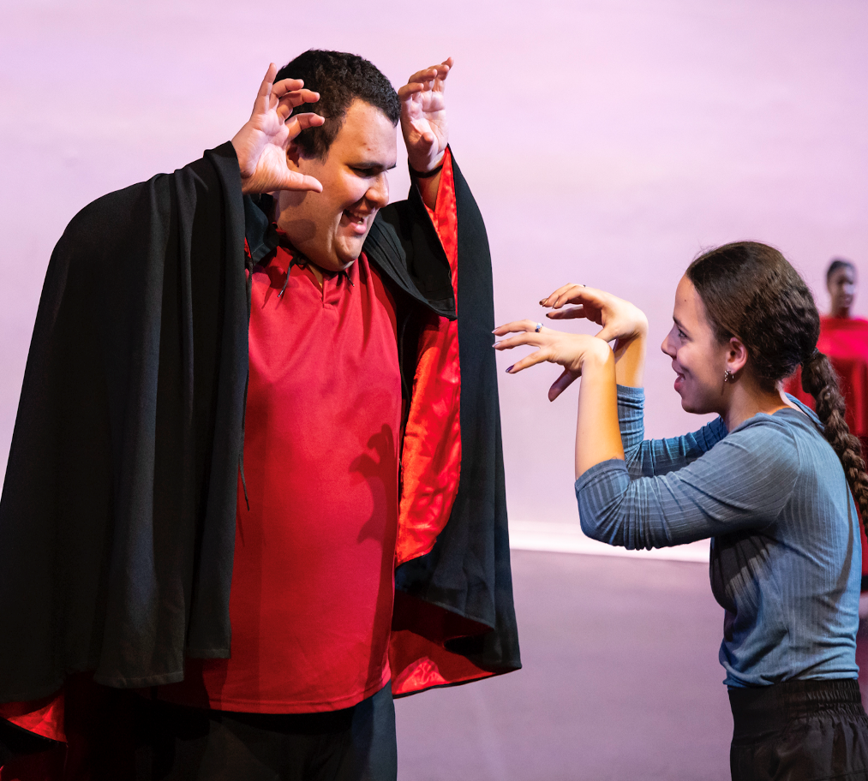
Community Dance for Neurodivergent populations
Dance classes for people who self-identify as neurodivergent, in partnership with Rutgers’ Center for Adult Autism Services
Separate classes are offered for verbal and non-verbal clients
Dance activities include training for:
  Improved body coordination
  Increased body-part to whole-body integration
  Cardio-vascular exercise
  Dyad and group collaboration

Slide 46

Short-term artist and scholar residencies
Dance artist Evan Ruggiero
  Single-lower limb amputation from sarcoma
  Used a peg-leg attachment for tap dance virtuoso performance
  Offers lecture-demonstrations for Rutgers University students in the Introduction to Dance Studies unit on dance and disa-bility
    Additional lecture-demon-stration for non-dance students and the general public at Douglass Library

Slide 47
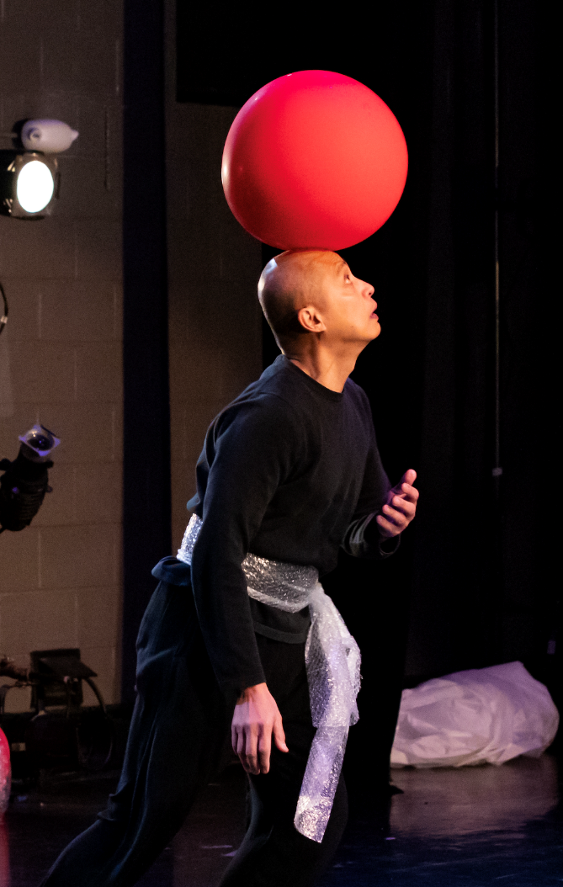
CHOREO LAB residencies for disabled choreographers
  Paul Ocampo, in AIR PLAY, by choreographer Pamela Quinn
    Quinn is a choreographer, self-identified with Parkinson’s disease
    Her new work AIR PLAY thematized the loss of lightness and grace from Parkin-son’s patients; she wanted to remediate that loss through her choreographic research supported by a CHOREO LAB residency in Winter 2024

Slide 48
Academic courses and program development
New academic courses include:
  Neuroscience in Partnership with Dance (3 credits)
  Adaptive Movement for Dance
  (3 credits)
  History and Theory of Integrated Dance (3 credits)
  Survey of Arts and Disability
  (3 credits)
    NOTE: All 4 courses qualify as elective dance courses that fulfill the new Disability Studies Minor
New non-credit professional development courses include:
  Pre-requisite Introduction to PreK-12 Dance Pedagogy and Education
  Able-ism and Able-ist Language for PreK-12 Dance Pedagogy and Education
  “CRIP” Time for PreK-12 Dance Pedagogy and Education
  How to Use the BrainDance for PreK-12 Dance Education
  Audio-description of Dance: Foundations and Creative Intervention

Slide 49
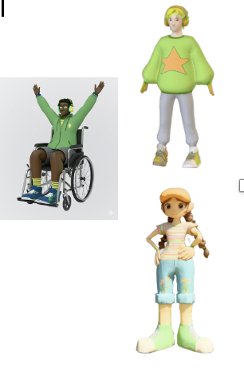
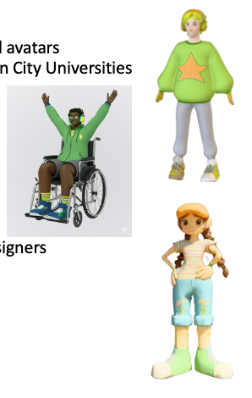
Scientific Study: A Dance-based Digital Game for Neurodivergent Populations
The dance-based digital game for neurodivergent populations involves a collaboration between Rutgers University and Dublin City University
2 Co-Principal Investigators
  Dr. Jeff Friedman, Dance/Rutgers University
  Dr. Marianna Pagkratidou, Psychology/DCU
4 Co-Investigators
  Dr. Natalie Schultz-Kahwaty, Dance/Rutgers
  Rick Anderson, Director of Rutgers University Continuing Education/Rutgers
  Aaron Vaders-Collins PhD/ABD, Music/Rutgers
  Dr. Orla Dunne, Director of the Center for Talented Youth/ DCU

Slide 50
Integrated Dance Collaboratory Funding
Chancellor’s Strategic Initiative Funds, Rutgers University-New Brunswick
GKV Family Foundation
New Jersey Health Foundation
Pinelands Alliance Foundation
Parkinson’s Foundation
Life Science Alliance, Rutgers-New Brunswick Office of Research
  “Gaitkeeping: An Innovative Telehealth Intervention for Improved Walking Gait for People with Parkinson’s”
  “A Dance-based Digital Game for Neurodivergent Populations”

Slide 51
Link to Mason Gross School of the Arts Integrated Dance Collaboratory
https://www.masongross.rutgers.edu/integrated-dance-collaboratory/

Slide 52
Link to IDC’s Community Dance Programs (scroll down for info…)
https://www.masongross.rutgers.edu/degrees-programs/dance/dance-in-the-community/

Slide 53
Contacting us:
Javier Robles, Assistant Teaching Professor / Special Populations
  Kinesiology and Health Department
  School of Arts and Sciences
  javier.robles@rutgers.edu
  Questions?
Jeff Friedman, Professor of Dance Studies
  Dance Department
  Mason Gross School of the Arts
  jfdance@rutgers.edu
  Thanks for your interest!

Slide 54

Thank You!
Information about the nTIDE partners may be found at
  Kessler Foundation (www.kesslerfoundation.org)
  UNH/Institute on Disability (www.ResearchOnDisability.org)
  AUCD (www.AUCD.org)
Contact us at
  Email: Disability.Statistics@unh.edu
  Call: 866-538-9521 (toll free)
  Twitter at #nTIDELearn

Slide 55
Bye!

Slide 56
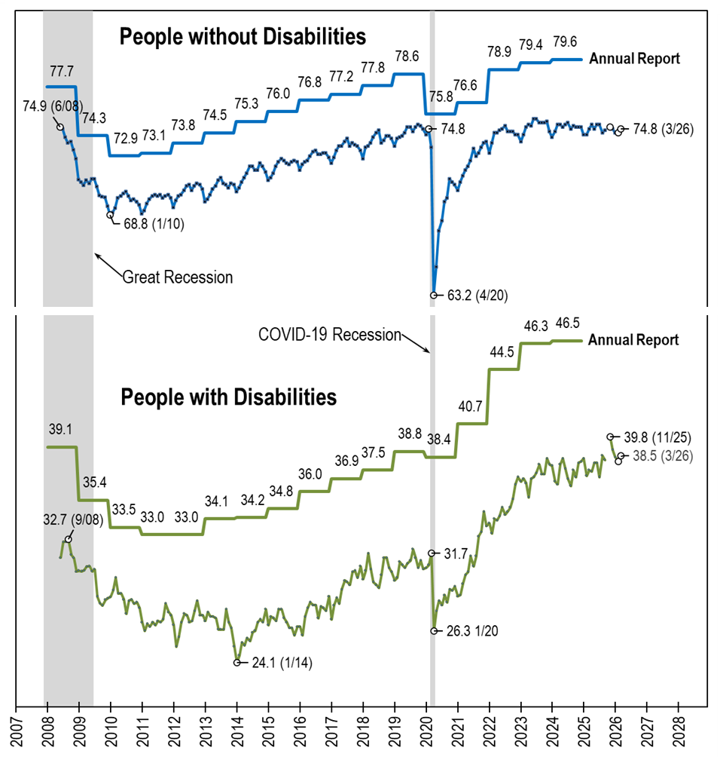
Employment- to-Population
Ratio:
Comparing: nTIDE (Ages 16-64)
AnnRpt (Ages 18-64)
Notes:
[Repeat of text from the photo’s alt text] A line chart with four lines, comparing the employment-to-population ratio trend lines from nTIDE, which uses CPS monthly data (June 2008-March 2026) and the Annual Report, which uses ACS annual data (2008-2024). Basically, the trend lines from the annual report (one for people with disabilities and one for people without disabilities) are overlayed on top of the standard trend lines from nTIDE. Overall, they follow the same pattern, which acts to verify the two data sources. The trend lines for from nTIDE are always lower than those of the Annual Report, in part because nTIDE includes 16 and 17 year olds, who are less likely to be employed.

