Slide 1
nTIDE Lunch & Learn
Webinar Series
Kessler Foundation, AUCD,
University of New Hampshire Institute on Disability
Season 11, Episode 6
Date: June 5, 2026

Slide 2

nTIDE Lunch & Learn
Webinar Series
Kessler Foundation, AUCD,
University of New Hampshire Institute on Disability
Season 11, Episode 6
Date: June 5, 2026

Slide 3
Up Front Matters
This webinar is being recorded. We will post an archive of along side the Monthly nTIDE broadcast on our webinar, each month, on our website at www.ResearchOnDisability.org/nTIDE. This site will also provide copies of the presentations, the speakers’ bios, full transcripts, and other valuable resources.
As an attendee of this webinar, you are a viewer. To ask questions of the speakers, click on the Q & A box on your webinar screen and type your questions into the box. Speakers will review these questions and provide answers during the last section of the webinar. Some questions may be answered directly in the Q & A box.

Slide 4
Up Front Matters – Contact Info
If you have any questions following this recording, please contact us at Disability.Statistics@unh.edu, or toll free at 866-538-9521 for more information. Thanks for joining us. Enjoy today's webinar!

Slide 5
Welcome to the nTIDE Lunch & Learn
  Occurs at noon Eastern-time on the first Friday day of each month, with the release of the nTIDE Report.
  A joint effort of the University of New Hampshire, Kessler Foundation, and the Association of University Centers on Disabilities (AUCD).

Slide 6
Today’s Session: Pathways to Work – Navigating Employment with Complex Life Challenges
Part 1: nTIDE Report … “The Numbers”
  Andrew Houtenville, University of New Hampshire (Stockton ’88)
Part 2: nTIDE News
  Shoshana Marin, Association of University Centers on Disabilities (AUCD)
Part 3: Guest Speakers
  Victoria Phillips, Mental Health Association in Atlantic County (NJ)
  Donald Campbell, Atlantic Center for Independent Living, Inc.
Part 4: Q&A

Slide 7

Part 1: The nTIDE Report

Slide 8
The Monthly nTIDE Report
The monthly nTIDE Report is a press release and infographic, looking at the latest employment statistics.
Uses data from the “jobs report” released by the U.S. Bureau of Labor Statistics, on the 1st Friday of each month.

Slide 9
Source of the Data
U.S. BLS, Current Population Survey (CPS).
  Source of the “official” unemployment rate.
Civilians, ages 16-64, not living in institutions.
Available September 2008 onward.
Not yet seasonally adjusted …
  Which is why the nTIDE Report also compares the same month last year.
  Since COVID, we started focusing on the month-to-month change.

Slide 10
The Numbers
Andrew Houtenville
University of New Hampshire

Slide 11
Employment- to-Population
Ratio:
Notes:
Blank page other than the title.

Slide 12
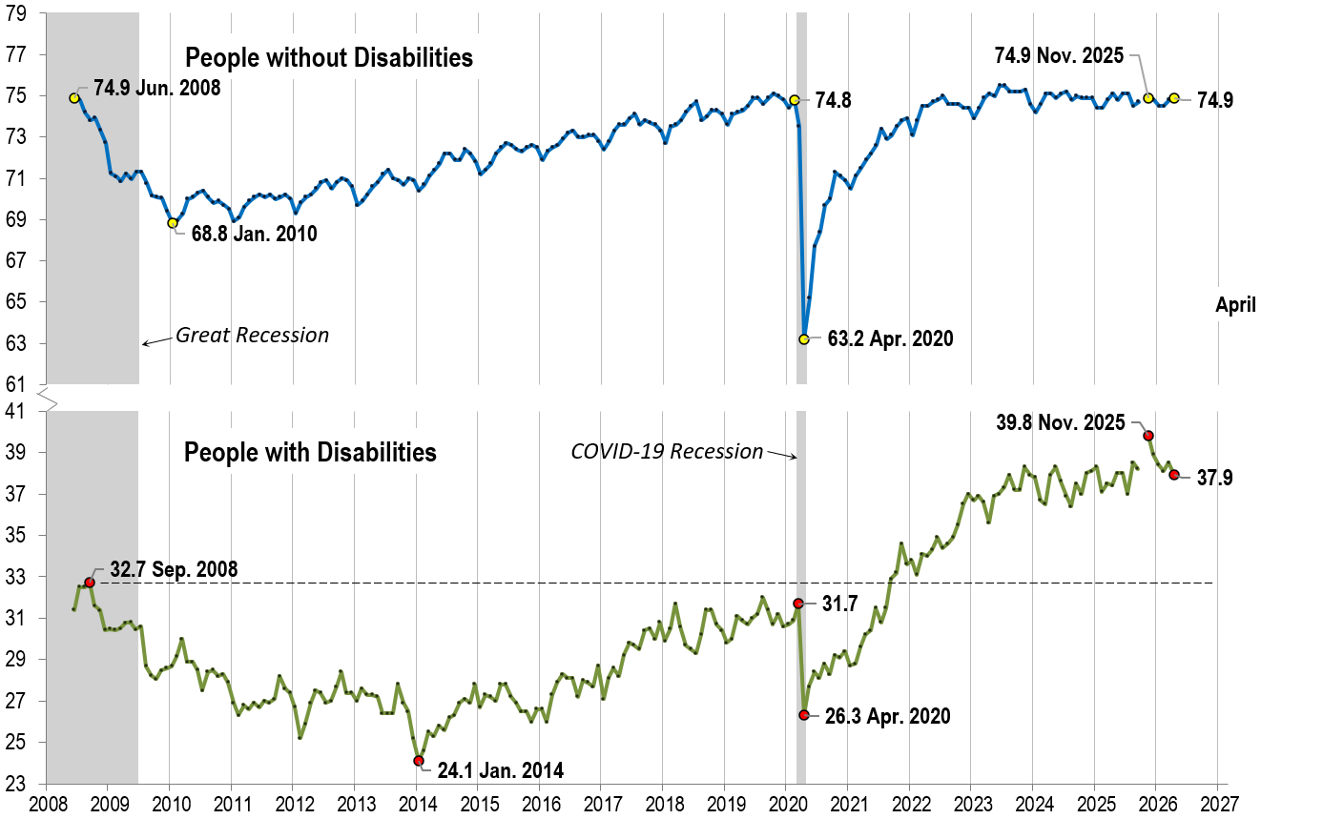
Employment- to-Population
Ratio:
April
Notes:
Chart Details:
The data series starts in June 2008 during the Great Recession which lasted until Mid-2009. The COVID-19 Recession started in April 2020 and last for two months.
Visible Data points (highlights start of the series, the lowest point pre-covid, the points right before and after the Covid-19 recession hit, and the current Employment-to-Population Ratio
People without Disabilities:
June 2008 74.9
January 2010 (lowest point pre-covid) 68.8
February 2020 74.8
April 2020 (Covid-19 Recession hits) 63.2 (lowest point)
November 2025 74.9
April 2026 74.9
People with Disabilities:
September 2008 32.7
January 2014 (lowest point pre-covid) 24.1 (lowest point)
March 2020 31.7
April 2020 (Covid-19 Recession hits) 26.3
November 2025 39.8
April 2026 37.9

Slide 13

Employment- to-Population
Ratio:
May
Notes:
Chart Details:
This is the same trend line as before with the two trendlines extended one month
People without Disabilities go from:
April 2026 74.9
May 2026 75.0
People with Disabilities go from:
April 2026 37.9
May 2026 37.8

Slide 14
Labor Force
Participation
Rate:
Notes:
Blank page other than the title.

Slide 15
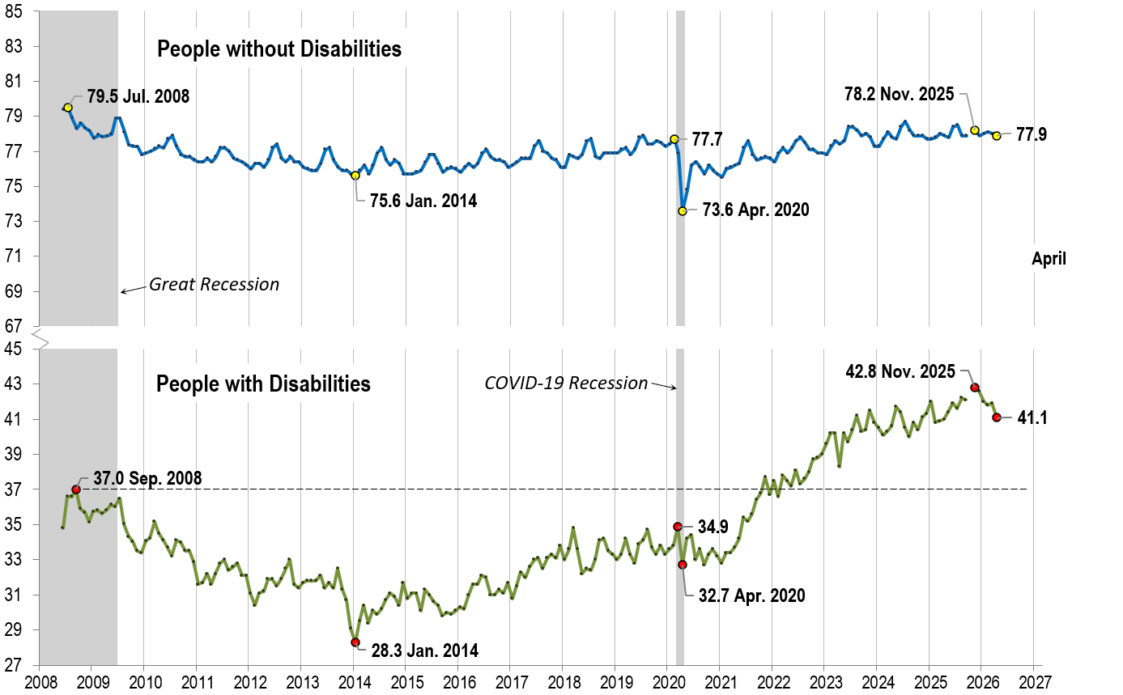
Labor Force
Participation
Rate:
April
Notes:
Chart Details:
The data series starts in June 2008 during the Great Recession which lasted until Mid-2009. The COVID-19 Recession started in April 2020 and last for two months.
Visible Data points (highlights start of the series, the lowest point pre-covid, the points right before and after the COVID-19 recession hit, and the current labor force participation rate.
People without Disabilities:
July 2008 79.5
January 2014 (lowest point pre-covid) 75.6
February 2020 77.7
April 2020 (Covid-19 Recession hits) 73.6 (lowest point)
November 2025 78.2
April 2026 77.9
People with Disabilities:
September 2008 37.0
January 2014 28.3 (lowest point)
March 2020 34.9
April 2020 (Covid-19 Recession hits) 32.7
November 2025 42.8
April 2026 41.1

Slide 16

Labor Force
Participation
Rate:
May
Notes:
Chart Details:
This is the same trend line as before with the two trendlines extended one month
People without Disabilities go from:
April 2026 77.9
May 2026 78.0
People with Disabilities go from:
April 2026 41.1
May 2026 42.0

Slide 17
Part 2 nTIDE News
Shoshana Marin
Association of University Centers on Disabilities (AUCD)

Slide 18
Medicaid Work Requirements
June 1, 2026, the Centers for Medicare and Medicaid Services (CMS) issued an Interim Final Rule (IFR) on Wednesday, June 3rd, regarding new Medicaid community engagement and work requirements. The IFR provides guidance to states on implementing the Medicaid community engagement requirements enacted last July as part of the sweeping changes and cuts to Medicaid in H.R. 1, the 2025 budget reconciliation bill.
Under these provisions, all 41 states that expanded Medicaid under the Affordable Care Act (ACA) will be required to implement work requirements for Medicaid recipients beginning January 1, 2027. The Medicaid work and community engagement requirements will apply everywhere except Alabama, Florida, Georgia, Kansas, Mississippi, South Carolina, Tennessee, Texas, Wisconsin, and Wyoming.
Notes:
Under the rule, affected Medicaid applicants and enrollees (referred to as “applicable individuals”) will be required to demonstrate 80 hours per month of qualifying activities, such as employment, participation in certain work programs, or community service, or be enrolled in educational program at least half time. Individuals may combine activities to meet the 80-hour requirement. or meet it by earning at least 80 times the Federal hourly minimum wage ($580 per month in 2026); for seasonal workers, there is a different calculation. Certain new Medicaid applicants will need to meet the requirement for at least one month before the month in which the applicant applies, and existing Medicaid beneficiaries will need to meet the requirement for one or more months between renewals.
https://www.cms.gov/newsroom/fact-sheets/medicaid-community-engagement-requirement-certain-individuals-interim-final-rule-comment-period-cms

Slide 19
OMB Grant Review Proposed Rule
OMB released a 400-plus page rewrite on Friday of the Uniform Administrative Requirements, Cost Principles, and Audit Requirements for Federal Awards that implements many of the changes President Donald Trump outlined in his August executive order, Improving Oversight of Federal Grantmaking. It also addresses areas that weren’t necessarily called out in the EO.
The proposed rules would set up a process for political review of grants, possibly helping insulate cancellations from legal challenges that stymied the administration in the past. Among many other changes, the rules direct “senior appointees” at federal agencies to take charge of awarding and terminating new and existing research grants and other federal awards—a change that reflects an August executive order.

Slide 20
FY27 Appropriations
House LHHS Subcommittee Markup on 6/5
Full Committee Markup 6/11
The House Appropriations Committee released the Fiscal Year 2027 Labor, Health and Human Services, Education, and Related Agencies bill, which funds a majority of disability programs. The bill proposes a four percent cut to the Department of Health and Human Services (HHS) and a 10 percent cut to the Department of Education.
Notes:
Annual appropriations process that funds federal agencies and underlying programs

Slide 21
Service Animal Limitations from HUD
  The U.S. Department of Housing and Urban Development is sharply limiting which types of animals people with disabilities who are renting a home can claim as a “reasonable accommodation.”
  New guidance indicates that the federal housing agency will only consider “animals trained to provide disability-related assistance” as an accommodation for people with disabilities under the Fair Housing Act.
  Previously, animals that provided emotional support qualified even if they didn’t have any specialized training. As a result, landlords generally could not charge a pet fee or deny housing to an individual with an emotional support animal.
Notes:
The directive to HUD’s Office of Fair Housing and Equal Opportunity staff late last month does not change existing law, but does influence enforcement by curtailing what types of Fair Housing Act complaints the agency will take up. It replaces guidance that was issued in 2020.
Per the new guidance, HUD will more closely align its standard for determining which animals qualify as reasonable accommodations with the Americans with Disabilities Act. One notable difference, however, is that the housing agency will recognize any species with proper training while the ADA definition is limited to dogs and miniature horses.

Slide 22
Texas v. Kennedy- Update
  On January 25, 2026, nine states – Alaska, Florida, Indiana, Kansas, Louisiana, Missouri, Montana, South Dakota, and Texas – renewed their attack on Section 504 and the right to live in the community. On May 1, 2026, Indiana dropped out of the Texas v. Becerra case, demonstrating the power of the disability community. On May 12, 2026, South Dakota dropped out of the case, too.
Notes:
Frame this as an update over may to this ongoing court case and refresh people on what the case was
Background/refresher info:
Texas v. Kennedy (previously Texas v. Becerra) is a court case in Texas that was filed in Texas in September 2024. A group of 17 states sued the United States government. The 17 states were Texas, Alaska, Alabama, Arkansas, Florida, Georgia, Indiana, Iowa, Kansas, Louisiana, Missouri, Montana, Nebraska, South Carolina, South Dakota, Utah, and West Virginia.
The complaint asked the court to get rid of Section 504 and its updated rules from 2024 that protect people with disabilities from discrimination in health care and human services. The case changed over time, in part due to the 2024 election and subsequent steps by the Trump Administration, and in part due to the advocacy of the disability community.

Slide 23


Part 3: Guest Speakers
Victoria Phillips
Executive Director
Mental Health Association in Atlantic County
Donald Campbell
Executive Director
Atlantic Center for Independent Living, Inc.

Slide 24






Pathways To Work:
Navigating Employment With Complex Life Challenges
Exploring community support for inclusion and workforce participation
Notes:
---

Slide 25

The People We Serve
Notes:
Why Disability, Mental Health, and Employment Must Be Addressed Together, Understanding the Complex Needs of the People We Serve, Hands-On Employment Support at the Mental Health Association, Independent Living and Employment Support Through CIL, Benefits Counseling and System Navigation as Employment Enablers, Virtual Supports, Service Gaps, and Community Innovation, Strengthening Partnerships for Sustainable Employment Outcomes

Slide 26


Why Disability, Mental Health, and Employment Must Be Addressed Together
Interconnected Challenges
Lived Experience Integration
Structured Employment Pathways
  Sustaining Employment
Notes:
This presentation is grounded in a community-level view of how disability, mental health, and employment intersect in the lives of individuals in Atlantic County. From the perspective of both the Atlantic Center for Independent Living and the Mental Health Association in Atlantic County, employment is not a standalone outcome. It is shaped by access to supports, the stability of mental health, the presence or absence of accommodations, and an individual’s confidence navigating complex systems. Too often, employment initiatives are designed in isolation, without recognizing how disability-related needs, behavioral health conditions, and long periods of service disconnection affect readiness for work.
Our organizations bring decades of experience supporting individuals with lived experience of disability and mental health conditions. Beginning in the mid-1990s, we were part of New Jersey’s early efforts to integrate people with lived mental health experience into the public behavioral health workforce. What began as a controversial idea has since evolved into a formalized, credentialed peer workforce recognized statewide. That evolution reflects a broader truth: when systems are designed with lived experience at the center, outcomes improve.
Today, this work continues through structured employment pathways such as the Certified Recovery Support Practitioner (CRSP) credential, which creates meaningful employment opportunities for individuals with lived mental health or co-occurring conditions. These pathways are not simply jobs; they represent stability, professional identity, and a way to transform lived experience into expertise. By framing employment within a larger ecosystem of support, this presentation sets the stage for understanding why integrated approaches are essential. The goal is not only to help people obtain jobs, but to help them sustain employment, protect benefits, advocate for accommodations, and build long-term independence. This purpose guides every slide that follows and reflects a shared commitment to stronger outcomes for individuals and for the broader community.

Slide 27
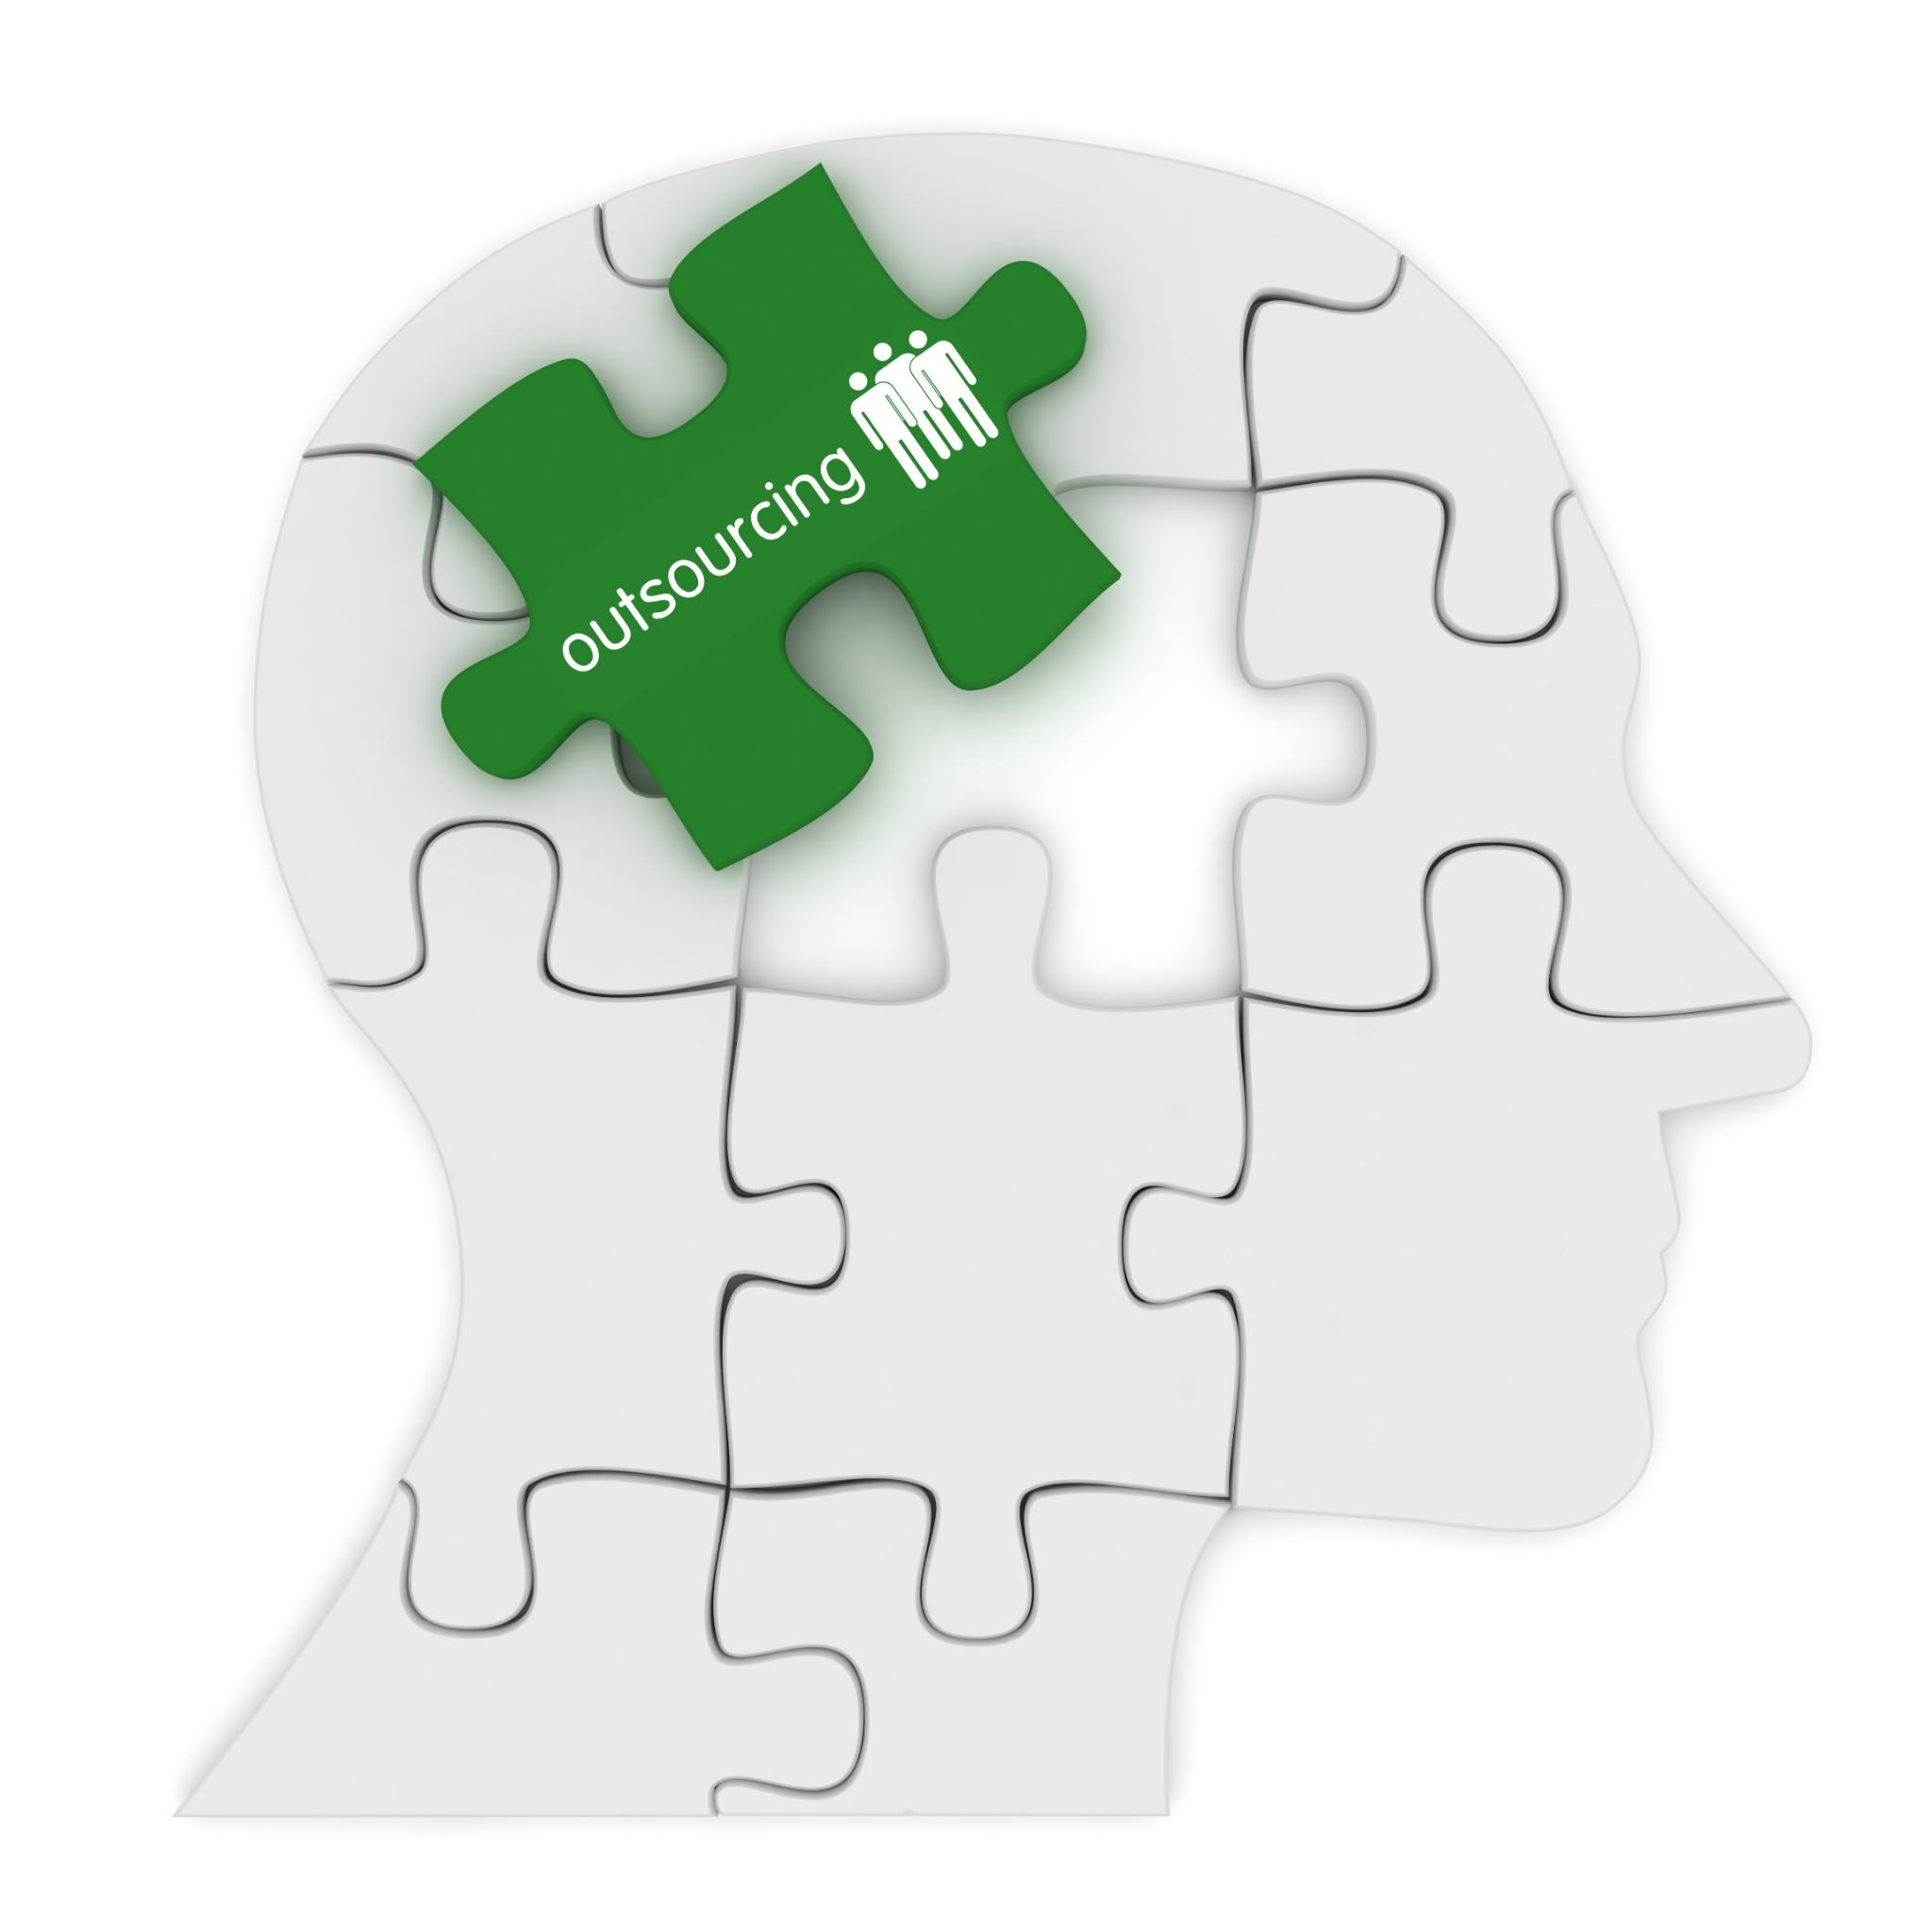
Hands-On Employment Support at the Mental Health Association
Personalized Career Exploration
Training and Credentialing Pathways
Hands-On Practical Support
Empowering Lived Experience
Notes:
At the Mental Health Association, employment support begins with a simple but often overlooked step: asking individuals what they want. Many people have not been invited to articulate career goals in years, particularly if they have cycled through crisis-driven systems. MHA staff start by identifying strengths, interests, and lived experience, recognizing that motivation grows when goals feel personally meaningful.
From there, individuals are introduced to concrete training and credentialing pathways. One of the most significant options in New Jersey is the Certified Recovery Support Practitioner credential. To earn the CRSP, individuals must identify as having lived experience with mental health or co-occurring conditions, complete a state-approved 84-hour core training program, participate in a Wellness Recovery Action Plan seminar, and accumulate 500 hours of supervised peer support experience. This structure provides clarity, legitimacy, and a clear professional identity.
For individuals with substance use or co-occurring recovery experience, MHA also discusses the Certified Peer Recovery Specialist credential. Many people pursue dual credentials, increasing their employability across behavioral health settings. These pathways demonstrate that lived experience can translate into sustainable, respected employment.
However, training alone is not enough. MHA’s approach is intentionally hands-on and relational. Staff help individuals address practical barriers such as transportation, documentation, scheduling conflicts, and anxiety about returning to work. This step-by-step support builds confidence and reduces the likelihood of disengagement. When individuals feel supported and seen, they are far more likely to persist through challenges and move forward on their employment journey.

Slide 28

Independent Living and Employment Support Through CIL
Building Foundational Skills
Navigating Vocational Rehabilitation
Workplace Accommodations and Advocacy
Strengthening Employment Outcomes
Notes:
Centers for Independent Living approach employment as one component of a broader goal: autonomy and self-determination. At the Atlantic Center for Independent Living, staff work with individuals to build the foundational skills that make employment sustainable over time. These include budgeting, time management, communication, and daily living routines that support consistency in the workplace.
CIL also plays a critical role in helping individuals navigate vocational rehabilitation systems. These systems can be complex and intimidating, particularly for people who have had negative experiences with bureaucracy in the past. Staff help translate processes, clarify expectations, and advocate when systems become barriers rather than supports. This guidance helps individuals prepare for job transitions and reduces the likelihood of disengagement.
Workplace accommodations are another key focus. Many individuals are unaware of their rights under disability law or unsure how to request accommodations without fear of stigma. CIL provides education and coaching on self-advocacy, helping individuals articulate their needs clearly and confidently. At the same time, CIL works with employers to promote inclusive practices that benefit both employees and organizations.
When combined with structured workforce pathways such as peer certification programs, the independent living model strengthens employment outcomes. Individuals are not only placed into jobs but are equipped with the skills and confidence needed to maintain employment, adapt to change, and make informed choices about their futures.

Slide 29

Benefits Counseling and System Navigation as Employment Enablers
Barrier of Benefit Loss Fear
Importance of Accurate Counseling
Need for Consistent Messaging
Empowerment Through Clarity
Notes:
Fear of losing public benefits is one of the most significant barriers to employment for people with disabilities and mental health conditions. Many individuals rely on SSI or SSDI as their primary source of income and fear that even attempting to work could jeopardize their financial stability. This fear is often fueled by misinformation, inconsistent guidance, and past experiences of sudden benefit disruptions.
Accurate benefits counseling is therefore essential. When individuals understand work incentives, income thresholds, and protections, they are better able to make informed decisions about employment. This is particularly important for those entering structured employment pathways such as CRSP or CPRS roles, where earnings may increase gradually over time.
Both MHA and CIL emphasize the importance of consistent messaging across systems. When behavioral health providers, vocational rehabilitation counselors, and independent living staff offer conflicting information, individuals lose trust and may abandon employment efforts altogether. Cross-agency coordination helps create a sense of safety and predictability.
Effective benefits counseling reframes employment as a calculated, manageable step rather than a risky leap. By reducing uncertainty and clarifying options, individuals are empowered to pursue work that aligns with their goals while protecting essential supports. This clarity often makes the difference between stagnation and progress on the path to employment.

Slide 30

Virtual Supports, Service Gaps, and Community Innovation
Virtual Engagement and Accessibility
Expanded Workforce Development
Filling Service Gaps
Community-Based Innovation
Notes:
The COVID-19 pandemic highlighted both the gaps in traditional service delivery and the potential of virtual support. Many individuals served by MHA and CIL face transportation barriers, health vulnerabilities, or anxiety that make in-person participation difficult. Virtual groups and meetings have proven to be powerful tools for maintaining engagement and continuity.
Virtual formats have also expanded access to workforce development activities, including peer training and certification preparation. Individuals working toward credentials such as CRSP can remain connected to learning and peer support even when in-person attendance is not feasible. This flexibility reduces dropout rates and supports sustained progress.
Beyond virtual services, both organizations frequently fill gaps left by larger systems. This may include assistance with paperwork, connections to housing resources, or simply providing a consistent, judgment-free point of contact. These seemingly small supports often stabilize individuals enough to allow them to focus on employment goals.
Community-based innovation thrives when organizations are willing to adapt to real needs rather than rigid program models. By meeting people where they are, both physically and emotionally, MHA and CIL create conditions in which employment becomes possible rather than overwhelming. These adaptive supports are a critical complement to formal workforce systems.

Slide 31

Strengthening Partnerships for Sustainable Employment Outcomes
Collaborative Agency Approach
Leveraging Combined Strengths
Enhanced Accountability
Inclusive Employment Outcomes
Notes:
Sustainable employment outcomes are strongest when agencies work together rather than in silos. Collaboration between mental health providers, independent living centers, vocational rehabilitation, and benefits counselors creates a more coherent experience for individuals navigating complex systems. Shared goals and aligned messaging reduce confusion and build trust.
Integrated approaches also allow organizations to leverage each other’s strengths. Peer certification pathways such as CRSP and CPRS are most effective when supported by independent living skills, accurate benefits counseling, and responsive behavioral health care. No single agency can provide all of these elements alone.
Partnerships improve accountability as well. When agencies share responsibility for outcomes, there is greater incentive to address barriers proactively rather than shifting blame. This collective approach benefits individuals, employers, and the broader community.
The central message of this presentation is simple: disability employment and mental health support cannot be separated. When they are integrated, people are more likely to thrive in the workplace and beyond. Investing in collaborative, lived-experience-informed systems strengthens not only individual outcomes but the resilience and inclusivity of the entire community.

Slide 32
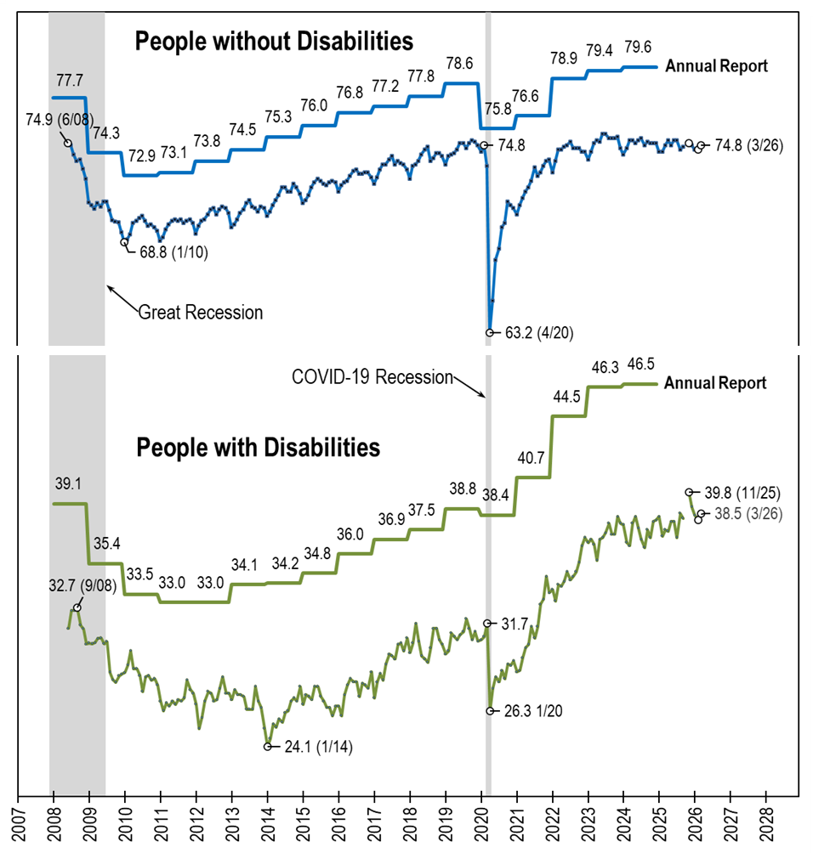
Employment- to-Population
Ratio:
Comparing: nTIDE (Ages 16-64)
AnnRpt (Ages 18-64)
Notes:
[Repeat of text from the photo’s alt text] A line chart with four lines, comparing the employment-to-population ratio trend lines from nTIDE, which uses CPS monthly data (June 2008-March 2026) and the Annual Report, which uses ACS annual data (2008-2024). Basically, the trend lines from the annual report (one for people with disabilities and one for people without disabilities) are overlayed on top of the standard trend lines from nTIDE. Overall, they follow the same pattern, which acts to verify the two data sources. The trend lines for from nTIDE are always lower than those of the Annual Report, in part because nTIDE includes 16 and 17 year olds, who are less likely to be employed.

Slide 33

Thank You!
Information about the nTIDE partners may be found at
  Kessler Foundation (www.kesslerfoundation.org)
  UNH/Institute on Disability (www.ResearchOnDisability.org)
  AUCD (www.AUCD.org)
Contact us at
  Email: Disability.Statistics@unh.edu
  Call: 866-538-9521 (toll free)
  Twitter at #nTIDELearn

Slide 34
Bye!

