Slide 1
nTIDE Lunch & Learn Webinar Series
Kessler Foundation, AUCD, University of New Hampshire Institute on Disability Season 11, Episode 5 Date: May 8, 2026

Slide 2

nTIDE Lunch & Learn Webinar Series
Kessler Foundation, AUCD, University of New Hampshire Institute on Disability Season 11, Episode 5 Date: May 8, 2026

Slide 3
Up Front Matters
This webinar is being recorded. We will post an archive of along side the Monthly nTIDE broadcast on our webinar, each month, on our website at www.ResearchOnDisability.org/nTIDE. This site will also provide copies of the presentations, the speakers’ bios, full transcripts, and other valuable resources.
As an attendee of this webinar, you are a viewer. To ask questions of the speakers, click on the Q & A box on your webinar screen and type your questions into the box. Speakers will review these questions and provide answers during the last section of the webinar. Some questions may be answered directly in the Q & A box.

Slide 4
Up Front Matters – Contact Info
If you have any questions following this recording, please contact us at Disability.Statistics@unh.edu, or toll free at 866-538-9521 for more information. Thanks for joining us. Enjoy today's webinar!

Slide 5
Welcome to the nTIDE Lunch & Learn
Occurs at noon Eastern-time on the first Friday day of each month, with the release of the nTIDE Report.
A joint effort of the University of New Hampshire, Kessler Foundation, and the Association of University Centers on Disabilities (AUCD).

Slide 6
Today’s Session: Disability Employment Beyond Traditional Workforce Models
Part 1: nTIDE Report … “The Numbers”
Andrew Houtenville, University of New Hampshire
John O’Neill, Kessler Foundation
Part 2: nTIDE News
Lillie Heigl, Association of University Centers on Disabilities (AUCD)
Part 3: Guest Speaker
Kimberly Knackstedt, Unlock Access, LLC
Part 4: Q&A

Slide 7
Part 1: The nTIDE Report
John O’Neill
Kessler Foundation

Slide 8
The Monthly nTIDE Report
The monthly nTIDE Report is a press release and infographic, looking at the latest employment statistics.
Uses data from the “jobs report” released by the U.S. Bureau of Labor Statistics, on the 1st Friday of each month.

Slide 9
Source of the Data
U.S. BLS, Current Population Survey (CPS).
Source of the “official” unemployment rate.
Civilians, ages 16-64, not living in institutions.
Available September 2008 onward.
Not yet seasonally adjusted …
Which is why the nTIDE Report also compares the same month last year.
Since COVID, we started focusing on the month-to-month change.

Slide 10
The Numbers
Andrew Houtenville University of New Hampshire

Slide 11
Employment- to-Population Ratio:
Notes:
Blank page other than the title.

Slide 12
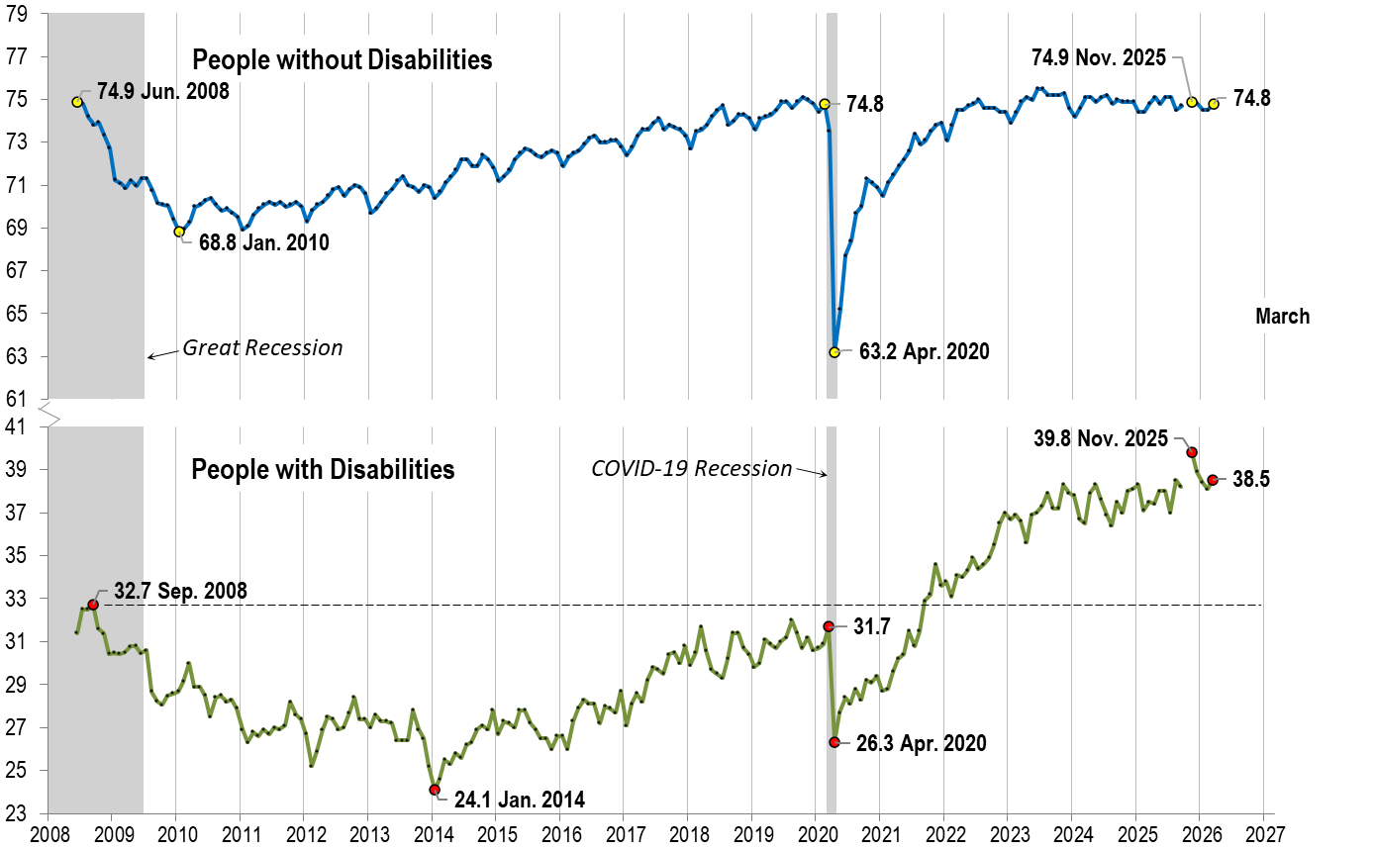
Employment- to-Population Ratio: March
Notes:
Chart Details:
The data series starts in June 2008 during the Great Recession which lasted until Mid-2009. The COVID-19 Recession started in April 2020 and last for two months.
Visible Data points (highlights start of the series, the lowest point pre-covid, the points right before and after the Covid-19 recession hit, and the current Employment-to-Population Ratio
People without Disabilities:
June 2008 74.9
January 2010 (lowest point pre-covid) 68.8
February 2020 74.8
April 2020 (Covid-19 Recession hits) 63.2 (lowest point)
November 2025 74.9
March 2026 74.8
People with Disabilities:
September 2008 32.7
January 2014 (lowest point pre-covid) 24.1 (lowest point)
March 2020 31.7
April 2020 (Covid-19 Recession hits) 26.3
November 2025 39.8
March 2026 38.5

Slide 13
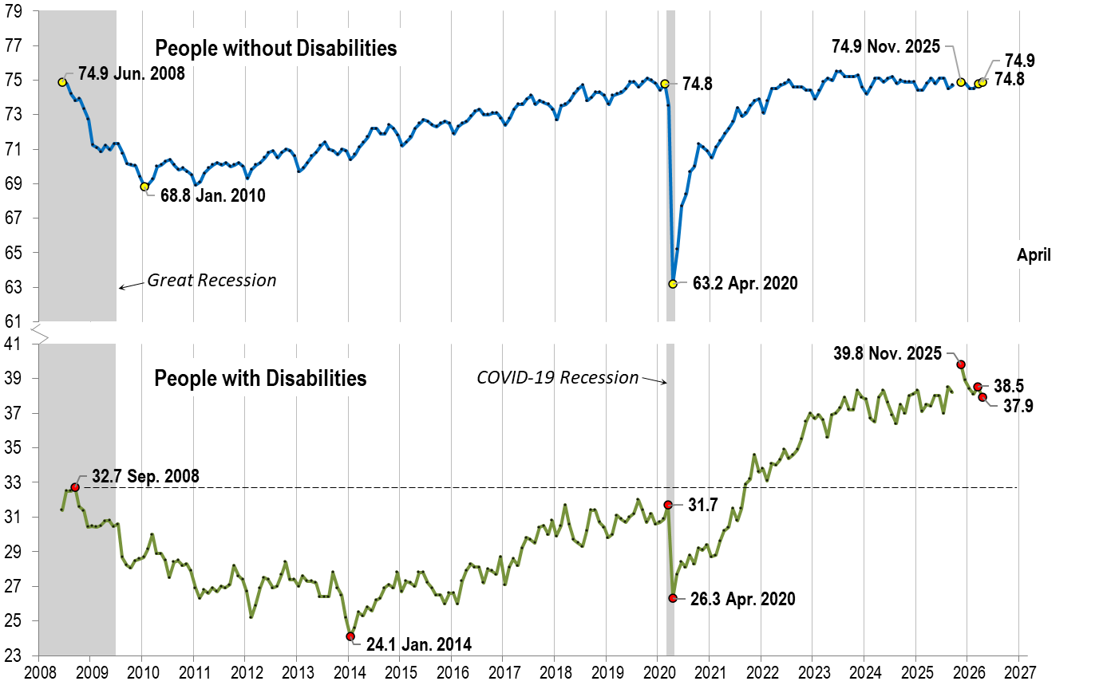
Employment- to-Population Ratio: April
Notes:
Chart Details:
This is the same trend line as before with the two trendlines extended one month
People without Disabilities go from:
March 2026 74.8
April 2026 74.9
People with Disabilities go from:
March 2026 38.5
April 2026 37.9

Slide 14
Labor Force Participation Rate:
Notes:
Blank page other than the title.

Slide 15
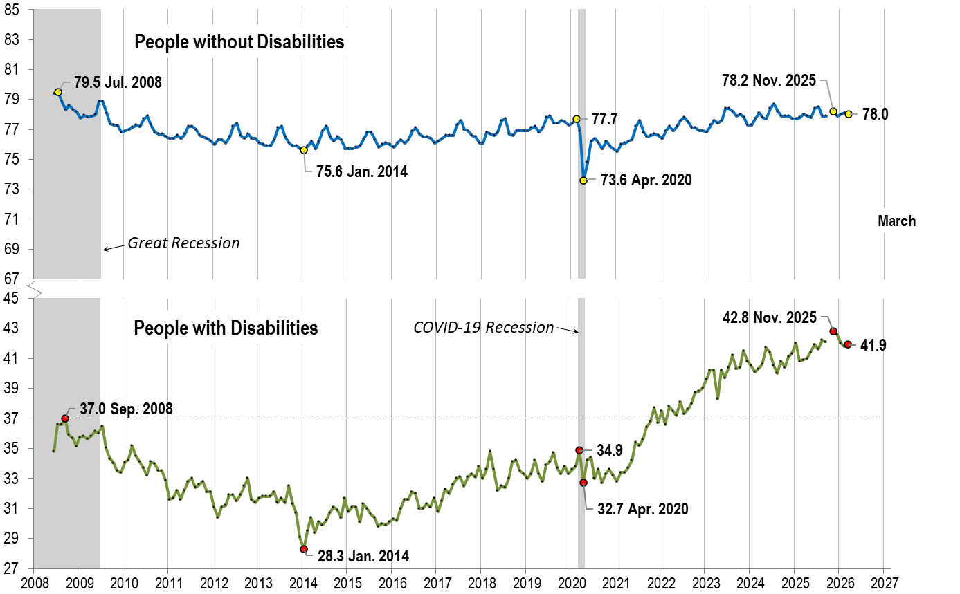
Labor Force Participation Rate: March
Notes:
Chart Details:
The data series starts in June 2008 during the Great Recession which lasted until Mid-2009. The COVID-19 Recession started in April 2020 and last for two months.
Visible Data points (highlights start of the series, the lowest point pre-covid, the points right before and after the COVID-19 recession hit, and the current labor force participation rate.
People without Disabilities:
July 2008 79.5
January 2014 (lowest point pre-covid) 75.6
February 2020 77.7
April 2020 (Covid-19 Recession hits) 73.6 (lowest point)
November 2025 78.2
March 2026 78.0
People with Disabilities:
September 2008 37.0
January 2014 28.3 (lowest point)
March 2020 34.9
April 2020 (Covid-19 Recession hits) 32.7
November 2025 42.8
March 2026 41.9

Slide 16

Labor Force Participation Rate: April
Notes:
Chart Details:
This is the same trend line as before with the two trendlines extended one month
People without Disabilities go from:
March 2026 78.0
April 2026 77.9
People with Disabilities go from:
March 2026 41.9
April 2026 41.1

Slide 17
Part 2 nTIDE News
Lillie Heigl
Association of University Centers on Disabilities (AUCD)

Slide 18
Part 2 nTIDE News
Lillie Heigl
Association of University Centers on Disabilities (AUCD)

Slide 19
Secretary of Labor
Labor Secretary Lori Chavez-DeRemer resigned
Chavez-DeRemer had been facing a probe from the Labor Department’s inspector general over potential misconduct. That investigation had already resulted in multiple of her top staffers being placed on administrative leave and then ultimately leaving their posts.
Keith Sonderling (Previously Deputy Secretary and Former EEOC Commissioner) will be acting labor secretary.

Slide 20
DHS Shutdown
Last week, President Donald Trump signed bipartisan legislation on Thursday to fund key agencies at the Department of Homeland Security, officially concluding the record-breaking shutdown

Slide 21
FY27 Appropriations
Budget Hearings before the House and Senate
House Beginning Markups
Senate aiming for June
Fund the government by Sept 30
Notes:
Budget hearings- note about McMahon going and saying still trying to offload special education to labor or ED

Slide 22
Reconciliation
H.R.1 “One Big Beautiful Bill Act
Reconciliation 2.0
Reconciliation 3.0?
Notes:
What is reconciliation
HR 1 “OBBBA” – sweeping Medicaid cuts, huge impacts to HCBS, implementation to really pick up speed as 2027 is when a lot of this goes into play (like work requirements)
Because of DHS shutdown, congress started on a “reconciliation 2.0” to fund DHS/ICE through 2029 without needing Dem votes. Senate budget really limited to DHS/Immigration space. If house wants to ram in more stuff it’ll get kicked by the senate. Pres. Trump has asked for something on his desk to sign into law by June 1.
Reconciliation 3.0- Potential of anti-fraud bills being included in Reconciliation 3.0 – a lot of GOP senate seems averse to this. Also SUPER tight timeline.

Slide 23
DOJ Web Access Rule
Web Access rule issued in 2024 had a compliance deadline in April 2026.
Rule aimed to change uncertainty for web access compliance under Title II of the ADA by pointing institutions to a set of technical guidelines known as WCAG 2.1. It provided a clear checklist of accessibility requirements their web and mobile content had to meet.
That includes transcripts for audio clips, captioning for videos and making sure PDFs and other webpages are friendly with screen readers, an assistive technology blind people use to interpret visual content into audible speech.
But just four days ahead of the deadline, the Justice Department overrode the original rule and said public entities serving 50,000 or more people will now have until April 26, 2027. Smaller public institutions will have until that date in 2028.
Notes:
Public colleges, K-12 schools, local governments and other public institutions will have an extra year to make their digital materials fully accessible for people with disabilities, according to the U.S. Department of Justice.
Many institutions had been racing, for at least two years, toward a deadline that was originally set for this Friday to comply with new federal accessibility guidelines updating the Americans with Disabilities Act (ADA). It was a day disability rights advocates had been eagerly awaiting.
But just four days ahead of the deadline, the Justice Department overrode the original rule and said public entities serving 50,000 or more people will now have until April 26, 2027. Smaller public institutions will have until that date in 2028.
Title II of the ADA, the 1990 law which has long promised accessibility to people with disabilities, including in the digital realm. But before this rule, the ADA didn't clearly lay out what accessibility had to look or sound like.
The new regulation, announced in 2024, aimed to change that by pointing institutions to a set of technical guidelines known as WCAG 2.1. It provided a clear checklist of accessibility requirements their web and mobile content had to meet.
That includes transcripts for audio clips, captioning for videos and making sure PDFs and other webpages are friendly with screen readers, an assistive technology blind people use to interpret visual content into audible speech.

Slide 24
SSI and SNAP Benefits
Administration is working on a rule change that would deduct the value of a disabled adult’s bedroom from their SSI allotment, even if the family members they live with are poor enough to qualify for food stamps
Notes:
Now, President Donald Trump’s administration is poised to penalize people simply for living in the same home as their families, according to four federal officials, internal emails and a federal regulatory listing. The administration is working on a rule change that would deduct the value of a disabled adult’s bedroom from their SSI allotment, even if the family members they live with are poor enough to qualify for food stamps. This would mean slashing the benefits of some of the most low-income SSI recipients by up to a third or ending their support altogether.
The effort to cut SSI for families who also rely on food stamps, also known as the Supplemental Nutrition Assistance Program, or SNAP, was initiated by top White House and Department of Government Efficiency officials last year, multiple Social Security officials said. It marks a second attempt by the Trump administration to quietly but dramatically downsize disability benefit programs overseen by the Social Security Administration, despite those programs’ strict eligibility standards and minimal instances of fraud.
The likely SSI cut will affect not just younger adults with disabilities such as Down syndrome and severe autism who are still living at home with their low-income parents, but also older people with health or financial problems who have had to move in with their adult children on tight budgets. All told, as many as 400,000 poor and disabled people and indigent older people across the United States could have their support cut or eliminated, according to a ProPublica analysis of actuarial figures from the Social Security Administration.

Slide 25
Apply Today! Scaling Independent Living Employment Programs Through Funding Diversification and Partnership Development RISE Community
Full Application Hyperlink: https://app.smartsheet.com/b/form/019d4a929a1174b7b196a9d6623305fc
Notes:
As trusted disability-led, community-based organizations, CILs play a vital role in advancing competitive, integrated employment (CIE). CILs provide services, supports, and community connections to support jobseekers with disabilities prepare for, obtain, and thrive in the workforce. This action‑oriented learning community will equip CILs with increased knowledge and capacity to develop, sustain, and scale employment programs, while navigating an evolving landscape for funding and partnerships. Participants will build skills in business development and communicating their value/impact to prospective partners by hearing first-hand about approaches and lessons learned from high ‑impact CIL peers.

Slide 26
DETAC Webinar
Scaling Supported Employment with Large Businesses: Lessons from the Evolution of Microsoft’s Supported Employment Program
Webinar Date: May 12, 2026 | Time: 3:00 to 4:30 PM Eastern Time
Office Hour Date: May 14, 2026 | Time: 3:00 to 4:00 PM Eastern Time
Notes:
Join DETAC for a webinar highlighting Microsoft’s Supported Employment Program as a proven, replicable model for building partnerships with large employers to advance competitive, integrated employment for people with disabilities. Speakers from the Washington Initiative for Supported Employment (Wise), Microsoft, and Microsoft’s supplier partners will discuss how they’ve aligned funding streams, addressed benefits concerns through planning, and collaborated with vocational rehabilitation and service providers to scale supported employment hiring across Microsoft’s supplier network over more than a decade.
https://aoddisabilityemploymenttacenter.com/webinar-office-hour-scaling-supported-employment-with-large-businesses-lessons-from-the-evolution-of-microsofts-supported-employment-program/

Slide 27
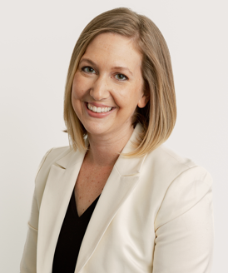
Part 3: Guest Speaker
Kimberly Knackstedt, PhD
Principal Consultant
Unlock Access, LLC

Slide 28
THE POWER OF PARTNERSHIPS:
How The Access Coalition Drives Accessibility in Retail
NTIDE Lunch & Learn Webinar Series
May 8, 2026
Presented by:
Kimberly Knackstedt, Ph.D.
Senior Advisor to The Access Coalition
Principal Consultant and Founder of Unlock Access, LLC.

Slide 29








MEET THE
ACCESS
COALITION

Slide 30
OVERVIEW
Vision
Innovate through inclusive design to include all people in retail and infrastructure experiences and create spaces that reflect the needs of diverse populations.
Mission
The Coalition helps retailers and others create inclusive spaces that welcome everyone by building co-authored frameworks, sharing open-source solutions, and proving the business case for accessibility.
The Access
Coalition
Creating More Inclusive Retail Spaces

Slide 31
OVERVIEW
Description
Inclusive design is not only good for people – it’s good for business. Research shows it spurs innovation, resulting in products and services in demand by the broadest possible audience, and workplaces that attract and retain a broad base of talent—including the historically underleveraged pool of talent represented by the disability community.
In search of design guidance that centers accessibility and inclusion for built retail environments, The Access Coalition launched in October 2024. The objective of the coalition is to create an open-source framework that builds on the strong foundation of the ADA, centered on five principles: human centered design, co-creation, transparency, research & evidence based, and a holistic systems approach to creating an accessible experience.
The Access
Coalition
Creating More Inclusive Retail Spaces

Slide 32
GUIDING PRINCIPLES
Human Centered Design:
Human centered design is the idea of putting real people at the center of the design process and problem solving. In the context of the Coalition, it is centering disabled people in retail environments and the problems they face accessing spaces every day.
Systems Approach:
This guiding principle enables members of the coalition to consider every problem and solution and design element as part of a bigger picture. Every part of a retail space is connected. The Coalition works to support bigger, more connected thinking.
The Coalition centers its work around five guiding principles
Co-Creation:
The work of the coalition is done with the disability community, with employees, and with customers, rather than to each of these communities. Inclusive design work is iterative and will always adapt and evolve; co-creation is imperative for the Coalition to learn, grow, and adapt.
Research & Evidence-Based:
The Coalition will center research and evidence as a guiding principle to ensure that decisions are based on fact and informed choices. Where possible, analysis of current research will be used to guide decisions and actions.
Transparency:
A unique element of the Coalition is multiple companies coming together, putting competition aside, and working toward improvement in accessibility and inclusive design. A guiding principle of this work is transparency and openness about the work to stakeholders and other companies.

Slide 33
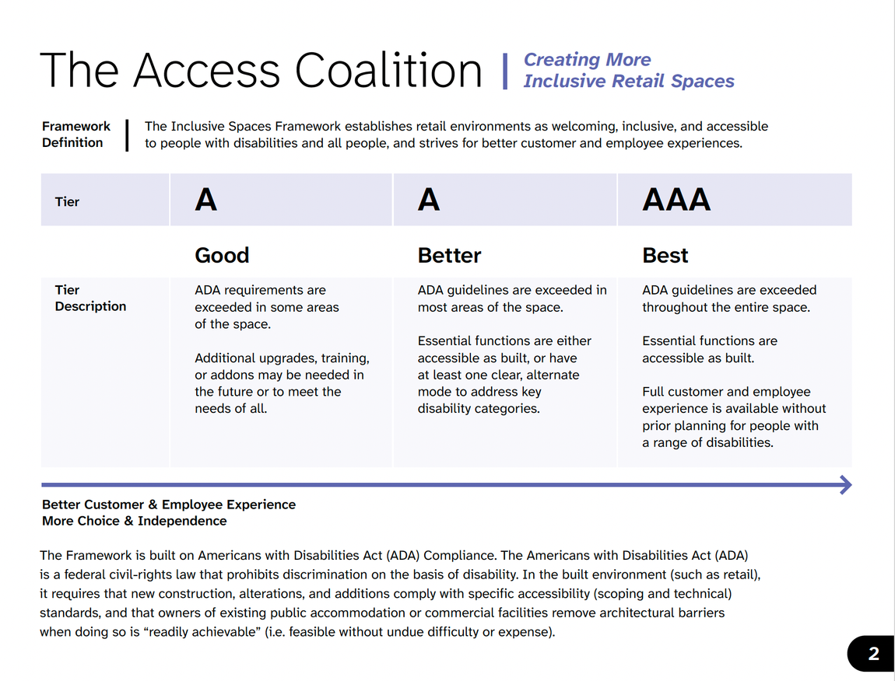
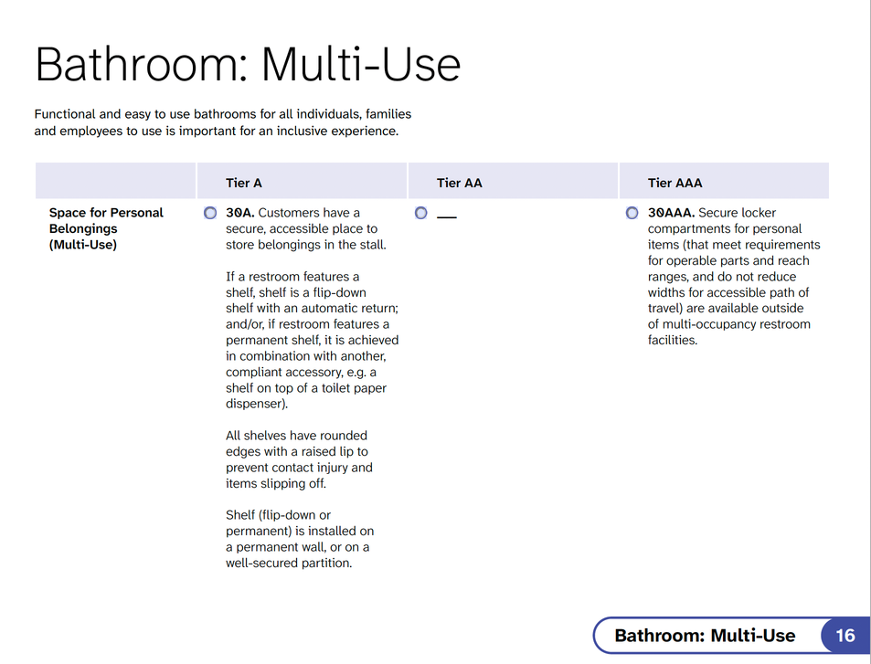
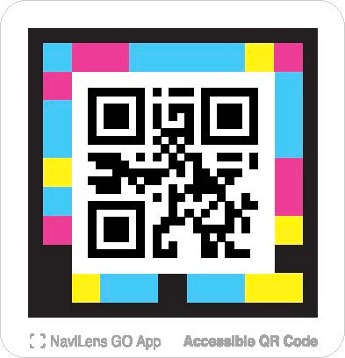
INCLUSIVE SPACES FRAMEWORK
The Access
Coalition
Creating More Inclusive Retail Spaces
Scan the accessible QR code to the right to access the full framework.

Slide 34
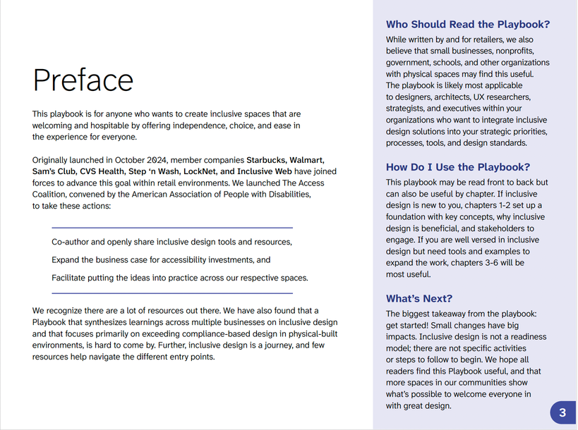
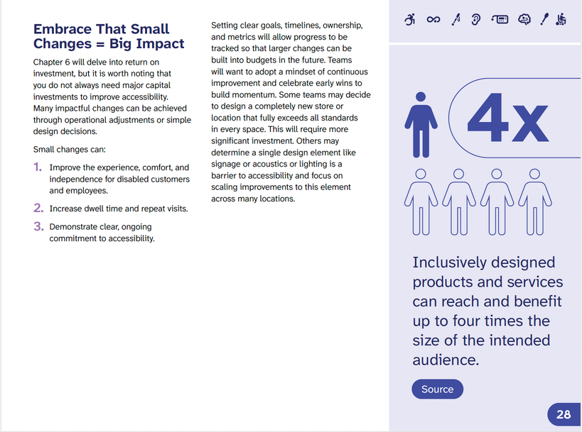
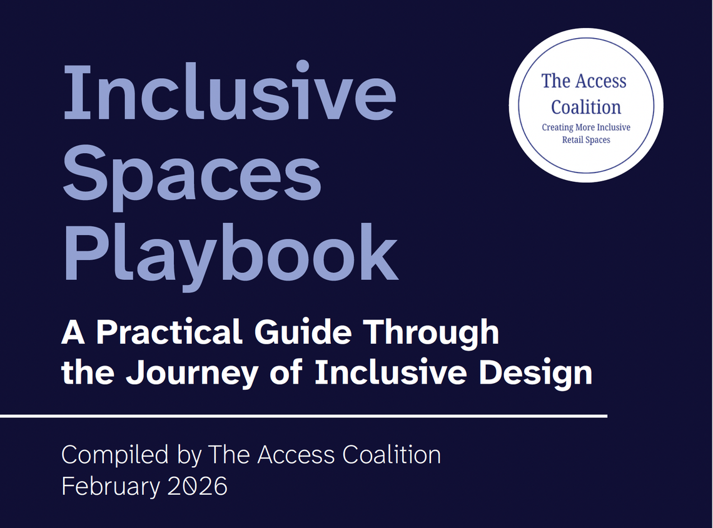
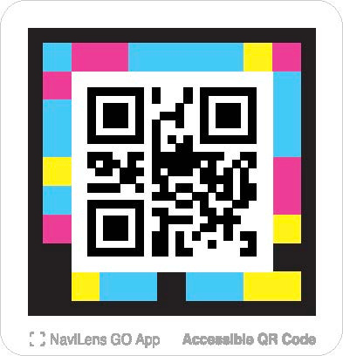
INCLUSIVE SPACES PLAYBOOK
Scan the accessible QR code below to access the full playbook.

Slide 35
NEW RESEARCH:
THE SURVEY
Goal of the research: To understand how restroom accessibility shapes customer behavior.
Open Inclusion designed an online survey with an experts group who have lived experience and Coalition members.
The survey was delivered to 1,000 US shoppers to ensure it captured real-world accessibility barriers.
Responses from disabled and non-disabled shoppers reveal how restroom use, access challenges, and overall experience shape shopping behavior, loyalty, and satisfaction.
Demographics of participants:
48% women, 51% men, 1% nonbinary, transgender, or other
Living in US regions: 25% west, 31% south, 23% midwest, 20% northeast
Ages ranged from 18-75+ with a nearly equal distribution.
Half of participants were disabled, half were nondisabled
Disabilities included blind/low vision, Deaf/hard of hearing, dexterity, mobility, neurodiveret, mental health chronic health, and communication
The Access
Coalition
Creating More Inclusive Retail Spaces

Slide 36
NEW RESEARCH:
RESTROOMS IMPACT THE RETAIL EXPERIENCE
One in five of all shoppers actively search for information about restrooms, before going to a retail space.
23%, nearly one in four, of disabled shoppers actively search for information about restrooms.
Information about restrooms determines:
How long I feel comfortable staying to shop
41% disabled and 44% nondisabled shoppers.
Whether I can visit at all
39% disabled and 34% nondisabled shoppers.
Which specific store I choose (over competitor)
33% disabled and 31% nondisabled shoppers.
The Access
Coalition
Creating More Inclusive Retail Spaces

Slide 37
INACCESSIBLE RESTROOMS HURT CUSTOMERS
Only 1 in 3 disabled shoppers feel very confident the restroom will meet their needs.
Because of that ... more than 1 in 4 disabled shoppers restricts eating and drinking.
And, more than 1 in 5 disabled shoppers time their retail visits around their bathroom schedule.
The Access
Coalition
Creating More Inclusive Retail Spaces

Slide 38
LESSONS LEARNED
Coalition Building
Bringing different companies together under shared goals has sweeping benefits. Member companies learn together and from one another. Problem solving with tough issues happens organically. Coalitions also bring shared risk management - working together, publicly shows unity over a complex issue.
Tools to Implement
The field wants resources and tools to use today. If something works, share it. The overall learnings from the Coalition captured in the playbook has been widely praised. We do not know what we do not know. Putting information out helps everyone to achieve the shared goals.
Open-Sourced Resources
Today, many resources are behind paywalls. Sharing what works helps every place in the community become more accessible, especially for small businesses without the resources of large companies.
Accessibility is Good Business
Accessibility is about creating spaces that work for everyone. This supports customers and employees with disabilities, aging customers, families, caregivers, and every person to belong in a space.
The Access
Coalition
Creating More Inclusive Retail Spaces

Slide 39
THE ACCESS COALITION
CREATING MORE INCLUSIVE RETAIL SPACES
For additional information:
knackstedt@unlockaccess.org
https://www.linkedin.com/company/the-access-coalition/
https://www.aapd.com/inclusive-retail-spaces-coalition/

Slide 40
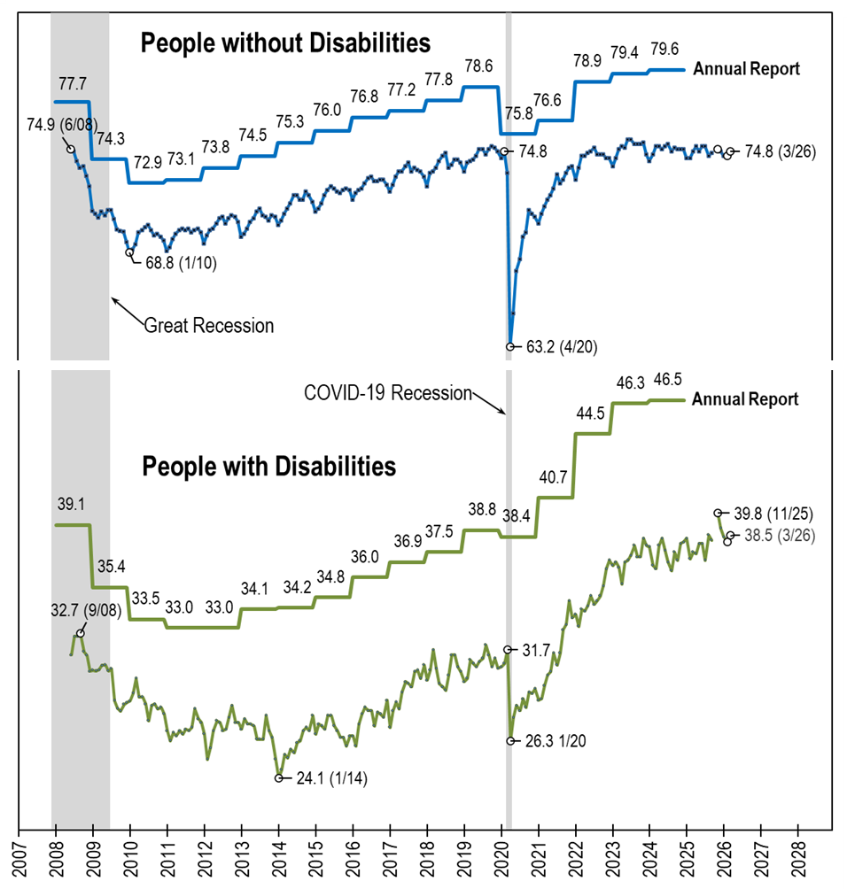
Employment- to-Population Ratio: Comparing: nTIDE (Ages 16-64) AnnRpt (Ages 18-64)
Notes:
[Repeat of text from the photo’s alt text] A line chart with four lines, comparing the employment-to-population ratio trend lines from nTIDE, which uses CPS monthly data (June 2008-March 2026) and the Annual Report, which uses ACS annual data (2008-2024). Basically, the trend lines from the annual report (one for people with disabilities and one for people without disabilities) are overlayed on top of the standard trend lines from nTIDE. Overall, they follow the same pattern, which acts to verify the two data sources. The trend lines for from nTIDE are always lower than those of the Annual Report, in part because nTIDE includes 16 and 17 year olds, who are less likely to be employed.

Slide 41

Thank You!
Information about the nTIDE partners may be found at
Kessler Foundation (www.kesslerfoundation.org)
UNH/Institute on Disability (www.ResearchOnDisability.org)
AUCD (www.AUCD.org)
Contact us at
Email: Disability.Statistics@unh.edu
Call: 866-538-9521 (toll free)
Twitter at #nTIDELearn

Slide 42
Bye!

