Slide 1
nTIDE Lunch & Learn Webinar Series
Kessler Foundation, AUCD, University of New Hampshire Institute on Disability Season 11, Episode 4 Date: April 3, 2026

Slide 2

nTIDE Lunch & Learn Webinar Series
Kessler Foundation, AUCD, University of New Hampshire Institute on Disability Season 11, Episode 4 Date: April 3, 2026

Slide 3
Up Front Matters
This webinar is being recorded. We will post an archive of along side the Monthly nTIDE broadcast on our webinar, each month, on our website at www.researchondisability.org/nTIDE. This site will also provide copies of the presentations, the speakers’ bios, full transcripts, and other valuable resources.
As an attendee of this webinar, you are a viewer. To ask questions of the speakers, click on the Q & A box on your webinar screen and type your questions into the box. Speakers will review these questions and provide answers during the last section of the webinar. Some questions may be answered directly in the Q & A box.

Slide 4
Up Front Matters – Contact Info
If you have any questions following this recording, please contact us at disability.statistics@unh.edu, or toll free at 866-538-9521 for more information. Thanks for joining us. Enjoy today's webinar!

Slide 5
Welcome to the nTIDE Lunch & Learn
Occurs at noon Eastern-time on the first Friday day of each month, with the release of the nTIDE Report.
A joint effort of the University of New Hampshire, Kessler Foundation, and the Association of University Centers on Disabilities (AUCD).

Slide 6
Today’s Session: Disability Employment Beyond Traditional Workforce Models
Part 1: nTIDE Report … “The Numbers”
Andrew Houtenville, University of New Hampshire
John O’Neill, Kessler Foundation
Part 2: nTIDE News
Lillie Heigl, Association of University Centers on Disabilities (AUCD)
Part 3: Guest Speakers
Stacia Kingsbury, University of New Hampshire
Nate Thomas, University of New Hampshire
Part 4: Q&A

Slide 7
Part 1: The nTIDE Report
John O’Neill
Kessler Foundation

Slide 8
The Monthly nTIDE Report
The monthly nTIDE Report is a press release and infographic, looking at the latest employment statistics.
Uses data from the “jobs report” released by the U.S. Bureau of Labor Statistics, on the 1st Friday of each month.

Slide 9
Source of the Data
U.S. BLS, Current Population Survey (CPS).
Source of the “official” unemployment rate.
Civilians, ages 16-64, not living in institutions.
Available September 2008 onward.
Not yet seasonally adjusted.
which is why we also compare to the same month last year.
although since COVID we started focusing on the month-to-month change.

Slide 10
The Numbers
Andrew Houtenville University of New Hampshire

Slide 11
Employment- to-Population Ratio:
Notes:
Blank page other than the title.

Slide 12
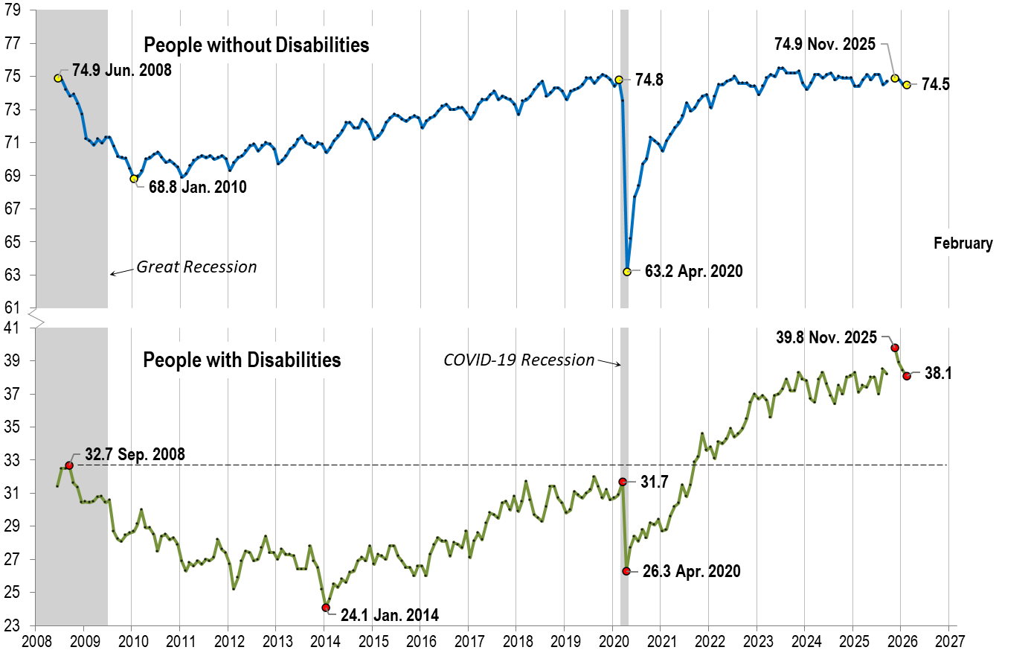
Employment- to-Population Ratio: February
Notes:
Chart Details:
The data series starts in June 2008 during the Great Recession which lasted until Mid-2009. The COVID-19 Recession started in April 2020 and last for two months.
Visible Data points (highlights start of the series, the lowest point pre-covid, the points right before and after the Covid-19 recession hit, and the current Employment-to-Population Ratio
People without Disabilities:
June 2008 74.9
January 2010 (lowest point pre-covid) 68.8
February 2020 74.8
April 2020 (Covid-19 Recession hits) 63.2 (lowest point)
November 2025 74.9
February 2026 74.5
People with Disabilities:
September 2008 32.7
January 2014 (lowest point pre-covid) 24.1 (lowest point)
March 2020 31.7
April 2020 (Covid-19 Recession hits) 26.3
November 2025 39.8
February 2026 38.1

Slide 13
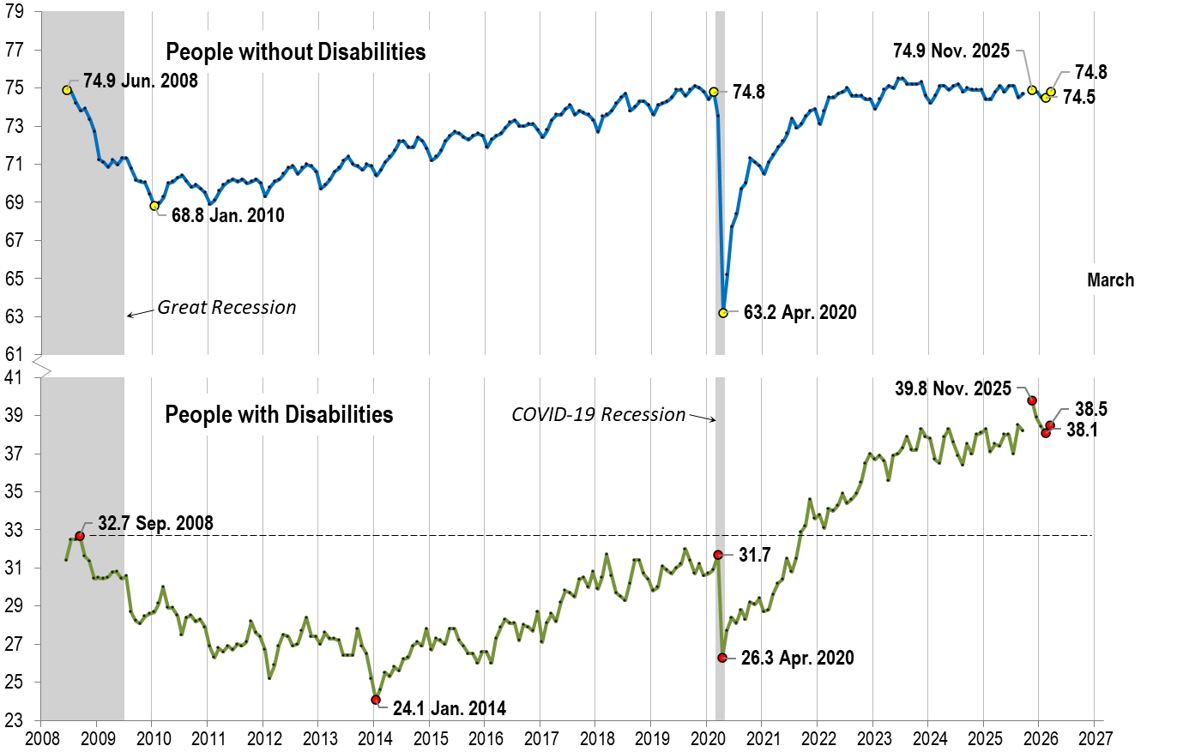
Employment- to-Population Ratio: March
Notes:
Chart Details:
This is the same trend line as before with the two trendlines extended one month
People without Disabilities go from:
February 2026 74.5
March 2026 74.8
People with Disabilities go from:
February 2026 38.1
March 2026 38.5

Slide 14
Labor Force Participation Rate:
Notes:
Blank page other than the title.

Slide 15
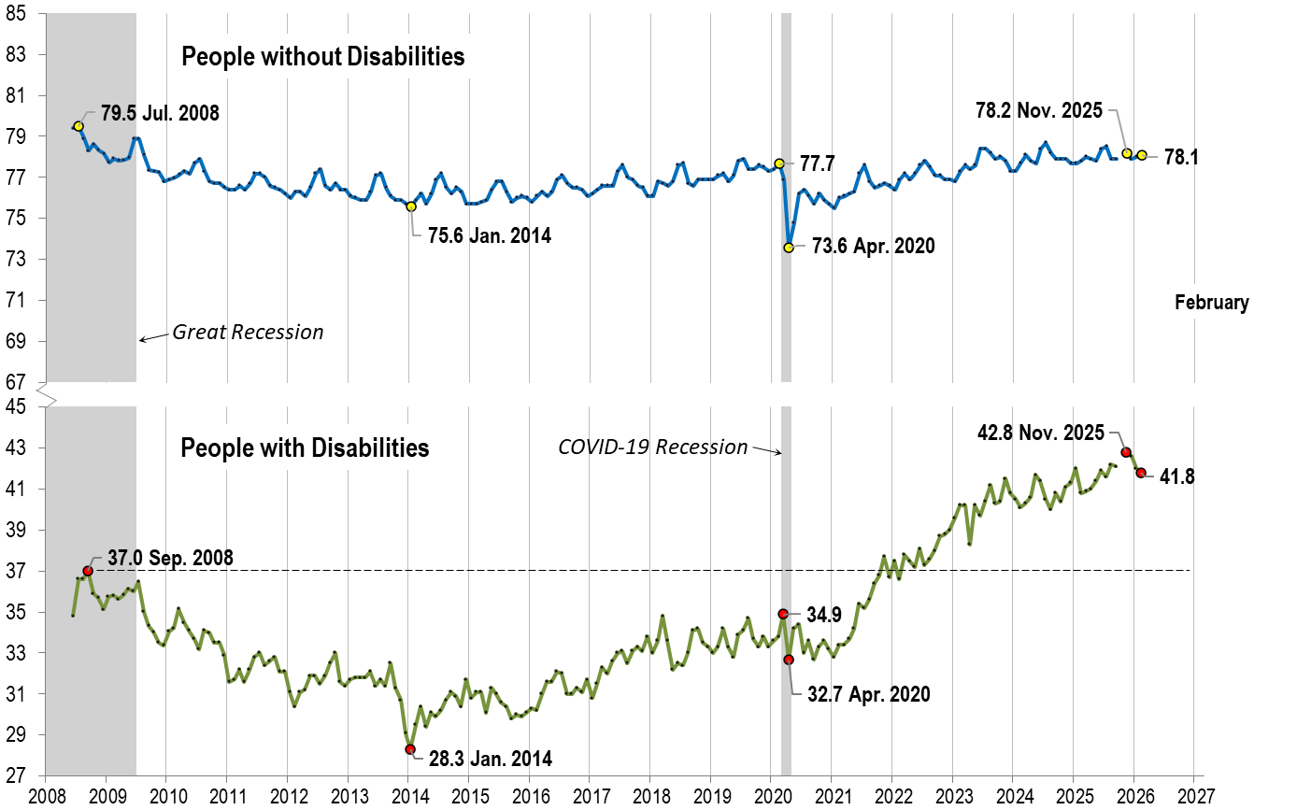
Labor Force Participation Rate: February
Notes:
Chart Details:
The data series starts in June 2008 during the Great Recession which lasted until Mid-2009. The COVID-19 Recession started in April 2020 and last for two months.
Visible Data points (highlights start of the series, the lowest point pre-covid, the points right before and after the COVID-19 recession hit, and the current labor force participation rate.
People without Disabilities:
July 2008 79.5
January 2014 (lowest point pre-covid) 75.6
February 2020 77.7
April 2020 (Covid-19 Recession hits) 73.6 (lowest point)
November 2025 78.2
February 2026 78.1
People with Disabilities:
September 2008 37.0
January 2014 28.3 (lowest point)
March 2020 34.9
April 2020 (Covid-19 Recession hits) 32.7
November 2025 42.8
February 2026 41.8

Slide 16

Labor Force Participation Rate: March
Notes:
Chart Details:
This is the same trend line as before with the two trendlines extended one month
People without Disabilities go from:
February 2026 78.1
March 2026 78.0
People with Disabilities go from:
February 2026 41.8
March 2026 41.9

Slide 17
Part 2 nTIDE News
Lillie Heigl
Association of University Centers on Disabilities (AUCD)

Slide 18
Federal Policy Update
President’s Budget
Expected Friday (4/3)
Budget request from the administration to Congress, telling Congress how the Administration would like to spend money in the coming year (discretionary funding)
Last year the President’s Budget proposed massive cuts and changes to disability programs
Connection to disability employment: Labor HHS bill funds disability employment through the Office of Disability Employment Policy (ODEP), Youth Employment Initiatives, WIOA and others

Slide 19
Federal Policy Update
Stricter rules limiting telework as a reasonable accommodation at the Department of Health and Human Services are leading to a spike in disability discrimination complaints and putting a toll on its workforce.
The new policy, as Federal News Network reported last December, restricts employees from using telework as an “interim accommodation,” while the agency processes their reasonable accommodation request. The department has a backlog of more than 3,000 reasonable accommodation requests that it expects will take six to eight months to process.
Notes:
https://federalnewsnetwork.com/workforce/2026/03/as-hhs-limits-telework-disabled-veterans-say-theyre-running-out-of-options-for-accommodations/?utm_source=chatgpt.com
Stricter rules limiting telework as a reasonable accommodation at the Department of Health and Human Services are leading to a spike in disability discrimination complaints and putting a toll on its workforce.
The new policy, as Federal News Network reported last December, restricts employees from using telework as an “interim accommodation,” while the agency processes their reasonable accommodation request. The department has a backlog of more than 3,000 reasonable accommodation requests that it expects will take six to eight months to process.
The HHS policy states all requests for telework, remote work or reassignment must be reviewed and approved by an assistant secretary or a higher-level official — a decision that has further slowed the approval process. The new policy prohibits an employee’s immediate supervisor from approving interim telework requests, even in cases where telework has already been identified “as the only effective accommodation.”
The new policy has had the greatest impact on employees at the Centers for Disease Control and Prevention. Yolanda Jacobs, president of AFGE Local 2883, which represents CDC employees at its Atlanta headquarters, wrote in a recent letter to agency leadership that the CDC “had the option to honor existing accommodations and continue approving interim relief for employees with pending requests.”

Slide 20
EEOC v. Kroger
The Equal Employment Opportunity Commission (EEOC) sued Kroger alleging it revoked reasonable accommodations and terminated a worker with a mobility disability.
Reinforces employer obligations under the ADA
Highlights risks of withdrawing accommodations after long-term use
Could influence employer practices nationwide
Notes:
Houston TX
EEOC charged that a self-service checkout attendant suffering from neuropathy, who for three preceding years worked successfully using a walker, was stripped of that reasonable accommodation by new management. The employee’s neuropathy limited her ability to walk and move, and her feet went numb if she was required to stand for too long.
Kroger’s new management failed to interact with the employee to determine if the previously granted accommodation was reasonable or if another was potentially available. Instead, management told her to seek leave – which she did not want or need – until she could return to work without an accommodation. The employee was terminated by Kroger when she could not support a need for leave with medical documentation, according to the suit.

Slide 21
NEON FY26
US Department of Labor selects participants for national effort to expand employment opportunities for individuals with disabilities
'Core states' to receive assistance focused on job seekers with mental health conditions
The U.S. Department of Labor today announced Colorado, Kansas, Kentucky, Maine, New York, Tennessee, and the District of Columbia will participate as “core states” in fiscal year 2026 in its National Expansion of Employment Opportunities Network initiative.
Notes:
National Expansion of Employment Opportunities Network initiative.
The U.S. Department of Labor today announced Colorado, Kansas, Kentucky, Maine, New York, Tennessee, and the District of Columbia will participate as “core states” in fiscal year 2026 in its National Expansion of Employment Opportunities Network initiative.
The selection will help connect these government agencies with targeted, ongoing technical assistance aimed at expanding job opportunities and improving the financial well-being of Americans with mental health conditions, including those with co-occurring disabilities.
The current NEON cohort will focus on deepening state agency partnerships and supporting efforts leading to sustainable employment outcomes for individuals with mental health conditions.

Slide 22
National Apprenticeship Week
Inaugural Spring National Apprenticeship Week (NAW) from April 26 - May 2, 2026.
Starting in 2026, NAW will continue to be held in the spring, and we're preparing for the biggest NAW ever! The theme for NAW 2026 is America at Work: Making America Skilled Again through Registered Apprenticeship.
Notes:
Daily NAW themes:
Monday, April 27: Registered Apprenticeships Building America at 250
Tuesday, April 28: Registered Apprenticeship Drives Growth and Innovation Across Critical Industries
Wednesday, April 29: Expanding AI in Registered Apprenticeship
Thursday, April 30: Realigning Education and Workforce Systems Around Registered Apprenticeship
Friday, May 1: Youth Pathways to Registered Apprenticeship

Slide 23
DETAC Webinar
DETAC Webinar on the ABLE Age Adjustment Act and Tools to Support Financial Empowerment
Tuesday, April 14, 2026 | 3:00-4:30 p.m. ET
Register for the webinar
Celebrate #ABLEtoSave, financial capability, and Autism Acceptance Month by joining the Disability Employment Technical Assistance Center and our partners for an empowering webinar on financial independence for people with disabilities. Hear from National Disability Institute’s ABLE National Resource Center(ABLE NRC) about recent updates to ABLE accounts and what they mean for individuals considering opening an account.
Notes:
Tuesday, April 14, 2026 | 3:00-4:30 p.m. ET
Register for the webinar
Celebrate #ABLEtoSave, financial capability, and Autism Acceptance Month by joining the Disability Employment Technical Assistance Centerand our partners for an empowering webinar on financial independence for people with disabilities. Hear from National Disability Institute’s ABLE National Resource Center(ABLE NRC) about recent updates to ABLE accounts and what they mean for individuals considering opening an account.

Slide 24
Part 3 nTIDE Guest Speakers Stacia Kingsbury Nate Thomas University of New Hampshire

Slide 25
The Annual Disability Statistics Collection
Stacia Kingsbury, MPP
Nate Thomas, MS

Slide 26
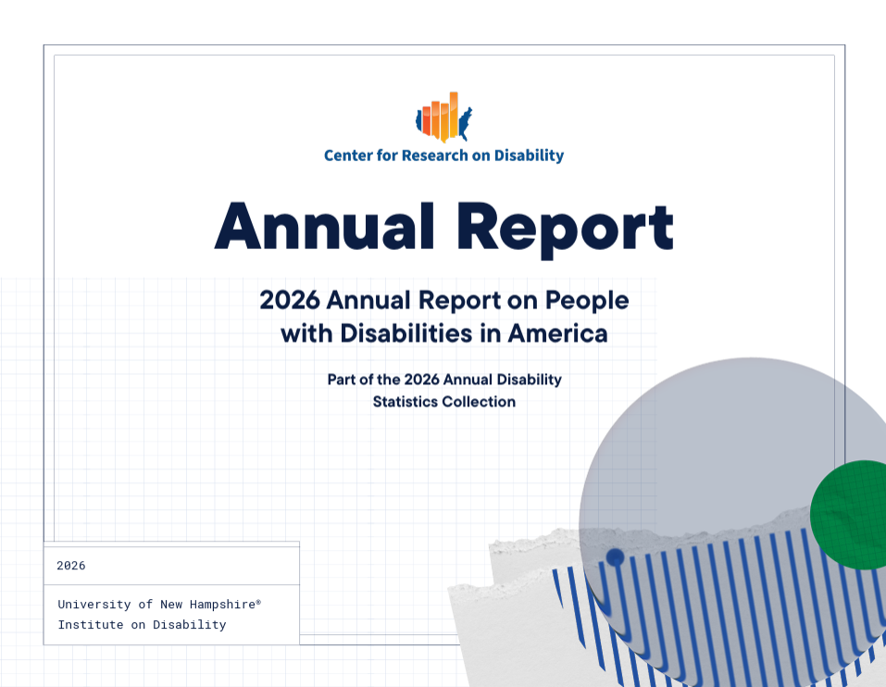
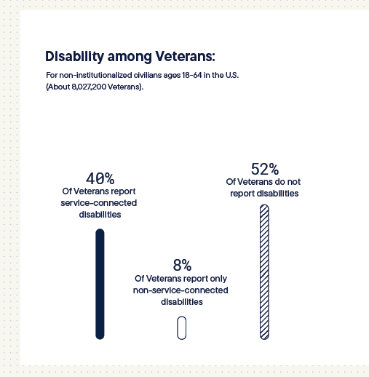
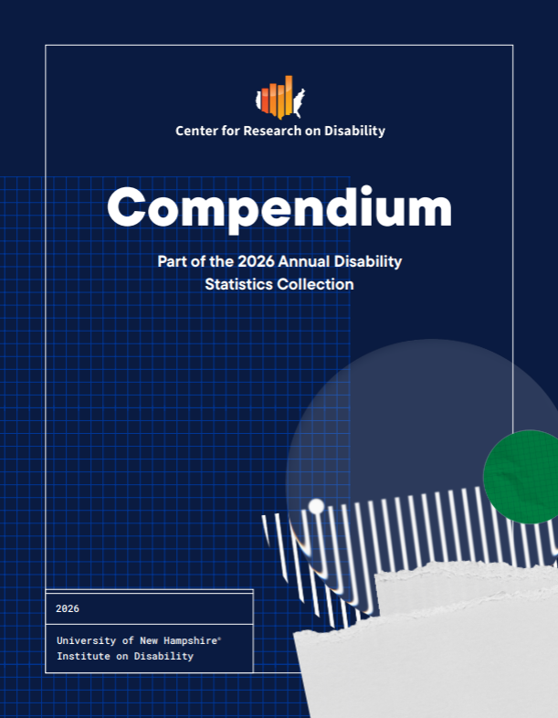
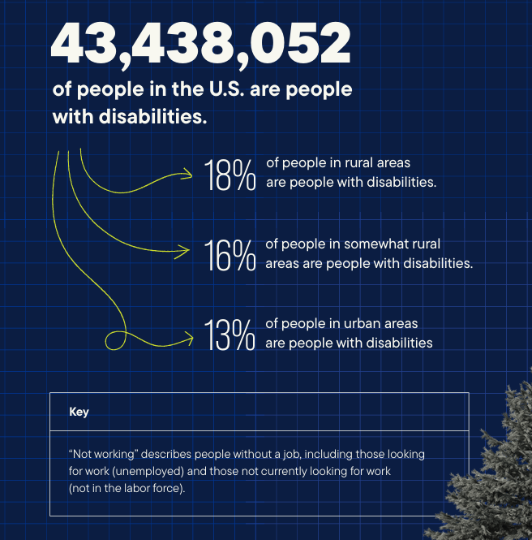
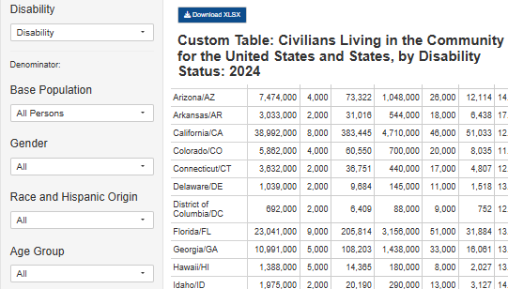
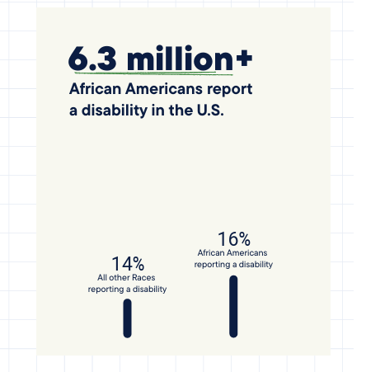
Largest collection of accessible disability statistics tools out there
What is the collection?
Notes:
Compendium which provides statistics on people ages generally 18-64, some variation
Annual report on people with disabilities in America time trends from 2008 to the most recent data year available
Build Your Own Statistics State and county level custom table builders. State level goes back to 2018, county level goes back to 2012
Three infographics that cover intersectional topics
I’m going to briefly discuss the annual report and infographics, Nate will discuss the Compendium and Build Your Own Statistics

Slide 27
What’s in the Annual Report
Topics
Keeping Track: National Disability Status and Program Performance Indicators¹ , 2008
Data
American Community Survey, 2008-2024 PUMS one-year files
Reported at the 95% confidence level using one tailed test
The Calls
Comparisons: Year-to-year changes for people with disabilities
Gaps: Year-to-year difference between people with and without disabilities
Notes:
So, this report covers 12 topics that were informed by the 2008 Keeping Track: National Disability Status and Program Performance Indicators study. Where people with disabilities, their advocates, and service providers determined the most important indicators to track for people with disabilities.
Data used is from the American Community survey, more details are in the report.
We conduct one tailed tests at the 95% Confidence level to see if these topics significantly change – these tests inform The Calls.
There are two types of calls:
Comparison- year to year change of the results for people with disabilities only
Gaps are year to year difference of the results between people with and without disabilities – we use a gap here instead of relative ratio, those are in the Compendium

Slide 28
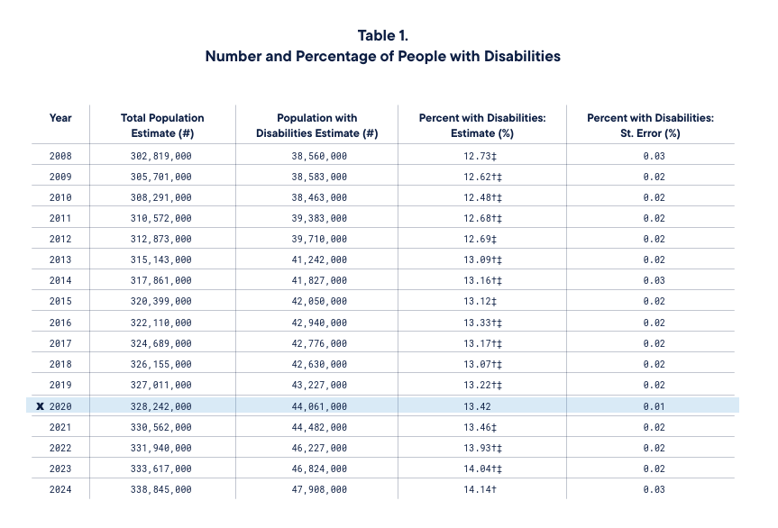
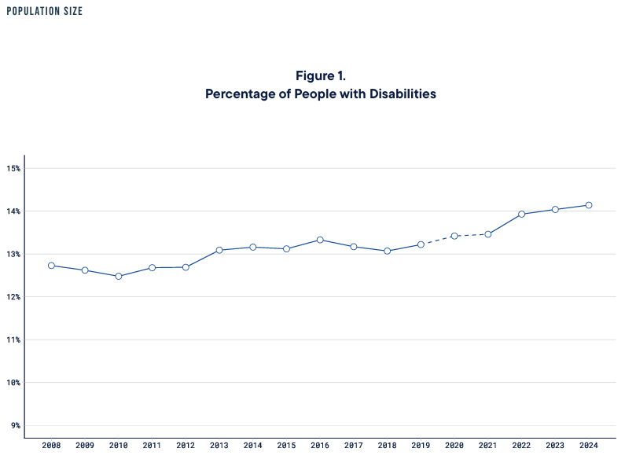
What’s Inside
Table
Corresponding time trend

Slide 29
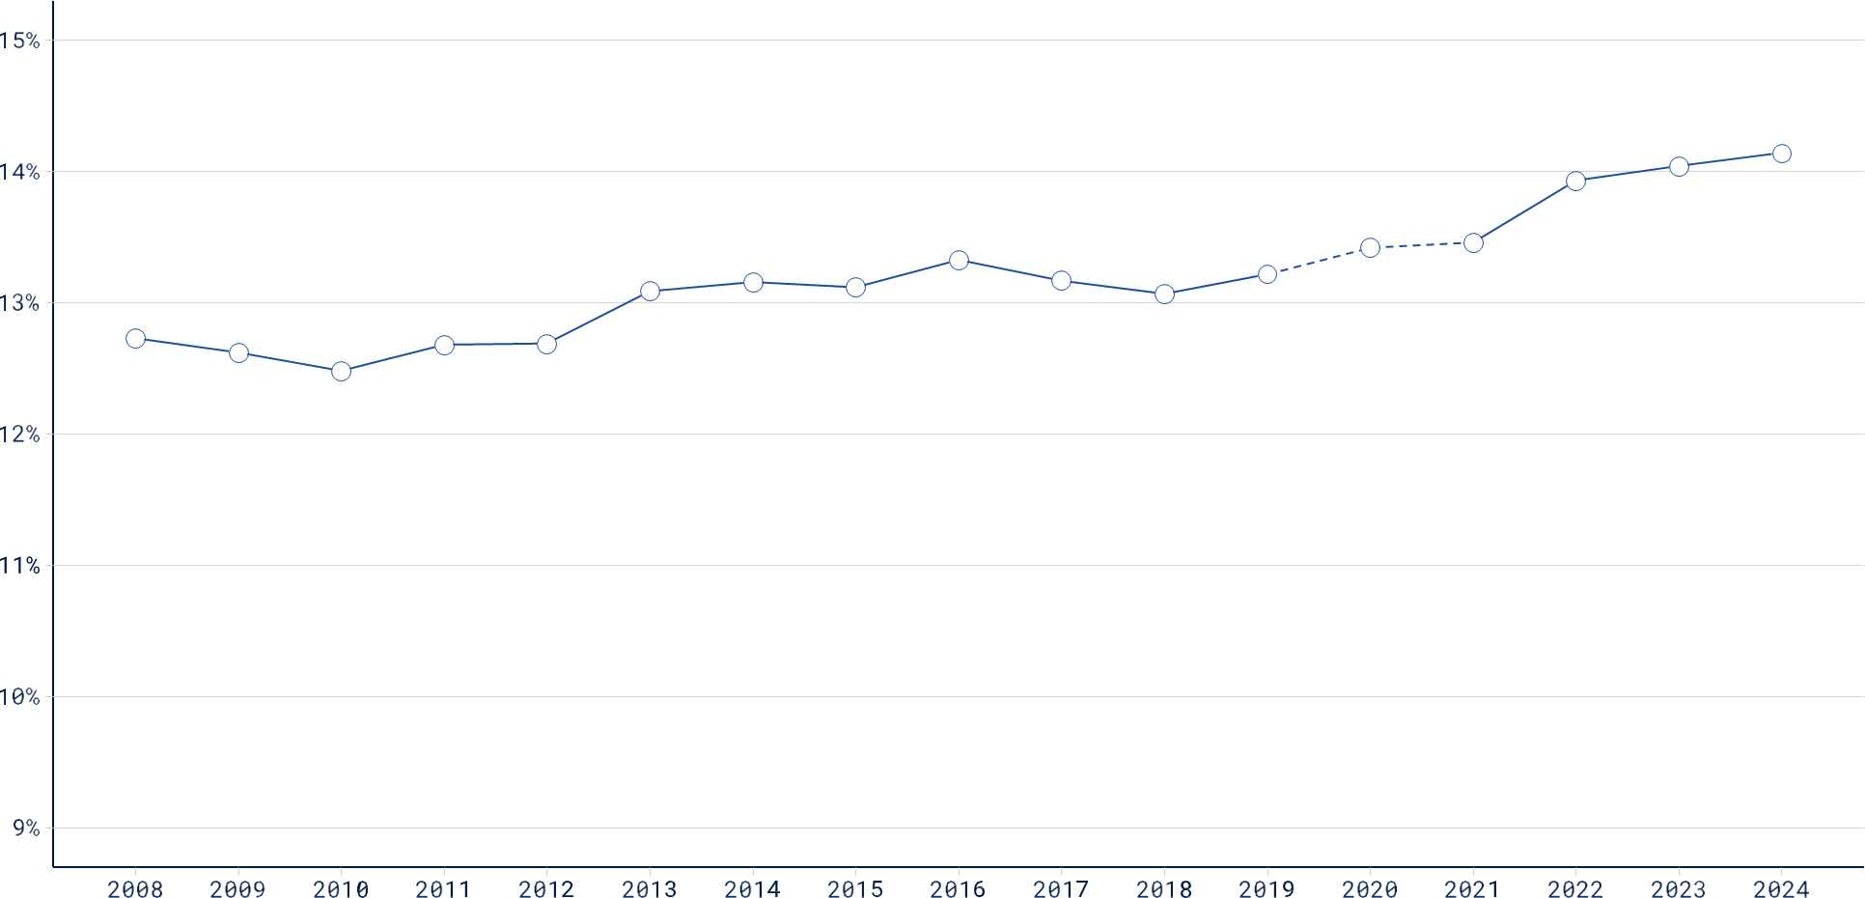
Population of People with Disabilities
Percent, all ages
14.14
14.04
12.73
Notes:
For this chart and the remainder presented,
This is a line graph showing change over time
The x axis (on the bottom) has the years from 2008 to 2024
The y axis (on the left) has the percentages or dollars (when we get to the wages)
In 2008 12.73%
In 2023 14.04% of the population in the US with disabilities
In 2024 this went up to 14.14%
What is the call?
(Civilians of all ages with disabilities in the U.S.)

Slide 30
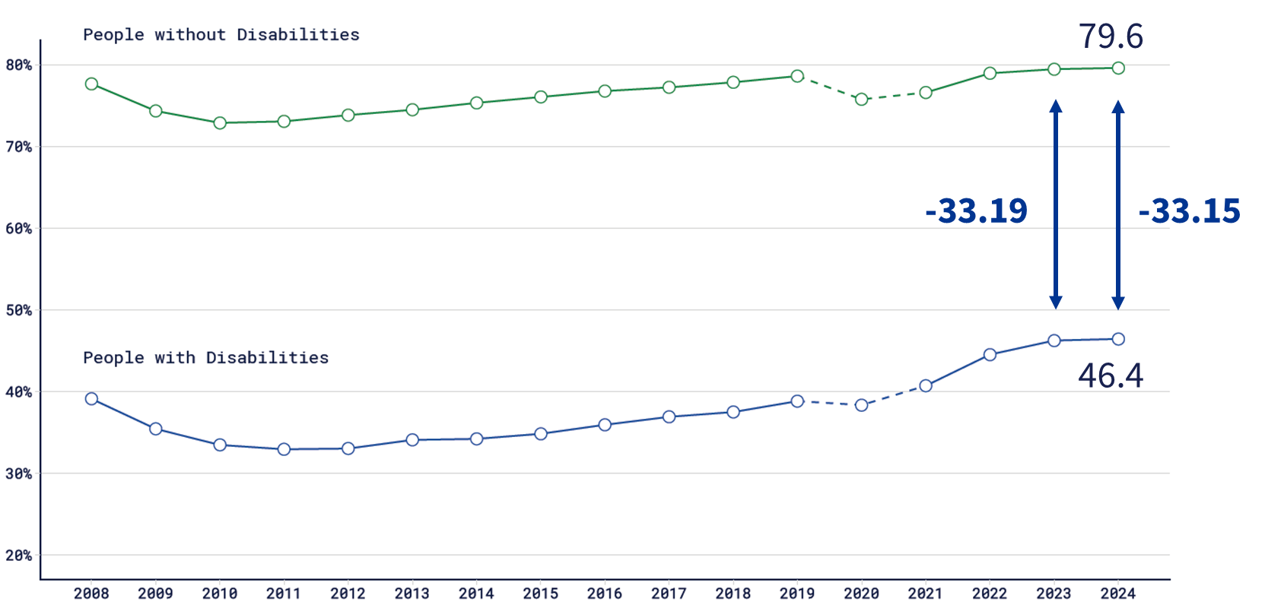
Employment-to-Population Ratio: Gap Percent, ages 18-64
Notes:
Employment-to-population ratio for people ages 18-64
The Gap in the employment to population ratio between people with and without disabilities narrowed from -33.19 percentage points in 2023 to
-33.15 in 2024.
Is this change statistically significant?
(Civilians with and without disabilities ages 18-64 in the U.S. who are living in the community and working)

Slide 31
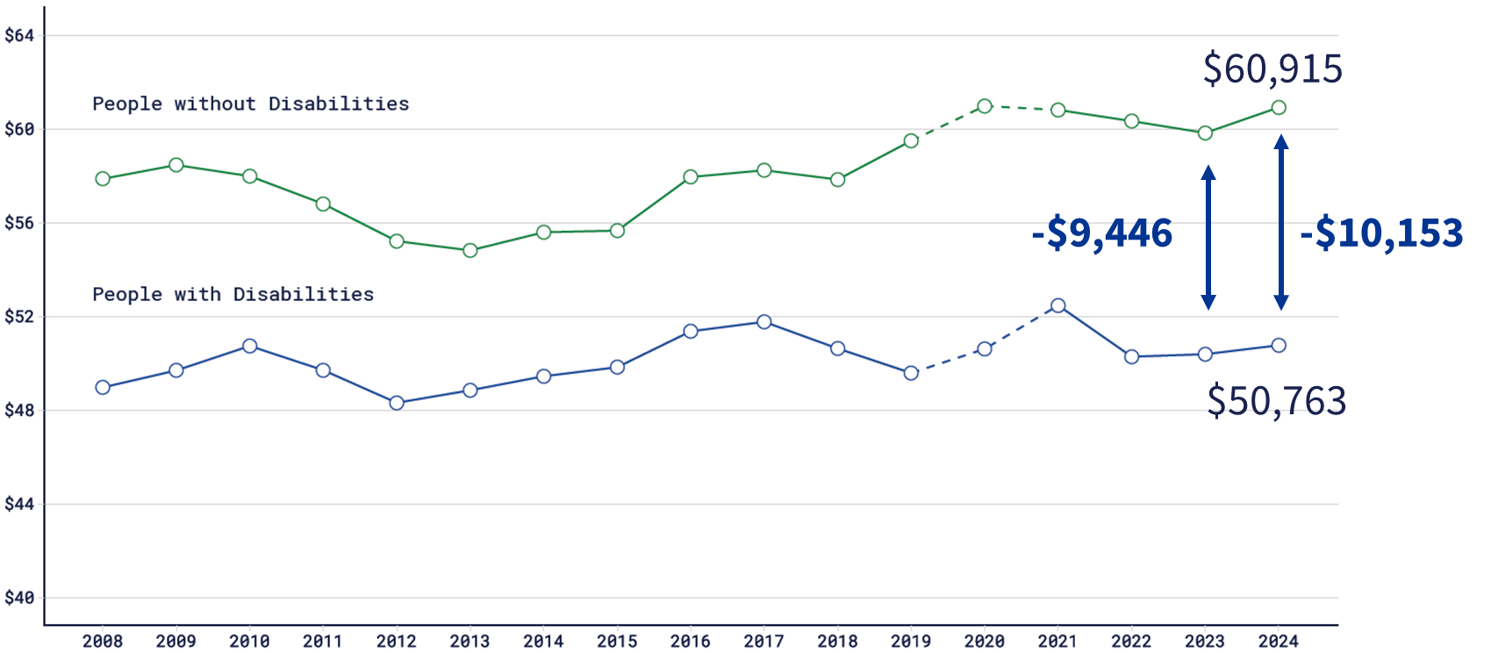
Median Earnings: Gap Full-Time and Full-Year, USD in the thousands, ages 18-64
Notes:
Median wages are reported on people ages 18-64
The Gap in wages for full time full year workers ages 18-64 with and without disabilities widened from -$9,446 in 2023 to -$10,153 in 2024.
Is this change statistically significant?
No. No change detected
(Civilians with and without disabilities ages 18-64 in the U.S. who are living in the community and working full-time, full-year, in thousands of USD)

Slide 32
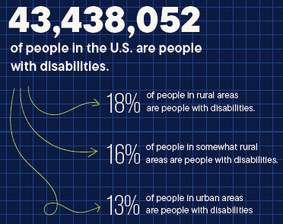
Experiences of People with Disabilities in Rural America
More in Section 10: Rural
of the Compendium
Notes:
Rural areas have higher percentages of people with disabilities.
43,438,052 People in the U.S. are people with disabilities
18% of people in rural areas are people with disabilities
16% of people in somewhat rural areas are people with disabilities
13% of people in urban areas are people with disabilities

Slide 33
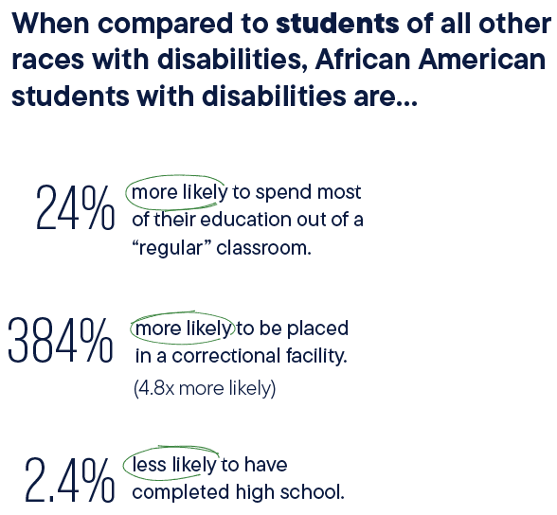
Social Inequities Experienced by African Americans
Leaders should prioritize investments to improve employment, health, and community participation.
Notes:
This was produced in part with the RRTC at Langston University
Dr. Manyibe and colleagues of Langston University urge policymakers and agency leaders should prioritize targeted investments designed to improve outcomes in employment, health, and community participation.
In this community we see higher rates of African American/Black students with disabilities being excluded from classrooms and having lower high school graduation rates

Slide 34
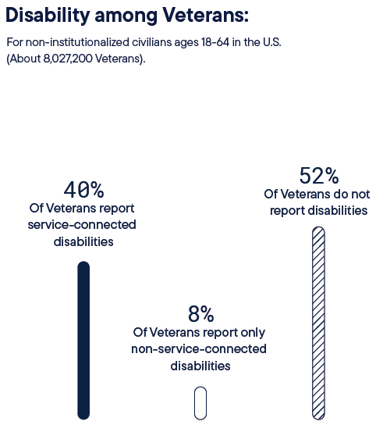
Experiences of Veterans with Disabilities (non-institutionalized civilians ages 18-64)
Veterans with Non-Service-Connected Disabilities are Often Overlooked
Notes:
More in Section 8: Veterans of the Compendium
This was done with Paralyzed Veterans of America
This infographic centers on about 8 million non-institutionalized veterans ages 18-64.
Although only 8% report only non-service-connected disabilities, outcomes for this group appear worse than those for veterans reporting service-connected disabilities and veterans not reporting disabilities.

Slide 35
What is the Compendium?

Slide 36
The first annual publication in 2009 (RRTC, 2009)
Useful:
“Overview: Statistics are a powerful tool – in research, policymaking, program evaluation, and advocacy. They are used to frame the issues, monitor current circumstances and progress, judge the effectiveness…”¹
From various sources:
“[Disability statistics] are often difficult to find.” ¹
So we collect, compile, and communicate:
“… the first Compendium, [focused] on state-level statistics” ¹

Slide 37
2026 Disability Stats
Data Sources
Topics
American Community Survey (ACS)
Population and Prevalence
Functioning
Employment (in Industry and Occupation)
Earnings (full-time full-year workers)
Poverty
Home Environment (component of multidimensional deprivation index)
Veterans
Rural
Education
Health Insurance Coverage
continued on next slide

Slide 38
2026 Disability Stats: Data Sources & Topics Continued
Dept. Veterans Affairs
Veterans
OMB
Rural (Metro. vs. Micro. vs. Noncore)
IDEA
Education
CPS
Voting and Registration
SSA
Social Security Disability Programs
WIOA
Vocational Rehabilitation
BRFSS
Health Outcomes
BRFSS: Behavioral Risk Factor Surveillance System Annual Survey
CPS: Current Population Survey
IDEA: Individuals with Disabilities Education Act
OMB: Office of Management and Budget
WIOA: Workforce Innovation and Opportunity Act
SSA: Social Security Administration

Slide 39
2026 Disability Statistics

Slide 40
Our statistics
Population size (#)
Percentages (%)
Relative Ratio (RR)
Margin of Error (ME – within 95% confidence interval)

Slide 41
Population and Prevalence
U.S. (2024) | Disability # (ME#) % (ME%) | Without Disability # (ME#) % (ME%)
CLC (includes age 65+) | 45,770,000 (180,000) 13.7% (0.1%) of CLC | 289,499,000 (86.3) 86.3% (0.1%) of CLC
CLC with Hearing Disabilities | 12,319,000 (71,000) 3.7% (0.1%) of CLC | -
CLC with Vision Disabilities | 8,537,000 (84,000) 2.5% (0.1%) of CLC | -
CLC with Cognitive Disabilities | 18,485,000 (132,000) 5.5% (0.1%) of CLC | -
CLC with Ambulatory Disabilities | 20,957,000 (100,000) 6.3% (0.1%) of CLC | -
CLC with Self-Care Disabilities | 8,201,000 (75,000) 2.4% (0.1%) of CLC
CLC with Independent Living Disabilities | 16,243,000 (97,000) 4.8% (0.1%)
2026 Disability Statistics
CLC: Civilians Living in the Community
Section 1

Slide 42
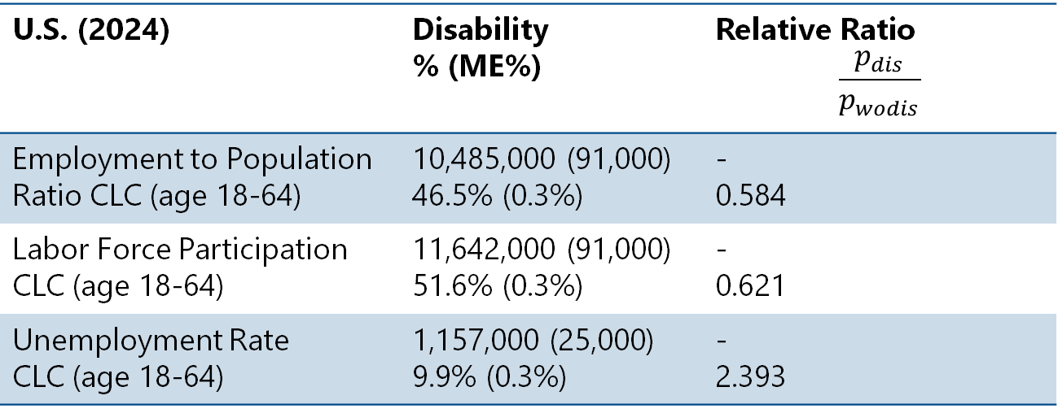
Employment
U.S. (2024) | Disability % (ME%) | Relative Ratio $$\frac{p_{dis}}{p_{wodis}}$$
Employment to Population Ratio CLC (age 18-64) | 10,485,000 (91,000) 46.5% (0.3%) | - 0.584
Labor Force Participation CLC (age 18-64) | 11,642,000 (91,000) 51.6% (0.3%) | - 0.621
Unemployment Rate CLC (age 18-64) | 1,157,000 (25,000) 9.9% (0.3%) | - 2.393
2026 Disability Statistics
Unemployment Rate 2023: 9.3% (0.2%)
Unemployment Rate 2024: 9.9% (0.3%)
A relative increase YoY in unemployment of 6.8% (95% CI: 3.8%-9.9%)
DC had the highest unemployment rate for people with disabilities 19.5% (10.9%).
CLC: Civilians Living in the Community
Section 3

Slide 43
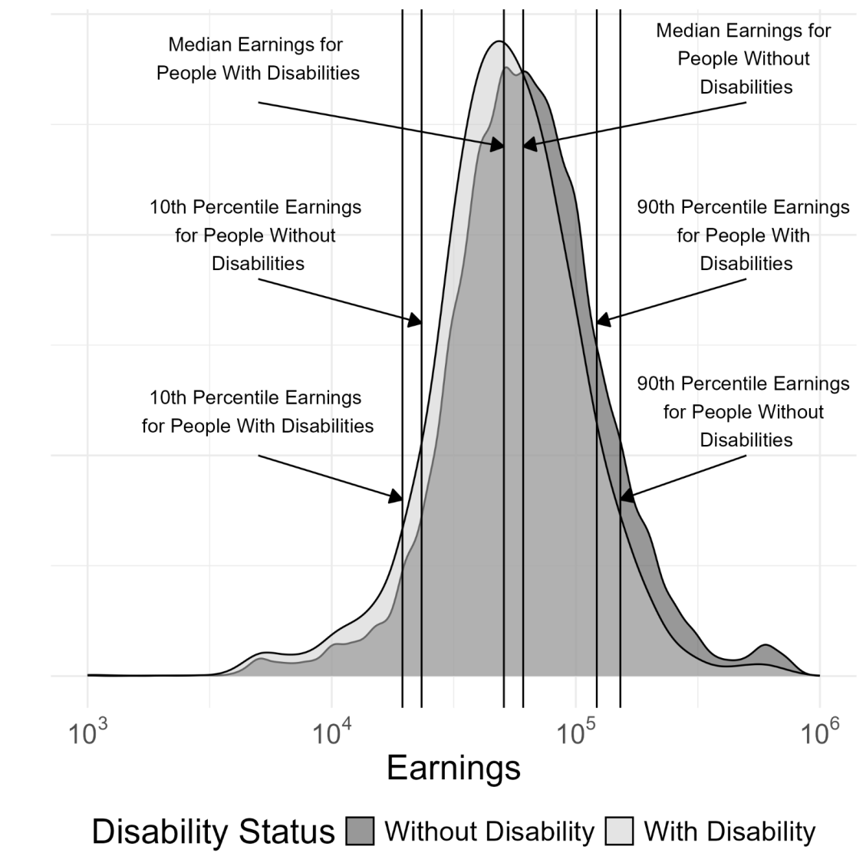
Earnings
2026 Disability Statistics
Kernel Density Plot of Annual Earnings Full-Time, Full-Year Civilian Workers Ages 18-64 in the United States with and without Disability (in 2024 Inflation-Adjusted Dollars): 2024
Section 5

Slide 44
Earnings
U.S. (2024) For CFTFY. $ 2024 inflation adjusted | People with Disabilities $ (ME$) | $ Gap
10th Percentile Earnings | 19,493 (812) | -3,858*
25th Percentile Earnings | 32,488 (1,015) | -6,092*
Median Earnings | 50,762 (2,030) | -10,152*
Mean Earnings | 65,353 (620) | -16,313*
75th Percentile Earnings | 80,205 (1,015) | -17,259*
90th Percentile Earnings | 121,830 (5,076) | -30,458*
2026 Disability Statistics
CFTFY: Civilian 18-64 Workers Working full-time full-year
Section 5
* Statistically non-zero

Slide 45
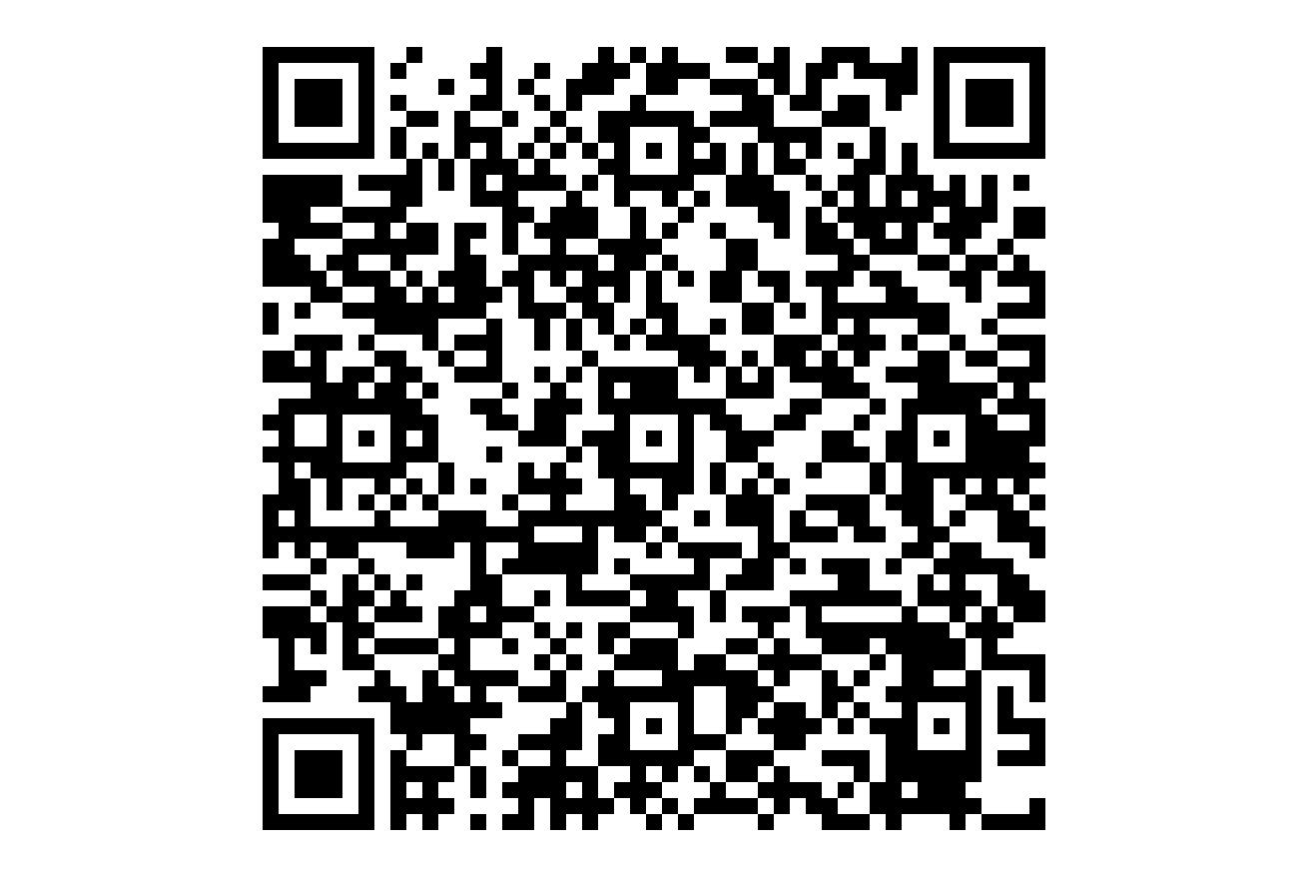
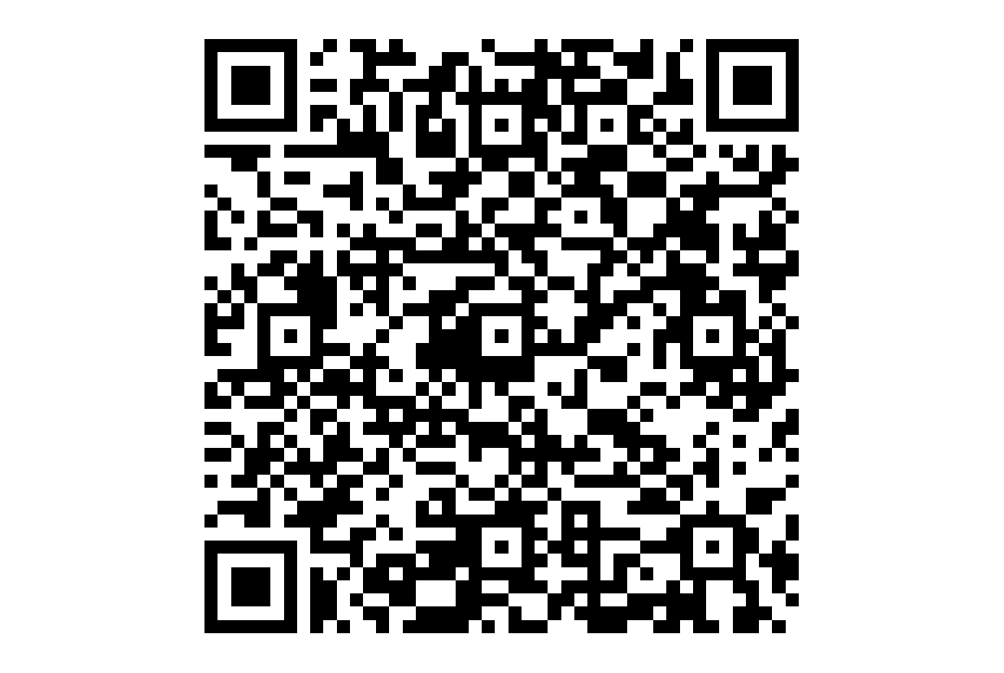
Build Your Own Statistics
State BYOS
https://www.researchondisability.org/annual-disability-statistics-collection/build-your-own-statistics/build-your-own-statistics-state-national-level-statistics
County BYOS
https://www.researchondisability.org/annual-disability-statistics-collection/build-your-own-statistics/build-your-own-statistics-county-level-statistics

Slide 46
References
1 . Rehabilitation Research and Training Center on Disability Statistics and Demographics (RRTC), 2009. Annual Compendium of Disability Statistics: 2009, Hunter College. disabilitycompendium.org
2. Thomas, N., Kingsbury, S., Lansing, J., & Houtenville, A. (2026). Annual Disability Statistics Compendium: 2026 (various tables). Durham, NH: University of New Hampshire, Institute on Disability. researchondisability.org

Slide 47
Thank You Stacia: Stacia.Kingsbury@unh.edu Nate: Nathan.Thomas@unh.edu TA: Disability.Statistics@unh.edu

Slide 48
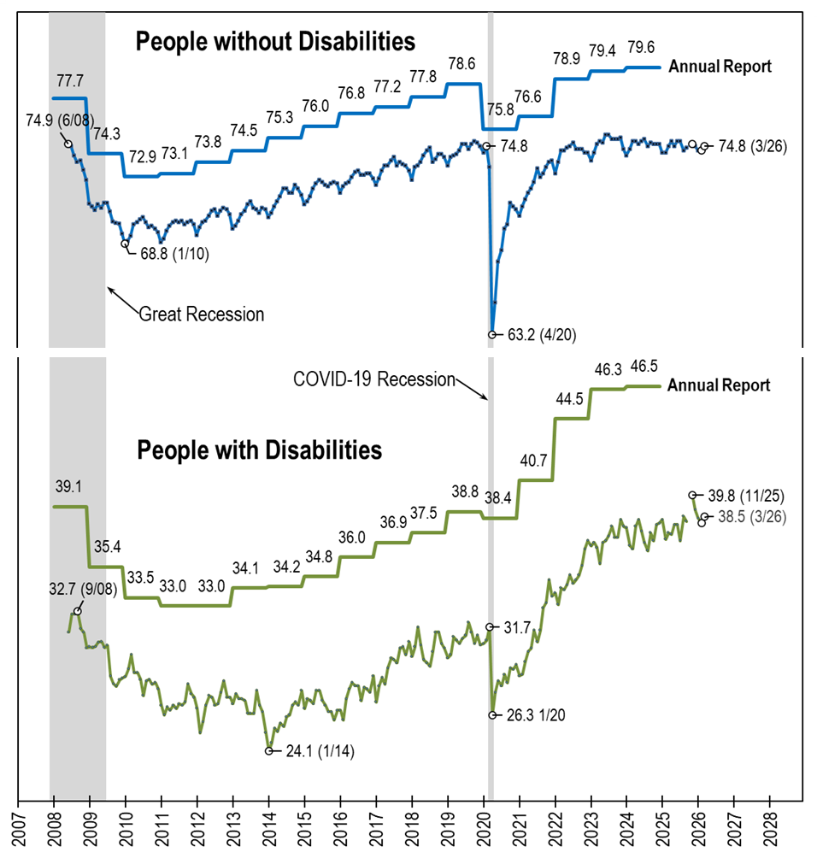
Employment- to-Population Ratio: Comparing: nTIDE (Ages 16-64) AnnRpt (Ages 18-64)
Notes:
[Repeat of text from the photo’s alt text] A line chart with four lines, comparing the employment-to-population ratio trend lines from nTIDE, which uses CPS monthly data (June 2008-March 2026) and the Annual Report, which uses ACS annual data (2008-2024). Basically, the trend lines from the annual report (one for people with disabilities and one for people without disabilities) are overlayed on top of the standard trend lines from nTIDE. Overall, they follow the same pattern, which acts to verify the two data sources. The trend lines for from nTIDE are always lower than those of the Annual Report, in part because nTIDE includes 16 and 17 year olds, who are less likely to be employed.

Slide 49

Thank You!
Information about the nTIDE partners may be found at
Kessler Foundation (www.kesslerfoundation.org)
UNH/Institute on Disability (www.ResearchOnDisability.org)
AUCD (www.AUCD.org)
Contact us at
Email: Disability.Statistics@unh.edu
Call: 866-538-9521 (toll free)
Twitter at #nTIDELearn

Slide 50
Bye!

