Slide 1
nTIDE Lunch & Learn Webinar Series
Kessler Foundation, AUCD, University of New Hampshire Institute on Disability Season 11, Episode 3 Date: March 6, 2026

Slide 2

nTIDE Lunch & Learn Webinar Series
Kessler Foundation, AUCD, University of New Hampshire Institute on Disability Season 11, Episode 3 Date: March 6, 2026

Slide 3
Up Front Matters
This webinar is being recorded. We will post an archive of along side the Monthly nTIDE broadcast on our webinar, each month, on our website at www.researchondisability.org/nTIDE. This site will also provide copies of the presentations, the speakers’ bios, full transcripts, and other valuable resources.
As an attendee of this webinar, you are a viewer. To ask questions of the speakers, click on the Q & A box on your webinar screen and type your questions into the box. Speakers will review these questions and provide answers during the last section of the webinar. Some questions may be answered directly in the Q & A box.

Slide 4
Up Front Matters – Contact Info
If you have any questions following this recording, please contact us at disability.statistics@unh.edu, or toll free at 866-538-9521 for more information. Thanks for joining us. Enjoy today's webinar!

Slide 5
Welcome to the nTIDE Lunch & Learn
Occurs at noon Eastern-time on the first Friday day of each month, with the release of the nTIDE Report.
A joint effort of the University of New Hampshire, Kessler Foundation, and the Association of University Centers on Disabilities (AUCD).

Slide 6


Slide 7
Today’s Special Session: Disability Employment Beyond Traditional Workforce Models
Part 1: nTIDE Report … “The Numbers”
Andrew Houtenville, University of New Hampshire
John O’Neill, Kessler Foundation
Part 2: nTIDE News
Shoshana Marin, Association of University Centers on Disabilities (AUCD)
Part 3: Guest Speakers
Helen Genova, Kessler Foundation
Part 4: Q&A

Slide 8
Part 1: The nTIDE Report
John O’Neill
Kessler Foundation

Slide 9
The Monthly nTIDE Report
The monthly nTIDE Report is a press release and infographic, looking at the latest employment statistics.
Uses data from the “jobs report” released by the U.S. Bureau of Labor Statistics, on the 1st Friday of each month.

Slide 10
Source of the Data
U.S. BLS, Current Population Survey (CPS).
Source of the “official” unemployment rate.
Civilians, ages 16-64, not living in institutions.
Available September 2008 onward.
Not yet seasonally adjusted.
which is why we compare to the same month last year.

Slide 11
The Numbers
Andrew Houtenville University of New Hampshire

Slide 12
Employment- to-Population Ratio:
Notes:
Blank page other than the title.

Slide 13
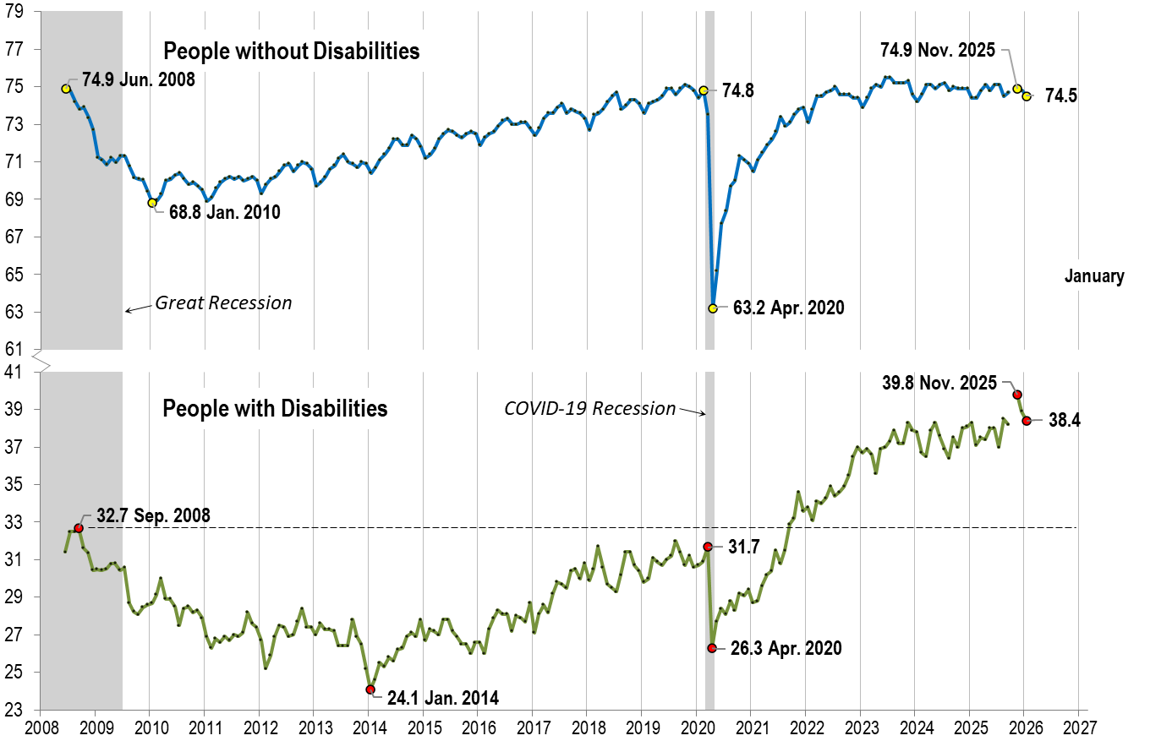
Employment- to-Population Ratio: January
Notes:
Chart Details:
The data series starts in June 2008 during the Great Recession which lasted until Mid-2009. The COVID-19 Recession started in April 2020 and last for two months.
Visible Data points (highlights start of the series, the lowest point pre-covid, the points right before and after the Covid-19 recession hit, and the current Employment-to-Population Ratio
People without Disabilities:
June 2008 74.9
January 2010 (lowest point pre-covid) 68.8
February 2020 74.8
April 2020 (Covid-19 Recession hits) 63.2 (lowest point)
November 2025 74.9
January 2026 74.5
People with Disabilities:
September 2008 32.7
January 2014 (lowest point pre-covid) 24.1 (lowest point)
March 2020 31.7
April 2020 (Covid-19 Recession hits) 26.3
November 2025 39.8
January 2026 38.4

Slide 14

Employment- to-Population Ratio: February
Notes:
Chart Details:
This is the same trend line as before with the two trendlines extended one month
People without Disabilities go from:
January 2026 74.5
February 2026 38.1
People with Disabilities go from:
January 2026 38.4
February 2026 38.1

Slide 15
Labor Force Participation Rate:
Notes:
Blank page other than the title.

Slide 16
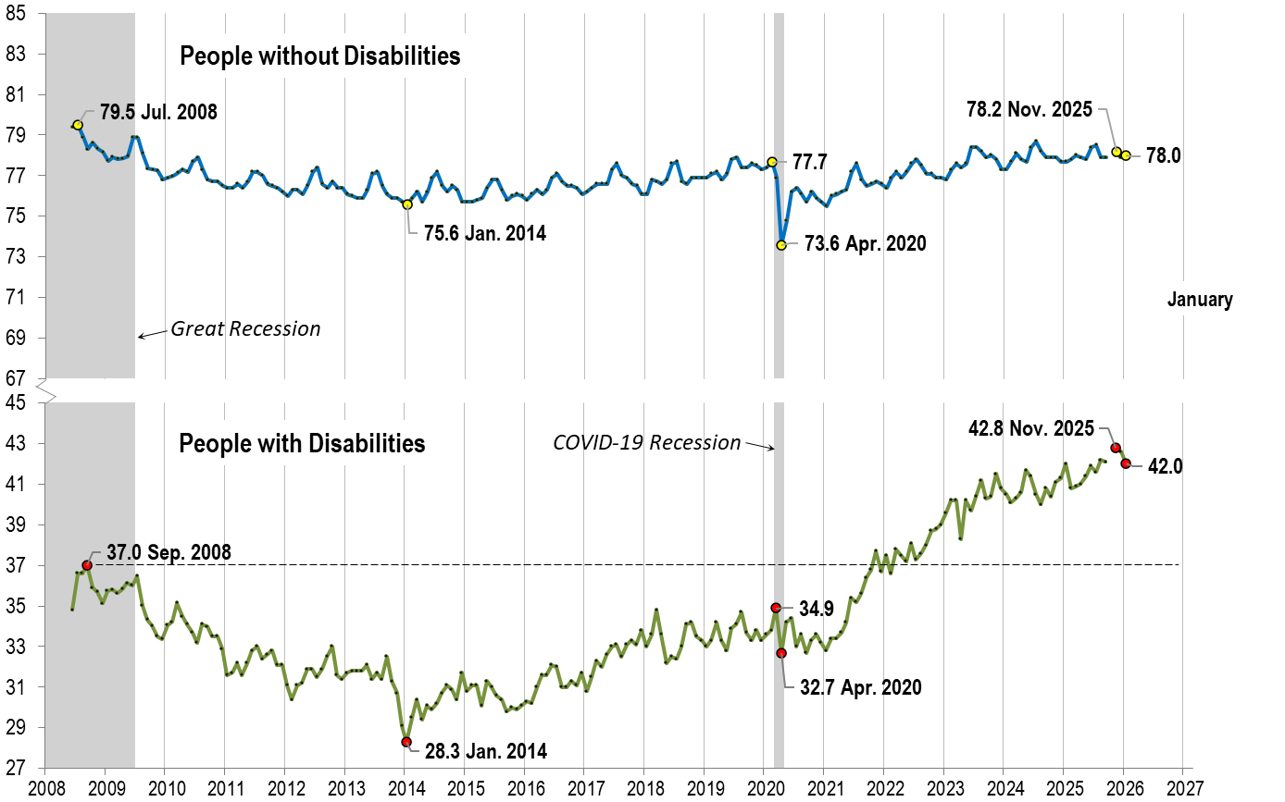
Labor Force Participation Rate: January
Notes:
Chart Details:
The data series starts in June 2008 during the Great Recession which lasted until Mid-2009. The COVID-19 Recession started in April 2020 and last for two months.
Visible Data points (highlights start of the series, the lowest point pre-covid, the points right before and after the COVID-19 recession hit, and the current labor force participation rate.
People without Disabilities:
July 2008 79.5
January 2014 (lowest point pre-covid) 75.6
February 2020 77.7
April 2020 (Covid-19 Recession hits) 73.6 (lowest point)
November 2025 78.2
People with Disabilities:
September 2008 37.0
January 2014 28.3 (lowest point)
March 2020 34.9
April 2020 (Covid-19 Recession hits) 32.7
November 2025 42.8

Slide 17

Labor Force Participation Rate: February
Notes:
Chart Details:
This is the same trend line as before with the two trendlines extended one month
People without Disabilities go from:
January 2026 78 .0
February 2026 78.1
People with Disabilities go from:
January 2026 42 .0
February 2026 41.8

Slide 18
Part 2 nTIDE News
Shoshana Marin
Association of University Centers on Disabilities (AUCD)

Slide 19
Government Funding
Congressional appropriators are beginning to plan for Fiscal Year 2027 appropriations
This is a crucial time when organizations, lobbyists, constituents schedule meetings with Congressional staff to ask for certain amounts of funding or report language
Connection to disability employment: Disability employment programs funded through annual federal appropriations primarily support vocational rehabilitation, policy development, and competitive integrated employment (CIE) initiatives. Major programs include Vocational Rehabilitation State Grants (authorized by IDEA), the Office of Disability Employment Policy (ODEP) initiatives and (in the past) the Disability Innovation Fund (DIF).

Slide 20
GAO Report on Disabled Job Seekers
The Government Accountability Office (GAO) released a new report on the challenges facing disabled job seekers. The report reviewed:
The number of people participating in certain Department of Labor (DOL) workforce programs, the services they use, and their employment outcomes
What state and local workforce agencies are doing to make sure that the programs are accessible to people with disabilities
DOL’s efforts to make sure that the programs are accessible
GAO’s investigation found that state and local workforce agencies face challenges to ensuring that programs are accessible, and DOL’s oversight of these programs is not comprehensive. GAO found gaps in data collection, and recommended that the Secretary of Labor collect more data on the types of disabilities people in workforce programs had.
Notes:
The report was requested by House Education and Workforce Committee Ranking Member Bobby Scott (D-VA) and Frederica Wilson (D-FL)
Reviewed the programs authorized by the Workforce Innovation and Opportunity Act (WIOA), which established “a system for federal, state, and local entities to implement workforce employment and training programs.” WIOA mandates that job centers and workforce programs are physically and programmatically accessible to people with disabilities, allowing accommodations when needed.
DOL disagreed with this recommendation on the grounds that “it does not require participants to disclose information on their disability type, consistent with non-discrimination provisions and supporting regulations of the Americans with Disabilities Act.” The Administration used a similar argument when it issued a proposed rule to revise regulations implementing Section 503 of the Rehabilitation Act, which you can read more about in this previous issue of DPN. DOL did agree with GAO’s recommendations for the Secretary of Labor to “develop a written procedure for routinely analyzing DOL's state monitoring reports” and “evaluate state and local workforce agencies' awareness and use of guidance.”

Slide 21
Department of Housing and Urban Development (HUD) Proposed Rule
The Department of Housing and Urban Development on Friday released a proposed rule allowing public housing authorities and certain landlords that rent to federally subsidized tenants to implement work requirements and time limits for nonelderly, nondisabled families.
HUD’s existing Moving to Work programs have allowed a select group of local public housing authorities to experiment with employment incentives and requirements for tenants. The newest proposed rule, which is set for publication on the Federal Register on Monday, will expand that permission to most public and federally supported housing managers, except for those in receivership or poor standing with the department.
https://public-inspection.federalregister.gov/2026-04095.pdf?source=email

Slide 22
National Apprenticeship Week 2026
DOL announced that National Apprenticeship Week 2026 will take place from April 26 to May 2. This annual celebration showcases how Registered Apprenticeship programs advance worker mobility and meet employers’ workforce needs by preparing Americans for jobs in high-growth, high-demand industries, including manufacturing, technology, and infrastructure. This year’s theme is “America at Work: Making America Skilled Again Through Registered Apprenticeship.”
Notes:
Wendy Strobel Gower, Development and Dissemination Lead, EARN
Wendy Strobel Gower is the Thomas P. Golden Executive Director at the K. Lisa Yang and Hock E. Tan Institute on Employment and Disability. Wendy leads the Development and Dissemination Team. Wendy has almost 30 years’ experience in employment and disability and has been with Cornell University for 14 years. She has extensive experience with knowledge translation, product development and project leadership. Wendy has a master’s degree from the Medical College of Virginia at Virginia Commonwealth University.
Tracie DeFreitas, Program Leader and Director of Training and Outreach, JAN
(can’t find longer bio)

Slide 23
Report
ICI UMN IMPACT: The Language of Inclusion
Plain language is both a tool and a movement. It means speaking or writing so that people understand the first time they read or hear it. It is not just about using short words or sentences. It is about making information accessible. We deserve to understand information about our lives, health, money, and futures. Plain language helps people with and without disabilities understand and remember information. It helps people make their own decisions. Written by Becca Monteleone, University of Toledo in Toledo, Jerry Smith, Institute on Community Integration at the University of Minnesota (ICI MN), and Liz Weintraub, AUCD.
Notes:
Wendy Strobel Gower, Development and Dissemination Lead, EARN
Wendy Strobel Gower is the Thomas P. Golden Executive Director at the K. Lisa Yang and Hock E. Tan Institute on Employment and Disability. Wendy leads the Development and Dissemination Team. Wendy has almost 30 years’ experience in employment and disability and has been with Cornell University for 14 years. She has extensive experience with knowledge translation, product development and project leadership. Wendy has a master’s degree from the Medical College of Virginia at Virginia Commonwealth University.
Tracie DeFreitas, Program Leader and Director of Training and Outreach, JAN
(can’t find longer bio)

Slide 24
Webinar
We’re Here. Then, Now, Always. The Evolving Role of DD Councils in Employment
March 10, 2026, 3:00-4:30 PM Eastern Time
In recognition of Developmental Disabilities Awareness Month (DDAM), join the Disability Employment Technical Assistance Center (DETAC) for a webinar featuring partners from the National Association of Councils on Developmental Disabilities (NACDD), the Nebraska DD Council, and NACDD self-advocate apprentice, Bryan Dooley.
Notes:
Wendy Strobel Gower, Development and Dissemination Lead, EARN
Wendy Strobel Gower is the Thomas P. Golden Executive Director at the K. Lisa Yang and Hock E. Tan Institute on Employment and Disability. Wendy leads the Development and Dissemination Team. Wendy has almost 30 years’ experience in employment and disability and has been with Cornell University for 14 years. She has extensive experience with knowledge translation, product development and project leadership. Wendy has a master’s degree from the Medical College of Virginia at Virginia Commonwealth University.
Tracie DeFreitas, Program Leader and Director of Training and Outreach, JAN
(can’t find longer bio)

Slide 25
Part 3 nTIDE Guest Speaker Helen Genova Kessler Foundation

Slide 26
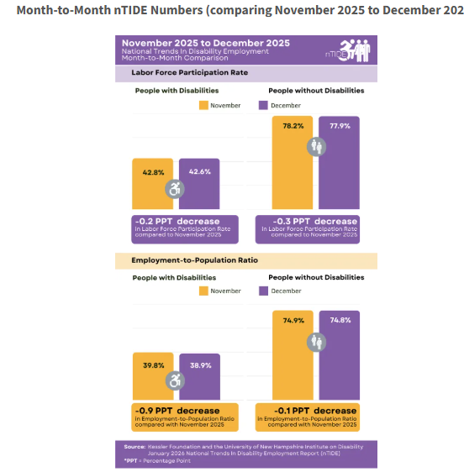
Current nTIDE Infographics
Notes:
This slide is the bar charts that are part of the nTIDE press release.

Slide 27
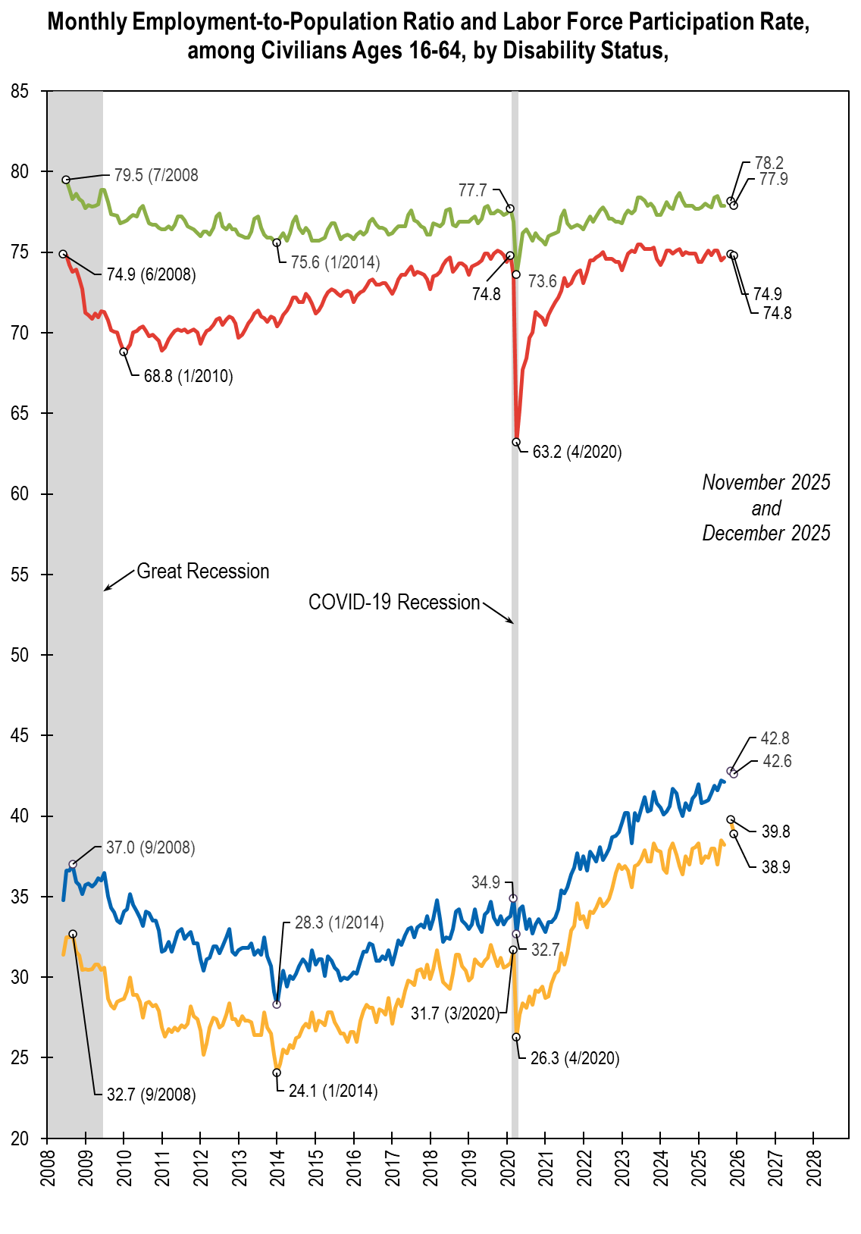
Possible New nTIDE Infographics
Notes:
A possible new nTIDE Infographic that mimics and combines the time trend graphs presented in nTIDE (above) and has the employment-to-population ratio and labor force participation rates all in the same graph.

Slide 28

Thank You!
Information about the nTIDE partners may be found at
Kessler Foundation (www.kesslerfoundation.org)
UNH/Institute on Disability (www.ResearchOnDisability.org)
AUCD (www.AUCD.org)
Contact us at
Email: Disability.Statistics@unh.edu
Call: 866-538-9521 (toll free)
Twitter at #nTIDELearn

Slide 29
Bye!

