Slide 1
From Noisy Data to Reliable County Disability Estimates
Center for Studying Disability Policy
2026 Annual Disability Statistics Conference
Yonatan Ben-Shalom
March 18, 2026

Slide 2
County-level disability and employment data matter for service delivery and policy
Many estimates based on the large American Community Survey (ACS) are too unreliable for local use
Small sample sizes yield large margins of error, especially when broken down into demographic groups

Slide 3
We used Bayesian methods to improve stability and precision of county-level estimates
Data
  Public ACS summary tables from IPUMS NHGIS (2015–2019)
Measures
  Prevalence of any disability (by sex and age)
  Employment rate (by disability status)
  Prevalence of self-care disability (by sex and age)
Method
  Bayesian model borrows strength across counties and groups
  Incorporates published margins of error (MOEs)

Slide 4
How can this help state disability-related initiatives?
Facilitate planning in rural areas with previously missing or unreliable data
  Example: help vocational rehabilitation agencies identify underserved areas and tailor outreach strategies

Slide 5
Our county-by-group estimates are more stable, precise, and reliable than raw ACS estimates

Slide 6
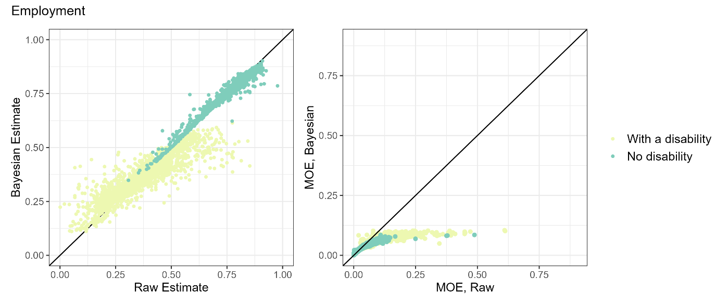
We find similar but muted improvements for employment rate estimates

Slide 7
One more example: self-care disability

Slide 8
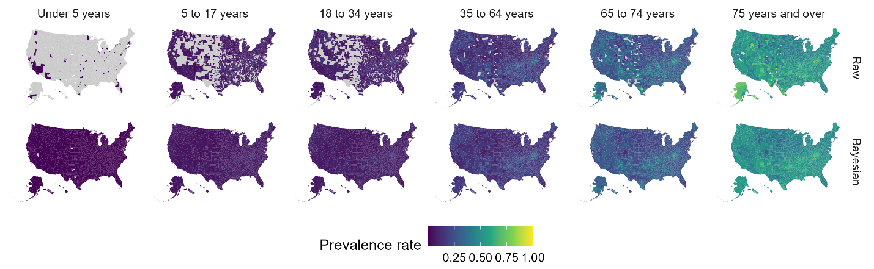
Any disability (national)

Slide 9
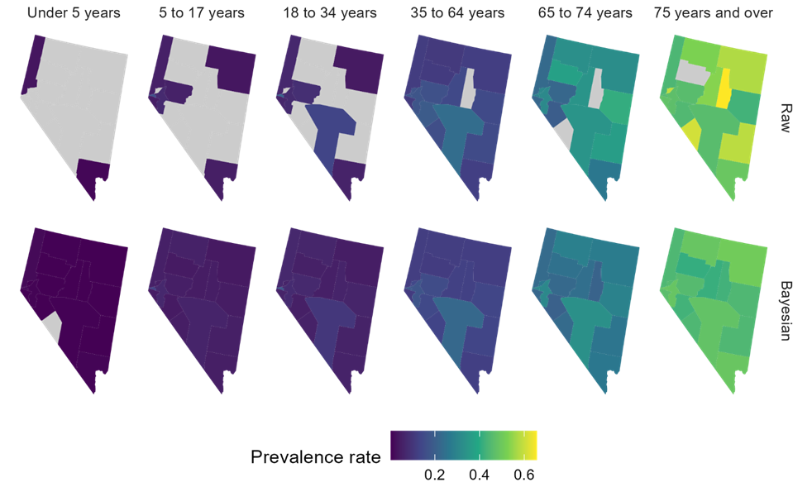
Any disability (NV)

Slide 10
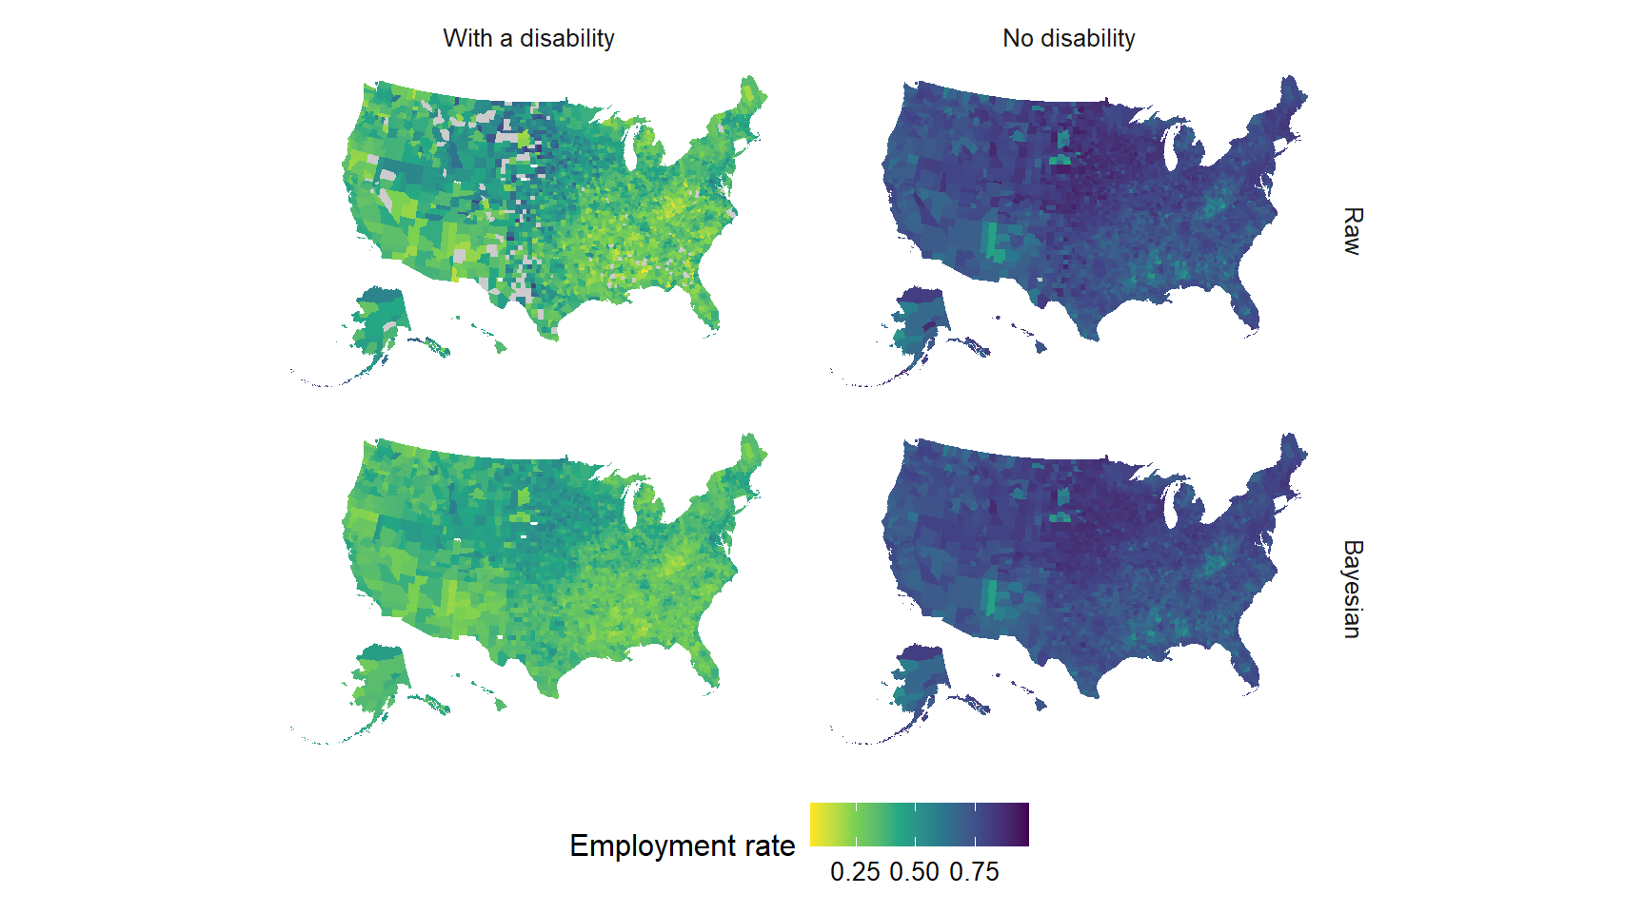
Employment (National)

Slide 11
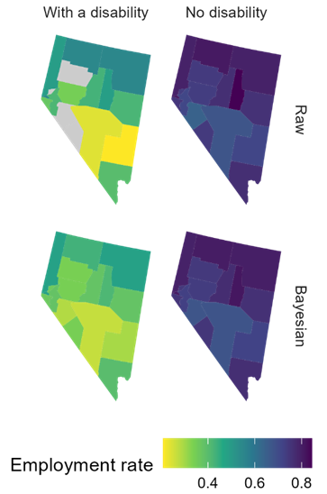
Employment (NV)

Slide 12
Key takeaways
Bayesian approach provides more precise and complete information to support better local decisions
Method is adaptable for SNAP, Medicaid, insurance coverage, etc.
Reproducible with publicly available ACS data tables

Slide 13
What’s in the OpenICPSR data?
Link: https://www.openicpsr.org/openicpsr/project/238616
Data dictionary
CSV files with county/group-level raw and Bayesian estimates
  Based on 2015-2019 ACS data
  One file per measure (e.g., any disability, employment, self-care disability, etc.)
  Grouping varies by measure (e.g., age groups, disability status, poverty level, veteran status)

Slide 14
Contact information
Yonatan Ben-Shalom
yben-shalom@mathematica-mpr.com

Slide 15
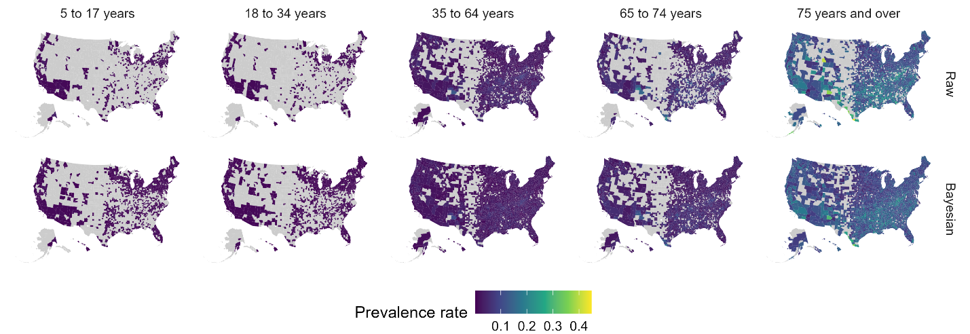
Self-care disability (national)

Slide 16
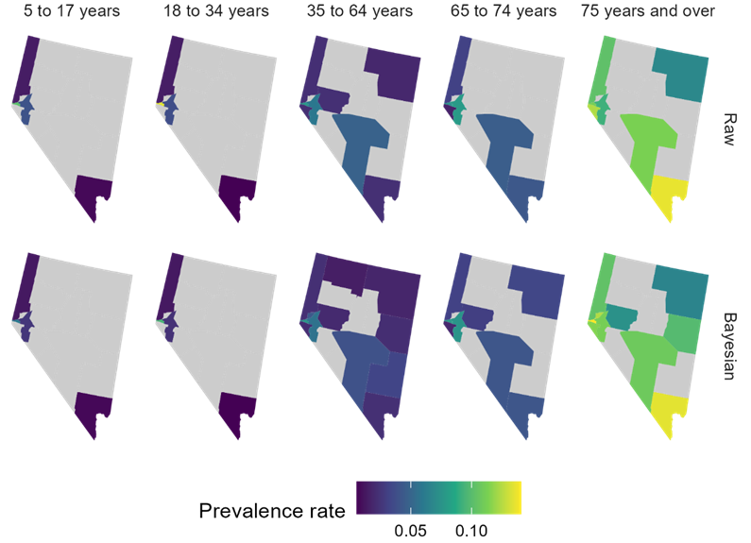
Self-care (NV)

Slide 17
Study limitations
Dropped small number of cells where raw estimates were too noisy to provide and useful information
Did not borrow strength based on proximity or similarities between counties
Did not borrow strength across all demographic factors

