Slide 1
Rural Disability Measurement and Trends
Research and Training Center on Disability in Rural Communities (RTC:Rural) at the University of Montana
Dr. Catherine Ipsen

Slide 2
Who – What – Where… is Rural America?
More than a dozen different definitions
County, zip, census tracts, urban areas
Population, housing, commuting patterns, economic activity
72% - 97% of total landmass
15-20% of total U.S. population
Rural is a broad term – anything not “urban”
Urban-centric, deficit-based concept
We primarily use county-based classifications set by the Office of Management and Budget.

Slide 3
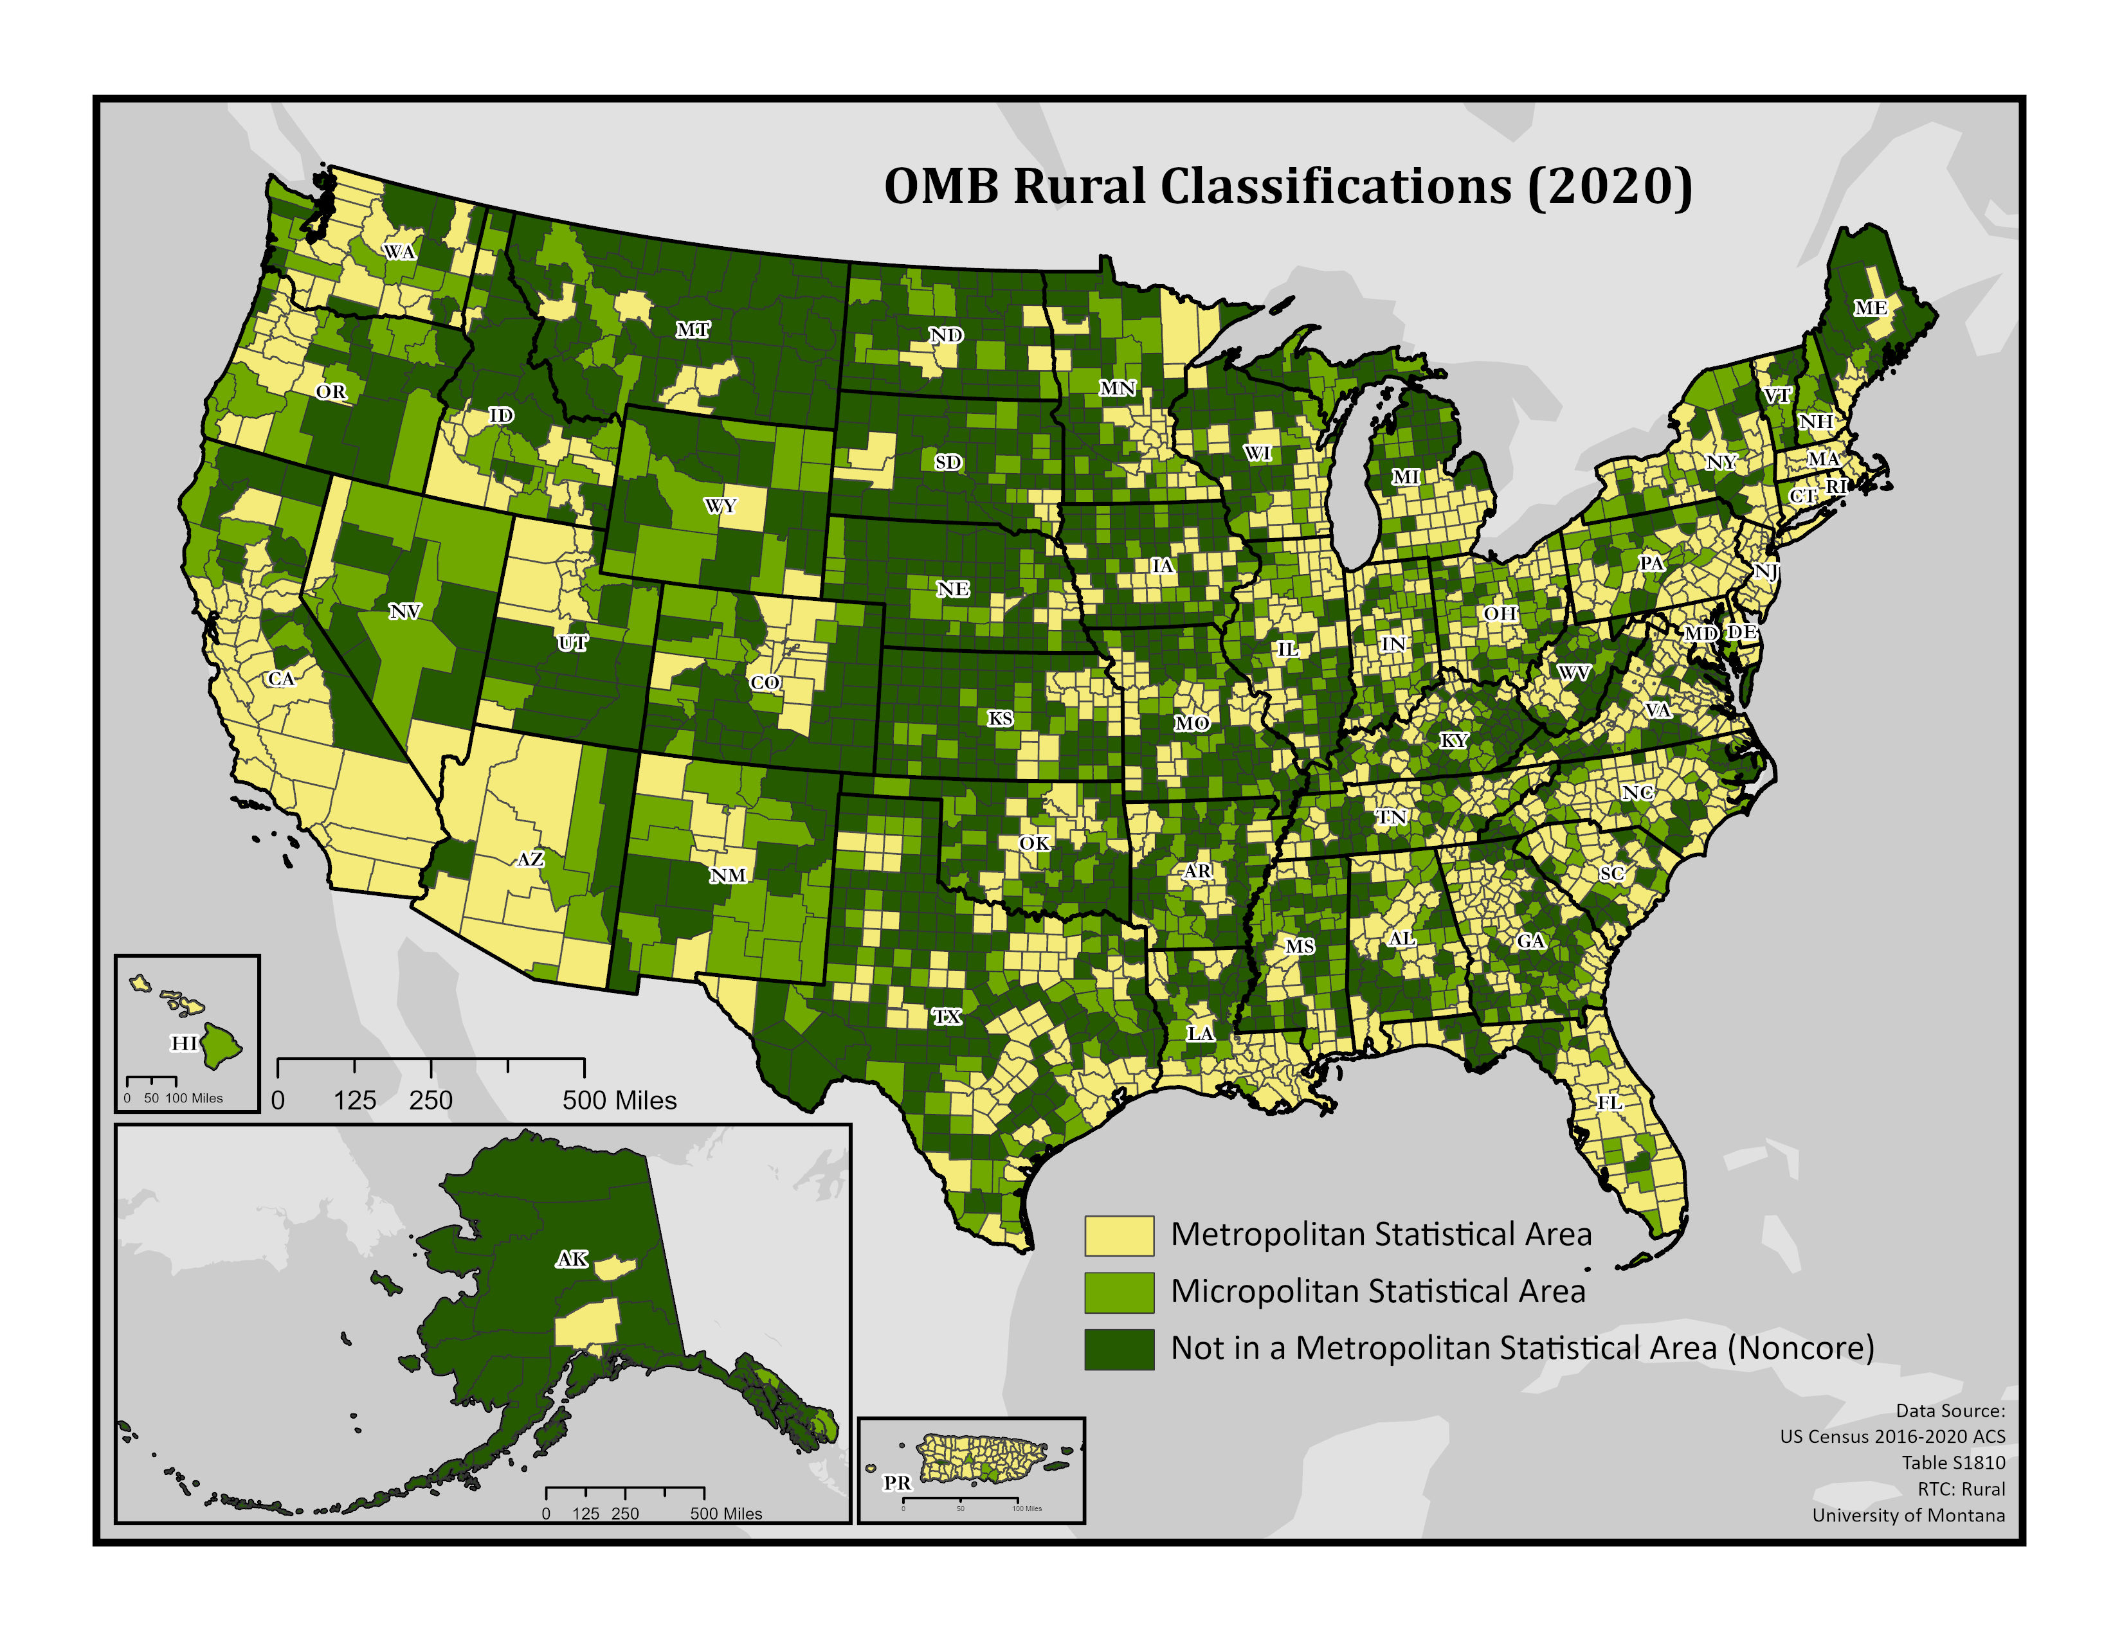
Office of Management and Budget (OMB)
Rural = Non-Metropolitan
Metro: counties with an urban area 50,000+
Micropolitan: counties with urban core 10,000 – 50,000
Noncore: counties with urban cluster less than 10,000
Considers population, density, and social/economic ties to adjacent counties
Pros: Aligns well with common data delineations (county)
Cons: Excludes areas that might otherwise be rural, under-count of rural
Notes:
OMB classifies counties into three categories, metro, micro, and noncore
Classifications area based on population, density and social/economic ties to adjacent counties.
The pros of OMB classifications are that they are delineated at the county level, which allows for matching with other county level indicators.
In contrast to the US Census definition, which overcounts rural, the OMB definition undercounts rural, as large counties capture many rural places.

Slide 4
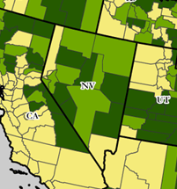
Large counties are a problem
Nevada
Micropolitan counties are largely noncore
Humboldt County: 17,028 pop; 9,600 sq miles, 1.77 people per square mile
Nye County: 58,554 pop, 18,200 sq miles, 3.21 people per square mile
Eureka County: 1,835 pop; 4,200 sq miles; .44 people per square mile
Commuting patterns between Elko and Eureka counties account for this perplexing designation
Metropolitan counties have vast noncore areas
Washoe county: Includes Reno in South, but is 200 miles from the Oregon border. Towns along the way include Vya: ghost town; Gerlach: pop 53; Empire: pop 70; Sand Pass: pop 50. Also includes the Pyramid Lake Paiute Reservation.
Humbolt
Washoe
Elko
Eureka
Nye

Slide 5
ACS 5-year data estimates
Complete county level data requires 5-year estimates to examine rural county demographics
Key indicators are dampened
E.g. employment rates during COVID
Notes:
ACS data is provided in both 1 year summary files and 5 year summary files. Data about rural communities can only be accessed within the 5-year data provides to protect privacy. Even then, with data aggregated across 5 years, there are high margins of error for many rural counties.
This is problematic, however, for telling a cohesive story about what is happening in rural vs urban communities. Key indicators are dampened when considering 1 year vs 5 year estimates. To illustrate this point, consider the differences in the one year and 5 year estimates of the civilian employment rate.
Additionally, 5-year data profiles do not allow for many subgroup analyses. For instance, while we can say something about male vs female people with disabilities, we cannot say anything about people whose identities are black and disability or employed, home-owner, with disability.
Also, to compare different counties, the unit of analysis in county level rates (e.g. percent of people with disabilities or percent of people living in poverty). This results in comparisons between counties that may look drastically different, such as flathead county (5,256 square miles) and rosebud county (5,027 square miles).
Both classified as rural (one micropolitan and one non-core). Add another county (apples to apples) Hill county – micropolitan with 16, 096 people across 2,899 counties. Flathead is fastest growing county in Montana (24%) with high rates of tourism. Havre is on the high line…a desolate area of the state that is losing population (-1.4%).
The ACS has person level files called PUMAs which are aggregated to 100,000 people within a state. The aggregation can make it difficult to parse out the rural story, since small places such as rosebud county are rolled in with places with larger populations. I recently read a paper that indicated PUMA files now include some rural urban continuum level codes. However, from my understanding these do not match with other codes.
Finally, any changes to the ACS survey, delays opportunities for comparable data at the urban and rural levels.

Slide 6
ACS Rural Limitations
Even with 5-year estimates, MOEs for many rural counties are very large
Estimates lack information on sub-groups
Black and disability
Employed, home-owner, and disability
Compares rates across geography, rather than weighted by population
County as unit of analysis
Flathead county rates (108, 454)
Rosebud county rates (8,124)
Public use micro sample (PUMS) and Public Use Microdata Areas (PUMAs)
Person level files aggregated to 100,000 within a state
Merges geographies so difficult to tell rural story
Survey changes delay comparable data
Wait 5-years for cross-sectional estimates
Wait 10-years for 5-year trend data

Slide 7
Disability Type

Slide 8
Disability by Age

Slide 9
Poverty by Disability

Slide 10
Disability by Region

Slide 11
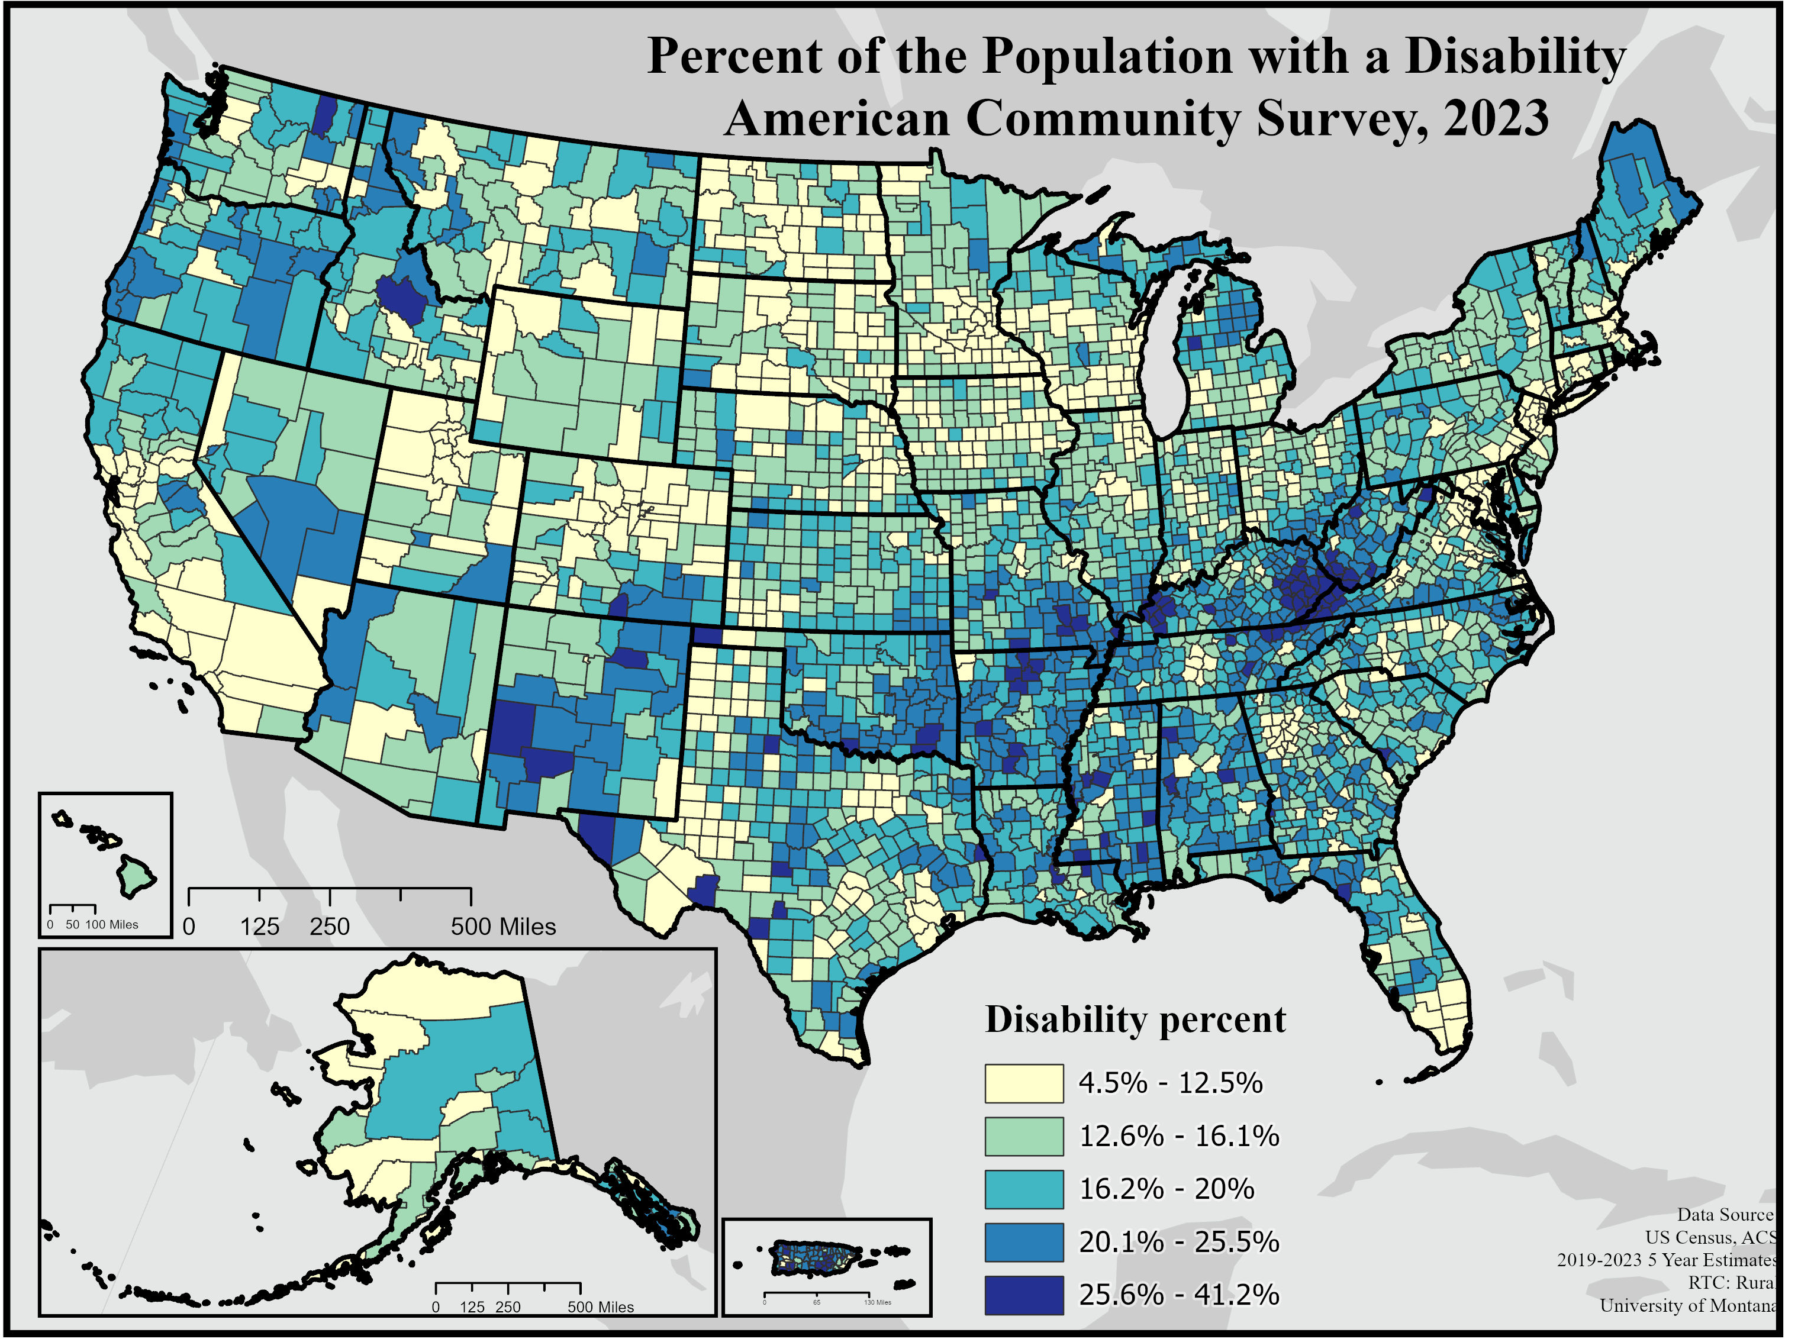
Aggregation masks geographic variation.

Slide 12
Needs for better rural disability data
It’s hard to tell an accurate and complete story of rural disability due to limited data and varied definitions across data sets for both rural and for disability variables.
Rural data collection is difficult
Lower response rates
Anonymity vs. usefulness
Small sample sizes + large margins of error = imperfect estimates
Narratives of lived experience matter for improving disability measurement

Slide 13
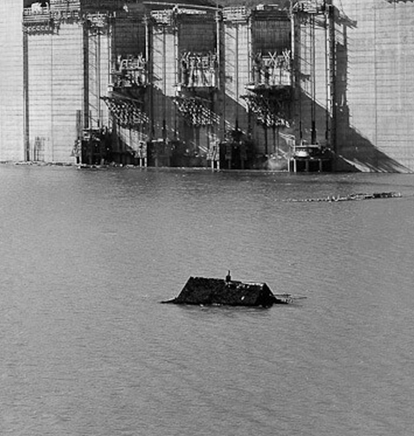
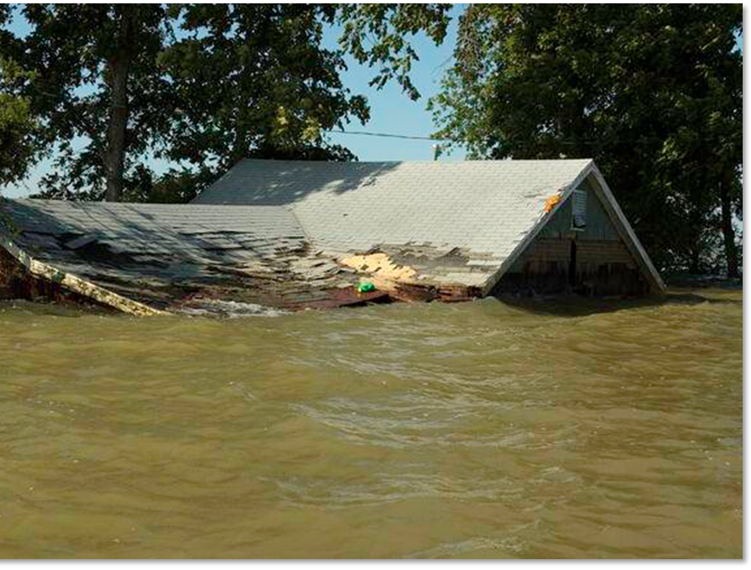
Data Impacts
Most data collecting entities are urban with urban centric priorities and methodologies. We need to ask:
Why are we collecting these data? / What are the questions we are answering?
Who are these data for? / Whose priorities do this efforts reflect?
People do not see the data working for them
Out of sync with rural values and experiences
Results in a continued cycle of marginalization and distrust
Photo Credit: Bureau of Reclamation
Photo Credit: Steve Zumwalt, FEMA
Notes:
Photo of a submerged house due to the construction of the Shasta, Dam in the 1940s
Photo from Pimhook, MO which was flooded in 2011 by the Army Corp of Engineers to remove pressure on a floodwall that protected Cairo, Illinois
Decision-making relies on data – and historically punished places with lower economic activity and populations with less political and sociodemographic clout.

Slide 14
Building trust through inclusion
Both rural communities and the disabled people within them share a history of being underserved and under resourced
The solution is in the community
listening to communities about what is most important to measure
Inclusion and representation
ensuring that values and experiences are reflected in the data
Reciprocity of data collection
giving power back to the communities that are being analyzed

Slide 15
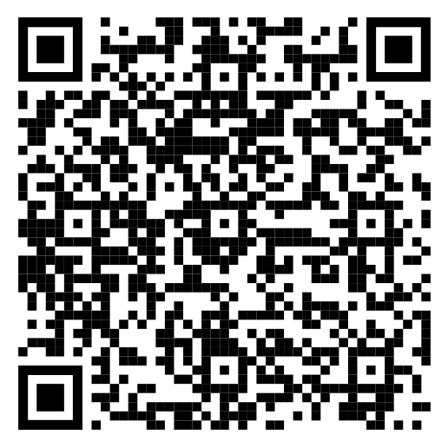
Thank you!
Understanding the Experience of Disabled Americans in Rural Communities through Data
Catherine.Ipsen@mso.umt.edu
Lillie.Greiman@mso.umt.edu

