Slide 1

We all do well when we all do well: Integrating rural and disability health policy
Kaitlin Bagley, MPH
Senior Program Manager, MCH Engagement
Association of University Centers on Disabilities

Slide 2
Disability + Rural Health Policy

Slide 3
Why do disability policy and rural health policy matter to each other?
Rural Health Policy
Disability Policy
People with disabilities are everywhere, including rural areas
Most people will become disabled at some point in their lifetime
Notes:
Aging!

Slide 4












Chronic Disease & Disability
1 in 4
Some healthcare providers:
Assume quality of life is lower for PWD
Refuse care for PWD
Request compensation for accommodations
Fail to provide reasonable accommodations
Americans with a disability
WHO
CDC
CMS
1 in 2
Americans with chronic disease
Differing definitions of disability and chronic disease
No consensus on how disability care should be taught
PWD delay and receive less preventive screening and testing
5.8 Million
Americans delayed care in 2017
Students and physicians with a disability are less likely to disclose and experience mistreatment
Significant lack of training for medical professionals
PWD = Person / People with disability(ies)
Created by Andrew Cope (AUCD Public Health and Disability Fellow)
Notes:
Setting the stage with some basic information on disability and chronic disease – many individuals with disabilities are also managing chronic conditions and do not receive adequate care.
Infographic created as a part of AUCD’s National Capacity Building Center for Disability and Public Health. We have a project funded by the CDC that aims to reduce health disparities among people with disabilities. This infographic was created after a literature review and environmental scan of literature in disability and chronic disease management.

Slide 5
Barriers to Care Amplified
Transportation
Availability of providers
Providers lack training
Lack of resources/technology
Lack of public transportation
Greater distances to travel
Scarcity of primary care and specialty providers
Less likely to find providers with adequate training on caring for people with disabilities
More difficult to find specialty equipment
Notes:
Many of the barriers to care experienced by PWD are amplified in rural settings.
Go through examples
Thus, any policies aiming to impact rural health need to include considerations for PWD. We need to ensure that the disability perspective is embedded in policy education and advocacy efforts.

Slide 6
Rural Health in the Federal Landscape

Slide 7
Health Policies that Impact Rural Populations
Rural Health Transformation Grants
Passed as part of the “One Beautiful Bill Act”
Empowers states to strengthen rural communities across America by improving healthcare access, quality, and outcomes by transforming the healthcare delivery ecosystem
Awards were decided by December 31, 2025
State award amounts announced early 2026
Notes:
How states will use these funds varies, opportunity to educate state leaders on the importance of including the perspective of PWD.

Slide 8
Health Policies that Impact Rural Populations
Protecting Telehealth Access
Bipartisan legislation to permanently extend Medicare telehealth flexibilities for rural communities
Protecting Rural Hospitals
Bipartisan legislation to strengthen the nation’s rural healthcare infrastructure and ease financial pressures faced by hundreds of rural hospitals across the country
Notes:
There have been several bills introduced so far in 2026 that aim to bolster rural health. Many of these bills fall into the following two categories. Much of the legislation is bipartisan. It will be important to include the perspective of PWD when advancing these bills and implementing them if they pass.

Slide 9
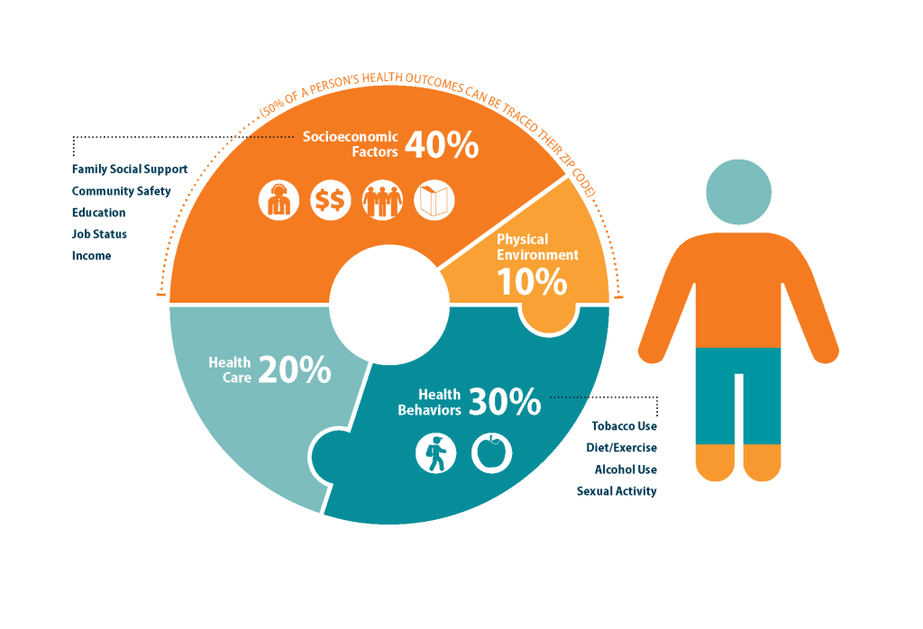
Other Policies that Impact Rural Health
50% of an individual’s health outcomes are due to socioeconomic and environmental factors
Opportunity to improve rural health through a “health in all policies” approach
Transportation
Education
Built environment
Food security
People with disabilities should be centered in ALL policies!
https://nhchw.org/social-determinants-of-health/
Notes:
Image from the New Hampshire Community Health Worker Coalition

Slide 10


Funding Opportunities
HRSA Federal Office of Rural Health Policy Grants and Programs: https://www.hrsa.gov/rural-health/grants
Rural Health Information Hub: https://www.ruralhealthinfo.org/funding

Slide 11

Thank you!
Contact Info:
Kaitlin Bagley
Senior Program Manager, MCH Engagement
AUCD
kbagley@aucd.org

