Slide 1
The Effect of Eliminating the 14(c) Subminimum Wage Programs on the Wage/Hours Surface of SSDI/SSI Beneficiaries
Xueting Sun, Ph.D.
Andrew Houtenville, Ph.D.

Slide 2
Purpose of the Study
Identify the impact of eliminating the 14(c) subminimum wage program on the wages and work hours of SSDI/SSI beneficiaries

Slide 3
Background Information
14(c) Subminimum Wage Program
  Program that allows to pay individuals with disabilities wages below the federal minimum
  Efforts to eliminate 14 (c)
  Concern about isolation and reduced hours of work
SSDI Cash Cliff & SSI Cash Slide
  Affects the wage may affect how many hours a person works because penalized if earn above Substantial Gainful Activity (SGA)
  Needs to be accounted for in any analysis

Slide 4
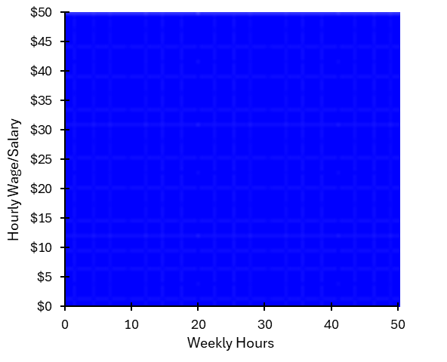
Combinations of Hourly Wage/Salary and
Weekly Hours

Slide 5
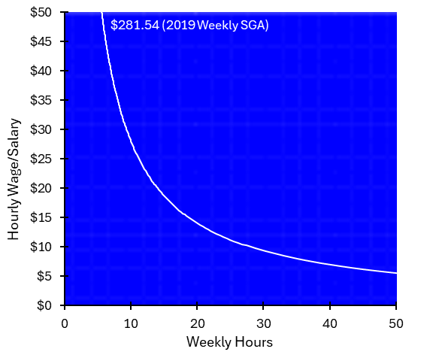
Combinations that yield a weekly value of SGA of $281.54 in 2019

Slide 6
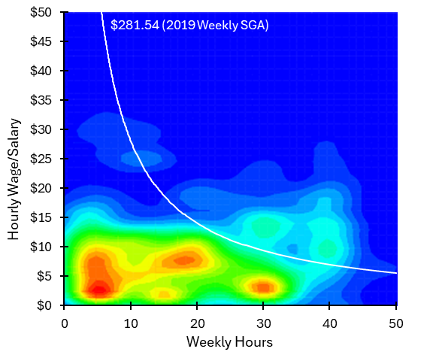
Combinations for civilians ages 22-64 with severe cognitive difficulty receiving SSDI/SSI in 2019
Bivariate Kernal Density Estimation
Of Cash Cliff/Slide
2019 data from the American Community Survey

Slide 7

Combinations add in Federal Minimum Wage
& Subminimum Wage

Slide 8
Identifying the Impact of Removing 14(c)
States Compared:
  Intervention group =Pennsylvania, Delaware, Virginia, and West Virginia
  Control group = Maryland
Years
  Pre-period = 2012-2015
  Post-period = 2016-2019

Slide 9
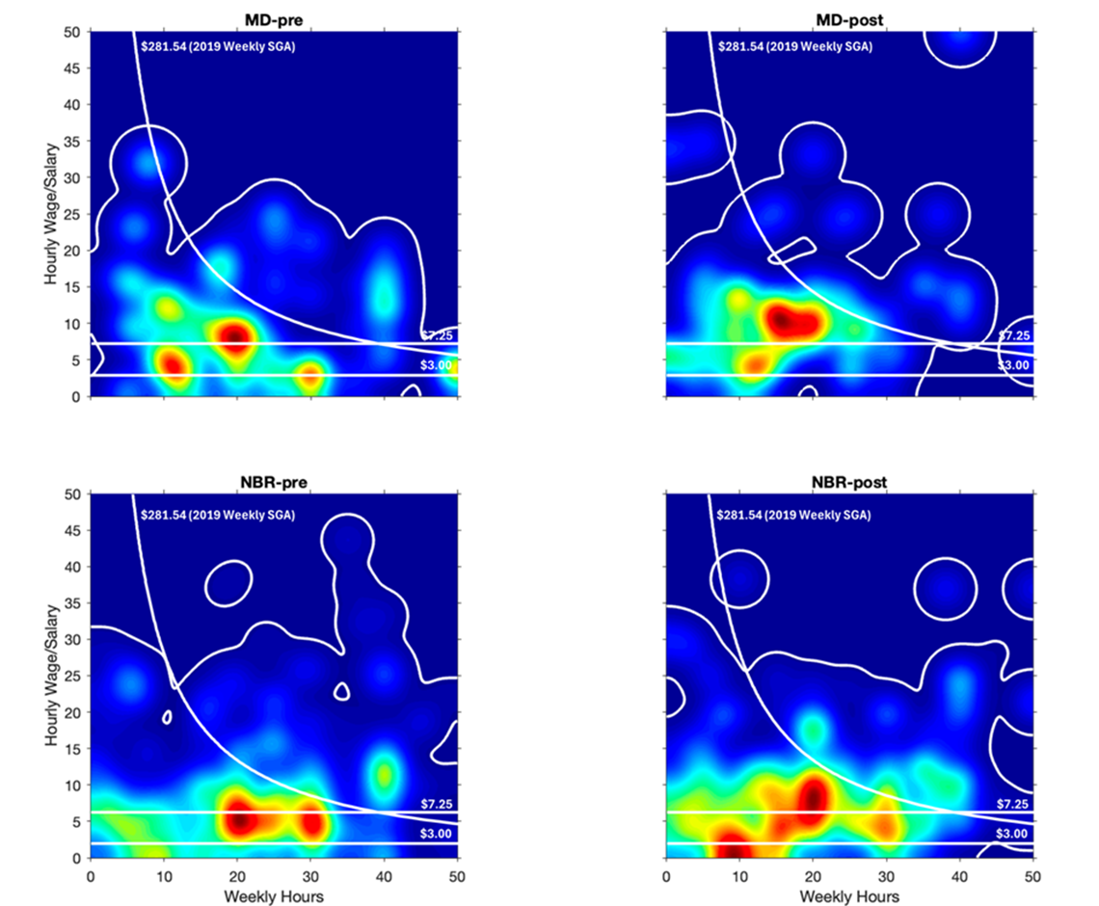
Compare:
Maryland & Neighbors
Wage ⬆️
Hours ⬇️
0 10 20 30 40 50
0 10 20 30 40 50
Weekly Hours
Weekly Hours
Wage: no change
Hours: no change
Notes:
This slide compares kernel density heat maps of hourly wage/salary (y-axis, $0–$50) versus weekly hours (x-axis, 0–50) for two groups before and after a policy change. The slide is titled "Compare: Maryland & Neighbors" in a black circle badge on the left.
The four heat maps are arranged in a 2×2 grid: Maryland pre-policy change (MD-pre, top left), Maryland post-policy change (MD-post, top right), neighboring states pre-policy (NBR-pre, bottom left), and neighboring states post-policy change (NBR-post, bottom right).
All panels display a white diagonal contour line representing the $281.54 (2019 Weekly SGA) threshold, and horizontal reference lines at $7.25 (federal minimum wage) and $3.00 (subminimum wage). Color intensity ranges from dark blue (low density) through green, yellow, and red (high density/concentration).
In the Maryland panels, the post-policy-change heat map shows a notable shift in the density cluster near the minimum-wage region, with annotations indicating that wages increased and hours decreased. The neighboring states panels show no visible change between pre- and post-policy distributions, with annotations reading "Wage: no change, Hours: no change," serving as the comparison group confirming the policy effect is specific to Maryland.

Slide 10
Concluding Remarks
Summary of Findings:
The elimination of 14(c) may lead to
  higher wages and fewer hours
  for SSDI/SSI beneficiaries with severe cognitive disabilities

Slide 11
Thank you!
Any questions?

Slide 12
Slides created for this presentation but not presented due to time.

Slide 13
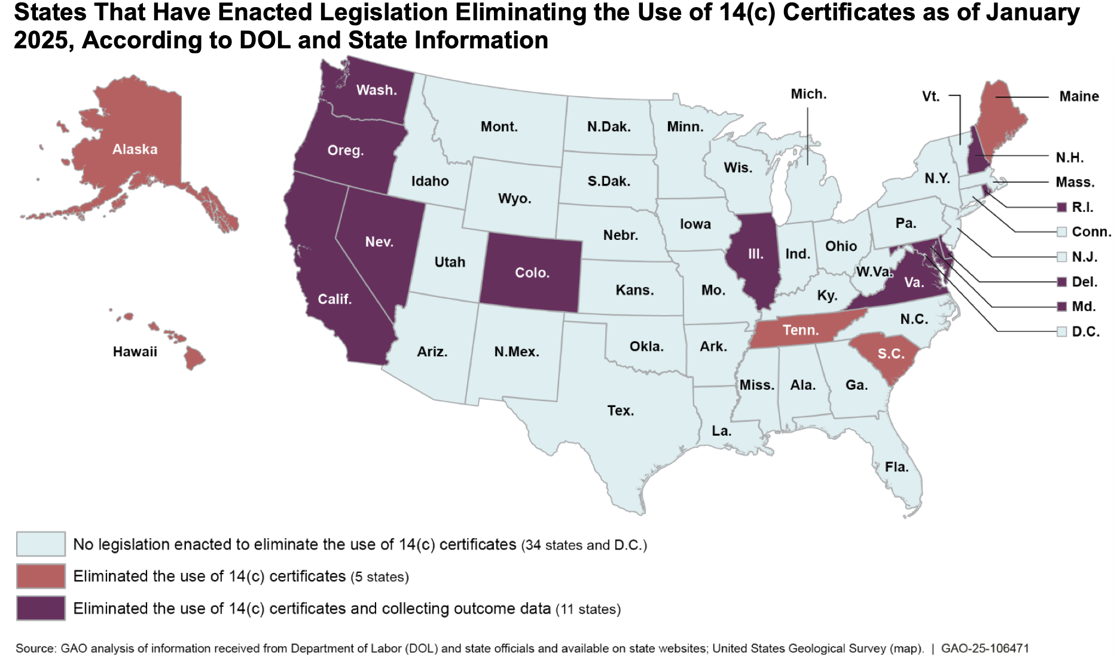
Current States
Notes:
A map of the united states.
Title: States That Have Enacted Legislation Eliminating the Use of 14(c) Certificates as of January 2025, According to DOL and State Information
States are highlighted into three categories:
(1) No legislation has been enacted to eliminate the use of 14(c) certificates
Which includes: 34 states and D.C. (AL, AZ, AR, CT, FL, GA, ID, IN, IA, KS, KY, LA, MI, MN, MS, MO, MT, NE, NJ, NM, NY, NC, ND, OH, OK, PA, SD, TX, UT, VT, WV, WI, and WY)
(2) Eliminated the use of 14(c) certificates
Which includes 5 states: Alaska, Hawaii, Tennessee, South Carolina, and Maine
(3) Eliminated the use of 14(c) certificates and collecting outcome data
Which includes 11 states:
Washington,
Oregon,
California,
Nevada,
Colorado,
Illinois,
Virginia,
Maryland,
Delaware,
Rhode Island,
New Hampshire
Source: GAO analysis of information received from Department of Labor (DOL) and state officials and available on state websites. United States Geological Survey (map). | GAO-25-106471

Slide 14
Data
American Community Survey (ACS)
  Annual data between 2012 and 2019
Sample
  Civilians 25-64
  SSDI and/or SSI Beneficiaries
  Less than regular high school diploma
  Cognitive disability and also report self-care disability and/or independent living disability

