Slide 1

Vocational Rehabilitation Participation and Employment Outcomes among Autistic Young Adults (2017–2020)
2026 Annual Disability Statistics Conference
Marisa Shenk
March 18, 2026

Slide 2
Research Support Services for Employment of Young Adults on the Autism Spectrum (REYAAS)
Project funded by Office of Disability Employment Policy (ODEP) via contract to Mathematica
Focuses on young adults on the autism spectrum (ages 16 to 28)
Project goals
  Understand barriers and facilitators to employment
  Identify ways to improve employment outcomes
  Highlight and fill gaps in the literature
  Suggest new activities to build evidence

Slide 3
Overview of Vocational Rehabilitation (VR)
VR agencies provide services to people with disabilities to help them prepare for, find, retain, or regain employment
Many separate agencies (78) in states and territories administer the services
Services may include, but are not limited to:
  Assessment
  Career guidance and counseling
  Community college or university training
  On-the-job training
  Job coaching
  Job placement services
  Transportation
Notes:
As a way of introduction, we’re going to talk a bit about VR agencies. They provide services to people with many types of disabilities to help them prepare for, find, retain, or regain employment. The Rehabilitation Services Administration or RSA in the US Department of Education funds VR and sets policy and has done so since the Rehabilitation Act of 1973, which established the agency. In 2014, this was amended in the Workforce Innovation and Opportunity Act, or WIOA. In all, 78 separate agencies in the US states and territories administer VR services; some geographies have two separate agencies: one for people who are blind or have visual impairments and another for everyone else. The services offered include among others: assessment, counseling, career guidance, college-level training, on-the-job training, job coaching, job placement services, and transportation. The services delivered depend on the individual person and their assessed needs.

Slide 4

Data and sample
Data: Case Service Reports from the RSA-911
  Cover all 78 agencies and all VR applicants from program years 2017–2019
Sample
  All young adults who had open VR cases during program years 2017–2019
  Ages 16–28 at the time of VR application
  Autism is recorded as the primary or secondary impairment
Notes:
We conducted an analysis of case records from the Rehabilitation Services Administration, which captures engagement with the 78 VR agencies nationwide. We’ll be zooming in on young adults ages 16–28 on the autism spectrum who apply to VR. These data represent everyone who received VR services in our time period, including several thousand autistic young adults.
We examined program years 2017-2020, which covers data from July 2017 to June 2021, which was the most recent data available to us. We are not examining earlier years because of some VR reporting changes in 2017, which were enacted to align with WIOA. For example, prior years only included closed cases, and we have access to all cases that were open in a given program year. We are also not capturing data on all autistic young adults because not all of them apply for VR services, and classification is decided by a VR staff member. With that said, we do examine all young adults who applied for VR services during 2017-2019 who were ages 16-28 at the time of application, and for whom autism was recorded as the source of their primary or secondary impairment. Out of almost half a million young adult applicants in program years 2017-2019, 14 percent of them, or 81,616, were on the autism spectrum.

Slide 5
Data challenges
Post-WIOA data (2017–2020)
  Reporting changed in 2017, making data since then incomparable to older data
  Overlap with COVID-19
Classification of “type of primary or secondary impairment” is decided by agency staff member
  Might result in an undercount of applicants with autism
  Could be differences across states
De-identified national data were not linkable across program years
  To avoid duplication, we looked at either year of application or year of exit
  Cannot examine associations between services and employment outcomes

Slide 6
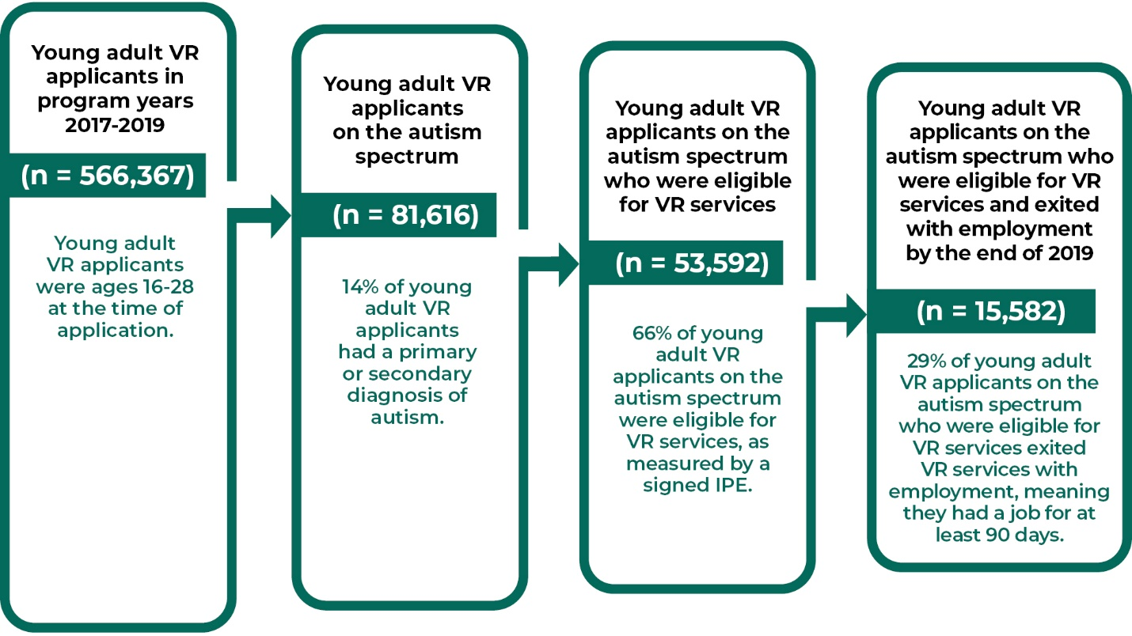
Many young adults on the autism spectrum applied for VR during 2017–2019
Note: Statistics are based on a sample of 566,367 young adults who applied for VR during 2017–2019 and who did not have any missing information on age, sex, race, and ethnicity. Employment outcomes as reported at VR exit by end of 2019; some young adults may have gone on to become employed after 2019. Years refer to program years.

Slide 7
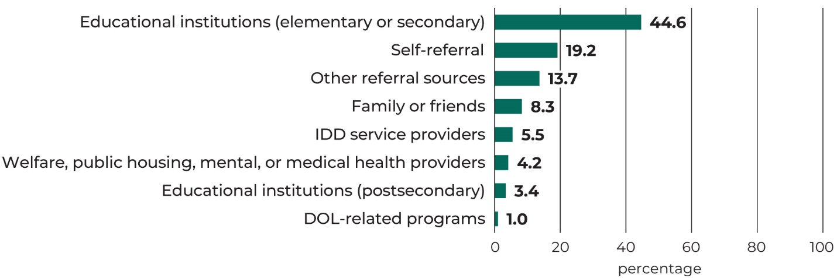
Schools were the most common source of referral for autistic young adult VR applicants
Note: Statistics are based on a sample of 81,616 young adults on the autism spectrum who applied for VR during 2017–2019. Percentages may not sum to 100 due to rounding. IDD = intellectual or developmental disabilities.
Notes:
Data on the sources of referral to VR point to the importance of schools as a crucial pipeline for autistic young adults to become engaged with VR. Educational institutions were the most common source of referral among autistic young adult VR applicants (45 percent from elementary or secondary schools). However, about 20 percent of autistic young adult applicants applied by themselves or relied on family or friends for referrals, and this share was even higher among autistic applicants older than age 22. Less common referral sources included intellectual or developmental disabilities service providers; providers of other services including welfare, public housing, mental health, or medical health; postsecondary educational institutions, and other Department of Labor programs such as Employment and Training Service Programs, Job Corps, and YouthBuild. The other category includes many smaller sources such as community rehabilitation programs, other VR state agencies, advocacy groups, and other not specified sources.
As might be expected, a large share of autistic applicants ages 16-22 were referred by elementary or secondary educational institutions. On the other hand, more older applicants ages 23-28 listed their source of referral as themselves.

Slide 8
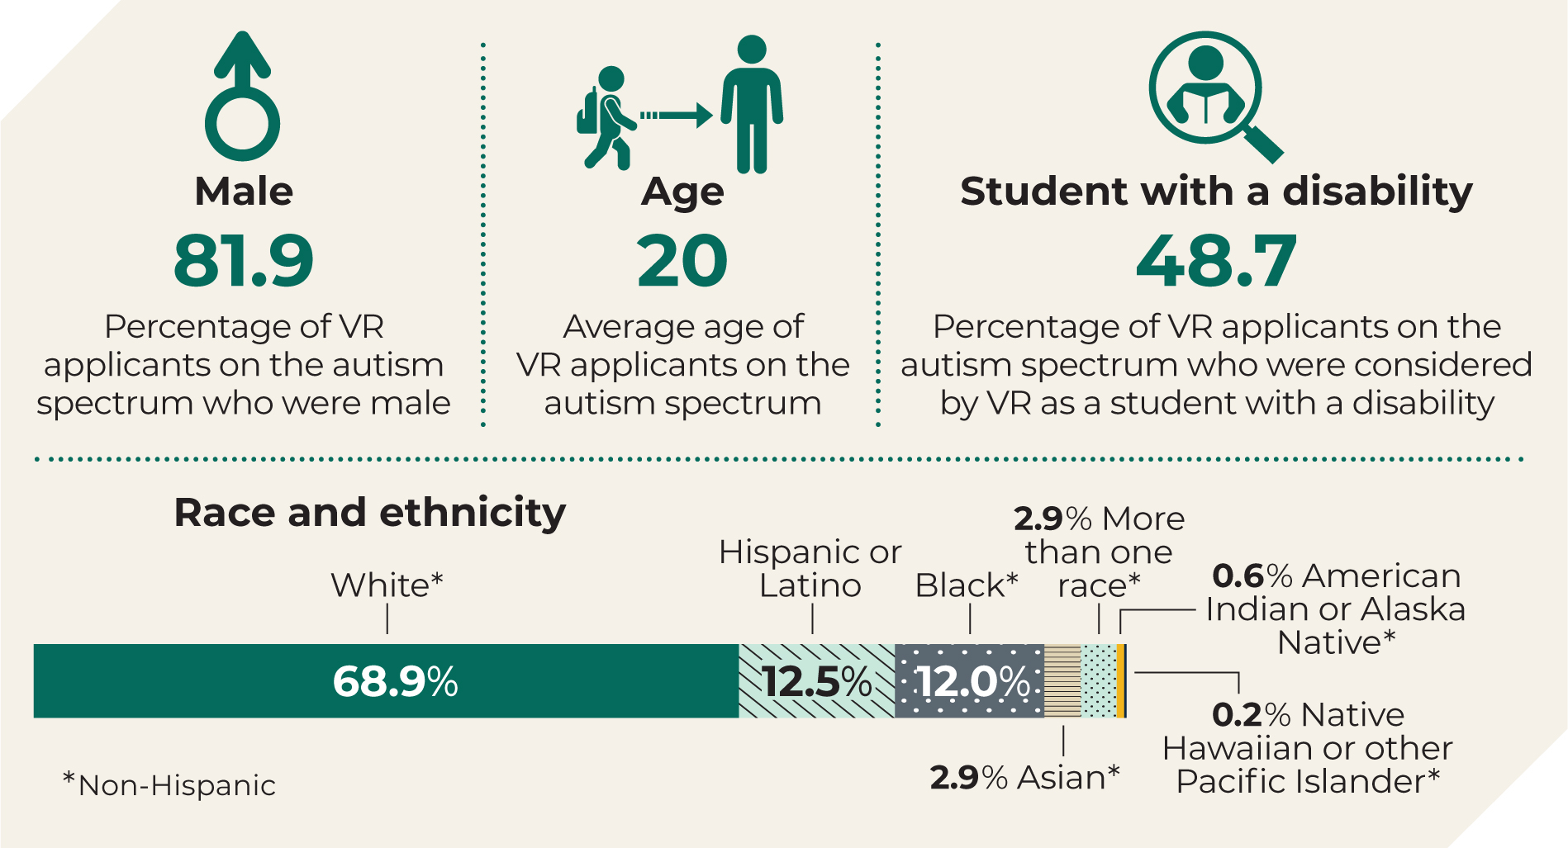
Autistic young adult VR applicants were primarily male and White, and about half were students
Notes:
Autistic young adult VR applicants were primarily male – 82 percent. This is consistent with documented differences in autism identification by sex, with boys being substantially more likely to be identified with autism than girls. The average age at VR application for autistic young adults IN OUR SAMPLE was 20. About 47 percent of autistic young adult VR applicants were ages 16 to 18, 28 percent were ages 19 to 21, 14 percent ages 22 to 24, and the remaining 11 percent were ages 25 to 28. VR considered almost half of all applicants as a student with a disability (49 percent). These applicants were individuals with disabilities enrolled in education programs who were eligible for and receiving services under the Individuals with Disabilities Education Act at the time of application or when they began receiving pre-employment transition services, or ETS.
69 percent of young adults on the autism spectrum who applied for VR were non-Hispanic White, followed by 13 percent who were Hispanic or Latino and 12 percent who were non-Hispanic Black. About 3 percent were non-Hispanic Asian, 3 percent were more than one race, and less than 1 percent were American Indian or Alaska Native, or Native Hawaiian or other Pacific Islander.

Slide 9
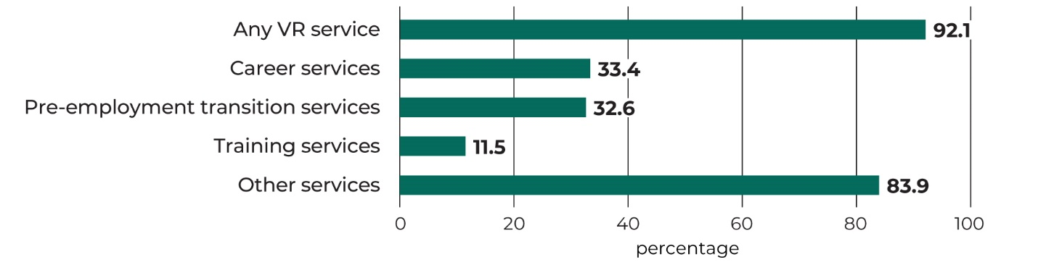
Service use among 66% of autistic young adults who developed an individualized plan for employment (IPE)
Note: Statistics are based on a sample of 53,592 young adults on the autism spectrum who applied for VR during 2017–2019 and signed an IPE.
Notes:
About 66 percent of autistic young adult VR applicants signed an IPE within the first year of their application. An IPE is required before receiving VR services (except for pre-ETS). Among those with an IPE, 92 percent received at least one service in their application year. They received a variety of career services, pre-employment transition services or pre-ETS, training services, and other types of services. I’ll give a few examples of each of these. For example, young adults on the autism spectrum often received career services including job placement and job search assistance, and some received short-term job supports or supported employment services. Pre-ETS are offered to students with disabilities starting at age 14. These include job exploration counseling, workplace readiness training, work-based learning experiences, counseling on enrollment opportunities, and instruction in self-advocacy. Job readiness training was often offered, and less common training services were on the job training, disability-related skills training, and four-year college or university training. Other services include VR counseling and guidance, which about two-thirds of applicants received; assessment, benefits counseling, transportation, and so on.
Larger shares of younger autistic applicants (ages 16–22) used pre-ETS than older applicants (ages 23–28). Larger shares of older autistic applicants used career services.

Slide 10
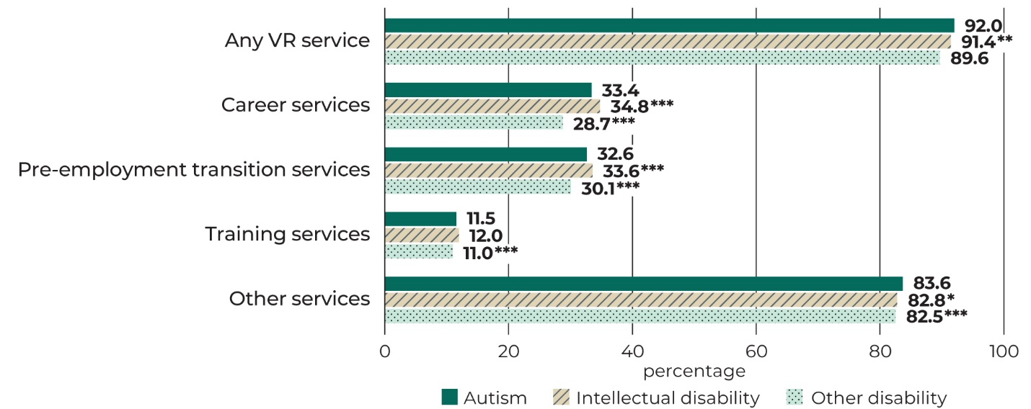
Among young adults, autistic VR clients and clients without autism were similarly likely to use different types of VR services
Note: Statistics are based on a sample of 296,579 young adults who applied for VR during 2017–2019 and signed an IPE. Statistics represent regression-adjusted means. */**/*** indicates the difference between the comparison group and young adults on the autism spectrum is statistically significant (p-value less than .10/.05/.01).

Slide 11
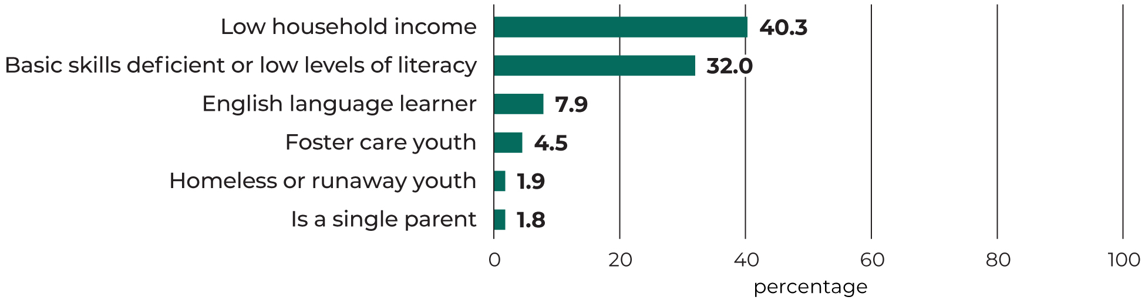
VR counselors identified many barriers to employment for autistic young adult VR applicants
Note: Statistics are based on a sample of 53,592 autistic young adults who applied for VR during 2017–2019 and signed an IPE.
Notes:
Among autistic young adult VR clients who newly applied and had a signed IPE, about 40 percent were identified as living in households with low incomes. This is consistent with recent estimates that suggest that a little more than half of children on the autism spectrum live in lower-income households.
Almost one-third were identified as having basic skills deficiency. VR counselors identified clients as having basic skills deficiency if they were young adults with literacy skills at or below the 8th-grade level or applicants of any age who were not able to solve problems or read, write, or speak English deemed necessary to function in a job or other setting.
Less than 10 percent of applicants were English language learners, and less than 5 percent were foster care youth, homeless or runaway youth, or a single parent.

Slide 12
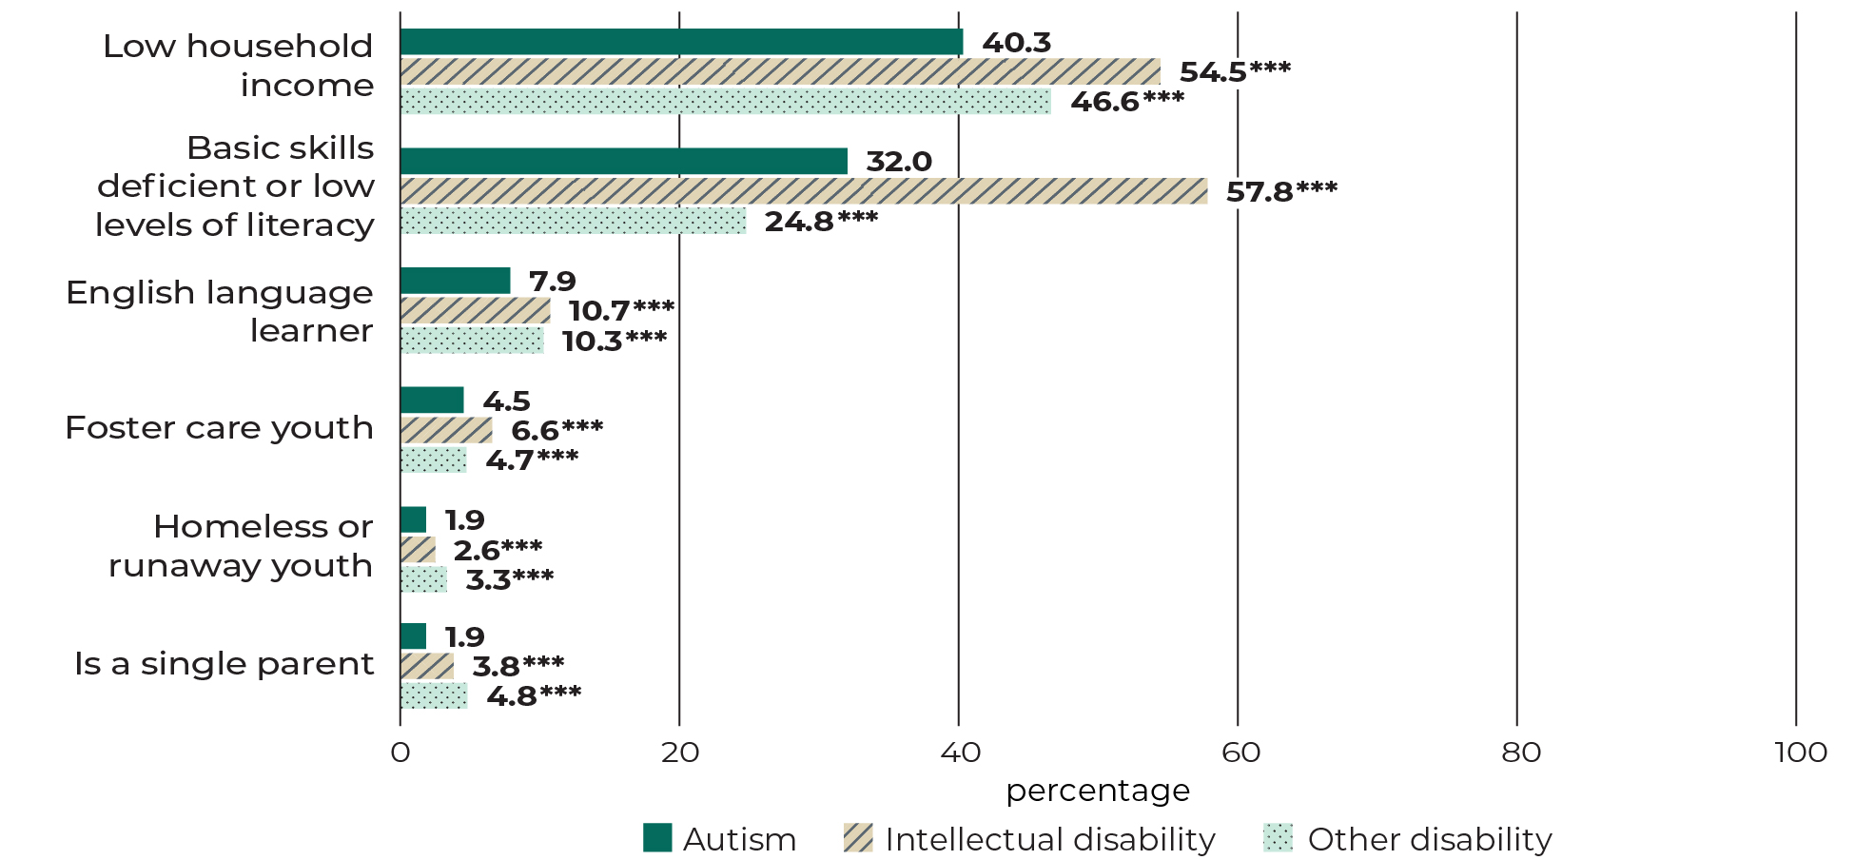
The barriers to employment that VR counselors assessed often differed by disability type
Note: Statistics are based on a sample of 296,579 young adults who applied for VR during 2017–2019 and signed an IPE. Barriers were assessed by VR counselors; an individual may have more than one barrier. Statistics represent regression-adjusted means. */**/*** indicates the difference between the comparison group and young adults on the autism spectrum is statistically significant (p-value less than .10/.05/.01).

Slide 13
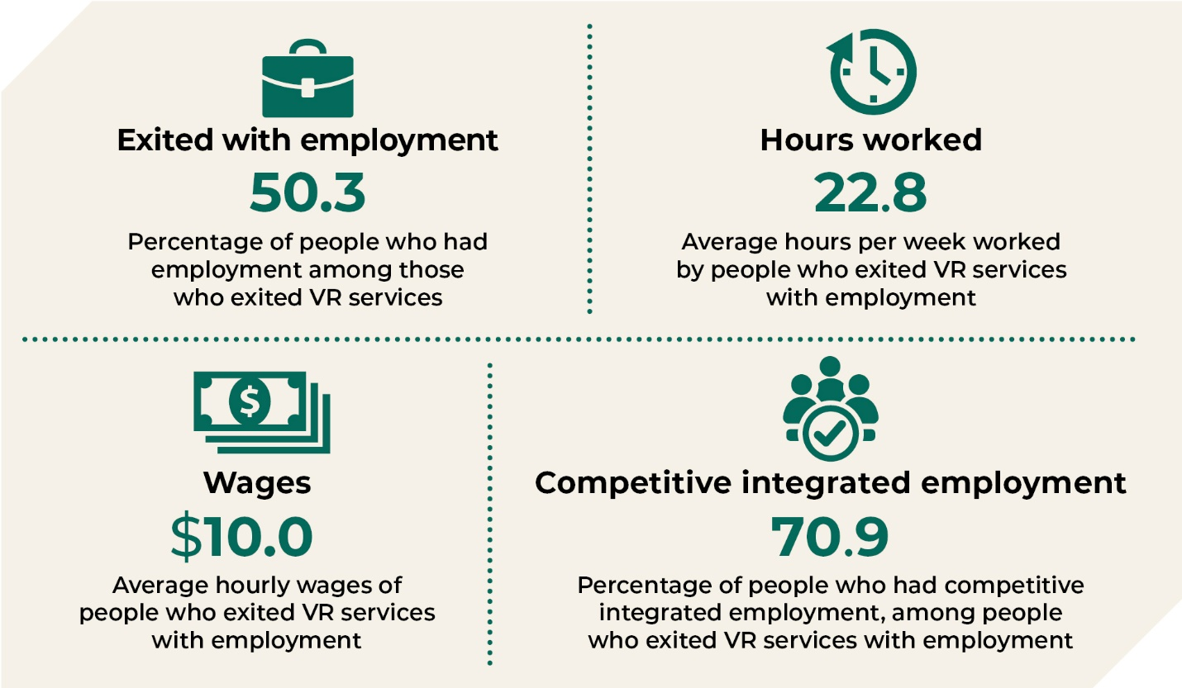
Among autistic young adults who exited VR after signing an IPE, about half were employed
Note: Statistics are based on a sample of 115,640 young adults on the autism spectrum who exited VR during 2017–2019 after signing an IPE. Employment outcomes as reported at VR exit.
Notes:
Next, we examined employment among all autistic young adults who exited VR with a signed IPE. So, these are clients who were eligible to receive services and then left VR during our sample period, though they could have applied in earlier years which is why the sample size is larger. We restricted to those who were young adults at the time of application. About half of these exiters had employment at the time of exit, meaning they held a job for at least 90 days. Among those who were employed, they worked on average 23 hours a week and earned $10 an hour. And 71 percent of those who were employed had competitive integrated employment. The rest had a form of supported employment.

Slide 14
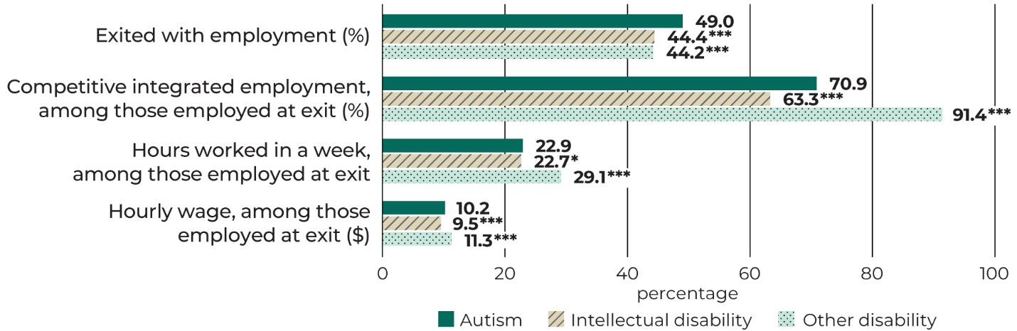
Among young adult clients who exited VR, case outcomes differed by disability
Note: Statistics are based on a sample of 803,183 young adults who exited VR during 2017–2019. Employment outcomes as reported at VR exit by end of program year 2019.
Statistics represent regression-adjusted means. */**/*** indicates the difference between the comparison group and young adults on the autism spectrum is statistically significant (p-value less than .10/.05/.01).
Notes:
These are regression-adjusted findings and thus differ slightly from group means shown earlier. How do these employment figures look compared to those with other disability types? A higher share of autistic clients who exited VR had employment: 49 percent compared to about 44 percent of those with an intellectual or other disability. Among those who had employment, 71 percent of autistic clients had competitive integrated employment, compared to 63 percent of those with an intellectual disability – and 91 percent of those with another disability. Clients on the autism spectrum or with an intellectual disability each worked about 23 hours a week, compared to 29 hours for those with another disability. Hourly wages followed a similar pattern, with an average of $10 an hour for those on the autism spectrum or with an intellectual disability, compared to $11 an hour for those with another disability, though this difference had a small effect size.

Slide 15
Among autistic young adults, there were large differences by age at application
Larger shares of younger autistic applicants (ages 16–22) were referred by elementary or secondary educational institutions and used pre-employment transition services than older applicants (ages 23–28)
Larger shares of older autistic applicants applied to VR themselves, used career services, and exited with employment

Slide 16
Contact information
Presenter: Marisa Shenk
mshenk@mathematica-mpr.com
Project director: Ankita Patnaik
APatnaik@mathematica-mpr.com
Website
Research Support Services for Employment of Young Adults on the Autism Spectrum
Project officer: David Rosenblum
Rosenblum.David.B@dol.gov

Slide 17
Bonus slides

Slide 18

Research questions
Among young autistic VR applicants:
  What were the most common referral sources?
  What were their characteristics, and what barriers to employment did they face?
Among young autistic VR applicants with a signed individualized plan for employment (IPE):
  What types of VR services did they use?
  What were their employment outcomes?
How did referral sources, service use, and employment outcomes:
  Vary across states?
  Compare between autistic young adults and young adults who were not autistic but had (1) an intellectual disability or (2) any other type of disability?
  Differ for subgroups of autistic young adults?
Were there changes in VR applications, service use, and employment outcomes during the COVID-19 pandemic (after March 2020)?

Slide 19
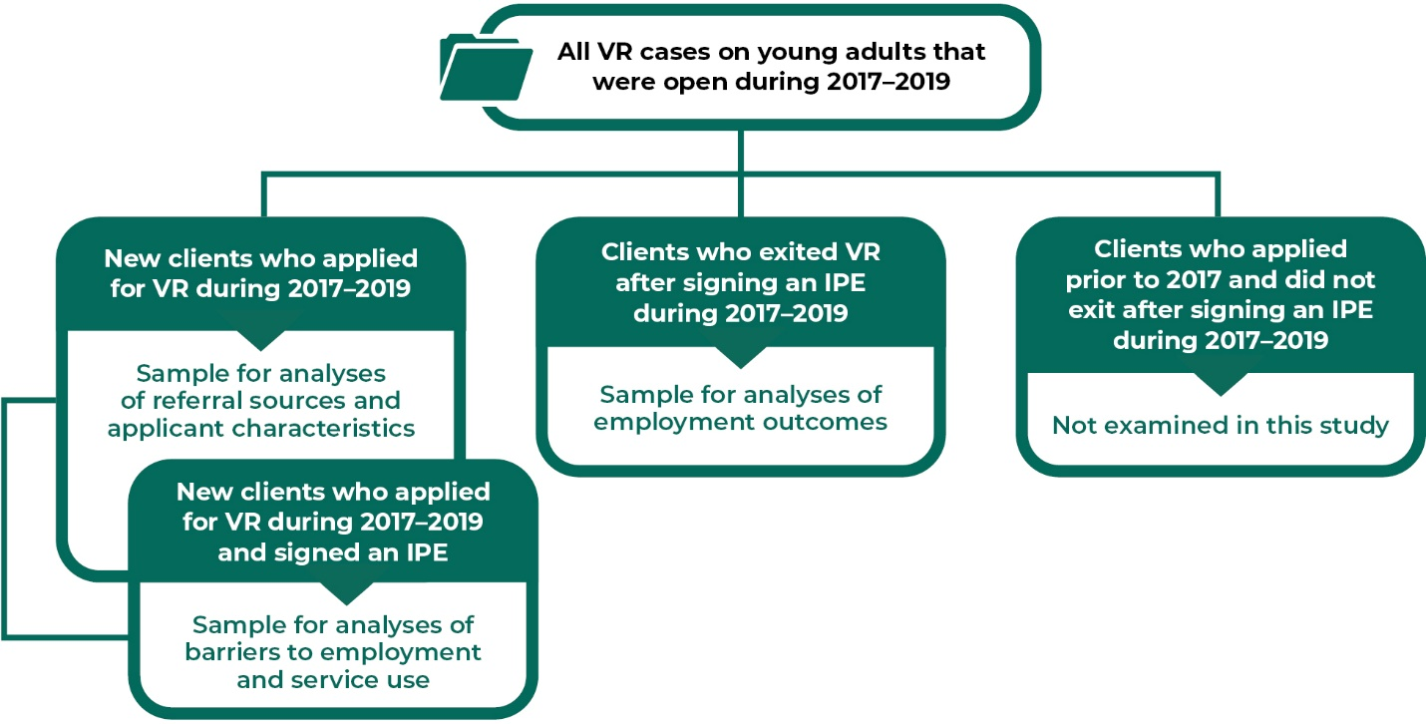
Cases included in study

Slide 20
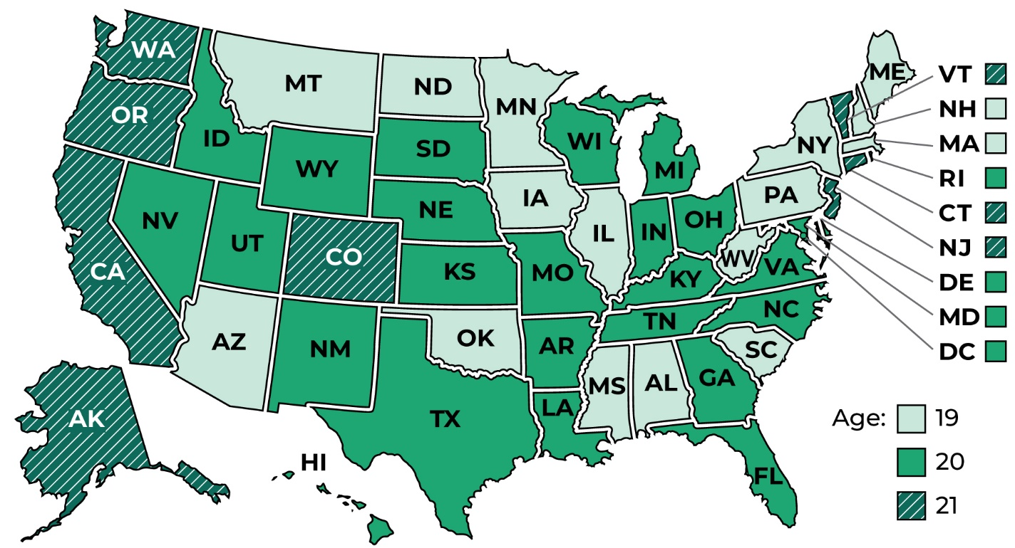
Average age at VR application varied by state

Slide 21
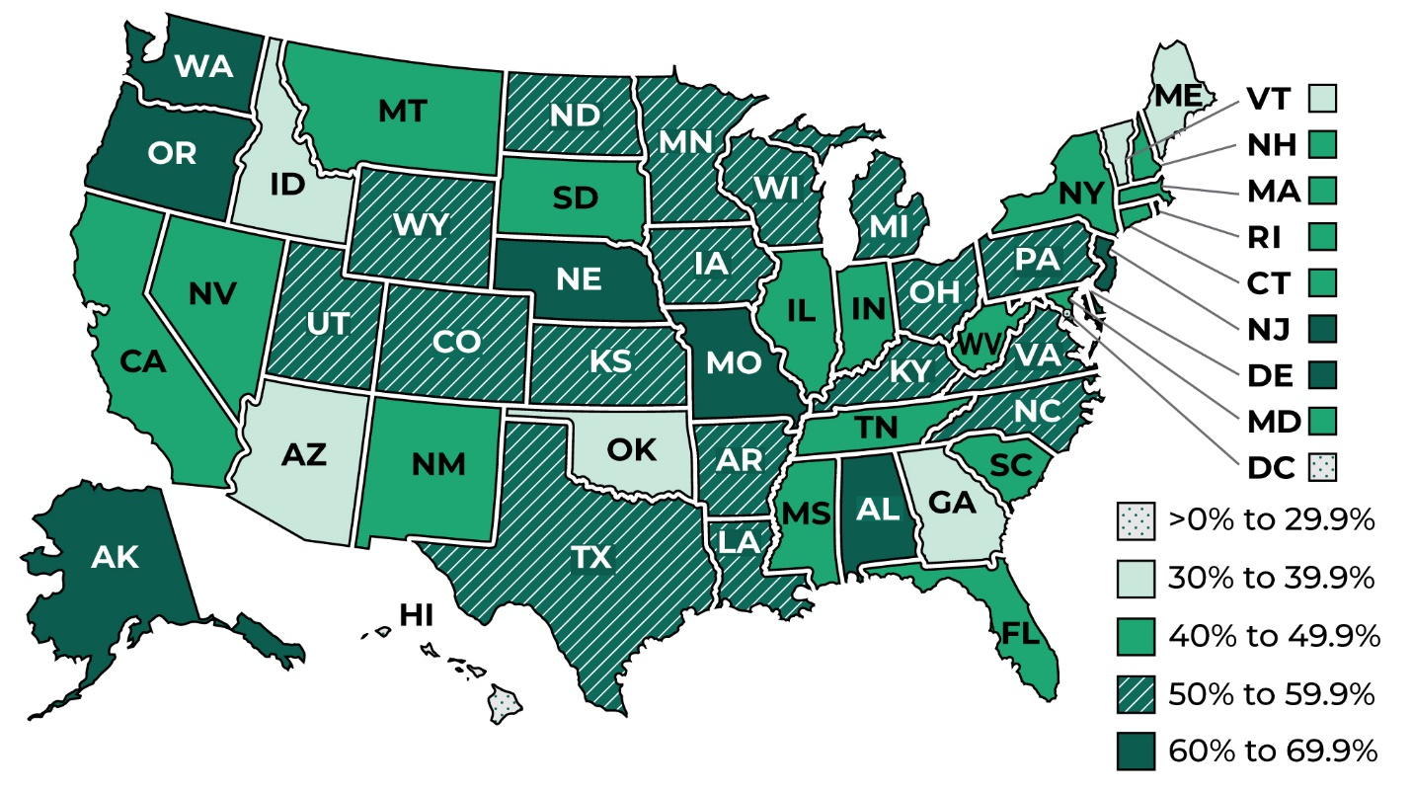
Percent of autistic young adults with IPEs who exited with employment by PY2019

Slide 22
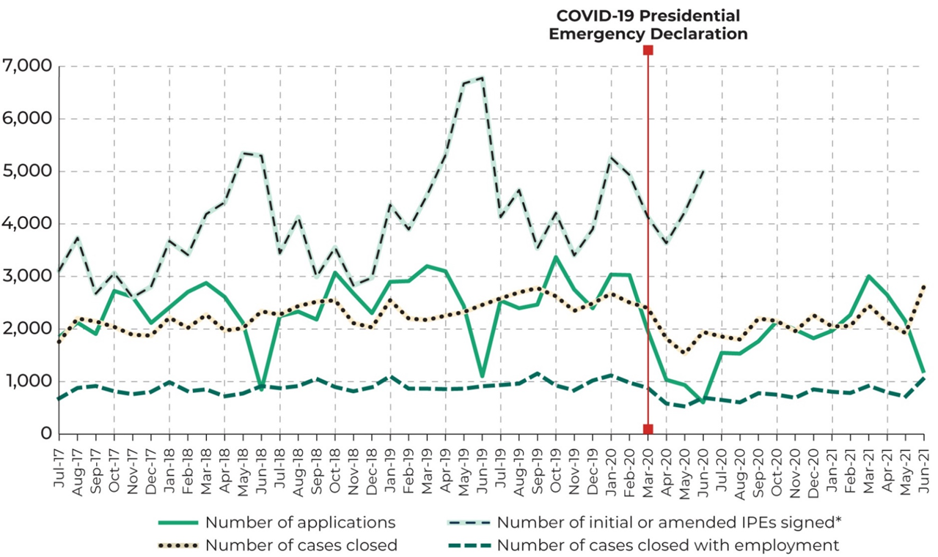
VR engagement was significantly altered in the early months of the COVID-19 pandemic (April–June 2020)

Slide 23
VR engagement was significantly altered in the early months of the COVID-19 pandemic (continued)
Applications from autistic young adults dropped sharply from an average of 2,677 applications per month (January–March 2020) to 859 per month (April–June 2020)
VR case closures per month dropped 30 percent compared to January–March 2020
New or amended IPEs did not drop substantially compared to January–March 2020, but they also did not grow as they had done in prior program years

