Slide 1
The Annual Disability Statistics Compendium (ADSC) - 2026
Nate Thomas, MS
Research Data Scientist

Slide 2
What is the Compendium?

Slide 3
The first annual publication in 2009 (RRTC, 2009)
Useful:
“Overview: Statistics are a powerful tool – in research, policymaking, program evaluation, and advocacy. They are used to frame the issues, monitor current circumstances and progress, judge the effectiveness…”¹
From various sources:
“[Disability statistics] are often difficult to find.” ¹
So we collect, compile, and communicate:
“… the first Compendium, [focused] on state-level statistics” ¹

Slide 4
2026 Disability Stats
Data Sources
Topics
American Community Survey (ACS)
Population and Prevalence
Functioning
Employment (in Industry and Occupation)
Earnings (full-time full-year workers)
Poverty
Home Environment (component of multidimensional deprivation index)
Veterans
Rural
Education
Health Insurance Coverage
continued on next slide

Slide 5
2026 Disability Stats: Data Sources & Topics Continued
Dept. Veterans Affairs
Veterans
OMB
Rural (Metro. vs. Micro. vs. Noncore)
IDEA
Education
CPS
Voting and Registration
SSA
Social Security Disability Programs
WIOA
Vocational Rehabilitation
BRFSS
Health Outcomes
BRFSS: Behavioral Risk Factor Surveillance System Annual Survey
CPS: Current Population Survey
IDEA: Individuals with Disabilities Education Act
OMB: Office of Management and Budget
WIOA: Workforce Innovation and Opportunity Act
SSA: Social Security Administration

Slide 6
2026 Disability Statistics

Slide 7
Our statistics
Population size (#)
Percentages (%)
Relative Ratio (RR)
Margin of Error (ME – within 95% confidence interval)

Slide 8
Population and Prevalence
U.S. (2024) | Disability # (ME#) % (ME%) | Without Disability # (ME#) % (ME%)
CLC (includes age 65+) | 45,770,000 (180,000) 13.7% (0.1%) of CLC | 289,499,000 (86.3) 86.3% (0.1%) of CLC
CLC with Hearing Disabilities | 12,319,000 (71,000) 3.7% (0.1%) of CLC | -
CLC with Vision Disabilities | 8,537,000 (84,000) 2.5% (0.1%) of CLC | -
CLC with Cognitive Disabilities | 18,485,000 (132,000) 5.5% (0.1%) of CLC | -
CLC with Ambulatory Disabilities | 20,957,000 (100,000) 6.3% (0.1%) of CLC | -
CLC with Self-Care Disabilities | 8,201,000 (75,000) 2.4% (0.1%) of CLC
CLC with Independent Living Disabilities | 16,243,000 (97,000) 4.8% (0.1%)
2026 Disability Statistics
CLC: Civilians Living in the Community
Section 1

Slide 9
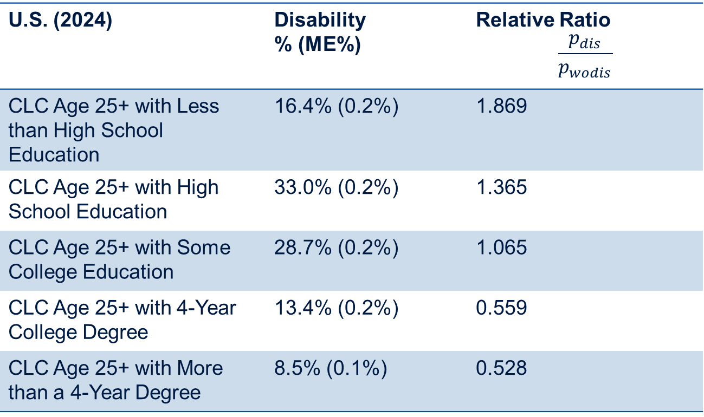
Education
U.S. (2024) | Disability % (ME%) | Relative Ratio $$\frac{p_{dis}}{p_{wodis}}$$
CLC Age 25+ with Less than High School Education | 16.4% (0.2%) | 1.869
CLC Age 25+ with High School Education | 33.0% (0.2%) | 1.365
CLC Age 25+ with Some College Education | 28.7% (0.2%) | 1.065
CLC Age 25+ with 4-Year College Degree | 13.4% (0.2%) | 0.559
CLC Age 25+ with More than a 4-Year Degree | 8.5% (0.1%) | 0.528
2026 Disability Statistics
CLC: Civilians Living in the Community
Section 13
The state with the greatest disparity in less than high school education attainment was Vermont/VT with RR of 3.6 (95% CI: 1.7-4.0).

Slide 10
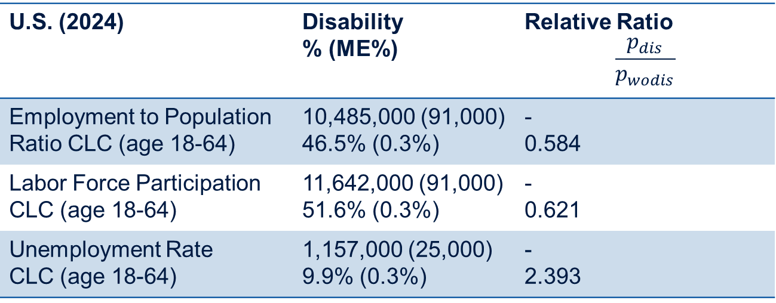
Employment
U.S. (2024) | Disability % (ME%) | Relative Ratio $$\frac{p_{dis}}{p_{wodis}}$$
Employment to Population Ratio CLC (age 18-64) | 10,485,000 (91,000) 46.5% (0.3%) | - 0.584
Labor Force Participation CLC (age 18-64) | 11,642,000 (91,000) 51.6% (0.3%) | - 0.621
Unemployment Rate CLC (age 18-64) | 1,157,000 (25,000) 9.9% (0.3%) | - 2.393
2026 Disability Statistics
Unemployment Rate 2023: 9.3% (0.2%)
Unemployment Rate 2024: 9.9% (0.3%)
A relative increase YoY in unemployment of 6.8% (95% CI: 3.8%-9.9%)
DC had the highest unemployment rate for people with disabilities 19.5% (10.9%).
CLC: Civilians Living in the Community
Section 3

Slide 11
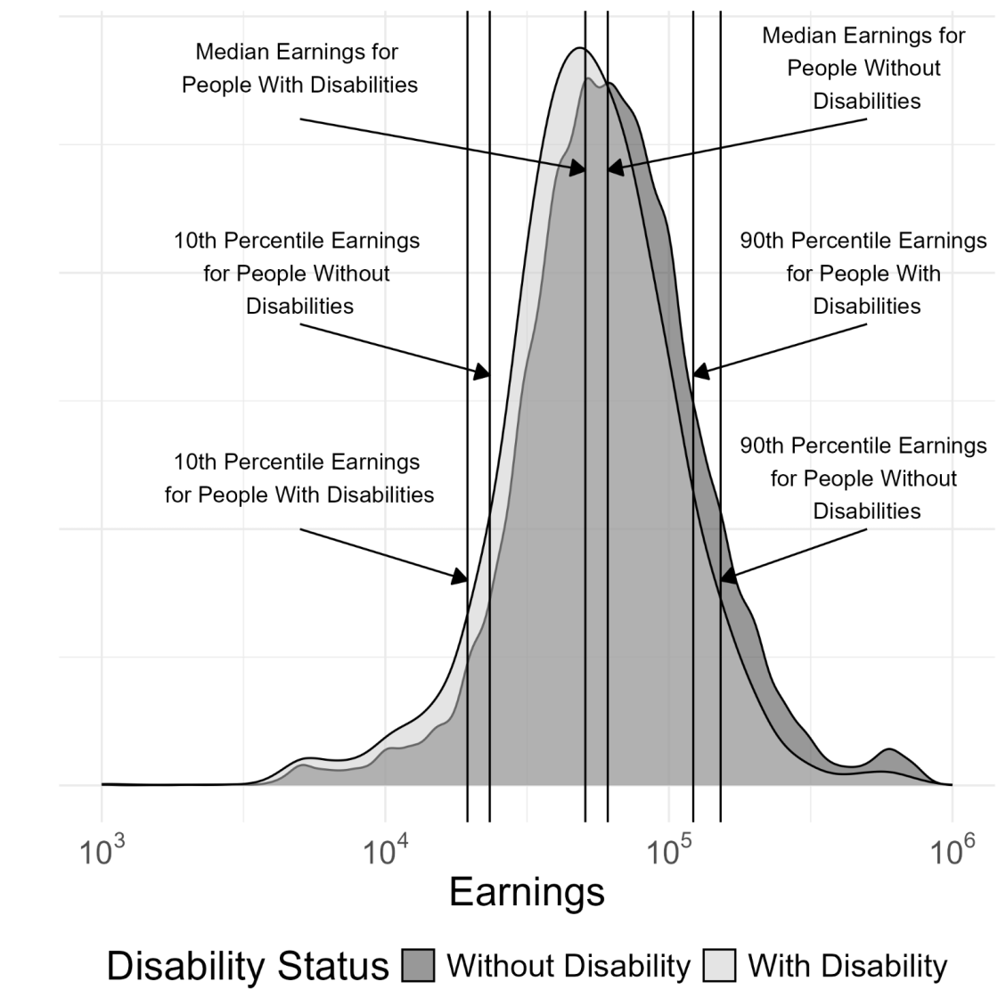
Earnings
2026 Disability Statistics
Kernel Density Plot of Annual Earnings Full-Time, Full-Year Civilian Workers Ages 18-64 in the United States with and without Disability (in 2024 Inflation-Adjusted Dollars): 2024
Section 5

Slide 12
References
1 . Rehabilitation Research and Training Center on Disability Statistics and Demographics (RRTC), 2009. Annual Compendium of Disability Statistics: 2009, Hunter College. disabilitycompendium.org
2. Thomas, N., Kingsbury, S., Lansing, J., & Houtenville, A. (2026). Annual Disability Statistics Compendium: 2026 (various tables). Durham, NH: University of New Hampshire, Institute on Disability. researchondisability.org

Slide 13
2026 Disability Stats Sources and Topics
American Community Survey (ACS)
Population and Prevalence
Functioning
Employment (in Industry and Occupation)
Earnings (full-time full-year workers)
Poverty
Home Environment (component of multidimensional deprivation index)
Health Insurance Coverage
BRFSS
Health Outcomes
Dept. Veterans Affairs
Veterans
OMB
SSA
Voc. Rehab.
Rural (Metro. vs. Micro. vs. Noncore)
IDEA
Education
Voting and Registration
CPS
WIOA
BRFSS: Behavioral Risk Factor Surveillance System Annual Survey
CPS: Current Population Survey
IDEA: Individuals with Disabilities Education Act
OMB: Office of Management and Budget
WIOA: Workforce Innovation and Opportunity Act
SSA: Social Security Administration
Notes:
Data for statistics on the following topics comes solely from the American Community Survey (ACS):
Population and Prevalence
Functioning
Employment (in Industry and Occupation)
Earnings (full-time full-year workers)
Poverty
Home Environment (component of multidimensional deprivation index)
Health Insurance Coverage
Data for Veterans comes from the American Community Survey (ACS) and the Department of Veterans Affairs.
The Social Security Administration (SSA) supplies its own data.
Data on Education comes from the American Community Survey (ACS) and IDEA: Individuals with Disabilities Education Act
Data for Rural (Metro. vs. Micro. vs. Noncore) statistics comes from the American Community Survey (ACS) and the Office of Management and Budget (OMB).
Data on Voting and Registration comes from the Current Population Survey (CPS).
Data for Vocational Rehab statistics comes from the Workforce Innovation and Opportunity Act (WIOA).
Data on Health Outcomes comes from the Behavioral Risk Factor Surveillance System Annual Survey (BRFSS).

