Slide 1
Making the Calls
Review of the Annual Report on People with
Disability in America and Infographics
Stacia Kingsbury, MPP

Slide 2
What’s in the Annual Report
Topics
Keeping Track: National Disability Status and Program Performance Indicators¹ , 2008
Data
American Community Survey, 2008-2024 PUMS one-year files
Reported at the 95% confidence level using one tailed test
The Calls
Comparisons: Year-to-year changes for people with disabilities
Gaps: Year-to-year difference between people with and without disabilities
Notes:
So, this report covers 12 topics that were informed by the 2008 Keeping Track: National Disability Status and Program Performance Indicators study. Where people with disabilities, their advocates, and service providers determined the most important indicators to track for people with disabilities.
Data used is from the American Community survey, more details are in the report.
We conduct one tailed tests at the 95% Confidence level to see if these topics significantly change – these tests inform The Calls.
There are two types of calls:
Comparison- year to year change of the results for people with disabilities only
Gaps are year to year difference of the results between people with and without disabilities – we use a gap here instead of relative ratio, those are in the Compendium

Slide 3
Topics in the Annual Report
Population
Disabling Environments Index
Living in Institutions
Educational Attainment – Less than High School and Bachelor’s or Higher
Employment
Earnings
Poverty
Health Insurance – All and Private Health Insurance
Mass Transit to Work
Age of Home: Built from 1990 to Present
Notes:
These are the topics in the report, and I’m only covering six of the twelve topics.
First, we’ll look at the year-to-year change comparison and if that is significant, Then we’ll look at the gap to see if that is significant.

Slide 4
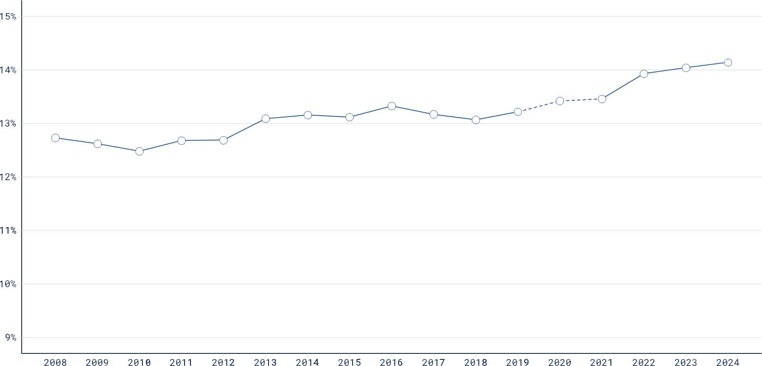
Population of People with Disabilities
Percent, all ages
14.14
14.04
12.73
Notes:
For this chart and the remainder presented,
This is a line graph showing change over time
The x axis (on the bottom) has the years from 2008 to 2024
The y axis (on the left) has the percentages or dollars (when we get to the wages)
In 2008 12.73%
In 2023 14.04% of the population in the US with disabilities
In 2024 this went up to 14.14%
What is the call?
(Civilians of all ages with disabilities in the U.S.)

Slide 5
Population of People with Disabilities
Percent, all ages
14.14
14.04
12.73
The Call.
Increased
Notes:
Yes population significantly increased year to year
Civilians of all ages with disabilities in the U.S.

Slide 6
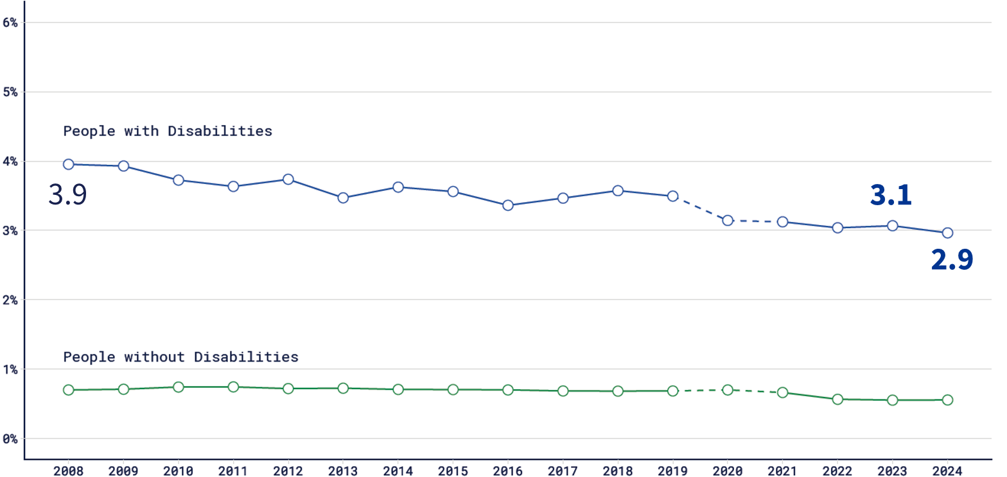
Institutional Group Quarters: Comparison Percent, ages 64 and younger
Notes:
About 3.1% of people with disabilities ages 64 and younger lived in institutional group quarters in 2024 compared to about 2.9% in 2023
Is this percentage decrease statistically significant?
(Civilians with disabilities ages 0-64 in the U.S.)

Slide 7
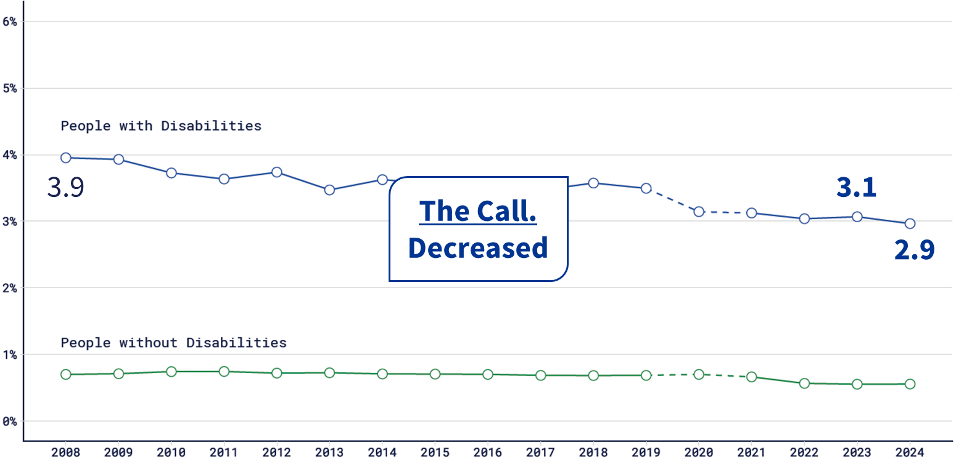
Institutional Group Quarters: Comparison Percent, ages 64 and younger
Notes:
Yes. This change is statistically significant
(Civilians with disabilities ages 0-64 in the U.S.)

Slide 8
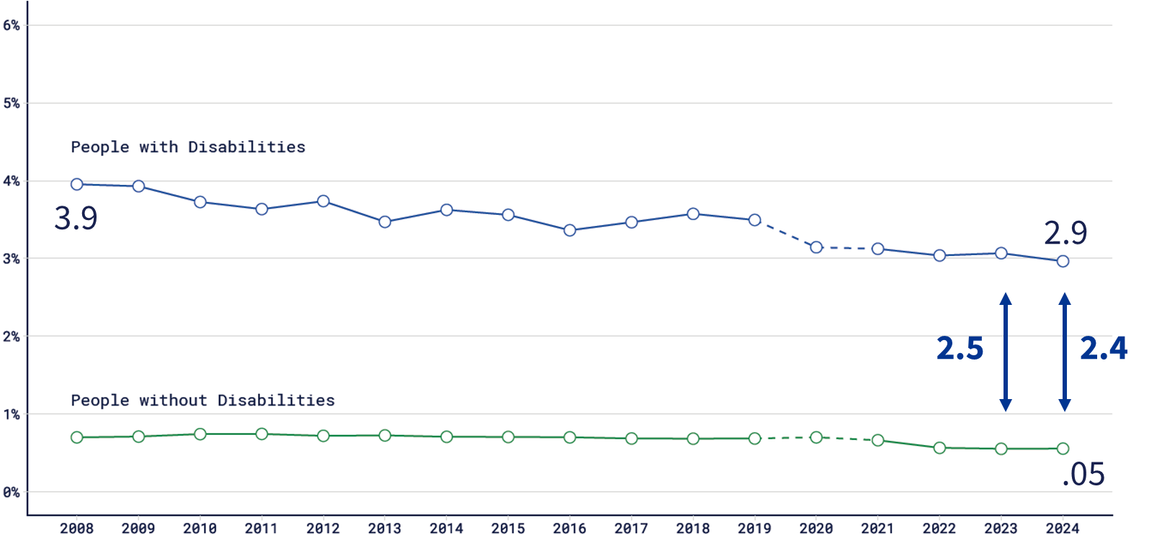
Institutional Group Quarters: Gap Percent, ages 64 and younger
Notes:
The gap between people with and without disabilities ages 64 and younger living in institutional group quarters was 2.5 percentage points in 2023 this narrowed to 2.4 percentage points in 2024
Is this change statistically significant?
(Civilians with disabilities ages 0-64 in the U.S.)

Slide 9
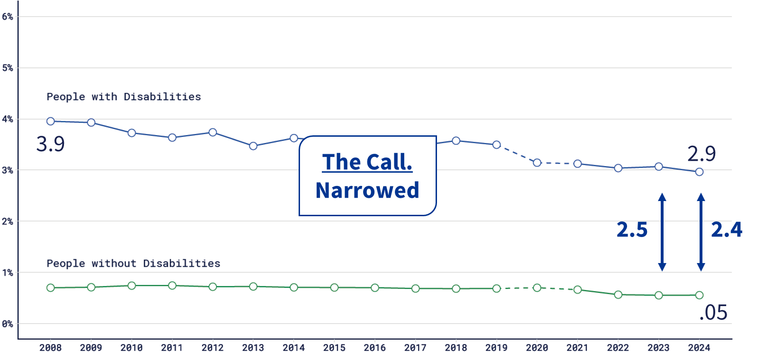
Institutional Group Quarters: Gap Percent, ages 64 and younger
Notes:
Yes. This change is statistically significant
(Civilians with disabilities ages 0-64 in the U.S.)

Slide 10
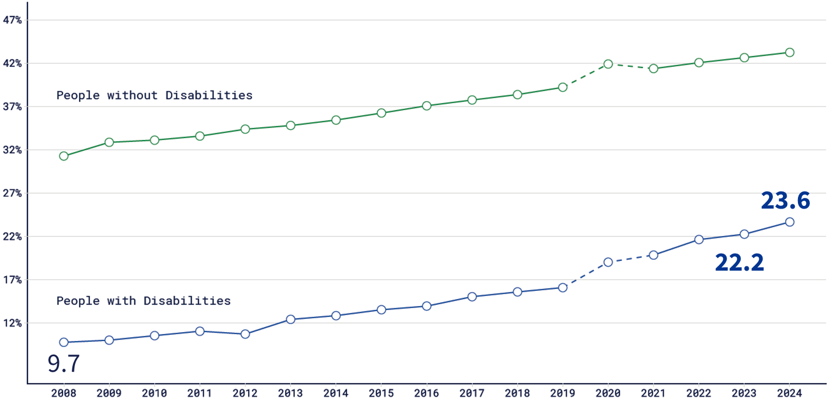
Bachelor’s Degree or Higher: Comparison Percent, ages 25 to 34
Notes:
Bachelor’s Degree or Higher for people between the ages of 25 and 34:
About 23.6% of people with disabilities ages 25 to 34 had a bachelor’s degree or higher in 2024 compared to about 22.2% in 2023
Is this percentage increase statistically significant?
(Civilians with disabilities ages 25-34 years old in the U.S. living in the community with a Bachelor’s degree or higher)

Slide 11
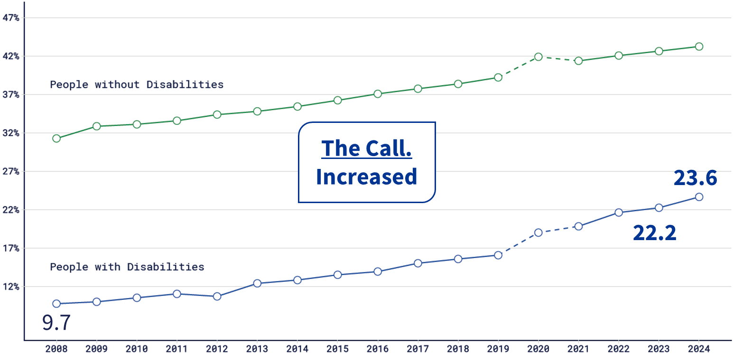
Bachelor’s Degree or Higher: Comparison Percent, ages 25 to 34
Notes:
Is this percentage increase statistically significant?
Yes. This increase is statistically significant
(Civilians with disabilities ages 25-34 years old in the U.S. living in the community with a Bachelor’s degree or higher)

Slide 12
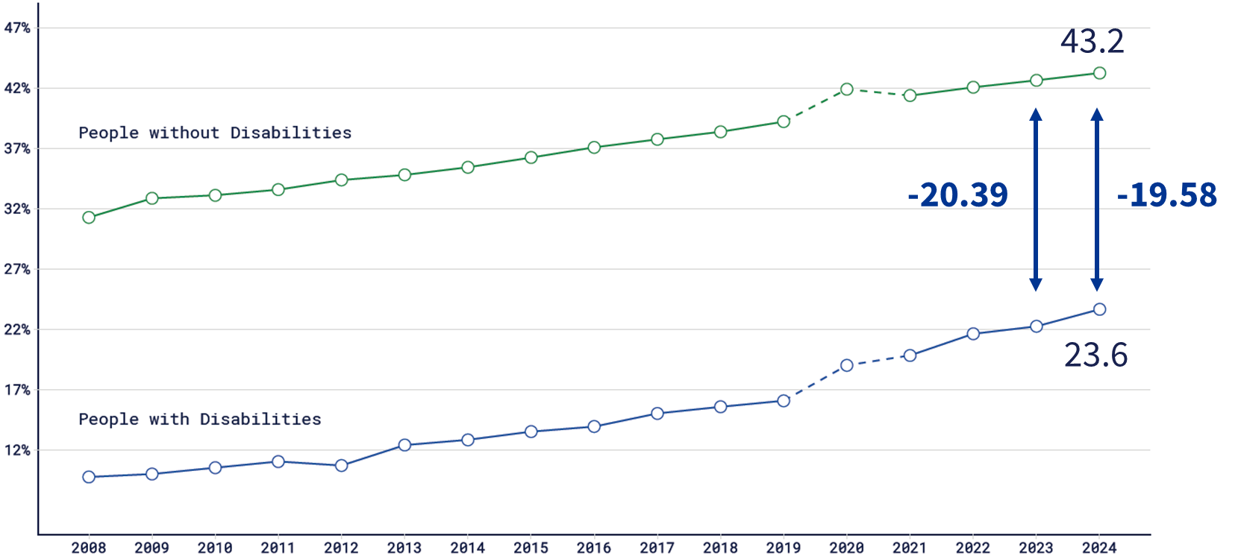
Bachelor’s Degree or Higher: Gap Percent, ages 25 to 34
Notes:
The gap between people with and without disabilities with bachelor’s degrees or higher ages 25 to 34 narrowed from -20.39 percentage points in 2023 to -19.58 in 2024.
Did the gap significantly narrow?
Yes! It did!
(Civilians with and without disabilities ages 18-64 in the U.S. who are living in the community and have a Bachelor’s Degree or Higher)

Slide 13
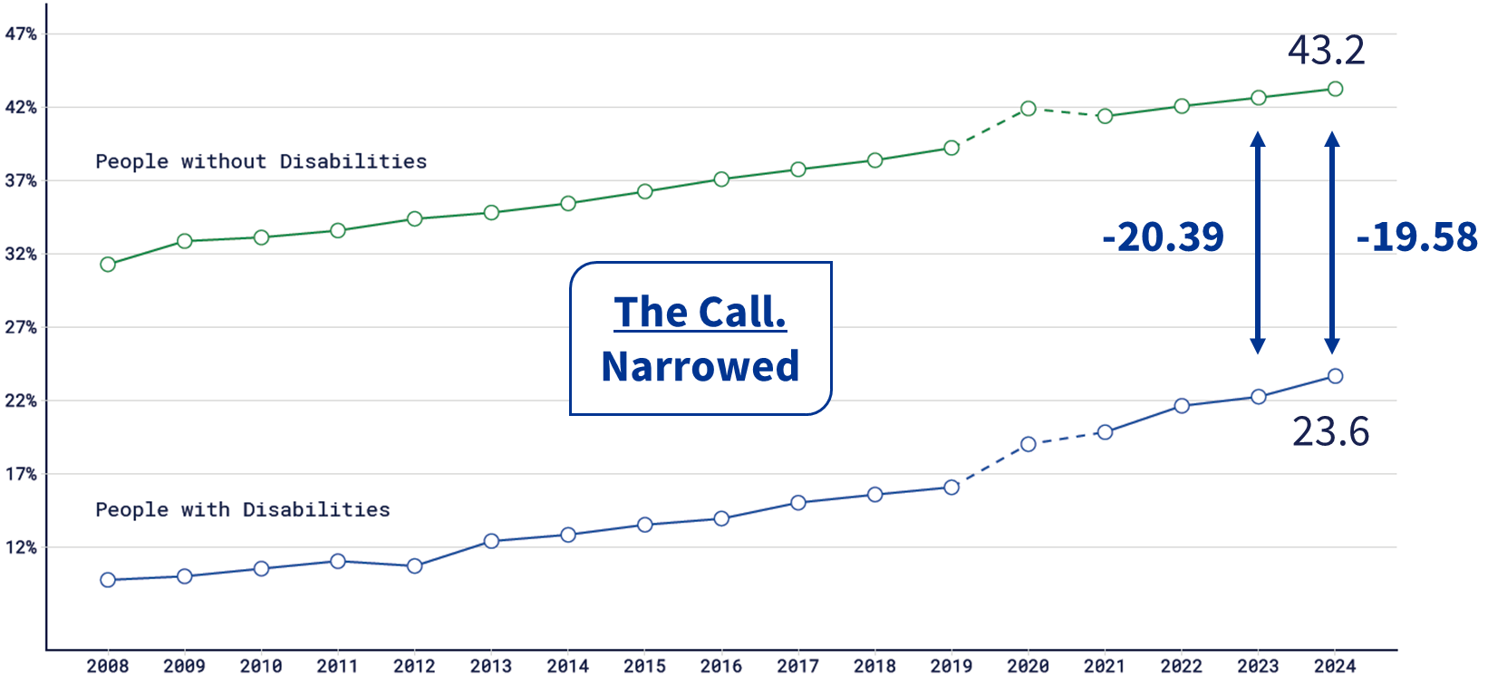
Bachelor’s Degree or Higher: Gap Percent, ages 25 to 34
Notes:
Did the gap significantly narrow?
Yes! It significantly narrowed!
(Civilians with and without disabilities ages 18-64 in the U.S. who are living in the community and have a Bachelor’s Degree or Higher)

Slide 14
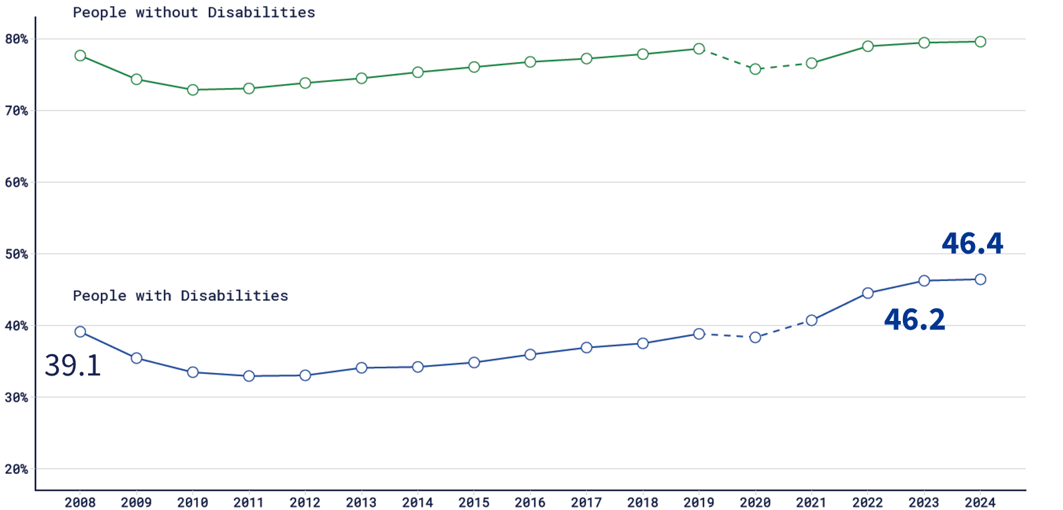
Employment-to-Population Ratio: Comparison Percent, ages 18-64
Notes:
Employment-to-population ratio for people ages 18-64
The employment to population ratio is working people divided by total pop (multiply by 100 to convert to %) - typically set for an age group in our case age group and disability status.
About 46.4% of people with disabilities were employed in 2024 compared to about 46.2% in 2023
(Civilians with disabilities ages 18-64 years old in the U.S. living in the community and working)

Slide 15
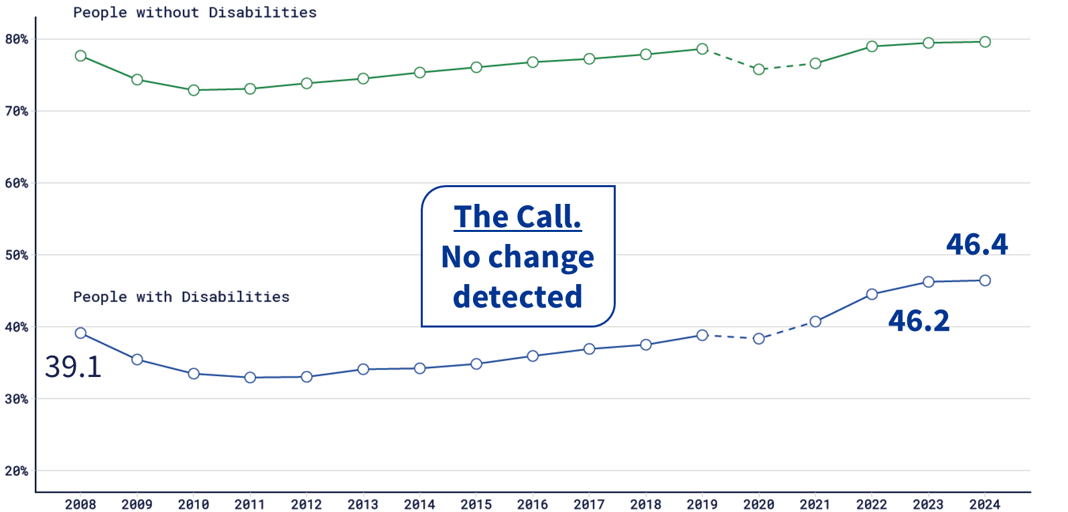
Employment-to-Population Ratio: Comparison Percent, ages 18-64
Notes:
Employment-to-population ratio for people ages 18-64
Is this percentage increase statistically significant?
No. This increase is not statistically significant
(Civilians with disabilities ages 18-64 years old in the U.S. living in the community and working)

Slide 16
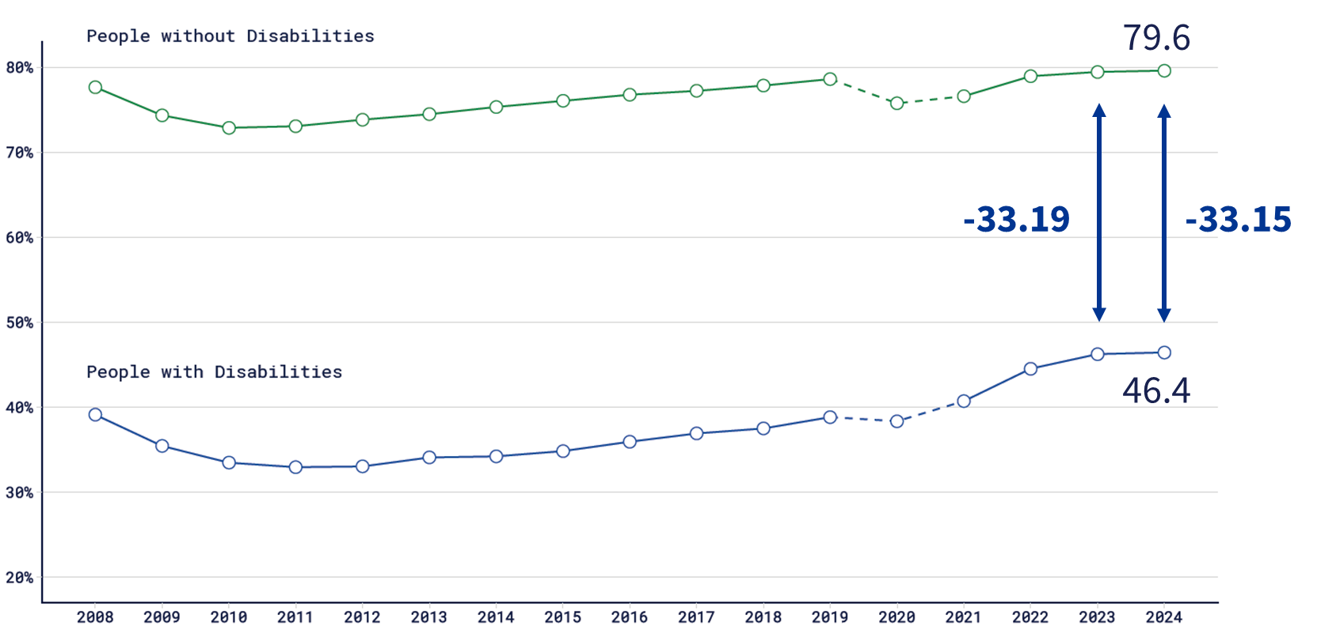
Employment-to-Population Ratio: Gap Percent, ages 18-64
Notes:
Employment-to-population ratio for people ages 18-64
The Gap in the employment to population ratio between people with and without disabilities narrowed from -33.19 percentage points in 2023 to
-33.15 in 2024.
Is this change statistically significant?
(Civilians with and without disabilities ages 18-64 in the U.S. who are living in the community and working)

Slide 17
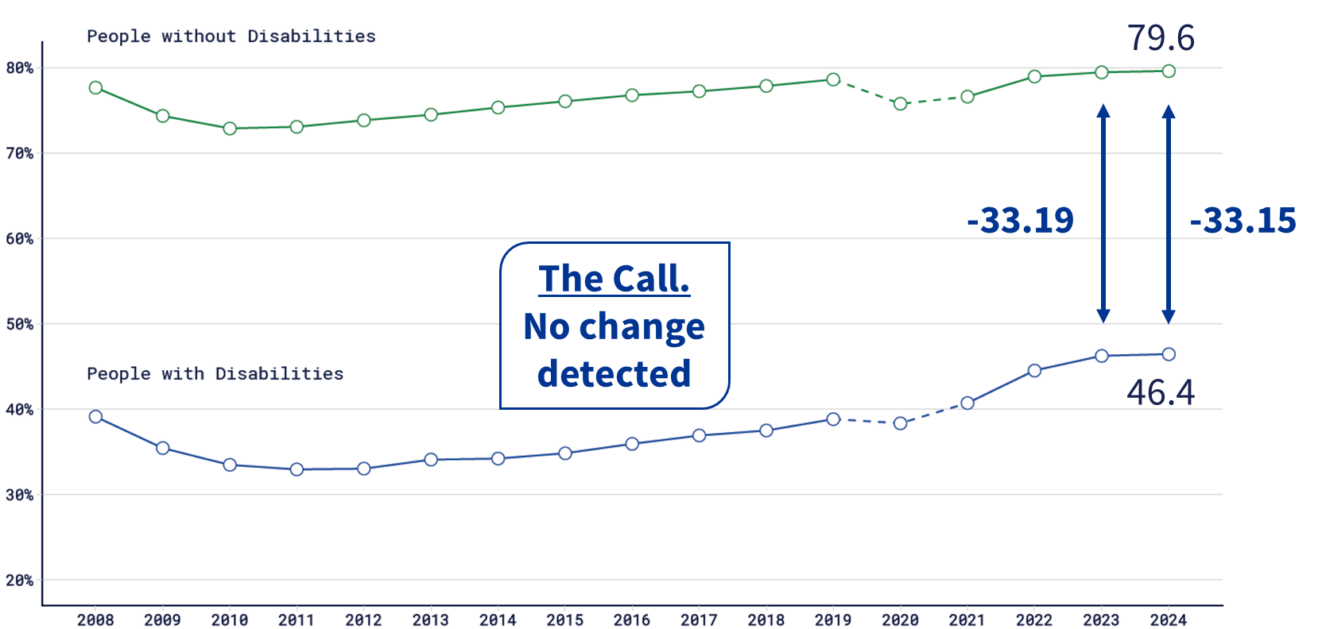
Employment-to-Population Ratio: Gap Percent, ages 18-64
Notes:
Is this change statistically significant?
No. No change detected
(Civilians with and without disabilities ages 18-64 in the U.S. who are living in the community and working)

Slide 18
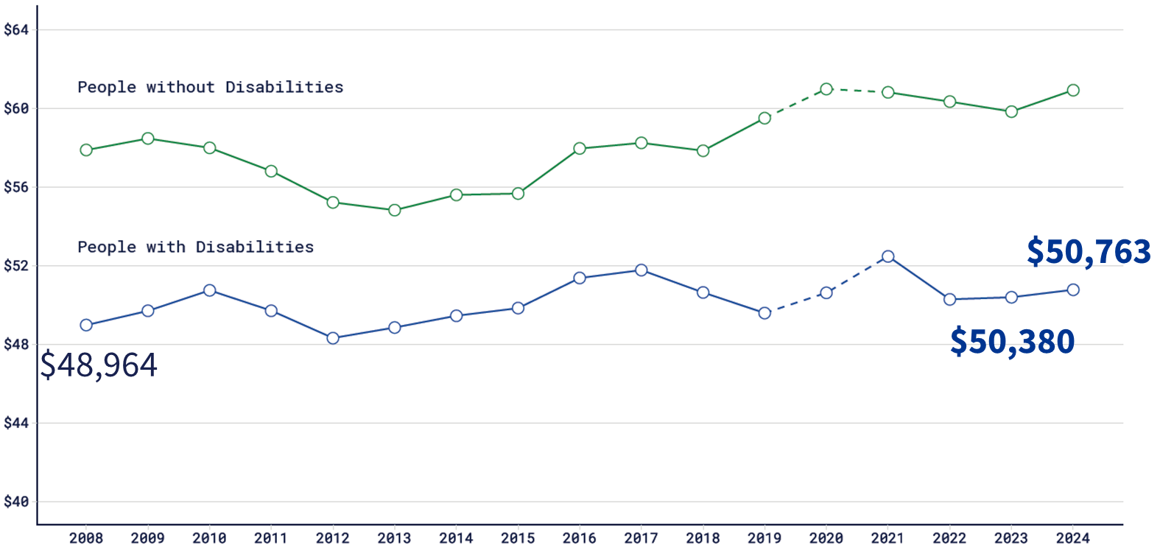
Median Earnings: Comparison Full-Time and Full-Year, USD in the thousands, ages 18-64
Notes:
Median earnings are reported on people ages 18-64
Comparison The median earnings of people with disabilities ages 18-64 who worked full time full year in 2024 was $50,763 annually, compared to $50,380 in 2023
Yes. This increase is statistically significant
(Civilians with disabilities ages 18-64 years old in the U.S. who are living in the community and working full-time, full-year, in thousands of USD)

Slide 19
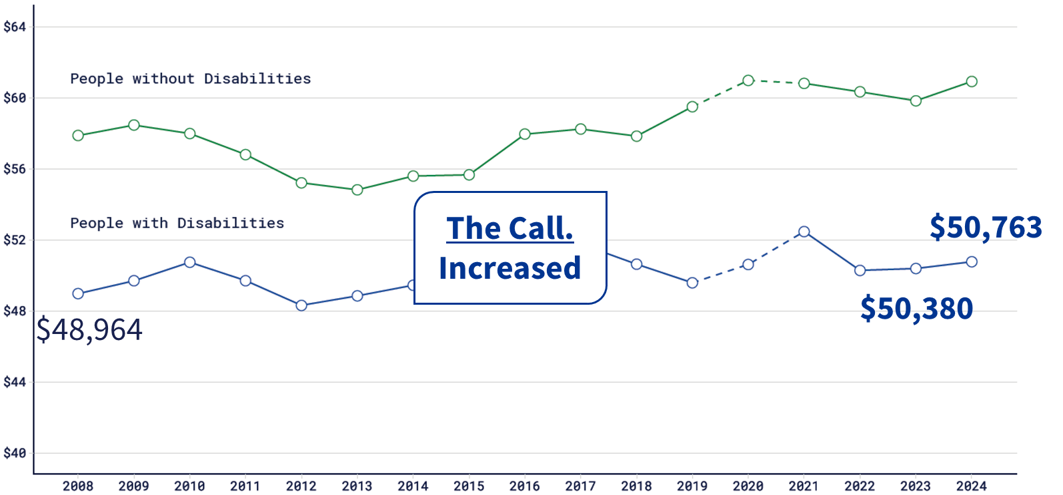
Median Earnings: Comparison Full-Time and Full-Year, USD in the thousands, ages 18-64
Notes:
Median earnings are reported on people ages 18-64
Yes. This increase is statistically significant
(Civilians with disabilities ages 18-64 years old in the U.S. who are living in the community and working full-time, full-year, in thousands of USD)

Slide 20
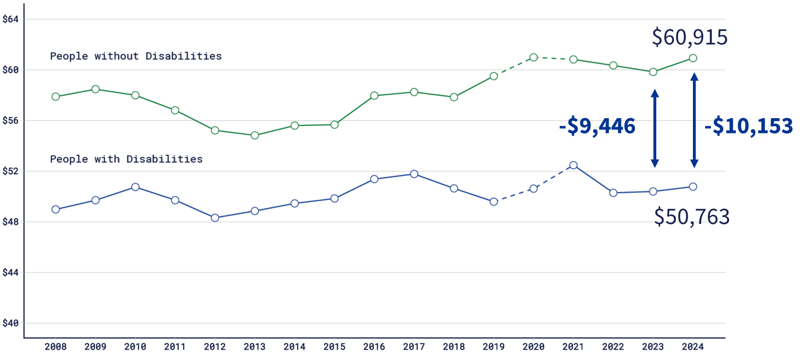
Median Earnings: Gap Full-Time and Full-Year, USD in the thousands, ages 18-64
Notes:
Median wages are reported on people ages 18-64
The Gap in wages for full time full year workers ages 18-64 with and without disabilities widened from -$9,446 in 2023 to -$10,153 in 2024.
Is this change statistically significant?
No. No change detected
(Civilians with and without disabilities ages 18-64 in the U.S. who are living in the community and working full-time, full-year, in thousands of USD)

Slide 21
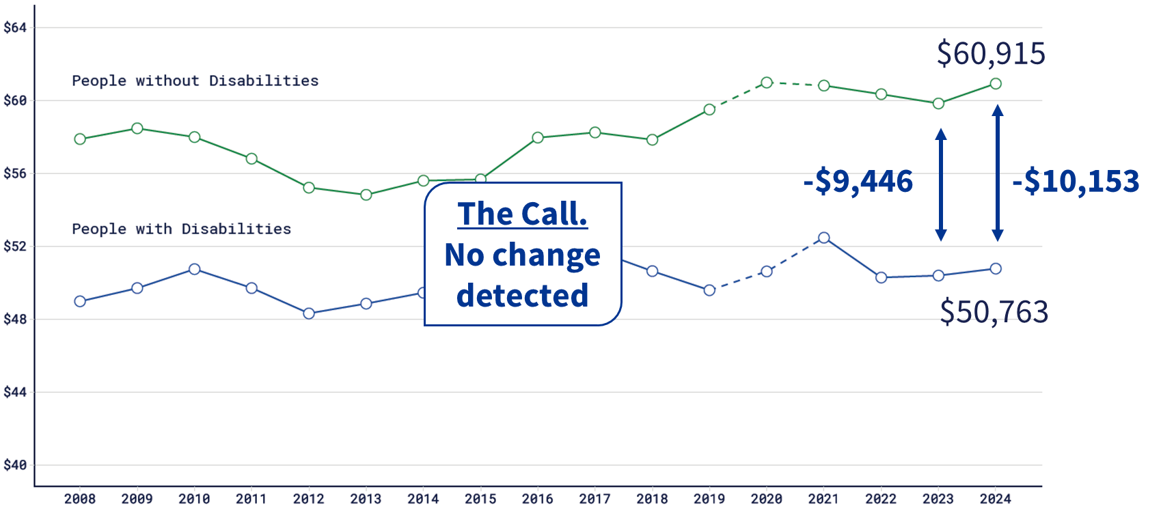
Median Earnings: Gap Full-Time and Full-Year, USD in the thousands, ages 18-64
Notes:
Median wages are reported on people ages 18-64
The Gap in wages for full time full year workers with and without disabilities widened from -$9,446 in 2023 to -$10,153 in 2024.
Is this change statistically significant?
No. No change detected
(Civilians with and without disabilities ages 18-64 in the U.S. who are living in the community and working full-time, full-year, in thousands of USD)

Slide 22
About the Infographics
Experiences of People with Disabilities in Rural America
Social Inequities Experienced by African Americans
Disability Experiences of Veterans Ages 18-64
Notes:
These are the titles of the three infographics.
To caveat the word “experiences”
These data show patterns, experiences are individual (even if they are systematic).
These titles were created most prior to 2020, we are working with our subject matter experts to make sure they still resonate.

Slide 23
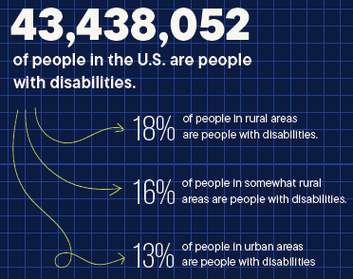
Experiences of People with Disabilities in Rural America
More in Section 10: Rural
of the Compendium
Notes:
Rural areas have higher percentages of people with disabilities.
43,438,052 People in the U.S. are people with disabilities
18% of people in rural areas are people with disabilities
16% of people in somewhat rural areas are people with disabilities
13% of people in urban areas are people with disabilities

Slide 24
A greater percentage of people with disabilities in rural areas are not working
Notes:
In Rural Areas, 65% of people with disabilities are not working
In Somewhat Rural Areas that lowers to 62% and is lower in Urban Areas at 57% not working

Slide 25
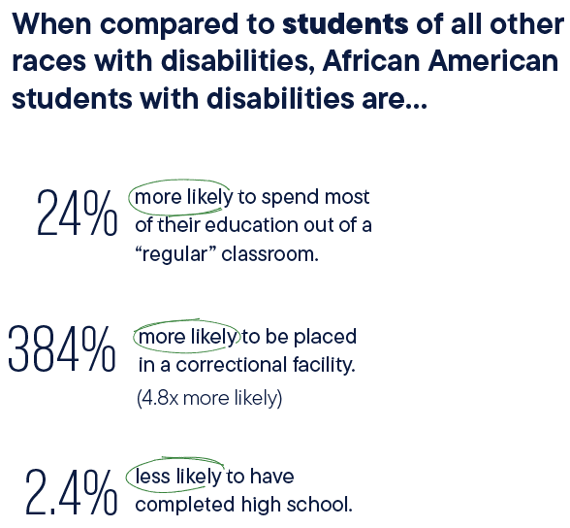
Social Inequities Experienced by African Americans
Leaders should prioritize investments to improve employment, health, and community participation.
Notes:
This was produced in part with the RRTC at Langston University
Dr. Manyibe and colleagues of Langston University urge policymakers and agency leaders should prioritize targeted investments designed to improve outcomes in employment, health, and community participation.
In this community we see higher rates of African American/Black students with disabilities being excluded from classrooms and having lower high school graduation rates

Slide 26
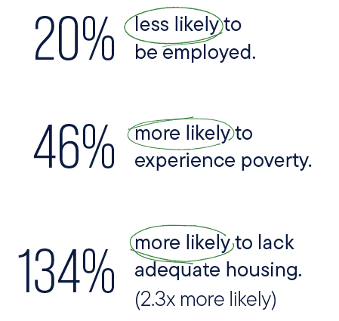
Catherine Lhamon quote
Discrimination based on race and disability in school discipline practices has plagued education across the United States for decades and can wreak significant harm on students and school communities...”
Catherine Lhamon
Chair of the U.S. Commission on Civil Rights
Associated Press, 2019
Notes:
Catherine Lhamon, the 2019 Chair of the U.S. Commission on Civil Rights connected poor educational outcomes with more harm on students. Currently adults African Americans with disabilities are less likely than adults with disabilities of all other ages to be employed, and also more likely to experience poverty and lack adequate housing.

Slide 27
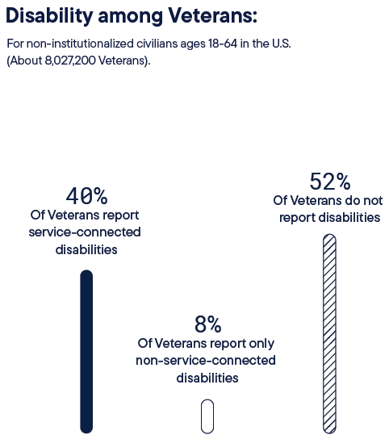
Experiences of Veterans with Disabilities (non-institutionalized civilians ages 18-64)
Veterans with Non-Service-Connected Disabilities are Often Overlooked
Notes:
More in Section 8: Veterans of the Compendium
This was done with Paralyzed Veterans of America
This infographic centers on about 8 million non-institutionalized veterans ages 18-64.
Although only 8% report only non-service-connected disabilities, outcomes for this group appear worse than those for veterans reporting service-connected disabilities and veterans not reporting disabilities.

Slide 28
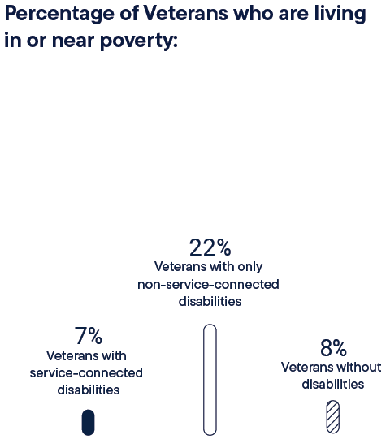
Veterans living in or near poverty
“Oh, it would have been a whole different life if this had happened when I was on active duty. If the VA could’ve taken care of me, I wouldn’t have to worry every day about just survival.”
John, Air Force
Paralyzed Veterans of America, 2024 Testimonial
Notes:
Remember we are talking about over 8 million US veterans. 22% of veterans with only non-service-connected disabilities live in or near poverty, contrasted against 7 and 8 percent of vets with service-conncted disabilities and without disabilities, respectively.
Veterans, like John of the Air Force, state that because they had non-service-connected disabilities they didn’t qualify for most federal programs for veterans, so they turned to a private entity for support.

Slide 29
Partner with us!
Stacia Kingsbury, MPP
Policy Analyst/Project Research Specialist
stacia.kingsbury@unh.edu
Technical Assistance
disability.statistics@unh.edu
Notes:
Dr. Arielle Silverman and Dr. Sarahelizabeth Bahgoon from the American Foundation for the Blind will present at the end of this session. We have partnered with AFB to bring you highly delineated statistics on the population of people who are Blind/low vision. Their contextual expertise drove the development of our Compendium expansions. Please email our team at disability.statistics@unh.edu or me if your organization wants to explore co-curating a highly customized expansion of the Compendium.

