Slide 1
nTIDE Lunch & Learn Webinar Series
Kessler Foundation, AUCD, University of New Hampshire Institute on Disability Season 11, Episode 1 Date: January 9, 2026

Slide 2

nTIDE Lunch & Learn Webinar Series
Kessler Foundation, AUCD, University of New Hampshire Institute on Disability Season 11, Episode 1 Date: January 9, 2026

Slide 3
Up Front Matters
This webinar is being recorded. We will post an archive of along side the Monthly nTIDE broadcast on our webinar, each month, on our website at www.researchondisability.org/nTIDE. This site will also provide copies of the presentations, the speakers’ bios, full transcripts, and other valuable resources.
As an attendee of this webinar, you are a viewer. To ask questions of the speakers, click on the Q & A box on your webinar screen and type your questions into the box. Speakers will review these questions and provide answers during the last section of the webinar. Some questions may be answered directly in the Q & A box.

Slide 4
Up Front Matters – Contact Info
If you have any questions following this recording, please contact us at disability.statistics@unh.edu, or toll free at 866-538-9521 for more information. Thanks for joining us. Enjoy today's webinar!

Slide 5
Welcome to the nTIDE Lunch & Learn
Occurs at noon Eastern-time on the first Friday day of each month, with the release of the nTIDE Report.
A joint effort of the University of New Hampshire, Kessler Foundation, and the Association of University Centers on Disabilities (AUCD).

Slide 6
Today’s Agenda
Part 1: nTIDE Report … “The Numbers”
Andrew Houtenville, University of New Hampshire
John O’Neill, Kessler Foundation
Part 2: nTIDE News
Lillie Heigl, Association of University Centers on Disabilities (AUCD)
Part 3: Guest Speakers
Yvonne Kellar-Guenther, Center for Public Health Innovation
Peter Pike, Division of Vocational Rehabilitation, CO
Part 4: Q&A

Slide 7
Part 1: The nTIDE Report
John O’Neill
Kessler Foundation

Slide 8
The Monthly nTIDE Report
The monthly nTIDE Report is a press release and infographic, looking at the latest employment statistics.
Uses data from the “jobs report” released by the U.S. Bureau of Labor Statistics, on the 1st Friday of each month.

Slide 9
Source of the Data
U.S. BLS, Current Population Survey (CPS).
Source of the “official” unemployment rate.
Civilians, ages 16-64, not living in institutions.
Available September 2008 onward.
Not yet seasonally adjusted.
which is why we compare to the same month last year.

Slide 10
The Numbers
Andrew Houtenville University of New Hampshire

Slide 11
Employment- to-Population Ratio:
Notes:
Chart Details:
The data series starts in June 2008 during the Great Recession which lasted until Mid-2009. The COVID-19 Recession started in April 2020 and last for two months
Visible Data points (highlights start of the series, the lowest point pre-covid, the points right before and after the Covid-19 recession hit, and the current Employment-to-Population Ratio
People without Disabilities:
June 2008 74.9
January 2010 (lowest point pre-covid) 68.8
February 2020 74.8
April 2020 (Covid-19 Recession hits) 63.2 (lowest point)
August 2024 74.8
September 2024 75.0
People with Disabilities:
September 2008 32.7
January 2014 (lowest point pre-covid) 24.1 (lowest point)
March 2020 31.7
April 2020 (Covid-19 Recession hits) 26.3
August 2024 38.4
September 2024 37.5

Slide 12
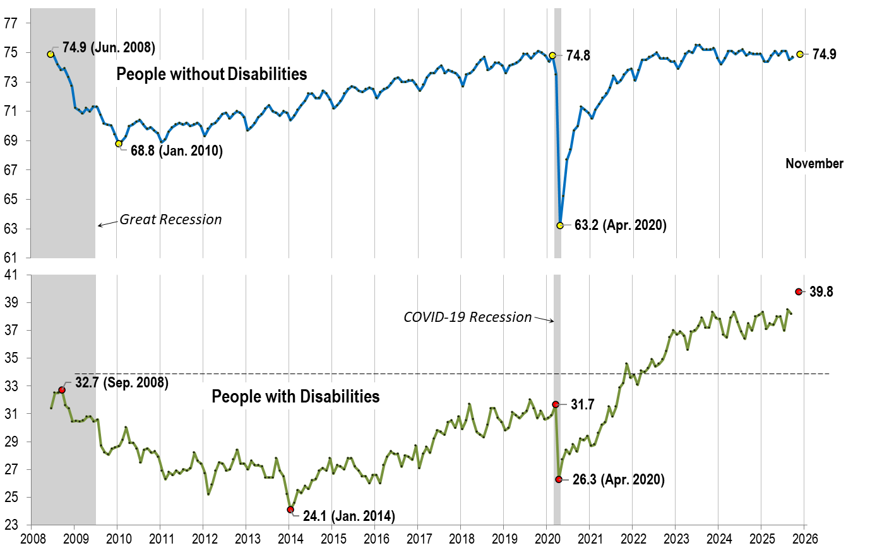
Employment- to-Population Ratio: November
Notes:
Chart Details:
The data series starts in June 2008 during the Great Recession which lasted until Mid-2009. The COVID-19 Recession started in April 2020 and last for two months.
Visible Data points (highlights start of the series, the lowest point pre-covid, the points right before and after the Covid-19 recession hit, and the current Employment-to-Population Ratio
People without Disabilities:
June 2008 74.9
January 2010 (lowest point pre-covid) 68.8
February 2020 74.8
April 2020 (Covid-19 Recession hits) 63.2 (lowest point)
November 2025 74.9
People with Disabilities:
September 2008 32.7
January 2014 (lowest point pre-covid) 24.1 (lowest point)
March 2020 31.7
April 2020 (Covid-19 Recession hits) 26.3
November 2025 39.8

Slide 13
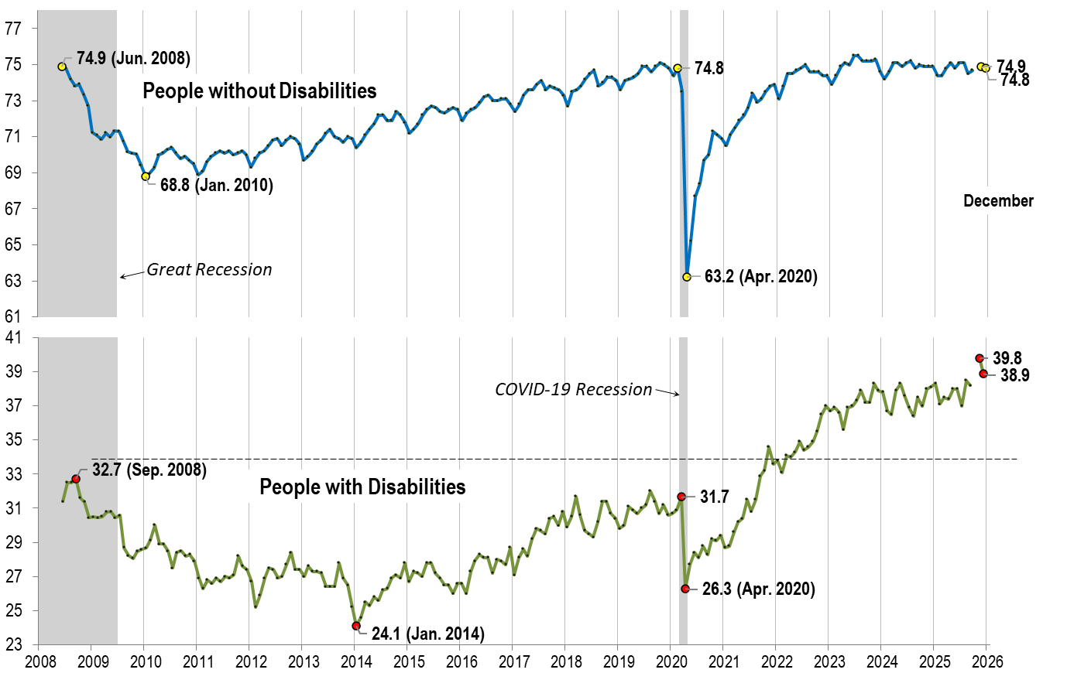
Employment- to-Population Ratio: December
Notes:
Chart Details:
The data series starts in June 2008 during the Great Recession which lasted until Mid-2009. The COVID-19 Recession started in April 2020 and last for two months.
Visible Data points (highlights start of the series, the lowest point pre-covid, the points right before and after the Covid-19 recession hit, and the current Employment-to-Population Ratio
People without Disabilities:
June 2008 74.9
January 2010 (lowest point pre-covid) 68.8
February 2020 74.8
April 2020 (Covid-19 Recession hits) 63.2 (lowest point)
August 2025 74.5
November 2025 74.9
December 2025 74.8
People with Disabilities:
September 2008 32.7
January 2014 (lowest point pre-covid) 24.1 (lowest point)
March 2020 31.7
April 2020 (Covid-19 Recession hits) 26.3
November 2025 39.8
December 2025 38.9

Slide 14
Labor Force Participation Rate:

Slide 15
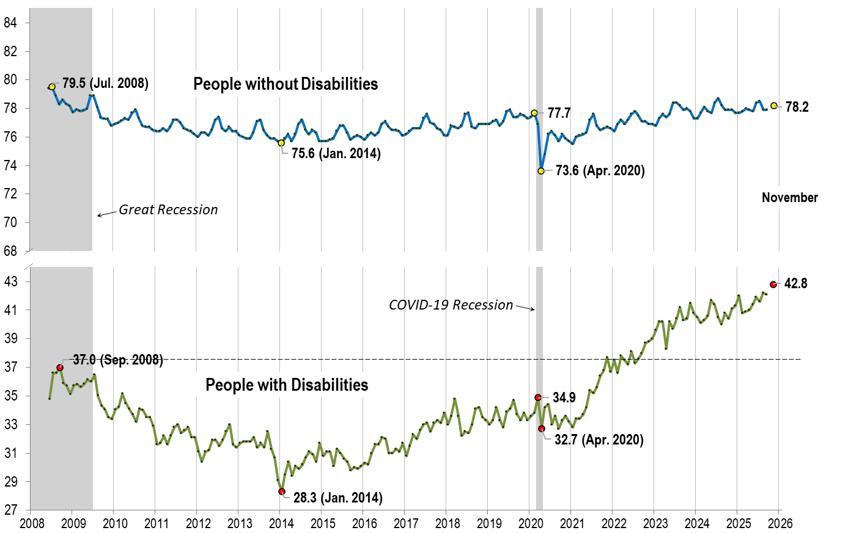
Labor Force Participation Rate: November
Notes:
Chart Details:
The data series starts in June 2008 during the Great Recession which lasted until Mid-2009. The COVID-19 Recession started in April 2020 and last for two months.
Visible Data points (highlights start of the series, the lowest point pre-covid, the points right before and after the COVID-19 recession hit, and the current labor force participation rate.
People without Disabilities:
July 2008 79.5
January 2014 (lowest point pre-covid) 75.6
February 2020 77.7
April 2020 (Covid-19 Recession hits) 73.6 (lowest point)
November 2025 78.2
People with Disabilities:
September 2008 37.0
January 2014 28.3 (lowest point)
March 2020 34.9
April 2020 (Covid-19 Recession hits) 32.7
November 2025 42.8

Slide 16
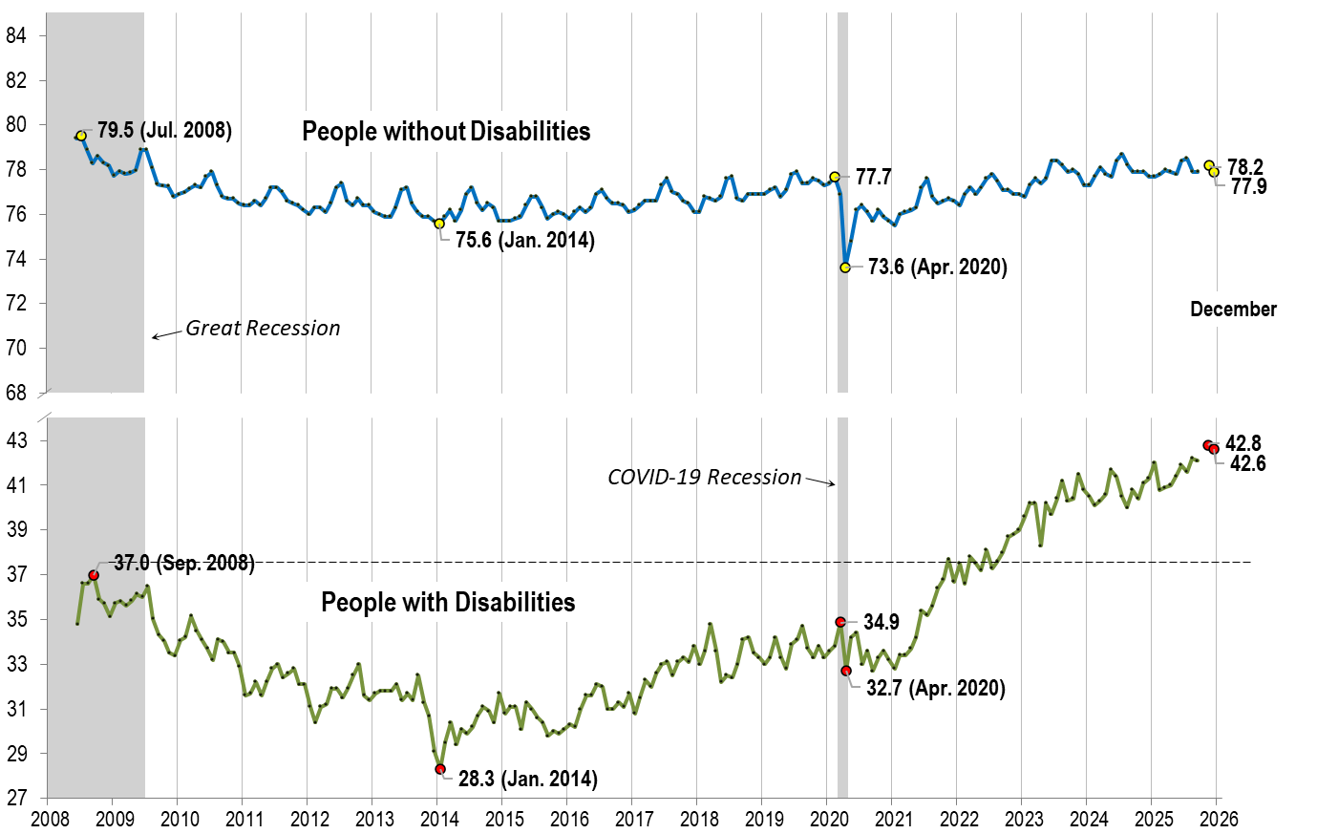
Labor Force Participation Rate: December
Notes:
Chart Details:
This chart adds another month to the previous chart.
The data series starts in June 2008 during the Great Recession which lasted until Mid-2009. The COVID-19 Recession started in April 2020 and last for two months.
Visible Data points (highlights start of the series, the lowest point pre-covid, the points right before and after the COVID-19 recession hit, and the current labor force participation rate.
July 2008 79.5
January 2014 (lowest point pre-covid) 75.6
February 2020 77.7
April 2020 (Covid-19 Recession hits) 73.6 (lowest point)
November 2025 78.2
December 2025 77.9
People with Disabilities:
September 2008 37.0
January 2014 28.3 (lowest point)
March 2020 34.9
April 2020 (Covid-19 Recession hits) 32.7
November 2025 42.8
December 2025 42.6

Slide 17
Part 2 nTIDE News
Lillie Heigl
Association of University Centers on Disabilities (AUCD)

Slide 18
Federal Policy Update
Government Funding
November CR was passed- funding the Federal Government through January
Congress currently working through funding bills before Jan 30
More than 75 percent of government programs still need to be funded
Options: pass funding bills, another CR, another shutdown
Connection to disability employment: Labor HHS bill funds disability employment through the Office of Disability Employment Policy (ODEP), Youth Employment Initiatives, WIOA and others
Notes:
Thursday The House passed three government spending bills Thursday, inching Congress closer to funding federal operations ahead of the Jan. 30 deadline to avoid a shutdown.
The measures would fund the departments of Energy, Commerce, Interior and Justice, as well as water programs, the EPA and federal science initiatives through the end of the current fiscal year. More than 75 percent of government programs still need to be funded.

Slide 19
Federal Policy Update
Last time: Department of Education Interagency Agreements
Elementary and Secondary Education Partnership
Postsecondary Education Partnership
December meeting with Secretary McMahon
Connection to disability employment: future questions around special education and RSA, movement of the above agencies to the Department of Labor
Notes:
the Administration wants to close the Department of Education and has begun to shift its work to other federal agencies. On November 18, the Administration announced that the Education Department is signing six new interagency agreements (IAAs) to shift some Education offices over to four other federal agencies—the Departments of Labor, Interior, Health and Human Services, and State. Education Department officials have said that the funding levels for these programs will stay the same. These are the six IAAs:
ED and DOL: Elementary and Secondary Education Partnership DOL will take on a greater role in administering federal K-12 programs, ensuring these programs are better aligned with workforce and college programs to set students up for success at every part of their education journey. With proper oversight by ED, DOL will manage competitions, provide technical assistance, and integrate ED’s programs with the suite of employment and training programs DOL already administers.
ED and DOL: Postsecondary Education Partnership DOL will take on a greater role in administering most postsecondary education grant programs authorized under the Higher Education Act.
In December, leaders in the disability community met with Sec. McMahon and Assistant Secretary for Civil Rights Kimberly Richey to to discuss the future of the agency’s Oﬃce of Special Education Programs, Rehabilitation Services Administration, and the Oﬃce for Civil Rights. There have been more recent indications that OSEP might move to Labor instead of HHS, keeping it with the other education programs that have already moved to labor.

Slide 20
Federal Policy Update
Changes to ABLE accounts in the new year
Age limit increasing from 26 to 46- estimated number of individuals eligible for ABLE accounts is expected to grow from 8 million to 14 million, according to the National Disability Institute.
Contribution limit increasing to $20,000 from $19,000
IRS raised the federal gift tax limit, which also serve as the cap on annual deposits for ABLE accounts
Exception to the limit: Workers with disabilities living in the 48 contiguous states are allowed to save up to $15,650 in earnings in ABLE accounts above and beyond the gift tax limit for the year if they do not participate in an employer sponsored retirement plan, according to the ABLE National Resource Center
Notes:
Access to special accounts that allow individuals with disabilities to save without losing out on government benefits will soon expand dramatically and people with the accounts will be able to save more in them than ever before.
ABLE accounts will be available to Americans with disabilities that onset by age 46 beginning in January. Until now, the age limit has been 26.
Created under a 2014 law, ABLE accounts offer people with disabilities the opportunity to save up to $100,000 without sacrificing eligibility for Supplemental Security Income. Medicaid and several other government benefits can be retained no matter how much is in the accounts.
Money saved can be used to pay for qualified disability expenses including education, health care, transportation and housing. Interest earned is tax-free.
With the change, the estimated number of individuals eligible for ABLE accounts is expected to grow from 8 million to 14 million, according to the National Disability Institute.
In addition to expanding the eligibility pool, people with disabilities will also be able to save more money in their ABLE accounts in 2026. The contribution limit will increase to $20,000, up from $19,000 this year.
That update comes after the Internal Revenue Service raised the federal gift tax limit, which also serves as the cap on annual deposits for ABLE accounts.
There is one exception to that limit, however. Workers with disabilities living in the 48 contiguous states are allowed to save up to $15,650 in earnings in ABLE accounts above and beyond the gift tax limit for the year if they do not participate in an employer sponsored retirement plan, according to the ABLE National Resource Center. For 2026, that figure rises to $19,550 for Alaska residents and $17,990 for those in Hawaii.
The increased savings allowance for workers with disabilities and a handful of other provisions were originally set to expire the end of 2025. But, federal lawmakers opted to make the option permanent as part of the “One Big Beautiful Bill Act,” which passed in July.
In addition, the legislation ensures that funds from traditional 529 college savings plans can roll over into ABLE accounts. And, ABLE contributions will remain eligible for what’s known as the Saver’s Credit.
As of the end of September, there were 223,182 ABLE accounts open with $2.87 billion in assets, according to ISS Market Intelligence, which tracks ABLE account trends.
There are programs offering ABLE accounts in 46 states and Washington, D.C., most of which are open to individuals nationwide with a disability who meet the age requirement.

Slide 21
NCI State of the Workforce 2024 Survey Report
Release of the NCI State of the Workforce for IDD (NCI-IDD SoTW)® 2024 report. The NCI-IDD SoTW is the most comprehensive data on the Direct Support Professional (DSP) workforce providing direct services to adults with intellectual and developmental disabilities (IDD).
A few report highlights:
In 2024, SoTW collected data from 3,936 provider agencies representing 344,179 DSPs in 26 states and the District of Columbia. The data for 2024 suggest some positive trends for the state of the IDD DSP workforce.
Findings
Across the nation, the median hourly wage for DSPs is $18.39 which is more than a dollar increase from the median hourly wage of $17.20 in 2023.
The weighted average turnover ratio was 37%, with nearly two in three DSPs who left their employers (64%) having been with their agency for less than one year.
On average, 26% of agencies report they turned away or stopped accepting referrals due to staffing issues, down from 38% in 2023.

Slide 22
Opportunities
The Joseph P. Kennedy, Jr. Foundation: 2026 Public Policy Fellowship - Application Deadline: January 31, 2026
2026 AAPD Fall Internship Program- Application Deadline: February 5, 2026
The 2026 AAPD Fall Internship Program Application is now open. The program places students and recent graduates with disabilities in paid internships

Slide 23
DETAC Webinar
Community Collaborations for Employment: Building Pathways That Work
January 13, 2026, 3:00-4:30 PM Eastern Time
ACL’s Projects of National Significance (PNS) Community Collaborations for Employment (CCE) grants, launched in 2021, support stakeholder collaborations to better facilitate transitions of youth with intellectual and developmental disabilities (I/DD) between schools to employment and community living. As the seven grants conclude their final year, the CCE teams from Kansas and North Carolina will share highlights from their work, including successful strategies, effective partnerships, outcomes, and lessons learned. Self-advocates will also discuss their employment journeys and their roles in CCE teams. This session will offer ACL grantees and organizations working to advance competitive integrated employment (CIE) practical approaches they can apply in their own communities.
Notes:
Yvonne Kellar-Guenther, PhD, is the Associate Director at Center for Public Health Innovation. She works in public health. Yvonne holds advanced degrees in Communication Theory and Interpersonal Communication. She was trained in both qualitative and quantitative methodology. She has been engaged in research for over 30 years and engaged in program evaluation for over 20 years. Dr. Kellar-Guenther was the lead researcher on SEEKS, a randomized control trial that tested a service delivery model designed to increase employment, increase gross income, and/or reduce social isolation for adults (ages 18-60 years of age) with disabilities who were likely eligible for SSI/SSDI. She was also the lead researcher and program evaluator on Colorado Youth WINS, a randomized control trial looking at providing employment support and benefit planning services for youth with disabilities aged 14-25 in Colorado. Some of her current projects include creating sustainable long-term follow-up for families whose child was diagnosed as a result of newborn screening, creating tools for birthing providers to educate families on newborn screeing, and co-leading learning collaboratives with state newborn screening programs and accredited cystic fibrosis centers focused on continuous quality improvement.
Peter J. Pike is the Program Manager, Colorado Department of Labor and Employment, Office of Independent Living Services. He oversees contracts worth over $7 million dollars annually with nine non-profits called Centers for Independent Living. These non-profits provide independent living services to support people with disabilities living independently in the communities of their choice. Peter is also the Director of a 5-year random assignment research project called Securing Employment and Economic Keys to Stability (SEEKS) funded by the National Institute on Disability, Independent Living, and Rehabilitation Research, $2.3 million.

Slide 24
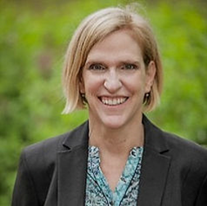

Part 3: Guest Speaker
Yvonne Kellar-Guenther
Associate Director at Center for Public
Health Innovation
Peter Pike
Program Manager, Colorado Department of Labor & Employment, Division of Vocational Rehabilitation, Office of Independent Living Services

Slide 25
Overview of the Securing Employment and Economic Keys to Stability (SEEKS) Research Study
Yvonne Kellar-Guenther, PhD, Center for Public Health Innovation, SEEKS Lead Researcher
Peter Pike, Colorado Division of Vocational Rehabilitation, Office of Independent Living Services, SEEKS Principal Investigator
January 9, 2026

Slide 26




SEEKS Paradigm
Changing the expectations around applying for Social Security disability benefits AND work
Typical Paradigm
SSI/SSDI OR Work
SEEKS Paradigm
SSI/SSDI AND Work

Slide 27
Study Goals
Increased Competitive, Integrative Employment
Increased Total Income
Increased Social Connection

Slide 28



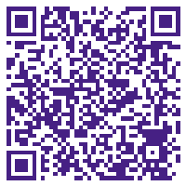
Participants
Conducted Randomized Control Trial
276 adults took part
18-60 years old when joined
Had a disability
Expressed interest in applying for SSI/SSDI
Deemed likely eligible for SSI/SSDI
https://docs.google.com/document/d/170YYc8LnFYlik9Bfdp4w__lI1LbSsyCe8Q46fnKJyWk/edit?tab=t.0

Slide 29

Randomized Control Trial
181 Randomized to Treatment
95 Randomized to Control
Connected to a Team who worked CONCURRENTLY with participant.
Worked with a SOAR/SSI SSDI Application Assistance
Worked with an Employment Specialist (CE, IPS)
Worked with a Benefits Planner (WIP-C)
Connected to a Center for Independent Living who offered business as usual.
May be able to provide services
May refer out
Did not have to offer concurrently
May not have had training that team had
Benefits Planning
Employment Services
SSI/SSDI Application Assistance
This Photo by Unknown Author is licensed under CC BY-ND

Slide 30


Data Collection
Participants provided data up to 4 times - baseline, 6 months, 12 months, and 18 months
14 treatment participants also did qualitative interviews

Slide 31
Findings

Slide 32

Groups Did Not Significantly Differ In Demographics
51% Female, 43% Male, 6% Non-Binary
80% Single
Average age 40 years when joined SEEKS
86% reported less than 4 years of college as highest education
For the most part Race/Ethnicity matches Colorado Demographics
68% of Control and 58% of Treatment group White
Most Frequently reported Primary Disability Types
43% of the Treatment and Control reported Physical Disability
36% of the Treatment and 28% of the Control reported Mental Emotional Disability

Slide 33

No Statistically Significant Difference In Employment
At Highest Point in Study
Baseline
20%
27.7%
control
21.2%
26.3%
treatment
In 2024, the employment-population ratio for people with disabilities was 22.7%, according to the Bureau of Labor Statistics (.gov)

Slide 34
Graph chart of percent of group enrolled in DVR

Slide 35
Interviewer and Participant Conversation
“Interviewer: And what was the most valuable resource?
Participant: Probably the DVR [connection]. [The DVR connection is the] one I seem to have used the most so far.” (Treatment group participant).”
“I was able to start a bootcamp that DVR funded to do software development.” (Treatment group participant).

Slide 36
The majority of participants who were employed
Reported having 1 job
Loved their jobs
Did not use job supports

Slide 37
The SEEKS Approach Shows Promise

Slide 38
Income Finding
A statically significantly higher percentage of treatment participants met with a Benefits Planner.

Slide 39
Average Yearly Income for those Who Worked With Certified Vendors
This team delivered the intervention with fidelity.
The other treatment group did not.

Slide 40




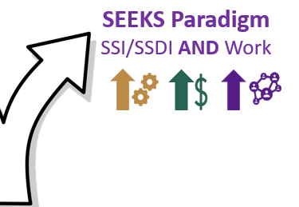


Certified Vendor Approach
Team of Experts
Not tied to one organization
Work concurrently with participant and remind participant about services other team members providers
Believe in SEEKS “AND” Paradigm
Replicate anywhere in the state because the team is not limited to a geographic catchment area

Slide 41
Statistics of Job Motivation
55.5% of the control group participants
84% of the treatment group participants
Who talked to a Benefits Planner reported that based on their conversation with the benefits planner they were motivated to get a job.
A statistically significantly higher percentage of treatment participants met with a Benefits Planner.

Slide 42


Benefits Planning Approach Used by SEEKS
SSI/DI
Benefits planning can start prior to employment
Do not have to be on SSI/SSDI because of goal of study
Emphasis starts with State and Local Benefits

Slide 43
Connection to Benefits Planning Beneficial
In a different study, Kellar-Guenther, Pike, et al. (manuscript in preparation) found connection to benefits planning beneficial for employment
Kellar-Guenther, Y., Pike, P., Smyth, H., and Phillips, W. (2025). A look at benefits planning services for vocational rehabilitation clients who get public benefits. [Manuscript submitted for publication] CPHI and Colorado DVR.
Higher Median increase in hourly pay & hours worked per week
Benefits planning group (n=377) had
than no benefits planning group (n=2264)

Slide 44
We end with a quote from one of our Treatment Group participants
“I really, really appreciate you guys and the program and I wish the [Center for Independent Living] still had it . . . I would do it again.”

Slide 45
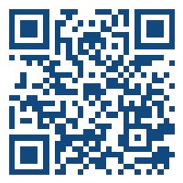
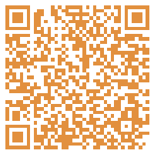
SEEKS Resources at Colorado Division of Vocational Rehabilitation https://dvr.colorado.gov/independent-living-services/benefits-planning/working-while-applying
SEEKS Executive Summary at the Center for Public Health Innovation
https://bit.ly/seeks-exec-summary

Slide 46
Contact Info
Yvonne Kellar-Guenther
Yvonne.Kellar-Guenther@CPHInnovation
303-829-0819
www.linkedin.com/in/yvonne-kellar-guenther-761bb645
Peter Pike
Peter.Pike@state.co.us
720-697-4794

Slide 47

Thank You!
Information about the nTIDE partners may be found at
Kessler Foundation (www.kesslerfoundation.org)
UNH/Institute on Disability (www.ResearchOnDisability.org)
AUCD (www.AUCD.org)
Contact us at
Email: Disability.Statistics@unh.edu
Call: 866-538-9521 (toll free)
Twitter at #nTIDELearn

Slide 48
Bye!

