Slide 1
nTIDE Lunch & Learn
Webinar Series
Kessler Foundation, AUCD,
University of New Hampshire Institute on Disability
Season 10, Episode 9
Date: September 5, 2025

Slide 2

nTIDE Lunch & Learn
Webinar Series
Kessler Foundation, AUCD,
University of New Hampshire Institute on Disability
Season 10, Episode 9
Date: September 5, 2025

Slide 3
Up Front Matters
This webinar is being recorded. We will post an archive of along side the Monthly nTIDE broadcast on our webinar, each month, on our website at www.researchondisability.org/nTIDE. This site will also provide copies of the presentations, the speakers’ bios, full transcripts, and other valuable resources.
As an attendee of this webinar, you are a viewer. To ask questions of the speakers, click on the Q & A box on your webinar screen and type your questions into the box. Speakers will review these questions and provide answers during the last section of the webinar. Some questions may be answered directly in the Q & A box.

Slide 4
Up Front Matters – Contact Info
If you have any questions following this recording, please contact us at disability.statistics@unh.edu, or toll free at 866-538-9521 for more information. Thanks for joining us. Enjoy today's webinar!

Slide 5
Welcome to the nTIDE Lunch & Learn
  Occurs at noon Eastern-time on the first Friday day of each month, with the release of the nTIDE Report.
  A joint effort of the University of New Hampshire, Kessler Foundation, and the Association of University Centers on Disabilities (AUCD).

Slide 6
Today’s Agenda
Part 1: nTIDE Report … “The Numbers”
  Andrew Houtenville, University of New Hampshire
  Elaine Katz, Kessler Foundation
Part 2: nTIDE News
  Denise Rozell, Association of University Centers on Disabilities (AUCD)
Part 3: Guest Speakers
  Emily Homer and Teresa Thomas, Melwood Community Services
Part 4: Q&A

Slide 7
Part 1: The nTIDE Report
Elaine Katz
Kessler Foundation

Slide 8
The Monthly nTIDE Report
The monthly nTIDE Report is a press release and infographic, looking at the latest employment statistics.
Uses data from the “jobs report” released by the U.S. Bureau of Labor Statistics, on the 1st Friday of each month.

Slide 9
Source of the Data
U.S. BLS, Current Population Survey (CPS).
  Source of the “official” unemployment rate.
Civilians, ages 16-64, not living in institutions.
Available September 2008 onward.
Not yet seasonally adjusted.
  which is why we compare to the same month last year.

Slide 10
The Numbers
Andrew Houtenville
University of New Hampshire

Slide 11
Employment- to-Population
Ratio:
Notes:
Chart Details:
The data series starts in June 2008 during the Great Recession which lasted until Mid-2009. The COVID-19 Recession started in April 2020 and last for two months
Visible Data points (highlights start of the series, the lowest point pre-covid, the points right before and after the Covid-19 recession hit, and the current Employment-to-Population Ratio
People without Disabilities:
June 2008 74.9
January 2010 (lowest point pre-covid) 68.8
February 2020 74.8
April 2020 (Covid-19 Recession hits) 63.2 (lowest point)
August 2024 74.8
September 2024 75.0
People with Disabilities:
September 2008 32.7
January 2014 (lowest point pre-covid) 24.1 (lowest point)
March 2020 31.7
April 2020 (Covid-19 Recession hits) 26.3
August 2024 38.4
September 2024 37.5

Slide 12
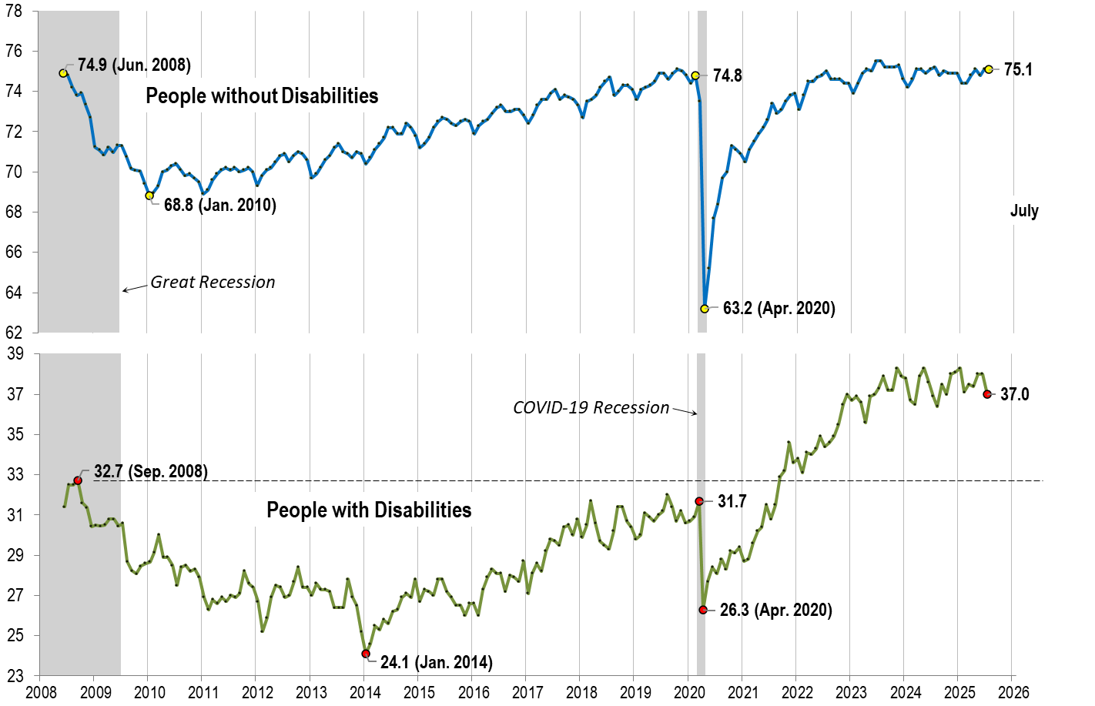
Employment- to-Population
Ratio:
July
Notes:
Chart Details:
The data series starts in June 2008 during the Great Recession which lasted until Mid-2009. The COVID-19 Recession started in April 2020 and last for two months.
Visible Data points (highlights start of the series, the lowest point pre-covid, the points right before and after the Covid-19 recession hit, and the current Employment-to-Population Ratio
People without Disabilities:
June 2008 74.9
January 2010 (lowest point pre-covid) 68.8
February 2020 74.8
April 2020 (Covid-19 Recession hits) 63.2 (lowest point)
July 2025 75.1
People with Disabilities:
September 2008 32.7
January 2014 (lowest point pre-covid) 24.1 (lowest point)
March 2020 31.7
April 2020 (Covid-19 Recession hits) 26.3
July 2025 37.0

Slide 13
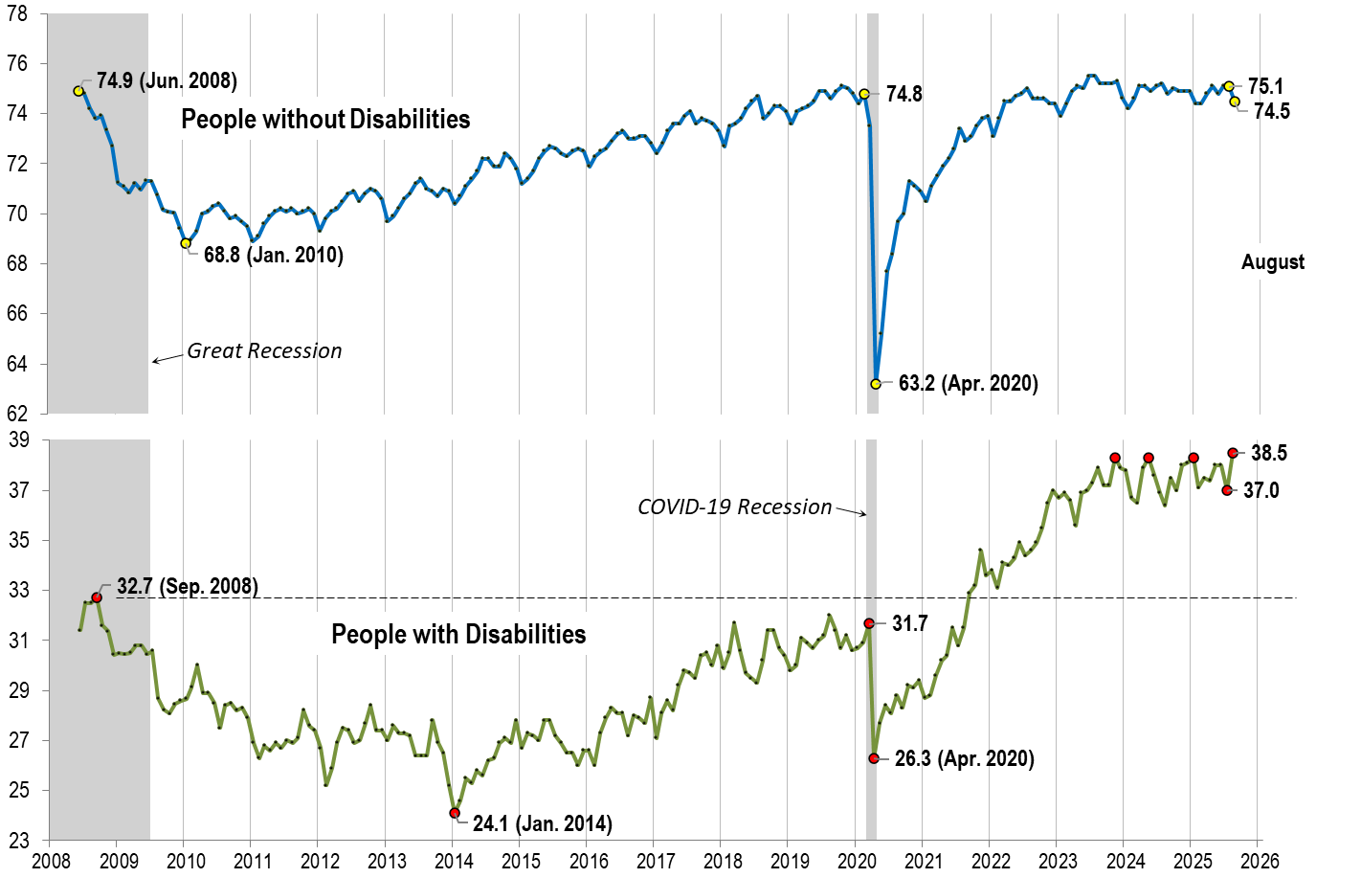
Employment- to-Population
Ratio:
August
Notes:
Chart Details:
The data series starts in June 2008 during the Great Recession which lasted until Mid-2009. The COVID-19 Recession started in April 2020 and last for two months.
Visible Data points (highlights start of the series, the lowest point pre-covid, the points right before and after the Covid-19 recession hit, and the current Employment-to-Population Ratio
People without Disabilities:
June 2008 74.9
January 2010 (lowest point pre-covid) 68.8
February 2020 74.8
April 2020 (Covid-19 Recession hits) 63.2 (lowest point)
May 2025 74.8
June 2025 75.1
People with Disabilities:
September 2008 32.7
January 2014 (lowest point pre-covid) 24.1 (lowest point)
March 2020 31.7
April 2020 (Covid-19 Recession hits) 26.3
June 2025 38.0
July 2025 37.0

Slide 14
Labor Force
Participation
Rate:

Slide 15
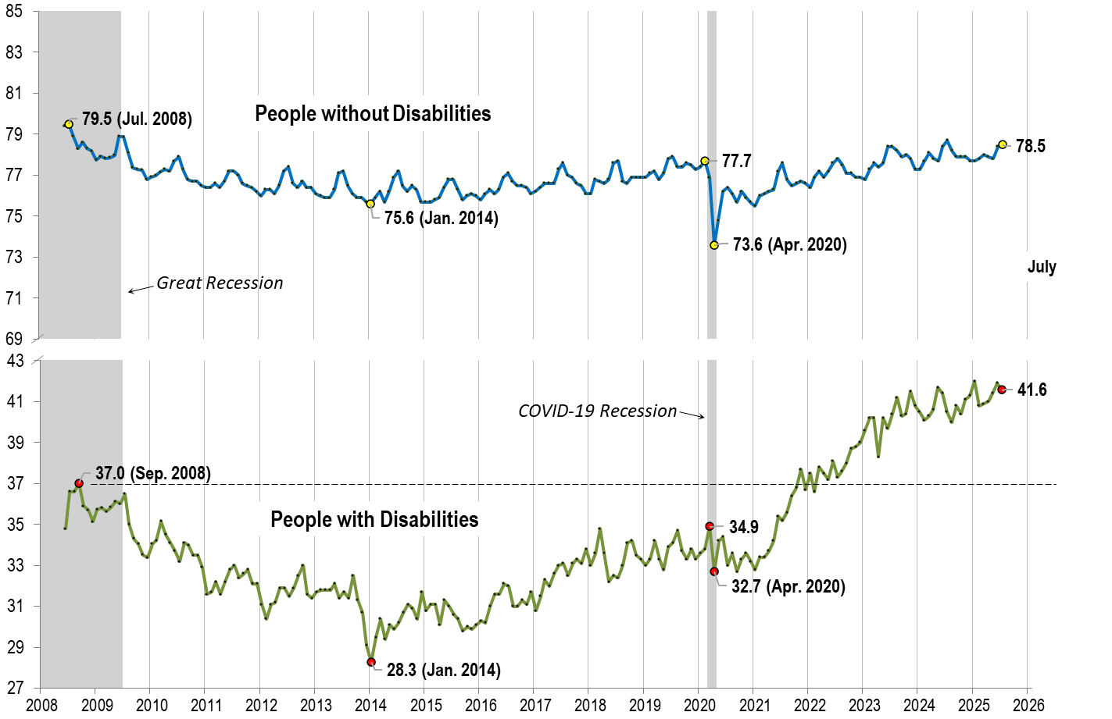
Labor Force
Participation
Rate:
July
Notes:
Chart Details:
The data series starts in June 2008 during the Great Recession which lasted until Mid-2009. The COVID-19 Recession started in April 2020 and last for two months.
Visible Data points (highlights start of the series, the lowest point pre-covid, the points right before and after the COVID-19 recession hit, and the current labor force participation rate.
People without Disabilities:
July 2008 79.5
January 2014 (lowest point pre-covid) 75.6
February 2020 77.7
April 2020 (Covid-19 Recession hits) 73.6 (lowest point)
July 2025 78.5
People with Disabilities:
September 2008 37.0
January 2014 28.3 (lowest point)
March 2020 34.9
April 2020 (Covid-19 Recession hits) 32.7
July 2025 41.6

Slide 16

Labor Force
Participation
Rate:
August
Notes:
Chart Details:
This chart adds another month to the previous chart.
The data series starts in June 2008 during the Great Recession which lasted until Mid-2009. The COVID-19 Recession started in April 2020 and last for two months.
Visible Data points (highlights start of the series, the lowest point pre-covid, the points right before and after the COVID-19 recession hit, and the current labor force participation rate.
July 2008 79.5
January 2014 (lowest point pre-covid) 75.6
February 2020 77.7
April 2020 (Covid-19 Recession hits) 73.6 (lowest point)
July 2025 78.5
August 2025 77.9
People with Disabilities:
September 2008 37.0
January 2014 28.3 (lowest point)
March 2020 34.9
April 2020 (Covid-19 Recession hits) 32.7
July 2025 41.6
August 2025 42.2

Slide 17
Part 2 nTIDE News
Denise Rozell
Association of University Centers on Disabilities (AUCD)

Slide 18
Federal Policy Update
Senate Appropriations Committee -- July 31, 2025
  Bill language https://www.appropriations.senate.gov/imo/media/doc/fy26_lhhs_bill_text.pdf
  Report language https://www.appropriations.senate.gov/imo/media/doc/fy26_lhhs_senate_report.pdf
House Appropriations Subcommittee – September 3, 2025
  Bill language
  https://docs.house.gov/meetings/AP/AP07/20250902/118570/BILLS-119-SC-AP-FY2026-LaborHHS-FY26LaborHealthandHumanServicesEducationandRelatedAgencies-SubcommitteeMark.pdf
  Report language – not yet!

Slide 19
Section 503 comments DUE September 17 – extended!
The Office of Federal Contract Compliance Programs (OFCCP) proposed changes to Section 503 of the Rehabilitation Act (Docket OFCCP-2025-0003).
  Eliminate the current 7% utilization goal, which asks federal contractors to aim for at least 7% of their workforce to be people with disabilities.
  Remove the requirement to invite applicants and employees to voluntarily self-identify as having a disability.
  Eliminate voluntary self-disclosure and 7% utilization goals in registered apprenticeships.
  Also change related data-collection and analysis requirements that allow contractors to measure, improve, and be accountable for disability inclusion.
  File Comments: https://www.regulations.gov/commenton/OFCCP-2025-0003-0001

Slide 20
New DETAC Resources
Disability Employment TA Center (DETAC) Funded by Administration on Community Living (ACL) and Administration on Disabilities (AOD)
Empowerment Through Partnership: Enhancing Employment Programs for People with Disabilities A Toolkit for Centers for Independent Living (CILs), Dr. Lidia Fonseca
  Includes strategies, and practical recommendations for elevator pitches, MOUs, templates, research and data points to demonstrate how disability-led initiatives can provide value.
Navigating Reasonable Accommodations: Preparing for Return-to-Work After Brain Injury, Maria Crowley, MA, CRC
  How individuals returning to work after brain injury can better prepare, and find support through resources and reasonable accommodations from their employer.

Slide 21
Urban Institute and Rural RRTC – Disability and Rural Communities
Understanding the Experience of Disabled Americans in Rural Communities through Data -- Rural communities have some of the highest rates of disability and often lack the resources and infrastructure necessary to meet the needs.
  Research and data leaves out disabled people in rural communities - definitions of “rural” and “disability”
  Data is often inaccessible and hard to use
  Rural communities lack the data they need for program planning—and the capacity to collect these data.
Includes recommendations and ideas from people already doing this work in their rural communities.

Slide 22
Pre-ETS as a Predictor of Wages
Education and Pre-Employment Transition Service Predictors of Wages for Transition Age Youth with Disabilities , Hartman, Brinck, Anderson, Hergenrather; Journal of VR, 2025
  Pre-employment transition services, credential attainment, and co-enrollment in partner employment programs were associated with increased wages.
    Analyzing RSA 911 data to look at employment outcomes, focusing on wages, credential attainment and co-enrollment in partner employment programs.
    Wage outcomes varied based on demographics, lived experiences, and state-level differences in service delivery.
    Highlight the importance of pre-ETS, connecting youth to postsecondary credential attainment opportunities, and improving collaboration with partner employment programs.
    Researchers emphasize the use of data to inform service delivery for diverse youth with varying lived experiences

Slide 23
Perkins College Readiness Resource Center
Perkins School for the Blind new resource center
  “To start, think about your role. Students, families, educators and other vision professionals all have a critical role to play — and each will have different needs across the journey. These resources will help support everyone along the way.”
  Sections for students families, educators and vision professionals with specific resources for each
    Students: College, or not? where to start; know the laws; study tips, and more
    Families: Planning early!; journey to independence; from parent advocate to partner …
    Vision Professionals: Guide your student – rights; academic rigor; college readiness.

Slide 24
Living Independently, Participating Fully
New report from Democrats - House Committee on Education and the Workforce
  History of Home and Community-Based Services and the Movement for Independence
    Legislation
    Creation of ACL
    Key programs within ACL
  The Disability Community is Facing Threats to Community Living
    Cuts to Medicaid
    Direct Care Workforce
  Trump Administration Moves to Dismantle ACL
  Repercussions and Impacts

Slide 25
Webinar Series: Ethics - From Philosophy to Practice
Sponsored by in TransCen - comprehensive 3 part webinar series looking at the gap between ethical principles and real-world application in service and support settings.
  September 11, 18, and 25
  Explore key ethical concepts like justice, autonomy, and beneficence, and learn how to apply them in diverse, practical scenarios.
  Case studies, group discussions, and interactive activities
  Leave with actionable strategies to strengthen your ethical framework and improve outcomes for the people you serve.
  Pre-approved for CRCC Continuing Education credits

Slide 26
TASH Webinar Series
Thursday, September 18, 2025, 2:00-3:00 PM EDT, Inclusive and Neurodiversity Affirming Online Course Design through Universal Design for Learning (UDL)
  Outline a process for and examples of embedding UDL and neurodiversity affirming inclusive teaching throughout all aspects of an inclusive online courses – includes strategies and examples
Thursday, September 25, 2025, 2:00-3:00 PM EDT, Best Practices for Supported and Customized Employment Found in Personal Stories
  Discuss themes and data gathered through analysis of publicly available successful employment stories; summary of information and data about best practices in supported and customized employment through personal stories.

Slide 27
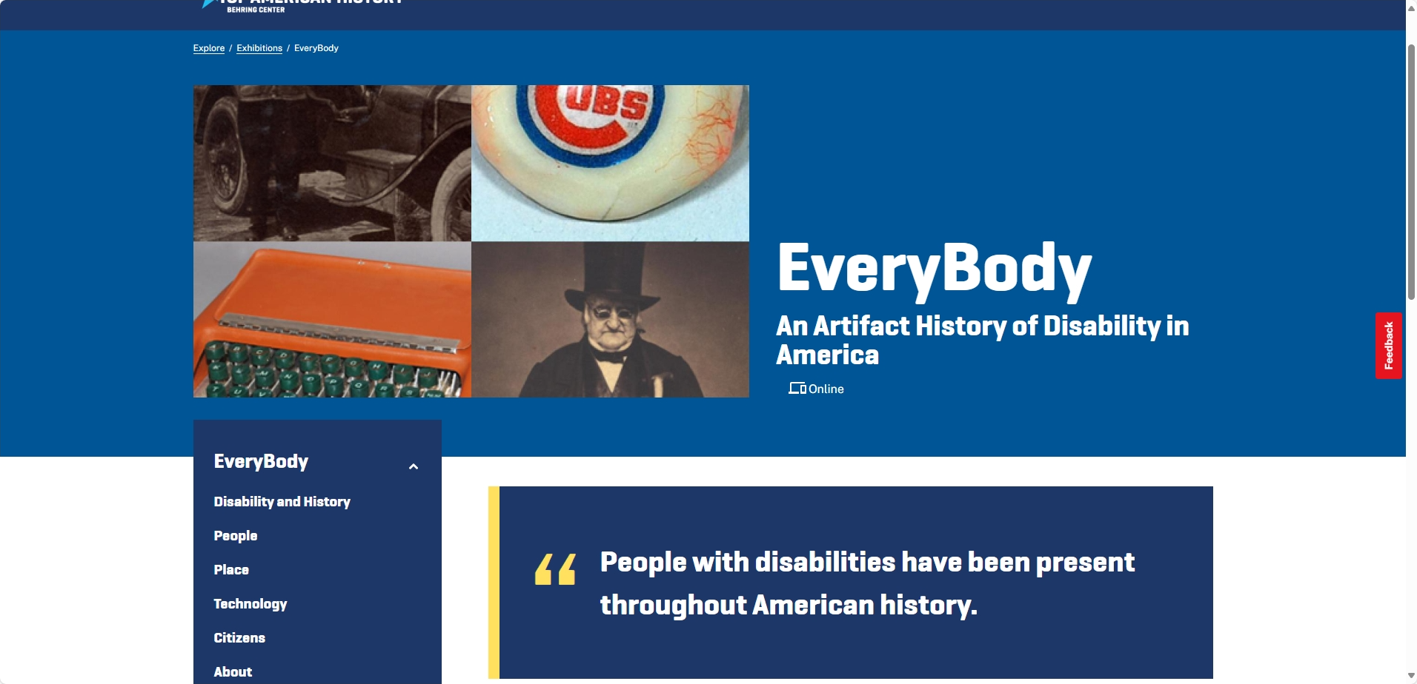
Smithsonian
Smithsonian -- National Museum of American History –
  EveryBody: An Artifact History of Disability in America
    “The notion that any one person is the single cause of any significant social change—that Abraham Lincoln alone freed the slaves—is a devastating stereotype which robs individuals of responsibility and credit, and actually inhibits social change.... You can be a revolution of one. In your living room, in your family, in your community." —
    Justin Dart, 1998

Slide 28
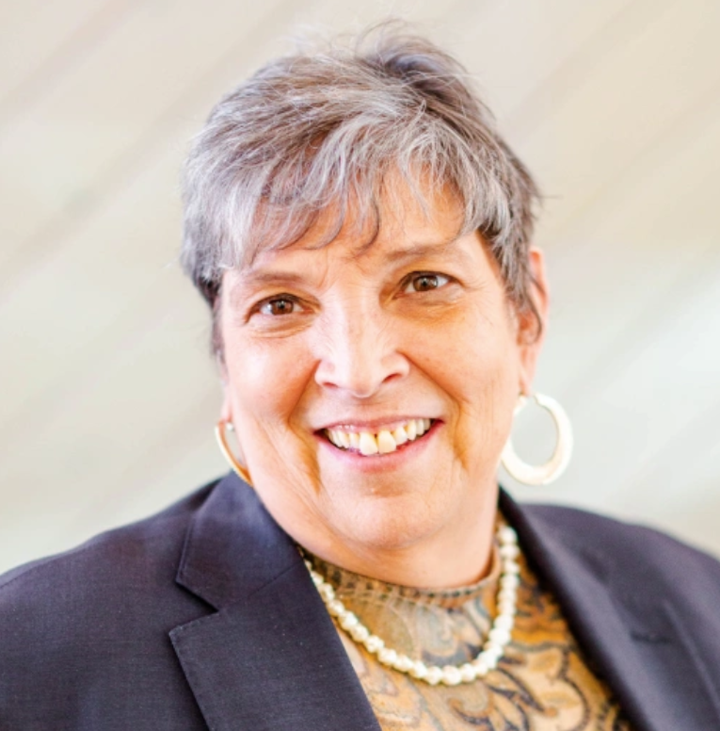
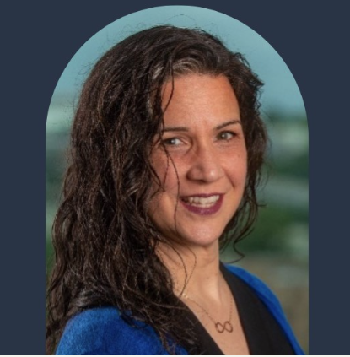
Part 3: Guest Speaker
Emily Homer Teresa Thomas
Executive Director Director of abilIT
Melwood Community Services Melwood Community Services

Slide 29

abilIT Across America
Creating Inclusive Tech Employment Pathways
2025

Slide 30


melwood
Founded in 1963, Melwood is one of the nation’s leading advocates, employers, and service providers for people with disabilities and their caregivers, serving more than 3,000 people each year in D.C., Maryland, and Virginia.
As part of the broader Melwood family of organizations, Melwood Community Services offers innovative programming that empowers children, youth, and adults with disabilities to live, work, and thrive in their communities.
Notes:
https://melwood.org/about-us/
https://melwoodcommunity.org/about-us/

Slide 31
abilIT Overview

Slide 32
abilIT by the numbers
14
3
20
3 COHORTS PER YEAR
20 PARTICIPANTS PER COHORT, DIVIDED INTO 2 LEARNING GROUPS
14-WEEK TRAINING COHORT
2019
$0
FIRST COHORT LAUNCHED IN 2019
NO COST TO THE STUDENTS
Notes:
Based on their success with the abilIT program, Melwood received a grant from the United States Department of Education, to launch abilIT Across America: Advancing Neurodiversity in the Workplace project. The purpose of this 5-year project is to provide training and programmatic support services at no cost to at least 15 non-profit organizations, empowering them to train at least 900 individuals with disabilities to prepare for and find competitive employment in information technology services.
Funded by an $8M grant from the United States Department of Education
5-year project
Providing training and programmatic support services at no cost to at least 15 non-profit partner providers
With a goal to train at least 900 individuals with disabilities to prepare for and find competitive employment in information technology services

Slide 33
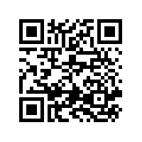
A Good Fit for
People over 18, who have a documented disability.
People with a basic knowledge of computers and how they work. (The course is not “How to Use a Computer”)
People who want to work in a tech related field and would benefit from industry standard credentials, some job readiness training, and some job search coaching.
People who have the capacity to commit to 14 weeks of study, including 5 hours of classroom time and at least 3 hours of self-guided study, 4 days a week.
https://melwood.org/abilit/
Notes:
+ Prospective participants utilize the Melwood abilIT webpage for reference and the "participant" section to complete the registration for an interview.
QR Code takes interested applicants to the registration page. Registration information is collected 24/7.
+Applicants are pre-screened and then scheduled for an interview beginning at least a month in advance of a cohort. Many applicants complete registration forms in the last weeks before a cohort and should be considered. Participants are notified at least one week before the cohort of their final status—accepted, waitlist, declined. Some applicants ask to defer to the next cohort.
+There are limited seats for every cohort. Ideal candidates have qualities of self-motivation and an eagerness for the program. They have the "knack" for example: building and repairing computers in the basement, built webpages and understand compputer language, credentials or college degrees but no experience or credentials. No one should be accepted without access to a home computer or will not be able to successfully complete their credential.
+Applicants follow an interview and selection protocol. Ideally two interviewers interview each candidate to assess potential success from both an IT and PDT perspective. Selection is a department discussion. Each screening and interview is documented in Melwood's data collection system.

Slide 34
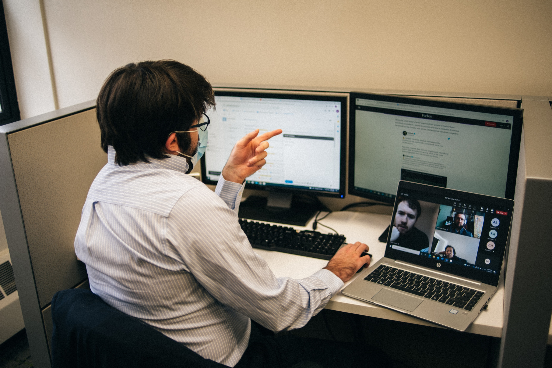
abilIT Program Components
Credential Coursework*
Cybrary Platform
CompTIA Tech+, A+, Security+, and Network+
Soft Skills Development*
Networking, Resumes & Cover Letters, Teamworking
Problem Solving
Teleworking
Interview Skills, Self-Advocacy
Communication
*List not fully inclusive
Notes:
+abilIT program structure is M-Th 9:00am-4:00pm and includes both professional development and IT training. All participants are expected to completed the Cybrary credential coursework outside of program hours. Staff are available outside of program hours for office hours and 1:1 assistance. IT tutoring is delivered on Fridays.

Slide 35
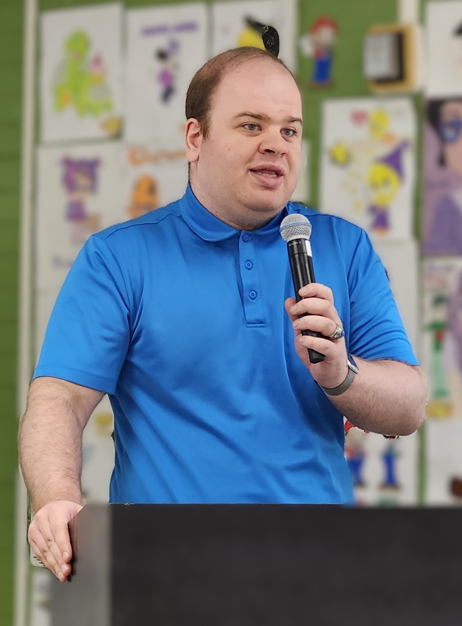
Job Development Activities
During cohort: Job Developer (JD) helps with resume building and interview readiness.
Post-graduation: Graduates meet regularly with JD for assistance with finding open positions, tailoring resumes, and practicing interview skills.
Ongoing: JD builds relationships with employers to develop opportunities for graduates.
Notes:
+The first priority is for the graduate to complete their credential. Seats are available for graduates to complete their coursework beyond the "graduation" date up to 90 days. Some people need extended time to go through the coursework and studies. Their progress is monitored by the IT Instructor. Participants may access extra help by appointment or attendance during scheduled tutoring on Fridays.
+The role of the Job Developer is to guide the graduate through career planning, preparation, search and placement. It is recommended that the Job Developer complete the ACRE and CESP certifications as part of their fundamental knowledge base. The Job Developer needs to develop a relationship with potential employers and understand the industry.
+Use the career plan developed during PDT for each graduate for job development. Each graduate is responsible for active participation in their own job search. The activities are a team effort with the job developer and the graduate. The Job Developer will complete retention follow-up and provide necessary supports at regular intervals up to 90 days.
+Explore development of post-"graduation" externship, apprenticeship, and internship (for recent college graduates) opportunities. Create relationships with the department team to potentially create opportunities for temp-to-perm employment with employer partners..

Slide 36
Sample Schedule
Monday - Thursday
Time | Tech+ Students (New) | A+ Students (New) | A+ Alumni (Returning)
9AM–12PM | Technical Training | — | —
10AM–12PM | — | Professional Development | Job Development (Tue/Thu)
1PM–3PM | Professional Development | — | —
1PM–4PM | — | Technical Training | Technical Training
Notes:
+abilIT is 5 hours of instruction per person; three hours per day of IT and 2 hours a day for PDT per person. The IT instructor facilitates learning through curriculum resources primarily from Cybrary and CompTIA within a scope and sequence of activities to reinforce learning. The PDT Instructor develops and implements daily activities from Melwood’s professional development abilIT curriculum and lesson plans.
+Fridays are set aside for tutoring, office hours, and department planning and meetings.
+ Special days are PDT Wednesdays to deliver outside employer and employee expertise on soft skill topics. Tech Thursdays are to delver outside employer and employee expertise on IT topics. Melwood utilizes employer partners and abilIT graduates as sources.

Slide 37














abilIT Partners, Relationships

Slide 38
abilIT Across America

Slide 39
abilIT Across America:
Advancing Neurodiversity in the Workplace
5
$8M
5-YEAR INITIATIVE
GRANT FROM THE UNITED STATES DEPARTMENT OF EDUCATION
15
900
15 NON-PROFIT PARTNER PROVIDERS
TRAIN AT LEAST 900 INDIVIDUALS TO FIND COMPETITIVE EMPLOYMENT TO INCLUDE INFORMATION TECHNOLOGY SERVICES
Notes:
Based on their success with the abilIT program, Melwood received a grant from the United States Department of Education, to launch abilIT Across America: Advancing Neurodiversity in the Workplace project. The purpose of this 5-year project is to provide training and programmatic support services at no cost to at least 15 non-profit organizations, empowering them to train at least 900 individuals with disabilities to prepare for and find competitive employment in information technology services.
Funded by an $8M grant from the United States Department of Education
5-year project
Providing training and programmatic support services at no cost to at least 15 non-profit partner providers
With a goal to train at least 900 individuals with disabilities to prepare for and find competitive employment in information technology services

Slide 40





Grant Partners
Outside Investigator
Mathematica
Tasked with tracking and measuring program outcomes and partner program fidelity.
Community of Practice Hosts
KPMG
Tasked with facilitating program improvements and production of resources.
Subject Matter Experts
Kathy Dow-Burger
Nancy Forsythe
Tasked with collaborating on Community of Practice facilitation and with building the community by recruiting other SME members.

Slide 41



Partnering with Melwood
Melwood provides:
abilIT license and program materials
Training-of-Trainers (ToT)
Ongoing support to partner providers
Partners agree to:
4 full-time, dedicated abilIT staff
classroom space, and equipment
training and testing vouchers
host three cohorts per year.
Notes:
Melwood will:
Provide partners with a license for no-cost use of abilIT program materials throughout the grant term, which ends September 30, 2029.
Deliver a Training-of-Trainers (ToT) at no cost to program partners and their staff; educating partners to fully utilize the curricula, course schedule, and licensing agreements, which have been developed for abilIT. It includes several weeks of demonstration teaching and co-teaching during the partner’s first cohort.
Provide ongoing technical support for up to a year post-ToT, including additional training for partner staff in order to accommodate growth or turnover.
Partners agree to:
Hire their own full-time staff positions as part of this project:
Attend one multi-day Train-the-Trainer session for all their abilIT program employees
Provide classroom space, training vouchers, and equipment for the program, including computers, wi-fi, etc.
Recruit for and host three cohorts (each with 20 students) per year
Partner with a minimum of 5 employers who are willing to hire abilIT graduates
Provide individualized support plans and follow-along supports for participants for up to one year after graduation, assisting them as they seek and apply for tech related jobs

Slide 42
Department of Education Disclaimer
The contents of this PowerPoint presentation (deck) were developed under grant H421F240094 from the U.S. Department of Education (Department). The Department does not mandate or prescribe practices, models, or other activities described or discussed in this document. The contents of this deck may contain examples of, adaptations of, and links to resources created and maintained by another public or private organization. The Department does not control or guarantee the accuracy, relevance, timeliness, or completeness of this outside information. The content of this deck does not necessarily represent the policy of the Department. This publication is not intended to represent the views or policy of or be an endorsement of any views expressed, or materials provided by any Federal agency.

Slide 43

Thank You!
Information about the nTIDE partners may be found at
  Kessler Foundation (www.kesslerfoundation.org)
  UNH/Institute on Disability (www.ResearchOnDisability.org)
  AUCD (www.AUCD.org)
Contact us at
  Email: Disability.Statistics@unh.edu
  Call: 866-538-9521 (toll free)
  Twitter at #nTIDELearn

Slide 44
Bye!

