Slide 1
nTIDE Lunch & Learn
Webinar Series
Kessler Foundation, AUCD,
University of New Hampshire Institute on Disability
Season 10, Episode 8
Date: August 1, 2025

Slide 2

nTIDE Lunch & Learn
Webinar Series
Kessler Foundation, AUCD,
University of New Hampshire Institute on Disability
Season 10, Episode 8
Date: August 1, 2025

Slide 3
Up Front Matters
This webinar is being recorded. We will post an archive of along side the Monthly nTIDE broadcast on our webinar, each month, on our website at www.researchondisability.org/nTIDE. This site will also provide copies of the presentations, the speakers’ bios, full transcripts, and other valuable resources.
As an attendee of this webinar, you are a viewer. To ask questions of the speakers, click on the Q & A box on your webinar screen and type your questions into the box. Speakers will review these questions and provide answers during the last section of the webinar. Some questions may be answered directly in the Q & A box.

Slide 4
Up Front Matters – Contact Info
If you have any questions following this recording, please contact us at disability.statistics@unh.edu, or toll free at 866-538-9521 for more information. Thanks for joining us. Enjoy today's webinar!

Slide 5
ASL & Captioning
To see the ASL interpreter and the gallery of speakers at the same time, we recommend using a computer or laptop, rather than a phone or tablet.
For closed captioning, click on the Closed Caption button and select Show Subtitle or View Full Transcript.

Slide 6
About nTIDE Lunch & Learn
  Occurs at noon Eastern-time on the first Friday day of each month, with the release of the nTIDE Report.
  A joint effort of the University of New Hampshire, Kessler Foundation, and the Association of University Centers on Disabilities (AUCD).

Slide 7
Today’s Special Session – Year End
Part 1: nTIDE Report … “The Numbers”
  Andrew Houtenville, University of New Hampshire
  John O’Neill, Kessler Foundation
Part 2: nTIDE News
  Denise Rozell, Association of University Centers on Disabilities (AUCD)
Part 3: Guest Speaker
  Rebecca Cokley, Ford Foundation
Part 4: Q&A

Slide 8
Part 1: The nTIDE Report
John O’Neill
Kessler Foundation

Slide 9
The Monthly nTIDE Report
The monthly nTIDE Report is a press release and infographic, looking at the latest employment statistics.
Uses data from the “jobs report” released by the U.S. Bureau of Labor Statistics, on the 1st Friday of each month.

Slide 10
Source of the Data
U.S. BLS, Current Population Survey (CPS).
  Source of the “official” unemployment rate.
Civilians, ages 16-64, not living in institutions.
Available September 2008 onward.
Not yet seasonally adjusted.
  which is why we compare to the same month last year.

Slide 11
The Numbers
Andrew Houtenville
University of New Hampshire

Slide 12
Employment- to-Population
Ratio:
Notes:
Chart Details:
The data series starts in June 2008 during the Great Recession which lasted until Mid-2009. The COVID-19 Recession started in April 2020 and last for two months
Visible Data points (highlights start of the series, the lowest point pre-covid, the points right before and after the Covid-19 recession hit, and the current Employment-to-Population Ratio
People without Disabilities:
June 2008 74.9
January 2010 (lowest point pre-covid) 68.8
February 2020 74.8
April 2020 (Covid-19 Recession hits) 63.2 (lowest point)
August 2024 74.8
September 2024 75.0
People with Disabilities:
September 2008 32.7
January 2014 (lowest point pre-covid) 24.1 (lowest point)
March 2020 31.7
April 2020 (Covid-19 Recession hits) 26.3
August 2024 38.4
September 2024 37.5

Slide 13
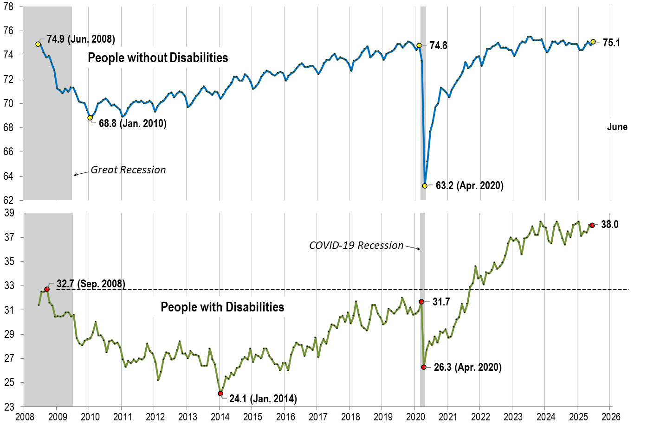
Employment- to-Population
Ratio:
June
Notes:
Chart Details:
The data series starts in June 2008 during the Great Recession which lasted until Mid-2009. The COVID-19 Recession started in April 2020 and last for two months.
Visible Data points (highlights start of the series, the lowest point pre-covid, the points right before and after the Covid-19 recession hit, and the current Employment-to-Population Ratio
People without Disabilities:
June 2008 74.9
January 2010 (lowest point pre-covid) 68.8
February 2020 74.8
April 2020 (Covid-19 Recession hits) 63.2 (lowest point)
June 2025 75.1
People with Disabilities:
September 2008 32.7
January 2014 (lowest point pre-covid) 24.1 (lowest point)
March 2020 31.7
April 2020 (Covid-19 Recession hits) 26.3
June 2025 38.0

Slide 14
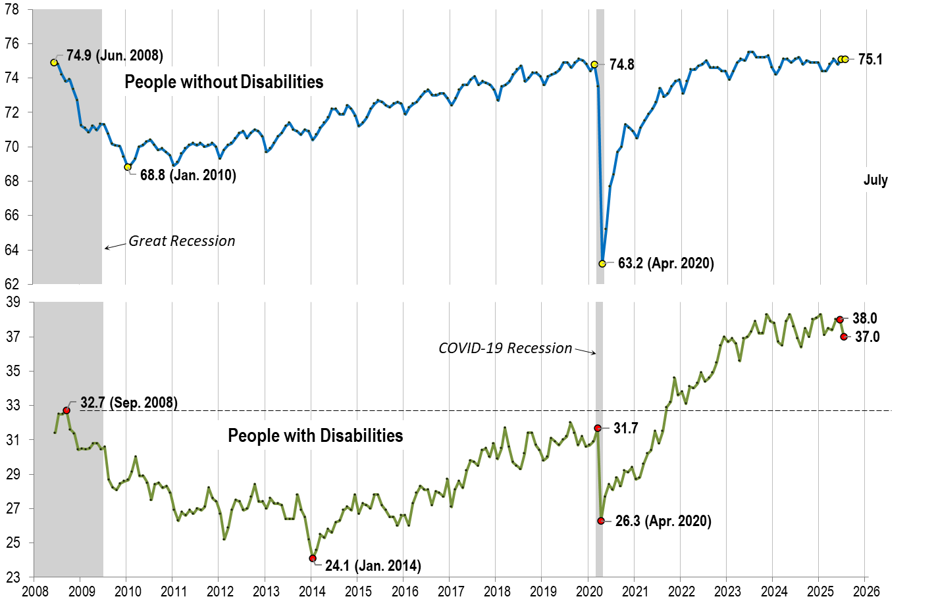
Employment- to-Population
Ratio:
July
Notes:
Chart Details:
The data series starts in June 2008 during the Great Recession which lasted until Mid-2009. The COVID-19 Recession started in April 2020 and last for two months.
Visible Data points (highlights start of the series, the lowest point pre-covid, the points right before and after the Covid-19 recession hit, and the current Employment-to-Population Ratio
People without Disabilities:
June 2008 74.9
January 2010 (lowest point pre-covid) 68.8
February 2020 74.8
April 2020 (Covid-19 Recession hits) 63.2 (lowest point)
May 2025 74.8
June 2025 75.1
People with Disabilities:
September 2008 32.7
January 2014 (lowest point pre-covid) 24.1 (lowest point)
March 2020 31.7
April 2020 (Covid-19 Recession hits) 26.3
June 2025 38.0
July 2025 37.0

Slide 15
Labor Force
Participation
Rate:

Slide 16
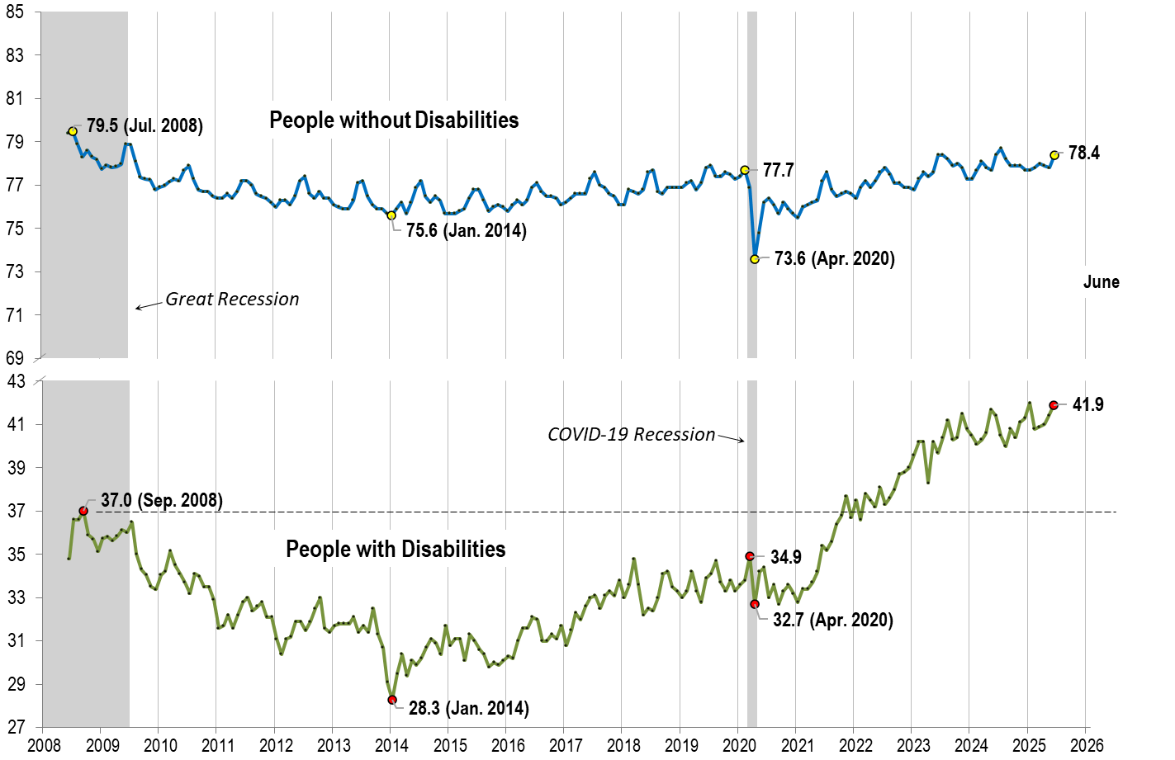
Labor Force
Participation
Rate:
June
Notes:
Chart Details:
The data series starts in June 2008 during the Great Recession which lasted until Mid-2009. The COVID-19 Recession started in April 2020 and last for two months.
Visible Data points (highlights start of the series, the lowest point pre-covid, the points right before and after the COVID-19 recession hit, and the current labor force participation rate.
People without Disabilities:
July 2008 79.5
January 2014 (lowest point pre-covid) 75.6
February 2020 77.7
April 2020 (Covid-19 Recession hits) 73.6 (lowest point)
June 2025 78.4
People with Disabilities:
September 2008 37.0
January 2014 28.3 (lowest point)
March 2020 34.9
April 2020 (Covid-19 Recession hits) 32.7
June 2025 41.9

Slide 17

Labor Force
Participation
Rate:
July
Notes:
Chart Details:
This chart adds another month to the previous chart.
The data series starts in June 2008 during the Great Recession which lasted until Mid-2009. The COVID-19 Recession started in April 2020 and last for two months.
Visible Data points (highlights start of the series, the lowest point pre-covid, the points right before and after the COVID-19 recession hit, and the current labor force participation rate.
July 2008 79.5
January 2014 (lowest point pre-covid) 75.6
February 2020 77.7
April 2020 (Covid-19 Recession hits) 73.6 (lowest point)
June 2025 78.4
July 2025 78.5
People with Disabilities:
September 2008 37.0
January 2014 28.3 (lowest point)
March 2020 34.9
April 2020 (Covid-19 Recession hits) 32.7
June 2025 41.9
July 2025 41.6

Slide 18
Government Employees
Still too soon for the reductions in federal workers to influence nTIDE numbers …
  The CPS survey was conducted typically in the second week of month.
Bureau of Labor Statistics (BLS) publishes “class of worker” statistics of First Fridays in …
  Table A-8, https://www.bls.gov/news.release/empsit.t08.htm
Current Population Survey (CPS)
  Asks about federal, state, and local governments, separately.
  Need the raw data (which comes out later in the month) to separate.

Slide 19
Part 2 nTIDE News
Denise Rozell
Association of University Centers on Disabilities (AUCD)

Slide 20
Federal Policy Update
President’ Budget
  HHS
    “Make America Healthy Again”
    ACL – Administration on Community Living – consolidated into Administration on Children and Families…
    Zero funding for UCEDDs; funding for PADD, DD Councils,, NIDILRR, Aging and more
  Education/Labor
    Special Education Simplified Funding Program
    K-12 Simplified Funding Program
    “Make America Skilled Again” – 11 programs into one with cuts of $1.6B including, Job Corps, apprenticeship, Youthbuild, WIOA Adult, Youth and more
      Pell grants
      Eliminates adult ed programs
      CTE level, but no postsecondary

Slide 21
Federal Policy Update – NEW!!
Senate Appropriations Committee -- July 31, 2025
  Bill language https://www.appropriations.senate.gov/imo/media/doc/fy26_lhhs_bill_text.pdf
  Report language https://www.appropriations.senate.gov/imo/media/doc/fy26_lhhs_senate_report.pdf
  Compared to the President’s Budget
    HHS
    Education
  Still has to pass Senate
House Appropriations Committee -- September

Slide 22
Federal Policy Update
TCIEA
  Transformation to Competitive Integrated Employment Act reintroduced (S. 2438) – to phase out use of subminimum wage for workers with disabilities and help transition to competitive integrated employment. Includes funding for shifting to new models.
DOJ Guidance – “Unlawful Discriminatory Practices”
  Not regulations/not legally binding
Court cases – Supreme Court ruled that Administration can continue plans to dismantle the Department of Education including firing 1400 employees
  Trump vs. American Federation of Government Employees

Slide 23
AAC recommendations
Williams, B. (2025). Reading, writing, and AAC are fundamental. Augmentative and Alternative Communication, 1–3. https://doi.org/10.1080/07434618.2025.2508492
  Actions to secure access to communication/literacy for people who need or use AAC:
    (1) Sustained research, demonstration, and system change at all levels to rectify the denial of communication and language supports (2) Invest in strategies that enhance literacy opportunities for people who need or use AAC at every stage of life; (3) Prioritize participatory action research to identify and remedy discrimination children and adults of color who need AAC; (4) Data to ensure the rights and bolster the participation of all who need AAC; and (5) A blueprint on what must be done to secure these individuals’ full civil rights and liberties.
AAC Peer Support Project: Findings and recommendations
  Oregon UCEDD, in partnership with CommunicationFIRST, released the Augmentative and Alternative Communication (AAC) Peer Support Project final report. Includes key findings and national recommendations to improve peer support for people who need or use AAC.

Slide 24
10 Fast-Growing Careers and VR
High Growth Careers and the Role of Vocational Rehabilitation: 2025 and Beyond
  The Vocational Rehabilitation Technical Assistance Center for Quality Employment's (VRTAC-QE)
  Top ten fastest growing occupations based on US Bureau of Labor Statistics
  Lists projected growth, median pay, and ideas of how VR can help expand this workforce
  Importance of championing quality employment in meaningful, sustainable careers
  Includes list of on demand training, resources for career pathways

Slide 25
Virtual Career Fair - NOD
Thursday September 4, 10:30 AM-1:30 PM EST
Employers: By participating – you will:
  Gain access to new jobseekers eager to join and contribute to the workforce,
  Expand your talent pipeline with the next generation of graduates, and
  Broadcast your disability-friendly workplace to candidates who value inclusive culture.
  Leadership Council Members: Enjoy priority access and waived fee to participate!
Register Your Company
Students and recent grads: By participating, you will:
  Learn about internships, apprenticeships, and full/part-time jobs
  Discover career paths across various fields,
  Meet with hiring managers and recruiters from well-known companies prioritizing equitable hiring, and
  Find job opportunities fitting your skills, experience, and professional aspirations.
Sign Up to Participate

Slide 26
How to Speak VR?
Acronym List for VR – 264 in the list!
  Includes definitions for all kinds of acronyms to help you “speak VR”
  Includes nonprofit organizations in the VR space, TA Centers, legislation, and more
From the Vocational Rehabilitation Technical Assistance Center for Quality Management

Slide 27
Success Stories from RSA
The Rehabilitation Services Administration (RSA) is amplifying the success stories of individuals with disabilities served by its programs across the country.
New webpage on rsa.ed.gov.
  Ten published success stories
  Goal is to highlight one from each of the 56 states and territories
  To propose a success story from your state or territory, please contact jessica.hawes@ed.gov

Slide 28

Accessibility in the National Parks
Accessibility in National Parks: An Intentional Approach to Ensuring Disabled Citizens Have Access to Recreation of Our Choice
  From Disability Belongs – previously Respectability
  Explanation of Access Pass - free, lifetime pass that provides admittance to more than 2,000 Federally managed recreation sites (including National Parks); must have been medically determined to have a permanent disability that severely limits one or more major life activity
  Includes more specific information on mobility devices in national parks, accommodations, service animals, help planning your visit and more!

Slide 29

Part 3: Guest Speaker
Rebecca Cokley
Program Officer
U.S. Disability Rights Program
Ford Foundation

Slide 30
NTIDE
Rebecca Cokley

Slide 31
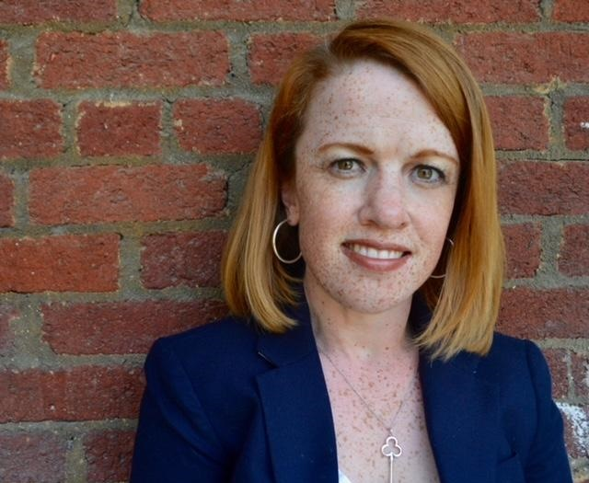
About Me
Rebecca Cokley
U.S. Disability Rights Program Officer, the Ford Foundation—speaking in my personal capacity, not as a Ford foundation staff person.
3x Presidential Appointee
AFOL
Grew up on a college campus
Daughter of the movement: Mom ran a DSS Office, Dad ran a CIL
Achondroplastic dwarfism and I live with chronic migraines

Slide 32

Welcome, Wherever you are
On Your Path

Slide 33
It is a unprecedently scary time. And it’s ok to be scared.
In this moment

Slide 34
The Disability Community Infrastructure is at risk
Disability policy did not just give rights, it built critical infrastructure from early childhood education to services for disabled veterans and seniors
State level organizations
  PTIs
  State DD Councils
  University Centers on Excellence and Disability
  Protection and Advocacy Agencies
Provided services
  Paratransit
  Captioning/ASL interpretation

Slide 35

50 years of Progress Under Attack
ADA
  “bad faith” arguments
  ADA Notification
Section 503
Subminimum Wage
Section 504
  Texas v. Becerra (paused)
Olmstead
  Dissolution of ACL

Slide 36
From Reality to Justice

Slide 37

Opportunities for Economic Change
Elimination of the Subminimum Wage
Raise Asset Limits/Eliminate Marriage Penalty
Medicaid Portability
Entrepreneurship
Disability and/in Labor

Slide 38

Thank You!
Information about the nTIDE partners may be found at
  Kessler Foundation (www.kesslerfoundation.org)
  UNH/Institute on Disability (www.ResearchOnDisability.org)
  AUCD (www.AUCD.org)
Contact us at
  Email: Disability.Statistics@unh.edu
  Call: 866-538-9521 (toll free)
  Twitter at #nTIDELearn

Slide 39
Bye!

