Slide 1
Survey Design for
People with Developmental Disabilities
: Focusing on the Survey on the Work & Life
of Persons with Developmental Disabilities in Korea
< 2025 Annual Disability Statistics Conference >
Yegick Lim
KEAD EDI
March 19th, 2025

Slide 2
About KEAD
Purpose for Establishment
- To contribute to the employment promotion, vocational
rehabilitation and employment of PWDs and support
business employers
Support Area
- Employment Support
· Assistive Technology, Personal assistance, rehabilitation, etc.
- Employer Support
· Disability employment incentives under Disability Employment
Quota system, Standard work places, free equipment, etc.
- Research & Development

Slide 3
Survey on the Employment of PWDs
Survey on the Economic Activity Status of the PWDs
- Calculation of economic activity indicators
Panel Survey of Employment for PWDs
- Analysis of changes and developments in the job market,
Identification of key factors of changes and developments in PWDs
Survey on the Current Situation of Disability Employment in Businesses
- Estimation of scales of employment of PWDS in the business sector
Survey on the Work & Life of Persons with Developmental Disabilities

Slide 4
Survey on the Work & Life
of Persons with
Developmental Disabilities

Slide 5
Key terms and Definitions
Developmental disabilities
- In South Korea, The term ‘developmental disabilities’ is commonly
used to encompass both intellectual disabilities and developmental
disabilities.
- In this presentation,
PwDD(People with Developmental Disabilities)
and IDD(Intellectual and Developmental Disabilities) are used
interchangeably to refer to the same concept.
PwDD (People with Developmental Disabilities)
TAPI (Tablet-Assisted Personal Interviewing)
AAC (Augmentative and Alternative Communication)

Slide 6
Background of the survey
Rapid growth in the population of People with Developmental Disabilities over the past decade in Korea
- Young PwDD growth shifts Korea’s disability demographics
Age Distribution – Developmental vs Physical Disabilities (%)
Notes:
[Description of Figure]
Age Distribution – Developmental vs Physical Disabilities (%)
1. Physical Disabilities
0~9 years 1.9%
10~19 years 4.8%
20~29 years 10.6%
30~39 years 23.0%
40~49 years 41.5%
50~59 years 49.4%
60~69 years 53.5%
70~79 years 49.4%
80+ years 39.9%
2. Developmental Disabilities
0~9 years 66.0%
10~19 years 76.8%
20~29 years 65.4%
30~39 years 42.3%
40~49 years 17.2%
50~59 years 7.5%
60~69 years 3.1%
70~79 years 1.0%
80+ years 0.3%

Slide 7
Survey Overview
Purpose
- Assessment of living conditions, employment status, and service
needs of PwDD to inform policy development
Sampling Frame
- Previous year-end disability registry from the Ministry of Health
and Welfare
Survey Subjects
- 3,000 households with PwDD aged 15+ and their caregivers,
residing in Korea (2024 Survey: 2,199 PwDD & 3,000 Caregivers)
Survey cycle and schedule
- Yearly Survey (Jun-Sep) since 2020
Survey Methodology
- TAPI(Tablet-Assisted Personal Interviewing)

Slide 8
Survey Structure
Paired Survey of Caregivers and PwDD
- Surveying both caregivers and PwDD
For ensuring data accuracy and reducing burden on PwDD
Survey Structure
Self-
reported Data
PwDD
Caregivers
Focus on
direct self-reporting items
(e.g., needs, satisfaction)
Main respondents
(Verification of objective conditions of PwDD)
Caregiver-
Reported Data
Annual participation: 3,000 caregivers (mandatory)
and approximately 2,000 PwDD (based on ability)

Slide 9
Paired respondent survey Framework
Caregivers are surveyed before PwDD
No duplicate questions* for PwDD if already answered by caregivers
*(e.g., employment status, current education level)
Paired respondent survey Framework
[survey interviewer Question]
Is (PwDD name) currently employed,
either for income(wages, self-employment)
or as an unpaid family worker?
[Caregivers Answer]
Yes, he is currently employed and working.

Slide 10
Paired respondent survey Framework, Cont’d
Survey Interviewer already known PwDD’s info
PwDD survey content adapts based on caregiver responses via TAPI
Paired respondent survey Framework
[survey interviewer Question]
(Since employment is known,
questions skip to job details directly.)
Do you enjoy your work?
[PwDD Answer]
Yes, I enjoy my work.

Slide 11
Framework of Assessment Indicators for Participation
Expert-developed screening indicators for direct surveys of PwDD
Four group PwDD classification via screening indicators
Framework of Assessment Indicators for Participation
Communication levels
Plain Language Group
(15-year-old literacy level)
Receptive/Expressive
language
Easy to Read group
(preschool literacy level)
Vocabulary
Graphic Symbols Group(AAC)
(Verbal/written questions reading difficulties)
Syntax reading ability
Literacy
Ineligible Group

Slide 12
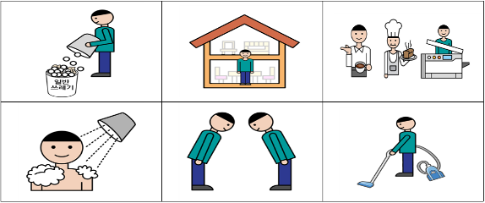
Examples of Screening Questions
Five screening items* arranged from simple to complex
- Symbol clarity test, Yes/No responses to questions, Sentence
completion and arrangements, Reading comprehension of texts
Examples of Screening Questions - Symbol clarity test
Please choose from these pictures what I am saying
(Wash, Clean, Work, Stay home, Throw away, Greet)

Slide 13
Examples of Guidelines for Screening Questions
Guidelines* provided for accurate responses to five questions
*Guidelines assist survey interviewers unfamiliar with PwDD
*Questions + Response scoring criteria(correct/incorrect)
Examples of Guidelines for Screening Questions
[ Symbol Clarity Test Questions ]
Let's go through the pictures one by one.
Please pick the picture that best matches what I say.
[Selected the right image]
· Pointing to the symbol with a finger
· Nodding or Responding vocally
when the examiner reads the symbol
· Self-corrects wrong answers

Slide 14
Examples of Guidelines for Screening Questions, Cont’d
Guidelines* provided for accurate responses to five questions
*Guidelines assist survey interviewers unfamiliar with PwDD
*Questions + Response scoring criteria(correct/incorrect)
Examples of Guidelines for Screening Questions
[Selected the wrong image]
· Selecting incorrect answers or providing off-list responses
· no response after 5-10 seconds
· Repeatedly requesting question repetition
[Proceeding after test results]
Unable to survey(Identifies ≤3 out of 6 images),
Graphic Symbols Group(Identifies 4 images),
Proceed to next question(Identifies ≥5 images)

Slide 15
Response questionnaires by group
Four-group classification system with level-appropriate questionnaires, excluding the ineligible group
Three types of PwDD questionnaires developed and utilized
Response questionnaires by group
Plain Language Group
(PL)
Easy-to-read questionnaire
+ Adding a difficult question
Easy to Read Group
(ER)
Easy-to-read questionnaire
Graphic Symbols Group
(AAC)
AAC questionnaire
Ineligible Group

Slide 16
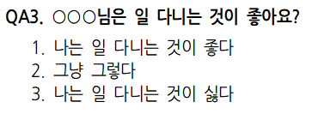
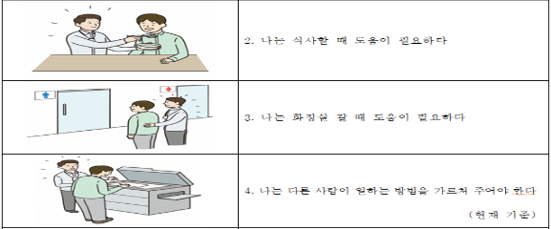
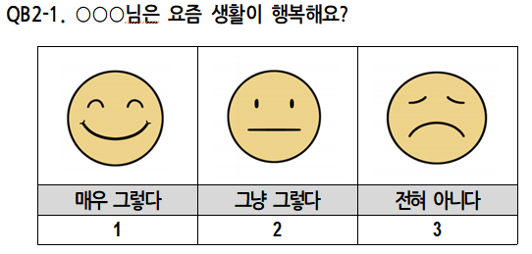
Example of easy-to-read questionnaires
Created and applied guidelines* for easy-to-read questionnaires
*(e.g., all ERs accessible level, single predicate per sentence, simple
language, affirmative phrasing, etc.)
Example of easy-to-read questionnaires for PL and ER Group
[Symbol support
for multiple response options]
[Easy questions with simple responses]
[Emotional expression symbols]

Slide 17
Example of AAC questionnaires
AAC response options provided for an individual with challenges using easy-to-read Korean questionnaires
Example of AAC questionnaires for Graphic Symbols Group
Do you want to work or not?

Slide 18
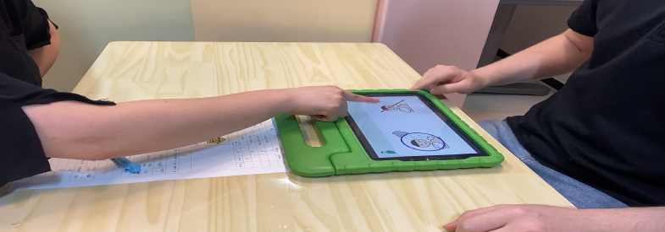
Methods for Direct Surveys of PwDD – Video Training
Video training for survey interviewers using AAC guidelines*
*Verbal(echoing words, responding 'yes’ without meaning),
Behavioral(attention difficulties, non-verbal sounds)
Example of Video Guidelines for AAC group – echoing words

Slide 19
Video Script - Echoing Words pt 1 of 3
English version of Korean Video Script - echoing words
[Survey Interviewer (she/her)] Can you clean? Can’t you clean?
[PwDD(he/him)] No, I can’t.
[Survey Interviewer (she/her)] Can you throw away trash?
[Survey Interviewer (she/her)] Can’t you throw away trash?
[PwDD(he/him)] No, I can’t
[Survey Interviewer (she/her)] Can you take a shower?
[Survey Interviewer (she/her)] Can’t you take a shower?
[PwDD(he/him)] No, I can’t
PwDD echoed(repeated) the last words three times

Slide 20
Video Script - Echoing Words pt 2 of 3
English version of Korean Video Script - echoing words
[Survey Interviewer (she/her)] Oh, sir. Then I’ll ask you again.
-- Attention redirection
-- the survey interviewer changed the order of the sentence and
asked again.
[Survey Interviewer (she/her)] Can’t you throw away trash?
[Survey Interviewer (she/her)] Can you throw away trash?
[PwDD(he/him)] Yes, I can
[Survey Interviewer (she/her)] Can’t you take a shower?
[Survey Interviewer (she/her)] Can you take a shower?
[PwDD(he/him)] Yes, I can

Slide 21
Video Script - Echoing Words pt 3 of 3
English version of Korean Video Script - echoing words
-- Again, noticing echolalia, the interviewer reordered
the sentence.
[Survey Interviewer (she/her)] Can you throw away trash?
[Survey Interviewer (she/her)] Can’t you throw away trash?
[PwDD(he/him)] No, I can’t
(Result)
Persistent terminal echolalia after three attempts classified
as non-response

Slide 22
Assessing the Reliability of PwDD Survey Data
Post-survey analysis excluded inappropriate PL and ER responses
- Data releases completely omit all content from samples identified
as inappropriate responses
Three-Dimensional Assessment of Inappropriate Responses
- (Step 1) Evaluation by survey interviewer of problematic response
patterns(e.g., echoing, number fixation, repetition, non-
response, refusal, etc.)
- (Step 2) Qualitative assessment of comprehension and reliability
(5-point scale)
- (Step 3) Non-response verification
(categorized by extent of missing responses)

Slide 23
Results of On-site Assessment and Non-Response Validation
(unit: person)
 | Fully unable | Mostly unable | Average | Mostly Able | Consistently able | Total
All non-response | 5 | 18 | 4 | 6 | 1 | 34
Most non-response | 1 | 2 | 0 | 1 | 0 | 4
Partial(4-6) | 0 | 6 | 3 | 1 | 2 | 12
Partial(1-3) | 0 | 6 | 19 | 33 | 51 | 109
No non-response | 6 | 51 | 205 | 427 | 949 | 1,638
Total | 12 | 83 | 231 | 468 | 1,003 | 1,797
Final analysis Sample(1,753 PL/ER)

Slide 24
Survey Category
Caregivers
- Data Most questions directed to caregivers as primary respondents
- Survey Category
1. Personal & Disability information
2. Education
3. Employment status
3-1. Employed Characteristics
3-2. Unemployed Characteristics
4. Job skills & Services
5. Daily Life
6. Household & Caregiver
7. COVID-19 (2022~2023 Supplementary Survey)

Slide 25
Survey Categories, Cont’d
Plain language and Easy-to-Read group
- Survey category
1. Employment & Jobs 2. Daily Life
Graphic Symbol Group
- Daily Life Performance, Desired activities
For detailed information, please refer to the appendix.

Slide 26
New findings from the survey
The number of PwDD aspiring for employment exceeded caregiver expectations
- Despite caregivers believing individuals did not desire employment,
17.6% of PwDD reported wanting to work.
Self-reported employment aspirations
 | Caregiver-perceived employment interest | Caregiver-perceived employment disinterest | Total
Self-reported preference for employment | 35.8 % | 17.6 % | 53.4 %
Self-reported preference for non-employment | 3.7 % | 41.5 % | 45.3 %
No response | 0.3 % | 1.0 % | 1.3 %
Total | 39.8 % | 60.2 % | 100.0 %

Slide 27
New findings from the survey, Cont’d
Employment generates positive outcomes for individuals with developmental disabilities as well as their family
- Employment benefits not only PwDD themselves but also reduces
family caregiving burden and increases caregivers' life satisfaction
Employment outcomes
 | Employed individuals | Job-seeking unemployed individuals | Non-Job-seeking unemployed individuals
(Caregivers response) Percentage reporting caregiving burden | 32.6 % | 51.6 % | 66.4 %
(Caregivers response) Quality of life among caregivers | 35.0 % | 25.3 % | 15.1 %
(Self-reported responses) Rate of strong self-satisfaction | 46.1 % | 40.8 % | 15.4 %

Slide 28
Thank you
Yegick Lim
yglim@kead.or.kr
https://edi.kead.or.kr

