Slide 1
Cognitively accessible patient reported outcomes
Ariel Schwartz, PhD, OTR/L

Slide 2
Acknowledgements
Conceptual work and examples developed with Jessica Kramer, PhD, OTR/L, University of Florida
Examples developed with the Youth and Young Adults Empowerment, Leadership, & Learning Lab
Funding for the PEDI-PRO:
NICHD STTR Phase II, 2R42HD090772-03A1; STTR Phase I, 1R41HD090772-01;
K12 HD055931 (PI: Kramer)

Slide 3
Outline
What is cognitive accessibility?
Components of cognitively accessible measures
Example patient-reported outcome measure

Slide 4
What is cognitive accessibility?

Slide 5
Cognitive Accessibility
Cognitive accessibility is present when assessment design:
anticipates respondent variability in cognitive abilities and, to the greatest extent possible, reduces cognitive demands and/or supports cognitive processes to enable respondents with a range of cognitive abilities to interpret and respond to assessment items as intended.

Slide 6
Why is cognitive accessibility important?
Promotes first-person responses
Respects autonomy
Proxy respondents many not have the same information (e.g., contexts, affective experiences, pain)^{1,2}
Increased engagement
Demonstrates respect and ethos of inclusion
¹White-Koning et al., 2005
²Kramer et al., 2012

Slide 7
Cognitive Accessibility Considers Capacities and Demands
Individuals’ Capacities
PROM (or survey) demands
Cognitive accessibility
World Health Organization, ICF
Notes:
The first assumption is that accessibility is achieved when individuals’ capacities are appropriately matched with the demands of a PROM. We also call these assessment demands.

Slide 8
Components of cognitively accessible measures

Slide 9
Components of Cognitively Accessible measures
Content
The meaning conveyed in each item.
Layout
The arrangement of words, images, and response options.
Administration Procedures
The processes followed by respondent and professional to complete the measure.
Cognitive Accessibility
Kramer & Schwartz, 2017
Notes:
Is this where you want me to start talking? YES! ☺
We have identified three components of PROs that impact cognitive accessibility: Content, layout, and administration procedures. We will now describe features related to these components that may support cog accessibility.

Slide 10
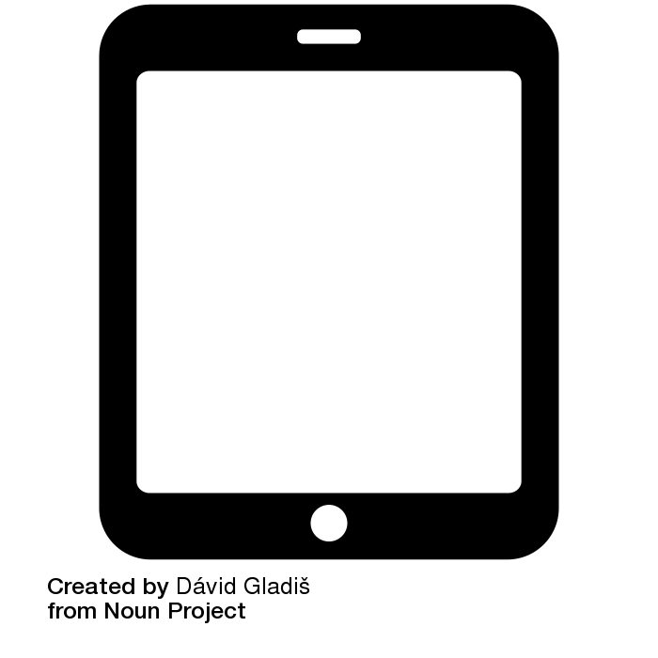
Example: Pediatric Evaluation of Disability Inventory-Patient Reported Outcome (PEDI-PRO)
Measures youth and young adult’s performance of discrete tasks/discrete activities while engaging in familiar everyday life situations.
Notes:
These everyday activities were chosen because they were important to our team of young adults with disabilities who helped design the app.
Their reasons were:
It is important to stay healthy, to be able to do the things you need to do independently.
It is important to be able to cook your own meal and know how to use materials while cooking.
It is important to know the different activities you can do when doing sports.

Slide 11
Development of the PEDI-PRO
Designed by and for transition age youth with IDD ages 14-22
Three domains aligned with the PEDI-CAT:
Daily Activities
Social/Cognitive
Mobility.
Youth with IDD interpret items in the intended manner to self-report functional skills.¹
Integrated with the ATLAS platform:
Independent use by people with IDD^{2,3}
Decreased error^{2,3}
Valid, reliable, and considered usable by clinicians
¹ Kramer & Schwartz, 2017 ²Davies et al., 2017
³ White et al., 2015
Notes:
Extensive cognitive testing indicated that youth with IDD interpret the items in the intended manner, and use response scales appropriately to describe their functional performance.
These items were integrated into the ATLAS software Platform
The Accessible Testing, Learning and Assessment System (ATLAS) is a proprietary survey platform designed by AbeleLink Technologies. The platform incorporates cognitive accessibility design strategies and has the capacity to administer questions and Likert responses. There is evidence that when adults with IDD use ATLAS they have significantly fewer errors and shorter assessment time compared to traditional written assessment format (Davies et al., 2017; Stock, Davies, & Wehmeyer, 2004). Adults with IDD also independently used the ATLAS system to report satisfaction with medical appointments (White, Liberatos, O’Hara, Davies, & Stock, 2015). In this study, we built upon the ATLAS survey engine to design a PROM software system for youth with IDD.

Slide 12
Content
Content: Meaning in conveyed in each item
Items and response scale(s)
Words
Grammar
Images

Slide 13
Content- Example Features
Conceptually congruent visuals
Construct-specific examples- relatable, relevant, comprehensive
Asks about current experiences
Language
Simple words
Simple grammar
Define unfamiliar words
Personal reference language (e.g., I can lift a bag of groceries)

Slide 14
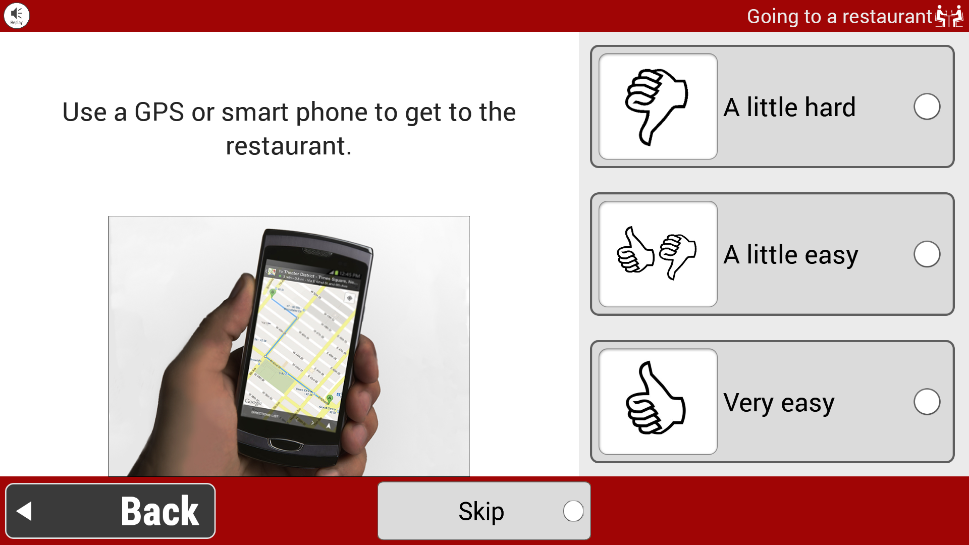
Content Features - Examples
Construct-specific images
Notes:
The words in this item incorporate several content features.
For example, the words in this item cue respondents to think about the context of going to a restaurant. If this item were “I can state my needs and preferences to someone I don’t know,” respondents would have to consider all the contexts in which they do this. People may do this in many contexts, including at the grocery store, the doctor’s office, at work, or at a restaurant. Averaging performance across all of these contexts requires high level cognitive processes. However, when items specify the context for performance respondents only need to consider their performance in that context. The words in this item indicate that respondents only need to consider the specific instance of ordering food at a restaurant, which reduces the cognitive demands of averaging.
Looking at your tables, do you see any other content features that this item incorporates?
Some main points
Simple and familiar words
When this is brought up, mention that it may sometimes be necessary to use unfamiliar word. For example, there may not be a simpler word to use. In these instances, the word should be defined.
Simple grammar
The ‘personal reference word” ,“my”, cues respondents to think about their own performance. This may improve response consistency
The words are present tense, so respondents are cued to think about their current performance, which decreases demands of recall.
The item only evaluates a single skill, or concept-telling a need to a stranger. Single-concept items are easier to understand than double-barreled items. Double barreled items, or items that evaluate multiple concepts, require respondents to recall and average their performance across tasks. Relate this to the example about contextual cues

Slide 15
Content Features - Examples
Construct-specific images
Context-specific reduces cognitive demands
Use a GPS or smart phone to get to the
restaurant.
Notes:
The words in this item incorporate several content features.
For example, the words in this item cue respondents to think about the context of going to a restaurant. If this item were “I can state my needs and preferences to someone I don’t know,” respondents would have to consider all the contexts in which they do this. People may do this in many contexts, including at the grocery store, the doctor’s office, at work, or at a restaurant. Averaging performance across all of these contexts requires high level cognitive processes. However, when items specify the context for performance respondents only need to consider their performance in that context. The words in this item indicate that respondents only need to consider the specific instance of ordering food at a restaurant, which reduces the cognitive demands of averaging.
Looking at your tables, do you see any other content features that this item incorporates?
Some main points
Simple and familiar words
When this is brought up, mention that it may sometimes be necessary to use unfamiliar word. For example, there may not be a simpler word to use. In these instances, the word should be defined.
Simple grammar
The ‘personal reference word” ,“my”, cues respondents to think about their own performance. This may improve response consistency
The words are present tense, so respondents are cued to think about their current performance, which decreases demands of recall.
The item only evaluates a single skill, or concept-telling a need to a stranger. Single-concept items are easier to understand than double-barreled items. Double barreled items, or items that evaluate multiple concepts, require respondents to recall and average their performance across tasks. Relate this to the example about contextual cues

Slide 16
Content Features - Examples
Construct-specific images
Context-specific reduces cognitive demands
Present tense reduces recall demands
Use a GPS or smart phone to get to the
restaurant.
Notes:
The words in this item incorporate several content features.
For example, the words in this item cue respondents to think about the context of going to a restaurant. If this item were “I can state my needs and preferences to someone I don’t know,” respondents would have to consider all the contexts in which they do this. People may do this in many contexts, including at the grocery store, the doctor’s office, at work, or at a restaurant. Averaging performance across all of these contexts requires high level cognitive processes. However, when items specify the context for performance respondents only need to consider their performance in that context. The words in this item indicate that respondents only need to consider the specific instance of ordering food at a restaurant, which reduces the cognitive demands of averaging.
Looking at your tables, do you see any other content features that this item incorporates?
Some main points
Simple and familiar words
When this is brought up, mention that it may sometimes be necessary to use unfamiliar word. For example, there may not be a simpler word to use. In these instances, the word should be defined.
Simple grammar
The ‘personal reference word” ,“my”, cues respondents to think about their own performance. This may improve response consistency
The words are present tense, so respondents are cued to think about their current performance, which decreases demands of recall.
The item only evaluates a single skill, or concept-telling a need to a stranger. Single-concept items are easier to understand than double-barreled items. Double barreled items, or items that evaluate multiple concepts, require respondents to recall and average their performance across tasks. Relate this to the example about contextual cues

Slide 17
Content Features - Examples
Construct-specific images
Context-specific reduces cognitive demands
Present tense reduces recall demands
Simple words and grammar
Notes:
The words in this item incorporate several content features.
For example, the words in this item cue respondents to think about the context of going to a restaurant. If this item were “I can state my needs and preferences to someone I don’t know,” respondents would have to consider all the contexts in which they do this. People may do this in many contexts, including at the grocery store, the doctor’s office, at work, or at a restaurant. Averaging performance across all of these contexts requires high level cognitive processes. However, when items specify the context for performance respondents only need to consider their performance in that context. The words in this item indicate that respondents only need to consider the specific instance of ordering food at a restaurant, which reduces the cognitive demands of averaging.
Looking at your tables, do you see any other content features that this item incorporates?
Some main points
Simple and familiar words
When this is brought up, mention that it may sometimes be necessary to use unfamiliar word. For example, there may not be a simpler word to use. In these instances, the word should be defined.
Simple grammar
The ‘personal reference word” ,“my”, cues respondents to think about their own performance. This may improve response consistency
The words are present tense, so respondents are cued to think about their current performance, which decreases demands of recall.
The item only evaluates a single skill, or concept-telling a need to a stranger. Single-concept items are easier to understand than double-barreled items. Double barreled items, or items that evaluate multiple concepts, require respondents to recall and average their performance across tasks. Relate this to the example about contextual cues

Slide 18
Layout
Layout: The arrangement of words, images, and response options.
Notes:
Layout features may support cognitive accessibility by decreasing overall demands associated with self-reporting, such as perception.

Slide 19
Layout- Example Features
Text features
Font (size, typeface)
Punctuation
Spatial arrangements
White space
Position of items in relation to images, response scale(s), etc.
Consistent and meaningful use of color
Notes:
Layout features may support cognitive accessibility by decreasing overall demands associated with self-reporting, such as perception.

Slide 20
Layout: Spatial arrangements
 | Hard | Easy
1. “Item 1” | _____ | _____
2. “Item 2” | _____ | _____
3. “Item 3” | _____ | _____
1. “Item 1” | Hard | Easy
2. “Item 2” | Hard | Easy
3. “Item 3” | Hard | Easy
Notes:
(item stem and items; rating scale images and words)
Again, requires visual scanning, shifting attention, and working memory
Define item stem if need to

Slide 21
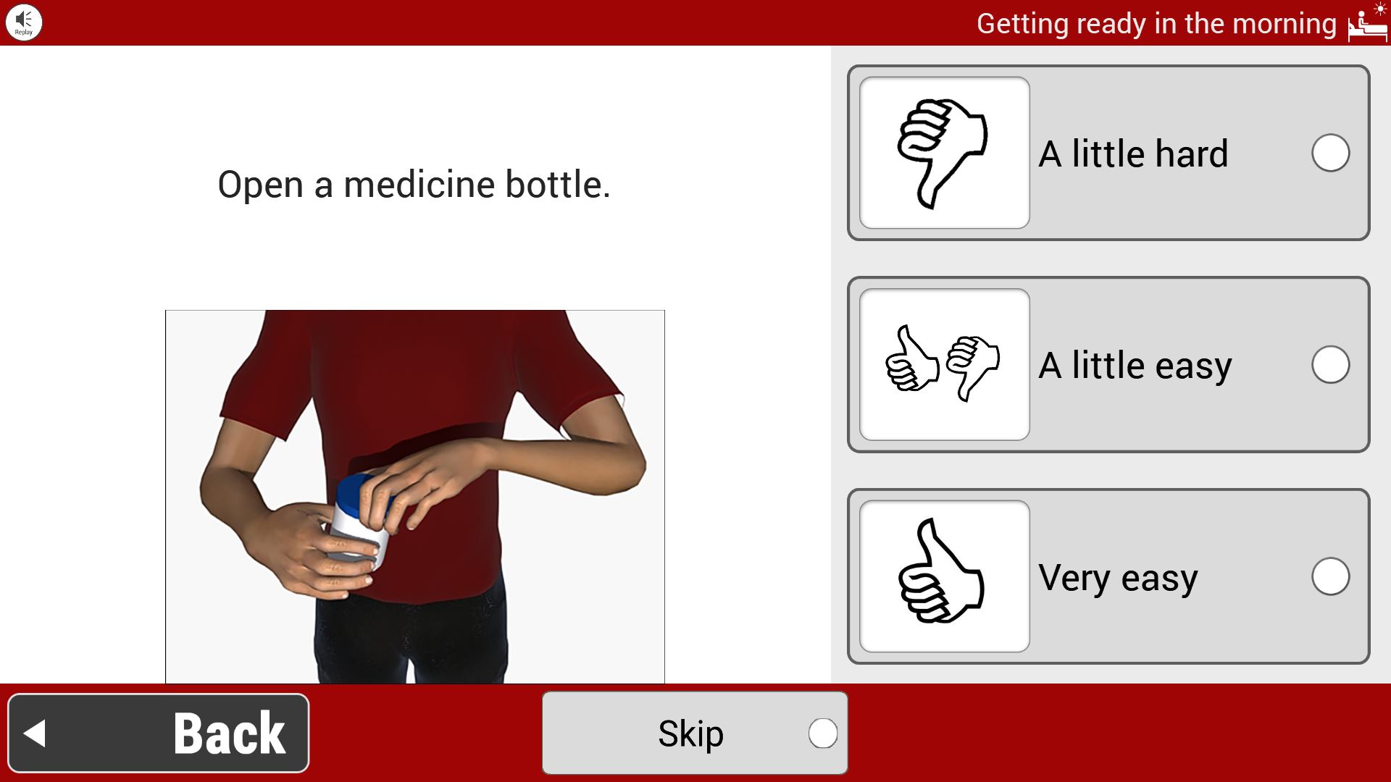
Layout Features- Example
Text adjacent to images
Notes:
Text adjacent to images
First, sufficient white space decreases reduces visual clutter and helps respondents focus on the essential content.
Consistent layout

Slide 22
Layout Features- Example
Text adjacent to images
Sufficient white space
Notes:
Text adjacent to images
First, sufficient white space decreases reduces visual clutter and helps respondents focus on the essential content.
Consistent layout

Slide 23
Layout Features- Example
Text adjacent to images
Sufficient white space
Images paired with response scale
Notes:
Text adjacent to images
First, sufficient white space decreases reduces visual clutter and helps respondents focus on the essential content.
Consistent layout

Slide 24
Administration Procedures
Administration procedures: The processes followed by respondent and professional to complete the PROM.
Individualization and flexibility
Social/emotional components of PROM/survey responses
Therapeutic/clinical interaction
Teaching
Notes:
Administration procedures are the processes followed by the respondent and professional to complete the PRO.
These features include:

Slide 25
Administration Procedures- Example Features
Self-paced
Content individualization
Variety of modes to read and respond
Skip option
Standard definitions/alternate wording
Teaching
Encouragement, validation
Notes:
Administration procedures are the processes followed by the respondent and professional to complete the PRO.
These features include:

Slide 26
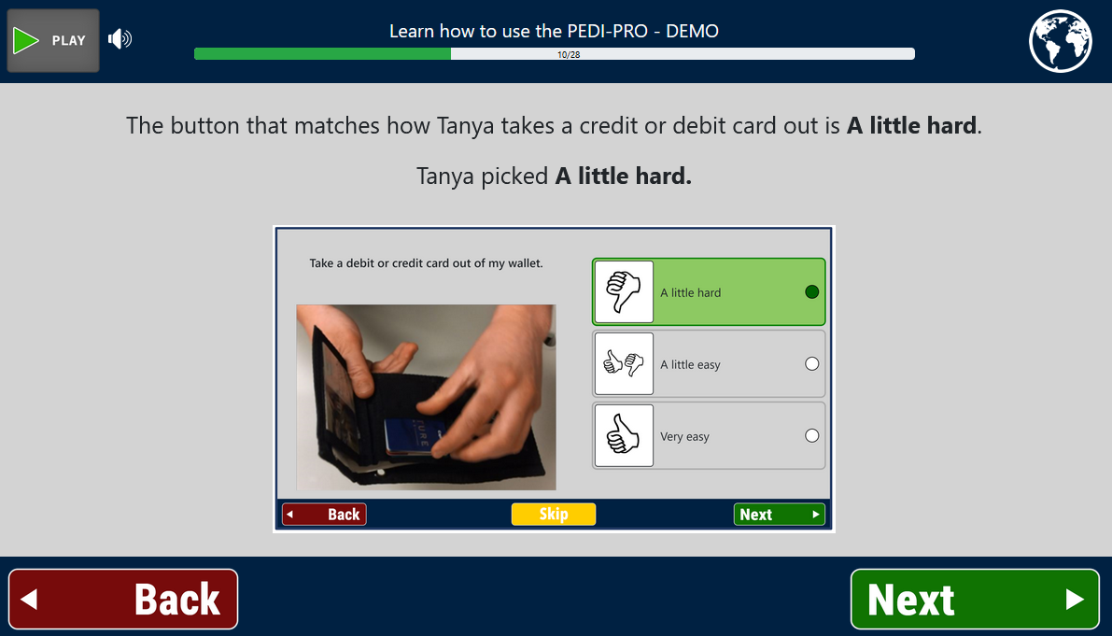
Administration Features - Examples
Practice
Teaching
-how to use platform
-response scale

Slide 27
Design Features to Optimize Cognitive Accessibility
Not all features need to be included to optimize cognitive accessibility.
Different assessment formats (e.g., card sort, computer-based) may be better suited to reduce specific cognitive demands
Different assessment formats may require different features
Individual respondents may interact with assessment demands differently, and different features may support the needs of different respondents.
Possible relationship between features:
Some features are synergistic and difficult to disentangle (e.g, simple grammar & positive words).
The inclusion of one feature may preclude the inclusion of another (e.g., use of images could decrease white space).
Notes:
It is important to remember that not all features need to be included to optimize cognitive accessibility.
Different assessment formats, such as card sorts or computer-based PROs may be better suited to reduce specific cognitive demands and may require different features
Individual clients may interact with assessment demands differently, and different features may support the needs of different clients.
For example, one client may increase their attention and motivation with a card sort, but it may increase motor demands for another client.
Possible relationship between features:
Some features are synergistic and difficult to disentangle. For example, simple words and simple grammar often work together to make an item easier to read. Often simple words lend themselves to simpler grammatical structures.
Finally, the inclusion of one feature may preclude the inclusion of another. For example, sometimes images may be used in a way that reduces white space.

Slide 28
References
Kramer, J. M., & Schwartz, A. (2017). Reducing barriers to patient-reported outcome measures for people with cognitive impairments. Archives of Physical Medicine and Rehabilitation, 98(8), 1705-1715.
Davies, D., Stock, S., King, L., Wehmeyer, M., & Shogren, K. (2017). An accessible testing, learning and assessment system for people with intellectual disability. International Journal of Developmental Disabilities, 63, 204–210.
Kramer, J., Walker, R., Cohn, E. S., Mermelstein, M., Olsen, S., O'Brien, J., & Bowyer, P. (2012). Striving for shared understandings: therapists' perspectives of the benefits and dilemmas of using a child self-assessment. OTJR: Occupation, Participation and Health, 32(1_suppl), S48-S58.
White, A., Liberatos, P., O’Hara, D., Davies, D., & Stock, S. (2015). Promoting self-determination in health for people with intellectual disabilities through accessible surveys of their healthcare experiences. Développement Humain, Handicap et Changement Social, 21(1), 29-39.
White-Koning, M., Arnaud, C., Bourdet-Loubère, S., Bazex, H., Colver, A., & Grandjean, H. (2005). Subjective quality of life in children with intellectual impairment–how can it be assessed?. Developmental medicine and child neurology, 47(4), 281-285.

