Slide 1
Using Disability Statistics in DRM Projects and Initiatives
Kristen Milefchik, MSW

Slide 2
Who We Are
Michigan’s federally designated protection and advocacy agency
There is a protection and advocacy organization in every state and territory
Funded by 9 federally mandated programs, state and private donors
Serve the entire state of Michigan
We receive over 4,000 calls per year
Notes:
In 1975 U.S. Congress passed the Developmental Disabilities Assistance and Bill of Rights Act enumerating rights of persons with developmental disabilities and mandating establishment of a protection and advocacy system in each state and territory as a condition for receiving funds under the Act.

Slide 3
Vaccination Advocacy
The Vaccine Advocacy Program was a time-limited outreach and advocacy program funded by federal and state grants to help people with disabilities, family members, and caregivers get vaccines. Our project aimed to:
Better understand the barriers facing people who have lower rates of vaccination.
Partner with communities to help people get vaccinated.
Improve access to vaccines.
Improve messaging around vaccination.

Slide 4
Collective Impact - MVP
The Autism Alliance of Michigan and the Michigan Developmental Disabilities Institute also received grants to ensure greater equity and vaccination access. Our organizations joined together to optimize the collective impact of our funding and formed MVP.
MVP certification ensures:
Healthcare workers complete MVP Disability Training
Clinic sites are accessible and sensory-friendly
Disability status questions are asked for each patient
Notes:
Briefly explain logo change

Slide 5
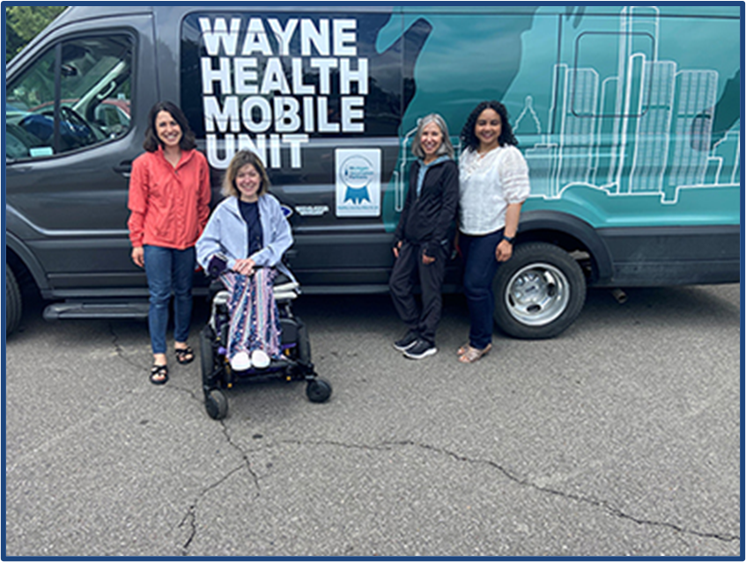
More Than Vaccines
DRM and MVP partnered with mobile health units to facilitate accessible, sensory-friendly vaccine and health clinics in communities throughout the state.
Our mobile unit partnerships helped pave the way for long-term impact on health equity and healthcare access.
The work called on DRM to formally address barriers to healthcare and recommendations for sustainable improvements to healthcare access for the disability community.

Slide 6
2023 Disability Health Equity Report
Over the course of two years, we gathered data from our work in the field and other reputable sources to create the 2023 Disability Health Equity Report.
Data gaps about people with disabilities existed for many of the topics we researched, making it difficult to draw substantial conclusions about barriers to healthcare and other healthcare trends.
DRM called on the Institute on Disability at the University of New Hampshire to help fill data gaps.
Notes:
1. Discuss how we gathered disability data due to lack of information about rates of mortality, hospitalization, and other stats for people with disabilities missing from the COVID-19 dashboard and other sources (EMR’s. etc.)
2. Discuss how we saw trends in the field, such as limited or no access to affordable, accessible transportation, but without the numbers to back it up
Go to Report site – briefly demonstrate what it contains

Slide 7
Racial Discrimination and Disability
“According to the CDC, non-White people experience discrimination in healthcare not experienced by their White counterparts. Racial and ethnic minority groups, throughout the United States, experience higher rates of illness and death across a wide range of health conditions (. . .) Interpersonal and structural racism has been the focus of health equity efforts that seek to improve conditions for people of color in socioeconomic areas such as housing, education, employment, and others. (. . .)
What is not often considered in these efforts is the intersection of race and disability. UNH IOD data show that disability prevalence is higher among non-White people than White people. For example, in Michigan, Black residents had a higher share of people with disabilities (17 percent) than White residents (11 percent)”
Relevant recommendation: “Include disability community when measuring health trends and impacts”
Notes:
Used data to establish important connections between disability stats and existing research

Slide 8
Transportation Data
Limited or no access to affordable, accessible transportation was one barrier to healthcare that emerged in several areas of our research.
Initial Project Survey (administered at the program’s outset)
Clinic Interviews
Focus Group Discussions

Slide 9
Project Survey Results
Survey identified seven key issues as barriers to vaccination, including Transportation/Travel Issues:
Multiple-choice selection (unvaccinated individual) regarding reason for not getting the COVID-19 vaccine: “I had challenges with transportation to an appointment“

Slide 10
Clinic Interviews
One-to-one interview with patient attending a clinic at a south-central Michigan homeless shelter:
One person had hypertension and needed monitoring and medication as well as dental care. They had insurance but missed several appointments with doctor due to transportation scheduled by insurance company falling through/not showing up. They were also having trouble getting medication. They were thankful for the monthly vaccine clinics provided at the shelter, saying if COVID clinic was not held at the shelter they would not have gotten vaccinated for COVID and would go to the ER for other care.

Slide 11
Focus Group Discussions
Comments made during project focus group discussion yielded a similar pattern:
“I think as a person with a disability, the transportation, and I use a wheelchair, so it might look different for other people, (. . .) as you may or may not know, the wheelchair accessible vans and conversions can be such a high cost. Even used wheelchair accessible cars can sometimes be like the cost of a sports car, so it’s just really hard to obtain.” (Participant 6, Session 2)
Notes:
Had an abundance of qualitative data regarding Michigan residents with disabilities transportation challenges, as well as data about the connection between lack of transportation leading to poorer health outcomes, but not enough qua

Slide 12
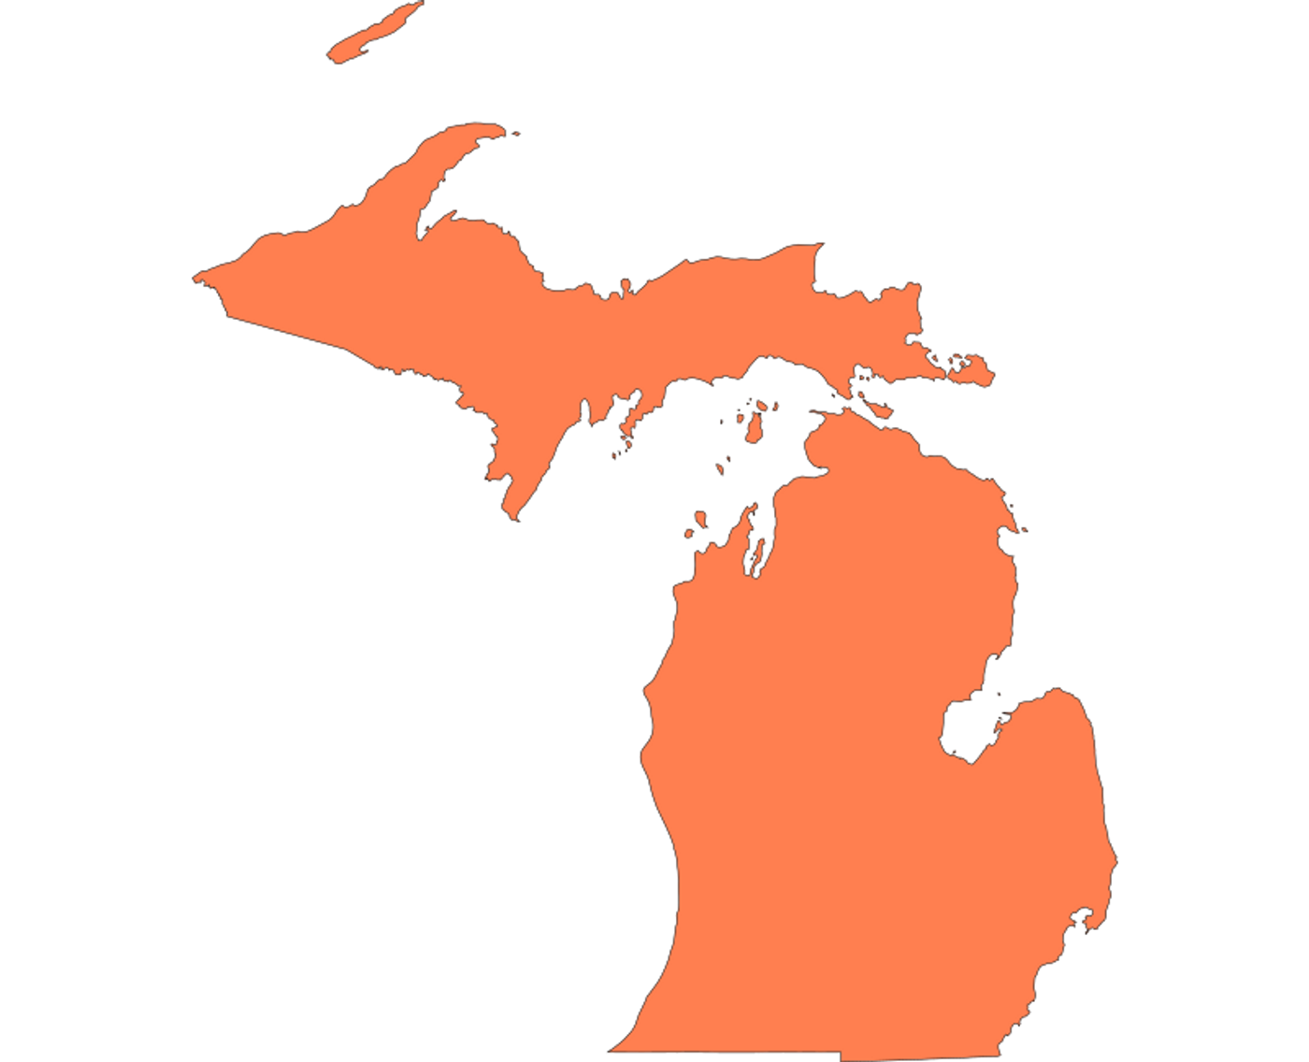
Access to Transportation and Disability
“Data from a recent report by the University of New Hampshire Institute on Disability (UNH IOD) shows that in Michigan, people tend to rely more heavily on personal vehicle ownership than other modes for their transportation needs (2023). Almost all Michigan residents (97 percent) live in households with at least one car, but 11 percent of Michigan residents with disabilities do not own any cars. This low level of private vehicle ownership among disabled residents may suggest that the high cost of vehicles, especially those modified for wheelchair access, makes car ownership out of reach for many Michigan residents with disabilities (Rahman, 2022). The lower rate of private vehicle ownership may also account for the higher dependency on public transit for Michigan residents with disabilities (three percent) compared to residents without disabilities (two percent; UNH IOD, 2023).”
Relevant recommendation: “Fix public transit to increase access to healthcare”
Notes:
Talk about how one of our report recommendations was to fix public transit in our state

Slide 13
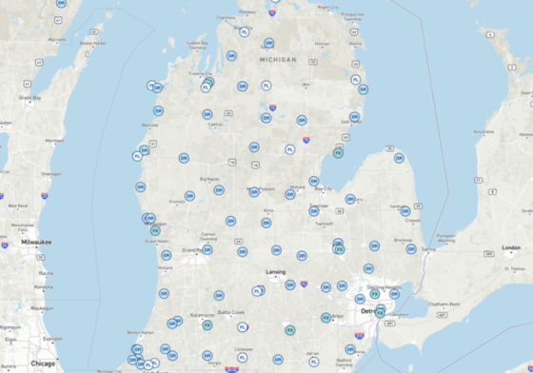
Transportation Data
The combination of qualitative and quantitative data regarding transportation challenges for Michiganders with disabilities also led to an online transportation guide and interactive map we designed to help people find affordable, accessible transportation in their geographic area.
Since its launch in February 2024, the DRM transportation landing page has reached 310,000 individuals across Michigan
It remains one of the top three most-visited landing pages on DRM’s website
www.drmich.org/transportation/index/
www.drmich.org > Resources > Transportation Guide
Notes:
Go to site. Briefly show site/purpose 165 services

Slide 14
Thank you

Slide 15
Disability Rights Michigan
4095 Legacy Parkway
Lansing, MI 48911
Hours
9:00am - 4:00pm (Monday – Thursday
9:00am – 12:00pm (Friday)
Phone
800.288.5923 (Toll Free)
517.487.1755 (Voice)
517.374.4687 (TTY)
www.drmich.org

