Slide 1
Local Perspectives on the Social Determinants of Health
Raeda Anderson, Pat M. Barrett, Daniel Pasciuti, Madelief Tilder, Lauren Leeder, Melissa Treanor, Patricia Lawrence, and Chloe Sellers

Slide 2
Shepherd Center and Georgia State University Sociology Partnership

Slide 3
Timeline
Learned about Disability Statistics Compendium
Converted entire 2022 state Compendium into SPSS
Formal Partnership Formed
Compendiums converted to SPSS
2023
2024
Poverty + Healthcare Access
Poverty & Housing
Poverty
Livability + Affordability
Compounding Issues
Veterans + Housing
Southern States + Gender
Housing
Healthcare, education, economics, + neighborhood
Social Determinants of Health

Slide 4
Projects and Partnerships
Department of Sociology
Center for Neighborhoods & Communities
Virginia C. Crawford Research Institute

Slide 5
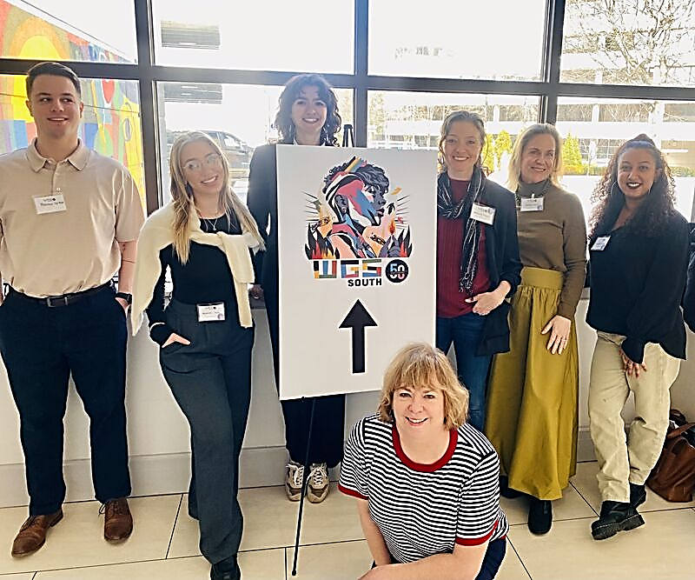
Research Group
Scientist and Biostatisticians from Shepherd Center
Faculty from Georgia State University in Sociology and Nursing
Sociology Student Scholars Graduate Students
Student Scholars

Slide 6
Research Outputs

Slide 7
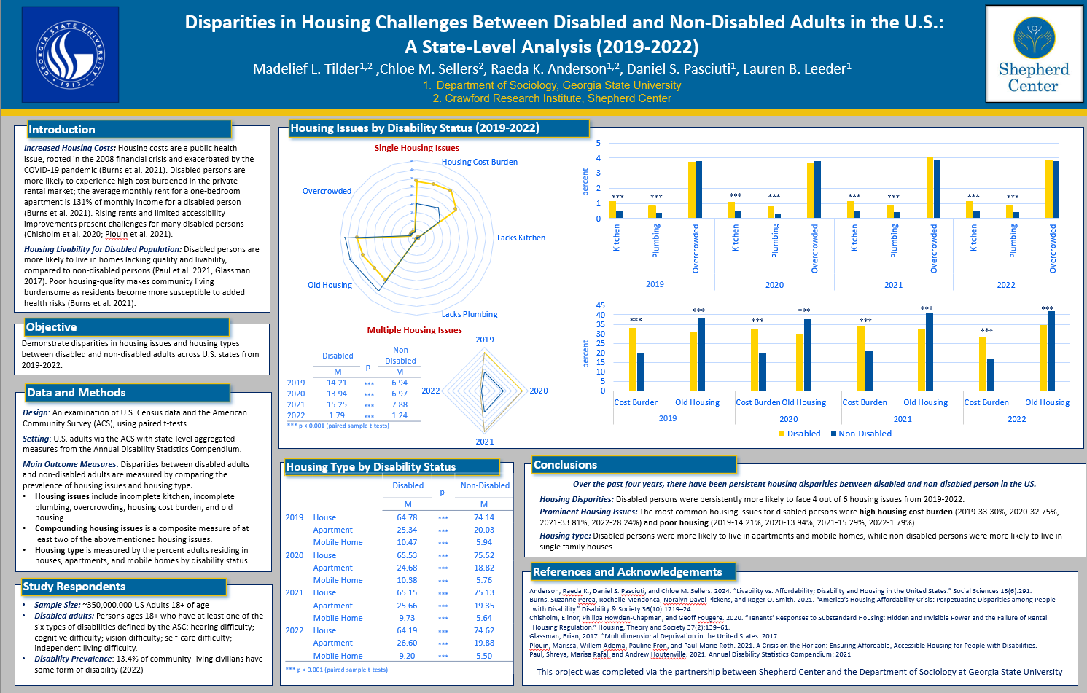
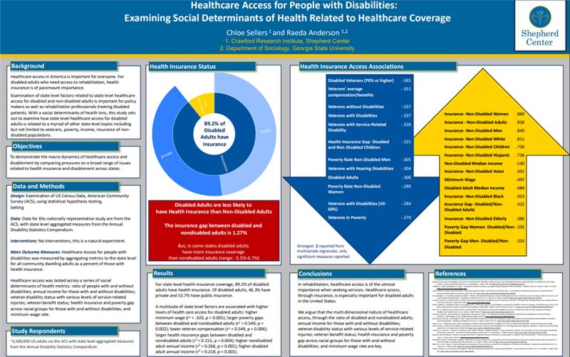
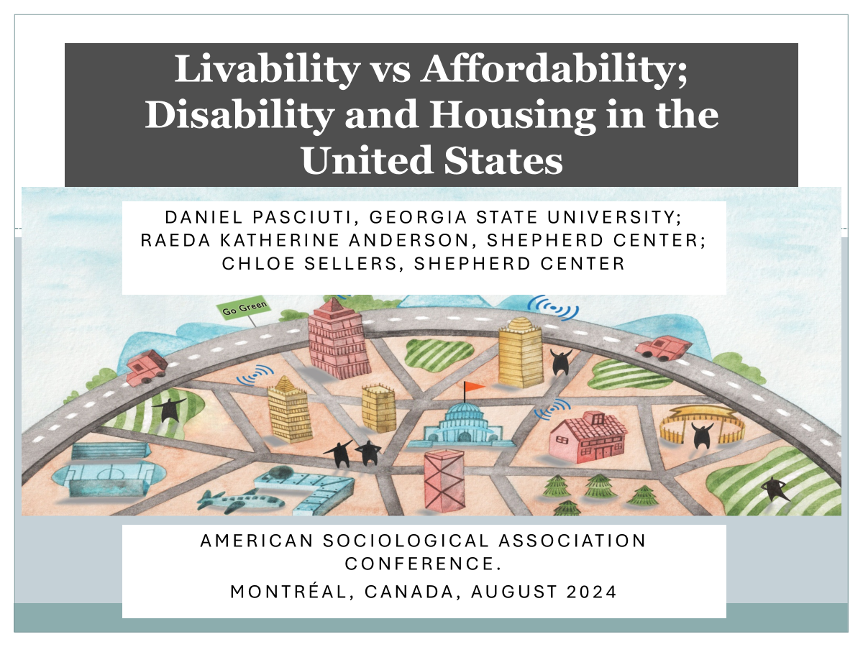
Conference Presentations

Slide 8
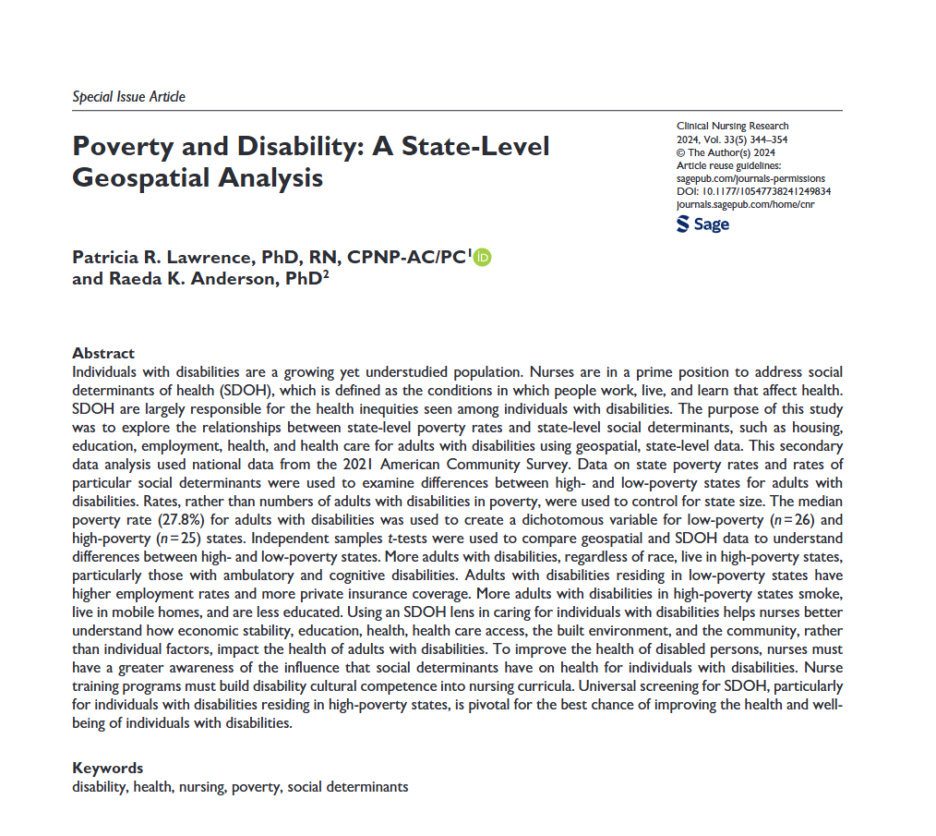
Publications

Slide 9
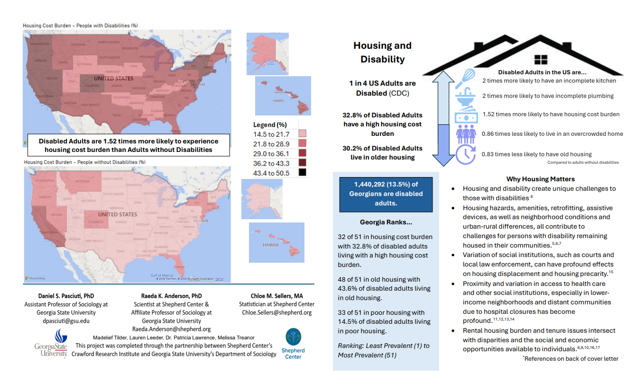
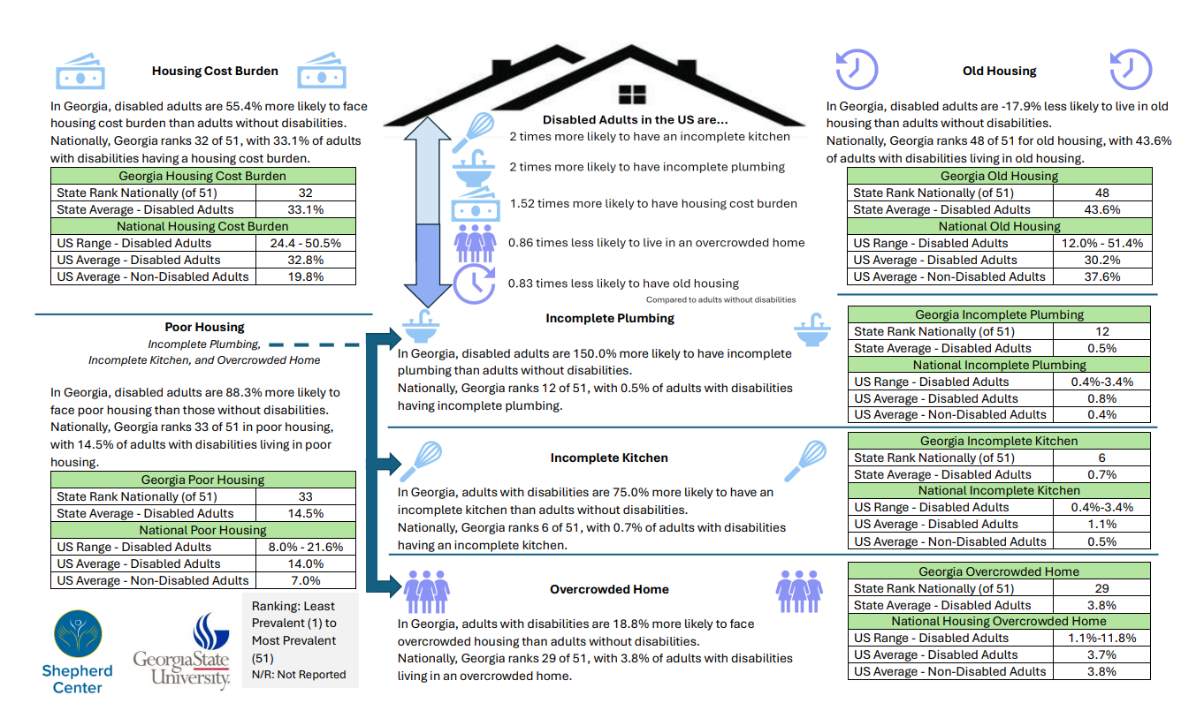
Housing White Paper
Mailing to:
State-level senators congress-people + housing policy groups

Slide 10
Invited Talks and Interviews
Disability and Community Participation

Slide 11
Disciplinary Reach
Nursing
Sociology
Public Health
Neuroscience
Women + Gender Studies
Policymakers
Rehabilitation
Urban Studies
Housing

Slide 12
On the horizon
Student publication in development: Disabled Women in the South
Cityscape publication: Veterans and Housing
Special issue publication: Social Determinants of Health + Housing
Nursing and Social Determinants of Health

Slide 13
Applied Sociology Course Project
Database Build
White Papers
PowerBI Dashboard

Slide 14
Key Findings

Slide 15
Key Study Findings
Poverty
Poverty is deeply associated with social and behavioral outcomes
People with disabilities fare worse in high-poverty states in multiple social determinants of health
Poor disabled adults are more-likely to live in apartments and mobile homes, compared to single family and other dwellings
Housing
Housing issues are more prevalent for adults with disabilities, compared to non-disabled adults
Those with multiple housing issues experience a higher cost burden, compared to those who only have one housing issue
These housing cost burdens lag over time, ~2 years later

Slide 16
Key Study Findings
Southern Context
The south has lower rates of healthcare access in the south, especially for women with disabilities
Disability, gender, race, and education are interrelated, affecting social and behavioral outcomes
Race interacts with other minority identities, leaving racial minorities with the most notable disparities
Overarching themes
State-level structures and time have a substantial effect, especially for people with disabilities
State-level structures have larger effects on outcomes than subgroup composition (e.g., gender, race)
Poverty, housing, and state context all impact the social determinants of health for people with disabilities

Slide 17
Raeda Anderson Raeda.Anderson@shepherd.org

