Slide 1
External Factors in Disability: A webapp for data sharing
March 19, 2025
Nate Thomas

Slide 2
External Factors Data Infrastructure: Objectives
Create a methodological technical assistance (TA) infrastructure – containing highly structured data and documentation within a web-based application
Support the systematic collection and use of environmental (“external”) factors in life outcomes for people with disability

Slide 3
External Factors Data Infrastructure: Design considerations
Create a “town-square” where disability researchers can go to:
find factors other researchers use
vote on factors
comment on factors
include citations of publications in which a factor is used
nominate and upload new factors for review and inclusion in the publicly available set
save factors in user defined folder structures to continued use

Slide 4
External Factors Data Infrastructure: Status report
Beta release for internal review and review by invitation: 07FEB2025
Input and feedback collection, prioritizing accessibility and functionality, is ongoing
Expect to release a publicly available version by the EOY 2025

Slide 5
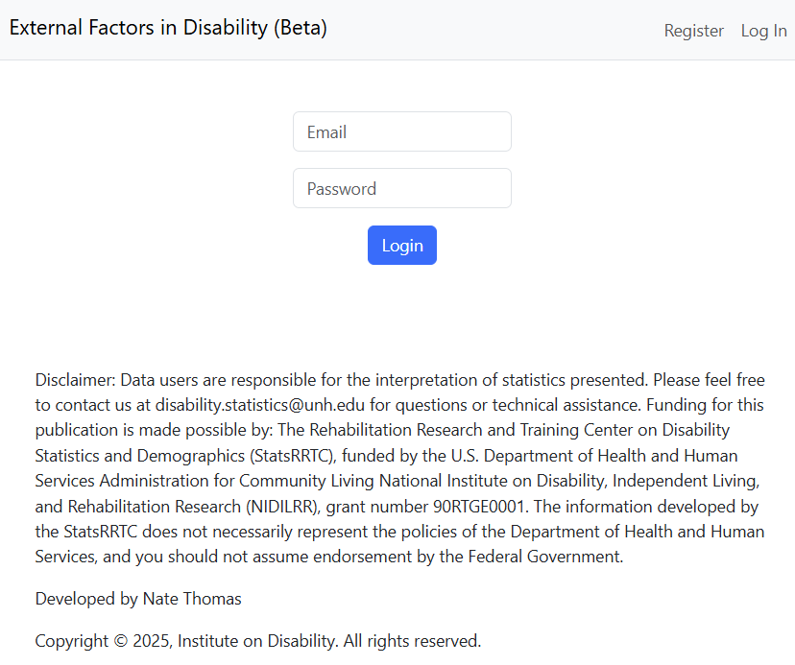
External Factors Data Infrastructure: Demonstration – Logging in
Once registered a researcher can login.
External Factors (Beta)

Slide 6
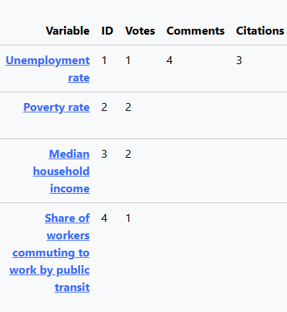
External Factors Data Infrastructure : Demonstration
Factors are displayed in a tab-indexed table (for web accessibility), with a search field to filter displayed factors
Factor fields include Variable, ID, Votes, Comments, Citations, Definition, ICF Code, Date Source, Geographic Unit Year, Unit of Measure, Obs. Frequency, Data Period, Source URL, and Rationale.
… many column are not shown
External Factors (Beta)

Slide 7
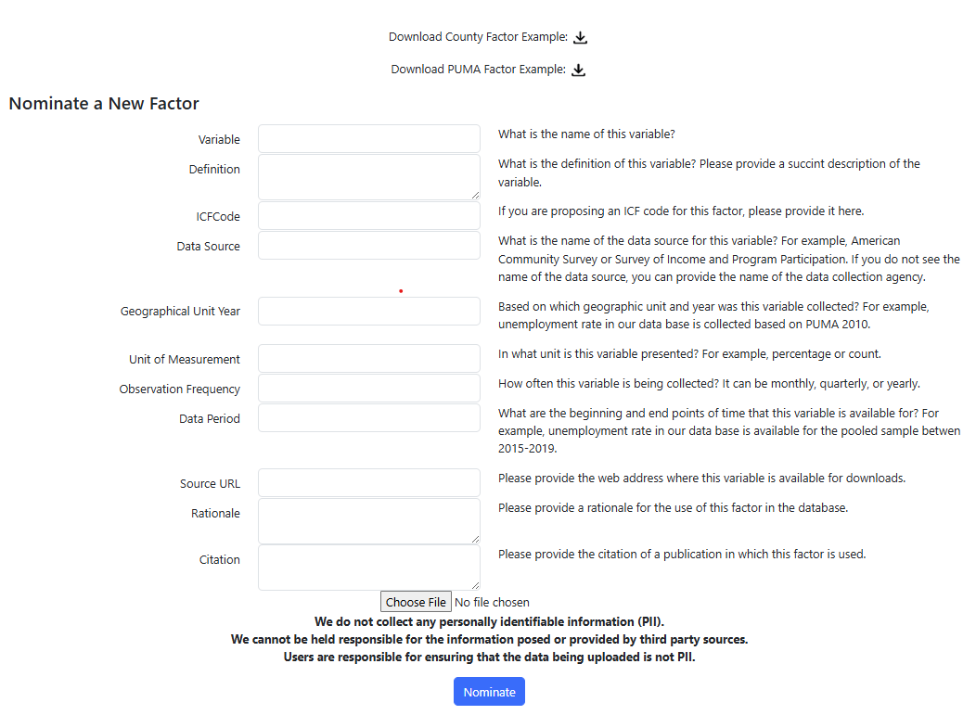
External Factors Data Infrastructure : Demonstration – Nominating Factors
Researchers can upload factors in preformatted excel (.xlsx) files at both PUMA and County geographic levels.
Factors will not be publicly available for download until they have been reviewed and validated
*Personally Identifiable information (PII) should never be uploaded*
External Factors (Beta)

Slide 8
External Factors Data Infrastructure : Demonstration – User account actions
A researcher can perform the following actions on the web-app once they are registered:
Search for factors
Download a factor in excel format
Sort factors displayed in the search table based on any column of interest
Click on factors for more detailed information
Up vote factors they find useful; down vote those which they do not
Add citations to a factor
Comment on a factor
Save factors in folders in their account on the web-app
Review actions taken on the web-app, like adding citations, comments, and nominating and downloading factors.

Slide 9
Questions?

