Slide 1
Build Your Own Statistics
Andrew Houtenville, Ph.D.

Slide 2
Build Your Own Statistics: New Part of DisabilityCompendium.org
Notes:
Let’s get right into updates to the Compendium

Slide 3
Background
Traditional Approach: Curated Materials
Annual Disability Statistics Compendium
Annual Report on Americans with Disabilities
Infographics, annually updated
[former] Annual Compendium Supplement
[former] Annual State Reports w/county-level stats
A New Complementary Approach:
Interactive web-based application
Ready-access to comprehensive/detailed stats
Breakdowns by many dimensions
New, Interactive Approach: Provide rea0dy access to specific statistics from a comprehensive set of statistics broken down by:
zzz

Slide 4
Topics
Prevalence and Population Size
Educational Attainment
Employment
Earnings from Work
Poverty
Health Insurance
Veteran Status

Slide 5
Breakdowns (dimensions)
National/State (based on ACS PUMS estimates)
or State/County (based on ACS summary files)
Disability Status
Disability Type
Age Group
Race/Ethnicity Gender
Year (will be adding more)
*Note: the breakdowns vary for the State/County
statistics, because the ACS summary files are
pre-estimated by the Census Bureau and less flexible

Slide 6
Statistics
Counts and Percentages
Risk Ratios (akin to “gaps”) when comparing PwD and PwoD
Quantiles: Q10, Q25, Q50 (Median) Q75, & Q90
Corresponding Margins of Error
Corresponding Sample Sizes

Slide 7
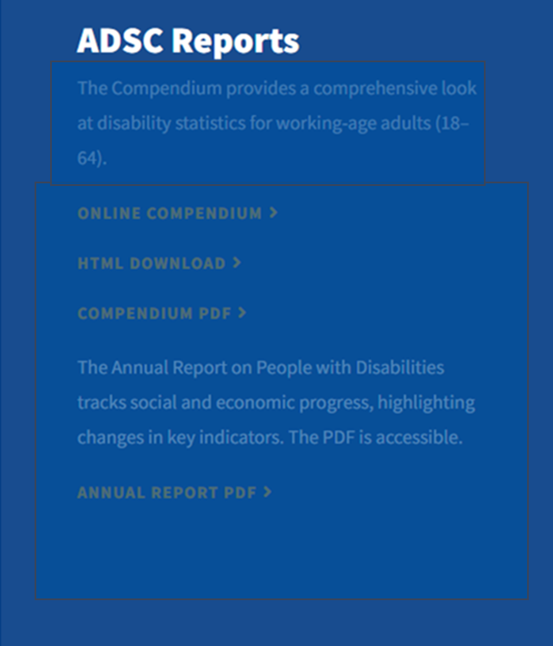
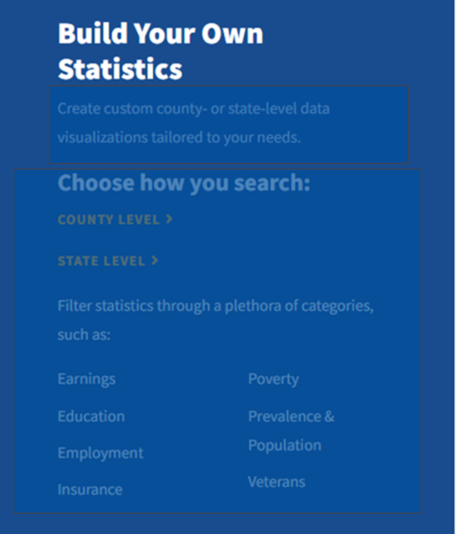
www.DisabilityCompendium.org
Curated Docs
Build a Table

Slide 8
Select Geography

Slide 9
Select Topic
Prevalence and Population
Insurance
Employment
Education
Earnings
Veterans
Poverty

Slide 10
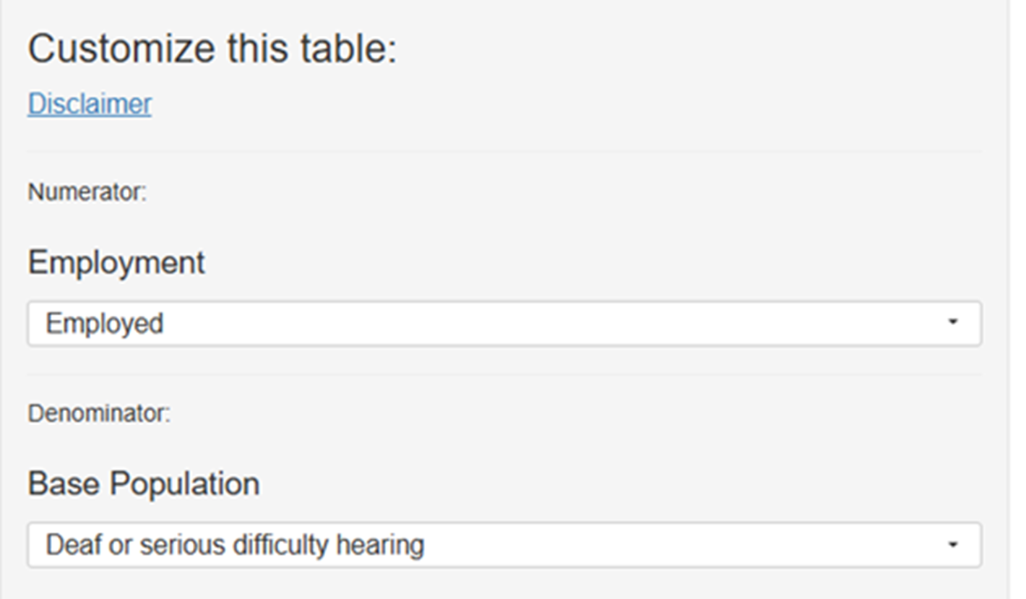
Select Population of Interest

Slide 11
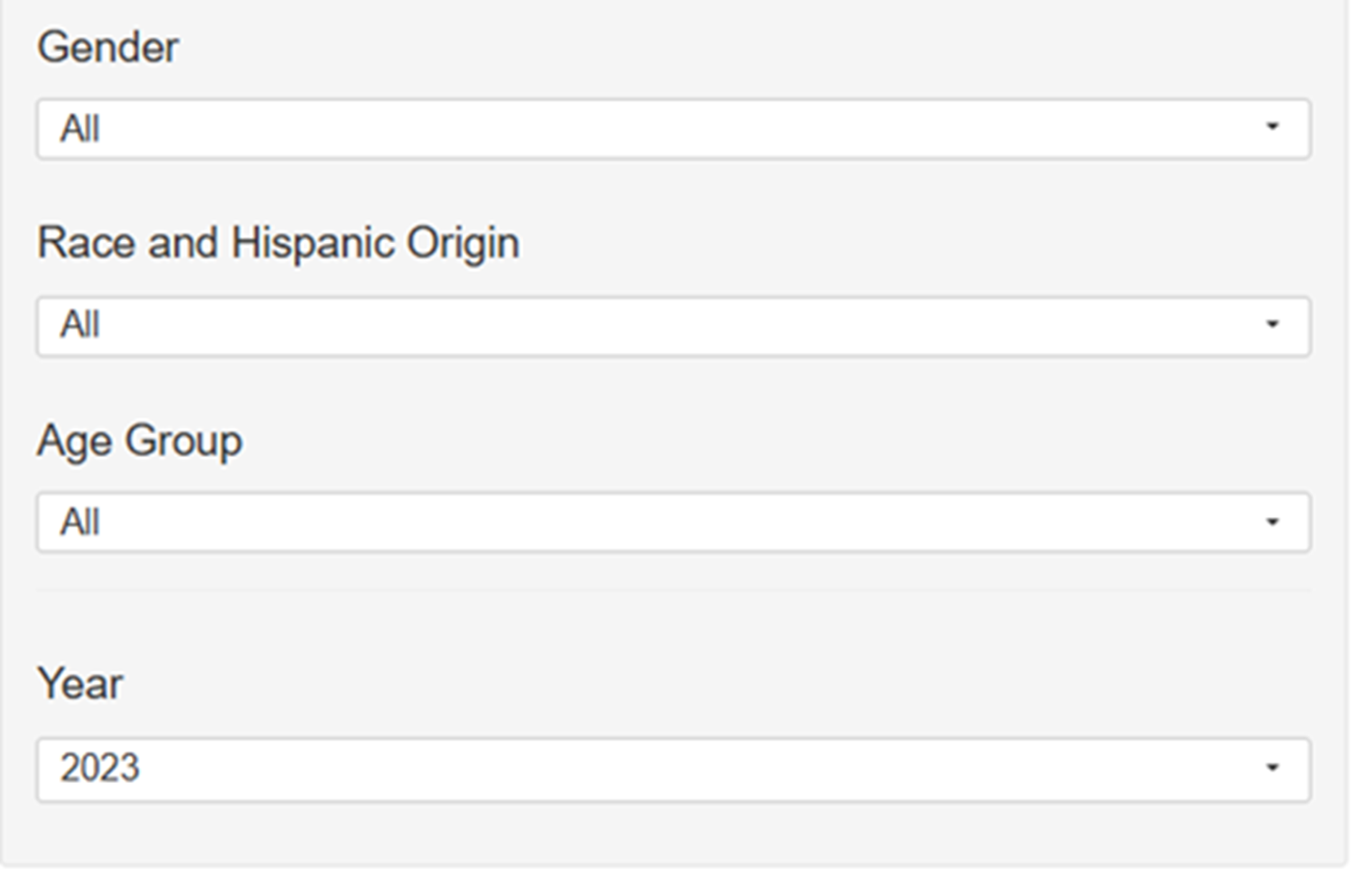
Select Population of Interest (cont.)

Slide 12
Resulting Table
Notes:
This shows table columns for State, total number, ME#, and Sample Size for Hearing Disabilitiy: total population, employed, and total population with no hearing disability. There is a vertical and horizontal scroll bar showing that there are more rows and columns you can view.

Slide 13
Resulting Table (cont.)
Notes:
This includes columns and data for the No hearing disability population that is employed and thre relative ratio confidence intervals.

Slide 14
Contact
Andrew Houtenville
Professor of Economics &
Director of the Institute on
Disability
Technical Assistance
Disability.Statistics@unh.edu

