Slide 1
Collection, 2025
Stacia Bach, MPP
Notes:
Hello, I am Stacia, I am a short woman with dark hair and light skin.
The Collection includes the
Annual Report on People with Disabilities in America,
The Annual Disability Statistics Compendium,
Infographics, and
the online Build your own statistics tools.
Nate Thomas and I work together to produce the Collection. Bianca Weatherly, our in-house designer was an immense support to this project as well this year.

Slide 2
New This Year
Disability Statistics Compendium additions
Build Your Own Statistics expansions
Redesigns
Notes:
This year we have
Added specialized expansion sections to the Online versions of the Compendium
Included more tables in Employment section 3
Added an earnings distribution graphic to Section 5: Earnings
Andrew will discuss Build Your Own Statistics tools and expansions in the next presentation
I’ll wrap up with redesigns to the infographics

Slide 3
Annual Disability Statistics Compendium
Notes:
Let’s get right into updates to the Compendium

Slide 4
Partnered Compilation & Expansion
American Foundation
for the Blind
Notes:
We’re instituting, with this year’s edition, a Compilation and Expansion section in the web based Compendium (available also as an accessible HTML download). we worked with Dr. Sarahelizabeth BuhGOON and Dr. Arielle Silverman of the American Foundation for the Blind to inaugurate the new Compilation and Expansion Section A: Statistics on the Blind and Low Vision Populations.
Our intentions are to continue partnering with different organizations to inform the public of the multifaceted experience of disability within the disability community, and to serve as a resource for people wanting stats on very specific disability subgroups. Let us know in the comments below what you’d like to see next (that’s for in the future when this gets posted to YouTube). But, for real, let us know.

Slide 5
Compilation and Expansion Section A: Statistics on the Blind and Low Vision Populations
Compiled tables
Prevalence, Self-Care/Independent Living Overlap with Vision, Employment, and Poverty
Expanded tables
Demographics, Industry, Occupation, Earnings, Technology Access, Education, and SSDI
Notes:
The Compilation and Expansion Section is composed of compiled tables and expanded tables with topics informed by Dr BugGOON and Dr Silverman to our team that help describe the blind and low vision population. They also provided compelling narrative contextualizing the statistics in this section.
Compiled tables are on topic such as Prevalence, Self-Care/Independent Living Overlap with Vision, Employment, and Poverty
Expanded tables are on topics such as Demographics, Industry, Occupation, Earnings, Technology Access, Education, and SSDI

Slide 6
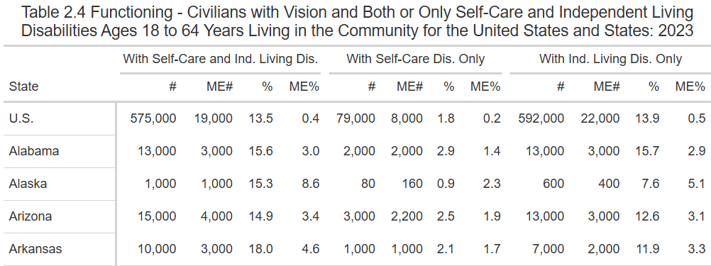
Compilation Table
Notes:
Compiled tables are duplicates from other sections of the Compendium, and they carry the same table number in this section as in the other section. This table 2.4, is located in Section 2: Functioning as well as in the Compilation and Expansion section.

Slide 7
Contextualization: Table 2.4 in Section A
“It is important to note that some people with vision difficulty, including some people who are totally blind, may not experience disability in these areas after having access to adequate education or rehabilitation services that equip them with the appropriate skills and assistive technologies to perform tasks independently and efficiently using alternate methods…”
Notes:
For example, this contextualization describes Table 2.4 Functioning (in Section A.
{read slide – these areas mean Self-Care and Independent Living Difficulties} the quote goes on to say:
“There are also features of the community environment, such as quality of mass transit systems, that impact blind and low vision individuals’ access to independent living, which is measured by a question about doing errands alone.”

Slide 8
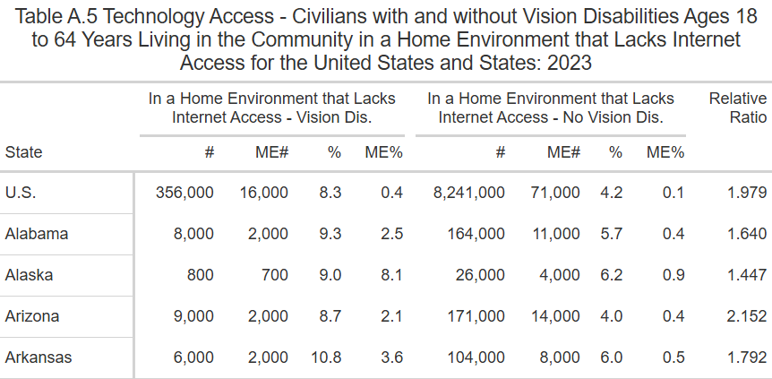
Expansion Table
Notes:
Expansion tables begin with the letter A and are exclusive to this section. They include topics of Demographics, Industry, Occupation, Earnings, Technology access, education, and SSDI.
This is table A5 technology Access – civilians with and without vision disabilities ages 18 to 64 years living in the community in a home environment that lacks internet access for the United States and States: 2023

Slide 9
Contextualization: Table A.5
“Technology access to the internet opens many opportunities for education, employment, and community access. Nationally, people with vision difficulties are twice as likely to live in a home without internet access as sighted individuals. As seen by relative ratios above 3.0, in some states they may even be three times more likely to live without internet access.”
Notes:
This contextualization describes Table A.5 Technology Access

Slide 10
New Tables in Section 3: Employment
Historically
Only employment to population ratio
New this year
Employment to population ratio
Labor force participation
Unemployment rate
Year over year comparisons of all these stats
Notes:
Historically, the Compendium has only had tables on the employment to population ratio of people with disabilities by overall prevalence and by the six disability types as in the ACS (hearing, vision, cognitive, ambulatory, self-care, and independent living).
This year the online and accessible HTML download versions include labor force participation stats and unemployment stats for all six ACS disability types and year over year comparison of overall prevalence

Slide 11
Employment Statistics for People with Disabilities (ages 18-64) – By Location, 2023
 | High | Low
Employment to Population Ratio | 61.1% South Dakota | 32.4% Puerto Rico
Labor Force Participation Rate | 66.0% District of Columbia | 37.3% Puerto Rico
Unemployment Rate | 18.0% District of Columbia | 2.2% South Dakota
Notes:
Here are the highs and the lows of each of the statistics reported in this year’s digital Section 3.
All these statistical categories are reported for overall prevalence as well as for each functional disability as defined in the ACS.

Slide 12
New Tables in Section 4: Industry & Occupation
2024: Top five industries and occupations
2025: All industries and occupations
ONLY the HTML and Online versions
Table numbering aligns with the print version
Notes:
2024: Top five industries and occupations
2025: All industries and occupations
ONLY the HTML and Online versions
Because the Print is truncated, and only has some of the industries and occs, Tables in the online and HTML versions are numbered to align with the print version of Section 4

Slide 13
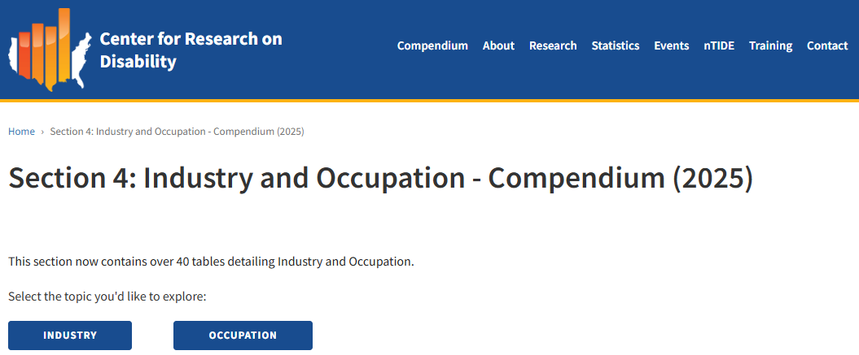
Appearance on Website
Notes:
When visiting the website, you must indicate if you want stats on industry or occupation

Slide 14
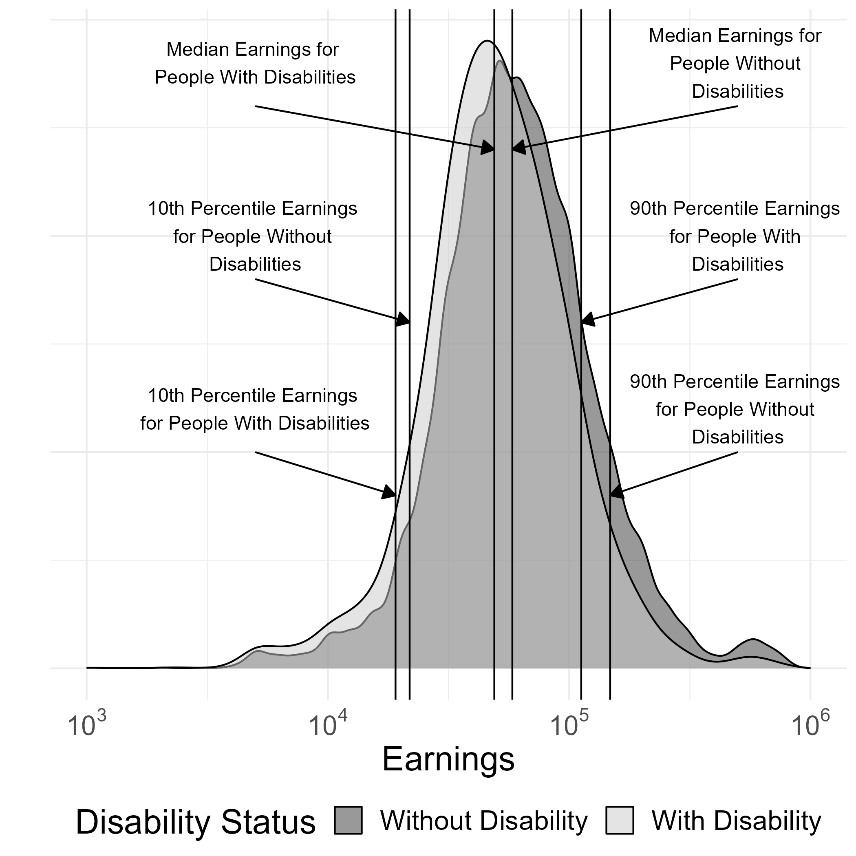
New Figure in Section 5: Wages
Earnings distribution of full-time, full-year workers
Compares earnings for people with and without disabilities at different percentiles of earnings
Ages 18-64 at the national level
Notes:
In section 5 Nate made an earnings distribution depicted by a kernel density plot.
This plot depicts the earnings distribution for full time full year workers ages 18-64 comparing people with and without disabilities on a national level look like in a picture format.

Slide 15
10th Percentile
$19,065 People with Disabilities (gold)
$21,818 People without Disabilities
(purple)
Notes:
Full time, full year workers ages 18-64 in the 10th percentile – this is the lowest level of earners
People with disabilities at the 10th percentile earn $19,065, whereas people without disabilities earn $21,818 annually

Slide 16
Median Earnings
$48,937 People with Disabilities (gold)
$58,113 People without Disabilities
(purple)
Notes:
Full time, full year workers ages 18-64 median earnings
For people with disabilities, it’s $48,937 annually
For people without disabilities, it’s $58,113 annually

Slide 17
90th Percentile
$112,147 People with Disabilities (gold)
$147,830 People without Disabilities
(purple)
Notes:
Full time, full year workers ages 18-64 in the 90th percentile, these are top earners
People with disabilities in the 90th percentile earn $112,147 annually,
whereas people without disabilities in the 90th percentile earn $147,830
There is a direct relationship between disability and the wage gap. As the percentile increases, the gap in wages earned between people with and people without disabilities also increases.
As such, this percentile has the largest gap in wages between people with and people without disabilities

Slide 18
Build Your Own Statistics Table Builder
Notes:
The one thing I want to touch upon – principally because I’m one of the faces behind TA, and I’m really excited about this improvement (Andrew, I apologize in advance if I’m stealing your thunder) but we have:

Slide 19
Reinstated County Level Statistics!
Notes:
Andrew will dive into this in the next presentation, so stay tuned!

Slide 20
Redesigns: Annual Report Infographic Website

Slide 21
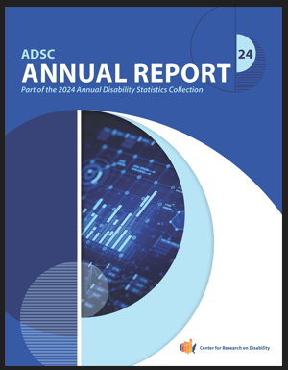
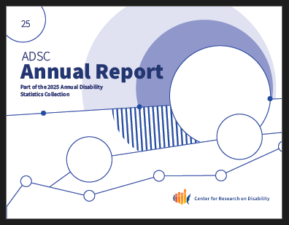
Annual Report on People with Disability in America
2024
2025
Notes:
The most massive change is reformatting from vertical with all the stats on one page to horizontal with to accommodate for the growing tables and figures

Slide 22
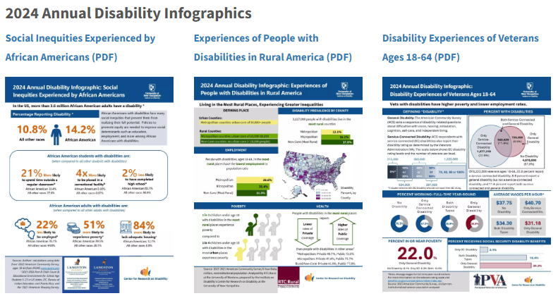
Infographics - Old
Notes:
With the help of Bianca Weatherly, our oh so talented graphic designer, we went from one-pager, fact-sheets to a more storytelling premise.
We dug in deep with our partners to curate the story of what these stats are trying to say.
We found quotes from reputable sources that contextualize the statistics and the literature on these topics.

Slide 23
African American/Black
Notes:
We worked with Dr. Andre Washington and Dr. Edward Manyibe from Langston University’s RRTCs
This infographic underscores the connection between unsupportive school environments for African American/Black students with disabilities and worse socioeconomic outcomes than their peers of all other races with disabilities.

Slide 24
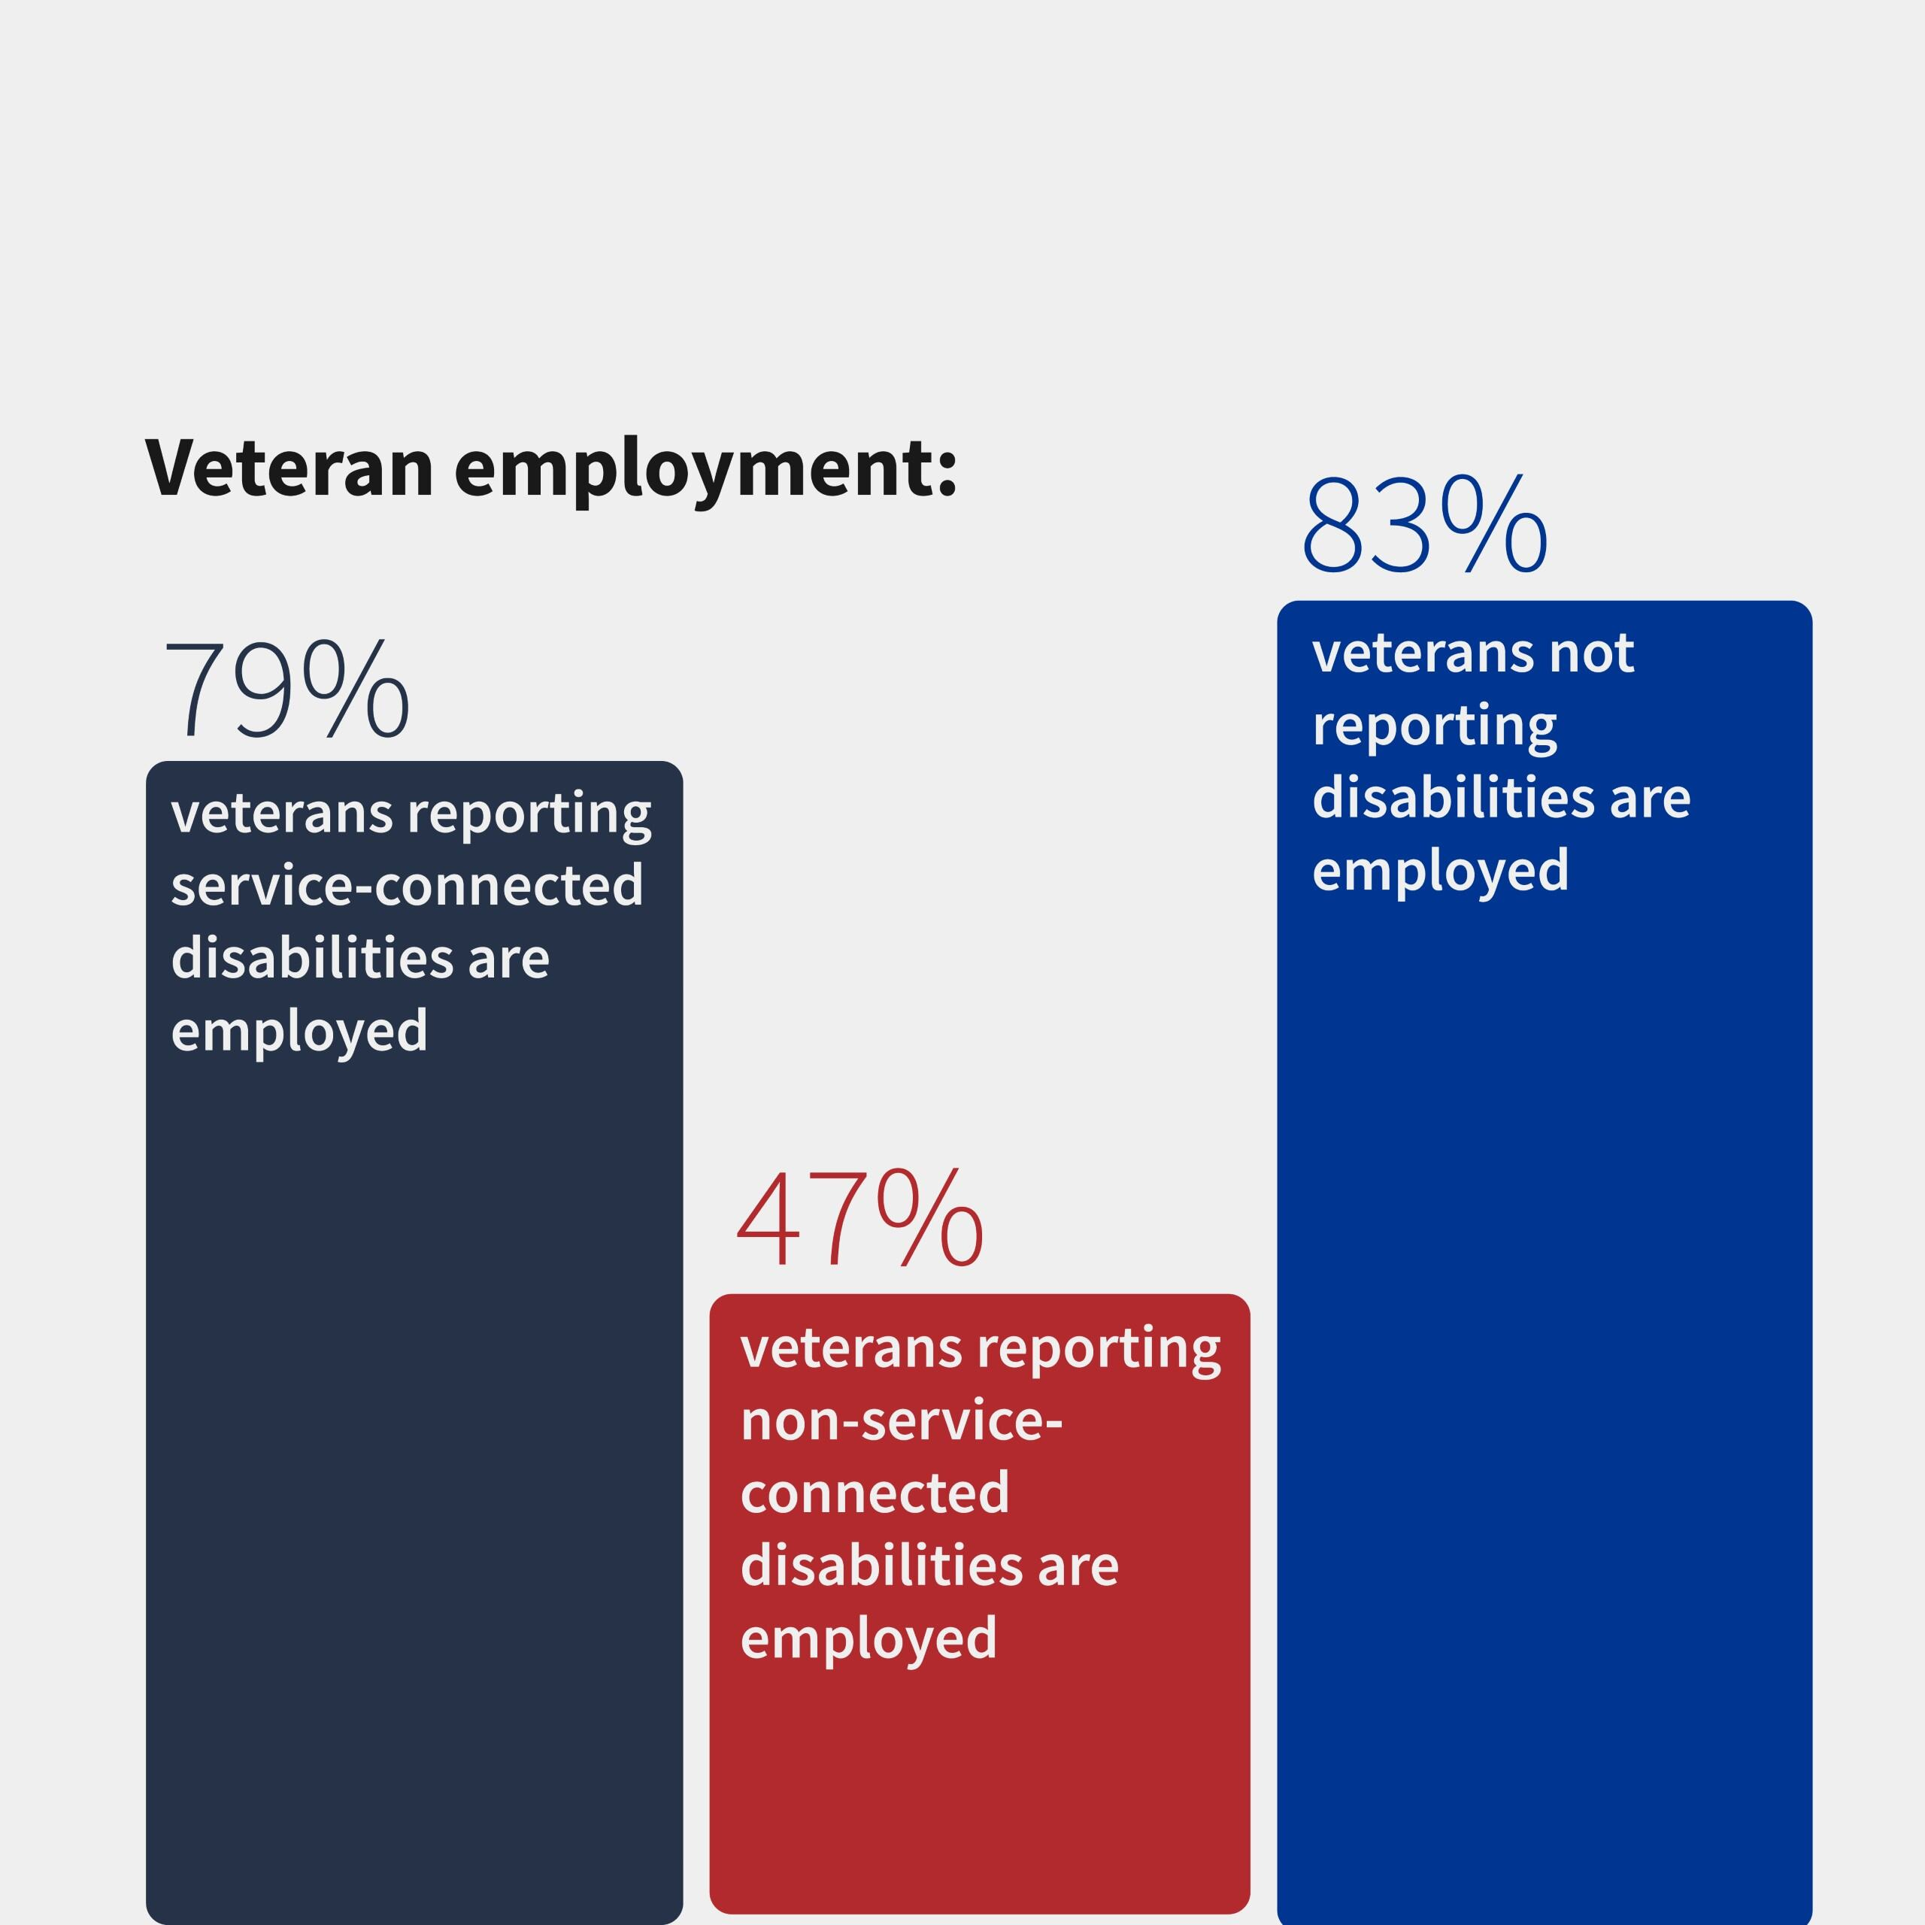
Veterans
Notes:
This was made in collaboration with Julie Howell and Geena Hack-en-berg at Paralyzed Veterans of America in memory of Charles McCaffrey
The data suggests that veterans with non-service-connected disabilities experience greater poverty, lower employment, and lower wages than veterans with service-connected disabilities and veterans without disabilities. Reach out if you want stats on veterans with both service and non-service- connected disabilities as those are available but are not presented here.

Slide 25
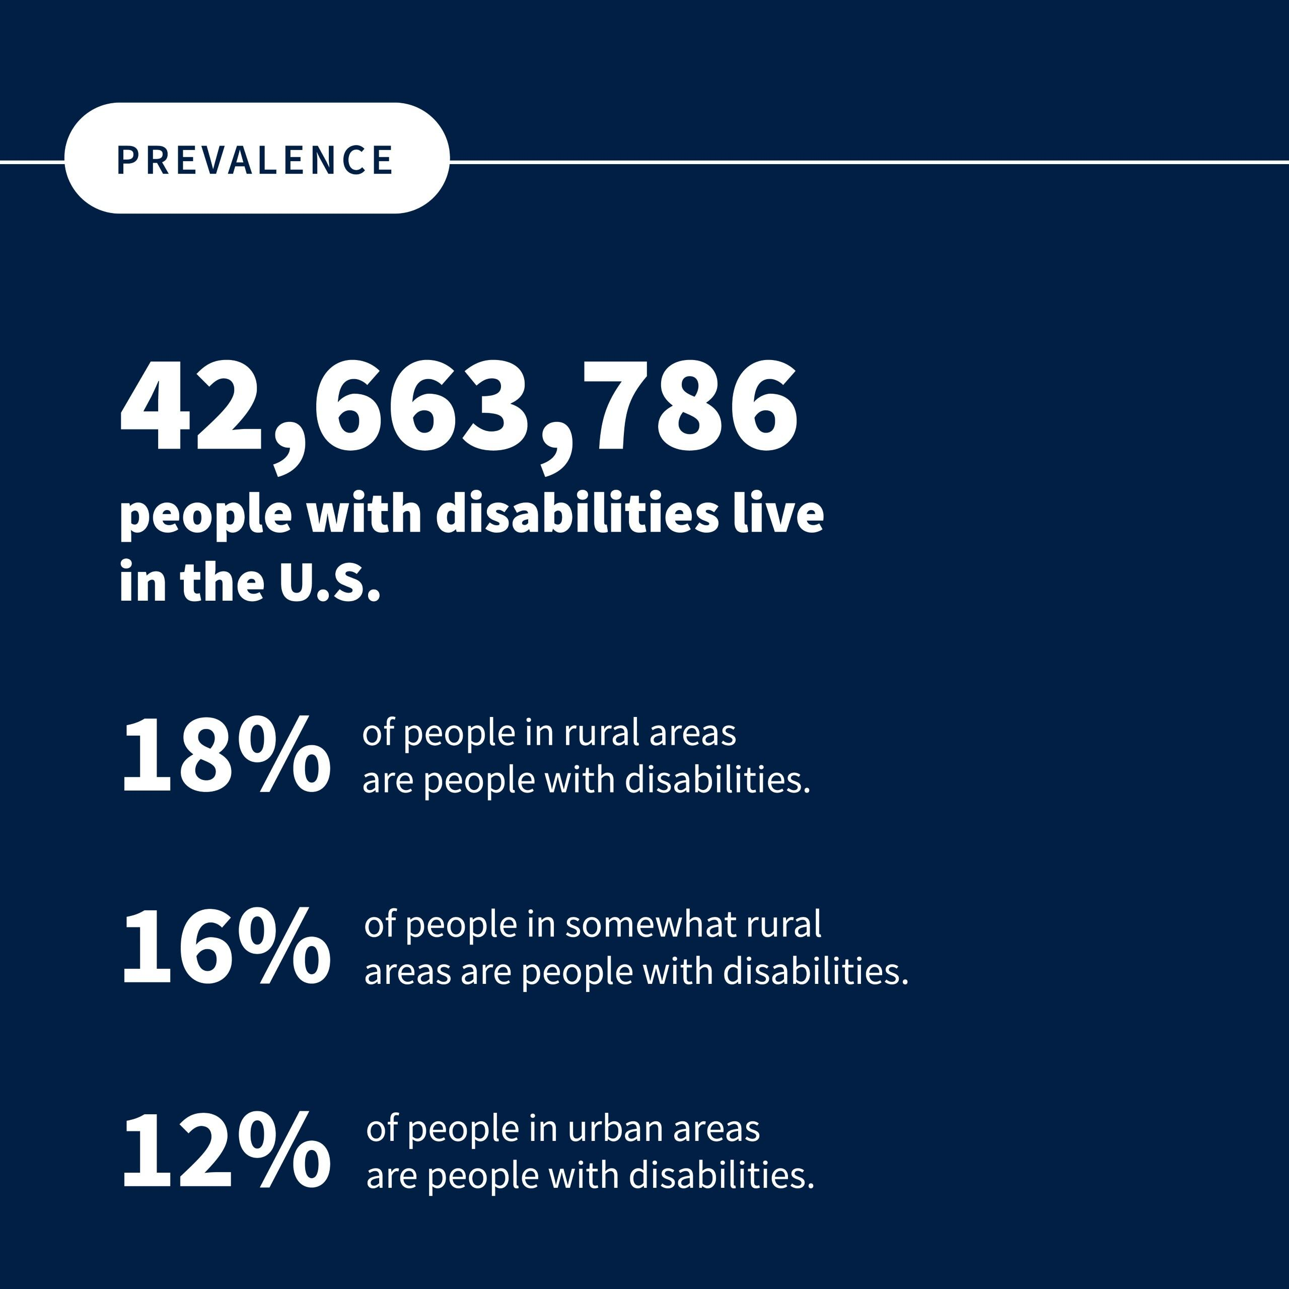
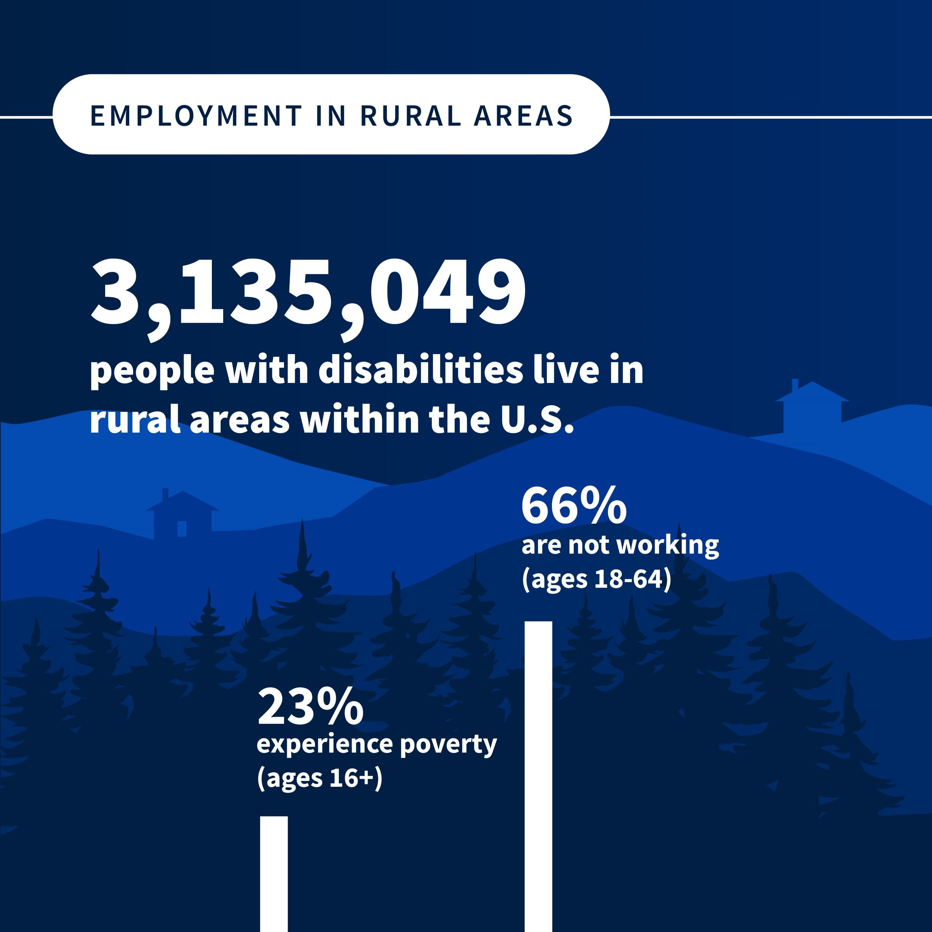
Rural Populations
Notes:
The Story here:
We worked with Lillie Greiman and Dr. Catherine Ipsen to pull from the stats the rural areas have higher percentages of their population being people with disabilities. Consequently, with all the challenges of living in rural areas (limited access to transportation, job options, etc), people with disabilities living in rural areas have higher rates of poverty and a higher percentage of people not working.

Slide 26
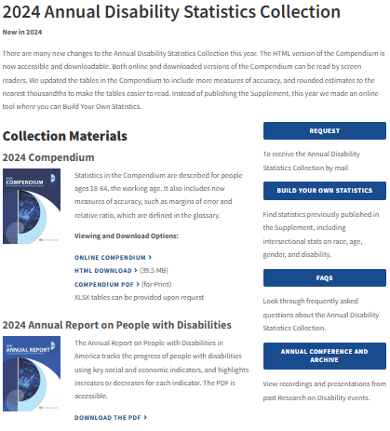
Website - Old

Slide 27
New

Slide 28
Stacia Bach, MPP
Policy Analyst/Project Research Specialist
stacia.bach@unh.edu
Technical Assistance
disability.statistics@unh.edu

