Slide 1
Status and Trends in Financing Supports and Services for People with IDD
2018 Annual Disability Statistics Compendium
February 13, 2019
Washington, DC
Amie Lulinski, PhD, FAAIDD
Emily Shea Tanis, PhD, FAAIDD
Joy Wu, PhD

Slide 2
“Don’t tell me what you value, show me your budget, and I’ll tell you what you value.”
~Joe Biden, 47th Vice President of the United States

Slide 3
Follow the money

Slide 4
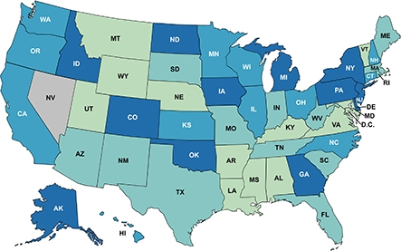
Data sources

Slide 5
What data do we collect?
I. INSTITUTIONAL SERVICES FINANCIAL DATA (16 or more persons)
A. Public 16+ Institutional Services Funds
1. State Funds
a. ICF/ID Medicaid Match
b. General Funds (not including state ICF/ID match)
c. Other State Funds (not including state ICF/ID match)
d. Local Funds in Excess of Match
2. Federal Funds
a. Federal ICF/ID
b. Title XX/Social Services Block Grant
c. Other Federal Funds
B. Private 16+ Institutional Services Funds
1. State Funds
a. ICF/ID Medicaid Match
b. General Funds (not including state ICF/ID match)
c. Other State Funds (not including state ICF/ID match)
d. Local Funds in Excess of Match
2. Federal Funds
a. Federal ICF/ID
b. Other Federal Funds
Sources: Braddock et. al. (1981-2017)

Slide 6
What data do we collect? (continued)
II. COMMUNITY SERVICES FINANCIAL DATA
(15 or fewer persons)
A. Community Services Funds for 15 or Fewer Persons
1. State Funds
a. ICF/ID Medicaid Match
b. General Funds (not including state ICF/ID match)
c. Other State Funds (not including state ICF/ID match)
d. Local/County Funds in Excess of Match
e. SSI State Supplement Funds
2. Federal Funds
a. Public ICF/ID (<16)
b. Private ICF/ID (<16)
c. HCBS Waiver
d. Other Medicaid Services
1. Rehabilitation Services
2. Clinic Services
3. Targeted Case Management
4. Personal Care Services
5. Other Medicaid Services
e. Title XX/Social Services Block Grant
f. Other Federal Funds
g. SSI and Adults Disabled in Childhood (ADC) benefits – HCBS Waiver participants

Slide 7
What data do we collect? (continued)

Slide 8
Key Program and Participant Categories
Sheltered Employment/Work Activity
Technology
Smart Homes
Institutional Settings (16+)
Community and Residential Settings (7-15)
Public & Private ICF/ID
Nursing Facilities
Other
Day Habilitation
Supported Employment
Individual Support Technology
Remote Monitoring
Public & Private ICF/ID
Supported Living
Personal Assistance
Family Support
Other Residential
Day/Work Program
Public & Private ICF/ID
Other Residential
Community and Residential Settings (1-6)

Slide 9
Data Note
Preliminary FY 2016-17 data
Additional analysis in progress

Slide 10
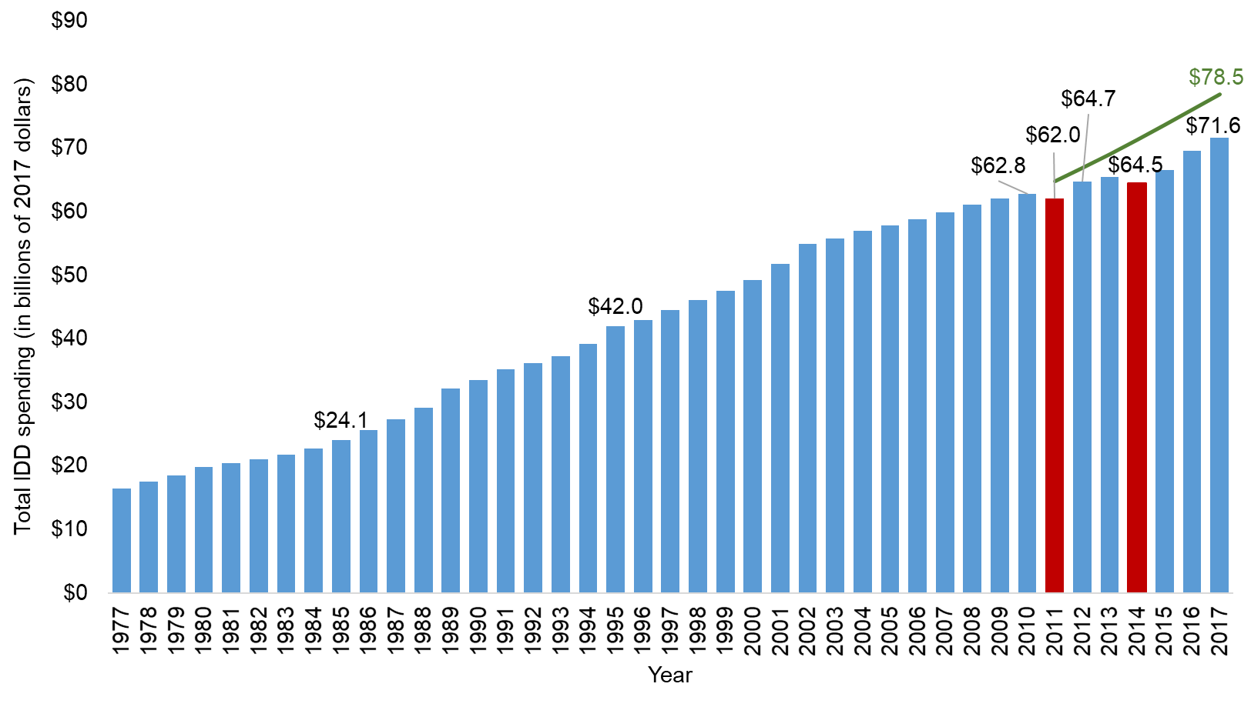
IDD services spending: FYs 1977 – 2017

Slide 11
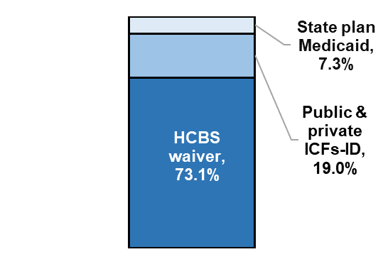
Federal, State, and Local Medicaid Spending in FY 2017
13.1%
19.0%
Total spending:
$71.6 billion
Total Medicaid spending:
$31.4 billion

Slide 12
Institutional and community spending

Slide 13
Number of people living in IDD Institutions in the US (FYs 1848 – 2017)
-91%

Slide 14
Projected Closure of State-Operated Institutions
Source: Braddock, D., Hemp, R., Tanis, E.S., et al.(2017).The State of the States in Intellectual Disabilities:2017

Slide 15
Increased Demand for Six or Fewer Residential Services in the U.S.
Source: Braddock, D., Hemp, R., Tanis, E.S., et al.(2017).The State of the States in Intellectual Disabilities:2017

Slide 16
Individual & family support and supported employment spending
Growth between 1993 – 2017:
Supported Living/Personal Assistance: 1746%
Total Spending: 915%
Family Supports: 889%
Supported employment: 74%

Slide 17
Caregiving families

Slide 18
State IDD Agency Technology Spending

Slide 19
Fiscal effort

Slide 20
The Book
Financial and Programmatic Trends Through FY 2015
Published by

Slide 21
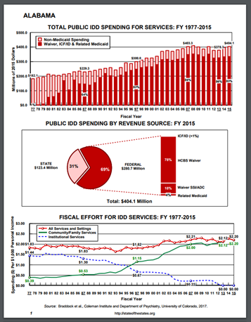
State profile www.stateofthestates.org

Slide 22
Create-a-chart
www.StateoftheStates.org

Slide 23
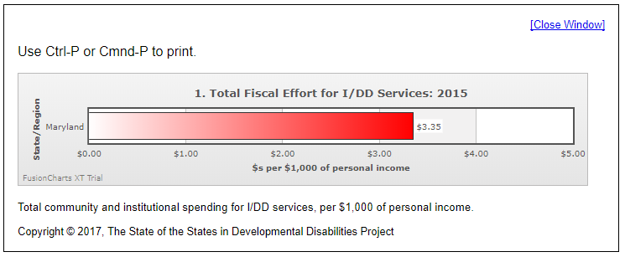
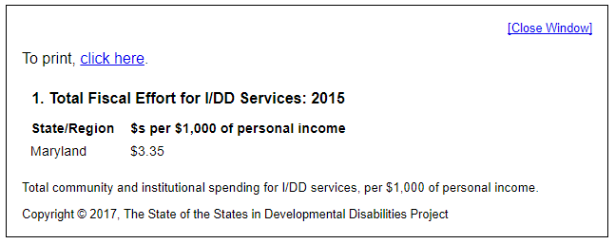
Create-a-chart (state) www.stateofthestates.org
Print to PDF & paste into documents and presentations (don’t forget to cite!)
Choose your variables
Choose your state(s)
Click table or chart
Click next

Slide 24
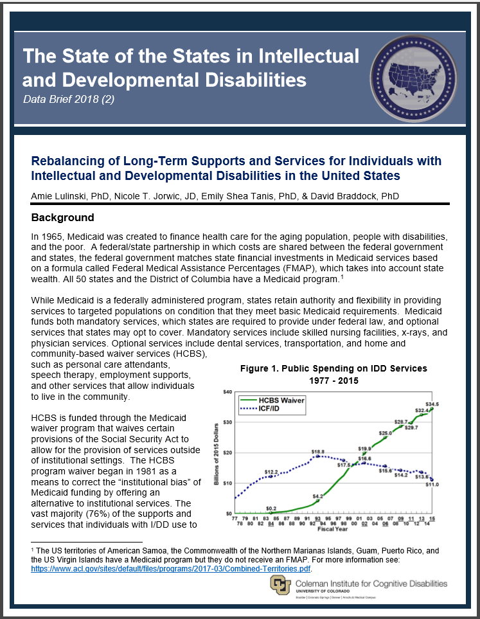
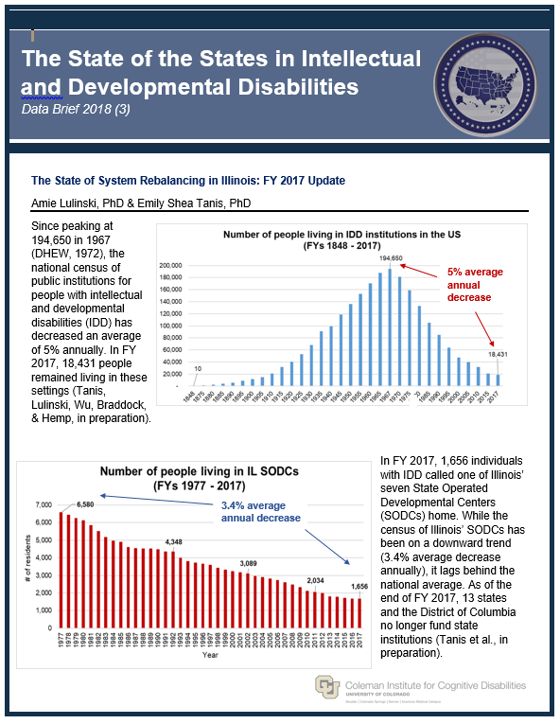
Data briefs, presentations, & TA

Slide 25
THANK YOU!
To learn more about the Coleman Institute visit www.ColemanInstitute.org
For more information about
State of the States visit: http://www.StateoftheStates.org
Like us on
Facebook
Follow us on Twitter @SOS_in_DD
Email us:
Shea.Tanis@cu.edu
Amie.Lulinski@cu.edu
Financial support was obtained from the U.S. Administration on Intellectual and Developmental Disabilities and the Coleman Institute for Cognitive Disabilities, University of Colorado.

