Slide 1
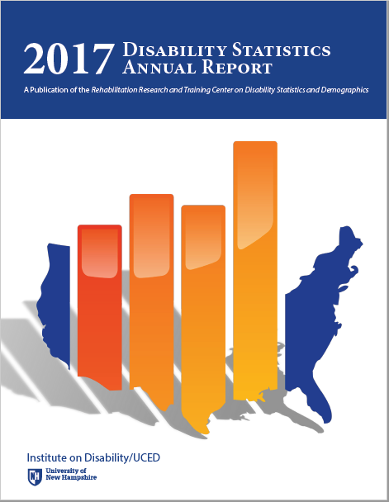
Annual Report on Disability Statistics
State Level Statistics
Lewis Kraus
Center on Disability at the Public Health Institute
1
Notes:
I am Lewis Kraus from the Center on Disability at the Public Health Institute and the lead author of the Disability Statistics Annual Report. I wanted to review the state level data from the Annual Report with you today. As some of you are familiar with the Annual Report, you know that the graphical display of data by state lends itself to a more nuanced understanding of the data.

Slide 2
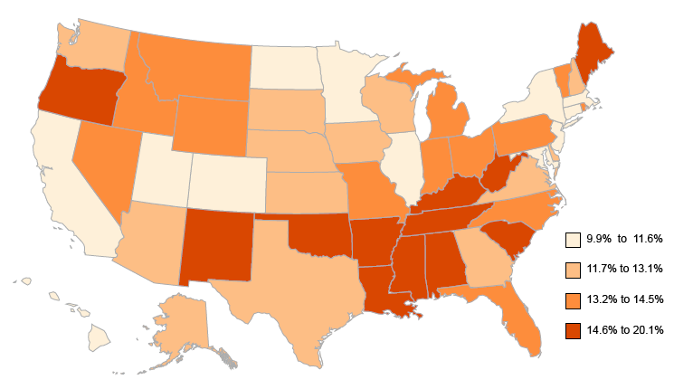
People with Disabilities Living in the Community as a Percentage of the US Population, by State, 2016
Data Source: 2016 American Community Survey, American FactFinder, Table B1810
2
Notes:
First, the percentage of people with disabilities.
In 2016, the state with the lowest percentage of its population having disabilities was Utah (9.9%).
The state with the highest percentage of people with disabilities, West Virginia, was more than twice as high with a percentage of 20.1%. For the most part, higher percentages of people with disabilities were clustered in the southern US, around the lower Mississippi river region, with concentrations also high in the states of Maine, New Mexico, Oklahoma, and Oregon.

Slide 3
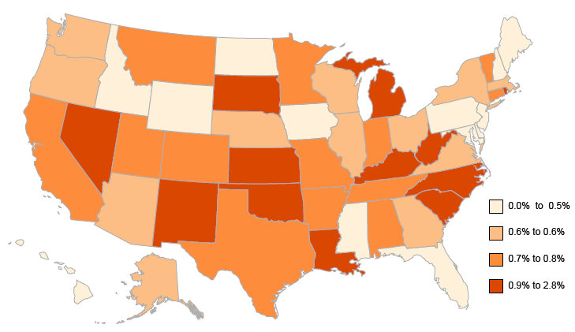
People with Disabilities Ages Under 5 Years Living in the Community, by State, 2016
Data Source: 2016 American Community Survey, FactFinder Table B1810
3
Notes:
Looking at the percentage of people with disabilities by age group, we can see that among children under 5 years old, the percentage of those with disabilities was very low, about 0.7% nationally, and 2.8% or less in every state. The states with the highest percentages were Nevada and Rhode Island. Forty states had percentages equal to or less than 1.0%.

Slide 4
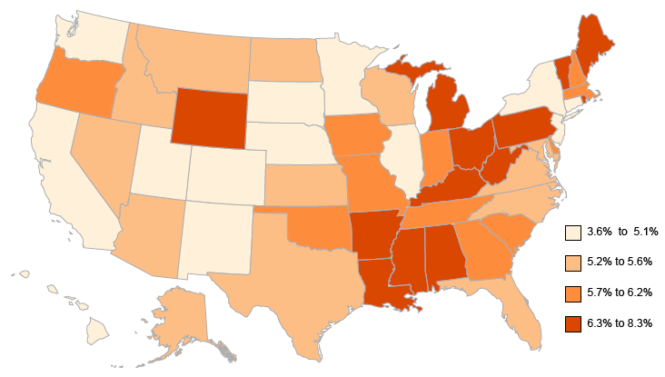
People with Disabilities Ages 5-17 Years Living in the Community, by State, 2016
Data Source: 2016 American Community Survey, FactFinder Table B1810
4
Notes:
For children ages 5-17, the percentages of those with disabilities ranged from 3.6% in Hawaii to more than twice that percentage in Maine at 8.3%. In general, percentages for this age group were lower in the states around the Rockies, the upper Great Plains, the Pacific Coast and Hawaii, and more concentrated in the eastern and southern US.

Slide 5
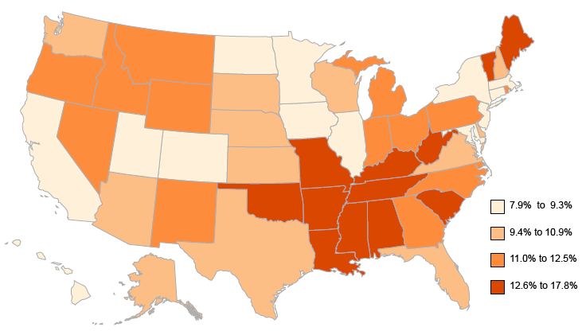
People with Disabilities Ages 18-64 Years Living in the Community, by State, 2016
Data Source: 2016 American Community Survey, FactFinder Table B1810
5
Notes:
For adults ages 18-64, the highest percentages of people with disabilities were in states in the southern US from Oklahoma to West Virginia, and also Maine and Vermont. The percentage was lowest in New Jersey and Hawaii (7.9%) and more than twice as high in West Virginia (17.8%).

Slide 6
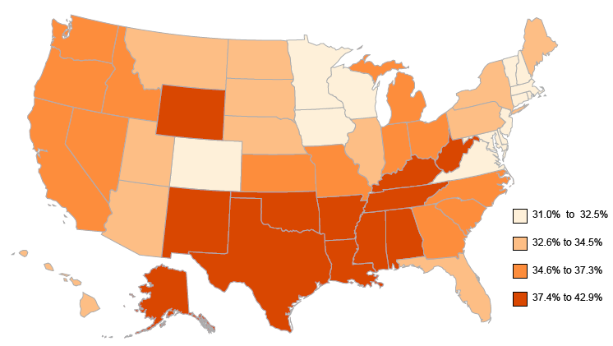
People with Disabilities Ages 65 and Over Living in the Community, by State, 2016
Data Source: 2016 American Community Survey, FactFinder Table B1810
6
Notes:
As I am sure you are aware, the highest percentages of people with disabilities were in the US population ages 65 and over; more than one third of the civilian population for this age group (35.2%) had disabilities. In nine states, primarily in the South, the percentage of people ages 65 and over with disabilities was 40% or over, or more than two in every five elderly people: West Virginia, Kentucky, Oklahoma, Mississippi, Alabama, Arkansas, New Mexico, Alaska, and Louisiana.
The percentages of people with disabilities were generally lowest in the Northeast, the central Atlantic states, and some upper Midwest states; fourteen states had disability percentages of less than one third (33.3%) of elderly: New Hampshire, Delaware, Vermont, Maryland, Colorado, Minnesota, Rhode Island, Connecticut, Wisconsin, Iowa, Massachusetts, New Jersey, Virginia, and New York.

Slide 7
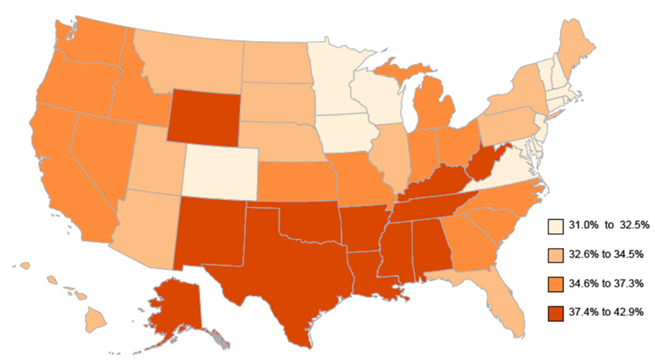
People with Disabilities Living in the Community, by Age Group and State, 2016
Under 5
5-17
18-64
65 and over
Data Source: 2016 American Community Survey, FactFinder Table B1810
7
Notes:
Now if we look at them all together, you can see a pattern emerging. As the population ages it moves from a disparate, almost random smattering of high and low disability states for those under 5 in the upper left map to a slow, but steady move to the Southern states and Maine and Vermont in the working ages, ending with a solid block of high disability percentage states in the central southern US, along with Wyoming and Alaska for those age 65 and over.

Slide 8
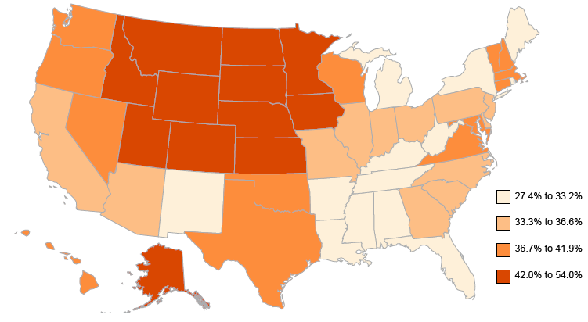
Percent Employed Among People with Disabilities, by State, 2016
Data Source: 2016 American Community Survey, American FactFinder, Table B18120
8
Notes:
Now let’s turn to a familiar topic – employment. This slide depicts how rates of employment varied by state. For people with disabilities, employment rates ranged from a high of 54.0% (North Dakota) to a low of 27.4% (West Virginia). But you can see a solid block of high disability employment states in the upper Midwest and a generally low disability employment segment in the southeast.

Slide 9
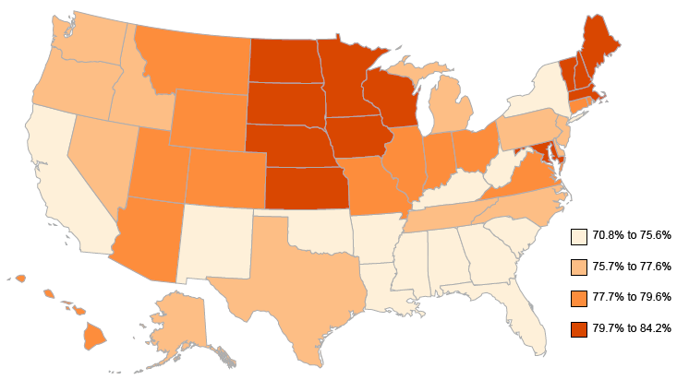
Percent Employed Among People without Disabilities, by State, 2016
Data Source: 2016 American Community Survey, American FactFinder, Table B18120
9
Notes:
This slide shows that for those without disabilities, the employment ranged from 70.8% (West Virginia) to 84.2% (North Dakota).

Slide 10
Percent of Persons With and Without Disabilities Employed, by State, 2016
With Disabilities Without Disabilities
Data Source: 2016 American Community Survey, American FactFinder, Table B18120
10
10
Notes:
If you now look at them side by side, you can see that the general rates of employment follow similar patterns for those with and without disabilities for the upper Midwest where we see high rates of employment and the Southeast where we see low rates of employment. So we chose to present this as a gap to show where there may be something particular happening for people with disabilities…[next slide]

Slide 11
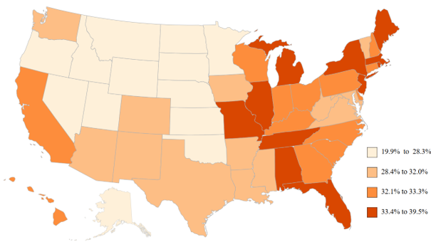
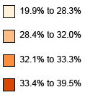
Gap of Percent Employed Among People with and without Disabilities, by State, 2016
Data Source: 2016 American Community Survey, American FactFinder, Table B18120
11
Notes:
This slide shows the gap in percent employment between those with and without disabilities by state in 2016. Now those upper Midwest states’ high employment rates for both people with and without disabilities change the map. What we are left with is that states with the largest gap were concentrated generally from Missouri eastward and California. While the states’ employment gaps narrowed from the previous year, in thirty four (34) states, the employment percentage gap was 30 percentage points or greater. The highest gaps were in Rhode Island (39.5 points), Maine (36.4 points), District of Columbia (35.7 points), New York (35.6 points), Illinois (35.3 points) and Florida (35.1 points). In only three states was the gap less than 23 percentage points - Alaska (19.8 points), and North and South Dakota (22.4 points).

Slide 12
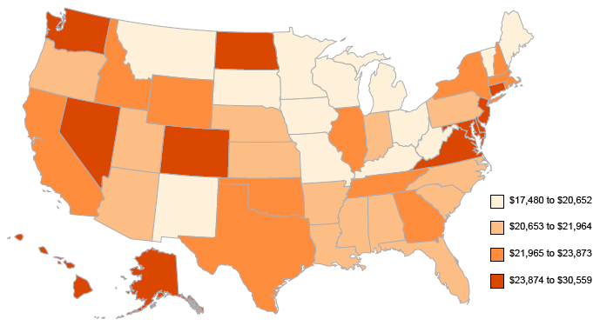
State Median Earnings, Past 12 Months, Ages 16 and Over with Disability, 2016
Data Source: 2016 American Community Survey, American FactFinder, Table B18140
12
Notes:
Looking now at median earnings by state, this slide shows the range of median earnings in states for people with disabilities in 2016 was $17,480 in West Virginia to $30,559 in Alaska. In eleven states (Alaska, Maryland, District of Columbia, New Jersey, Hawaii, Nevada, Virginia, Delaware, Connecticut, North Dakota, and Washington), the median earnings for people with disabilities was over $25,000, while six states had median earnings for people with disabilities lower than $20,000 (Minnesota, Wisconsin, Maine, Michigan, Montana, and West Virginia).

Slide 13
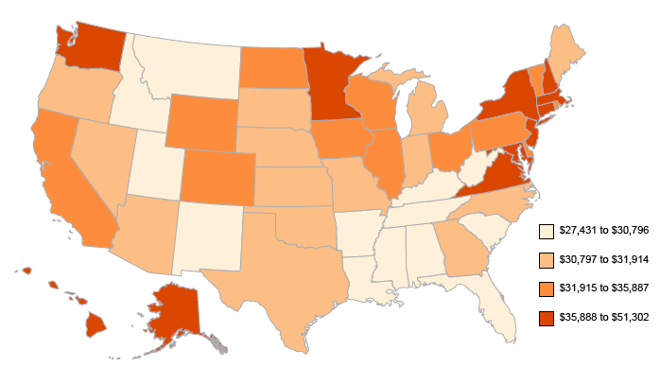
State Median Earnings, Past 12 Months, Ages 16 and Over without Disability, 2016
Data Source: 2016 American Community Survey, American FactFinder, Table B18140
13
Notes:
In comparison to the last slide, the median earnings for people without disabilities ages 16 and over ranged from $27,431 in Idaho to $51,302 in the District of Columbia in 2016.

Slide 14
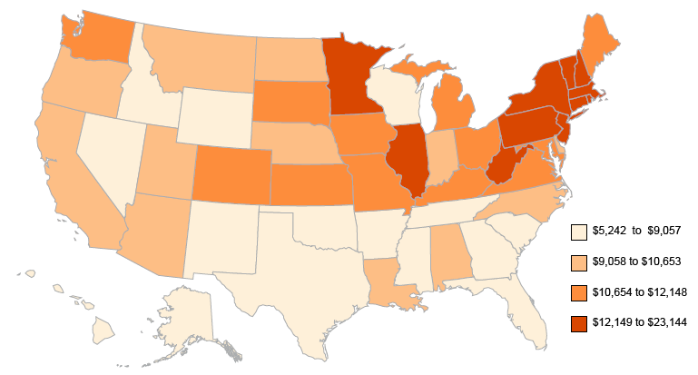
Median Earnings Gap of People 16 Years and Over in the Past 12 Months, by State, 2016
Data Source: 2016 American Community Survey, American FactFinder, Table B18140
14
Notes:
Now, using the gap map again, we can see that while states varied widely in earnings gap – from a low of $5,242 in Idaho to a high of $23,144 in the District of Columbia, generally, states in the northeastern US had a higher earnings gap; states in the southern US had a lower earnings gap

Slide 15
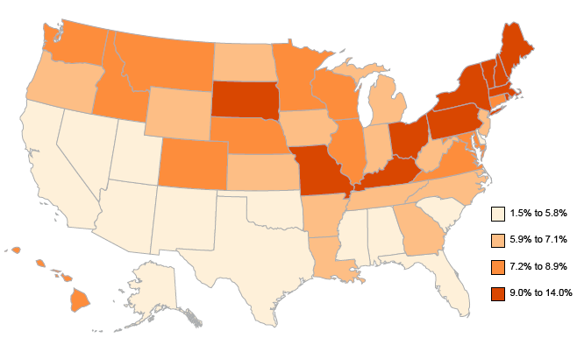
Poverty Percentage Gap Among People with and without Disabilities, by State, 2016
Data Source: 2016 American Community Survey, American FactFinder, Table B18130
15
Notes:
Moving on to Poverty. Here is the poverty gap between those with and without disabilities by state in 2016. The highest poverty gaps were seen mostly in the Northeast US, states bordering the Great Lakes, Kentucky, Missouri, and South Dakota. Gaps ranged from a high of 14.0 percentage points (District of Columbia) to a low of 1.5 percentage points in New Mexico.

Slide 16
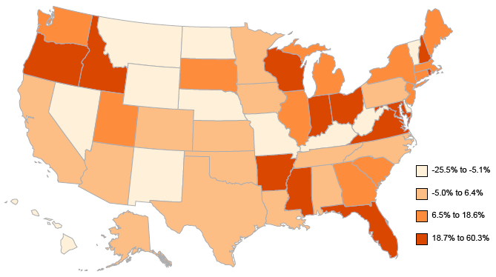
Poverty Percentage Gap Among People Ages 5 and Under with and without Disabilities, by State, 2016
Data Source: 2016 American Community Survey, American FactFinder, Table B18130
16
Notes:
For children under age 5, the poverty gap was highest in New Hampshire (60.3 percentage points), Arkansas (47.2), and Mississippi (42.6). For children ages 5 and under, fifteen states had a negative poverty gap (a higher percentage of those without disabilities were in poverty than those with disabilities).

Slide 17
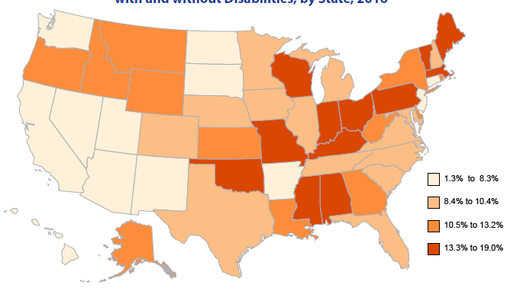
Poverty Percentage Gap Among People Ages 5-17 with and without Disabilities, by State, 2016
Data Source: 2016 American Community Survey, American FactFinder, Table B18130
17
Notes:
The poverty gap for those ages 5-17 with and without disabilities ranged from a low of 1.3 percentage points in Hawaii to 19 points in Maine.
There are nine states with a gap of at least 15 points and 26 with a gap of at least 10 points, meaning that in those states the poverty rates were 10-15 or more percentage points higher for those with disabilities than for those without disabilities.

Slide 18
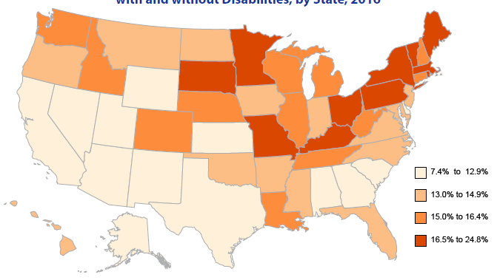
Poverty Percentage Gap Among People Ages 18-64 with and without Disabilities, by State, 2016
Data Source: 2016 American Community Survey, American FactFinder, Table B18130
18
Notes:
For people in the 18-64 year old working- age, the poverty gap between those with and without disabilities ranged from a low of 7.4 percentage points in Delaware to a high of 24.8 points in District of Columbia. Nearly half of the states (24) had gaps of 15 points or more. All but 3 states had gaps over 10 points or more.

Slide 19
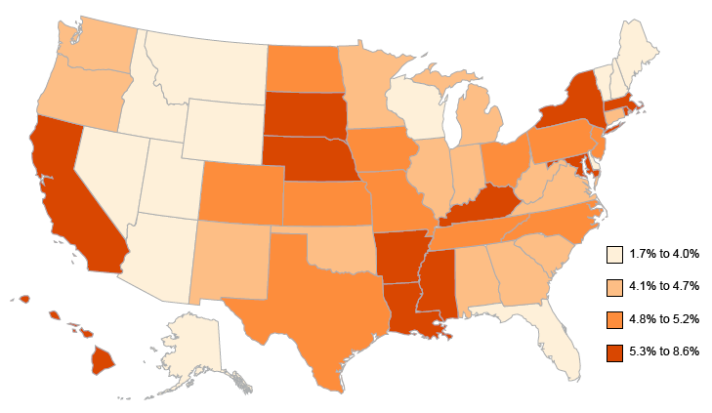
Poverty Percentage Gap Among People Ages 65 and Over with and without Disabilities, by State, 2016
Data Source: 2016 American Community Survey, American FactFinder, Table B18130
19
Notes:
Poverty gaps for those age 65 and over with and without disabilities had a low of 1.7 percentage points (Nevada) to 8.6 points (South Dakota) in 2016. Three states had gaps below 3 points (Nevada, Vermont, and Delaware).

Slide 20
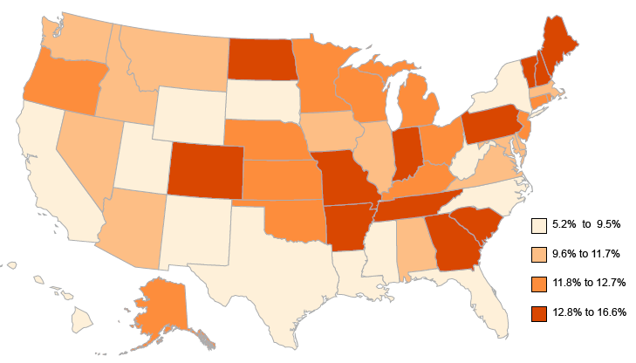
Smoking Percentages Gap Among People with and without Disabilities By State, 2016
Data Source: Authors' calculations using data from the 2016 Behavioral Risk Factor Surveillance Survey BRFSS *
20
Notes:
Turning now to health, the gap between smokers with and without disabilities by state in 2016 ranged from a low of 5.2 percentage points in South Dakota to a high of 16.6 points in Missouri. Thirty six states had a gap of 10 percentage points or higher; South Dakota was the only state to have a gap of 6 percentage points or lower.
*- Note that this data is from the Behavioral Risk Factor Surveillance System (BRFSS), which in 2016 changed the questions used measure disability to match those used in the American Community Survey (ACS).

Slide 21
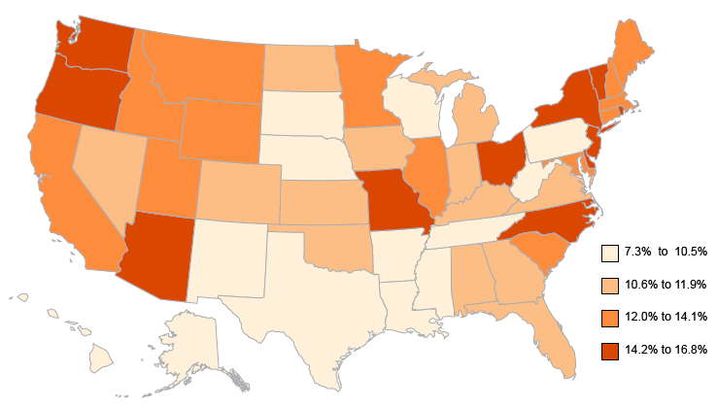
Obesity Percentages Gap Among People with and without Disabilities, by State, 2016
Data Source: Authors' calculations using data from the 2016 Behavioral Risk Factor Surveillance Survey BRFSS
21
Notes:
This slide shows that the gap in obesity percentages for states ranged from a high of 16.8% in Rhode Island to a low of 7.3% in Mississippi. Nine states had a gap under 10 percentage points while seven states had a gap of 15 points or more.

Slide 22
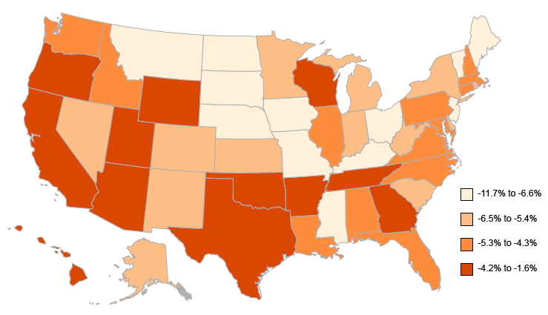
Binge Drinking Percentage Gap Among People with and without Disabilities, by State, 2016
Data Source: Authors' calculations using data from the 2016 Behavioral Risk Factor Surveillance Survey BRFSS
22
Notes:
This slide shows gaps in binge drinking for people with and without disabilities by state in 2016. Gaps in binge drinking for those ages 18 and over ranged from 11.7 points less (thus more people without disabilities binge drinking than those with disabilities) in District of Columbia to 1.6 points less in Utah. Twenty one states had a gap of less than 5 points.

Slide 23
For more information
Lewis Kraus
Center on Disability at the Public Health Institute
510-285-5600
lkraus@centerondisability.org
23

