Slide 1
Surveying the Landscape of Disability Data and Statistics:
A Toolkit for Interagency Collaboration
Radha Holavanahalli, PhD
NIDILRR Project Officer
Co-Chair of ICDR Subcommittee on Disability Statistics
March 28, 2024

Slide 2
Interagency Committee on Disability Research (ICDR)
The ICDR was authorized by the amended 1973 Rehabilitation Act to coordinate federal research efforts about disability, independent living, and rehabilitation research.
ICDR’s Vision: To have wide recognition for facilitating and coordinating federal interagency efforts and for promoting collaborative relationships that maximize the best use of federal resources for disability, independent living, and rehabilitation research.

Slide 3
ICDR Subcommittee on Disability Statistics
The ICDR Interagency Subcommittee on Disability Statistics (ISDS)
Formed in 1981 and met consistently through 2015
Served as integral part of several major disability statistics initiatives
Recently reestablished to coordinate/collaborate to advance the quality and availability of disability statistics.

Slide 4
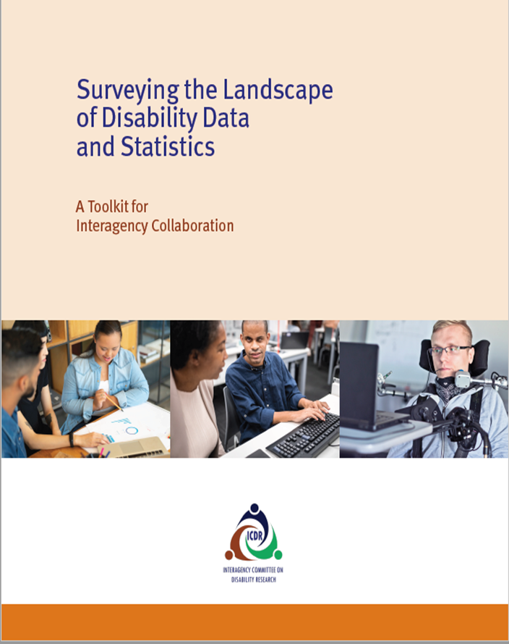
Disability Statistics Toolkit
Purpose of the Toolkit:
To outline the current federal landscape of disability data and statistics, with the intention of promoting interagency collaboration at the federal level.

Slide 5
Disability Statistics Toolkit Background
Over 40 pages of research and resources
Gaps in research on disability data and statistics
Ideas for future research and collaboration

Slide 6
Federal Resources and Research on Disability Data and Statistics
National Science Foundation
Social Security Administration
US Agency for International Development
US Department of Commerce
US Department of Education
US Department of Health and Human Services
US Department of Housing and Urban Development
US Department of Justice
US Department of Labor
US Department of Transportation
US Department of Veterans Affairs
US Environmental Protection Agency

