Slide 1
Changing Disability Landscapes: A Brief Overview

Slide 2
Historical perceptions and framing of disability

Slide 3
Parallels in Time Part One: The Ancient Era to the 1950’s
Source:
Minnesota Developmental Disabilities Council, Parallels in Time

Slide 4
Parallels in Time Part Two: 1950 to Today
Source:
Minnesota Developmental Disabilities Council, Parallels in Time

Slide 5
What’s Changed?
Our perceptions
Our language
Our scientific approaches
Our public policies
Our values

Slide 6
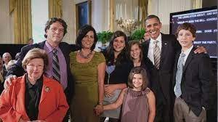
Modern Applications: Language
Rosa Marcellino and her family with President Barack Obama, and Senator Mikulski​
Image credit: Marcellino family
Notes:
Our language

Slide 7
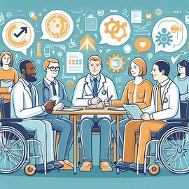
Modern Applications: Research
Image Credit: Idea Scale
Notes:
Research design and approaches

Slide 8
Modern Applications: Priorities
Source:
NIH Press Release 9/26/23
Source: NIDILRR Long Range Plan 2024-2028
Notes:
Federal agencies priorities, focus, and guidance

Slide 9
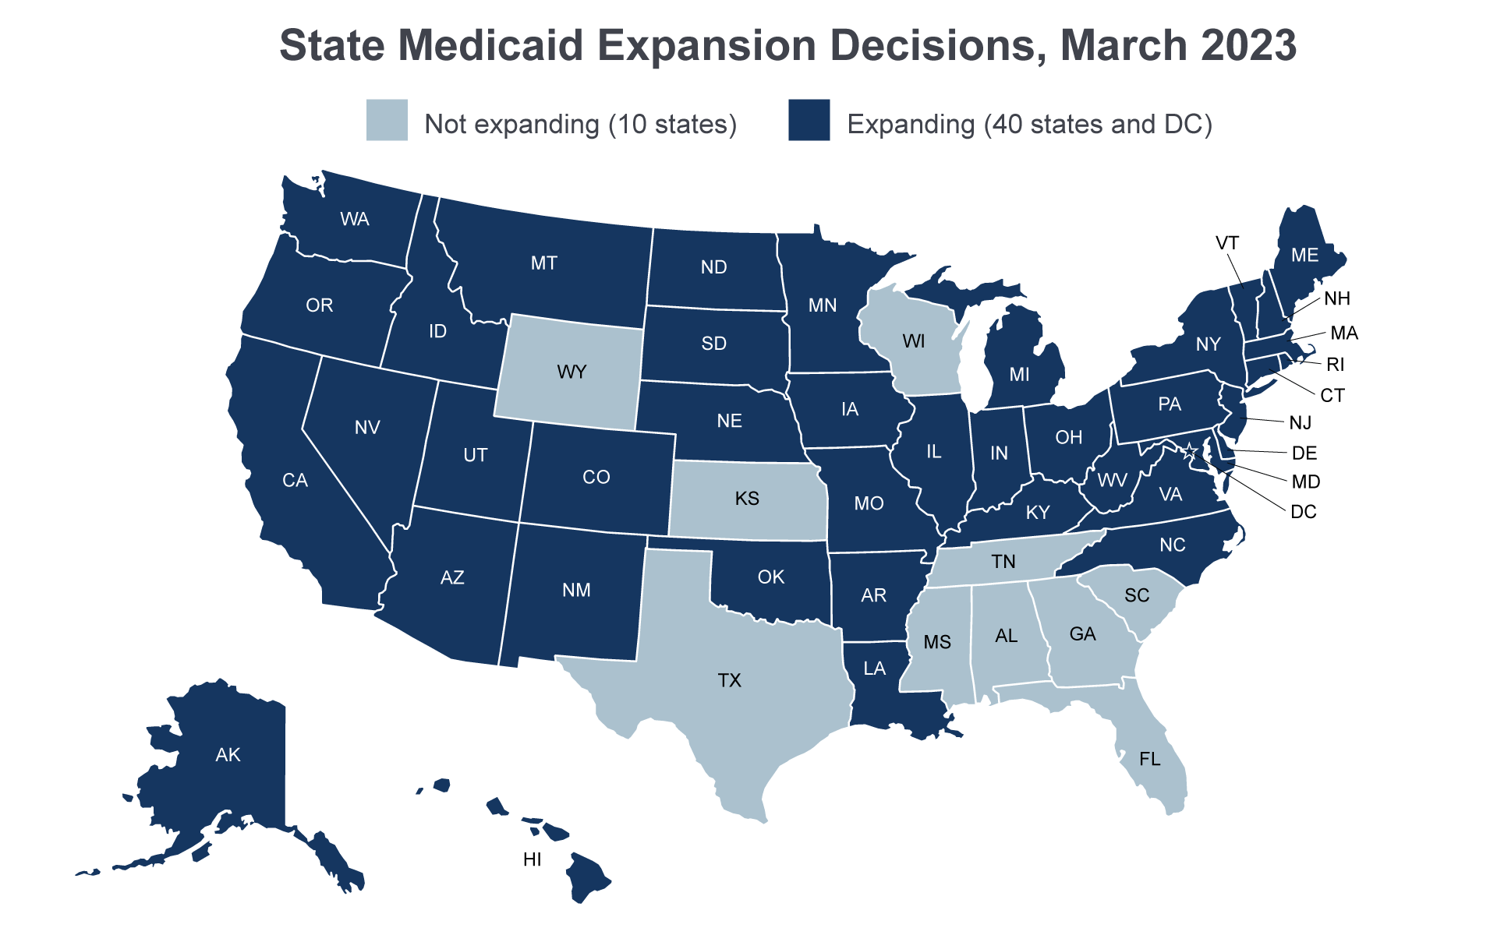
Modern Applications: Public Policies
State Medicaid Expansion Decisions, March 2023
Image credit & source: MACPAC
Image credit & source:
Special Needs Answers
Notes:
Federal policies

Slide 10
Competing Interests & Priorities
Do no harm
Inclusive and diverse approaches
Maximize benefit
Scientific rigor
Policy / Administrative rule application
Representation
Policy implications
Timeliness
Tax-payer and public benefit
Others?

Slide 11
What’s Your Role? Our Role?
Collaborative problem solving
Respectful listening and engagement
Shared learning
Transparent processes
Concrete and specific recommendations
Others?

Slide 12
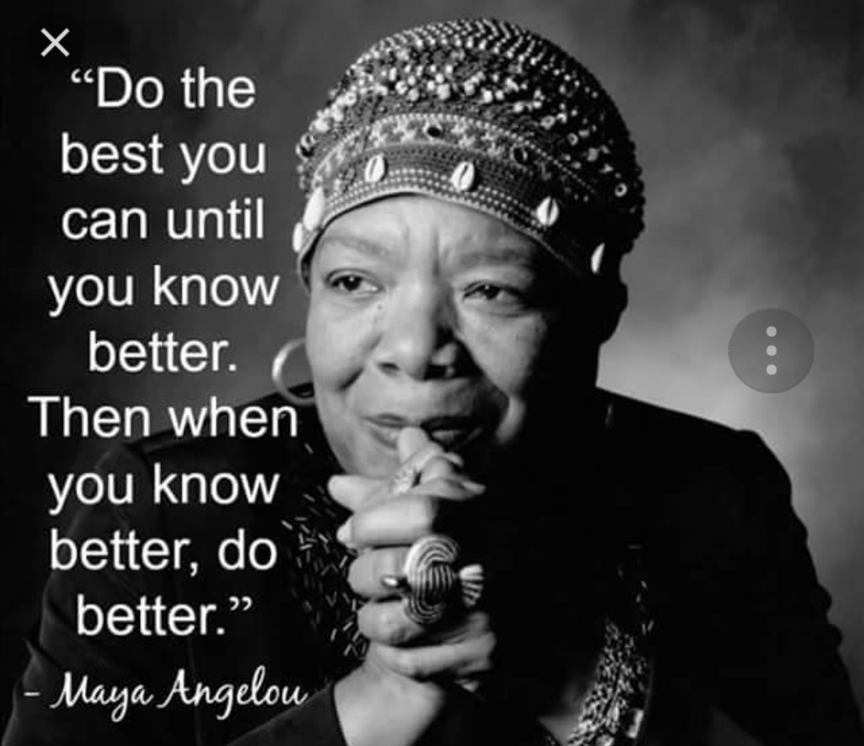
Maya Angelou Quote

Slide 13
Thank You
Kelly Nye-Lengerman, PhD, MSW
Director & Research Professor
Institute on Disability
Kelly.nye@unh.edu

