Slide 1
ADSC – Build Your Own Statistics
Nate Thomas, MS
Data Analyst | Research Associate II
Notes:
Hello - my name is Nate Thomas and I am a data analyst and research associate at the University of New Hampshire Institute on Disability. I will be summarizing some of the structural changes to the Disability Statistics Collection I’ve been honored to be a part of this year. The statistics presented are based on estimates for 2022

Slide 2
Objectives
Why a new Supplement, and with a name?
“Build Your Own Statistics” – Our goals for this new product
“Build Your Own Statistics” – A demonstration
“Build Your Own Statistics” – Some example findings
“Build Your Own Statistics” – Product Lifecycle: What is coming next?
Notes:
The objective of this presentation are to provide information about the new “Build Your Own Statistics” web interface:
Why a new Supplement, and with a name?
“Build Your Own Statistics” – Our goals for this new product
“Build Your Own Statistics” – A demonstration
“Build Your Own Statistics” – Some example findings
“Build Your Own Statistics” – Product Lifecycle: What is coming next?

Slide 3
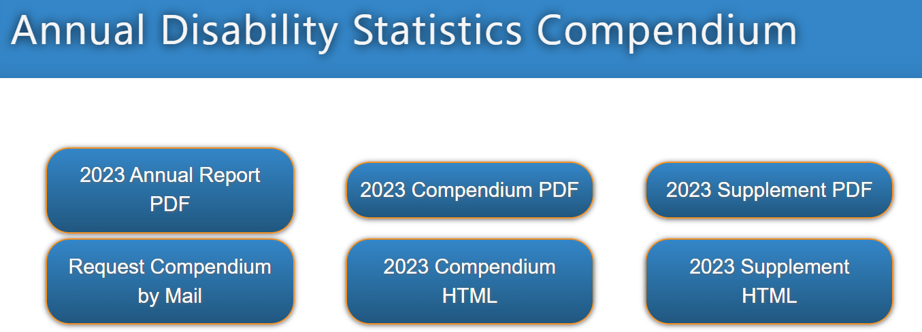
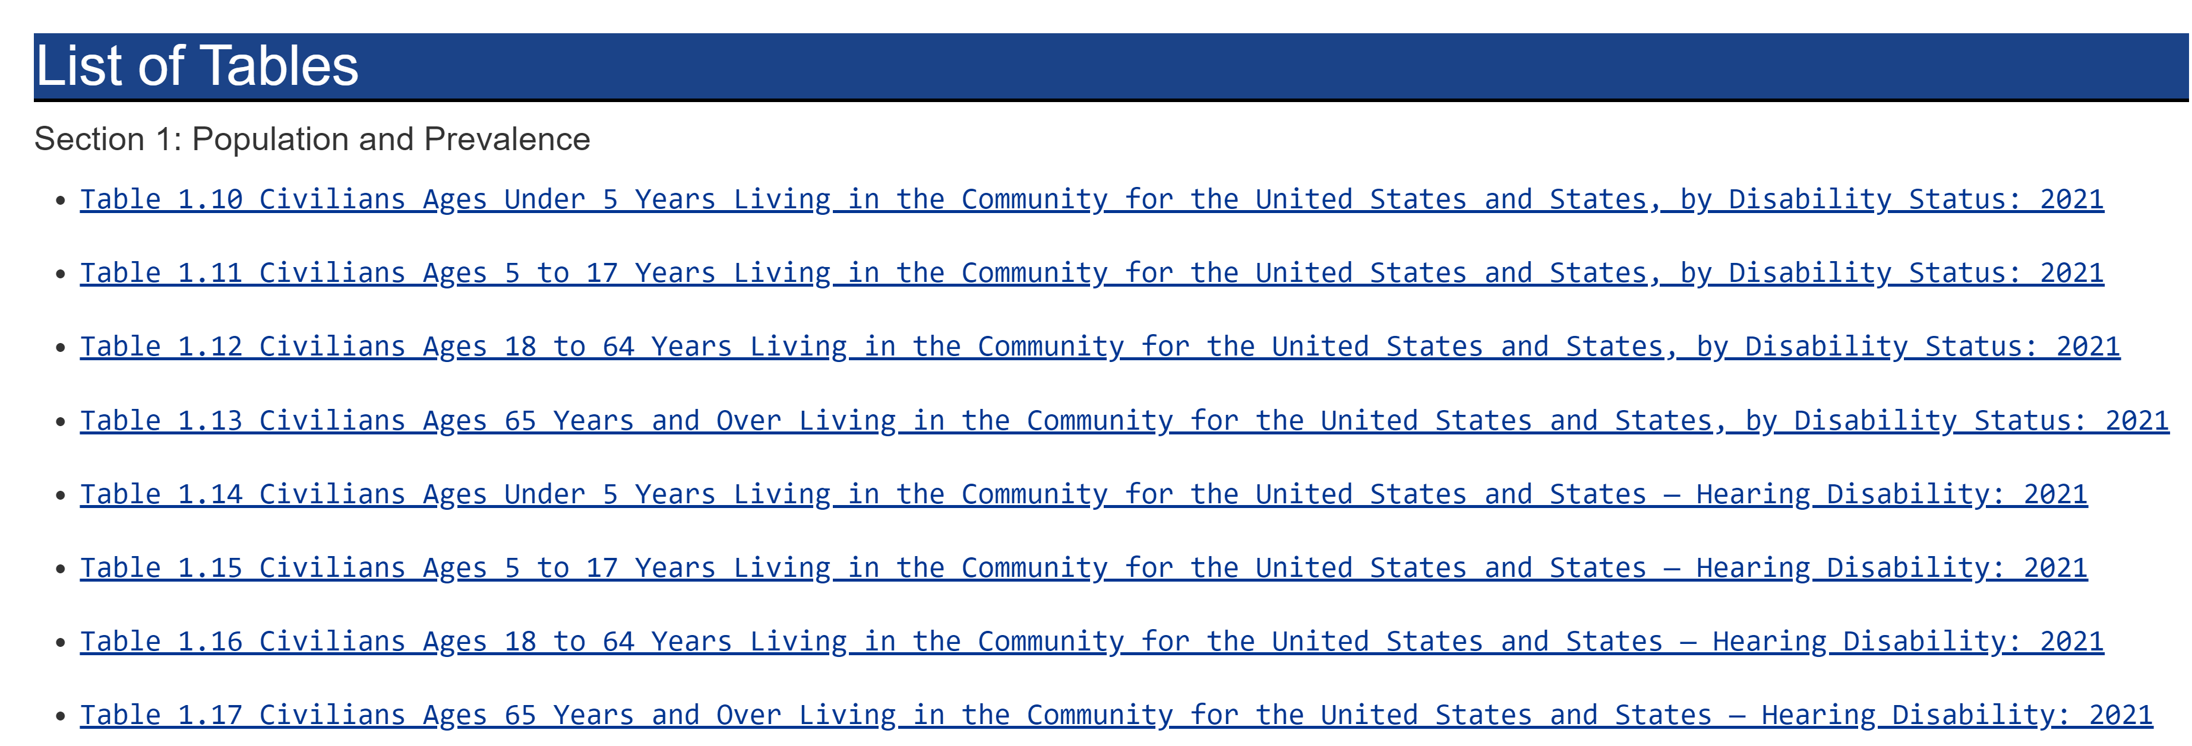
Why a new supplement, with a new name?
Notes:
The existing supplement had the following characteristics we wanted to maintain: (1) depth of information; (2) consistent table naming conventions; (3) consistent table structure/content to the Annual Disability Statistics Compendium. This allowed someone familiar with the Compendium, to investigate various measures by diving deeper (disaggregating) along multiple characteristics, including disability, age group, race/ethnicity, and sex. – so: “If it’s not broken don’t fix it…”

Slide 4
Build Your Own Statistics – Tables
Greater disaggregation
User-led investigation
Improved HTML structure
Sample size and margin of error
Intuitive comparisons
Notes:
But we wanted to provide (1) greater disaggregation, (2) a web interface with user-led investigation, (3) HTML table structure to facilitate screen-reader application users (4) context of the statistics presented (margins of error, and sample size), and (5) comparison of these measures to the negation population set (those without disability/the disability type in question) for intuitive comparison.

Slide 5
Build Your Own Statistics
https://www.researchondisability.org/collection/2024/build-stats
Notes:
This is the link to the Build Your Own Statistics data communication product. I’ll be demonstrating how to navigate the web interface.

Slide 6
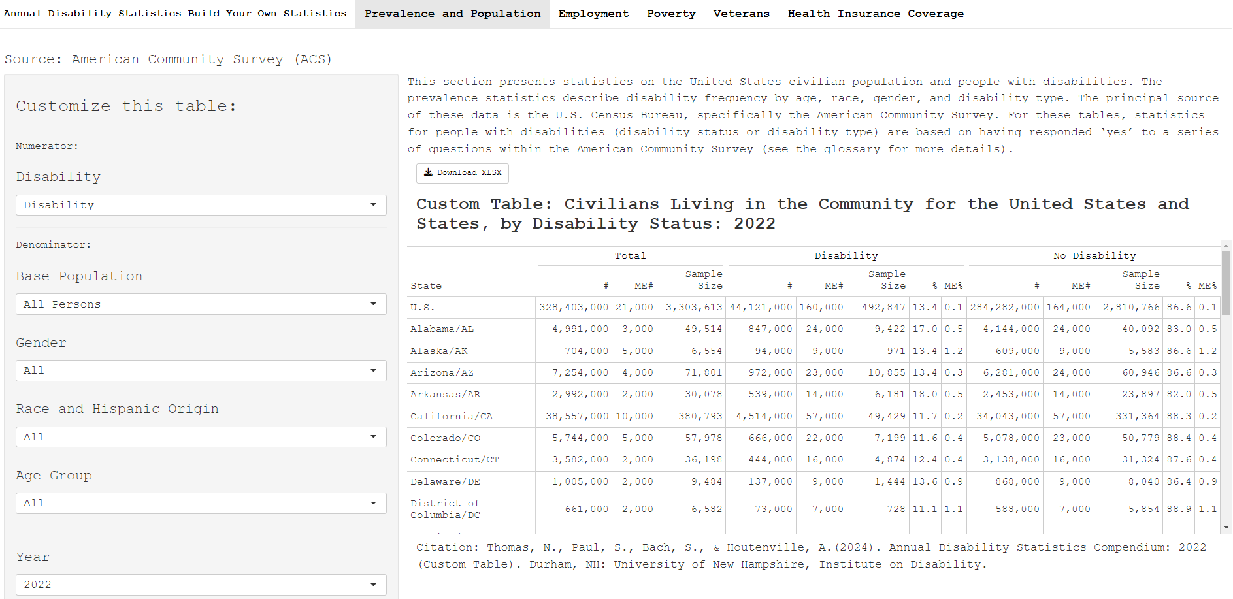
The Interface
Notes:
This is an image of the Build Your Own Statistics interface; this is included in the presentation slides to ensure the information is contained within this deck. The live presentation will include a short demonstration of the interface.

Slide 7
The Interface: Measurement Category
Notes:
In this initial release, dashboard tabs allow users to select a measurement category: “Prevalence and Population”, “Employment”, “Poverty”, “Veterans”, and “Health Insurance Coverage”

Slide 8
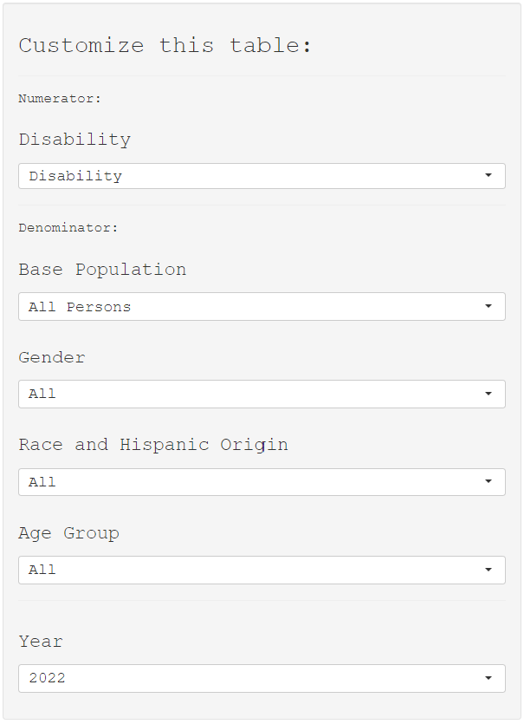
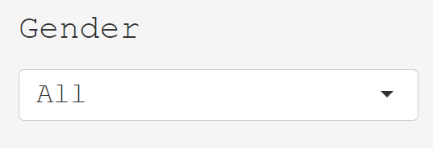
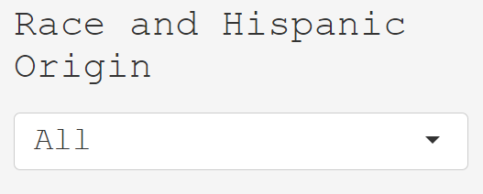
The Interface: Selections and Filters
Notes:
Within the “Prevalence and Population” tab to "Customize this table" one can select a numerator ("Disability" is selected), a denominator ("All Persons" is selected), and domain filters for gender, race and Hispanic origin, age group and year. One can “zoom in” or out using these filters

Slide 9
Ex. Prevalence of Ambulatory Disability – within Gender, Race, and Age Group
Group | Ambulatory Disability Prevalence (%)
Non-Hispanic Asian Female Civilians Ages 5 to 17 Years Living in the Community, in the U.S. | 0.3 ± 0.2
Non-Hispanic Asian Female Civilians Ages 18 to 64 Years Living in the Community, in the U.S. | 1.8 ± 0.1
Non-Hispanic Asian Female Civilians Ages 65 Years and Over Living in the Community, in the U.S. | 21.9 ± 0.8
Notes:
As an example of the type of analysis the tool provides.

Slide 10
Ex. Poverty of People with Disabilities – within Gender, Race, and Age Group
Group | Poverty (%) | RR_{No S.C. Dis.} (L95%CI)
Non-Hispanic Asian Female Civilians Ages 45 to 54 Years Living in the Community, in the U.S. | 18.0 ± 2.9 | 2.9 (1.9)
Non-Hispanic Asian Female Civilians Ages 55 to 64 Years Living in the Community | 15.7 ± 2.7 | 2.1 (1.6)
Non-Hispanic Asian Female Civilians Ages 65 Years and Over Living in the Community | 17.7 ± 1.3 | 1.4 (1.2)
Note: RR_{No S.C. Dis.}is the relative ratio of poverty rate within the group with disability type, compared to the poverty rate within group without the disability. This is the estimated increased likelihood of living in poverty for people with disability type compared to peers without disability type.
Notes:
As an example of the type of analysis the tool provides. Note: RR_{No S.C. Dis.}is the relative ratio of poverty rate within the group with disability type, compared to the poverty rate within group without the disability. This is the estimated increased likelihood of living in poverty for people with this disability type compared to their peers. The reduction in relative ratio is determined by the increase in poverty for people without disability with respect to age.

Slide 11
Build Your Own Statistics – Accessibility
Incorporated Considerations:
Keyboard (tab) accessible tables
Unique row & column HTML IDs
Text size – dynamic resizing with browser
Typical data filter controls
Downloadable as .xlsx file

Slide 12
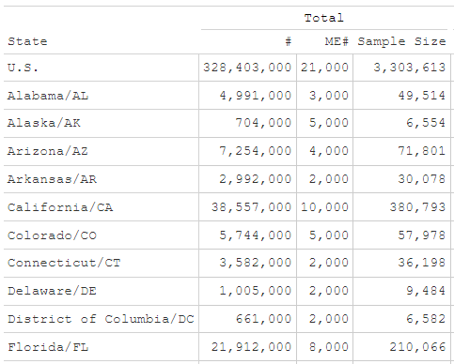
Build Your Own Statistics – Lifecycle
Notes:
This is a brand-new release, with greater versatility; the development process is ramping into the feedback collection and continuous improvement phase. In collaboration with native screen-reader users we’re looking into ways to improve the readability of tables with column category spanning labels, as seen here. We are committed to ensuring our statistics are usable and accessible to the community and are working on code-based solutions to ensure an intuitive user experience. These column spanners are in a continuous improvement and evaluation phase to ensure usability.

Slide 13
Build Your Own Statistics – Lifecycle
Potential Expansions and Improvements:
More measures (ex. earnings, housing cost burden, etc.)
Greater granularity – increased filtering options
Intersections of disability types (ex. difficulty seeing and hearing)

Slide 14
Contact Information
Nate Thomas
Nate.Thomas@unh.edu
Institute on Disability
University of New Hampshire
10 West Edge Drive, Suite 101
Durham, NH 03824
Website: www.disabilitycompendium.org
Technical Assistance: disability.statistics@unh.edu
866-538-9521
Build Your Own Statistics questions: Nate.Thomas@unh.edu

Slide 15
Thank you

