Slide 1
2024 Annual Disability Statistics Compendium
Shreya Paul

Slide 2
Objectives
Background
Introduce the Compendium
  New – Build your own statistics web interface
  New – Margin of errors
  New – Relative ratios
How to access the Compendium and the technical assistance
2024 Statistics

Slide 3
Background
In the U.S. disability statistics are often difficult to find or scattered across multiple sources.
The Compendium and the expanded tables aim to compile all these statistics in one place.
Accurate, reliable, accessible, nationally representative source of disability statistics.
Counting people with disabilities is essential for allocating public funds to programs.

Slide 4
The Annual Disability Statistics Collection
The Annual Disability Statistics Compendium
The Annual Report on People with Disabilities in America
“Build your own statistics” Web Interface
Three Infographics
Experience of People with Disabilities in Rural America
Social Inequities Experienced by African Americans
Disability Experiences of Veterans Ages 18-64

Slide 5
The Annual Disability Statistics Compendium
A collection of important information about people with disabilities in each state of the United States
It includes data from multiple government agencies and programs.
The Compendium gathers these statistics together, making it easy for everyone to find and use.

Slide 6
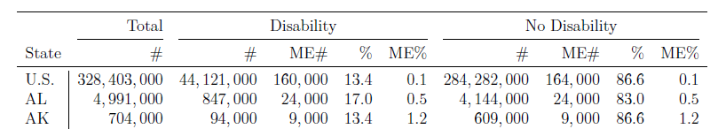
New - Tables feature Margin of Errors (ME)
Understanding how many people are in a group is important, but it’s also important to know how certain we are about that information.
Survey data relies on sampled responses for population prediction.
Margin of error that can be used to calculate the range of numbers possible for any single estimate.
For example, the larger the margin of error, the more likely it is that our best guess is higher or lower than the true number.
Notes:
Survey data rely on the answers of some people to predict the total population in each group. For this reason, all statistics are estimates or best predictions.
The margin of error can help you understand the uncertainty in the collected information.

Slide 7
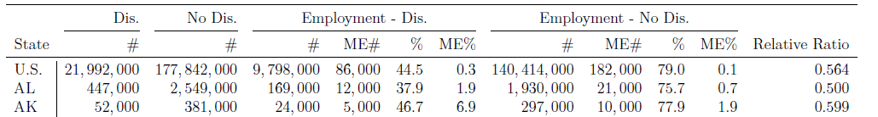
New - Some tables feature relative ratios
Makes comparison between two groups (people with and without disabilities) clearer
Relative ratios make it easier to compare groups of different sizes.
If the relative ratio is higher than one, in the Compendium, this generally means that a bigger group of people with disabilities are experiencing something compared to people without disabilities.

Slide 8

New – Build Your Own Statistics
A web interface that lets you build customized tables.
Link -
https://www.researchondisability.org/collection/2024/build-stats

Slide 9
The Website
www.disabilitycompendium.org
Download our products
Request copies by mail
Contact us

Slide 10

Accessibility Efforts
Use of Plain Language
Screen-reader-friendly HTML

Slide 11

Population and Prevalence 2022
For the United States
Resident Population – 333, 288, 000
Civilian Living in the Community –
328, 403, 000
Civilians with Disabilities Living in the Community –
44, 121, 000 (13.4%)
Civilians without Disabilities Living in the Community – 284, 282, 000 (86.6%)

Slide 12
Percent of People with Disabilities in the US by Disability Type: 2022

Slide 13
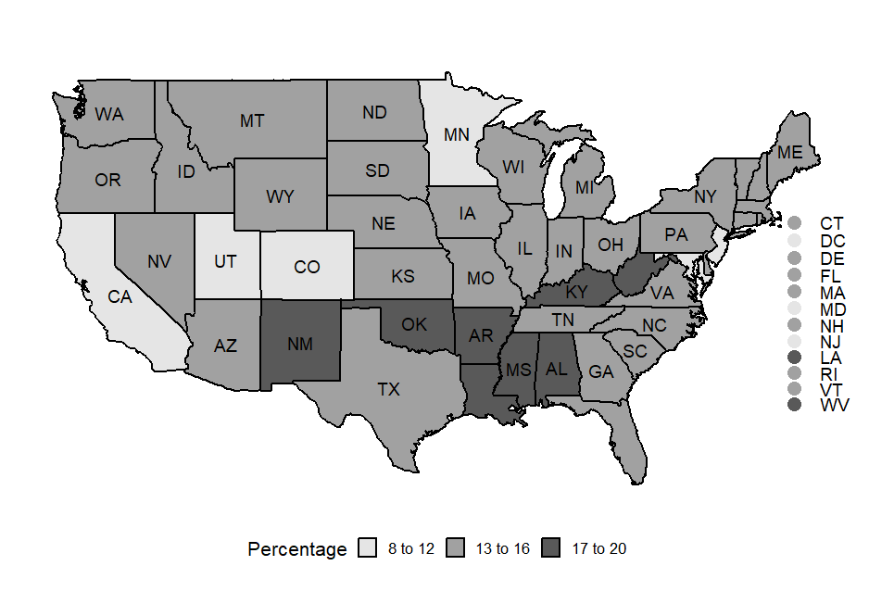
Percent of People with Disabilities by State
Notes:
The states with the highest prevalence (17 to 20 %) are New Mexico, Oklahoma, Arkansas, Louisiana, Mississippi, Alabama, Kentucky, and West Virginia.
The states with the lowest prevalence ( 8 to 12 %) are California, Utah, Colorado, and Minnesota.
The rest of the states in the continental US fall into a mid-range of 13 to 16 percent prevalence.

Slide 14





In 2022, for individuals with disabilities ages 18-64 years living in the community
5,469,000 individuals with disabilities were living in poverty (24.9%).
9,798,000 individuals were employed (44.5%)
For full-time, full-year workers with disabilities, median earnings were $46,904
90.5% of individuals with disabilities had health insurance coverage

Slide 15
Contact Information
Shreya Paul
Shreya.Paul@unh.edu
Institute on Disability
University of New Hampshire
10 West Edge Drive, Suite 101
Durham, NH 03824
Website: www.disabilitycompendium.org
Technical Assistance: disability.statistics@unh.edu
866-538-9521

Slide 16
Thank You

