Slide 1
2024 Annual Report on People with Disabilities in America
Andrew Houtenville

Slide 2
Background
Tracking Key Indicators: Informed by the National Council on Disability (NCD) report from 2008, calling for monitoring the status of people with disabilities.
Time Trends: Each year, looking to make a “call” each year on whether we observe statistically significance improvement.
Every 2019 to 2021 call reported below is statistically significant!
Gaps: Focus on the “gaps” between people with and without disabilities.
Data Source: American Community Survey (ACS) Public Use Microdata Sample (PUMS)

Slide 3
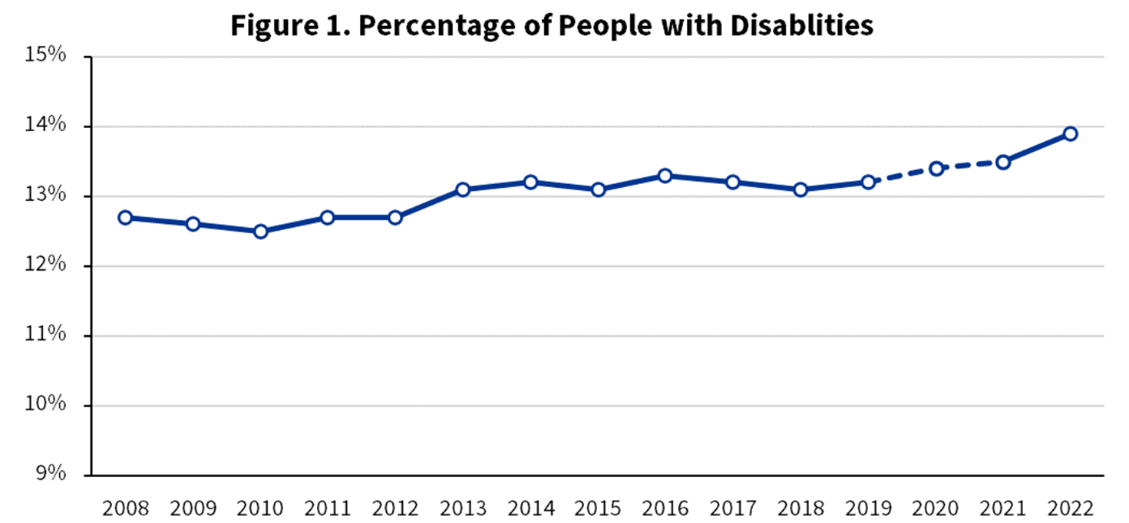
The “Call” … Reporting a Disability(ies)
13.9
13.5
12.7

Slide 4
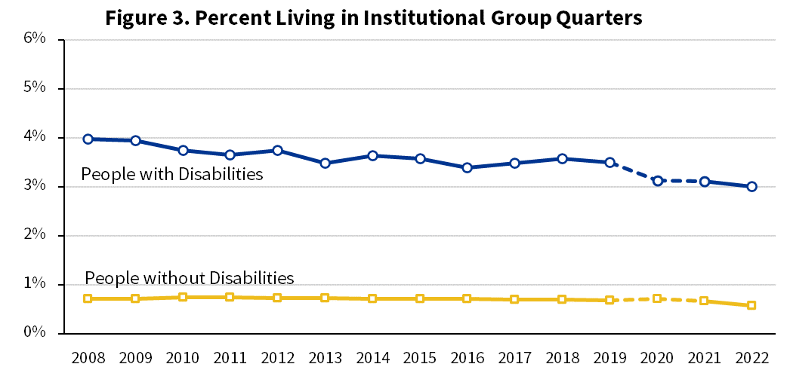
The “Call” … Living in Institutional GQ

Slide 5
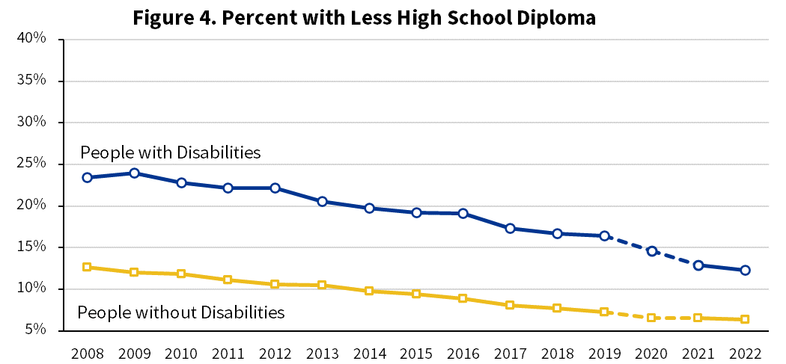
The “Call” … Less than High School Diploma

Slide 6
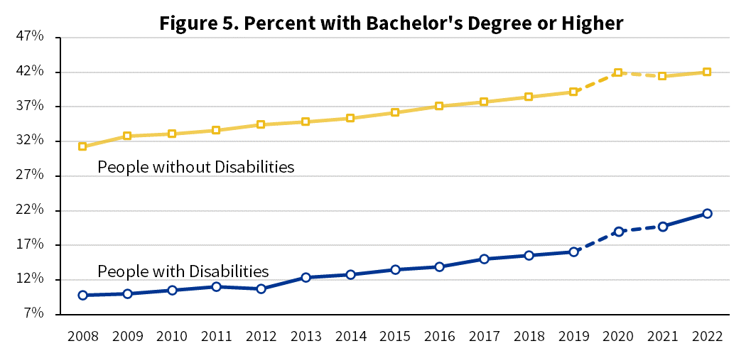
The “Call” … Bachelors Degree or Higher

Slide 7
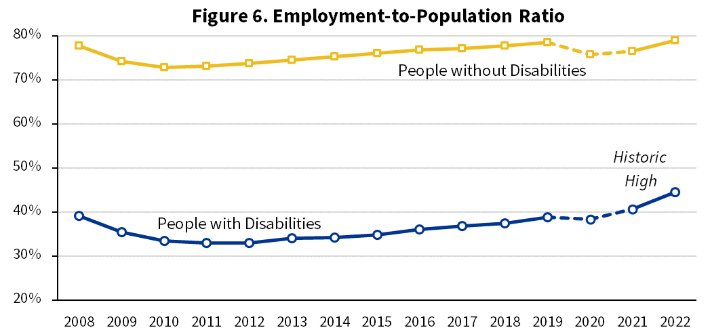
The “Call” … Employment
76.9
44.5
40.7
39.1

Slide 8
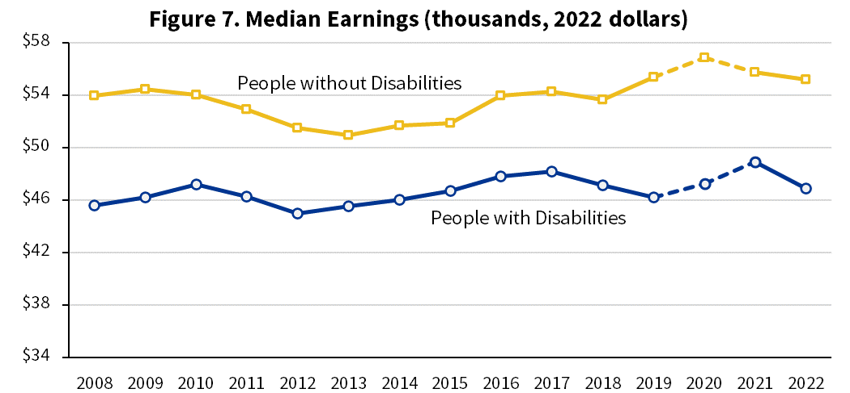
The “Call” … Earnings from Work (FT/FY)
$55,208
$48,940
$46,887

Slide 9
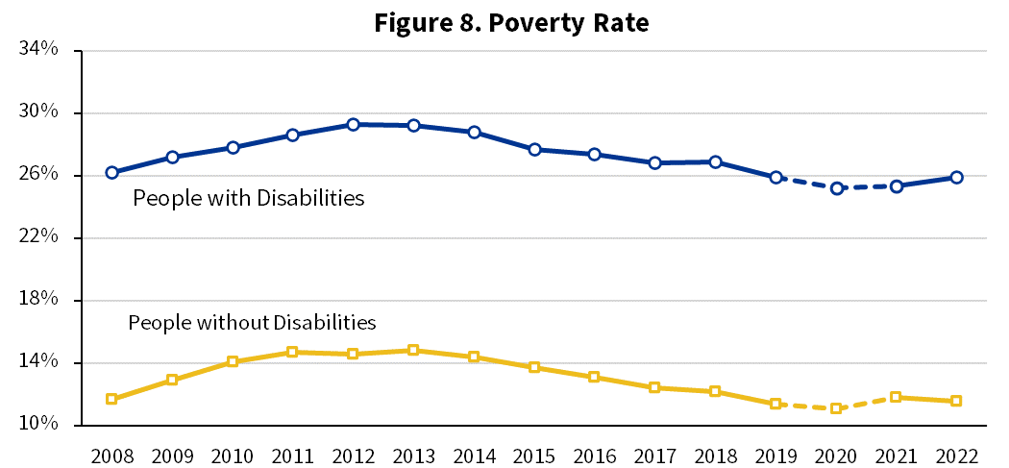
The “Call” … Poverty

Slide 10
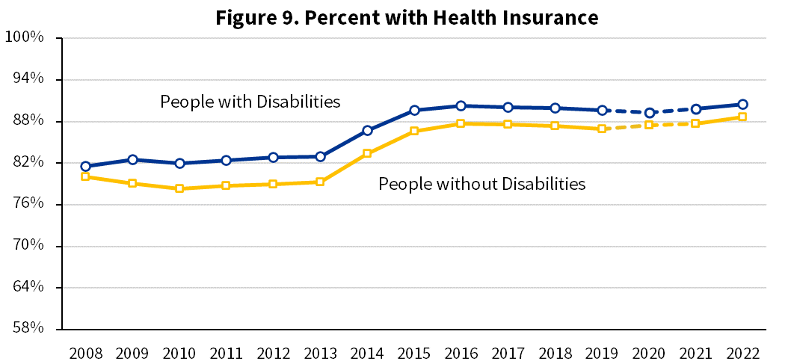
The “Call” … Health Insurance

Slide 11
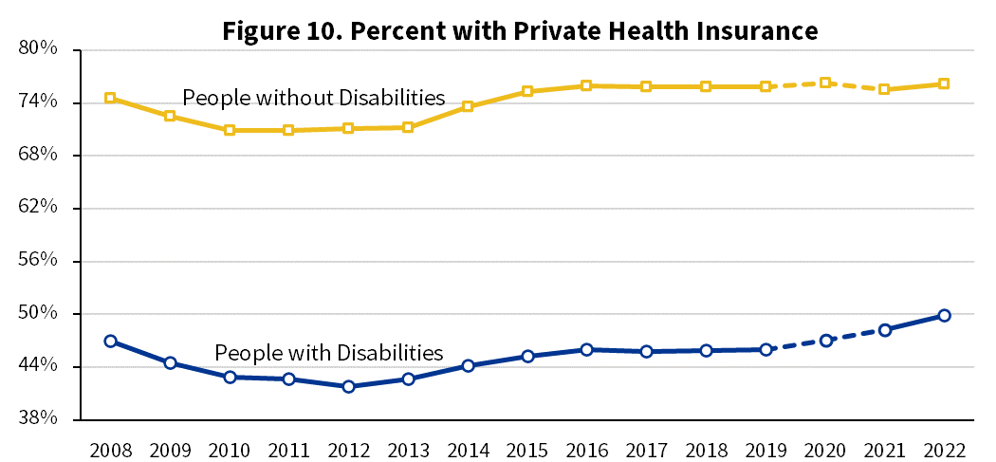
The “Call” … Private Health Insurance

Slide 12
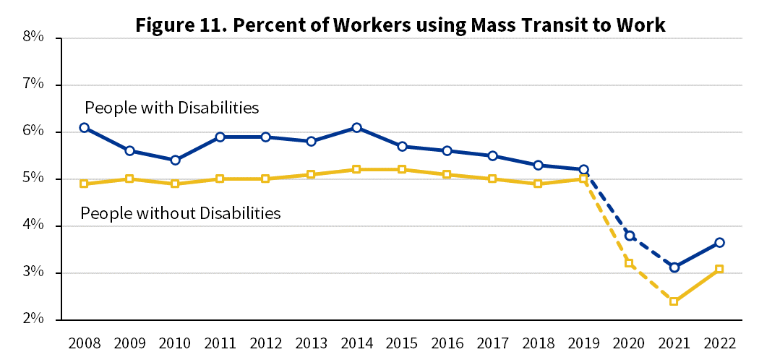
The “Call” … Workers using Mass Transit

Slide 13
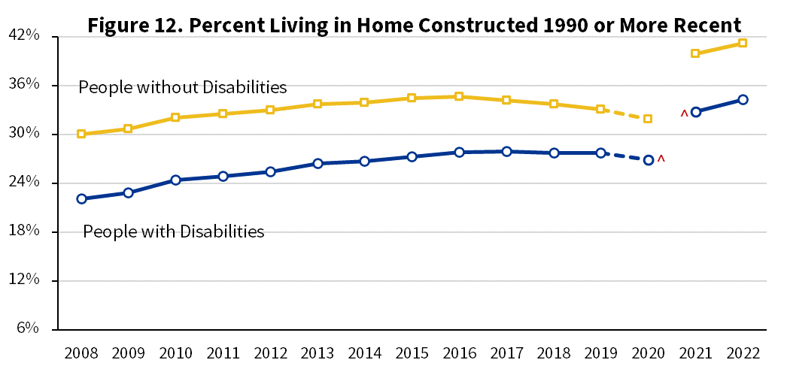
The “Call” … Living in Recently Built Home

Slide 14
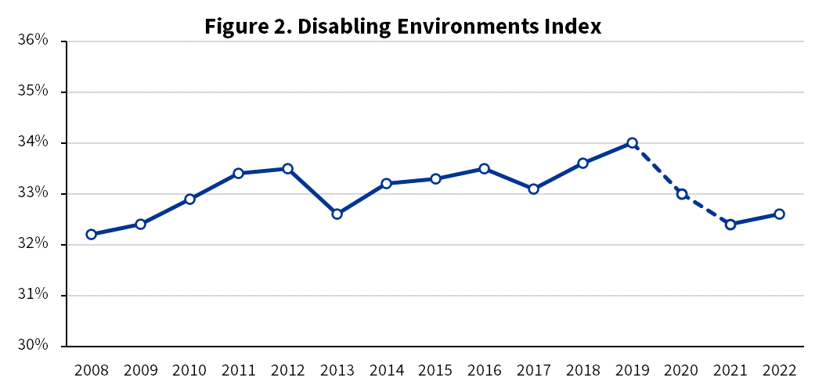
The “Call” … Disabling Environments Index
34.2
32.6
32.4

Slide 15
The “Call” … … … Next Year
Any Requests?

