Slide 1
Longitudinal Trends in In-home and Residential LTSS for People with IDD from the Residential Information Systems Project
February 12, 2019
Sherri Larson larso072@umn.edu
Citation: Larson, S.A., Eschenbacher, H.J., Anderson, L.L., Taylor, B., Pettingell, S., Hewitt, A., Sowers, M., & Bourne, M.L. (2018). In-Home and Residential Long-Term Supports and Services for Persons with Intellectual or Developmental Disabilities: Status and Trends through 2016. Minneapolis: University of Minnesota, Research and Training Center on Community Living, Institute on Community Integration.
Disclaimer: Preparation of this presentation was supported, in part, by cooperative agreement (90DNPA0001-01) from the US Health and Human Services, Administration on Community Living. Grantees undertaking projects under government sponsorship are encouraged to express freely their findings and conclusions. Points of view or opinions do not, therefore necessarily represent official AIDD policy.
Notes:
Longitudinal data collection for the RISP project began in 1977 with a national census of living arrangements of people with IDD served by state IDD systems.
A second census was conducted in 1982.
AIDD has funded the project continuously since 1988.

Slide 2
Long-term Supports and Services Dimensions FY 2016
Age (LT 22 years)
39% Nationally
Range: 0% (RI) to 65% (AZ)
Operating Entity
(State vs Non-state)
94% of people not living with family members lived in nonstate settings
Setting Type
(Own home, family home, host/foster home, group homes, institutions)
58% lived with a family member
Range: 8% in MD to 87% in AZ
Funding Authority
(State only; Medicaid: State Plan, Waiver, ICF/IID)
92% of Waiver + ICF/IID recipients got Waiver services, Range: 74% in AK to 100% (7 states)
Setting Size
(1-3, 4-6, 7-15, 16+)
82% not living with a family member live in settings of 6 or fewer people
Range: 42% (IL) to 100% (VT)
Notes:
The RISP project tracks long-term supports and services for people with IDD along 5 key dimensions: operating entity, setting type, funding source, setting size, and recipient age.
Operating entity
Historically, most LTSS services were provided in state-operated settings but by 2016, only 6% of the people living in settings other than with a family member were in a state operated setting. The range was from 0% in 10 states to 61% in Mississippi (Table 1.9).
Setting type
The RISP project monitors LTSS provided in six types of settings: the home of a family member, the person’s own home, a host or foster family home, a group home or an IDD or generic institution. In 2016, 58% of LTSS recipients with IDD lived with a family member. States ranged from 8% in MD to 87% in AZ. A very high proportion of recipients in AZ were children (Figure 1.2)
Funding authority
Several different Medicaid funding authorities are used to fund LTSS for people with IDD. In 2016, of the 882,076 people receiving Medicaid ICF/IID or Waiver funded supports, 92% received Waiver funded supports (Table 2.13). Range: 74% in AK to 100% in 7 states.
Setting size
The RISP project tracks the size of non family residential settings in four broad categories: 1 to 3 people, 4 to 6 people, 7 to 15 people and 16 or more people. The CDC tracks the proportion living in institutions of 7 or more people for HP 2030. In 2016, 82% of people not living with a family member lived in settings of 6 or fewer people (56% lived with three or fewer people). The range was from 42% in IL to 100% in Vermont (Figure 1.4)
Age
In 2016, 39% of LTSS recipients with IDD were 21 years or younger. The proportion ranged from 0% in Rhode Island to 65% in Arizona (Table 1.2)

Slide 3
Why RISP?
Annual updates on living arrangement for long-term supports and service (LTSS) recipients with IDD
Longitudinal trends in deinstitutionalization, provision of LTSS funding to people living with family members, and utilization of Home and Community Based residential settings.
Shows state-to-state variation
Informs policy development, progress monitoring and advocacy
Provides a context for research
Notes:
RISP data are used to
track deinstitutionalization and community supports,
advocate systems changes,
Inform policy decisions by Congress, State Legislatures, Federal and State Agencies and the courts.

Slide 4
IDD Prevalence Rates
0 to 17 years 6.99%
(ID, ASD, Developmental Delay, Zablotsky et al, 2017)
18+ years 0.79%
(ID, DD or Both,
Larson et al., 2001)
Notes:
Prevalence rates differ between children and adults because different data sources were used and because those sources included slightly different groups of people. For children, the estimate included children with ID, ASD and developmental delays. For adults, the estimate includes those with ID, or with DD as defined in the DD Act of 2000 (a stricter criteria than used for children)
The estimate is based on
the number of adults and children in the US from the 2016 census,
prevalence estimates for intellectual or developmental disabilities in adults from the 1994/95 National Health Information Survey – Disability Supplement (NHIS-D; Larson et al., 2001),
prevalence estimates for ID, ASD and other developmental delays in children from the 2016 NHIS (Zablotsky et al, 2017), and
RISP data on people with IDD in congregate settings (those people are not included in the NHIS sample).
This prevalence estimate is higher than previously reported because the current prevalence estimates for children use a broader definition of DD than in the past.

Slide 5
Proportion Children 21 years or younger vs Adults with IDD in 2016
Notes:
Of the US population, 23% (73.6 million) are children; 77% are adults
Of people with IDD, 70% (5.2 million) are children and 30% are adults.
Of people with IDD served known to state IDD systems, 39% (576 thousand) are children, 61% are adults
Of people with IDD in congregate settings of 4+ people, 6% (16 thousand) are children, 94% are adults.
State IDD agencies know of or serve 41% of all adults with IDD but only 11% of children with IDD.

Slide 6
Service Recipients by Residence Type and Size in 2016
Notes:
Of the 513,790 people who lived in a setting other than with a family member,
56% lived in settings of 3 or fewer people,
26% lived in settings of 4 to 6 people,
10% lived in settings of 7 to 15 people, and
3% lived in settings of 16 or more people

Slide 7
LTSS Recipients with IDD Living with a Family Member by State on June 30, 2016
US Average 58%
Range: Maryland 8% to Arizona 87%
Notes:
58% of people who receive long-term supports and service live with family members
Factors associated with state differences
Extent to which state plan HCBS services are used and reported in the RISP survey
Target population – states that do not serve kids through the IDD agency serve fewer people living in the home of a family member.

Slide 8
Medicaid ICF/IID and Waiver Recipients with IDD 1982 to 2016
Notes:
The transition from institutional to HCBS settings as the predominant model for people with IDD happened in 1995.
The number of people with IDD living in institutional ICF/IID settings declined from 140,752 in 1982 to 74,614 in 2016.
The number of people with IDD receiving Medicaid LTSS funded by a Medicaid waiver increased from1,381 in 1982 to 907.462 in 2016.

Slide 9
Waiver Recipients vs People with IDD Waiting for Waiver Funding 1996 to 2016
Notes:
As the number of Medicaid Waiver recipients increased from 291,255 in 1996, to 807,462, the number of people waiting for Medicaid waiver funding also increased (from 87,187 to 193,828.
The proportion of those waiting to those receiving services declined from 30% in 1996 to 24% in 2016.

Slide 10
Per Person Medicaid Expenditures by Age and Residence Type FY 2016
Notes:
There are dramatic differences in the average annual per person Medicaid Expenditures by setting type and age.
The average annual per person costs for children was $17,404 for Waiver recipients versus $117,7114 for those in ICF/IID settings.
The average annual per person costs for adults were much higher - $52,918 for Waiver recipients and $142,499 for those in ICF/IID settings.
For waiver recipients alone there were also clear differences in per person annual expenditures based on where the recipient lived.
The average annual per person Waiver expenditures for children were $13,831 for children living with family members vs $37,360 for children living in any other type of setting.
Adults were more expensive regardless of setting type.
The average annual per person Waiver expenditures for adults living with a family member was $26,486 versus $72,224.
Several factors contribute to these differences.
People living with family members rarely receive 24 hour paid supports. Most often family members provide a substantial portion of the daily supports needed.
Waiver recipients living in other settings were less expensive than those living in ICF/IID settings because the ICF/IID program is a one size fits all program with fixed per person costs regardless of variation in individual needs within a setting.
Children are less expensive than adults because they are eligible to receive free educational services. The costs of educational services is not included in these cost estimates.

Slide 11
People with IDD in Large State-Operated Residential Facilities 1880 to 2016
Notes:
The number of people with IDD living in state-operate IDD facilities increased from 2,429 in the 1880 census to 194,650 in 1967 (47% of whom were children). By 2016, the total had declined to 19,502 people (4% of whom were children). The number of people with IDD living in state operated facilities in 2016 was the lowest it had been since 1910.
In 2016, a total of 39,705 people with IDD lived in institutional settings of 16 or more people (Table 1.9).
In 2016, an estimated 15,712 children ages 21 years or younger lived in congregate settings of 4 or more people (Table 1.12).

Slide 12
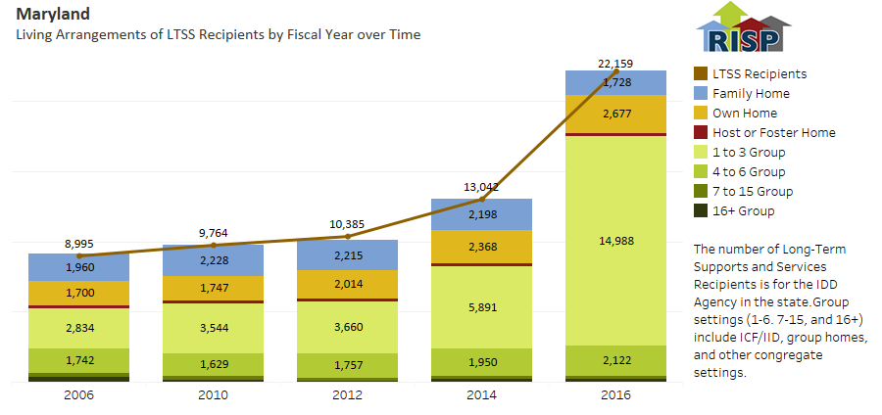
RISP Online Resources: Annual Reports, Interactive Visualizations and State Profiles (https://risp.umn.edu/)

Slide 13
Infographics: Closures of State IDD Facilities
Notes:
The total number of state operated IDD facilities of 16 or more people declined from 327 in 1977 to 140 in 2016.
In 1977 there was at least 1 facility in each of the 50 states plus the District of Columbia.
By 2016, 15 states had closed all of their large state-operated institutions (Alabama, Oklahoma, New Mexico, Oregon, Alaska, Hawaii, Minnesota, Michigan, Indiana, West Virginia, the District of Columbia, Rhode Island, Vermont, New Hampshire, and Maine).
Eight states had not closed any large state-operated IDD institutions (Idaho, Colorado, Wyoming, Nebraska, Iowa, Mississippi, South Carolina and New Jersey).

Slide 14
RISP Staff and Contact Information
Project staff
RISP MN: Sheryl Larson (Principal Investigator), Heidi Eschenbacher, Lynda Anderson, Sandy Pettingell, Kristin Dean, Jonathan Walz, Shawn Lawler, John Westerman, Sarah Hollerich
HSRI: Brittany Taylor, Yoshi Kardell, John Agosta
NASDDDS: Mary Lee Fay, Mary Sowers, Mary Lou Bourne
Website: https://risp.umn.edu/
Email address risp@umn.edu
Research and Training Center on Community Living Institute on Community Integration (UCEDD) University of Minnesota, Twin Cities
214 Pattee Hall, 150 Pillsbury Drive SE
Minneapolis, MN 55455

