Slide 1
National Trends in Disability and Employment (nTIDE) Elaine Katz, Kessler Foundation John O’Neil, Kessler Foundation Andrew Houtenville, UNH February 12, 2019
#nTIDELearn

Slide 2
The nTIDE Story
#nTIDELearn
A Reporter’s Mistake – Getting It Right
Brainstorming a New Concept
Dissemination
Social Media
Webinar – “nTIDE Lunch and Learn”

Slide 3
The Monthly nTIDE Report
#nTIDELearn
The monthly nTIDE Report is a press release and infographic, looking at the latest employment statistics.
Uses data from the “jobs report” released by the U.S. Bureau of Labor Statistics, on the 1st Friday of each month.
Joint effort of Kessler Foundation and UNH.

Slide 4
Source of the Data
#nTIDELearn
U.S. BLS, Current Population Survey (CPS).
Source of the “official” unemployment rate.
Civilians, ages 16-64, not living in institutions.
Available September 2008 onward.
Not yet seasonally adjusted.
which is why we compare to the same month last year.

Slide 5
nTIDE Lunch and Learn
#nTIDELearn
Part 1: nTIDE Monthly Report Findings
John O’Neill, Kessler Foundation
Andrew Houtenville, UNH/Institute on Disability
Part 2: nTIDE News
Denise Rozell, AUCD
Interviewee from the Field:
Alec Frazier, Director, Autistic Reality
Part 3: Guest Speakers
Tari Hartman Squire, CEO, EIN SOF Communications, Inc.
Q&A for all parts will be at the end of program.

Slide 6
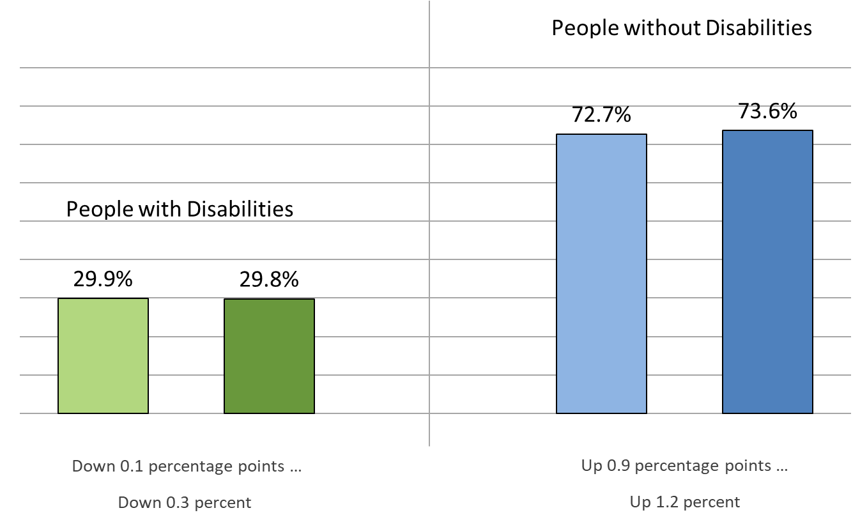
Employment-to-Population Ratio
#nTIDELearn
1/2018
1/2019
1/2018
1/2019

Slide 7
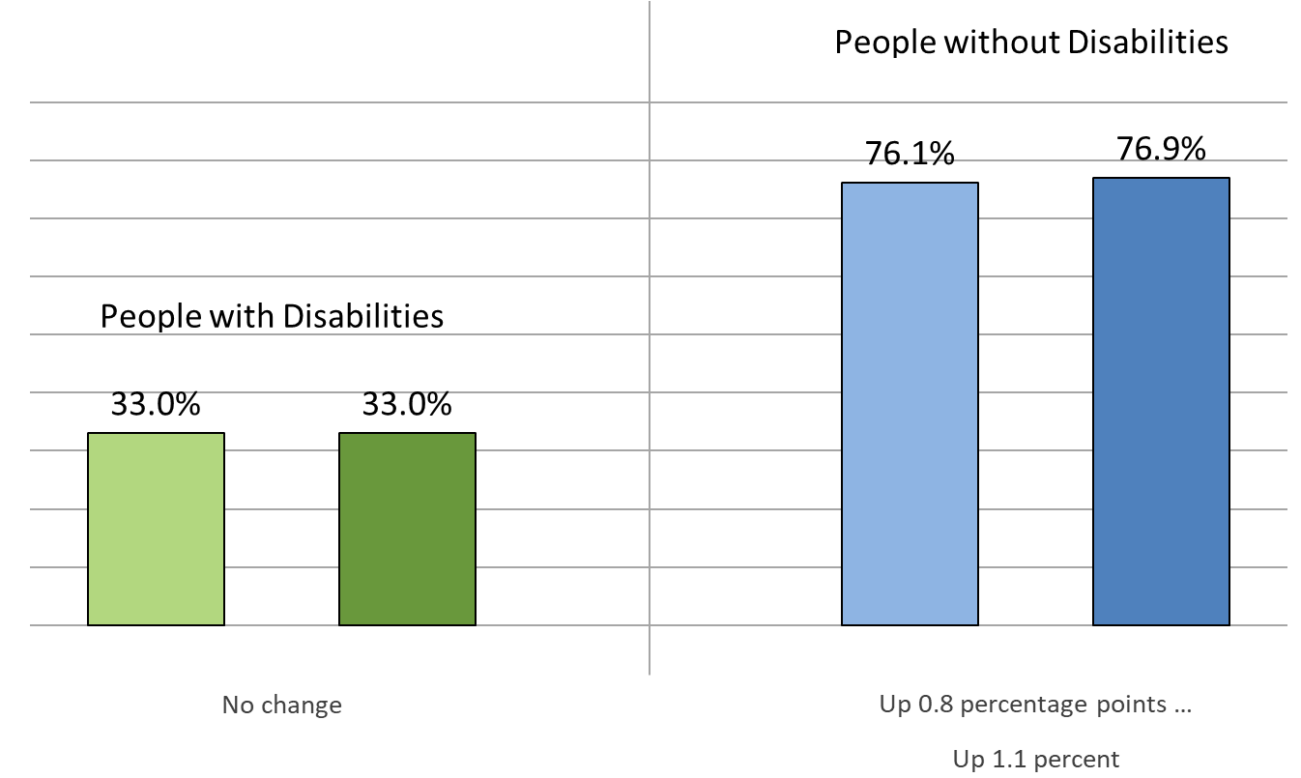
Labor Force Participation Rate
#nTIDELearn
1/2018
1/2019
1/2018
1/2019

Slide 8
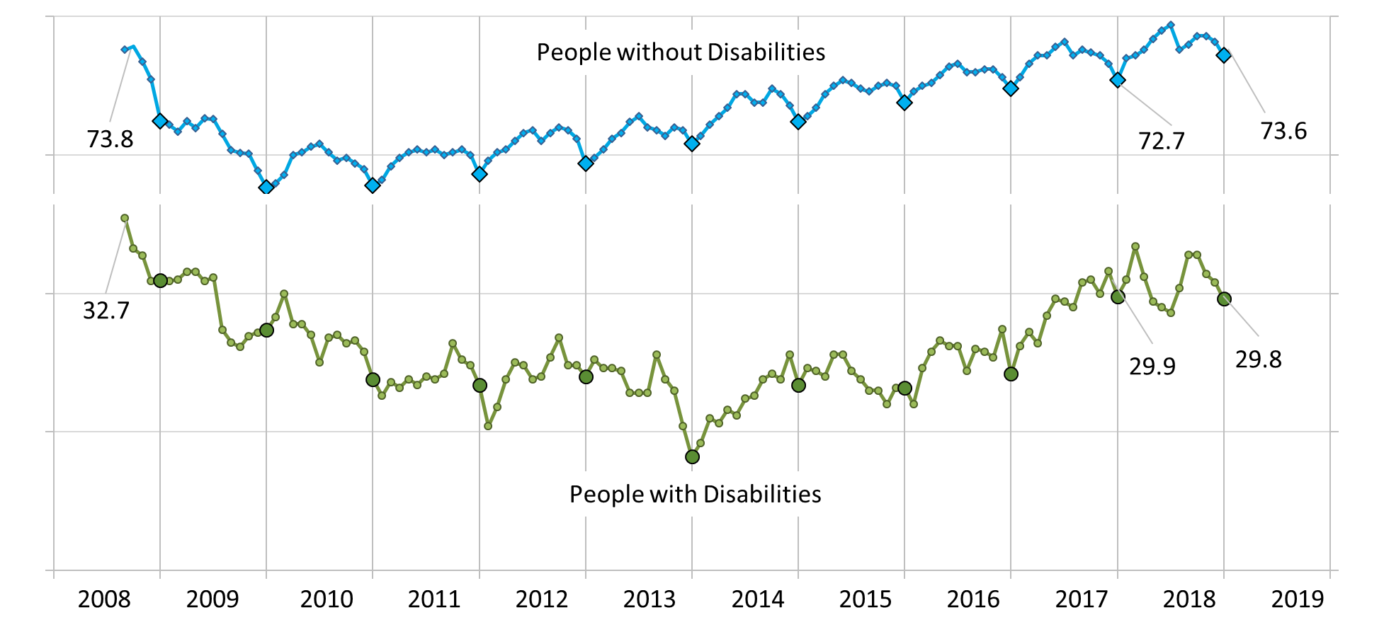
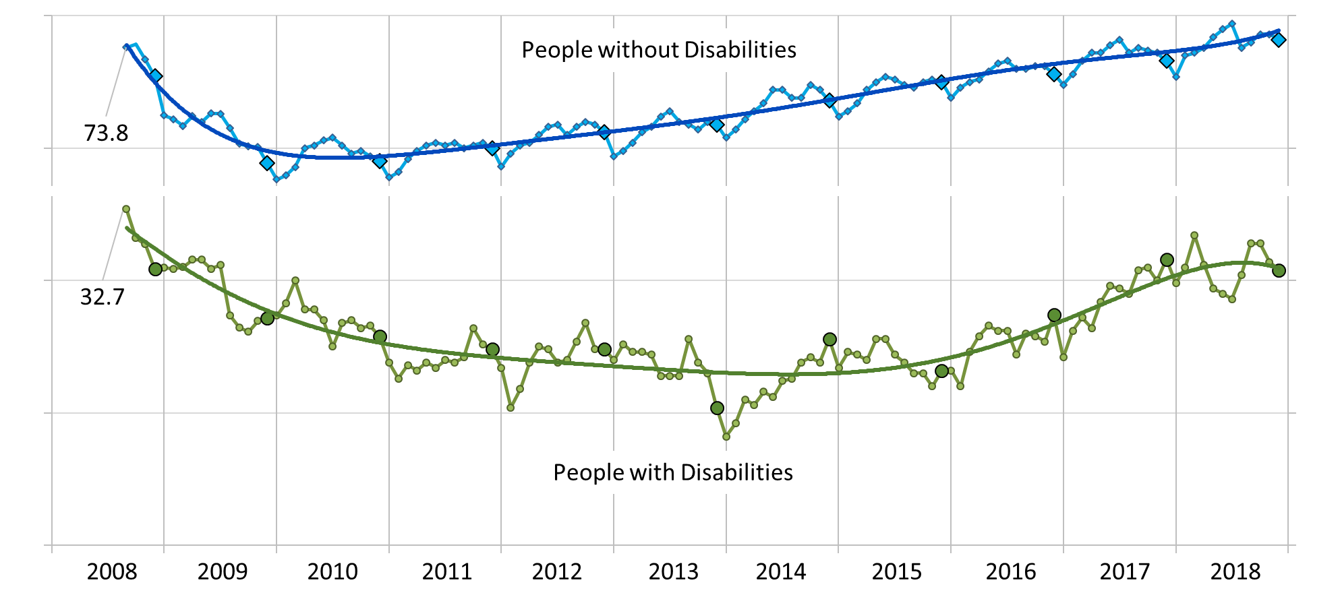
Employment-to-Population Ratio
#nTIDELearn

Slide 9
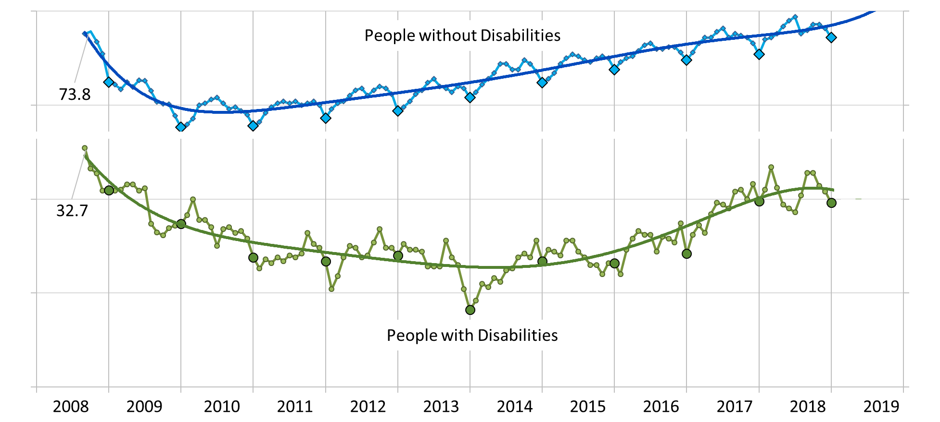
Employment-to-Population Ratio
#nTIDELearn

Slide 10
Future: Intersectionalities (2018)
#nTIDELearn
White
Only
76.3%
No Disability
74.0%
12.1% pts
15.9% Δ
Everyone Else
64.2%
43.5% pts
White Only
27.2%
Disability
30.4%
0.6% pts
2.3% Δ
Everyone
Else
26.5%

Slide 11
Future: Intersectionalities (2018)
#nTIDELearn
Men
79.5%
No Disability
74.0%
11.0% pts
13.8% Δ
Women
68.5%
43.5% pts
Men
32.7%
Disability
30.4%
4.4% pts
13.5% Δ
Women
28.3%

Slide 12
Questions and Answers
#nTIDELearn
Zoom’s Q&A button
Take our survey and tell us what you think! www.researchondisability.org/ntide/ntide-survey
Thanks to our partners: Institute on Disability www.ResearchOnDisability.org Kessler Foundation www.KesslerFoundation.org AUCD www.AUCD.org
Contact us: Email: Disability.Statistics@unh.edu Call: 866-538-9521 (toll free)
Twitter at #nTIDELearn

