Slide 1
Hear from Federal Partners:
Anjali J. Forber-Pratt, Ph.D.
Director, National Institute on Disability, Independent Living and Rehabilitation Research
@anjalifp
Adam Politis
Senior Policy Advisor for Disability and Equity, White House Office of Science and Technology Policy
Bob Sivinski, Ph.D.
Senior Statistician in the Office of the Chief Statistician of the United States
March 28, 2024

Slide 2
Vision for Uses of Data Bob Sivinski, Ph.D. Senior Statistician in the Office of the Chief Statistician of the United States

Slide 3
Federal Agency Uses For Demographic Data
Enforcement & Enforcement
Services & Products
Eligibility Determination
Equity Analysis
Grants
Operations & Facilities
CS/CX
Human Resources
General Use Statistics

Slide 4
Examples

Slide 5
Demographic measurement design factors that (sometimes) conflict
Factor | Summary
Usefulness | Collecting the right data for equity analysis, eligibility determinations, and monitoring/enforcing civil rights laws.
Quality | Respondents understand the question and are able and willing to provide the requested information.
Flexibility | Allowing agencies to collect data specific to their programs, and to modify questions over time or across circumstances.
Consistency | Ensuring data across government is comparable.
Identity | Providing response options that reflect how people think of themselves.
Efficiency | Minimizing burden to respondents and space on forms. Collecting data only when its value justifies its cost.
Compliance | Following existing statutory/regulatory language and judicial precedent
Continuity | Maintaining trend data

Slide 6
Vision for Equitable Disability Data
“Equitable data are those that allow for rigorous assessment of the extent to which government programs and policies yield consistently fair, just, and impartial treatment of all individuals. Equitable data illuminate opportunities for targeted actions that will result in demonstrably improved outcomes for underserved communities.”
A Vision for Equitable Data: Recommendations from the Equitable Data Working Group
Notes:
We need data to identify problems, design solutions, and measure success. Then we iterate that cycle over and over.
What we hope to accomplish in the working group is to institutionalize this data-driven mindset across Federal agencies in regards to disability data.

Slide 7
Disability Data Logic Model
Create Learning Agenda
Develop Action Plans
Collect Data
Improve Outcomes
Use Data
Notes:
Adapted from the logic model used in the development of the SOGI Data Action Plans
A logic model is helpful for situating whatever specific work is going on within the context of improving real, measurable outcomes for people with disabilities.
This working group intends to provide agencies with tools to improve the quality and availability of “disability data”, and I want to make sure that we’re not focused too narrowly in that there are different kinds of data and different kinds of uses for those data.
There’s statistical data from surveys that’s intended to be used for evidence building, usually identifying problem areas and analyzing potential solutions.
And there’s administrative data, usually intended to help agencies administer Federal programs but also increasingly used for evidence building to identify disparities, design solutions, and evaluate effectiveness.
So, as usual our major deliverable will be a report and this model also gives us a good framework for thinking about what we want that report to accomplish.
We want to provide a roadmap for surveys to provide statistical data that can not just identify but also help inform interventions for people with disabilities.
We want agencies with program and outcome data to be thinking about how their data can be used for other things aside from program administration and eligibility determination.

Slide 8
Using the Data
Create Learning Agenda
Develop Action Plans
Improve Outcomes
Use Data
Collect Data
Statistical and program data identifies disparities
Policies and programs designed to address disparities
Program and outcome data used to evaluate effectiveness
Notes:
Adapted from the logic model used in the development of the SOGI Data Action Plans
A logic model is helpful for situating whatever specific work is going on within the context of improving real, measurable outcomes for people with disabilities.
This working group intends to provide agencies with tools to improve the quality and availability of “disability data”, and I want to make sure that we’re not focused too narrowly in that there are different kinds of data and different kinds of uses for those data.
There’s statistical data from surveys that’s intended to be used for evidence building, usually identifying problem areas and analyzing potential solutions.
And there’s administrative data, usually intended to help agencies administer Federal programs but also increasingly used for evidence building to identify disparities, design solutions, and evaluate effectiveness.
So, as usual our major deliverable will be a report and this model also gives us a good framework for thinking about what we want that report to accomplish.
We want to provide a roadmap for surveys to provide statistical data that can not just identify but also help inform interventions for people with disabilities.
We want agencies with program and outcome data to be thinking about how their data can be used for other things aside from program administration and eligibility determination.

Slide 9
Disability Data Landscape
Anjali J. Forber-Pratt, Ph.D.
Director, National Institute on Disability, Independent Living and Rehabilitation Research
@anjalifp

Slide 10
The Importance of Collecting Data on Disability
Federal agencies use data collected on the U.S. population, such as in the Census and in the American Community Survey (ACS), to make funding decisions regarding a variety of important government programs. These programs provide access to services related to health care, food and nutrition, education, civil rights and advocacy, housing, education, and employment. Further, the findings of the Census affect congressional seats, legislative, school, and voting precincts, and the fair distribution of over $800 billion of annual federal funding across the government programs (Lee et al., 2019). Identifying and counting people with disabilities in federal data collection efforts can provide important information about the population with disabilities that may be relevant to these government programs.

Slide 11
Representation Matters: Nothing About Us Without Us!
Artwork from Ricardo Levins Morales

Slide 12
Federal Disability Data Landscape
Multiple departments and agencies across the federal government collect data on people with disabilities. In addition to the Census Bureau, other federal entities that collect data on disability include the Administration for Community Living (ACL) and Centers for Disease Control (CDC) in the Department of Health and Human Services (HHS), Social Security Administration (SSA), Department of Education (ED), Department of Justice (DOJ), and Department of Labor (DOL). Despite the efforts of these departments to collect disability data, comparison of findings across agencies and programs remains challenging or impossible due to differing conceptual and operational definitions and classifications of disability.

Slide 13
Key Players
White House Office on Science Policy & Technology: Disability Data Interagency Working Group
Connected to Equitable Data Working Group
Interagency Council on Statistical Policy
NIDILRR
Interagency Committee on Disability Research
Stats RRTC
Other Grantees
Subcommittee on Disability Statistics
Other Federal Agencies with Disability Equities
13 principal statistical agencies and 3 recognized statistical units, 24 Statistical Officials (includes Census)
IDD Counts

Slide 14
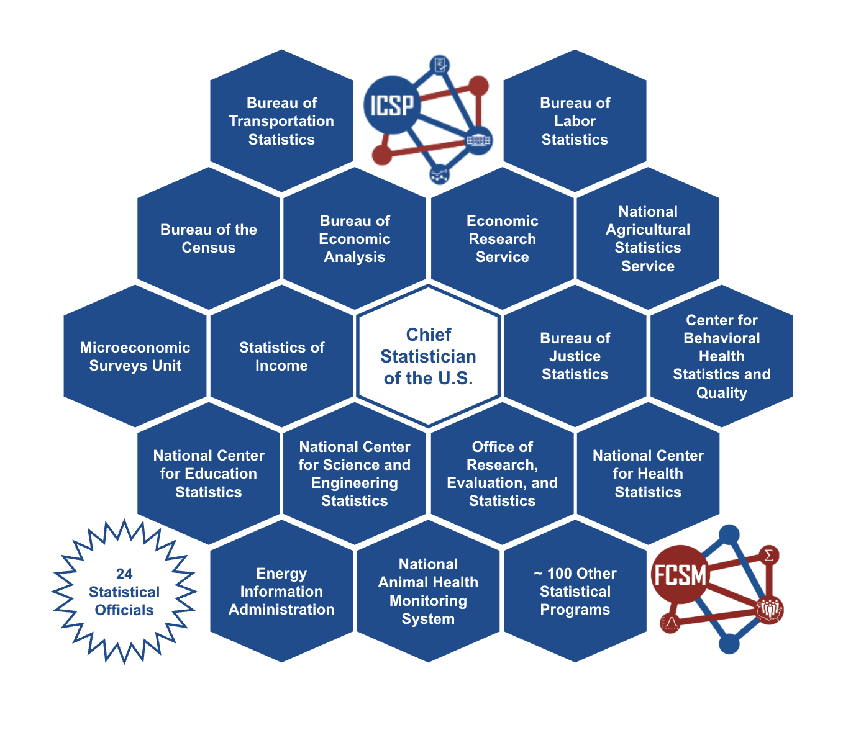
Interagency Committee on Statistical Policy

Slide 15
Interagency Committee on Disability Research: Subcommittee on Disability Statistics
The ICDR Subcommittee on Disability Statistics (SDS) aims to advance the quality and availability of disability statistics and data by establishing greater coordination and collaboration of existing and newly developing relevant federal activities, including data standards, by promoting the adoption and implementation of related efforts, and by acting as a resource for others interested in disability statistics and data.

Slide 16
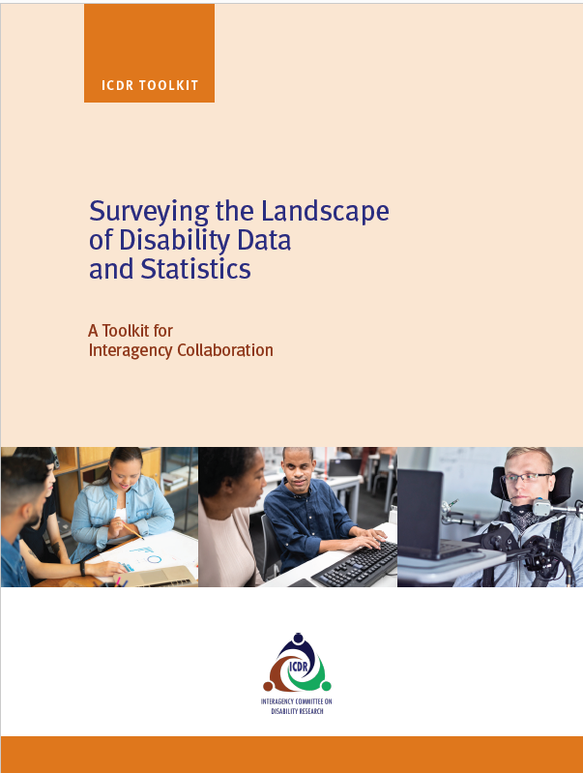
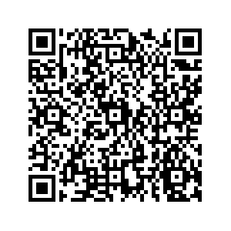
Coming Soon!

Slide 17
USING DATA TO DELIVER EQUITABLE OUTCOMES FOR THE AMERICAN PEOPLE
USING DATA TO DELIVER EQUITABLE OUTCOMES FOR THE AMERICAN PEOPLE
Adam Politis, Senior Policy Advisor for Disability and Equity
White House Office of Science and Technology Policy
March 28, 2024

Slide 18
“A first step to promoting equity in Government action is to gather the data necessary to inform that effort.”
President Joseph R. Biden
Notes:
Executive Order 13985 On Advancing Racial Equity and Support for Underserved Communities Through the Federal Government (January 20, 2021)
https://www.whitehouse.gov/briefing-room/presidential-actions/2021/01/20/executive-order-advancing-racial-equity-and-support-for-underserved-communities-through-the-federal-government/

Slide 19
Equitable Data…
Allow for rigorous assessment of the extent to which government programs and policies yield consistently fair, just, and impartial treatment of all individuals.
Illuminate opportunities for targeted actions that will result in demonstrably improved outcomes for underserved communities.

Slide 20
Recommendations of the Equitable Data Working Group
Make disaggregated data the norm while protecting privacy
Catalyze existing federal infrastructure to leverage underused data
Build capacity for robust equity assessment for policymaking and program implementation
Galvanize diverse partnerships across levels of government and the research community
Be Accountable to the American Public
Notes:
A Vision for Equitable Data: Recommendations from the Equitable Data Working Group
https://www.whitehouse.gov/wp-content/uploads/2022/04/eo13985-vision-for-equitable-data.pdf

Slide 21
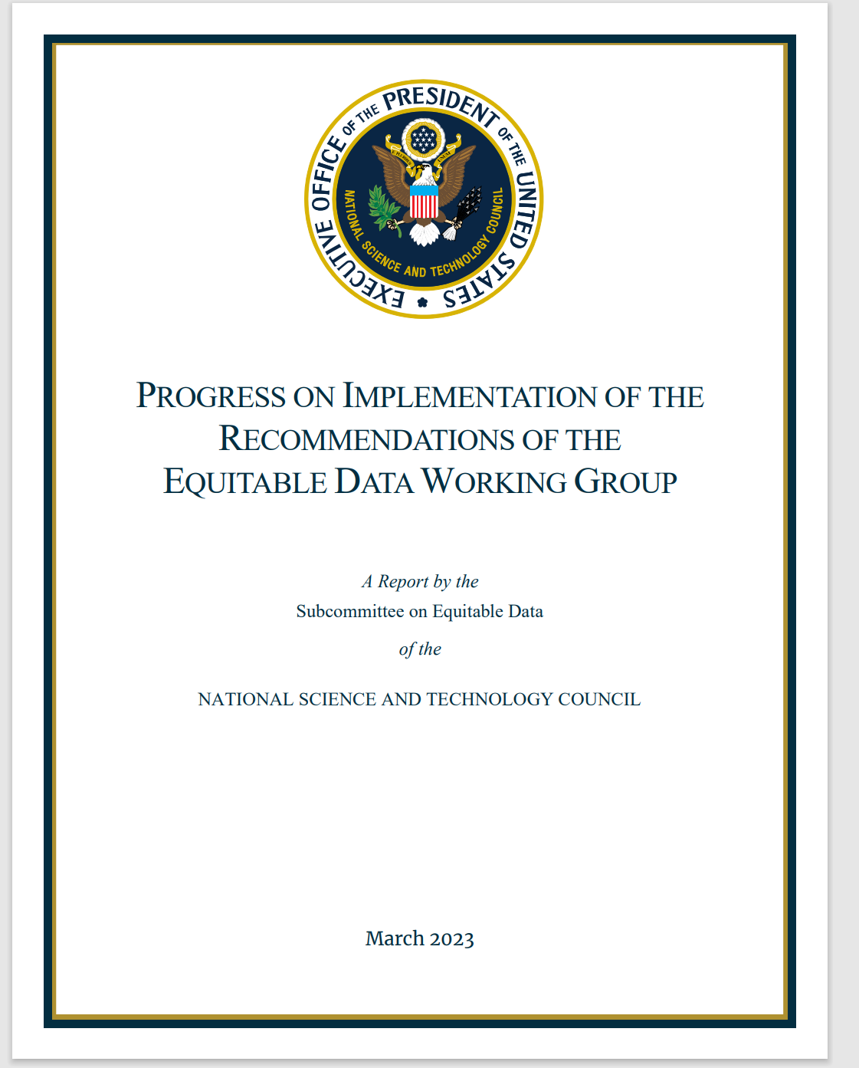
Equitable Data Working Group Progress Report
Provides descriptions of the progress federal agencies and EDWG subgroups are making on the 5 recommendations
Includes relevant federal success stories and findings from public engagement so far
Includes next steps for the work
Notes:
Progress on Implementation of the Recommendations of the Equitable Data Working Group
https://www.whitehouse.gov/wp-content/uploads/2023/03/Progress-on-Equitable-Data-Mar2023.pdf

Slide 22
Disability Data IWG (DDIWG)
From the Equitable Data Working Group Progress Report:
“The SED will begin building comparable best practices for other high-priority under-collected demographic variables, including disability…As the work matures, the SED will likely create additional IWGs and assign specific deliverables to advance equitable data for other populations under-represented in federal datasets.”

Slide 23
DDIWG Purpose and Scope
To coordinate activities to strengthen the federal government’s use of disability data to advance equity for people with disabilities
Within the broader scope of equitable data, this work will allow for rigorous assessment of the extent to which government programs and policies yield consistently fair, just, and impartial treatment of people with disabilities

Slide 24
DDIWG Functions
Facilitate effective and meaningful community engagement to identify barriers to and opportunities for using federal data to advance equity for people with disabilities
Identify existing federal disability data resources and support agencies in optimizing, improving, and increasing those resources
Create a Federal Evidence Agenda on Disability Equity

Slide 25
Coming Soon…
Request for Information (RFI) on the Federal Evidence Agenda on Disability Equity
Listening Sessions and SME Interviews with individuals, businesses, and organizations that interact with Federal agencies and federally-funded programs

Slide 26
End Slide

Slide 27
Questions & Discussion
Questions & Discussion

