Slide 1
Long Term Trends in the Employment of People with Disabilities
Andrew Houtenville
Bryce Stanley
University of New Hampshire
1

Slide 2
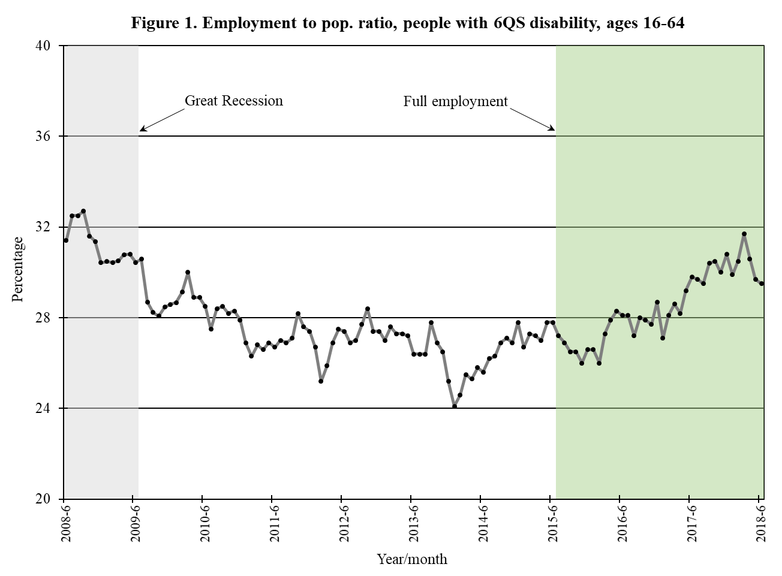

Slide 3
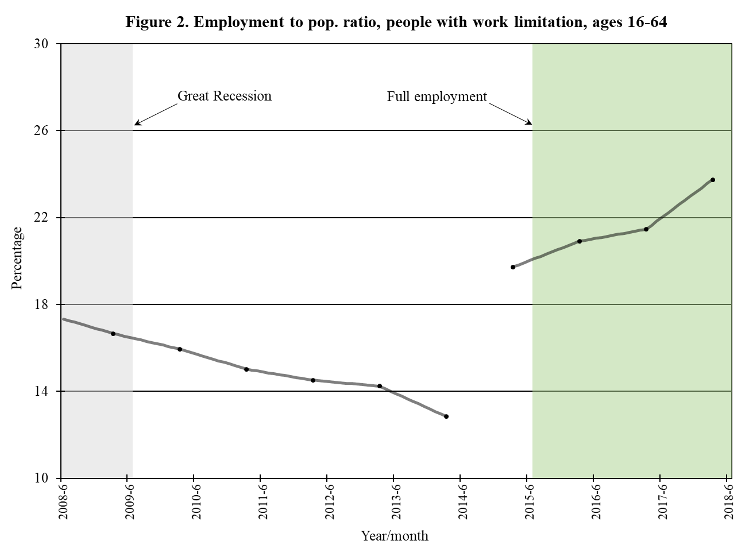

Slide 4
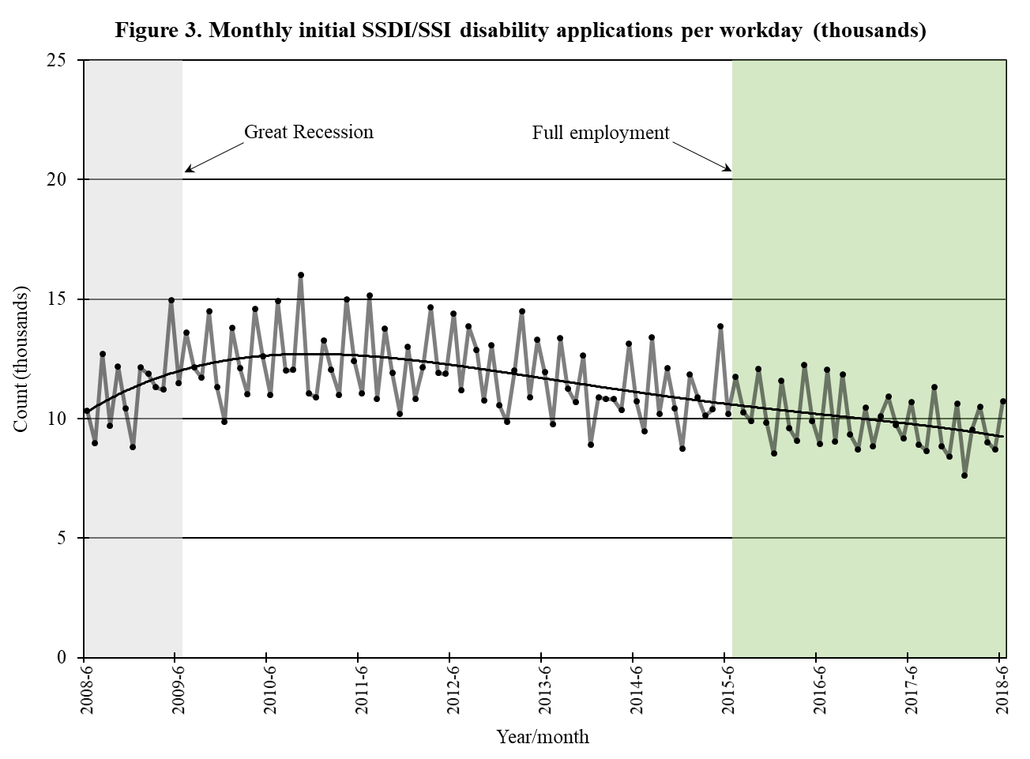

Slide 5
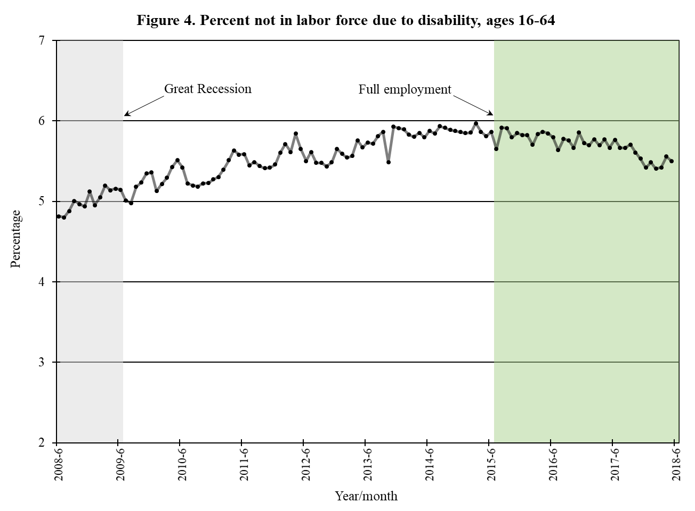

Slide 6
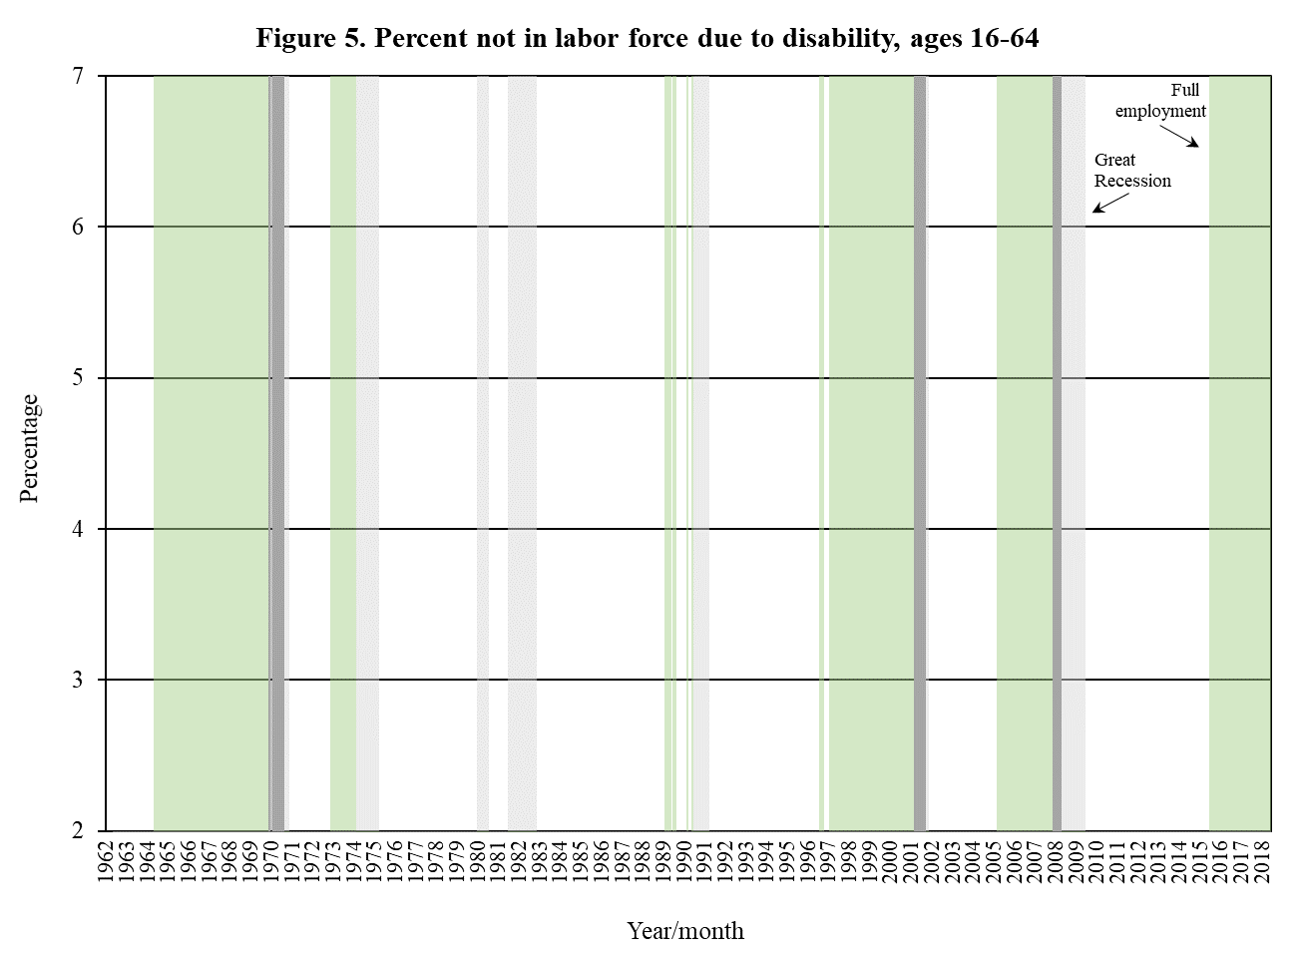

Slide 7
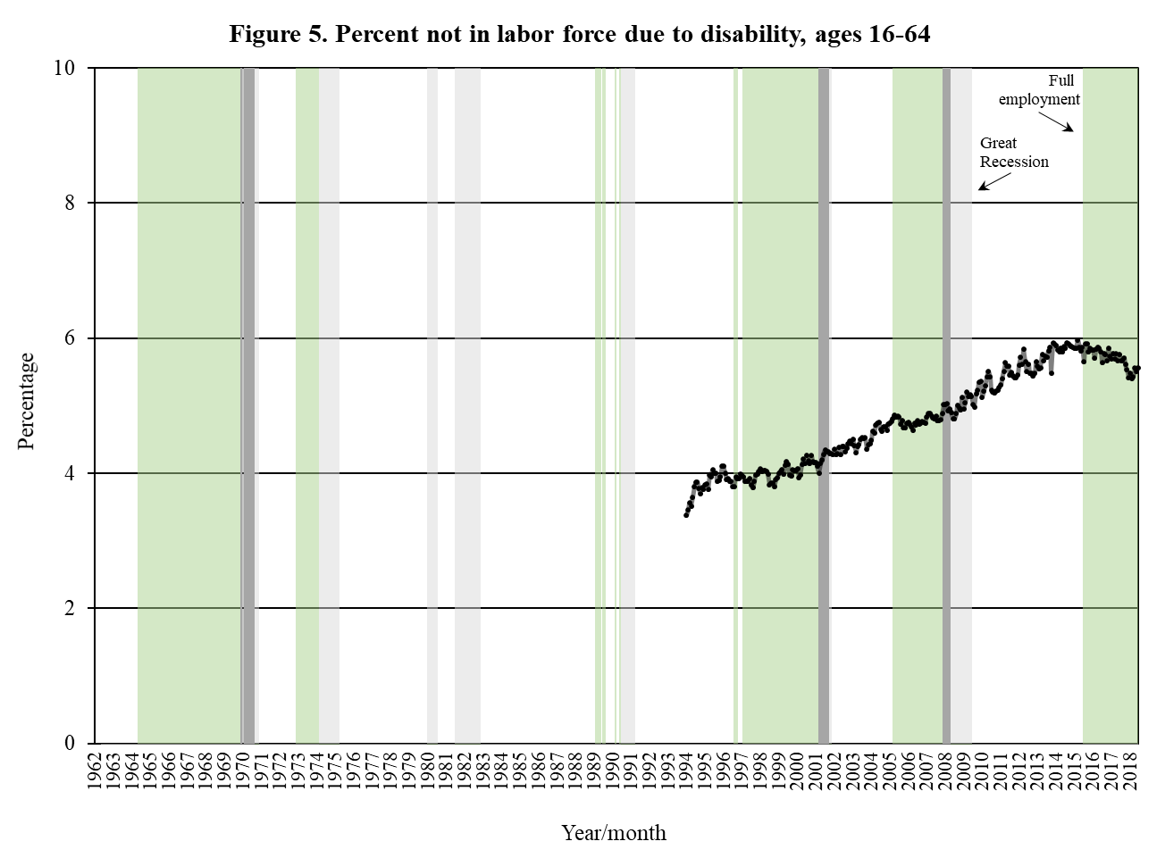

Slide 8
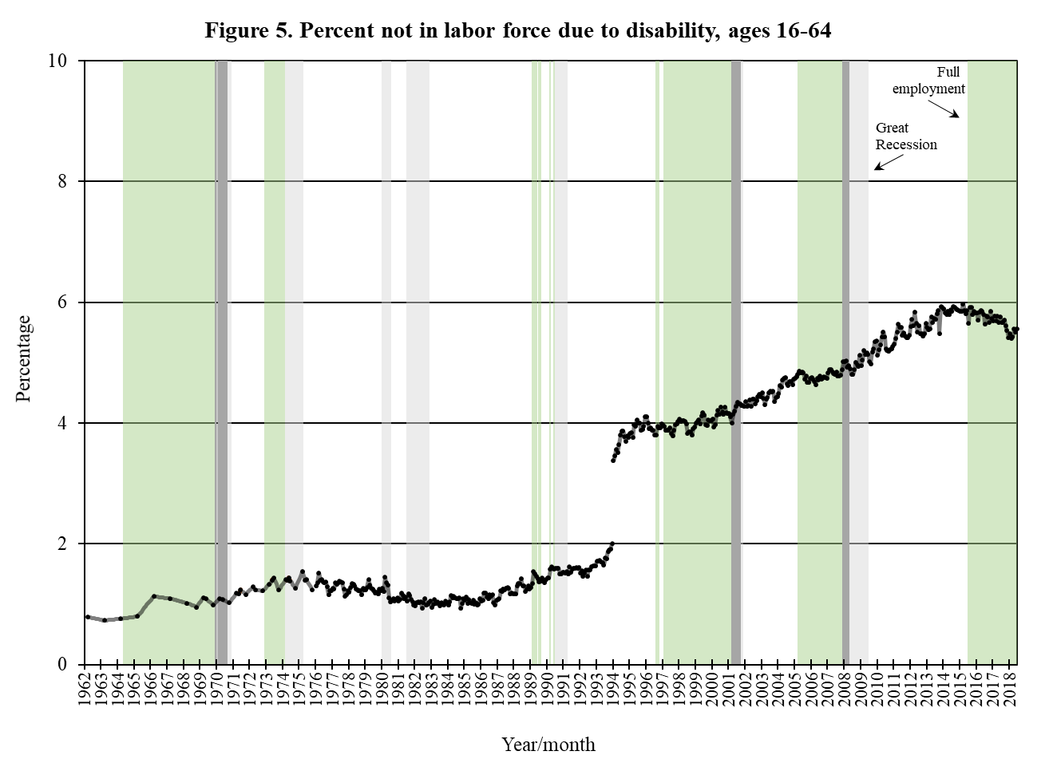

Slide 9
Next Steps
Hold compositional changes constant.
Look to get SSDI/SSI applications and recipients going further back.
Investigate dynamics of recession – no recovery.
Investigate why current period is so different from past recovery and full employment periods.
9

Slide 10
Contact Information
Andrew J. Houtenville, Ph.D.
Associate Professor of Economics and
Research Director, Institute on Disability
University of New Hampshire
10 West Edge Drive, Suite 101 Durham, NH 03824-3593
Email: Andrew.Houtenville@unh.edu
Office: (603) 862-3999
10

