Slide 1
Job Quality among workers with a disability
Megan Henly
Debra Brucker
UNH

Slide 2
Acknowledgements
Funding for this study was provided by the Research and Training Center on Employment Policy and Measurement at the University of New Hampshire, which is funded by the National Institute for Disability, Independent Living, and Rehabilitation Research, in the Administration for Community Living, at the U.S. Department of Health and Human Services (DHHS) under cooperative agreement 9ORT5037-02-00. The contents do not necessarily represent the policy of DHHS and you should not assume endorsement by the federal government (EDGAR, 75.620 (b)).

Slide 3
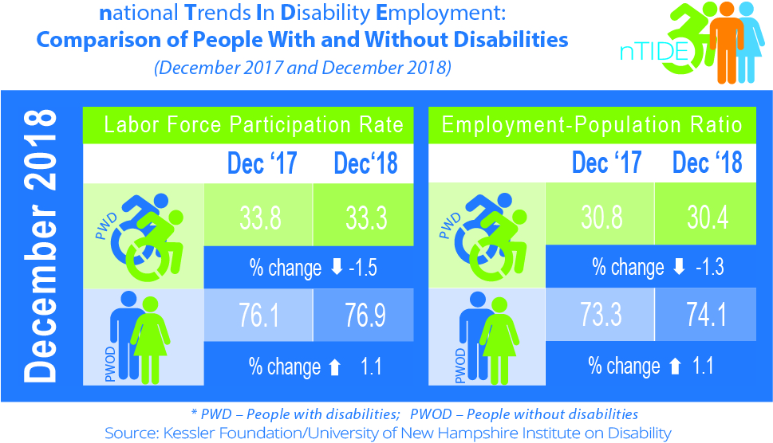
Employment: What measures do we have?
Labor force participation rate
Employment
-to-population ratio
Job Quality

Slide 4
Our interest: Job Quality
Are workers with disabilities less likely than
workers without disabilities to hold good quality jobs in the U.S.?

Slide 5
International measures of job quality
European Job Quality Index
Pay & benefits
Intrinsic quality of work
Employment quality
Health & safety
Work-life balance
Paper 1
Paper 2
Paper 3

Slide 6
Job Quality Measure 1: Pay and Benefits
Following Jones & Schmitt (2016), a good quality job:
Offers health insurance benefits,
Pays more than median wages, &,
Offers a pension/retirement program.
Fair job = 1 or 2 of the above
Bad job = None of the above

Slide 7
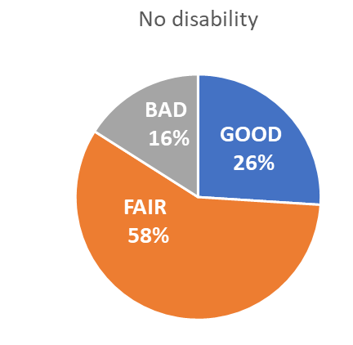
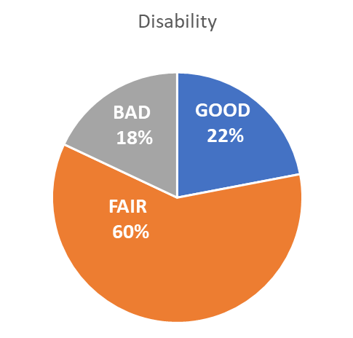
Measure 1. Job quality by disability status, 2014-2016
These differences are not statistically significant once we control for health status
Source: Current Population Survey (CPS)
Brucker & Henly (in press) Job quality for Americans with disabilities.
Journal of Vocational Rehabilitation. doi: 10.3233/JVR-180994

Slide 8
Job Quality Measure 2: Intrinsic characteristics
We include 5 dimensions:
Skills
Autonomy
Powerfulness
Meaningfulness
Self-fulfillment

Slide 9
Measure 2. Job quality for full-time workers with a college degree
Source: National Survey of College Graduates (NSCG)

Slide 10
Job Quality Measure 3: Employment quality
We include 6 dimensions
Fringe benefits
Job security
Workplace safety
Work-life balance
Work support
Workplace autonomy

Slide 11
Measure 3. Adjusted percent of full-time workers holding good quality jobs
Source: General Social Survey (GSS)

Slide 12
Conclusions
Understanding employment trends means looking at a variety of measures
There are different ways to assess job quality
For some measures, workers with a disability have substantially lower rates of job quality than workers with no disability

