Slide 1
Using All-Payer Claims Data to Investigate the Health and Health Care Utilization of People with Disabilities
Kimberly G. Phillips, PhD

Slide 2
Acknowledgements
This project is funded by a cooperative agreement with the U.S. Centers for Disease Control and Prevention (CDC) and a grant from the National Institute on Disability, Independent Living, and Rehabilitation Research (NIDILRR).
The New Hampshire (NH) Division of Health and Human Services and NH Department of Insurance are the source of data used to create this presentation.
This presentation is solely the responsibility of the author and does not necessarily represent the views of the U.S. Administration on Community Living, U.S. or NH Divisions of Health and Human Services, NIDILRR, or CDC.

Slide 3
10-State Collaboration
Notes:
CDC currently funds 10 states
Collaborating on analyses related to Medicaid claimants with IDD:
OR, MT, KS, IA, AR, MI, SC, NY, MA, NH

Slide 4
Purpose of the Collaboration
Medicaid claims - better understand the health of beneficiaries with IDD
Identify IDD – CMS algorithm diagnosis codes for “intellectual disabilities & related conditions”
Enhanced by input from the field

Slide 5
Mutually Exclusive Hierarchy
Down syndrome or Trisomy / Autosomal deletions | 1
Cerebral Palsy | 2
Pervasive Developmental Disorders / Autism | 3
Other genetic conditions | 4
Mild intellectual disabilities | 5
Moderate, severe, or profound intellectual disabilities | 6
Unspecified intellectual disabilities | 7
Notes:
The most current:
3 Developmental disabilities
4 Intellectual disabilities

Slide 6
Current Research Topics of 10 States
Use Medicaid claims
Diabetes
Heart disease and hypertension
Epilepsy
Avoidable emergency department utilization
Notes:
Prevalence, utilization, and effectiveness of care related to chronic conditions
(HEDIS: healthcare effectiveness data and information set)
And, a paper about avoidable ED utilization
Transition: In addition, in NH specifically we are working to bring in findings from commercial claims.
Our research to date shows how important it is to consider data from the privately insured.

Slide 7
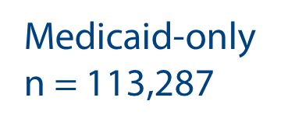
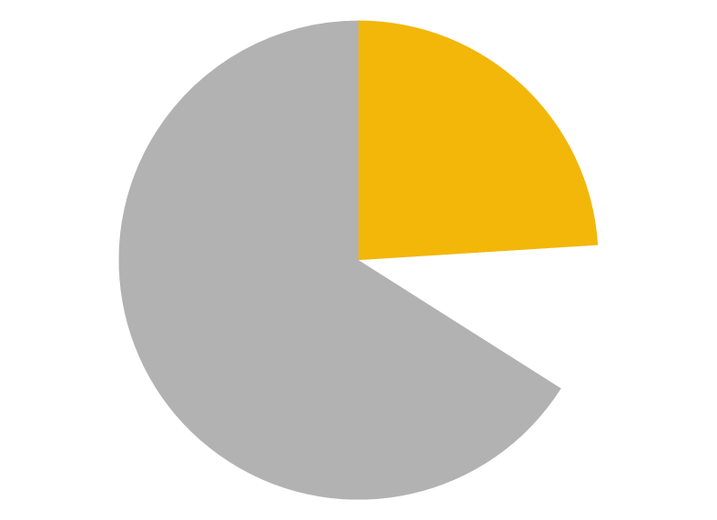
Sample from 2010-14 All-Payer Claims
Notes:
First, it provides a much more complete picture
76% of NH Population under 65 in 2010

Slide 8
IDD Prevalence: Medicaid vs Commercial
 | Medicaid | Private
Any IDD | 4,918 (4.3%) | 3,910 (0.5%)
Notes:
Second, although the prevalence of IDD is, not supririsingly, smaller - the sample size increases by 80%

Slide 9
IDD Type: Medicaid vs Commercial
 | Medicaid | Commercial
Any IDD | 4,918 (4.3%) | 3,910 (0.5%)
Cerebral Palsy | t_{(8,826)} = 4.28
Down Syndrome | t_{(8,826)} = -8.52
Autism / PDD | t_{(8,826)} = -16.74
Non-specific IDD | t_{(8,826)} = 29.37
Notes:
Compared to Medicaid claimants, commercial claimants with IDD are less likely to have CP, more likely to have Down or Autism, less likely to have non-specific ID (mild, moderate, profound or unspecified ID)

Slide 10
ED Visits with Admission: Children 0-17
Medicaid |  |  |  | Commercial
IDD | % |  |  | IDD | %
Children Ages 0-17
General symptoms | 7.34 |  |  | General symptoms | 9.17
Pneumonia, organism unsp. | 6.33 |  |  | Epilepsy | 8.02
Respiratory & chest symptoms | 5.78 |  |  | Pneumonia, organism unsp. | 6.88
Epilepsy | 4.22 |  |  | Respiratory & chest symptoms | 5.73
Nonsp. findings radiologic exam | 2.75 |  |  | Symptoms of abdomen & pelvis | 4.3
Notes:
Top 5 most frequent reasons for ED visits that resulted in inpatient admissions:
Among children and youth ages 0-17,
Epilepsy more common among commercially insured

Slide 11
ED Visits with Admission: Adults 18-64
Medicaid |  |  |  | Commercial
IDD | % |  |  | IDD | %
Adults Ages 18-64
General symptoms | 7.12 |  |  | Respiratory & chest symptoms | 6.35
Respiratory & chest symptoms | 6.09 |  |  | General symptoms | 5.85
Pneumonia, organism unsp. | 4.14 |  |  | Other diseases of lung | 3.61
Symptoms of abdomen & pelvis | 3.65 |  |  | Symptoms of abdomen & pelvis | 2.86
Other procedures & aftercare | 3.21 |  |  | Septicemia | 2.62
Notes:
Among adults ages 18-64:
Pneumonia was more common among Medicaid-insured while other lung diseases more common among commercially insured;

Slide 12
Next Steps in NH
Continue 10-state collaboration
Continue to include commercial claims
Physical disabilities
CMS-identified conditions
Input from the field
Notes:
With CDC funds
Find ways to continue with commercial claims: ACSC paper submitted for approval
With NIDILRR funds, expand the research to investigate health & health care utilization of people with physical disabilities.

Slide 13
Contact Information
Institute on Disability
University of New Hampshire
kimberly.phillips@unh.edu
603-862-4320 | Relay 711

