Slide 1
Disability Statistics from the U.S. Census Bureau in 2018/2019
Danielle Taylor
U.S. Census Bureau
February 13, 2019
Presented at the 2018 Annual Compendium on Disability Statistics Release
This presentation is released to inform interested parties of ongoing research and to encourage discussion of work in progress. The views expressed are those of the author and not necessarily those of the U.S. Census Bureau.
Notes:
1) I am Danielle Taylor, with the US Census Bureau.
2) I’m here today to talk about our disability data and statistics, as well as give you some updates on releases we’ve made in the past year.

Slide 2
Overview
Surveys
American Community Survey (ACS)
Survey of Income and Program Participation (SIPP)
Social Security Administration Supplement to the 2014 SIPP (SSA)
American Housing Survey (AHS)
Sponsor: Department of Housing and Urban Development (HUD)
Current Population Survey (CPS)
Sponsor: Bureau of Labor Statistics (BLS)
Research and Products
Americans with Disabilities: 2014
High School Equivalents and Disability Status: The Role of Context
Understanding Changes in the Disability Prevalence in the 2014 Survey of Income and Program Participation
Notes:
The Census Bureau produces a lot of data, and much of it is used in statistics organized within the compendium.
Some of our surveys that have disability data are:
The ACS, the SIPP, the AHS, and the CPS.
In 2014, we also had a supplement to the SIPP sponsored by the SSA. more about that later.
So, I’ll go over these surveys, and their data, and at the end I’ll talk a little about the research we’ve done related to disability and our data.
Links to everything presented here will be available at the end of the presentation.
--------------------------------
2) The American Community Survey is the current embodiment of the census long form. it’s greatest asset is it’s sample size, allowing for estimates at very low levels of geography.
3) The Survey of Income and Program Participation, uses a smaller sample, but provides greater richness of its various topics including more questions on disability. And it allows study of outcomes for persons with disabilities across the course of several years, via its longitudinal survey design.
4) In 2014, the Social Security Administration fielded a supplement to respondents of wave 1 of the SIPP. The supplement collected questions previously asked in the Adult and Child Functional Limitation modules
5) The American Housing Survey (AHS) is sponsored by HUD and is the most comprehensive national housing survey in the United States.

Slide 3
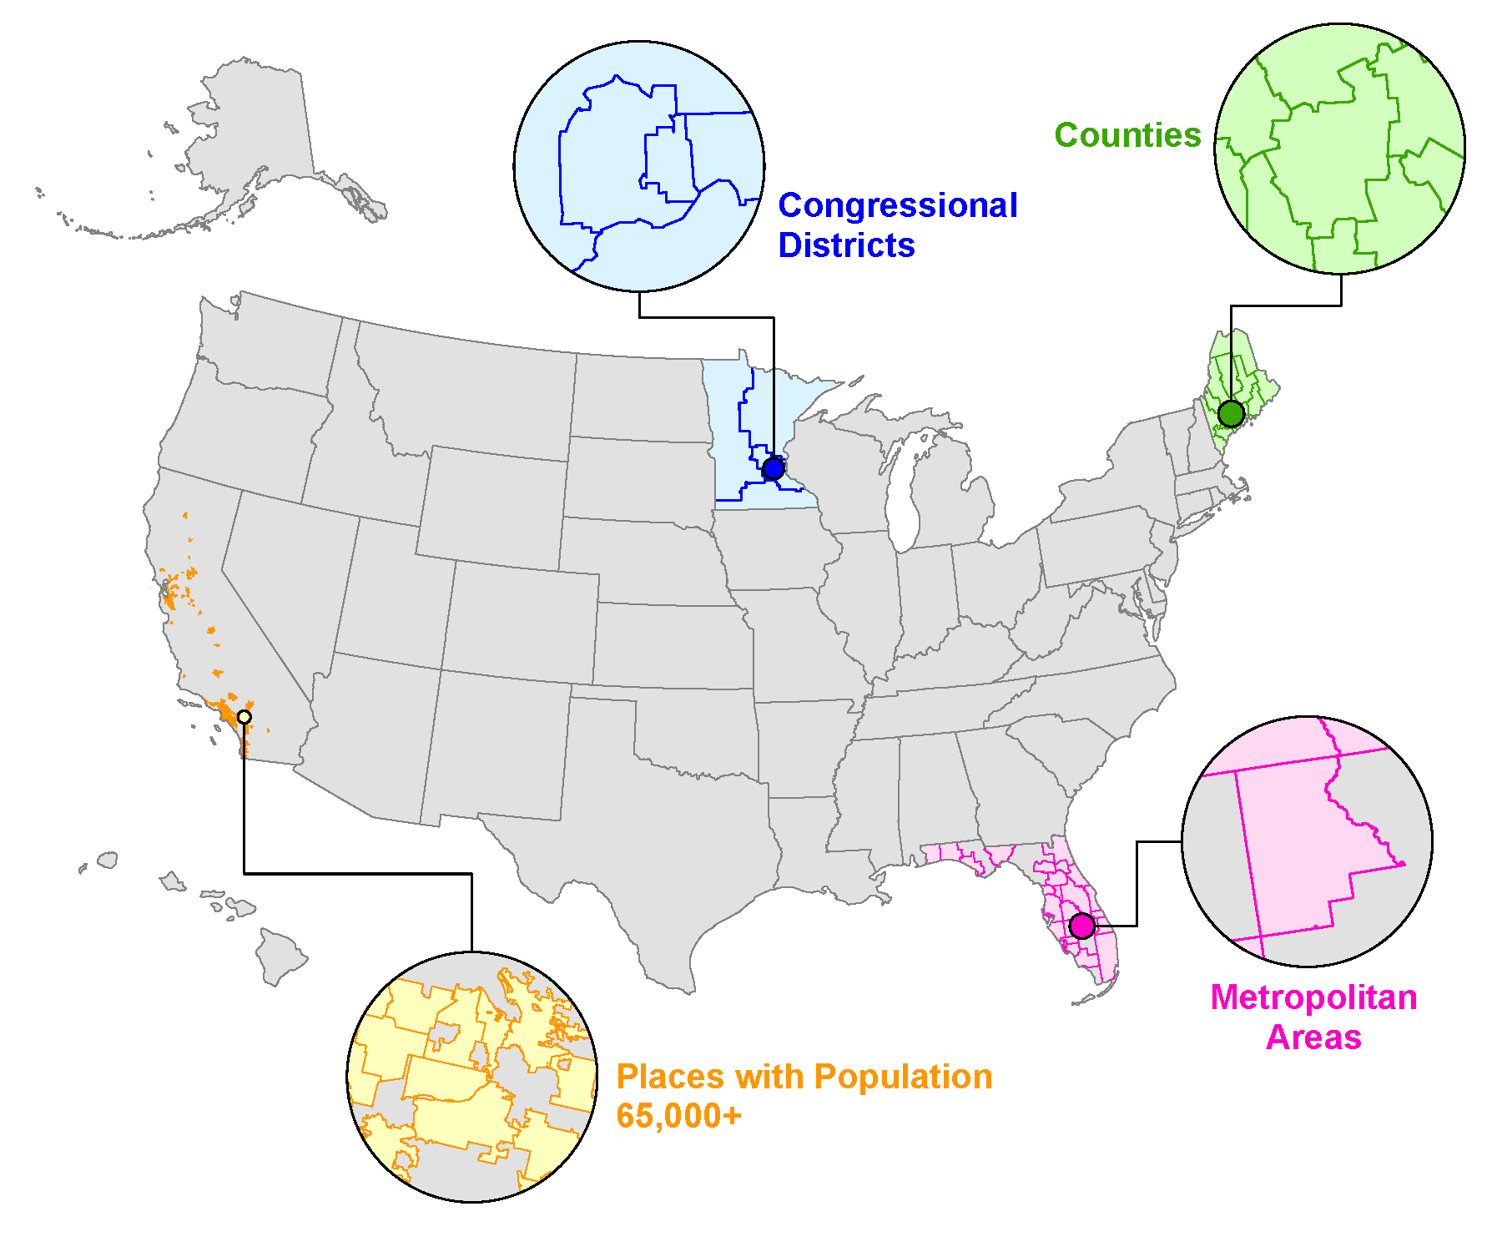
American Community Survey (ACS)
1-Year Data:
Produces estimates for areas with a population of 65,000+
1-Year Supplemental Estimates:
Provides selected estimates for areas with a population of 20,000+
5-Year Data:
All counties, places, and census tracts
Notes:
The American Community Survey has by far the largest sample size Of all our surveys.
(In 2017 the ACS conducted interviews for over 2 million households, and over 157,00 people living in group quarters. )
As a result, the ACS produces estimates for a variety of smaller geographies, and is used widely among local governments for project planning and resource allocation.
From the ACS we get the 1-yr and 5-yr estimates which y’all are probably familiar with. The 1-yr estimates are for all areas with a population of at least 65,000+, and the 5 year estimates, for all geographies down to the census tracts.
the supplemental estimate tables use 1-year data to produce selected estimates for areas with a population of 20,000+. These products were created to fill in the gap left when the 3-year data products were discontinued.
------------------------------------------
Supplemental products:
disability by age,
work experience by disability,
types of disability

Slide 4
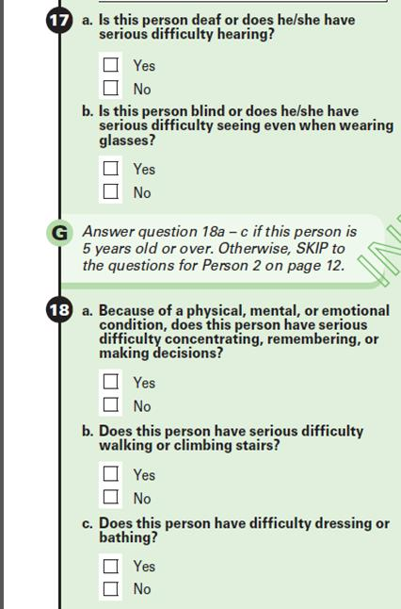
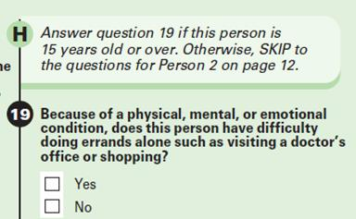
American Community Survey (ACS):
Six Disability Questions
Notes:
As many of you are aware, the six disability questions used in the ACS are also used in many other federal surveys. Including the two most recent SIPP panels, the AHS, and the CPS.
This image is from our ACS paper form.
Just to touch on an overview of the core questions, the six domains covered are:
hearing,
vision,
cognitive functionality (defined as difficulty concentrating, remembering, or making decisions),
ambulatory functionality (defined as difficulty walking or climbing stairs),
self-care (defined as difficulty dressing or bathing),
and independent living (defined as difficulty doing errands alone).
Based on input received by the Interagency Council on Statistical Policy, the Census Bureau has formed a subcommittee of federal stakeholders to review the current ACS disability questions.
IF asked why or how:
If you would like to know more or have additional questions, I can put you in touch with the head of ACSO – Jennifer Ortman.
-----------------------------------------------------------------
The Census Bureau’s American Community Survey Office (ACSO) is tasked by the Interagency Council on Statistical Policy Subcommittee on the ACS (ICSP-SACS) with conducting periodic reviews of the justifications for the survey questions, considering any addition, revision, or deletion of questions. These reviews are conducted with Federal stakeholder agencies’ input.
Last year, the ACS asked the interagency committee to formally notify us about changing needs. We received input from several agencies on a variety of topics, including disability (Step 1). OMB and the Census Bureau decided which submissions had merit (Step 2) and subcommittees on these topics (including disability) were formed. As the Census Bureau moves forward in testing and evaluation, we will keep our community of stakeholders informed.
We've released a nice graphic explaining the process of revising content. https://www.census.gov/content/dam/Census/library/visualizations/2017/comm/acs-questions.pdf

Slide 5
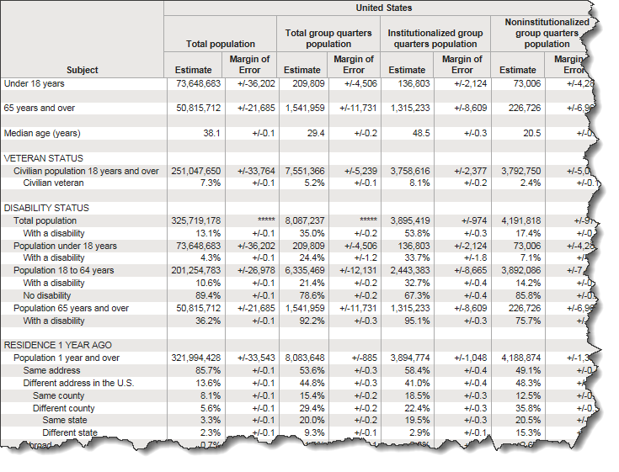
American Community Survey (ACS)
Recent Releases in American FactFinder (AFF) and Data.Census.Gov:
2017 1-year estimates
(Sept. 2018)
2017 Supplemental Estimates (Oct. 2018)
2013-2017 5-year estimates
(Dec. 2018)
Notes:
In the ACS data products, you can find lots of tables focused specifically on Disability, tabulated by a variety of demographic and socioeconomic characteristics.
American Fact Finder is the main tool for disseminating ACS products. The Bureau has also been developing a new platform at data.census.gov Data.Census. Gov will provide all of the tables currently released on AFF as well as the public-use microdata files. The website is live and being actively developed so if you want to get familiar with it and provide feedback on its development, you have the opportunity to do so.
(You can also find a few tables for group quarters that provide disability status for the institutional and non-institutional populations (S2601A-C))
-----------------------------------------
Data releases:
3) One-year estimates for calendar year 2017 were just released this past September. (65k+)
3b) Supplemental estimates for calendar year 2017 were released in October. (20k+)
4) Five-year estimates for 2013-2017 were released this past December. With the release of this five-year file we now have two non-overlapping 5-year files with disability data, which allows for comparisons of disability estimates across time for those geographies with populations under 65,000 people.
[Official statement on removal of 3-year estimates---- if asked]
2012-2014 ACS 3-year estimates
Posted November 24, 2015
Please note that the ACS 3-year estimates have been discontinued. Every community in the nation will continue to receive a detailed statistical portrait of its social, economic, housing and demographic characteristics through 1-year and 5-year ACS products.
Posted March 2, 2015
Census Bureau Statement on American Community Survey 3-Year Statistical Product
The U.S. Census Bureau has proposed discontinuing a statistical product from the American Community Survey. The product, often called the "3-year estimates," combines three years of data collection into a three-year rolling average and covers communities with populations of 20,000 or more. If approved, the Census Bureau would not release the 2012-2014 3-year estimates.
In the fiscal year 2016 budget request, the Census Bureau proposed not reinstating the three-year product in order to prioritize activities that would preserve the integrity of the sample, enhance the quality of the entire data set, and ensure a better experience for the respondent. For example, these activities include reinstating an operation that collects data left incomplete by respondents, additional training for field representatives, continued review of the survey questions, and expanded outreach and partnership with stakeholders.
Although the Census Bureau would discontinue the 3-year product, every community in the nation will continue to receive a detailed statistical portrait of its social, economic, housing and demographic characteristics through other American Community Survey products. Specifically, the Census Bureau will continue producing annual estimates for communities of 65,000 or more, and communities of all sizes, including the nation's smallest, will continue to receive updated five-year rolling averages each year

Slide 6
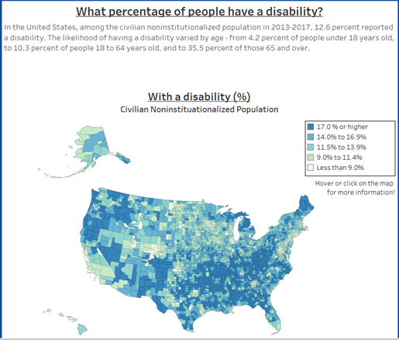
What can you learn about counties from the American Community Survey (ACS)
New mapping tool across counties
Select features:
Disability
Age
Employment Status
Poverty
Etc.
Uses ACS 5-yr data
Notes:
These next two slides are new tools that use ACS data to get snapshots of disability and other population characteristics in the county.
This tool uses the ACS 5-year data to illustrate selected topics across counties in the US.
The map is interactive and hovering over a given county provides the specific details.

Slide 7
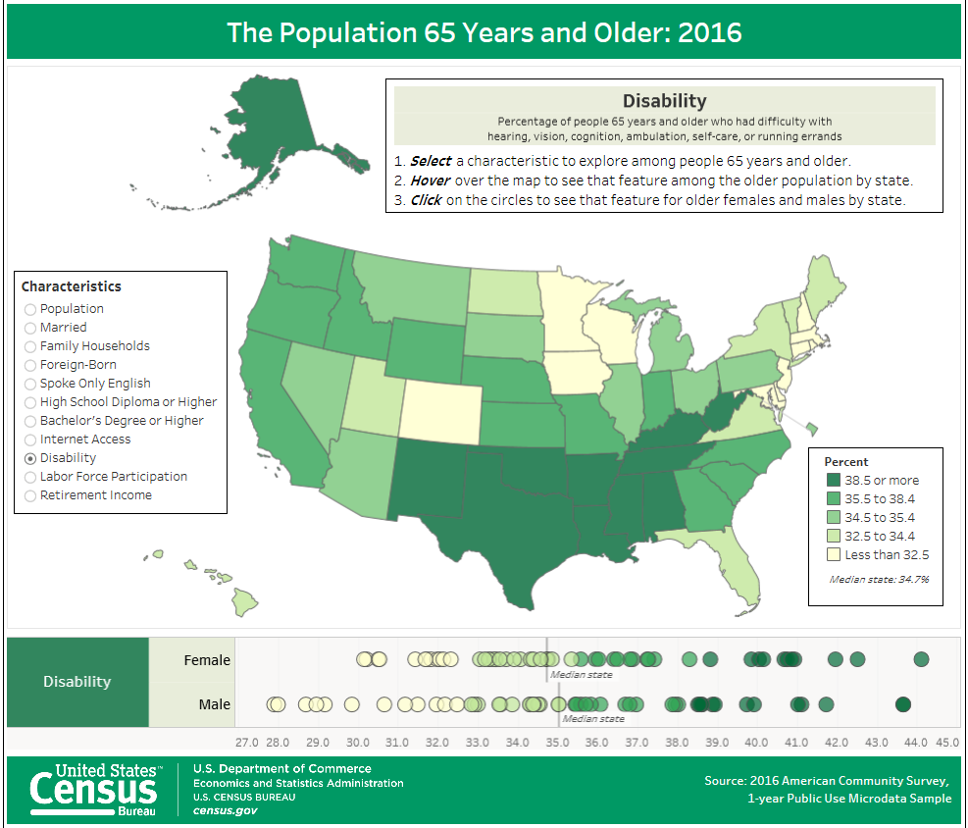
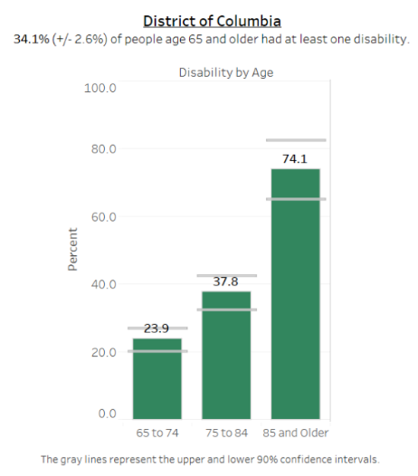
The Population 65 Years and Older: 2016
New mapping tool across states
Select features:
Disability
Labor Force Participation
Education
Etc.
Based on ACS 1-year data
Notes:
This tool focuses on the population aged 65 years and older.
It displays various characteristics of the older population, including disability, by state.
Breakdowns are provided by sex in the bottom dot graph, and by hovering over a state a figure will display the selected statistic by age group for that state
----------------------------
based on 1-year ACS data.

Slide 8
American Housing Survey (AHS)
Statistics from the 2017 American Housing Survey
Conducted every 2 years
2017 data released: September 2018
National & State statistics, plus selected Metropolitan Areas
Statistics on Disability Status alongside a variety of Household Characteristics, such as:
Recent home improvements
Neighborhood characteristics
Housing quality measures
The 2019 survey will also include questions on home accessibility
Available through the AHS Table Creator
8
Notes:
Another survey that collects disability data is The American Housing Survey which is conducted every two years. This past year the 2017 data was released.
The AHS provides information on the size and composition of the housing in the US for 25 selected metropolitan areas, as well as states, and the nation.
It Contains a variety of housing or household characteristics that can be looked at in conjunction with disability, including:
Neighborhood characteristics such as safety or public transportation
Whether any home improvements were done to make the home more accessible
The 2019 survey will also have additional questions on home accessibility covering such topics as
The use of mobility equipment to get around inside the home
Difficulty entering the home,
Difficulty accessing or using rooms such as the kitchen, bathroom, bedroom due to a long-term health condition
Estimates are available through the AHS Table Creator where you can create estimates from the variables you are interested in

Slide 9
Survey of Income and Program Participation (SIPP)
Redesigned SIPP Survey beginning with the 2014 Panel
Administered once a year
Contains questions on:
health status, medical utilization, adult and child well-being, and many other topics
Collection occurred between February and May of each year
2014 Wave 1 released: March 2017
2014 Wave 2 released: August 2018
An online code book allows for interactive variable look-up
Notes:
And this brings us to SIPP.
The SIPP is a longitudinal survey that gives in-depth information for data users and researchers about a variety of topics.
The Survey of Income and Program Participation was redesigned, beginning with the 2014 Panel. (Notable changes include interviews once a year rather than four times a year, and collecting all topics in the core questionnaire, which includes disability.)
The 2014 panel contains 4 waves collected between 2014 and 2017. We have released two of the four waves from the 2014 panel so far, and have finalized our response processing system so that waves 3 and 4 should be released more quickly. We have also begun collection on the 2018 panel.
Both the 2014 and the 2018 SIPP asks about a variety of topics including public programs, health status, living conditions, and medical utilization
-----------------------------

Slide 10
Survey of Income and Program Participation (SIPP)
Disability questions asked each wave
6 ACS questions
Additional questions
Developmental delays (age <5)
Difficulty playing with other children and limitations with school work (age 5-14)
Employment difficulties (age 15+)
The SIPP allows for longitudinal analyses of disability along with other topics (such as outcomes of wellbeing)
Notes:
1) Since the redesign, disability is asked each wave. Which allows for longitudinal analyses of disability along with the wealth of other socio-economic topics collected in the survey.
2) The disability questions included in the SIPP are the standard 6 questions previously covered, as well as three questions for children, and three questions for work.
-----------------------------------
If you get questions about it, you can say something like,
"SSA is interested in adding some disability content to SIPP, but nothing is finalized yet."
-----------------------------
5) developmental conditions or delays that limit ordinary activity for children under age 5.
6) And two questions about limitations in their ability to play with other children of the same age, and their ability to do regular school work For children ages 5-14, .
7) Adults are also asked several questions about work disability: if they have limitations in the amount or kind of work they can do, if they have difficulty finding a job or remaining employed, and whether they are prevented from working.

Slide 11
SIPP Social Security Administration (SSA) Supplement
Collected in 2014
Has an extensive disability section that includes:
Work disability history
Limitations in Activities of Daily Living (ADL)/ Instrumental Activities of Daily Living (IADL)
Mental conditions and symptoms
41 Health conditions related to limitations
Can be merged with the 2014 SIPP panel
Notes:
Building on the 2014 SIPP, the SSA sponsored a one-time supplement, that was fielded in 2014 as a follow-up interview to wave 1 SIPP respondents.
(The supplement contains a number of topics previously collected in topical modules, such as
Retirement related activities (Personal retirement account contributions and withdrawals; Pensions and retirement plan participation)
Marital history)
The SSA Supplement contains more than 130 questions on limitations and covers many disability areas:
Such as work limitations and likelihood of working,
ADLs, and IADLs,
as well as psychological conditions and symptoms,
And It can be merged with the 2014 SIPP panel to produce all sorts of analyses.
------------------------------------------------------------------------------------------
3) The health conditions collected in the SSA were also expanded to include the original 29 categories from previous panels, as well as 10 additional categories.
======================================
In total, 41 categories are provided which include the original 29 health conditions, and 10 additional conditions. The other two categories being “other” and “none”.
31 autistic or other developmental disorders
32 autoimmune disorders
33 brain Injury/Damage
34 conditions or diseases affecting the veins/arteries
35 hematological disorders
36 other neurological disorders or conditions
37 other digestive system disorders or conditions 38 other endocrine system disorders (including pituitary, parathyroid, adrenal, or pancreas)
39 other genetic or congenital conditions 40 pain disorders
------------------------------
How capture worked then and now [if needed]:
3) Previously, the SIPP topical modules used a list of 29 health conditions, plus a final catch-all category of “other”.
4) Naturally, it may be difficult mid-interview to scan such a long list to figure out where a reported condition fits in. And a great many conditions did not fit into the list of 29, particularly over the course of time as the contours of public health change.
5) For both of these reasons, an excessive number of responses were reported as “other”.
6) This new survey design allows the name of the health condition to be typed into the instrument as reported.
7) As soon as the first three letters are typed in, a short list of conditions containing those letters will pop up for the interviewer to choose from.
8) The instrument will offer about 400 different condition names total, with each one already associated with an ICD-10 code to help with data processing.

Slide 12
Americans with Disabilities: 2014
Used data from the SSA Supplement as well as wave 1 of the 2014 SIPP
Released November of 2018
Provides statistics on:
Prevalence of disability and types of disability
Severe vs non-severe
Functional limitations
ADLs and IADLs
Health conditions
Socio-economic characteristics of the population with a disability
Personal earning and family income
Employment status and work limitations
Health care utilization
Disability prevalence among children and school engagement
12
12
12
Notes:
Using data collected in the SSA Supplement as well as wave 1 of the 2014 SIPP panel, we released The Americans with Disabilities: 2014 report
released in November of 2018.
Which provides statistics on a broad range of areas such as
severe and non-severe disability, specific functional limitations, and psychological symptoms.
As well as various socio-economic characteristics of the population with disabilities.
--------------------------------------
Disability types:
Hearing, seeing, functional limitations, ADLs & IADLs, cognitive, mental, and emotional functioning
Socio-economic characteristics:
Personal Earnings, Family Income, Poverty Status, participation in public programs, health insurance coverage, and health care utilization
Disability prevalence among children, and school engagement of children with a disability.

Slide 13
Research:
High School Equivalents and Disability Status: The Role of Context
Ongoing research by Edward R. Berchick
Presented at the 2018 PAA Annual Meeting - Denver, CO
Investigates the ways in which a local context might modify the “GED penalty” on disability.
Findings:
The strength of association between GED attainment and disability varies appreciably across counties
Individual and county-level characteristics were not able to explain why this relationship varies across counties
Future research will look at other possible explanations, e.g. school quality
13
13
13
Notes:
This brings us to some recent research that we’ve done.
This paper is by Edward Berchick and he presented it at the 2018 PAA Annual Meeting, Denver, CO
Used ACS 5-year data (2012-2016) to explore the variation across counties between disability status and GEDs as the highest level of educational attainment
(One of the reasons he wanted to look at this is because other research has shown that GED earners are less healthy than those who have high school diplomas and have health profiles that are generally indistinguishable from those of high school dropouts.)
Results indicate that the association between GEDs and disability varies by county, however, the individual and county-level characteristics modeled could not explain why that variation exists.
Some of the county characteristics he modeled were: GED educational attainment rates, poverty rates, and unemployment rates
Future research will look at other possible explanations for the variation across counties, such as:
School quality within counties; or Variation in local availability of postsecondary options that may impact who is captured as a GED recipient in the ACS
----------------------------------------------------------------------
Building on previous research that found variation by states in the relationship between disability status and GED attainment
Does the relationship between health and GED attainment depend on whether the person lives in an area where GED receipt is common?
Nested hierarchical models with random intercepts and random slopes for education
Estimated Men and Women separately
===============================================
County-level:
(M3) Percent of county with GED only
(M3) Percent of county that did not finish high school
(M4) Percent of count in poverty
(M4) County-level unemployment rate
Individual-level – did not help explain county-level variation of the relationship between GED and disability:
Race/ethnicity
Poverty status
Marital status
Movement from state of birth
Health insurance coverage
-----------------------------------------------
Model 1: Basic model, without individual or county-level characteristics
For both men and women, the odds of having any disability are significantly higher for GED recipients compared with people who hold high school diploma. Odds varies by county.
there is less variation in the relationship between GED receipt and disability status than in the relationship between high school noncompletion and disability.
Model 2: adds individual level characteristics
Results indicate that individual characteristics do not explain county-level variation in the association between GED receipt and disability.
Model 3 & 4: adds county level characteristics
Results indicate that county-level attainment of GED or HS non-completion help explain variation in disability across counties
Results do not explain county-level variation in relationship between disability and educational attainment
====================================================
Background:
GEDs are about 20% of new high school credentials (Heckman & LaFontaine 2006; National Council on Education 2013)
About 4% of GED recipients earn a college degree (Goldberger 2007; Tyler & Lufstrom 2010)
Debate about whether GED holders have outcomes equivalent to traditional high school graduates
Lower family income (Caputo 2008)
Worse physical health (Caputo 2008)
Twice the odds of reporting fair/ poor health (Zajacova & Everett 2014)
More likely to have a disability (Liu et al. 2012)
More likely to have and ADL or IADL than high school graduate (Liu et. al. 2013)
Zajacova and Montez (2017): - used the National Longitudinal Survey of Youth 79.
a combination of:
noncognitive skills (as measured by a combination of self-esteem, mastery, locus-of-control, and time preferences),
health behaviors (smoking, alcohol use, physical activity, and body mass index),
and economic resources (employment and income)
explained the majority of association between GED status and negative health outcomes.
Geography:
In a recent paper, Montez, Zajacova, and Hayward (2017) documented considerable variation in the relationship between education and disability status across states.
Found, for older adults with relatively low levels of educational attainment had
different probabilities of having a disability depending on their states of residence—probabilities varied by more than 10 percentage points across states.
Individual-level socioeconomic resources and local differences in poverty and educational attainment explained a substantial share of this state-level variation

Slide 14
Research:
Understanding Changes in the Disability Prevalence in the 2014 Survey of Income and Program Participation
Heide Jackson and Danielle M. Taylor
Presented at 2018 FCSM – Washington, DC
Explores the disability prevalence in wave 1 of the 2014 SIPP panel
Compares to the ACS, NHIS, and 2008 SIPP
Used descriptive and decomposition techniques to quantify how much of the difference in the disability prevalence is related to differences in the characteristics of the samples interviewed in the 2008 and 2014 SIPP panels.
Used descriptive analyses to test whether errors in data collection may have resulted in a higher disability prevalence.
Findings suggest that the high disability prevalence in the 2014 SIPP is a function of how disability status was reported rather than:
weighting, data processing, changing sample composition, or data collection error
14
14
14
Notes:
This paper was conducted by Heide Jackson and myself, and we presented it at the 2018 FCSM conference.
(Federal Committee on Statistical Methodology Research and Policy Conference March 7th-March 9th, 2018 )
Disability in wave 1 of the 2014 SIPP panel was higher than other federal surveys (about a 5.2 percentage point increase from wave 10 of the 2008 panel).
The paper looks at the disability prevalence in wave 1 of the of 2014 SIPP panel in comparison to other national surveys and details the different techniques used to determine if this difference may have come from sample design, data collection, editing, or weights.
-Findings suggest 2014 Wave 1 SIPP data is of high quality and changes in disability are driven by changes in respondent reporting.
-----------------------------------------------------------
Used data from the: ACS, NHIS, 2008 SIPP Panel, wave 1 of the 2014 SIPP Panel, SSA Supplement
REASON:
-Shows that disability prevalence in Wave 1 of the 2014 SIPP Panel was higher than other federal surveys. (about a 5.2 percentage point increase from Wave 10 of the 2008 panel (35% increase))
- for adults aged 40 to 64,
Other surveys measuring disability over the same time period did not indicate the same increase
-Compares trends in disability across the ACS, NHIS, and SIPP surveys. - as well as uses sample decomposition to explore possible sources of the higher reporting rate

Slide 15
Online Resources
Disability Webpage at Census.gov
https://www.census.gov/topics/health/disability.html
American Community Survey (ACS) Statistics
American FactFinder (AFF) http://factfinder2.census.gov/
Data at Census.gov https://data.census.gov/
American Housing Survey (AHS) Statistics
2017 Data https://www.census.gov/programs-surveys/ahs/data.html
Survey of Income and Program Participation (SIPP)
2014 Wave 1 Data https://www.census.gov/programs-surveys/sipp/data/2014-panel/wave-1.html
2014 Wave 2 Data https://www.census.gov/programs-surveys/sipp/data/datasets/2014-panel/wave-2.html
SSA Supplement
2014 Data https://www.census.gov/programs-surveys/sipp/data/2014-panel/ssa.html
Notes:
And that’s my time.
All of the information I’ve presented is available from our Census website.
The various links to data, infographics, and research can be found on these last two slides.

Slide 16
Online Resources (Cont.)
Tools
What can you learn about Counties from the American Community Survey https://www.census.gov/library/visualizations/interactive/acs-counties.html
The Population 65 Years and Older: 2016 https://www.census.gov/library/visualizations/interactive/population-65-years.html
My Congressional District https://www.census.gov/mycd/
Research/Products
Americans with Disabilities: 2014 https://www.census.gov/library/publications/2018/demo/p70-152.html
High School Equivalents and Disability Status: the role of Context https://www.census.gov/library/working-papers/2018/demo/SEHSD-WP2018-05.html
Understanding Changes in the Disability Prevalence in the 2014 Survey of Income and Program Participation: Three Explanations Considered https://www.census.gov/library/working-papers/2018/demo/SEHSD-WP2018-04.html

Slide 17
Thank You
Danielle Taylor
U.S. Census Bureau
danielle.taylor@census.gov
Health and Disability Statistics Branch
U.S. Census Bureau
301-763-9112
Notes:
This is my contact information. As well as how to get in touch with the health and disability statistics branch.
If you have any questions on our data products, you are welcome to call or email me and I will be happy help you find the information you are looking for.
Thank you.

