Slide 1
Data Activity Updates from NCBDDD’s Disability and Health Branch
Catherine Okoro, PhD
Epidemiologist, Disability Research and Epidemiology Team
Division of Human Development and Disability
Contact Information: cokoro@cdc.gov / 770.488.5220
February 13, 2019

Slide 2
Outline
Organizational Structure
Mission and Core Principles
Disability and Health Programs
Disability and Health Data System (DHDS)
Population-level Data Sources and Other Data Sources
Data-related Activities
Recent Publications and Works in Progress
Upcoming…..
Notes:
Briefly, this slide depicts what I will share with you today on the data activities of the Disability and Health Branch.
First, I’ll provide an overview of the National Center on Birth Defects and Developmental Disabilities organizational structure and where the Disability and Health Branch is sited
Second, DHB’s mission, core principles, and the roadmap we use to implement our multi-level approach through a socio-ecological framework.
Third, an overview of our national and state programs and partners
Fourth, an introduction to the state-level disability data available through the Disability and Health Data System and its capabilities
Fifth, other data sources we utilize in the Disability and Health Branch
Sixth, scientific research published in 2018 and other works in progress
And Finally, what the Disability and Health Branch has planned for 2019

Slide 3
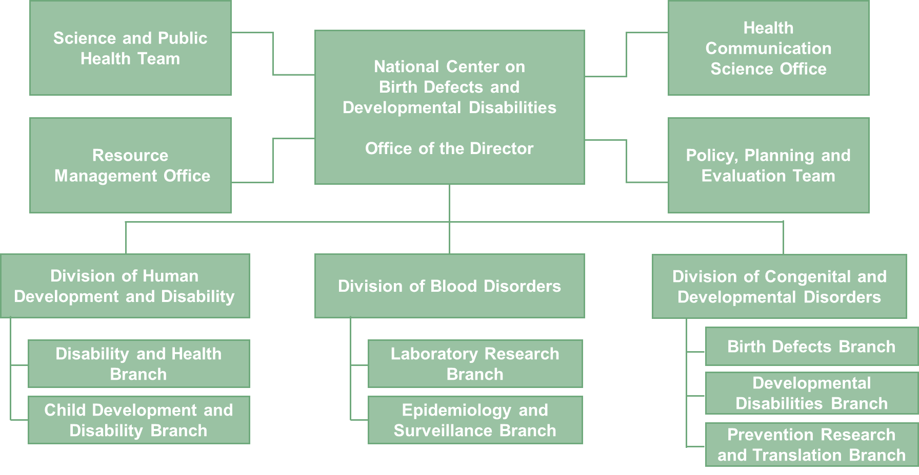
NCBDDD Organizational Chart
Notes:
The National Center on Birth Defects and Developmental Disabilities has 3 Divisions, Division of Blood Disorders, Division of Congenital and Developmental Disorders, formerly known as the Division of Birth Defects and Developmental Disabilities, and Division of Human Development and Disability.
The Disability and Health Branch sits within the Division of Human Development and Disability.

Slide 4
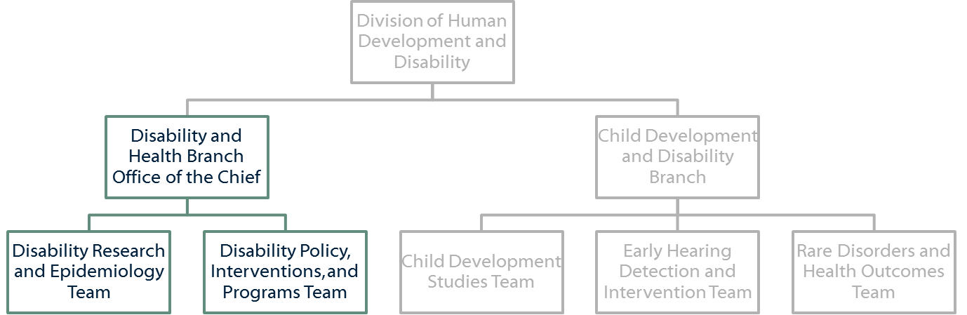
Disability and Health at CDC
Notes:
I am an epidemiologist on the Disability Research and Epidemiology team. Also within the Branch is the Office of the Chief and the Disability Policy, Interventions, and Programs team. We have evaluation and communication components to much of our work, and those functions and personnel sit within the Office of the Chief.
Today I’m going to talk a little bit about the Branch broadly, then more specifically about some of the data-related activities we’re working on, many of which sit with the DRE team.

Slide 5
Disability and Health Branch (DHB) Mission
Promote the health and full participation in society by people with disabilities across the lifespan.
Notes:
We have fine tuned our mission to promote the health and full participation in society by people with disabilities across the life span. Our work spans all age groups and all 6 functional disability types, but we have a concentrated effort in mobility limitations and intellectual disabilities.

Slide 6
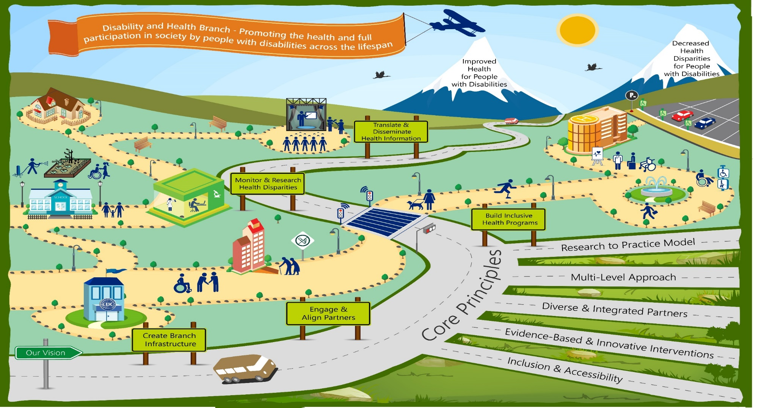
CDC’s Disability and Health Branch: Disability Roadmap (2016-2026)
Notes:
The pursuit of improved health outcomes for people with disabilities requires our branch understand the health disparities faced by people with disabilities across the lifespan and address them thru effective programmatic efforts with partners at the Local, State, and National levels.
This is our Disability Roadmap and it illustrates HOW we go about executing our collective efforts. As depicted in this Roadmap, the branch works along these 5 core principles to:
• Work across public health systems to encourage inclusion and make sure people with disabilities have access to the public health interventions that seek to improve the health of the whole population;
• Focus on specific functional populations as a whole, with accommodations as necessary; and
• Develop and implement public health programs for people with specific impairments or limitations.
The next slide depicts our Disability Roadmap using the socio-ecological model, which is an example of our multi-level approach.

Slide 7
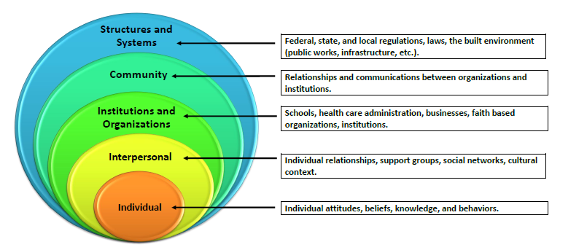
MULTI-LEVEL APPROACH:
Socio-Ecological Model
Notes:
Our Branch focuses on implementing inclusive public health programs using a socio-ecological model, which includes increasing healthy behaviors, decreasing the prevalence of chronic disease risk factors, such as smoking, obesity and physical inactivity, increasing the sustainability of programmatic, policy, systems, and environmental improvements such as the availability of effective health promotion programs for people with disabilities. These public health interventions will achieve greater impact when changing the environmental context, so that individuals can easily take healthy actions in the normal course of their lives. In short, the Disability and Health Branch aims to increase social and environmental improvements in infrastructure and services that foster the successful participation of people with disabilities in all areas of life.
The next few slides list our national and state programs and partners with whom we collaborate AND implement specific levels of this model to create sustainable improvements that will impact the successful participation of people with disabilities in the communities in which they live, learn, work, and play.

Slide 8
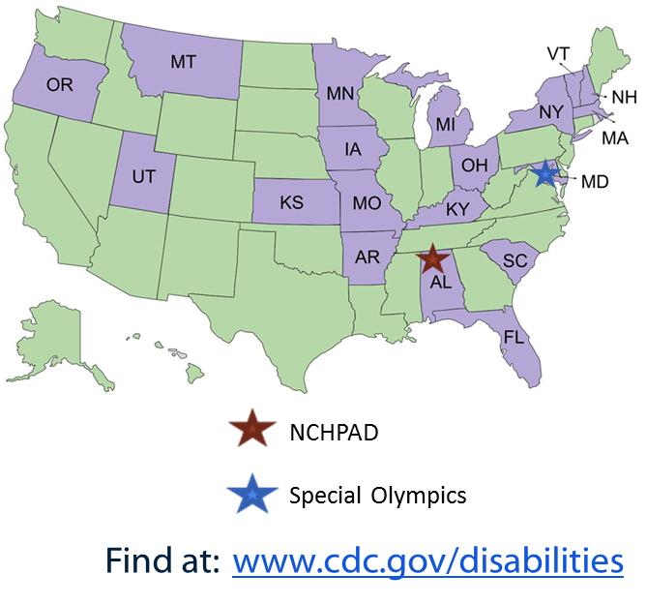
Disability and Health Programs
19 State Disability and Health Programs
National Centers on Disability
  National Center on Health, Physical Activity and Disability (NCHPAD)
  Special Olympics
Other disability and health programs and research
  American Public Health Association
  Association of University Centers on Disabilities
  Disability Research and Dissemination Center
  National Association of County and City Health Officials
  National Association of Chronic Disease Directors
Notes:
The Branch funds 19 State Disability and Health Programs who are working to improve the health and quality of life among people with mobility limitations and/or IDD through adaptation and implementation of evidence-based strategies in their communities. (5-yr cooperative agreement ending JUN 30 2021.)
The Branch also funds 2 National Centers on Disability – the National Center on Health, Physical Activity and Disability, or NCHPAD, and Special Olympics – who are working to develop, implement, evaluate, and report on activities aimed at reducing health differences between people with and without disabilities, again aiming to improve the health of people with mobility limitations and/or IDD. (5-yr cooperative agreement ending MAR 31 2021.)
In addition, shown on this slide are several other disability and health partners that we collaborate with on disability-specific programs and research. One that I would like to highlight is a collaborative project with the National Association of Chronic Disease Directors to promote disability inclusion strategies to make healthier choices the easier choices for all people where they may live, learn, work, and play. (Map of 5 states and 2 communities/state on next slide.)

Slide 9
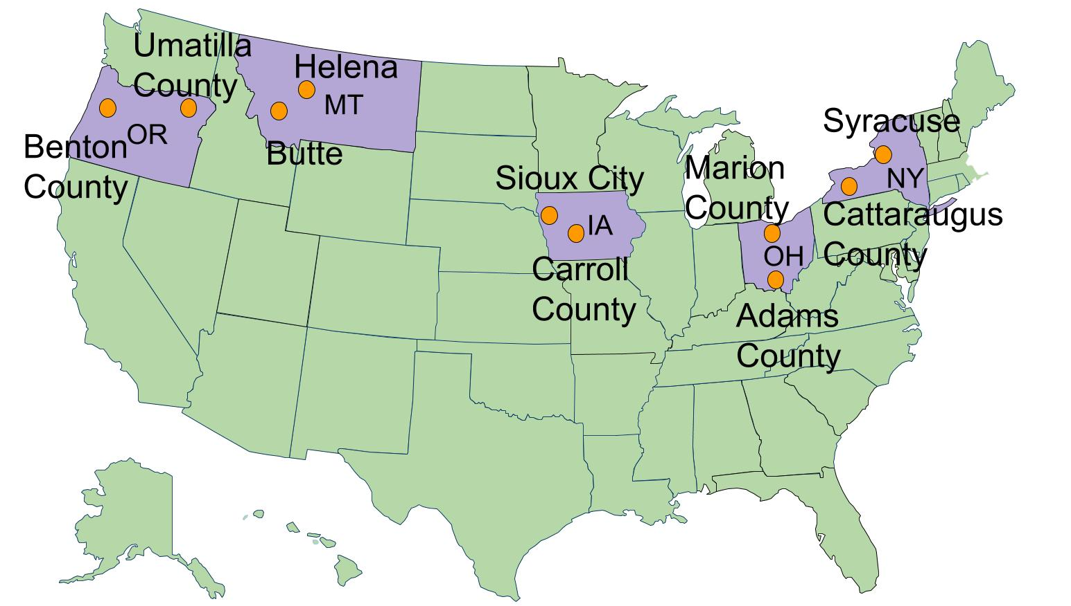
Reaching People with Disabilities Through Healthy Communities
Notes:
DHB currently provides funding to its partner, the National Association of Chronic Disease Directors (NACDD), for a project entitled Reaching People with Disabilities through Healthy Communities. Through this project, five states and ten local communities are working together to build healthy communities specifically designed to include people with disabilities, so they have the same opportunities for physical activity, healthy eating, and social participation as people without disabilities. This map shows the states and communities we fund (IA, MT, NY, OH, OR).

Slide 10

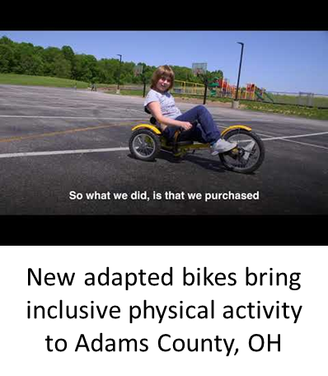
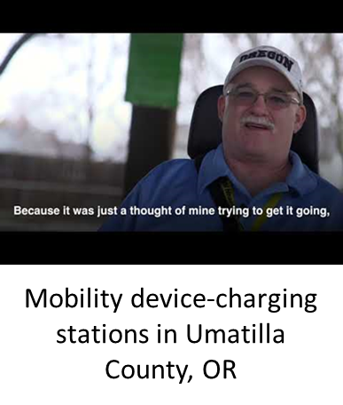
Reaching People with Disabilities
Through Healthy Communities
Watch how 10 communities foster disability inclusion in healthy activities….
Visit CDC’s Disability and Health website at https://www.cdc.gov/ncbddd/disabilityandhealth/reaching-people.html to see all the videos.
Notes:
Three of the Reaching People with Disabilities Through Healthy Communities projects are highlighted on this slide and the link to access the project-specific videos are available at the link shown here:
Sioux City, IA : The Long Line Family Recreation Center in Sioux City, Iowa, is an example of a facility that was changed to be inclusive. The recreation center met ADA accessibility standards for the building and grounds, however, the climbing wall was not designed for use by people with mobility disabilities. The Reaching People with Disabilities through Healthy Communities project team worked with the City of Sioux City and the Miracle League of Sioux City—a local nonprofit that provides recreational opportunities for children and adults with disabilities—to propose ideas and find the best approaches for improving the climbing wall. People with disabilities, family members, and other agencies came together to carry out the plan and created changes to the wall to make it useable by people with disabilities. The change has helped make the recreation center more inclusive of the 10,000 community members with disabilities.
Adams County, OH About one in six school-aged children in Adams County has a disability, and until recently, it was difficult for these students to participate in physical activity. However, Community Coaches for NACDD’s Reaching People with Disabilities through Healthy Communities project met with superintendents and directors of special education from two school districts and things began to change. Community Coaches, who are leading experts in healthy communities and disabilities and health, provided education to these officials about the importance of inclusive physical activity and various uses for adapted bicycles by students, teachers, and schools.
Due to the success of the project efforts, both school districts now have formally adopted a new physical activity inclusion policy stating that children with disabilities should have the same opportunity to participate in physical education classes and activities as children without disabilities. Also, as result of project team’s recommendations, all seven schools in Adams County are now equipped with adapted bicycles that students with disabilities can enjoy.
Umatilla County, OR Approximately one in seven community members in Pendleton, Oregon, are living with a disability and many of them rely on power wheelchairs and other mobility devices to get around and actively participate in their communities. However, all these devices run out of power after a certain period of time and when the battery dies, users can get stuck. Community Coach Darrin Umbarger, participant in NACDD’s Reaching People with Disabilities through Healthy Communities project and a power wheelchair user himself, found the perfect solution; he developed the mobility device-charging station. This unit, which can easily be mounted anywhere there is an electrical outlet, can assist power wheelchair users who need to charge batteries while in the community. Mr. Umbarger and other community coaches collaborated with the Pendleton Parks and Recreation Department to install the power charging stations and accompanying signage in locations around the community. Ten mobility device-charging stations have been installed in various community settings so far, including a recent installation at the Oregon Statehouse, serving as the first power charging station at a state capitol location in the country. Now, Mr. Umbarger and other power wheelchair users have an added sense of security, safety, and belonging to the community, where access to healthy living venues like community parks and places of interest are improved.

Slide 11
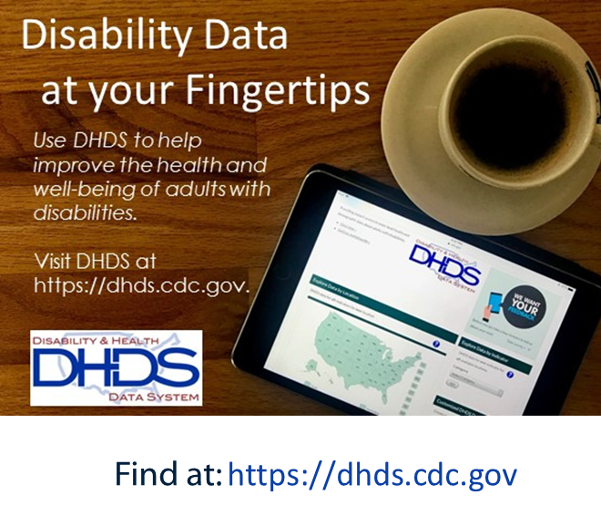
Disability and Health Data System (DHDS)
2016 data analyzed from Behavioral Risk Factor Surveillance System
  Disability status & types (hearing, vision, cognition, mobility, self-care, & independent living)
  30 health topics, including smoking, obesity, heart disease, & diabetes
Interactive maps, state profiles, and comparison reports
DHDS instructional videos
Notes:
Disability and Health Data System, or DHDS, which is our online, interactive tool presenting state-level data on measures of health for adults with disabilities. DHDS allows you to identify differences in health among adults with different types of disabilities compared with adults without disabilities.
Currently, DHDS includes 2016 data analyzed from the Behavioral Risk Factor Surveillance System (BRFSS). The main focus is on disability status (any disability or no disability) and disability types (hearing, vision, cognition, mobility, self-care, and independent living disabilities). There are data on over 30 demographic and health measures including hypertension, smoking, physical activity, obesity, heart disease, and diabetes.
There two main ways we like to think about viewing the data DHDS. The first way is to view data on one topic for all states and territories. This can be done through interactive maps, as well as customizable data tables, and downloadable data tables. The second way is to view data by comparison reports. For example, DHDS users can identify health differences between adults with and without disabilities overall and by location, demographics, and year.
Instructional videos on the use of the DHDS are available on-line at the DHDS website or through YouTube. We have one video targeted to beginning users of the DHDS and another for users who want instruction on more advanced features of the system, including examples of how the data can be used to plan for disability inclusive programs and services.
I would also like to mention that with the 2016 DHDS, we now have data on serious difficulty hearing or deafness and have implemented improvements to user experience and data visualizations.

Slide 12
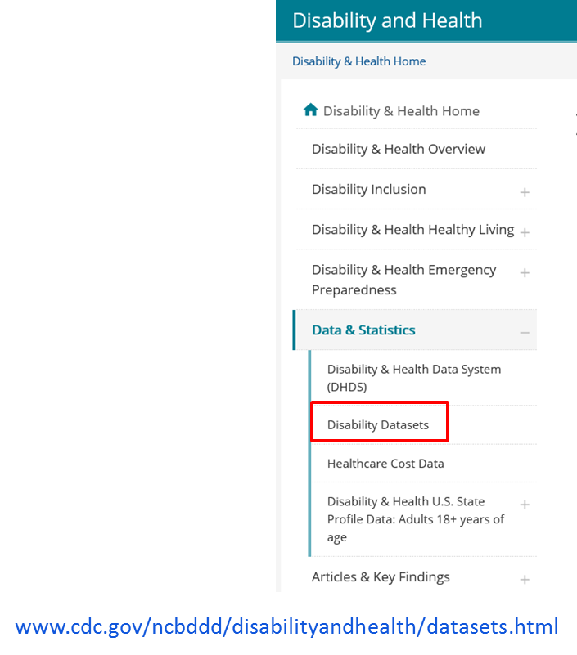
Population-based Data
Health surveys
  Behavioral Risk Factor Surveillance System (BRFSS)
  National Health Interview Survey (NHIS)
  National Health and Nutrition Examination Survey (NHANES)
Other surveys
  American Community Survey (ACS)
  Survey of Income and Program Participation (SIPP)
Notes:
For much of our work, we rely on the use of the six standard disability questions recommended by HHS and asked in many population-based data sources; some of the most common being national- and state-level health surveys, such as the Behavioral Risk Factor Surveillance System, the National Health Interview Survey, and the National Health and Nutrition Examination Survey. We also use some other population-based surveys that are not necessarily health-focused but do collect some information on disability; examples are the American Community Survey and the Survey of Income and Program Participation, both of which are conducted by the U.S. Census Bureau.
Information on these and other surveys that include questions on disability can be found on CDC’s Disability and Health website under “Data & Statistics” then “Disability Datasets”. I’ve also included the link on this slide.

Slide 13
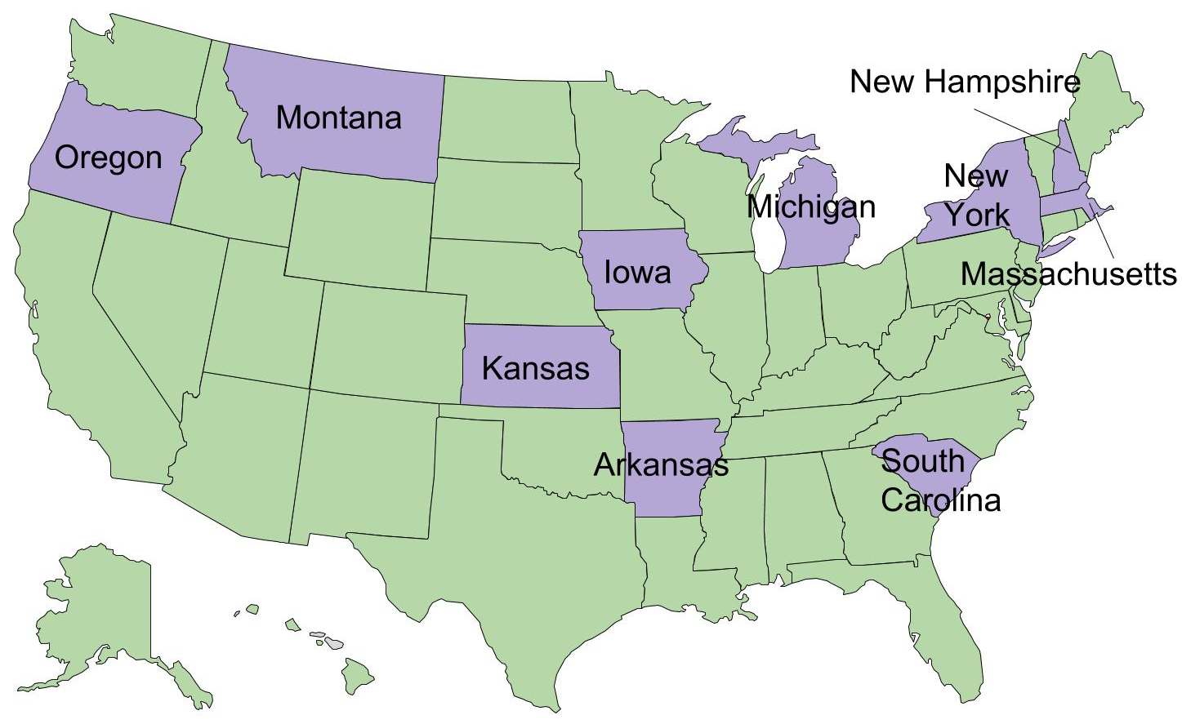
Administrative Data
State Medicaid Project
  10 states funded
  Identify patterns of health and health care use for people with IDD
Anti-hypertensive medication adherence randomized intervention trial
Utilization of hospital services among opioid users with disabilities
State- and national-level disability associated healthcare expenditures for adults in the U.S.
Seat at the CMS Virtual Research Data Center (VRDC)
Notes:
We are increasingly looking at utilizing administrative datasets, such as Medicaid data, which can allow us to better identify and characterize health for individuals who have IDD and who may be harder to identify in the population-based surveys I mentioned.
This ‘State Medicaid Project’ has developed over the last few years, and has grown from 1 state to now where currently we’re able to fund 10 states to access and utilize Medicaid data to identify patterns of health and health care utilization for people with IDD in their states.
We are also funding a randomized intervention trial in SC to test whether monthly prompts about hypertension/hypertension medication improves adherence to blood pressure-lowering medication in the adult Medicaid population who have with IDD. This is a multi-year study that just began in late 2017 (October). Medicaid data are being used to identify study participants with IDD and recruit a sufficient number of study participants. On completion of the trial an assessment will be conducted on whether the intervention successfully increased adherence.
In addition, two projects have recently been funded. One will use National Health Interview Survey (NHIS) and Medical Expenditure Panel Survey (MEPS) data from 2010-2016 to examine risk factors for opiate use in adults with physical disabilities and adults with IDD, and describe the prescription filling behavior and the health care utilization of adults with these disabilities. The second project will use nationally-representative data to estimate disability associated healthcare expenditures for adults. MEPS data will be used to identify those with disabilities and Medicaid, Medicare, and other data sets will be used to estimate costs. This will be an update of our previously published 2006 estimates.
The branch also holds a seat at the CMS Virtual Research Data Center. This seat allows researchers to securely perform their own analyses using Medicare and Medicaid data. Currently, we have used the seat to identify the ID population in each state and plan to conduct an initial study on oral health utilization among adults with ID. As we get more into these data, we see this as an area ripe for collaboration.

Slide 14
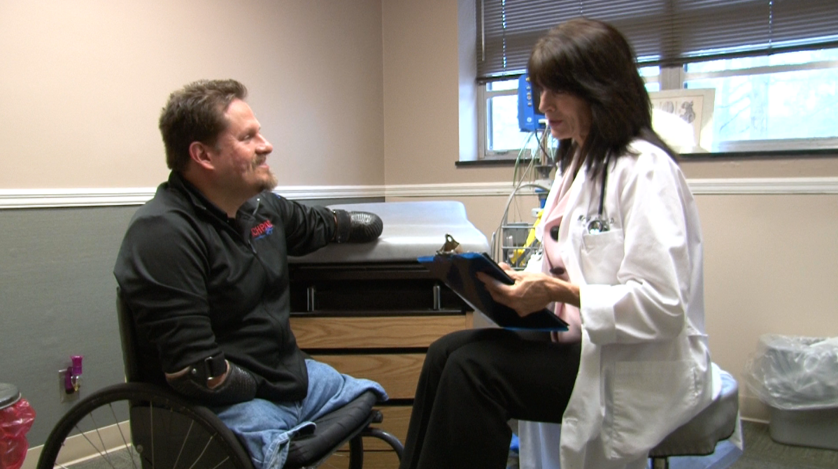
Other Data-Related Activities
Porter Novelli Styles data
  Hearing difficulty
  Intellectual disability
  Physical activity
  Emergency preparedness
2017 & 2018 NHIS
  Added a question to investigate factors that may contribute to cognitive difficulty
    “What is the MAIN reason for your difficulty concentrating, remembering or making decisions?”
Notes:
Some of our other data-related activities include our work with Styles data and NHIS.
The Styles surveys are a series of web-based surveys that are developed by Porter Novelli with technical guidance from federal public health agencies and others; CDC licenses the results of these surveys. Over the last few years we have added questions on hearing difficulty, intellectual disability, physical activity, and emergency preparedness; analysis and write-up of these results are ongoing or have been published. For example, “Primary Care Providers’ Level of Preparedness for Recommending Physical Activity to Adults With Disabilities” (PCD; Nov 2017).
We were also able to add a question to both the 2017 and 2018 NHIS which investigates factors that may contribute to cognitive difficulty. If someone responds that “yes” “because of a physical, mental, or emotional condition, they have serious difficulty concentrating, remembering, or making decisions” they are asked about the main reason for that difficulty. The 2017 data have been released and the 2018 data will likely be released in 2019.
What is the MAIN reason for [fill 1: your/ALIAS's] difficulty concentrating, remembering or making decisions?
01 Intellectual disability (formerly known as mental retardation)
02 Developmental disability (such as cerebral palsy or autism)
03 Dementia or Alzheimer’s disease
04 Learning disability or ADHD
05 Education level
06 Mental illness (such as depression, anxiety, post-traumatic stress disorder, emotional problem)
07 Traumatic brain injury or stroke
08 Age-related changes
09 Chronic health condition (such as diabetes, high blood pressure, heart disease, cancer, multiple sclerosis, Parkinson’s
disease, epilepsy)
10 Drugs or medications
11 Other (specify)
97 Refused
99 Don't know

Slide 15
Recent Publication Titles
Prevalence of disabilities and health care access by disability status and type among adults – United States, 2016
Using Medicaid data to characterize persons with IDD in five US states
Factors associated with ambulatory care sensitive emergency department visits for South Carolina Medicaid members with ID
Enhancing individual and community disaster preparedness: Individuals with disabilities and others with access and functional needs
Considering disability and health: Reflections on the Healthy People 2020 Midcourse Review
Find at: https://www.cdc.gov/ncbddd/disabilityandhealth/articles.html
Notes:
This slide contains a listing of recent publications.
Two, that I would like to highlight are products from our state Medicaid project:
Using Medicaid Data to Characterize Persons with Intellectual and Developmental Disabilities in Five U.S. States (American Journal on Intellectual and Developmental Disabilities; Jul 2018) and
Factors associated with ambulatory care sensitive emergency department visits for South Carolina Medicaid members with intellectual disability (Journal of Intellectual Disability Research; Mar 2018)
1. Prevalence of disabilities and health care access by disability status and type among adults – United States, 2016 (MMWR; Aug 2018)
2. Using Medicaid Data to Characterize Persons with Intellectual and Developmental Disabilities in Five U.S. States (American Journal on Intellectual and Developmental Disabilities; Jul 2018)
3. Factors associated with ambulatory care sensitive emergency department visits for South Carolina Medicaid members with intellectual disability (Journal of Intellectual Disability Research; Mar 2018)
4. Enhancing individual and community disaster preparedness: Individuals with disabilities and others with access and functional needs (Disability and Health Journal; Apr 2018)
5. Considering disability and health: Reflections on the Healthy People 2020 Midcourse Review (Disability and Health Journal; Jul 2018)

Slide 16
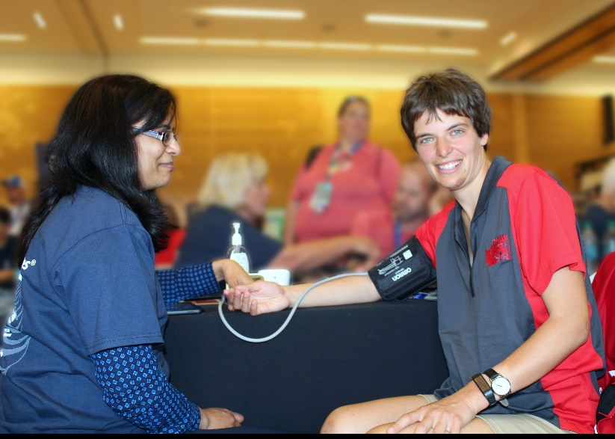
Works in Progress
Anti-hypertensive medication use among adults with IDD (in press)
Physical activity types among US adults with mobility disability (under review)
Utilization of emergency and inpatient care by children with IDD (in clearance)
Utilization of emergency and inpatient care by adults with IDD (in clearance)
2019 MMWR on food insecurity by disability and gender
Notes:
We also have a few publications either in press or under review; one looking at anti-hypertensive use among adults with IDD, two examining health care utilization among populations with IDD – one focused on children with IDD and the other adults with IDD, and, finally, a paper examining types of physical activity among adults with mobility disability.
Our branch also has a MMWR planned for later this year on food insecurity by disability and gender. Specifically, we will examine the intersection between food insecurity, disability, and gender by estimating household food insecurity prevalence among adults with any disability and six functional disability types (hearing, vision, cognitive, mobility, self-care, and independent living), compared to those without a disability, and stratified by socio-demographics (e.g., age, education). Additionally, we plan to describe gender differences in food insecurity by disability status and types. For this report, we will use 2015-16 National Health and Nutrition Examination Survey data to estimate household food insecurity

Slide 17
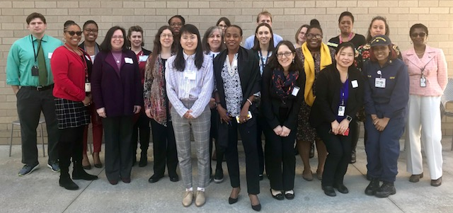
Upcoming…
State Medicaid Project Meeting
  SC, AR, IA, KS, MA, MI, MT, NH,
  NY, OR
  Spring 2019
DHDS update planned for spring 2019
  2017 adult population-based data
Continued support and collaboration with the Administration on Intellectual and Developmental Disabilities, Administration for Community Living
State Medicaid Project Meeting, 2018
Notes:
In Spring 2019, we’ll be meeting with both data/program reps from all 10 Medicaid states to look at/discuss data and continue work on an intervention which will be the primary focus of the last 3 years of their workplans. The proposed intervention is to develop, disseminate, and evaluate an evidence-based video series about diabetes self-management education and support for people with IDD, their caregivers, and health care providers. We'll have more to share after that meeting happens, but again, we’d be happy to set up a call with you all afterwards to keep you in the loop.
There is a DHDS update planned for later this spring. We’ll be doing communication and promotion when the 2017 DHDS data are rolled-out.
Finally, this past year we have had the privilege to participate in two work groups spearheaded by the Administration on Intellectual and Developmental Disabilities in the Administration for Community Living that have focused on future data needs for people with IDD. You will hear more about their efforts and the outputs of these workgroups in this afternoon’s session.

Slide 18
Thank you!
disabilityandhealthbranch@cdc.gov

Slide 19
Publications and Resources
Notes:
The pursuit of improved health outcomes for people with disabilities requires our branch understand the health disparities faced by people with disabilities across the lifespan and address them thru effective programmatic efforts with partners at the Local, State, and National levels. Thru a recent strategic planning process that has unfolded over the last few years, the branch has created a laser focus on our mission and HOW we go about executing our collective efforts.
As a result, we have fine tuned our mission to promote the health and full participation in society by people with disabilities across the life span. Our work spans all age groups and all 6 functional disability types, but we have a concentrated effort in mobility limitations and intellectual disabilities.

Slide 20
Publications (2018)
Kruger J, Hinton CF, Sinclair LB, Silverman B. Enhancing individual and community disaster preparedness: Individuals with disabilities and others with access and functional needs. Disab Health J 2018;11(2):170-173. doi: 10.1016/j.dhjo.2017.12.005
McDermott S, Royer J, Mann JR, Armour BS. Factors associated with ambulatory care sensitive emergency department visits for South Carolina Medicaid members with intellectual disability. J Intellect Disabil Res 2018;62(3):165-178. doi: 10.1111/jir.12429
McDermott S, Royer J, Cope T, et al. Using Medicaid data to characterize persons with intellectual and developmental disabilities in five U.S. states. AM J Intellect Dev Disabil 2018;123(4):371-381. doi: 10.1352/1944-7558-123.4.371
Okoro CA, Hollis ND, Cyrus AC, Griffin-Blake S. Prevalence of Disabilities and Health Care Access by Disability Status and Type Among Adults — United States, 2016. MMWR Morb Mortal Wkly Rep 2018;67:882–887. doi: http://dx.doi.org/10.15585/mmwr.mm6732a3
Notes:
We also have a few publications either in press or under review; one looking at anti-hypertensive use among adults with IDD, two examining health care utilization among populations with IDD – one focused on children with IDD and the other adults with IDD, and, finally, a paper examining types of physical activity among adults with mobility disability.
Our branch also has a MMWR planned for later this year on food insecurity by disability and gender. Specifically, we will examine the intersection between food insecurity, disability, and gender by estimating household food insecurity prevalence among adults with any disability and six functional disability types (hearing, vision, cognitive, mobility, self-care, and independent living), compared to those without a disability, and stratified by socio-demographics (e.g., age, education). Additionally, we plan to describe gender differences in food insecurity by disability status and types. For this report, we will use 2015-16 National Health and Nutrition Examination Survey data to estimate household food insecurity

Slide 21
Sinclair LB, Fox MH, Jonas BS, et al. Considering disability and health: Reflections on the Healthy People 2020 Midcourse Review. Disab Health J 2018;11(3):333-338. doi: 10.1016/j.dhjo.2018.04.001
Resources
A Data Users’ Guide to the Disability Questions Included in the Behavioral Risk Factor Surveillance System. Disability and Health Branch, Division of Human Development and Disability, National Center on Birth Defects and Developmental Disabilities, Centers for Disease Control and Prevention. URL: https://www.cdc.gov/brfss/data_documentation/pdf/BRFSS_Data_Users_Guide_on_Disability_Questions_2018-508.pdf
Articles about Disability and Health. Disability and Health, National Center on Birth Defects and Developmental Disabilities, Centers for Disease Control and Prevention. URL: https://www.cdc.gov/ncbddd/disabilityandhealth/articles.html
Disability and Health Data System (DHDS) Data [online]. Disability and Health, National Center on Birth Defects and Developmental Disabilities, Centers for Disease Control and Prevention. URL: https://dhds.cdc.gov
Notes:
We also have a few publications either in press or under review; one looking at anti-hypertensive use among adults with IDD, two examining health care utilization among populations with IDD – one focused on children with IDD and the other adults with IDD, and, finally, a paper examining types of physical activity among adults with mobility disability.
Our branch also has a MMWR planned for later this year on food insecurity by disability and gender. Specifically, we will examine the intersection between food insecurity, disability, and gender by estimating household food insecurity prevalence among adults with any disability and six functional disability types (hearing, vision, cognitive, mobility, self-care, and independent living), compared to those without a disability, and stratified by socio-demographics (e.g., age, education). Additionally, we plan to describe gender differences in food insecurity by disability status and types. For this report, we will use 2015-16 National Health and Nutrition Examination Survey data to estimate household food insecurity

Slide 22
Disability and Health Healthy Living. Disability and Health, National Center on Birth Defects and Developmental Disabilities, Centers for Disease Control and Prevention. URL: https://www.cdc.gov/ncbddd/disabilityandhealth/healthyliving.html
Disability and Health National Partner Organizations. Disability and Health, National Center on Birth Defects and Developmental Disabilities, Centers for Disease Control and Prevention. URL: https://www.cdc.gov/ncbddd/disabilityandhealth/partnerorganizations.html
Disability and Health State Programs. Newly Funded State Disability and Health Programs. Disability and Health, National Center on Birth Defects and Developmental Disabilities, Centers for Disease Control and Prevention. URL: https://www.cdc.gov/ncbddd/disabilityandhealth/programs.html
Disability and Health U.S. State Profile Data: Adults 18+ Years of Age. Disability and Health, National Center on Birth Defects and Developmental Disabilities, Centers for Disease Control and Prevention. URL: https://www.cdc.gov/ncbddd/disabilityandhealth/impacts/index.html
Disability and Health Branch. URL: http://www.cdc.gov/ncbddd/disabilityandhealth
Notes:
We also have a few publications either in press or under review; one looking at anti-hypertensive use among adults with IDD, two examining health care utilization among populations with IDD – one focused on children with IDD and the other adults with IDD, and, finally, a paper examining types of physical activity among adults with mobility disability.
Our branch also has a MMWR planned for later this year on food insecurity by disability and gender. Specifically, we will examine the intersection between food insecurity, disability, and gender by estimating household food insecurity prevalence among adults with any disability and six functional disability types (hearing, vision, cognitive, mobility, self-care, and independent living), compared to those without a disability, and stratified by socio-demographics (e.g., age, education). Additionally, we plan to describe gender differences in food insecurity by disability status and types. For this report, we will use 2015-16 National Health and Nutrition Examination Survey data to estimate household food insecurity

Slide 23
Disability Datasets. Population Surveys that Include the Standard Disability Questions. Disability and Health, National Center on Birth Defects and Developmental Disabilities, Centers for Disease Control and Prevention. URL: https://www.cdc.gov/ncbddd/disabilityandhealth/datasets.html
Disability Impacts All of Us. Disability and Health, National Center on Birth Defects and Developmental Disabilities, Centers for Disease Control and Prevention. URL: https://www.cdc.gov/ncbddd/disabilityandhealth/infographic-disability-impacts-all.html\
National Center on Birth Defects and Developmental Disabilities (NCBDDD). URL: https://www.cdc.gov/ncbddd
National Centers on Health Promotion for People with Disabilities. Disability and Health, National Center on Birth Defects and Developmental Disabilities, Centers for Disease Control and Prevention. URL: https://www.cdc.gov/ncbddd/disabilityandhealth/national-programs.html
Reaching People with Disabilities Through Healthy Communities. Disability and Health, National Center on Birth Defects and Developmental Disabilities, Centers for Disease Control and Prevention. URL: https://www.cdc.gov/ncbddd/disabilityandhealth/reaching-people.html
Notes:
We also have a few publications either in press or under review; one looking at anti-hypertensive use among adults with IDD, two examining health care utilization among populations with IDD – one focused on children with IDD and the other adults with IDD, and, finally, a paper examining types of physical activity among adults with mobility disability.
Our branch also has a MMWR planned for later this year on food insecurity by disability and gender. Specifically, we will examine the intersection between food insecurity, disability, and gender by estimating household food insecurity prevalence among adults with any disability and six functional disability types (hearing, vision, cognitive, mobility, self-care, and independent living), compared to those without a disability, and stratified by socio-demographics (e.g., age, education). Additionally, we plan to describe gender differences in food insecurity by disability status and types. For this report, we will use 2015-16 National Health and Nutrition Examination Survey data to estimate household food insecurity

