Slide 1
Contingent Employment of Individuals with Disabilities: Key Issues and Challenges
Nathan W. Moon, PhD Frances Hughes Harris, PhD
Senior Research Scientist Research Scientist
Center for Advanced Communications Center for Assistive Technology
Policy (CACP) and Environmental Access (CATEA)
Georgia Institute of Technology Georgia Institute of Technology
Atlanta, Georgia Atlanta, Georgia

Slide 2
A Nation of Contingent Workers
Transformation in work arrangements in United States: Increasingly a nation of contractors and freelancers
What is “contingent employment?”: Definitions vary
Lack of attachment between employer and worker
Reliance upon conditional factor for employment: fixed, limited period of time or specific job to be done

Slide 3
Implications for Individuals with Disabilities
Complex, to say the least
Positive – Entry into workforce, Opportunities to counter unemployment and underemployment, Flexibility that standard employment may not offer
Negative – Potential for lower pay and few benefits, no provisions for workplace accommodations, undermine goals of full employment
Truth is, we know very little…
Schur (2003) and others – Health needs and flexibility as drivers
Kennedy and Olney (2006) – Implications of SSDI benefits on work
Zyskowski et al (2015) – Participation in so-called “gig economy”

Slide 4
A Major Research Gap Remains
Actual participation and experiences of individuals with disabilities in contingent work remains understudied
Prevalence or incidence of contingent work among this group
Individual and environmental factors associated with efficacious outcomes
Purpose of our project (Field Initiated Project on Contingent Employment of Individuals with Disabilities, FIP-CE)
Qualitative research to identify variables associated with practices and experiences
Produce and test survey that operationalizes key concepts
Establish a preliminary, generalizable evidence base

Slide 5
Qualitative Research Overview
Exploratory in nature; they tease out the complexity of a person’s experiences and choices regarding non-traditional employment
Data can generate categories and themes that can be operationalized to build quantitative research instruments, such as self-reports
Analysis of 60-90 minute telephone interviews (N=22)
All interviews were taped, transcribed verbatim. Data were entered into NVivo for content analysis
Findings presented here as “personas,” a composite character representing the behaviors, needs, goals, and attitudes described in participants’ interviews.

Slide 6
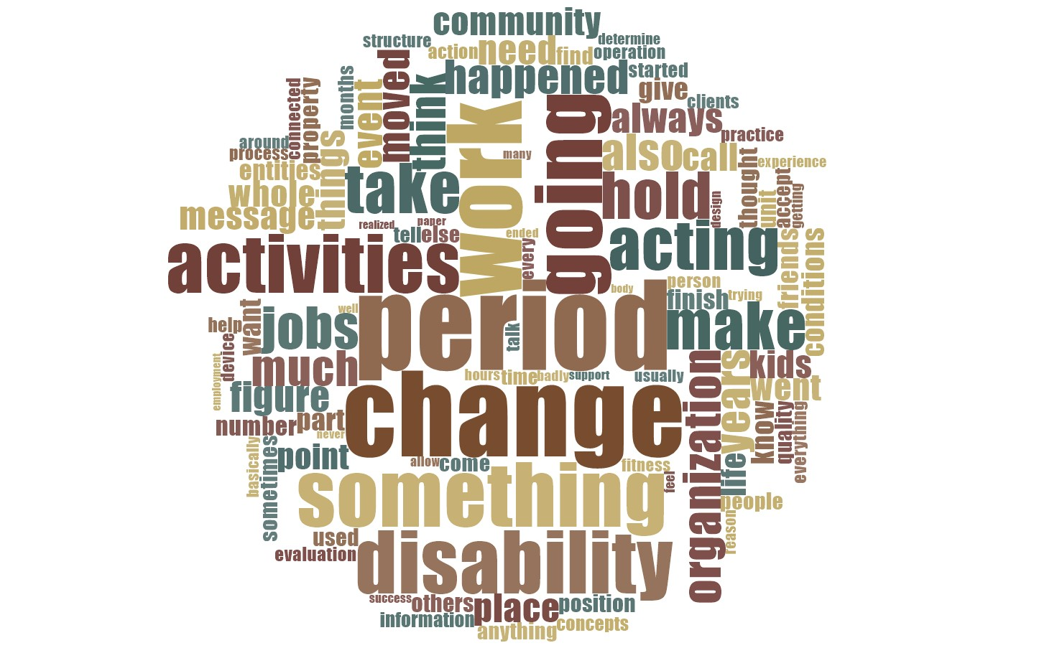
Example Word Cloud
Notes:
Alt text: A circular grouping of words based on our coding of interviews, with the most frequently occurring words appears the largest. Words are generalizations in which synonyms are included. The largest words or concepts included: period (denoting time), change, work, disability, and activities.

Slide 7
Persona #1 - David
45-year-old, male, Hispanic origin
Spinal cord injury (T-11) resulting from a bicycle accident nearly 4 years ago, paraplegic, manual wheelchair user, able to drive a car
Previously, David worked in the hoteling industry as a bartender. Since the accident he has been unable to find full-time employment.
David’s main recreational activity and passion is scuba diving, and he has developed strong friendships with other divers through a local scuba shop.
He makes ends meet by working at the dive shop repairing scuba equipment. He charges a flat rate for a specific repair and has an informal agreement to invoice the shop owner for a percentage of the fee (i.e. piece rate work).
Before his accident, David’s income was approximately $50,000. Currently, he earns approximately $15,000 a year. Together with SSDI and his savings, he has been able to make ends meet.

Slide 8
David (continued)
David’s goal remains full-time employment, and he continues to look for a job.
Fatigue, particularly the need to change positions and stretch, influence the work he can do.
Although David was successful in his work prior to the accident, he now struggles with having to find another way to earn income. His SSDI is critical to surviving financially. However, he’s concerned that if his income increases over the SSDI cap by even a little, he will lose his benefits.
His current contingent work has been an important constant throughout his work history and currently provides the financial means to maintain a key activity in his life – diving.
In the months immediately following his injury the dive shop also became an emotional refuge, and the owner and other employees provided essential social support.
Assistive technology is also essential to his new life. He has a standing wheelchair at the dive shop, paid partly by State VR, without which he couldn’t do his work.

Slide 9
Persona #2 - Angela
24-year-old, female, born with spinal muscular atrophy (SMA)
Angela has a BA in English literature and earns approximately $28,000 a year
She freelances as a copy editor and reviewer for various online publications. Work is on a contract basis (a flat rate per review)
She commutes 4 hours once a week to a paid internship in a theater focusing on inclusivity and diversity themes. The internship is to learn about managing and supporting theater operations
Angela also volunteers to edit and review for a number of online disability periodicals and websites, and uses her expanding social network to increase her employment opportunities.

Slide 10
Angela (continued)
Angela uses both assistive technology (i.e., a power wheelchair, leg and wrist braces, Dragon Dictate), and personal assistance (i.e. her mom helps her to get ready in the morning and evening. A paid attendant is hired when she travels between home and one of her jobs.)
Angela has never had a permanent job. However, she’s satisfied with the online, contractual, freelance nature of her current work, and values both the education and income it provides. In addition, contingent work is consistent with her goal to be independent and to work on jobs that are meaningful to her.
Angela’s case underscores the importance of volunteering as a deliberate strategy to gain work experience and to establish a social network comprised of people who are simultaneously friends, coworkers, and employers. These increase her exposure to different kinds of career paths as well as to other job opportunities.

Slide 11
Persona #3 - Jackie
45-year-old woman who has been Deaf since birth.
She has worked for many years as a ”secret shopper” (i.e., someone hired to measure quality of service, or observe compliance with regulations, or gather specific information about products or services)
Some of Jackie’s jobs involve a mobile phone app that will offer her “microtask” jobs (taking a photo of a product display at a local drug store)
Other jobs include a contract with a pharmaceutical company to periodically audit doctors’ offices and ensure that doctors’ samples are being dispensed appropriately.
She views her primary work as the contract jobs she enjoys and has relied on for income most of her working life. Although her income has varied over the years, she currently earns approximately $75,000 a year.

Slide 12
Jackie (continued)
Jackie’s primary vocation is her “contingent work” which interests her the most and has provided consistent “side work” throughout her life. She has had traditional work before, mainly for the purposes of obtaining healthcare benefits.
Her contingent work is a goal in itself and can be combined (or not) with either full-time or part-time work.
Jackie’s interview emphasizes the importance the emerging “gig economy” in her work.
The development of online resources, cell phones, and apps have made it possible to do Jackie jobs – not only more effectively and efficiently – but also with greater autonomy. They allow her to set the pace of her work, her interactions with the companies she contracts with, and the work activities she performs.

Slide 13
Persona 4 - Jimmy
56-year-old male who has been blind (no light perception) since birth, born in Brazil and adopted, has spent most of life in Kansas City
Completed a bachelor’s degree in communications
Held numerous contract-based call center jobs, first in debt collections and then telemarketing
Eventually worked for Gateway Computer and then Freedom Scientific, all of which was part-time, contract-based, and done remotely
Based on his computer expertise and knowledge of accessibility, would accept “jobs” to visit clients with blindness and low vision around the country to help them set-up and use screen reading software
Worked as a paid musician to make ends meet, occasionally doing call-based work while on the road
Recently accepted a full-time, permanent position as an Assistive Technology Professional for the State of Washington

Slide 14
Discussion
Role of disability benefits (e.g. SSDI) in contingent work decisions
Flexibility and life-work balance
Importance of volunteering as strategy to get contingent employment
Differences in people with congenital vs acquired disabilities
Importance of technologies to contingent employment (assistive tech as well as computers, cell phones, and apps – (e.g., secret shopper).
Contingent work as: 1) a means to or strategy in career development, 2) as a goal in itself that combines flexibility with life-work balance, and 3) as a transitional or experimental approach to employment after a disability is acquired.

Slide 15
Thank you
For questions or a copy of this presentation, please e-mail: nathan.moon@gatech.edu or frances.harris@design.gatech.edu
We acknowledge our co-investigators Maureen Linden and Salimah LaForce at the Georgia Institute of Technology
The FIP on Contingent Employment of Individuals with Disabilities is funded by the National Institute on Disability, Independent Living and Rehabilitation Research of the Administration for Community Living (ACL), Department of Health and Human Services (HHS) under NIDILRR grant number 90IFRE0004. The opinions contained in this presentation are those of the grantee and do not do not necessarily represent the policy of NIDILRR, ACL, HHS, and you should not assume endorsement by the Federal Government.

