Slide 1
BLS Occupational Requirements Survey (ORS)
2016 Annual Compendium on Disability Statistics
February 14, 2017
Renee Marshall
Supervisory Economist
Office of Compensation and Working Conditions

Slide 2
What is ORS?
A new Bureau of Labor Statistics survey
Designed to produce occupational requirement estimates similar to the Dictionary of Occupational Titles data
Collected from employers by interview
Funded by the Social Security Administration

Slide 3
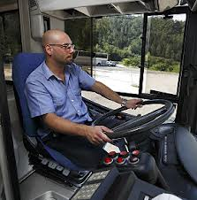
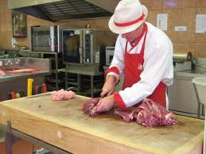
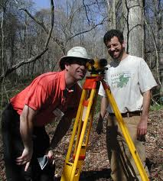
The Occupational Requirements Survey
The Occupational Requirements Survey (ORS) – provides occupational-related data including:
Vocational Preparation
Physical Demands
Environmental Conditions
Cognitive Demands

Slide 4
ORS Testing and Implementation
Proof of Concept
Design Testing
Implementation
Pre-Production
Ongoing
Production
Phase 1
Feasibility
Job Observation & Cognitive Testing
Production
Phase 2
Phase 3
Consultant
Report
Publish
2013 2014 2015 2016 2017

Slide 5
We have data!!
First set of estimates published on December 1, 2016
Building the sample
Full sample considered 3 years
First year sample group was smaller than subsequent years
Complete set of estimates expected by 2019

Slide 6
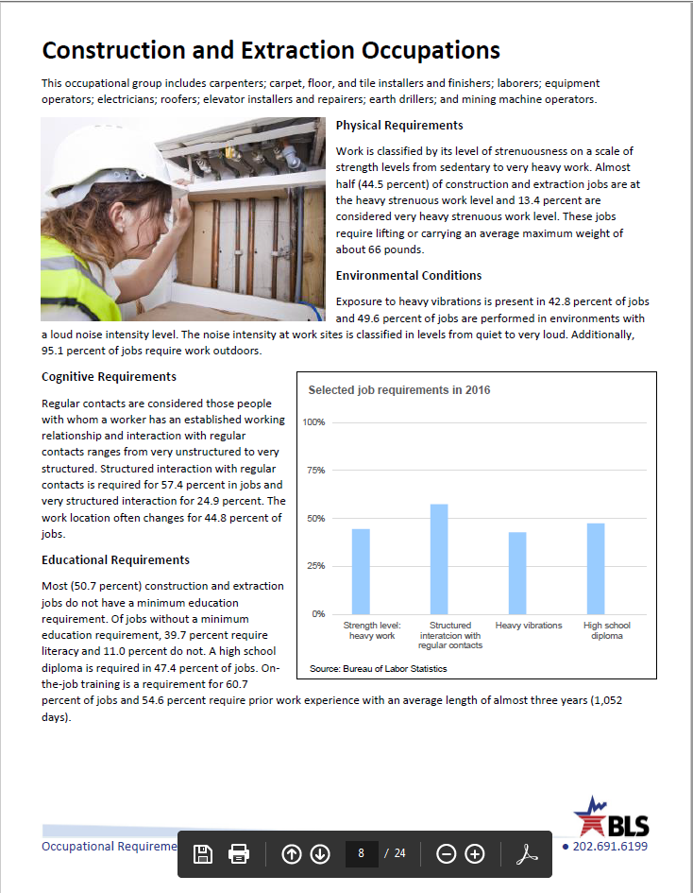
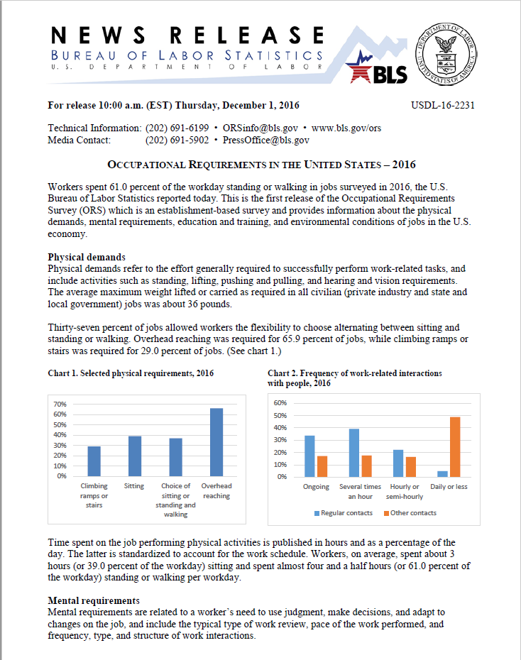
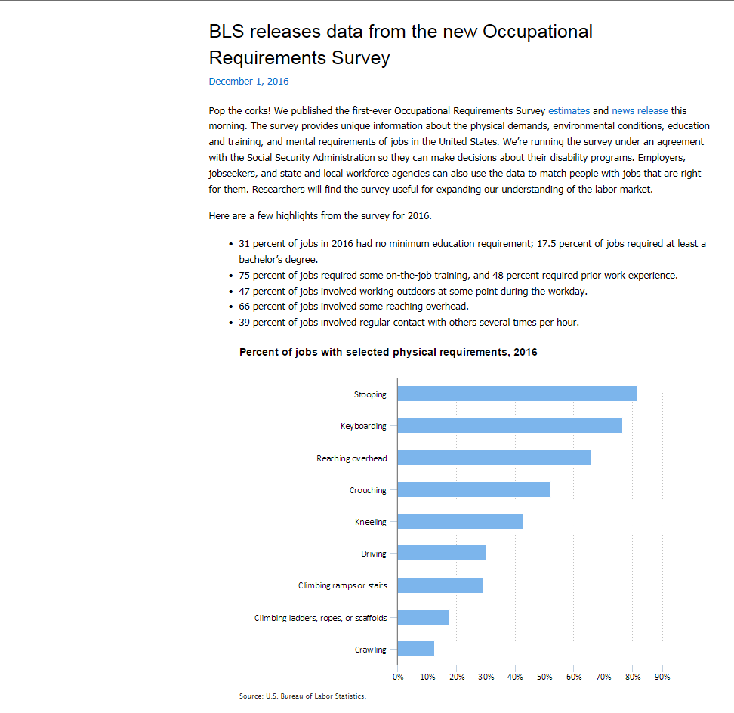
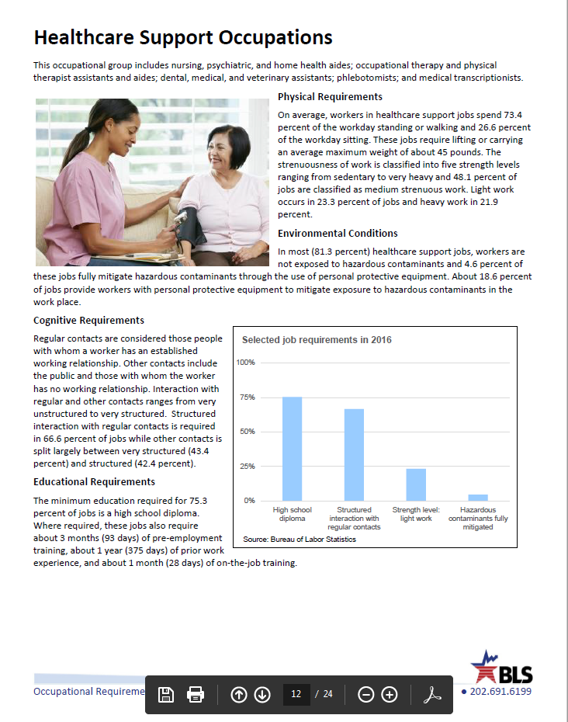
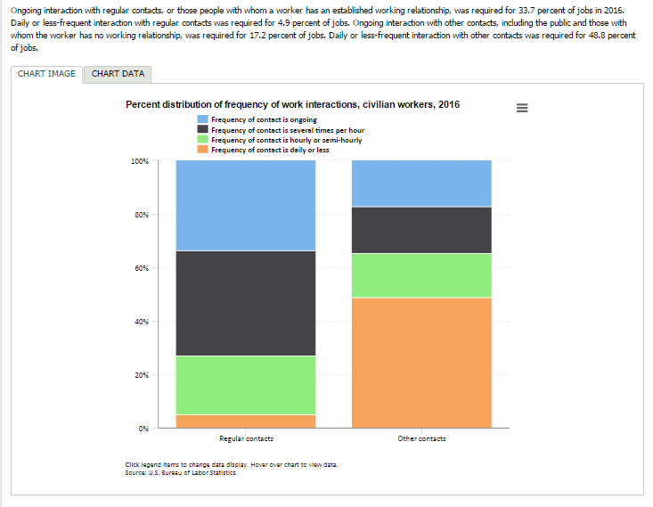
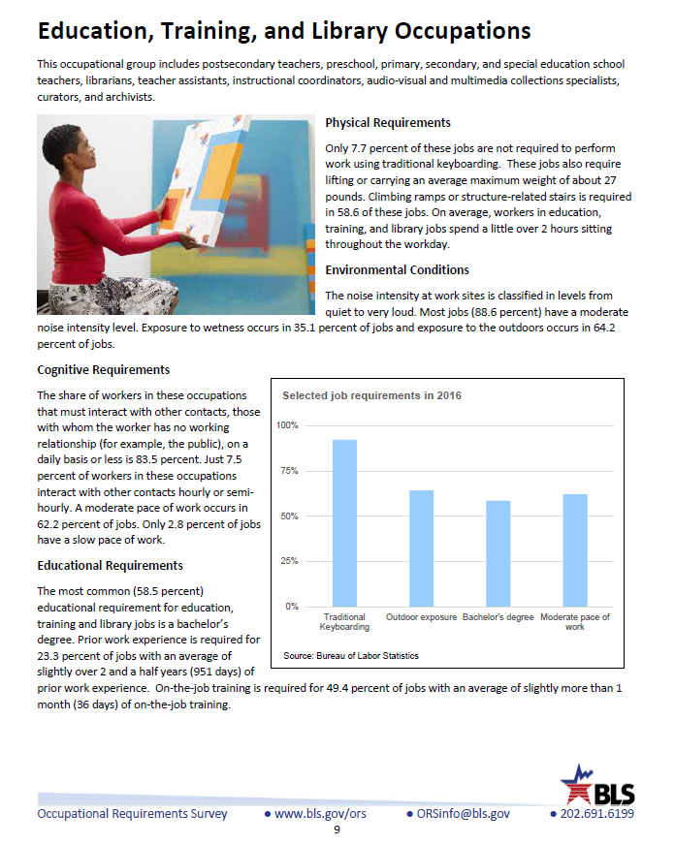
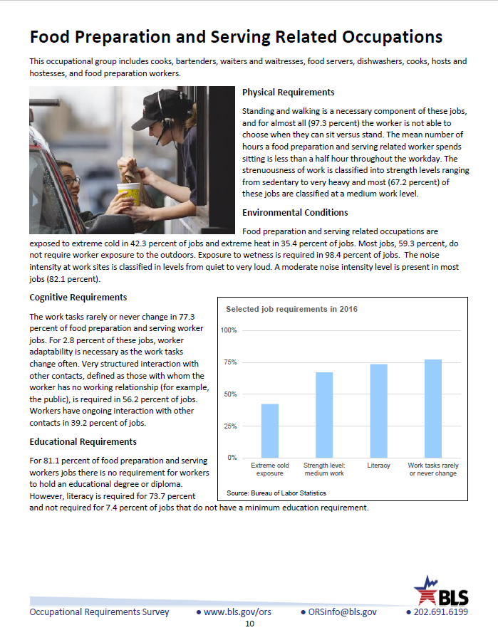
What’s been published

Slide 7
Percent Distribution SVP, Civilian Workers, 2016

Slide 8
All Worker versus Occupation Data
Computer User Support Specialists Overhead Reaching | Estimate | Std. Error
Not required | 56.0 % workers | 8.1
Hours, mean | 0.25 hours | 0.05
% of day, mean | 3.1% | 0.6
% of day (10th percentile) | 1.0% | -
% of day (50th percentile - median) | 2.5% | -
% of day (75th percentile) | 3.0% | 0.7

Slide 9
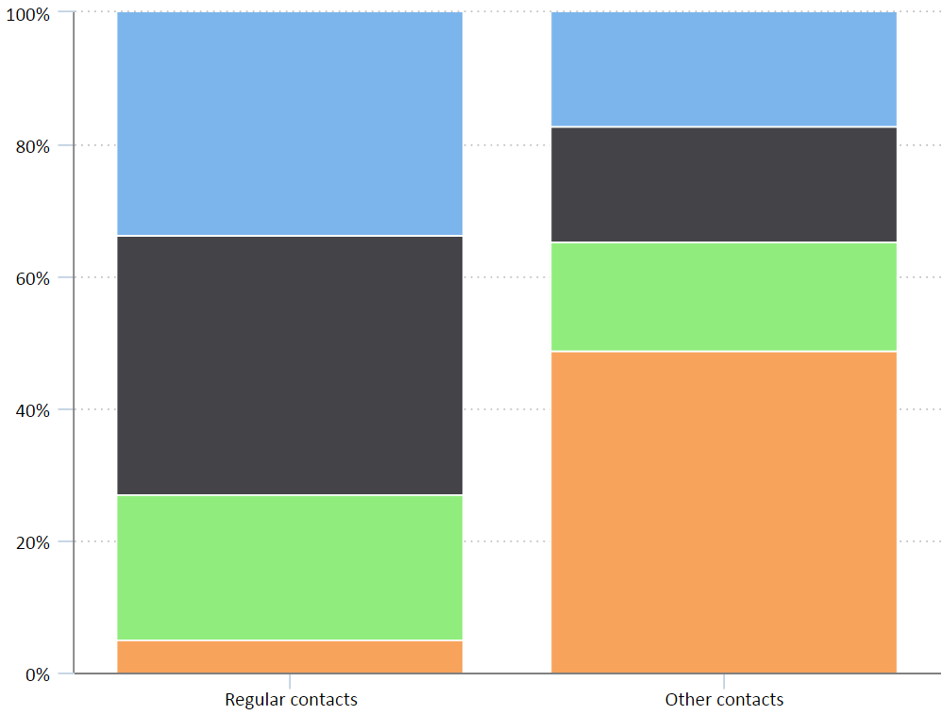
Percent distribution, Frequency of Work Interactions, Civilian Workers, 2016

Slide 10
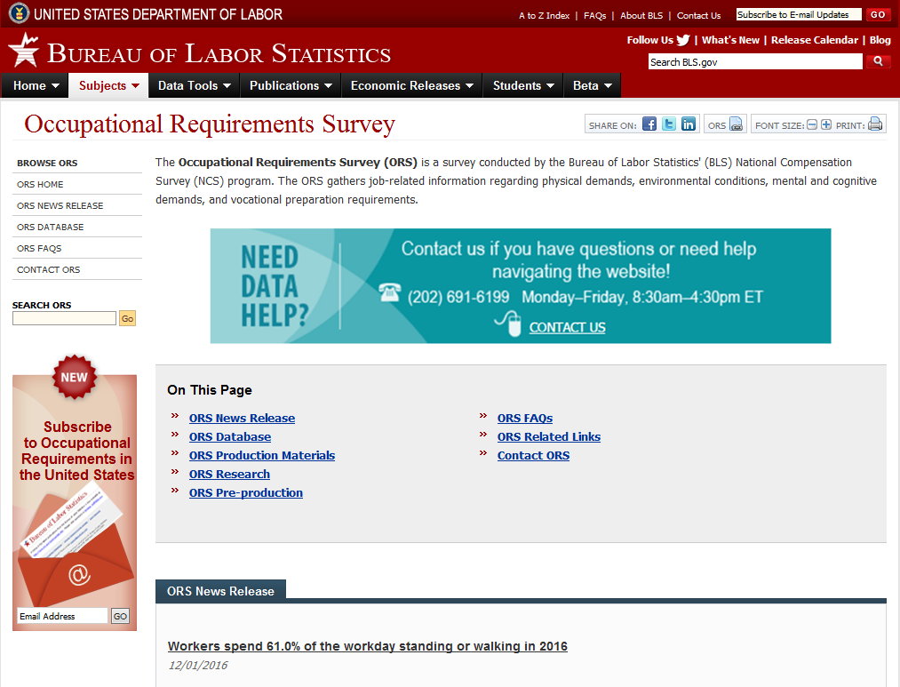
How can I find the data?

Slide 11
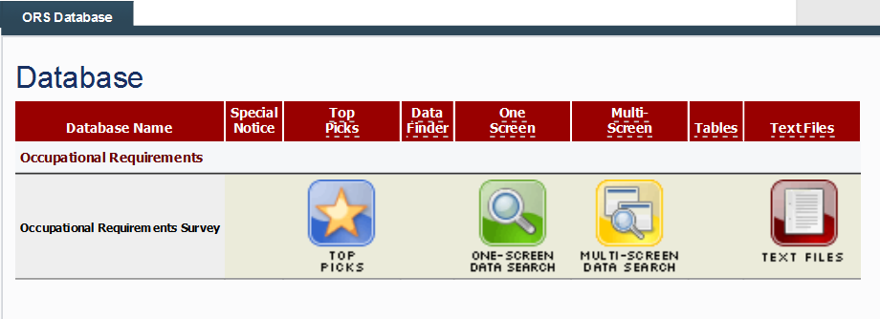
How can I find more data?

Slide 12
One Screen Query

Slide 13
BLS ongoing partnership with SSA
Involved in validity testing
Invested in ongoing program development
Expands data available for disability process

Slide 14
2016 Research Papers
Dynamics of occupational change
Data Visualization Methods
Imputation Methodology
Assessing the Reliability of Conversational Interviewing
Variance Estimation

Slide 15
Where to find more information?
www.bls.gov/ors
Telephone: (202) 691-6199 (Monday - Friday, 8:30 A.M. - 4:30 P.M.)
TDD Information voice phone: (202) 691-5200
The Federal Relay Service: 1-800-877-8339

Slide 16
Renee Marshall
marshall.renee@bls.gov
(202) 691-6242

