Slide 1
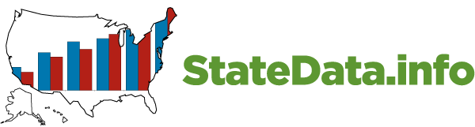


Access to Integrated Employment
Outcomes, Services, & Opportunities
February 13, 2019
Notes:
Brief summary of where we are nationally
We have challenges at three levels:
Systems that establish a priority for employment
Organizations that get there
Supports that are innovative, flexible, and creative

Slide 2
Core Activities
National Survey on Day and Employment Services
State IDD Agencies
VR services and outcomes
RSA 911
National Core Indicators
American Community Survey
Employment participation and outcomes
Social Security Administration
Work incentive use, work participation
Workforce development
Number of customers, entry into employment

Slide 3
Core Activities
Promising Practices
IDD Agency, Community Providers,
Community Life Engagement
National Survey of Community Rehabilitation Providers
1987, 1992, 2002-2003, 2010
Employment first case studies
Young Adult Outcomes and Services Report
Real People Real Jobs
www.realworkstories.org

Slide 4
How many people are employed?
No disability
No disability
Any disability
Any disability
Cognitive disability
Cognitive disability
Source: American Community Survey
Notes:
Population focus
Earned income, Hours worked, Poverty,
Ability to explore other areas including unearned income, occupation, living situation

Slide 5
Number in Employment and Day Services
Draft 1/15/19
637,000
312,448
Source: ICI National Survey of
State IDD Agencies
Notes:
JB

Slide 6
Number in Employment and Day Services
Draft 1/15/19
637,000
312,448
+18%
Source: ICI National Survey of
State IDD Agencies
Notes:
JB

Slide 7
Participation in integrated employment services varies widely
Source: 2017 ICI National Survey of
State IDD Agencies
Notes:
JB

Slide 8
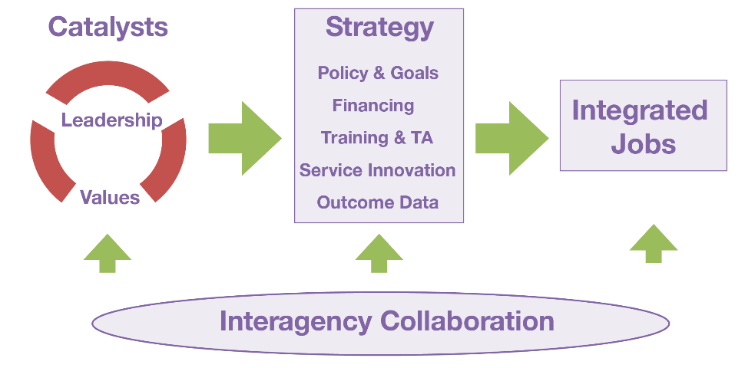
Context matters
Higher-Performing States Model
Hall et al., 2007
Notes:
8

Slide 9
Works In Integrated Employment
Nation
Notes:
Montana 13% in integrated employment. Percent working?

Slide 10
NCI How spend time

Slide 11
Supporting Choice
Paid job 20%
Does not want job
53%
Wants job
47%
Job goal 39%
No job goal in ISP
61%
No paid job 80%
637,000
297,480
180,270

Slide 12
Changing Investments
Integrated Employment
13.0%
Integrated Employment
18.8%
Services
Funding
Source: ICI National Survey of
State IDD Agencies 2016
Notes:
49697
16-21 24437 49% (49.2)
22-30 10520 21% (21.1)
Other 30% (29.7%)

Slide 13
Self Sufficiency & Meaningful Day
Mean Hours and Wages per week
 | Hours worked | Gross Wages
Individual job with supports | 12.5 | $106
Individual job without supports | 14.5 | $129
Group supported job | 15.1 | $87
Notes:
People in group supported jobs are also more likely to say they want to work somewhere else
25% for those in individual jobs with or without support
34% for those in group supported jobs

Slide 14
Self Sufficiency & Meaningful Day
Mean hours worked/week
Individual Supported Jobs
13
Notes:
High Performing:
DE,SC, OK, CT, LA, NY, OH
Need to figure out the whole day – if we don’t someone else will

Slide 15
VR trends: Nation
Number of closures: Persons with ID
Total closures
Closed into employment
Recession
* PY2017 adjusted due to 9 month year
Source: RSA 911

Slide 16
VR: Engagement
Percent of closures with an ID
Source: RSA 911 PY2017

Slide 17
Use of work incentives:
Impairment Related Work Expenses
Source: SSA

Slide 18
Policy Influences
CMS Employment Guidance
CMS Settings Rule
Department of Justice
WIOA
State Employment First

Slide 19
Focus Areas
WIOA Implementation
Pre-employment Transition Services
Section 511: Subminimum wage
Interagency collaboration
Community Life Engagement
Provider capacity
Case Management
Service definition redesign
Funding

Slide 20
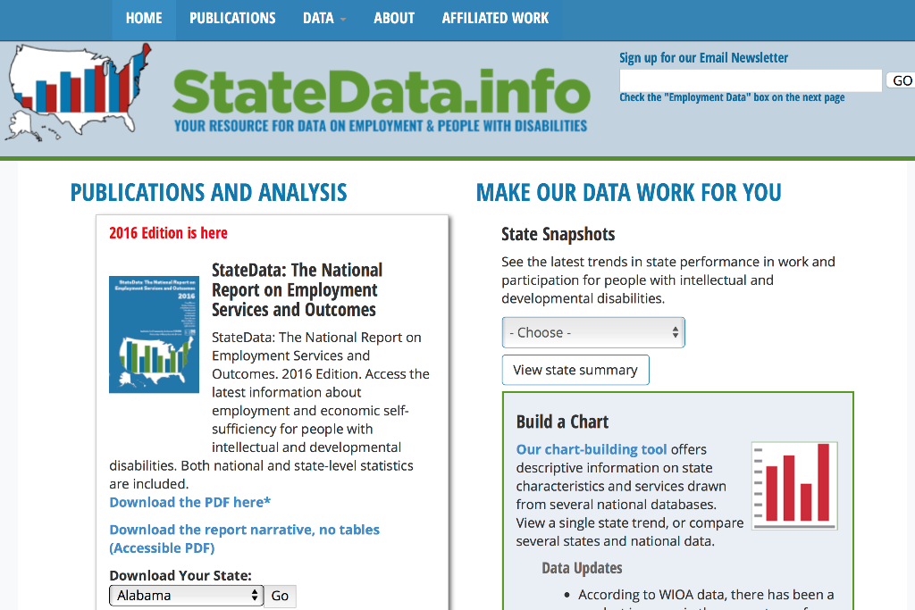
2
1
3

Slide 21
John Butterworth
(617) 287-4357
john.butterworth@umb.edu
www.ThinkWork.org
www.RealWorkStories.org
www.StateData.info

