Slide 1
Using Behavioral Science to Improve Survey Participation: An Experiment with the National Beneficiary Survey
Jason Markesich, Ryan Callahan, Jesse Chandler
and Amy Johnson
Presented at the 2017 Annual Disability Statistics Compendium Event
Washington, DC
February 13, 2018

Slide 2
About the National Beneficiary Survey (NBS)
Sponsored by the Social Security Administration’s (SSA’s) Office of Retirement and Disability Policy
Mathematica has conducted six rounds of the survey since the NBS began in 2004
Collects data on the employment-related activities of working-age Social Security Disability Insurance (SSDI) and Supplemental Security Income (SSI) beneficiaries

Slide 3
About the NBS (cont’d)
Dual-mode administration: telephone interviewing with in-person locating and interviewing
Methods to promote response include:
  Incentives ($30)
  Advance letters and reminder notifications
  Spanish language interviews
  Assistive technologies
  Assisted interviews and proxies

Slide 4
Growing Challenge: Reaching Sample Members and Gaining Cooperation
Metric | Trend (2004 to 2015)
Call-in rate
Completion rate
Refusal rate
Attempts/complete
Attempts/non-complete
Interviewer hours/complete

Slide 5
Strategy: Leverage Behavioral Science
The study of how people make decisions in a complex world where making the right decision is often difficult
Involves diagnosing and designing solutions to common behavioral bottlenecks:
  Limited attention
  Forgetfulness
  Procrastination

Slide 6
Could the Advance Letter be Contributing to Bottlenecks?

Slide 7
Comparing the Four Advance Letters Tested in the Experiment
Letter Type | Feature
Original | States that an interviewer will call soon Invites sample members to call in or call/email with questions
Concrete | Provides a clear action step. Call to: complete the interview, schedule a time to be interviewed, or decline participation
Personally Relevant | Incorporates language that explains how SSA would like “you to tell us about yourself and your experiences with programs like SSDI and SSI”
Concrete and Personally Relevant | Includes both the personable language and the action step mentioned above

Slide 8
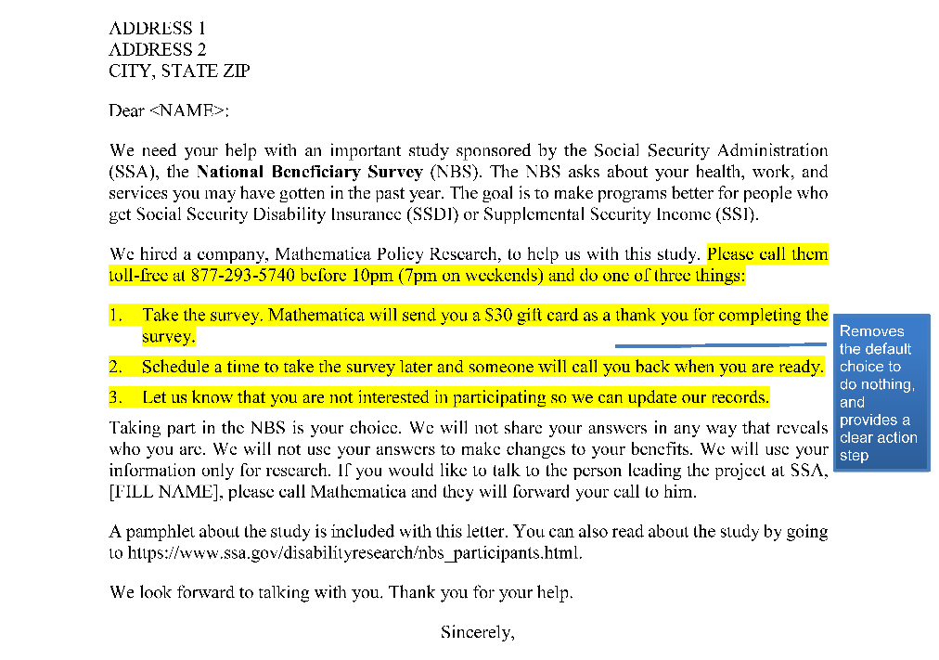
Concrete Letter

Slide 9
Methods
Randomly assigned 5,020 cases to one of four experiment groups
Mailed the advance letters first class
Did not conduct any outbound dialing for 8 days after letters mailed; accepted call-ins and tracked call-in outcomes during this timeframe

Slide 10
Concrete Letter Boosted Call-In Rates by More Than 50%

Slide 11
Concrete Letter Generated Highest Percentage of Completed Interviews for Call-Ins
Note: Others include gatekeepers/family members who provided new contact information, and sample members who were ineligible for the interview.

Slide 12
Behavioral Science Tips to Improve Your Communications
Apply a skim test
Put your bottom-line up front
Use simple, non-technical language
Provide a clear, single next step or action
for the reader to take

Slide 13
Contact Information
Jason Markesich
Center for Studying Disability Policy
Mathematica Policy Research
600 Alexander Park
Princeton, NJ 08540
(609) 275-2326
JMarkesich@mathematica-mpr.com
http://www.DisabilityPolicyResearch.org

