Slide 1
Telehealth experiences of adults with and without disabilities during COVID-19
Kimberly Phillips
February 12, 2021

Slide 2
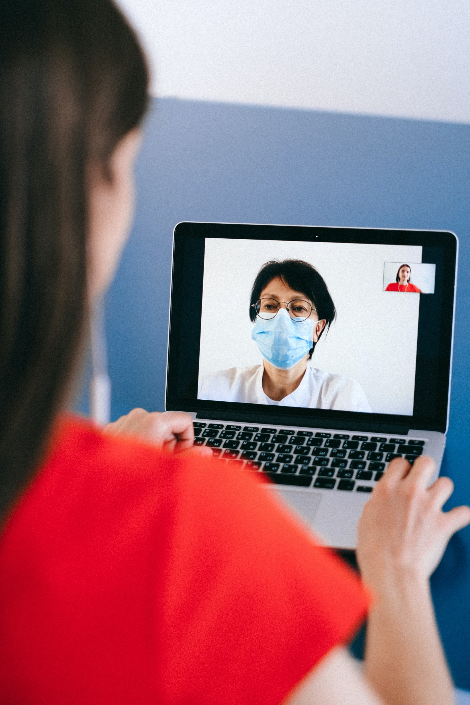
Background
People with disabilities experience many barriers to quality health care
COVID-19: switch to remote care or telehealth
Equitable access for people with disabilities

Slide 3
Research Questions
Who is accessing telehealth?
For which kinds of care?
Is telehealth working for people with disabilities?
If not, what can be done to improve it?

Slide 4
Methods
Internet panel survey
n = 13,277, ages 18-64
Previous 6 months (March-August 2020)
Donelan et al., 2019
Frequencies, logistic regression

Slide 5
Sample Characteristics
Quotas based on American Community Survey
age, race & ethnicity, gender, household income, region
People with disabilities (n = 3,880, 29.2%)
younger, more diverse, lower income

Slide 6
Telehealth Utilization
Disability
 | Percent
Any telehealth visits | 66.1 | 2.3 |  | ***
Any remote primary care | 51.2 | 1.9 |  | ***
Any remote mental health care | 38.3 | 3.4 |  | ***
Odds Ratio
Adjusted for age, race, gender, household income, health insurance status, region
***p < .001

Slide 7
How COVID Affected Use
 | Disability | No Disability
Stay-at-home order | 30.0 | 25.5 | ***
Didn’t want go to office | 27.3 | 25.2
Remote visit sooner | 18.8 | 15.4 | **
No transportation | 4.1 | 2.2 | ***
%
%
***p < .001; **p < .01

Slide 8
Patient Experience
Disability
 | Percent
Overall quality fair or poor | 10.1 | 1.7 |  | ***
Lack confidence in provider | 12.7 | 1.8 |  | ***
Not recommend telehealth | 17.3 | 1.3 |  | ***
Odds Ratio
Adjusted for age, race, gender, household income, health insurance status, region
***p < .001

Slide 9
Primary Care
Disability
 | Percent
Overall quality fair or poor | 10.0 | 2.0 |  | ***
Lack confidence in provider | 11.8 | 1.8 |  | ***
Not recommend provider | 10.7 | 1.8 |  | ***
Not recommend telehealth | 16.1 | 1.3 |  | ***
Odds Ratio
Adjusted for age, race, gender, household income, health insurance status, region
***p < .001

Slide 10
Mental Health Care
Disability
 | Percent
Overall quality fair or poor | 10.1 | 0.9
Lack confidence in provider | 17.2 | 1.6 |  | *
Not recommend provider | 10.0 | 0.8
Not recommend telehealth | 17.2 | 1.5 |  | **
Odds Ratio
Adjusted for age, race, gender, household income, health insurance status, region
*p < .05
**p < .01

Slide 11
Areas for Improvement
Provider did not... | Disability Odds Ratio
Explain in a way I understand | 2.1 | ***
Listen carefully to me | 1.9 | ***
Show respect for what I say | 1.8 | ***
Make personal connection | 1.5 | ***
Understand my health need | 1.6 | ***
Spend enough time with me | 1.3 | **
Adjusted for age, race, gender, household income, health insurance status, region
**p < .01
***p < .001

Slide 12
Limitations
Self-report, Internet panel
Does not account for the digital divide

Slide 13
Limitations
Self-report, Internet panel
Does not account for the digital divide
 | Disability | No Disability
Smartphone (vs laptop) | 60.9 | 56.4 | ***
Dial-up internet (vs cable) | 4.0 | 2.2 | ***
Audio/video quality fair or poor | 13.3 | 6.6 | ***
%
%
***p < .001

Slide 14
Questions?
Kimberly.Phillips@unh.edu
603-862-0060 | Relay 711
Thank you

