Slide 1
Long-Term
Trends in
Employment
Andrew J. Houtenville
University of New Hampshire
February 13, 2018

Slide 2
Employment-Population Ratio, Since 2008
Civilians Ages 18-64 (Living in the Community)
38.6 pts
39.0 pts
39.4 pts
40.2 pts
40.9 pts
40.3 pts
41.0 pts
41.1 pts
40.9 pts
Percentage
2

Slide 3
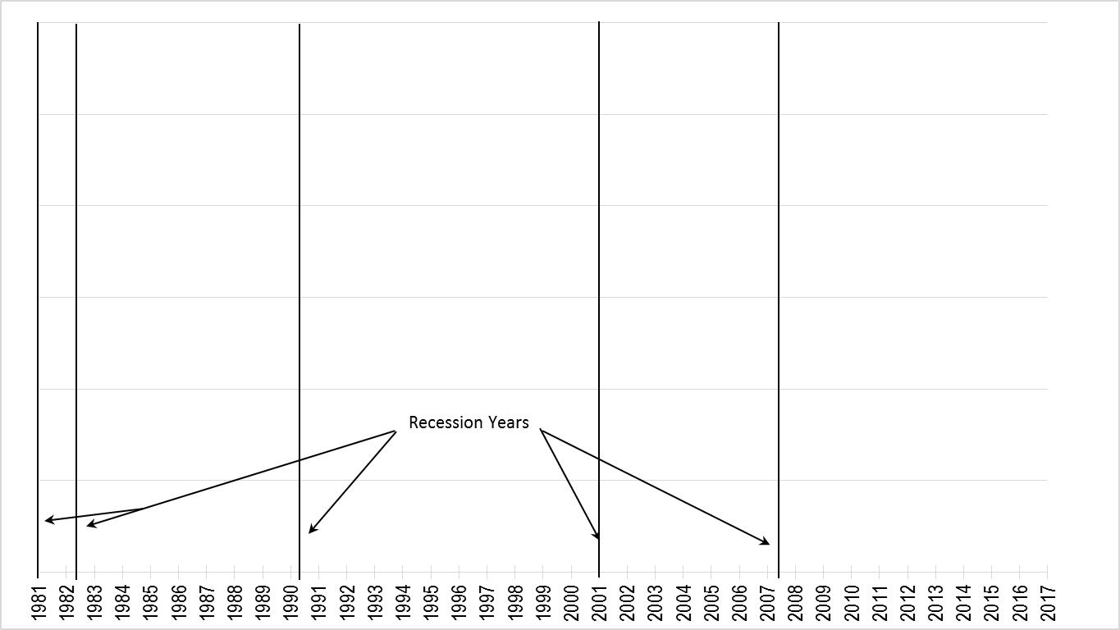
Gap in Emp-Pop Ratio, Since 1981
3

Slide 4
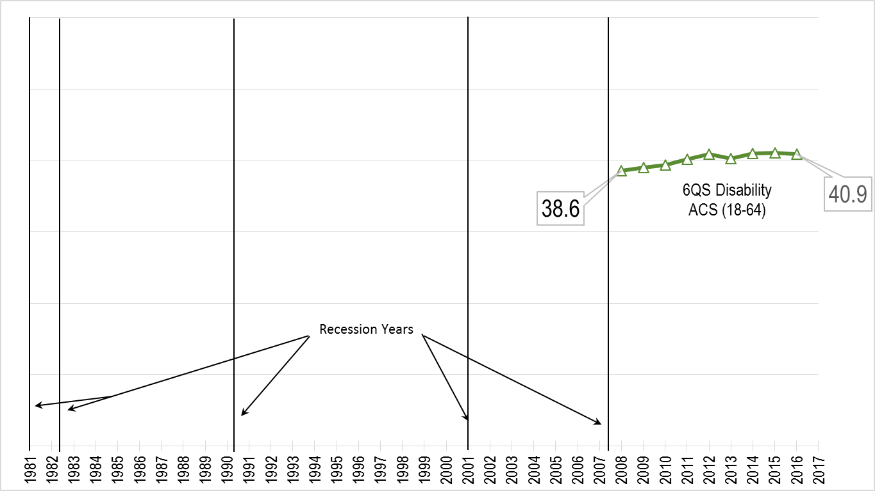
Gap in Emp-Pop Ratio, Since 1981
4

Slide 5
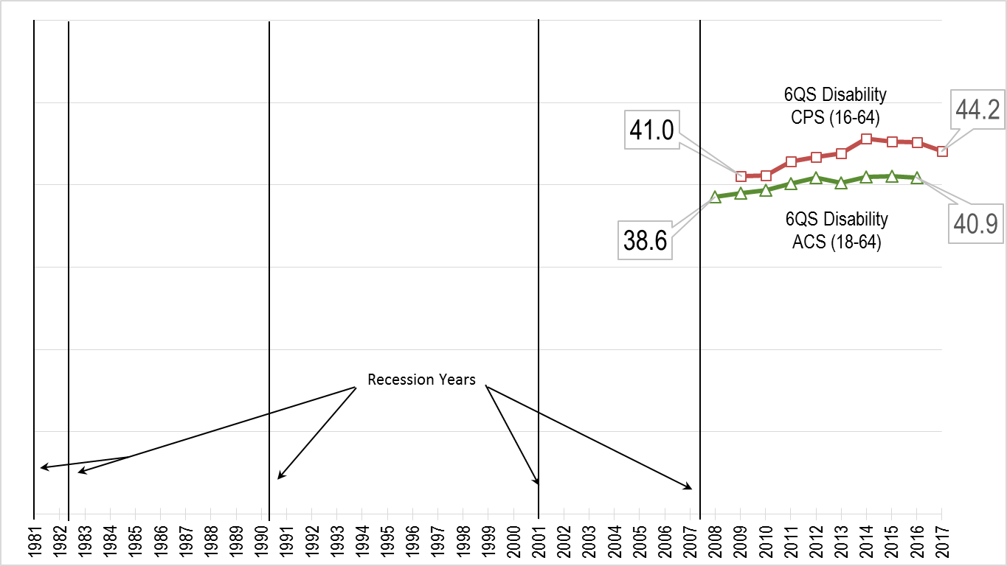
Gap in Emp-Pop Ratio, Since 1981
5

Slide 6
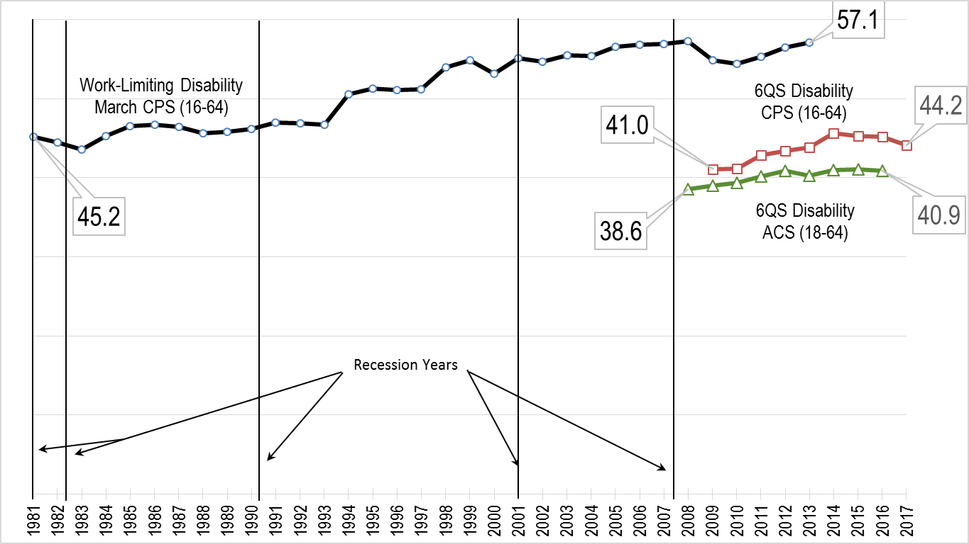
Gap in Emp-Pop Ratio, Since 1981
6

Slide 7
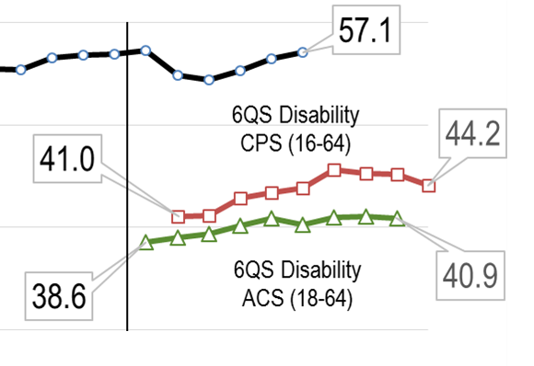
Gap in Emp-Pop Ratio, Since 1981
7

Slide 8
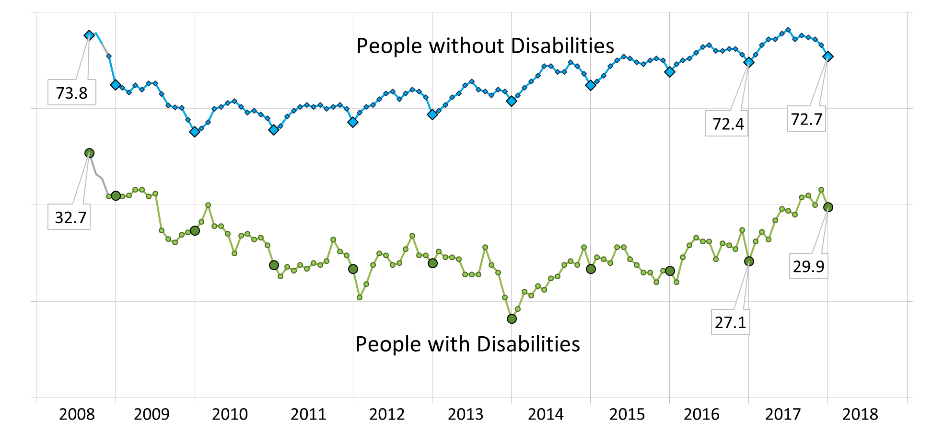
nTIDE: Monthly Emp-Pop Ratio (CPS, 18-64)
8

Slide 9
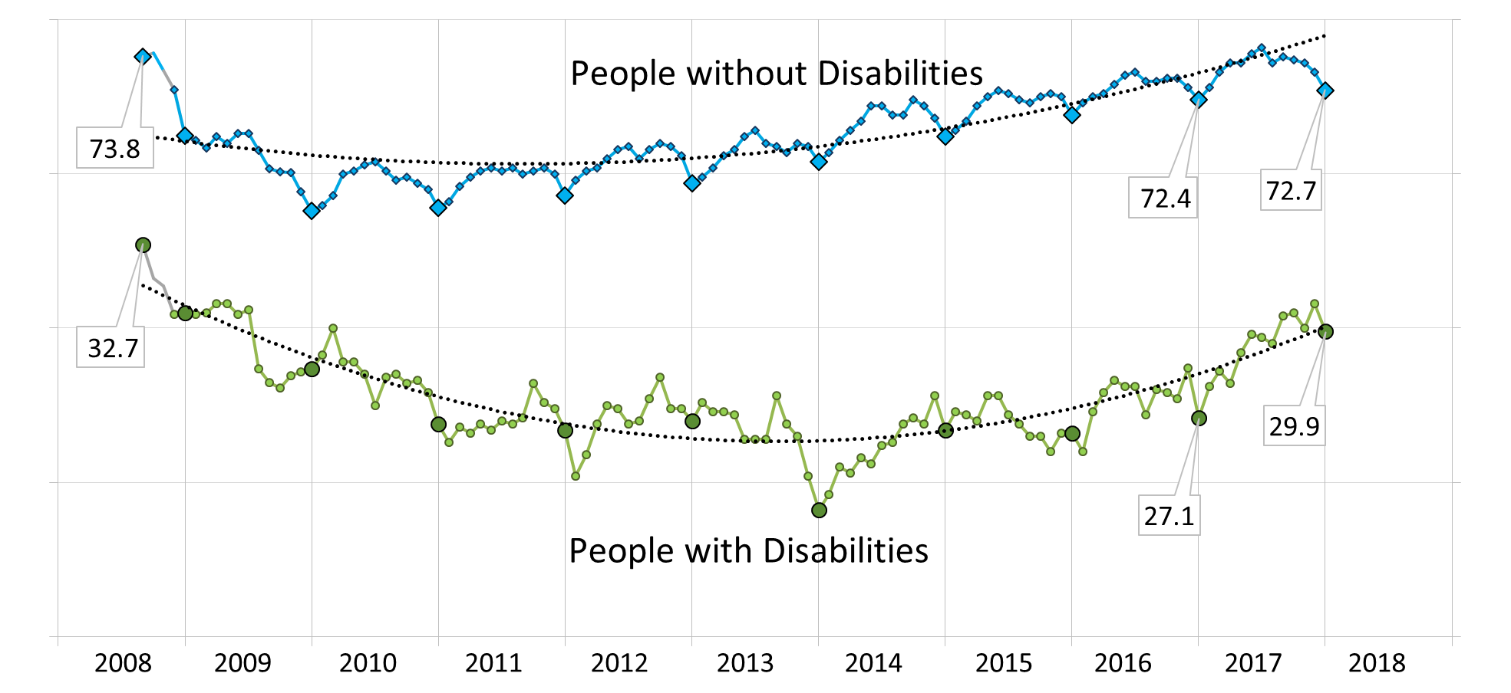
nTIDE: Monthly Emp-Pop Ratio (CPS, 18-64)
9

Slide 10
Contact Information
Institute on Disability
University of New Hampshire
10 West Edge Drive, Suite 101
Durham, NH 03824
Andrew J. Houtenville, Ph.D.
(603) 862-3999
Andrew.Houtenville@unh.edu
10

