Slide 1
Occupational Requirements Survey (ORS)
Michelle Dressner
Bureau of Labor Statistics
Disability Statistics Compendium
February 10, 2021

Slide 2
Objectives
Provide background
Introduce estimates
Physical demands
Environmental conditions
Education, training, and experience
Cognitive and mental requirements
Tools and resources

Slide 3
Types of Estimates - Percentages

Slide 4
Types of Estimates - Means

Slide 5
Types of Estimates - Percentiles

Slide 6
Survey Scope
Includes
Private industry
State & local government
Excludes
Federal government & military
Agriculture workers
Volunteers
Self-employed/business owners

Slide 7
Classifying Jobs
Standard Occupational Classification (SOC) System
Allows for comparison
Updated to reflect modern jobs
Based on job requirements
Critical job function
Critical tasks

Slide 8
2020 Estimates – Year 2 of the ‘Second Wave’
20,000 Establishments
35,693 Estimates
305 Detailed occupations
22 Occupational groups

Slide 9
Job Requirements
Physical demands
Environmental conditions
Education, training and experience
Cognitive and mental requirements

Slide 10
Physical Demands

Slide 11
Strength level required for civilian workers, 2020

Slide 12
Percentage of workers with strength levels by occupational group, 2020

Slide 13
Environmental Conditions

Slide 14
Percentage of workers exposed to the outdoors by occupation, 2020

Slide 15
Education, Training and Experience
Formal education
Prior work experience
Specific vocational preparation
Credentials
On-the-job training

Slide 16
Percentage of workers by minimum education level, 2020

Slide 17
Cognitive and Mental Requirements
Work Review
Frequency of work being checked
Presence of supervisor
Pace
Control of workload
Work pace
Pause control
Interactions
Working with the general public
Working around crowds
Telework
Problem Solving
Personal Contacts
Verbal interactions
People skills
Supervising Others

Slide 18
Percentage of workers required to work around crowds by occupational group, 2020

Slide 19
Accessing the Estimates
Accessible via www.bls.gov/ors/data.htm
Single screen and multi-screen options for data retrieval
Excel spreadsheet
Occupation profiles for major groups
Highlights in “The Economics Daily”

Slide 20
Accessing the Estimates
Accessible via www.bls.gov/ors/data.htm
Single screen option for data retrieval
Text files for all data available

Slide 21
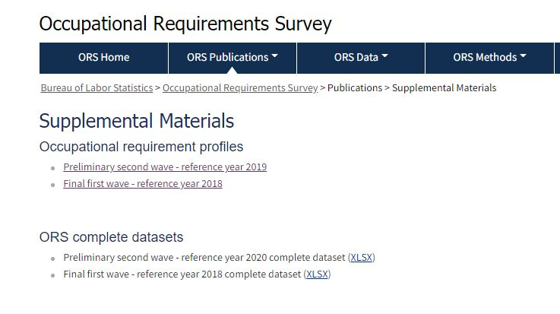
Accessing the Estimates: Excel Dataset
Accessible via www.bls.gov/ors/additional-publications/publications.htm
Excel spreadsheet
Contains all estimates

Slide 22
Occupational Requirements Survey
www.bls.gov/ors
Michelle Dressner
202-691-6199
orsinfo@bls.gov

