Slide 1
State Reports with County Data
Megan Henly
February 9, 2021
Rehabilitation Research and Training Center on Disability Statistics and Demographics (StatsRRTC)
University of New Hampshire Institute on Disability

Slide 2
State Reports
  State- and county- level statistics
  American Community Survey (ACS) 5-year data
  Individualized reports for all 50 states on each topic
    Disability prevalence
    Employment
    Poverty
  2019 State Reports now available
    Based on 2015-2019 ACS 5-year data

Slide 3
Disability Prevalence

Slide 4
Disability Prevalence

Slide 5
Disability Employment

Slide 6
Disability Poverty

Slide 7
Rural Infographic
Marisa Rafal
February 9, 2021
Rehabilitation Research and Training Center on Disability Statistics and Demographics (StatsRRTC)
University of New Hampshire Institute on Disability

Slide 8
Introduction
-The Statistics and Demographics RRTC team will make a new infographic each year and will update the previous ones
-This shows the updated numbers for the first one in this series:
U.S. Rural Disability Statistics
-On Friday the new one will be released
Disability Infographic: Social Inequities Experienced by African Americans

Slide 9
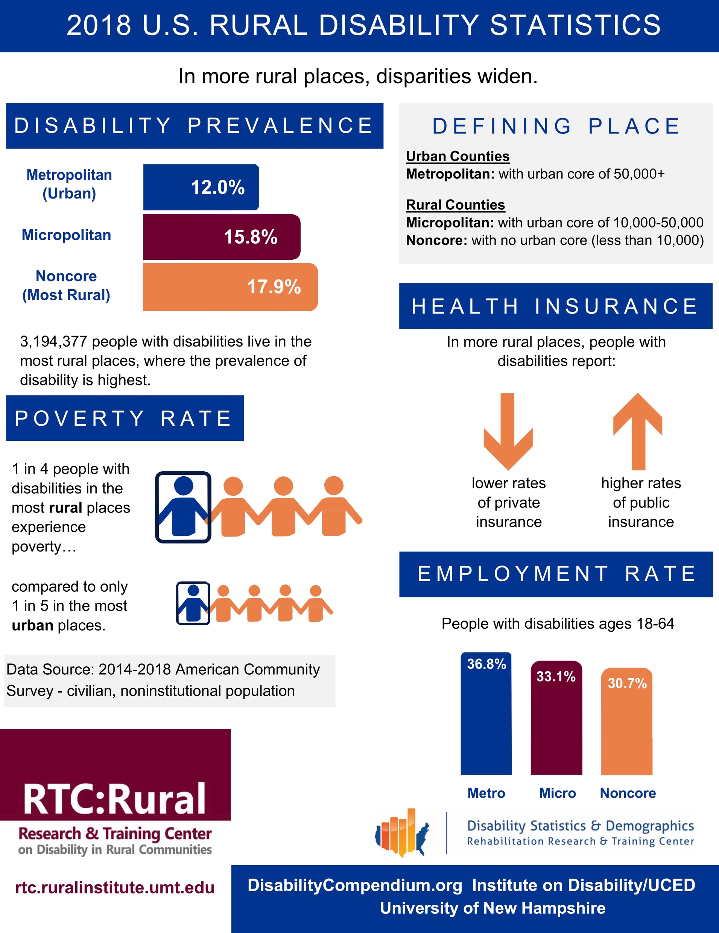
Updated numbers: 2014-2018 ACS 5-year data
“In more rural places,
disparities widen”

Slide 10
Prevalence

Slide 11
Poverty Rate

Slide 12
Health Insurance

Slide 13
Employment

Slide 14
Thank You
Infographic made in collaboration with
University of Montana RTC:Rural
Please reach out with any questions! disability.statistics@unh.edu
Marisa.Rafal@unh.edu
Megan.Henly@unh.edu

