Slide 1
Disability Infographic: Social Inequities Experienced by African Americans
February 12, 2021
Kimberly Phillips & Marisa Rafal

Slide 2
Introduction
Infographic series to explore intersection of disability with other identities
African Americans with disabilities
>3.5 million adults (13.3% vs 10.4%)
ACS and other data sources
Partnership with Langston University

Slide 3
Promoting Equity
Lack adequate housing
Social inequities are compounded at the intersection of disability and race

Slide 4
Promoting Equity
Lack adequate housing
Social inequities are compounded at the intersection of disability and race
No Disability
Disability

Slide 5
Promoting Equity
Lack adequate housing
Social inequities are compounded at the intersection of disability and race
All races
African American
No Disability

Slide 6
Promoting Equity
Lack adequate housing
Social inequities are compounded at the intersection of disability and race
All races
African American
All races
African American
No Disability
Disability

Slide 7
Promoting Equity
Lack adequate housing
Social inequities are compounded at the intersection of disability and race
All races
African American
Disability

Slide 8
Promoting Equity
Areas where policy can promote equity (e.g., social determinants)
Remove barriers that prevent full potential and participation

Slide 9
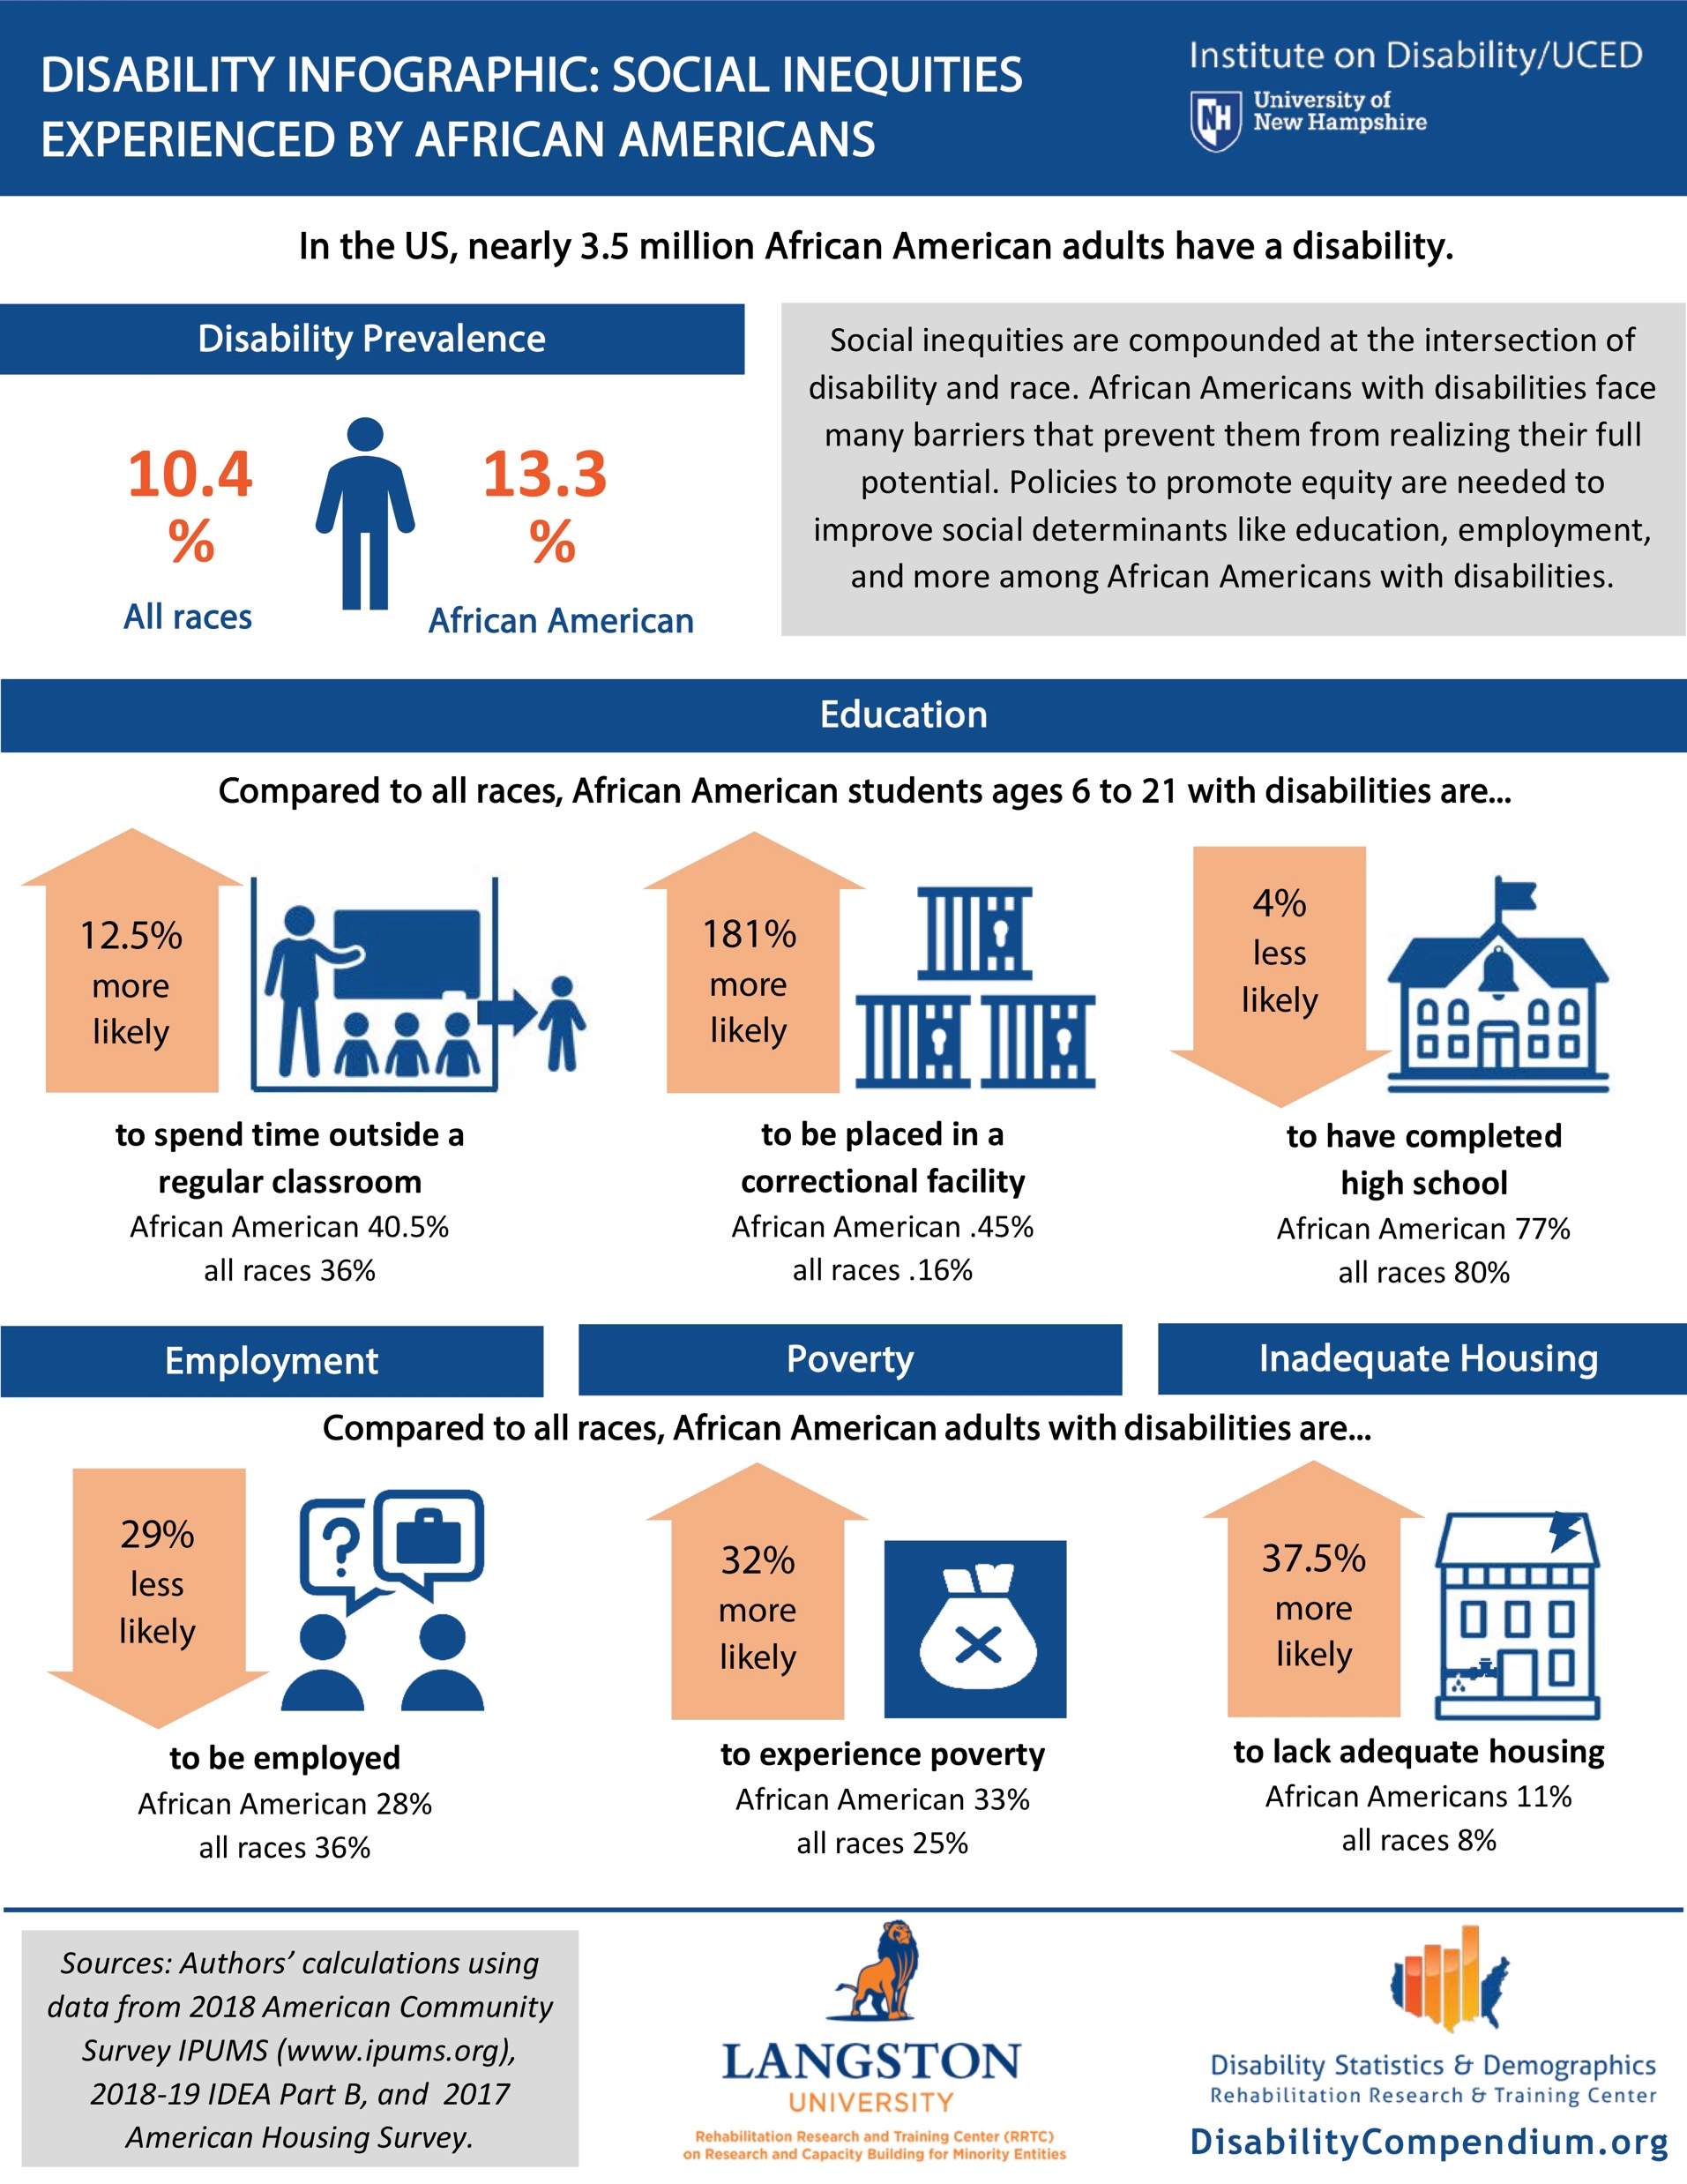

Slide 10
Education

Slide 11
Employment

Slide 12
Poverty

Slide 13
Housing

Slide 14
Thank you

Slide 15
Questions?
kimberly.phillips@unh.edu
marisa.rafal@unh.edu
(603) 862-4320 | Relay 711

