Slide 1

The intersection of race, disability, and COVID-19: a machine learning approach
Allison Kolbe, Ph.D.
Office of the Assistant Secretary for Planning and Evaluation
allison.kolbe@hhs.gov
Disclaimer: The findings and conclusions in this presentation are those of the author and do not necessarily represent the views of the Office of the Assistant Secretary for Planning and Evaluation or the U.S. Department of Health and Human Services.

Slide 2
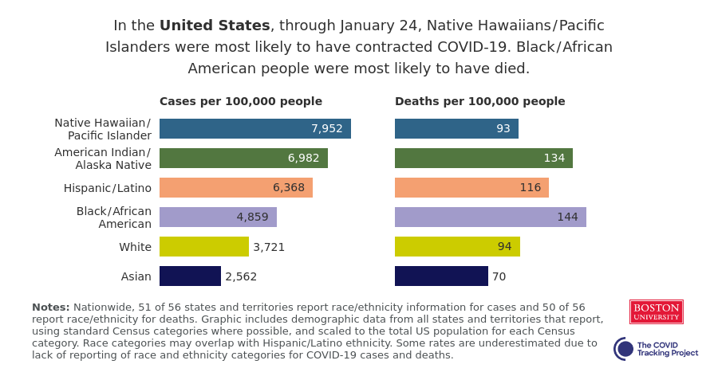
Background
Racial and ethnic minorities are experiencing higher rates of COVID-19 infection, hospitalization, and death
How can machine learning be used to fill in these gaps related to COVID-19 risk factors?
People with disabilities also have a higher risk of infection and death, but relatively little data available

Slide 3
Using county-level characteristics to predict disparities in COVID-19 death rates
Socio-demographics
Income
Education
Overall health
Prevalence of chronic conditions
Healthcare access
Physical environment
COVID-19
Population density
Insurance coverage
PCPs, ICU beds per capita
Access to COVID-19 testing
Local policies
Employment
Food insecurity/ access
Health behaviors
Google mobility data
Pollution

Slide 4
Using county-level characteristics to predict disparities in COVID-19 death rates
Socio-demographics
Income
Education
Overall health
Prevalence of chronic conditions
Healthcare access
Physical environment
COVID-19
Population density
Insurance coverage
PCPs, ICU beds per capita
Access to COVID-19 testing
Local policies
Employment
Food insecurity/ access
Health behaviors
Google mobility data
Pollution
Disparities
(death rates for Black population relative to White population)

Slide 5
Model Details
Used supervised machine learning (Random Forest) to classify counties into high and low disparity groups
  Random Forest can evaluate complex, non-linear relationships between many variables
  Generally handles correlated variables more robustly than other methods

Slide 6
Model Details
Used supervised machine learning (Random Forest) to classify counties into high and low disparity groups
  Random Forest can evaluate complex, non-linear relationships between many variables
  Generally handles correlated variables more robustly than other methods
Variables
  66 county-level numeric descriptors
  491 counties that had at least 50 deaths with at least 1% of these in Black individuals (updated 1/26/21)

Slide 7
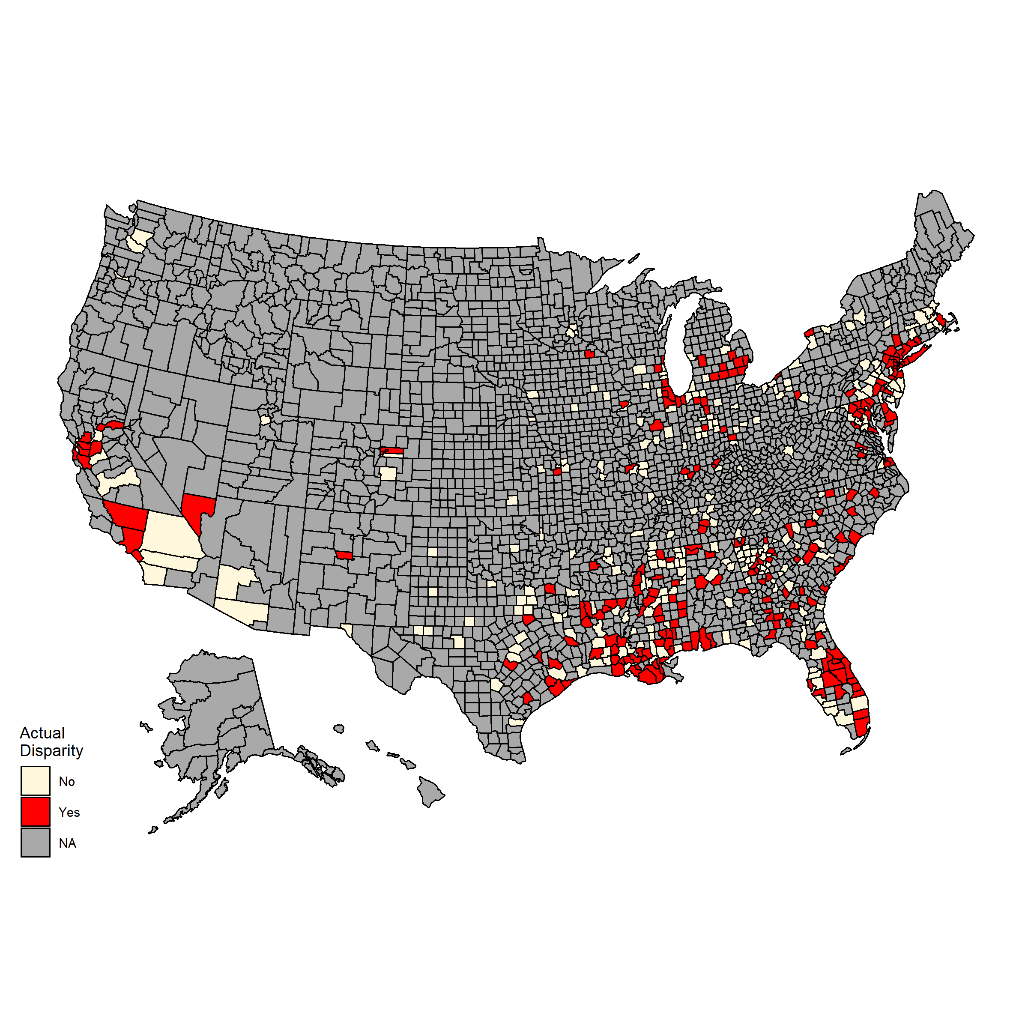
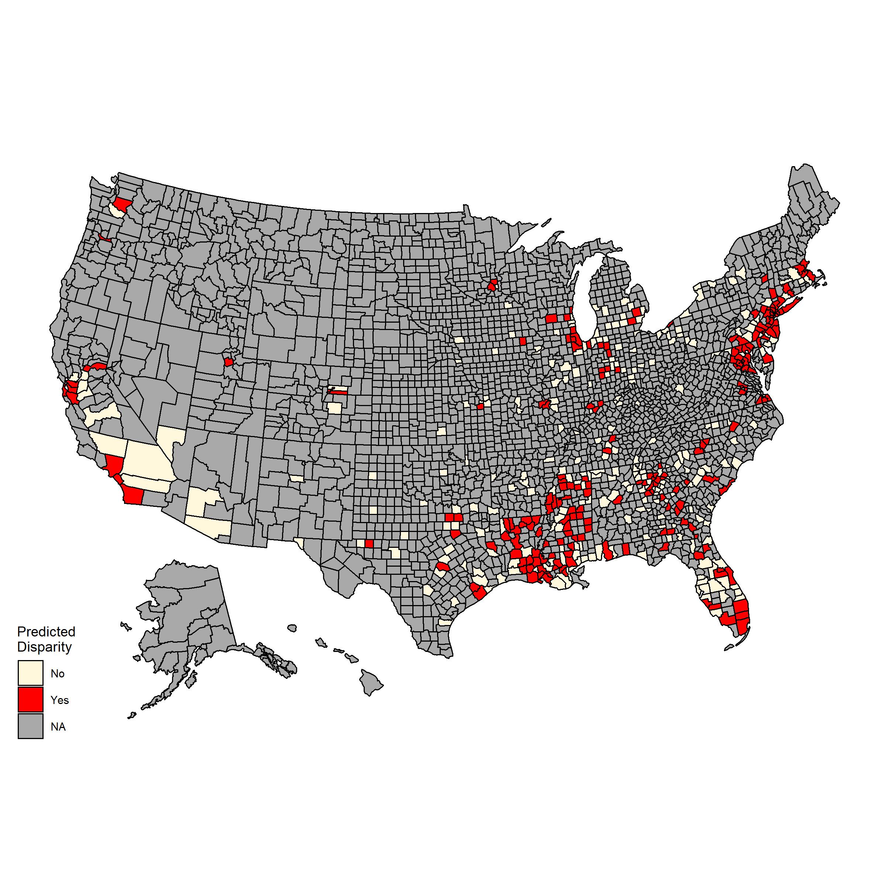
Model performance (n = 491)
Counties with known disparities (225/491)
Counties with predicted disparities
Model predictions
64% accuracy

Slide 8
Which factors are associated with disparities?
Social vulnerability
Socioeconomic variables
Disability
Health
Obesity
Healthcare access
COVID-19 related behaviors
ICU beds per 100,000 residents
Distance to testing sites
Self-reported poor health
Change in visits to retail and recreation sites
Proportion of people who stayed at home

Slide 9
Which factors are associated with disparities?
Social vulnerability
Socioeconomic variables
Disability
Health
Obesity
Healthcare access
COVID-19 related behaviors
ICU beds per 100,000 residents
Distance to testing sites
Self-reported poor health
Change in visits to retail and recreation sites
Proportion of people who stayed at home
Notes:
Top 5 variables highlighted – includes 2 variables related to SES (mobile homes, no vehicles)
Interestingly, not associated:
Percent of population >65 years of age
Rural/urban

Slide 10
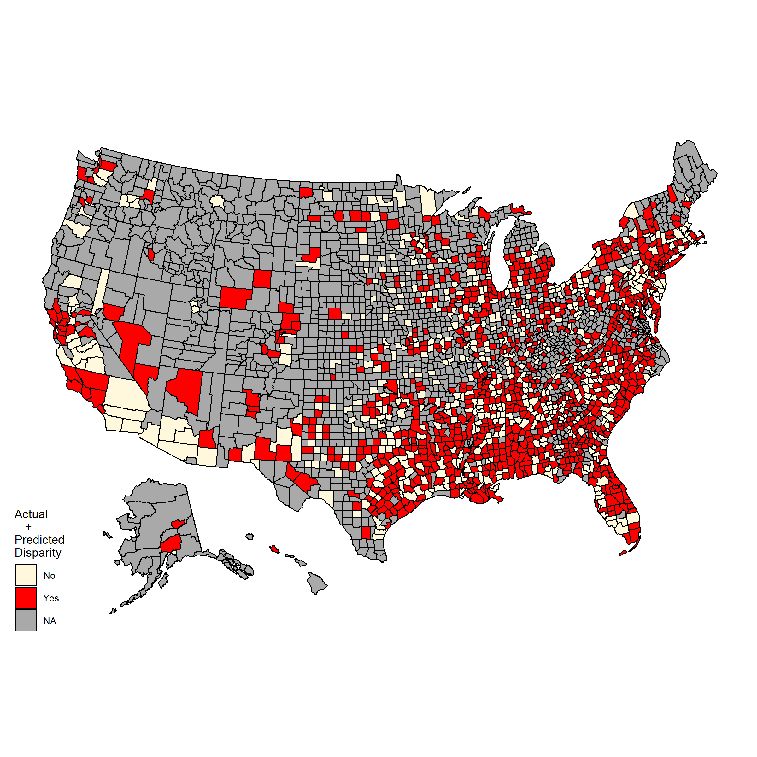
Predicting where disparities may be occurring
Among counties with > 20 COVID-19 deaths and >1% Black population:
Model predicts an additional 725 counties with likely disparities
Notes:
Many counties are missing data
Data can lag up to 8+ weeks
Machine learning can help us identify where disparities may be occurring

Slide 11
Conclusions
Disparities in COVID-19 deaths for Black Americans are driven by many different factors
Machine learning is a powerful tool to make predictions where data are limited
Improvements in data reporting will be key to help us understand risk factors for COVID-19 deaths in diverse populations

Slide 12
Questions?
allison.kolbe@hhs.gov

