Slide 1
Employment Trends and State Patterns
Andrew Houtenville & Shreya Paul
Feb 11, 2021
University of New Hampshire

Slide 2
Topics Covered
National trends in employment
Employment-to-population ratio
Labor force participation rate
State level estimates

Slide 3
National Trends in Employment 2019-2020
Notes:
Hi! My name is Shreya Paul, and I am a project director at IOD. I will be discussing the trends in employment that we are seeing both before and during covid at a state level.

Slide 4
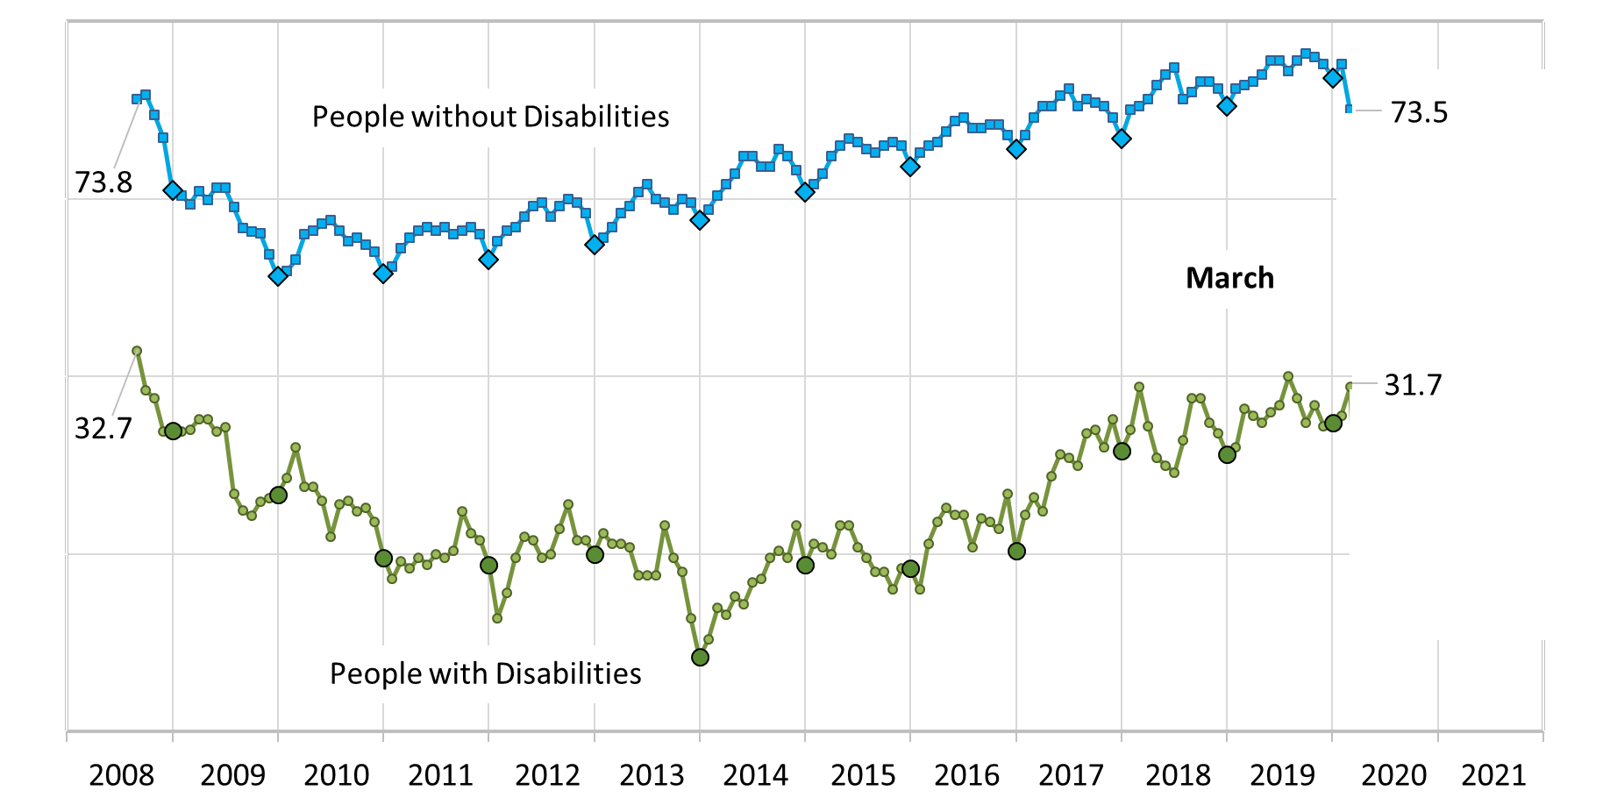
Employment-to-Population Ratio

Slide 5
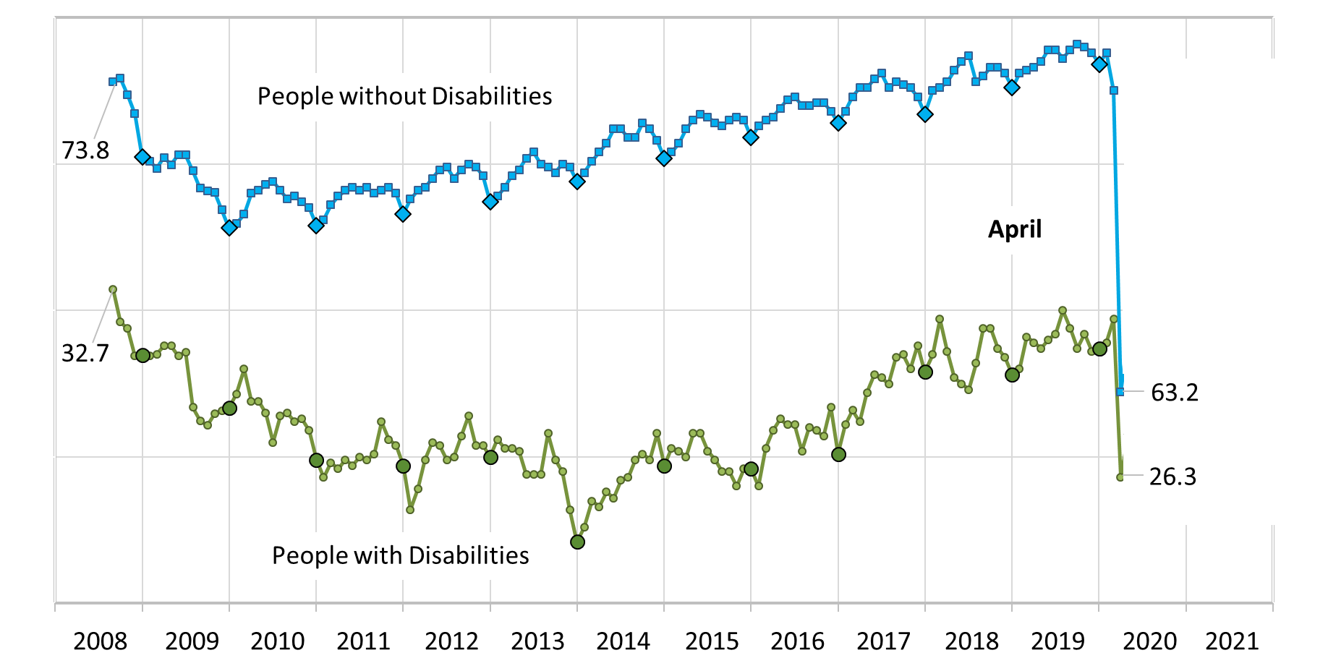
Employment-to-Population Ratio

Slide 6
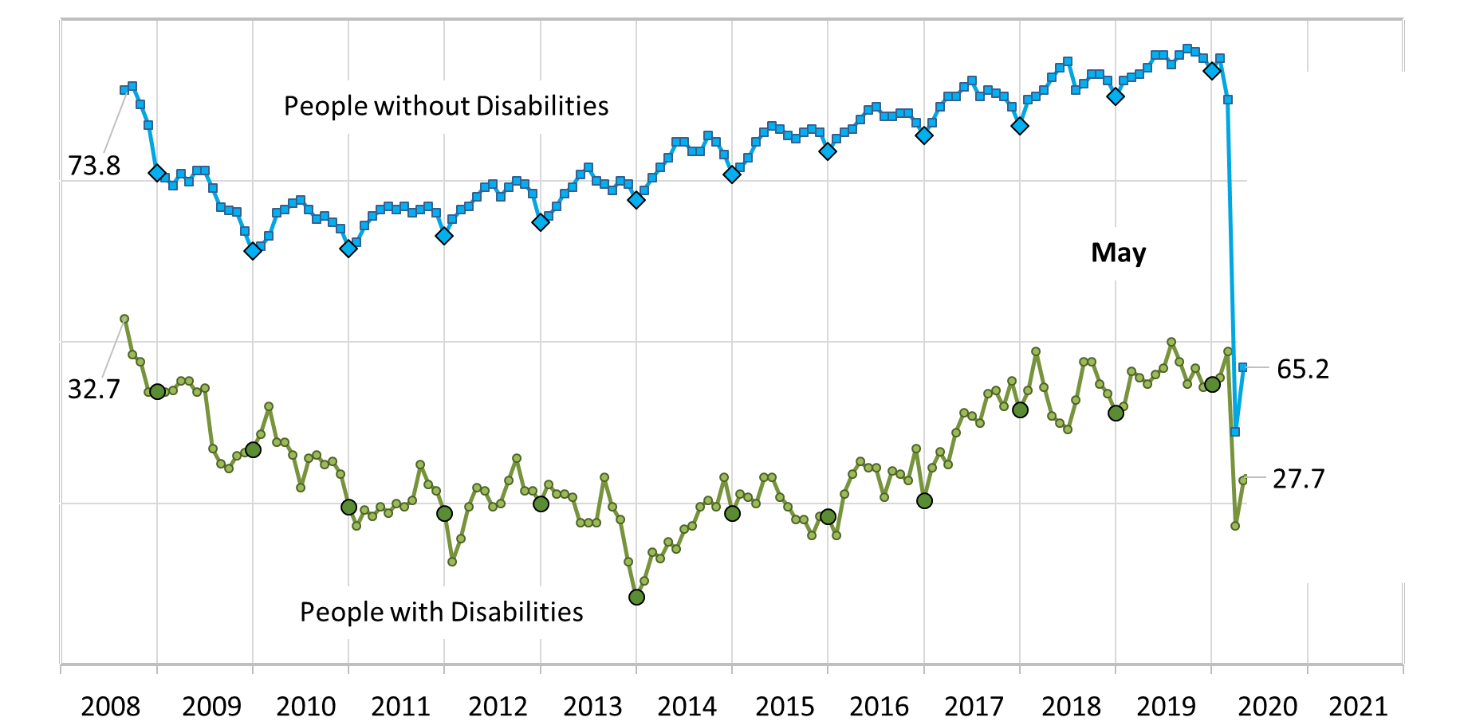
Employment-to-Population Ratio

Slide 7
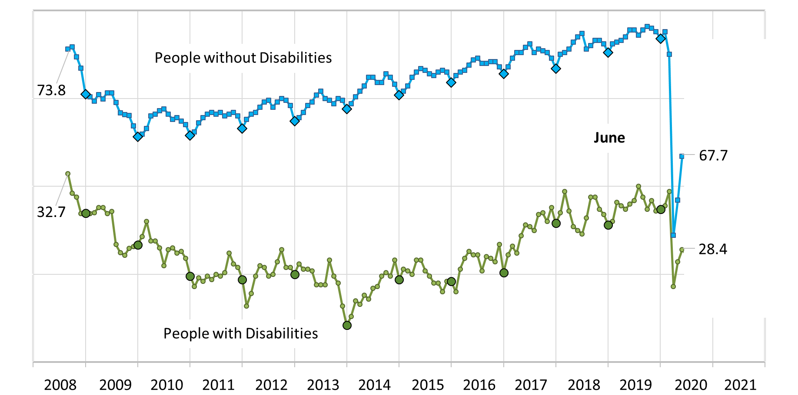
Employment-to-Population Ratio

Slide 8
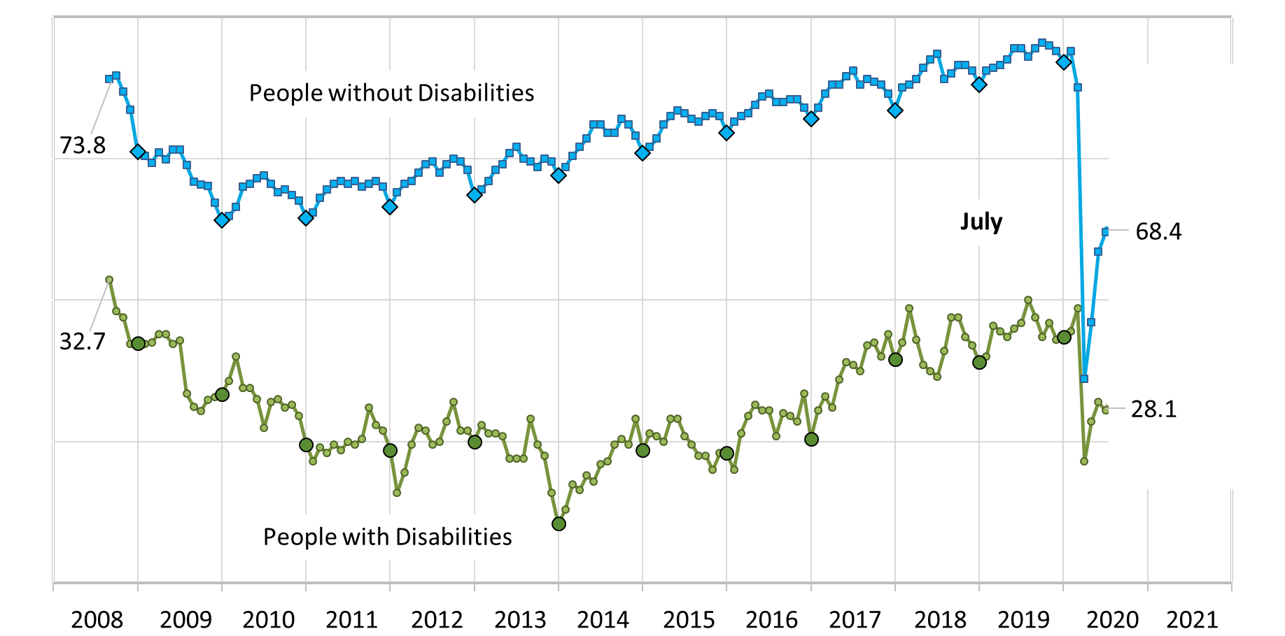
Employment-to-Population Ratio

Slide 9
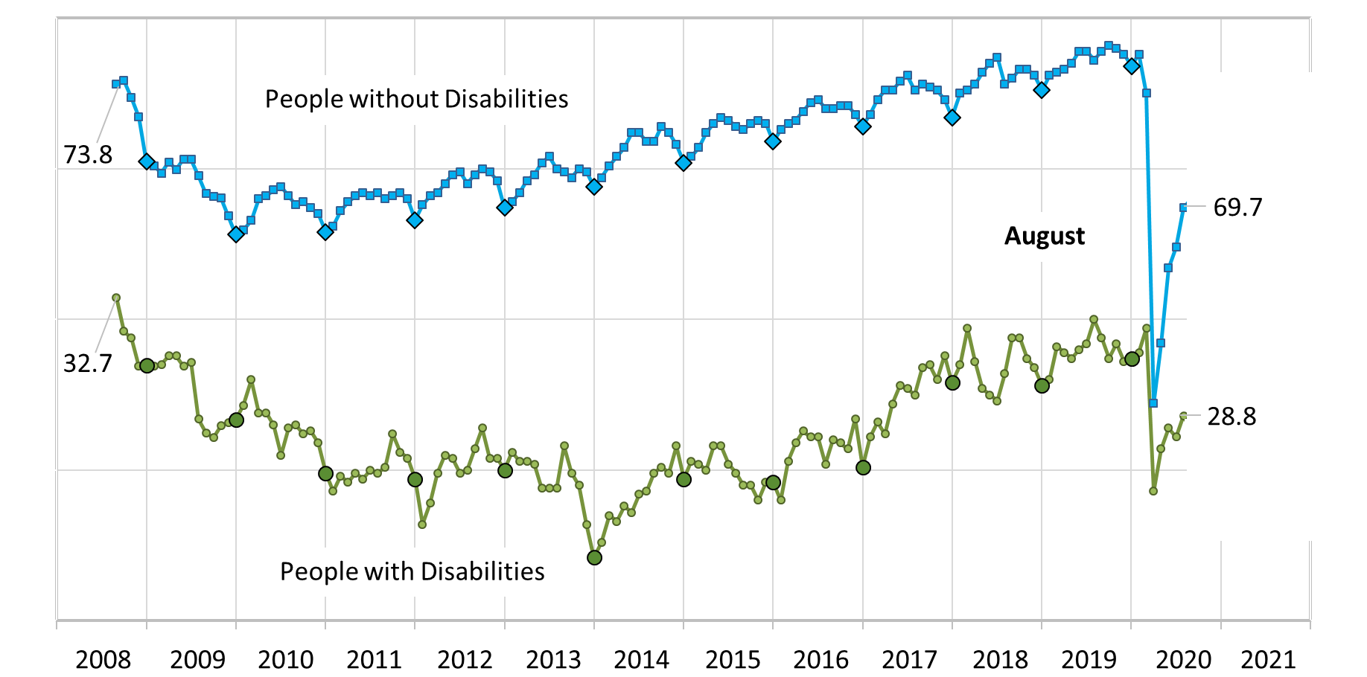
Employment-to-Population Ratio

Slide 10
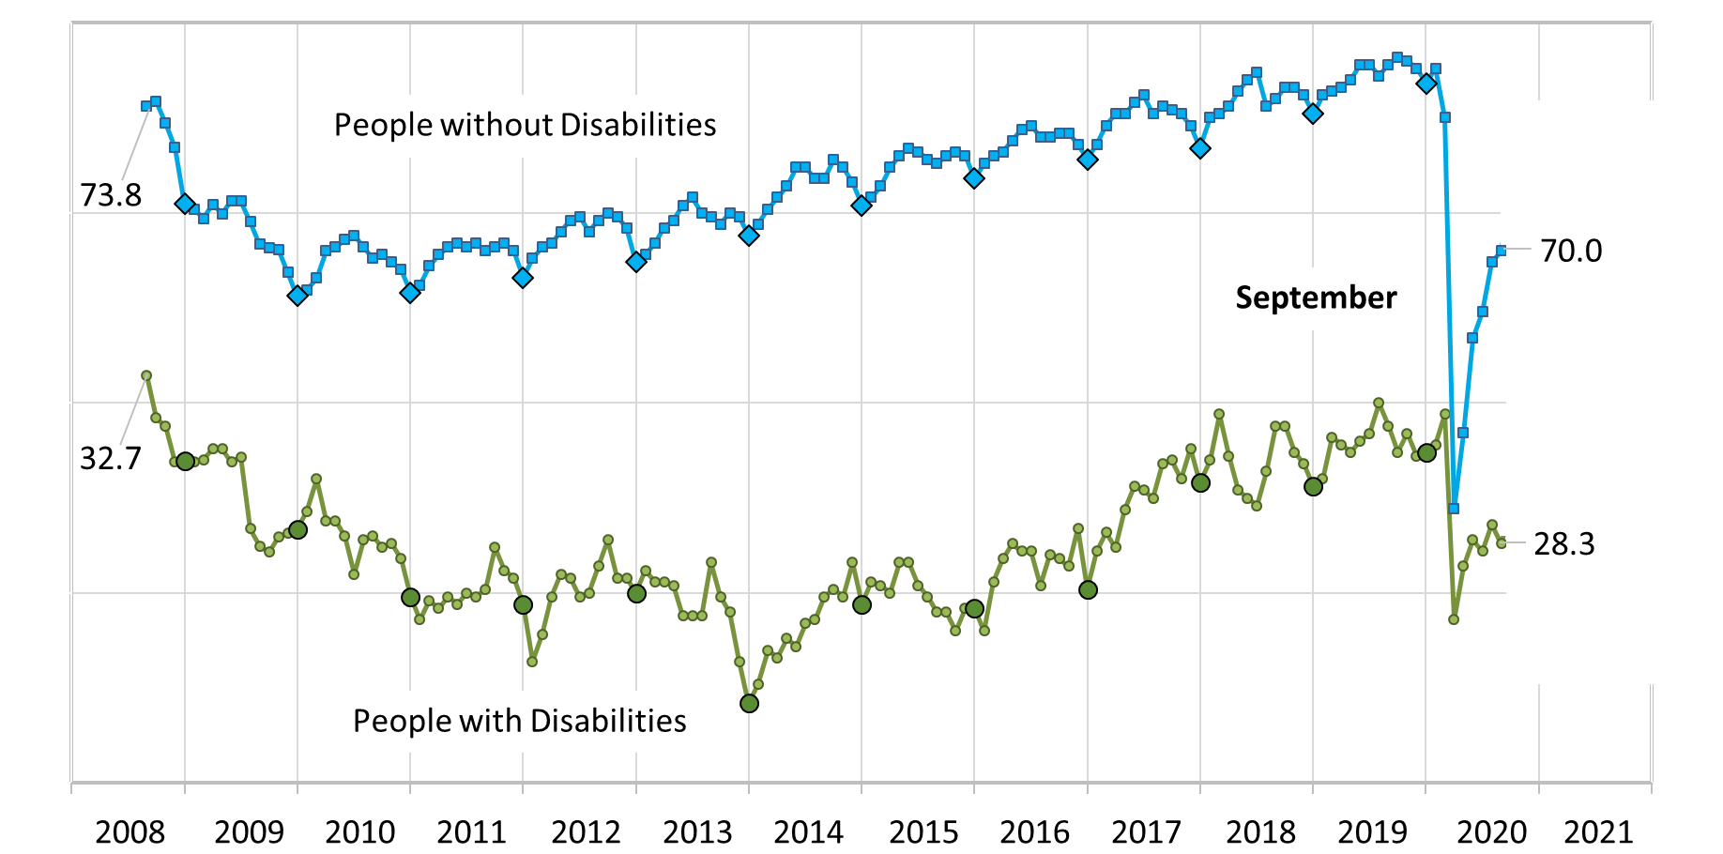
Employment-to-Population Ratio

Slide 11
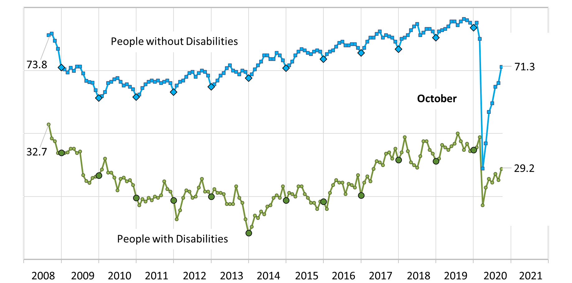
Employment-to-Population Ratio

Slide 12
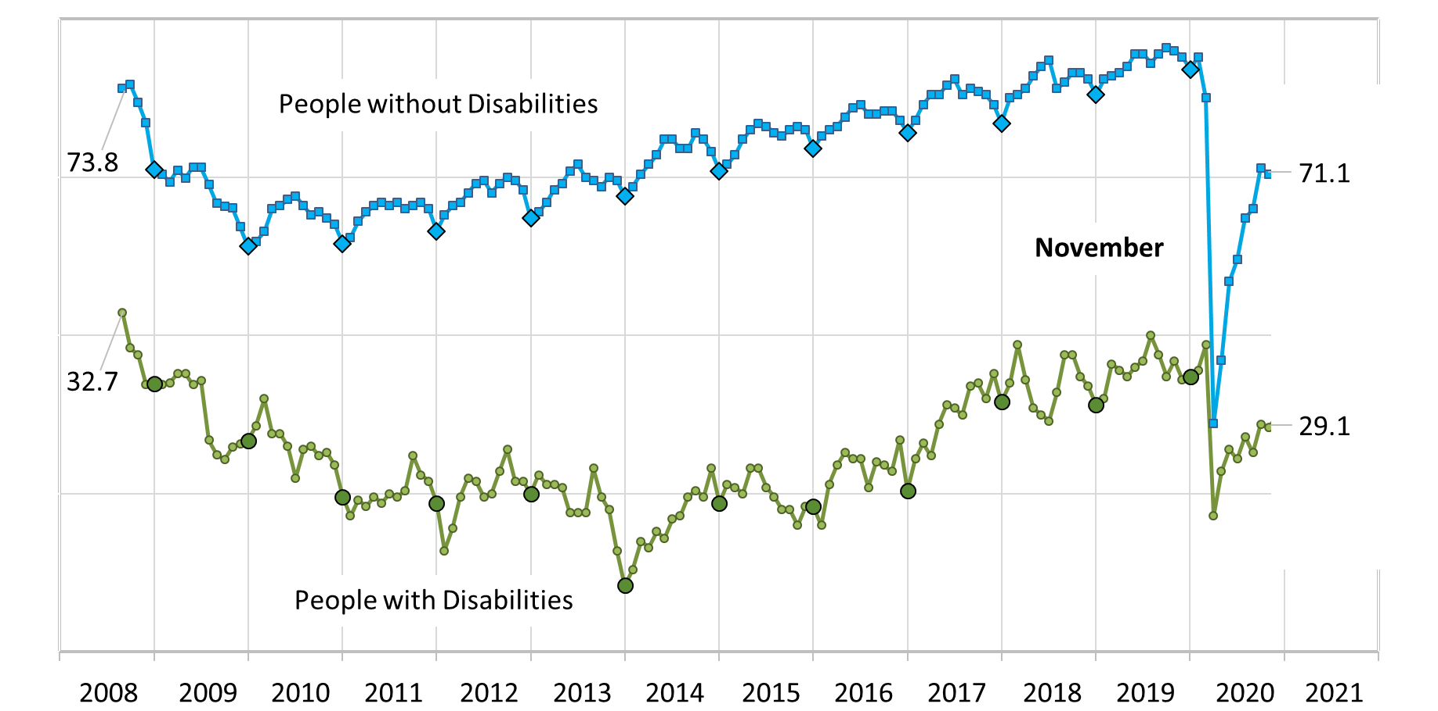
Employment-to-Population Ratio

Slide 13
Employment-to-Population Ratio

Slide 14
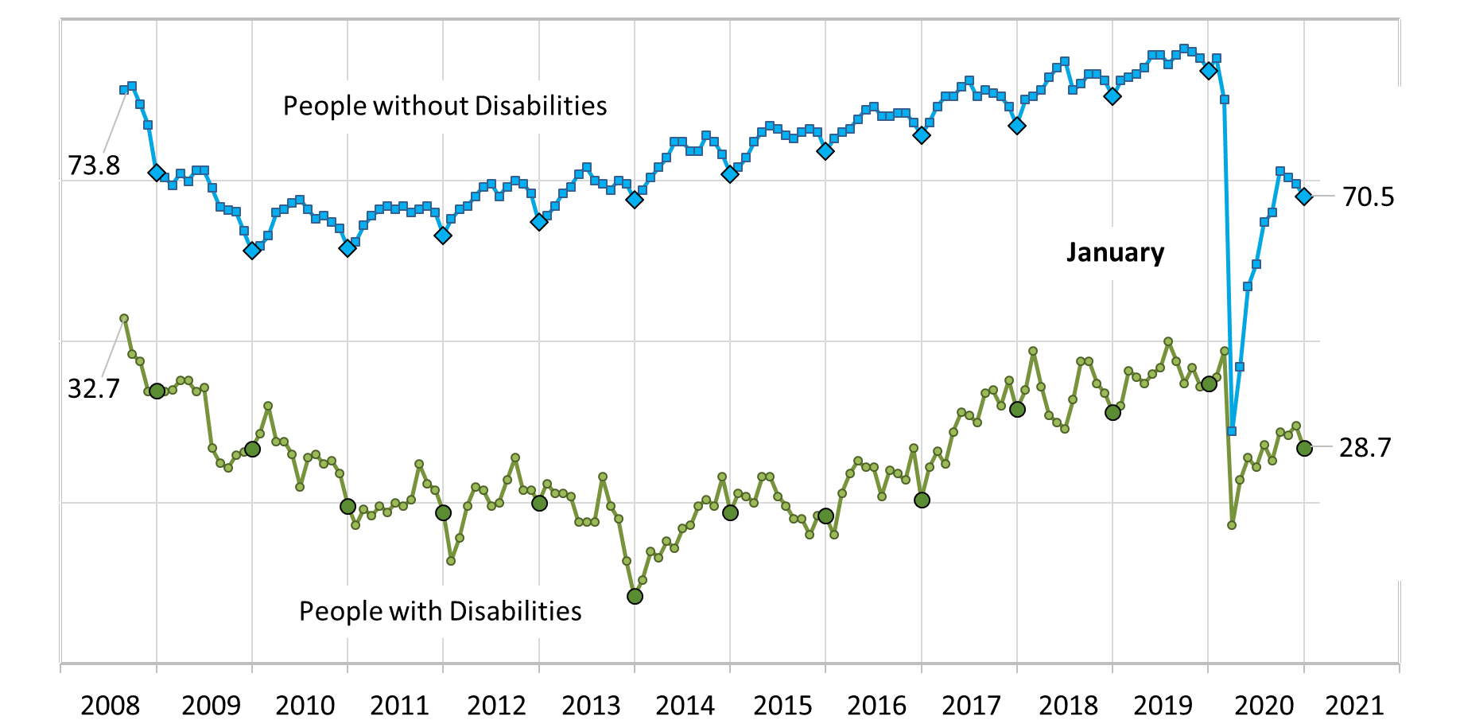
Employment-to-Population Ratio

Slide 15
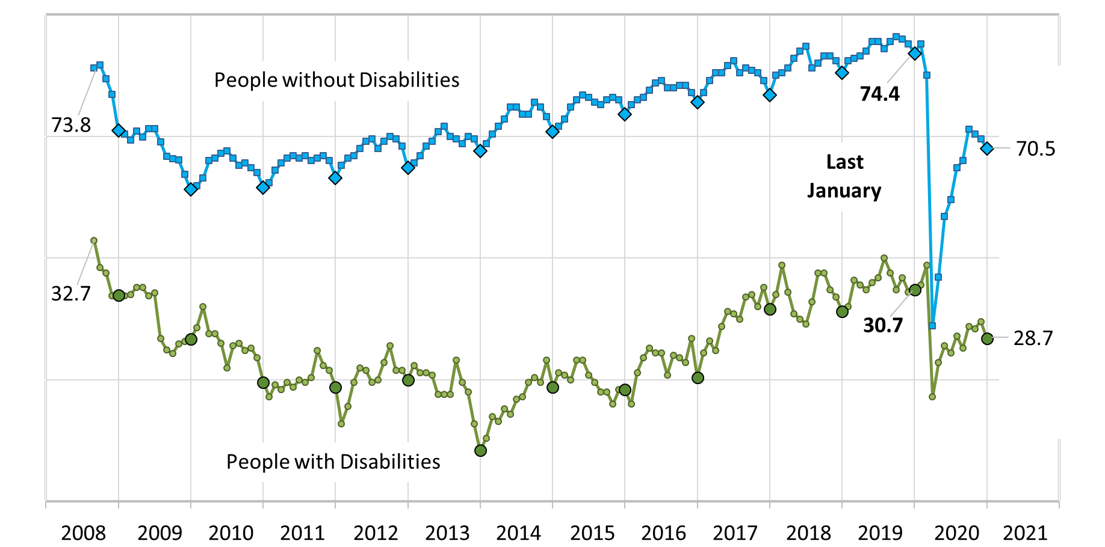
Employment-to-Population Ratio

Slide 16
Labor Force Participation Rate

Slide 17
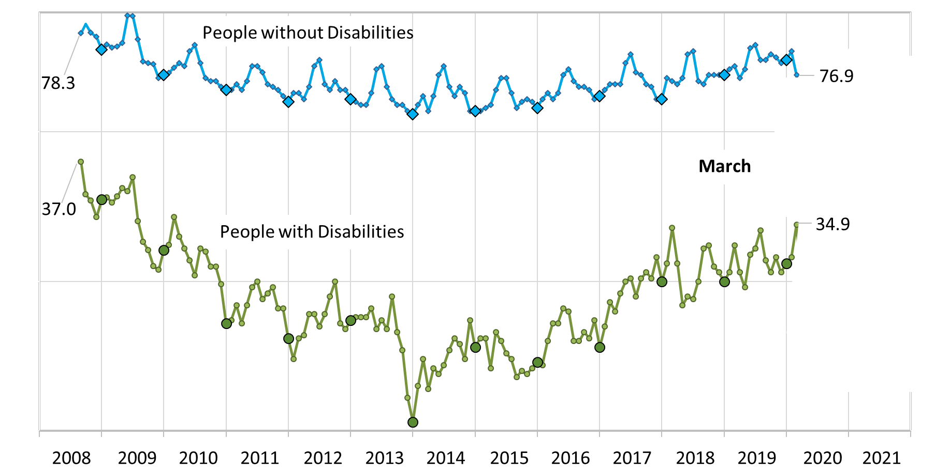
Labor Force Participation Rate

Slide 18
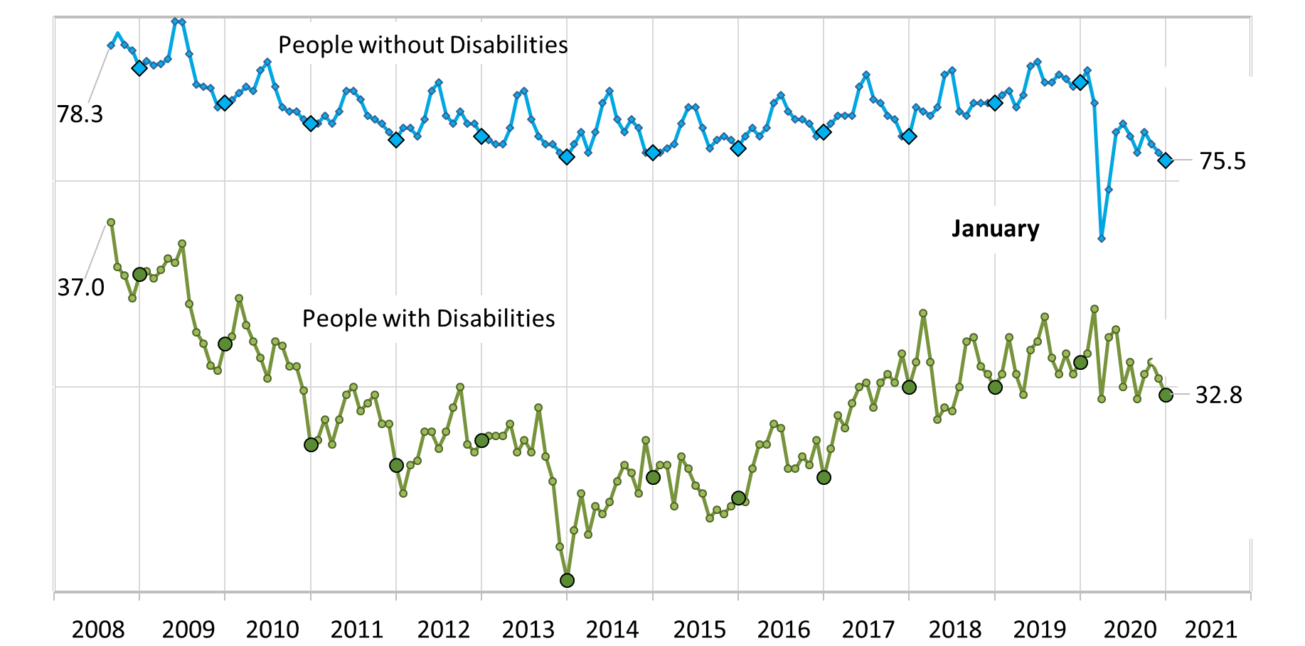
Labor Force Participation Rate

Slide 19
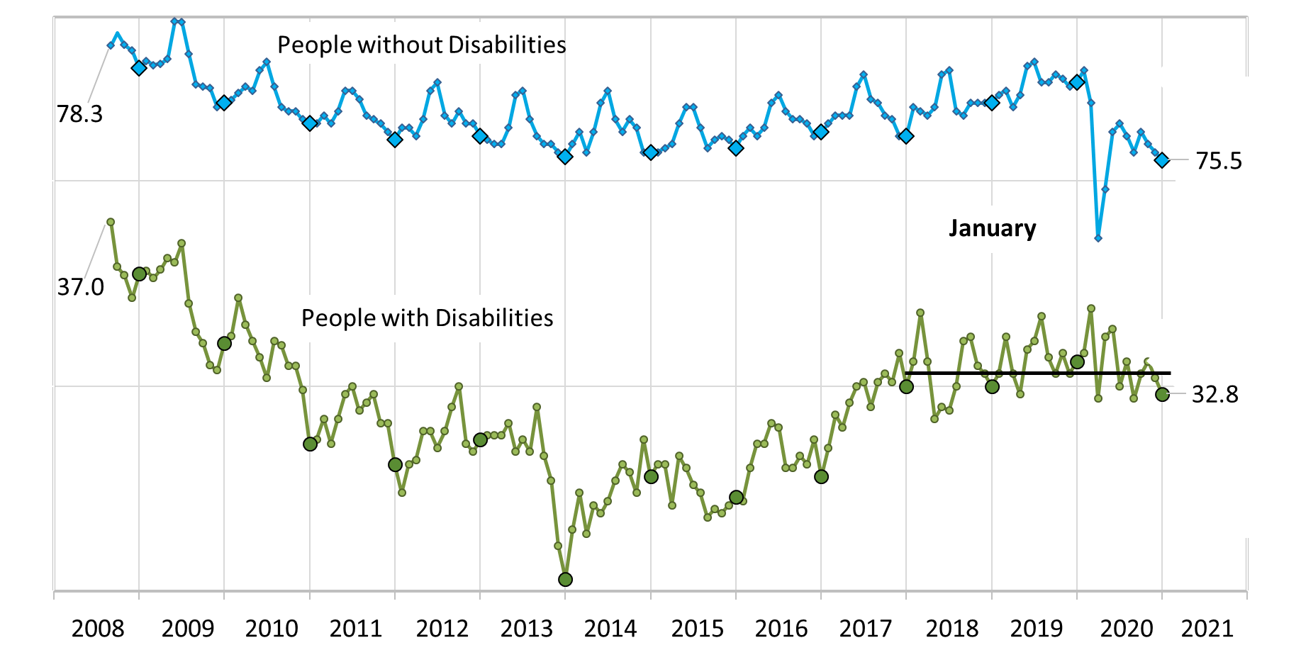
Labor Force Participation Rate

Slide 20
State Trends in Employment 2019-2020 Average monthly employment-to-population ratio, non-institutional civilians with ages 16-64
Notes:
Hi! My name is Shreya Paul, and I am a project director at IOD. I will be discussing the trends in employment that we are seeing both before and during covid at a state level. In the next few slides, we will be looking at the average monthly employment-to-population ratio of non-institutional civilians ages 16-64. The pre covid data that we have is from April 2019-December 2019 and for the during covid months we have April 2020-December 2020. The purpose is to do a state-to-state comparison of the impact of Covid – 19 and make a call which states showed a positive change as well as which states showed a negative change.

Slide 21
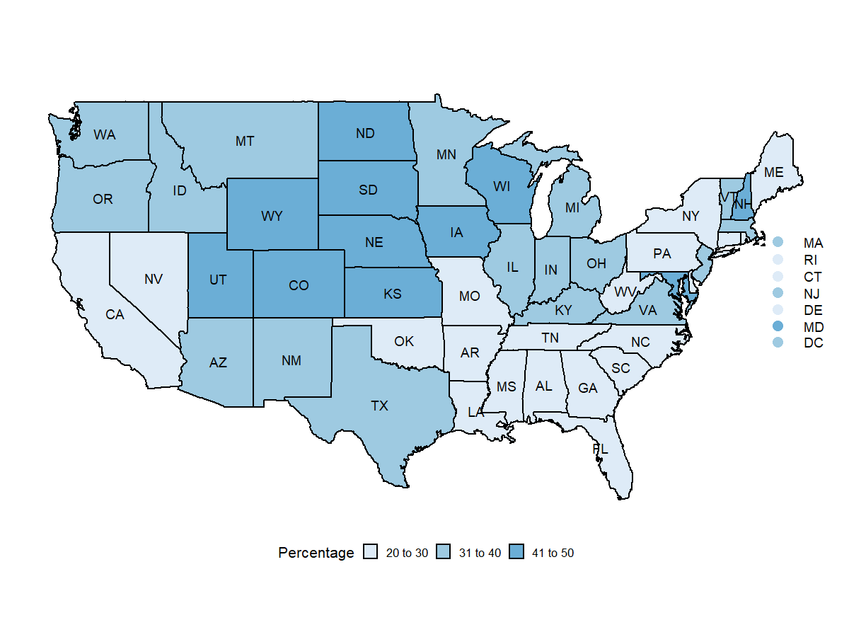
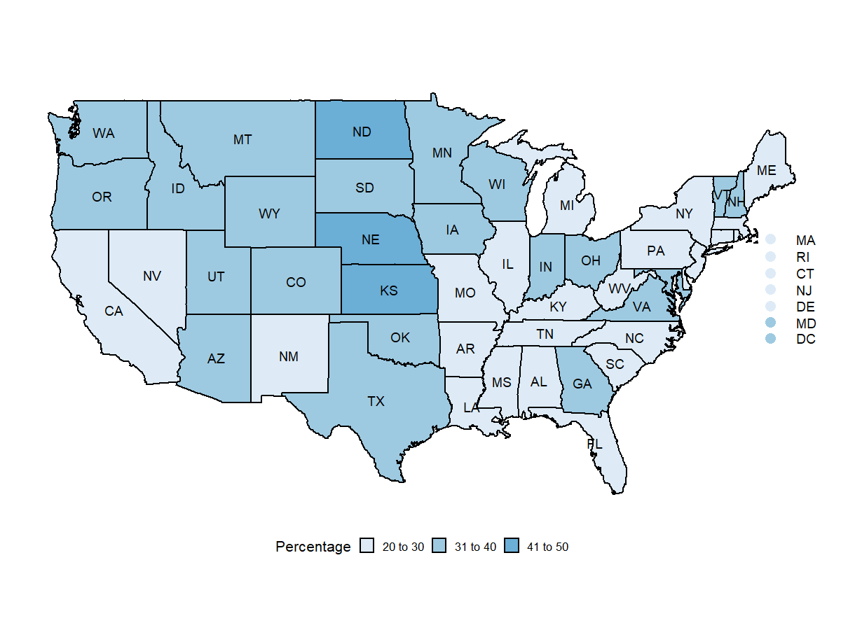
Civilians with Disabilities 2019 vs 2020
April 2019 – December 2019
April 2020 – December 2020
Source : Current Population Survey
Notes:
The slide shows the employment rate in 2020 i.e. after covid hit. <needs to be edited> Here we are talking about ages 16-64 years. As you can see the average monthly employment-to-population ratio is the highest in states like New Hampshire, Wisconsin, Wyoming, Utah, Colorado, North Dakota and South Dakota between 41 and 50 percent meaning 41-50 percent of people with disabilities in these states are employed. Another significant change we see are states like New Mexico, Michigan, Illinois and Georgia they changed from the lighter blue shade to white showing that employment rate dropped significantly in these states as well i.e. it fell from 31-40% to 20-30 range.
States like California, Maine, New York, Pennsylvania, though they remained white on the maps did see a small drop-in employment rate when you look at the actual data.
But there are states which surprisingly showed an increase in employment rate. These states are Oklahoma and Georgia, they saw an increase in employment rate during covid-19.
In summary, yes covid has hit hard the employment rate of all civilians but people with disabilities. According to an article published by SHRM on Aug 28,2020 around a million people with disabilities have lost their jobs due to covid 19, they have been disproportionately affected by the pandemic. The article also states the greatest job losses have been in the retail and hospitality sectors. And because many people with disabilities have underlying conditions, so many of these roles in retail and hospitality that serve the public place people with disabilities at a greater risk of getting covid-19.

Slide 22
April 2019 – December 2019
April 2020 – December 2020
With Disabilities
Without Disabilities
Source : Current Population Survey
Notes:
In the next slide, we are doing a comparison between the employment to population ratio for people with disabilities and people without disabilities so the two maps shown here are from the previous slide.

Slide 23
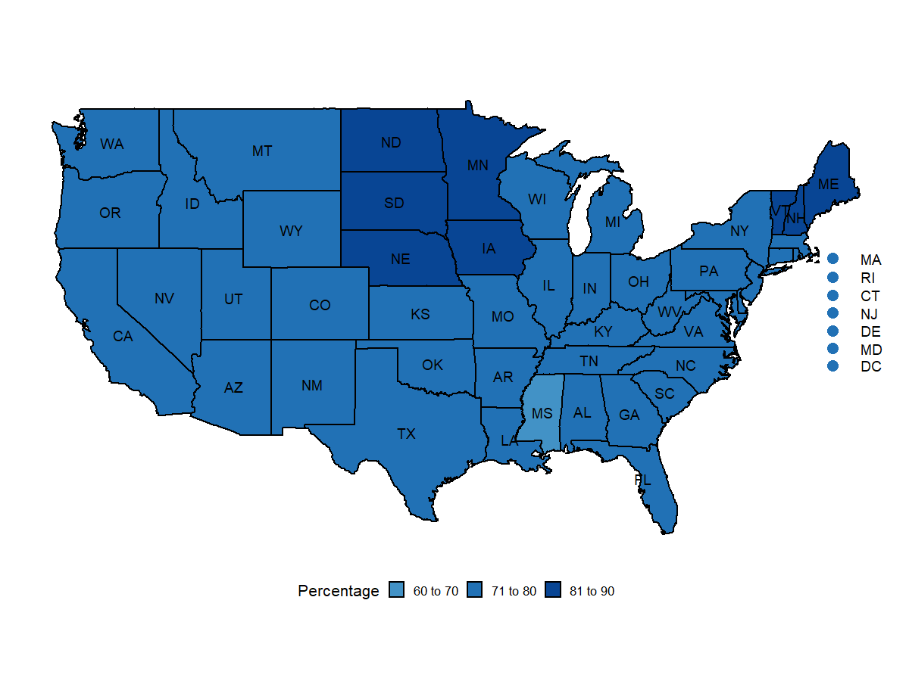
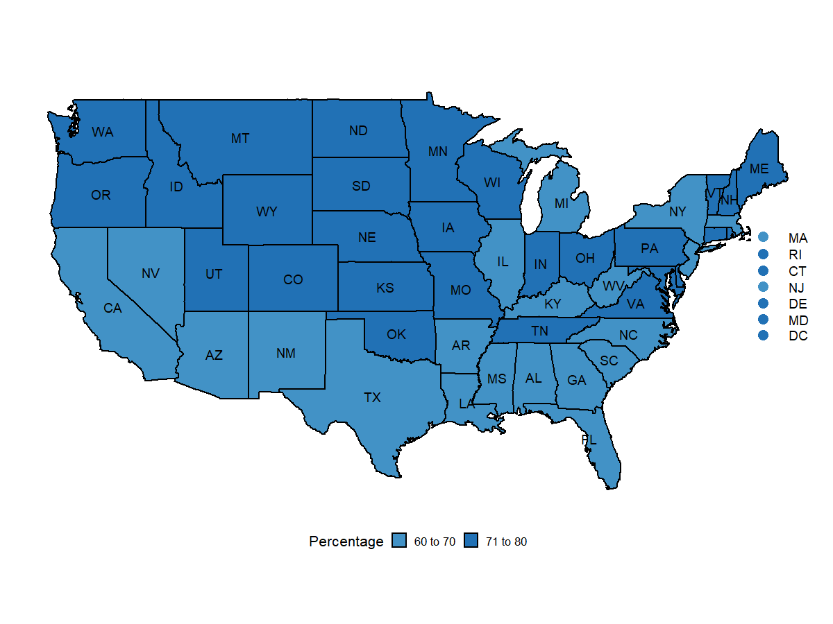
April 2019 – December 2019
April 2020 – December 2020
With Disabilities
Without Disabilities
Source : Current Population Survey
Notes:
The bottom two maps present the employment to population ratio for people without disabilities. As you can see, for people without disabilities the employment rate is 60 and above. Especially, in states like Maine, Vermont and Minnesota, the disparity appears to be huge. If we carefully notice the maps for people without disabilities, we will see that employment rate for people without disabilities has dropped significantly as well during covid. The map becomes lighter as well in 2020.
But what about the gap in employment rate between people with disabilities and people without disabilities? Do you think the gap has narrowed or widened? Lets find out in the next slide.

Slide 24
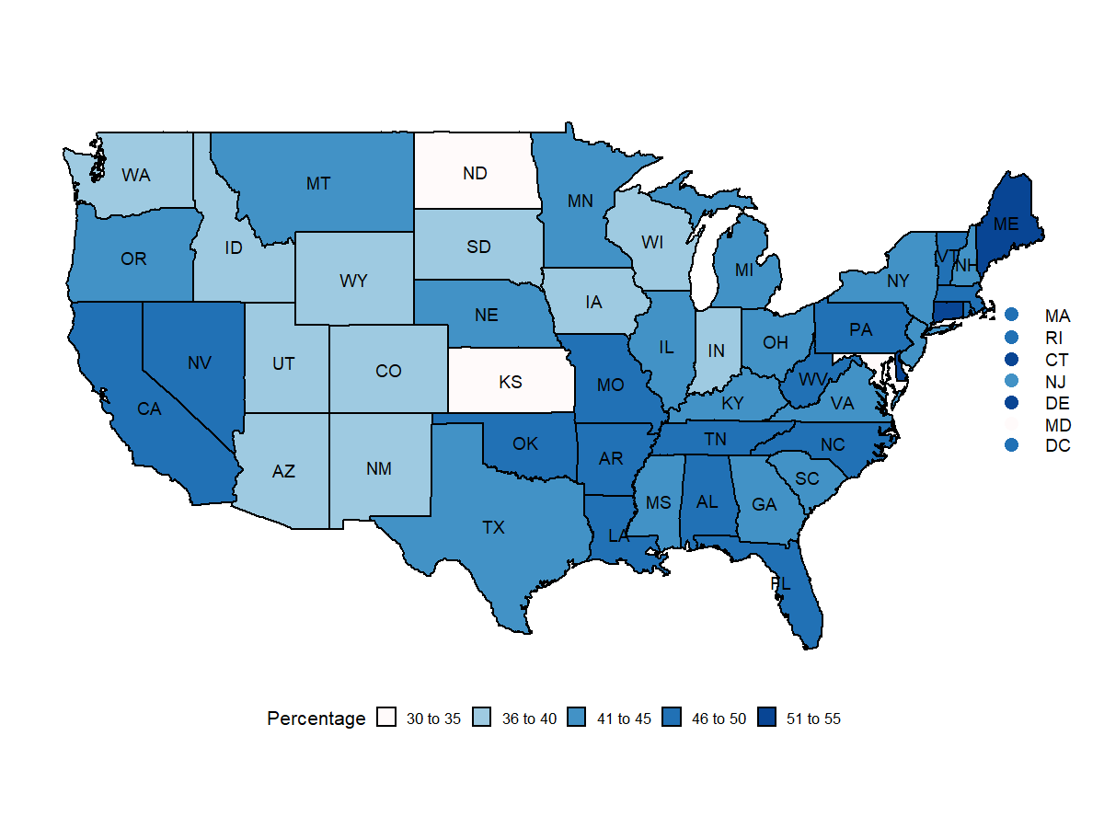
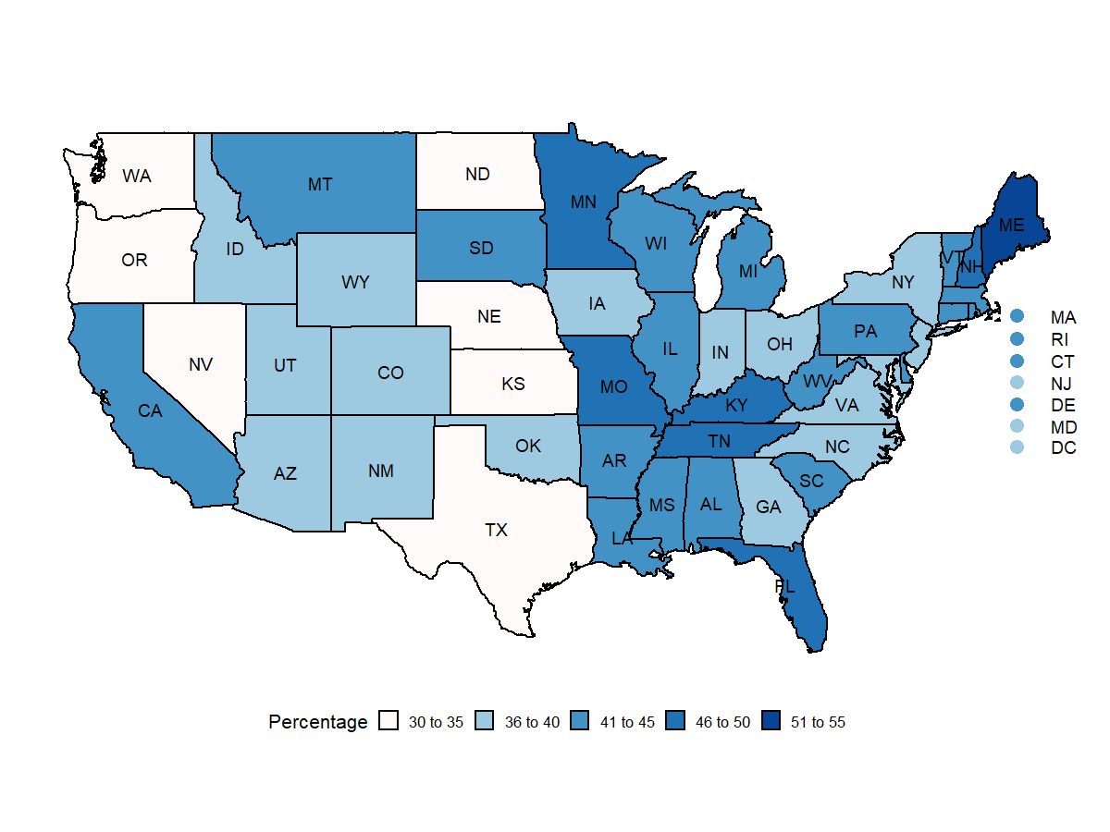
Employment gap between Civilians without and with Disabilities
April 2019 – December 2019
April 2020 – December 2020
Source : Current Population Survey
Notes:
From the first look at the maps, we can infer that the gap seems to have narrowed as we see more white colored states in 2020 than in 2019. One possible (not proven) reason may be that people without disabilities lost jobs at a rate higher than people with disabilities. On following closely, you will observe that yes, the gap has narrowed in states like Washington, California, Oregon, Nevada, Texas and so on. But the gap has also widened in states like New Hampshire, Kentucky, Minnesota and South Dakota. Overall, for United States, the gap seems to have narrowed by almost 2%.

Slide 25
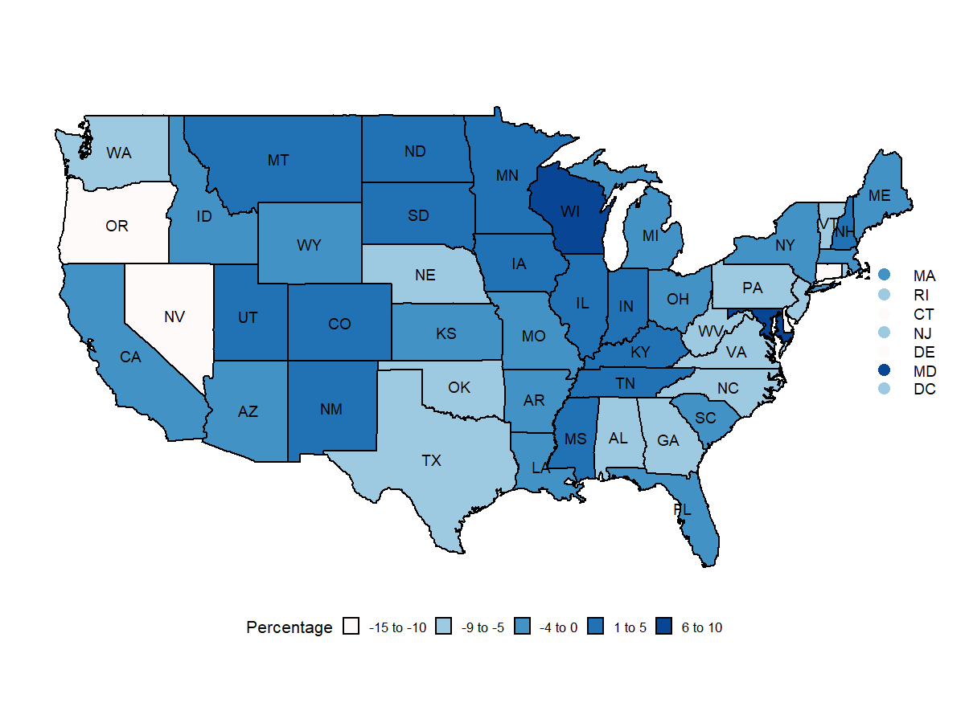
Difference in Difference of Employment Gap between Civilians without and with Disabilities
Notes:
Moving on to our next slide, this slide shows change in gap of employment rate between civilians with and without disabilities i.e., it shows the employment gap between people without disabilities and people with disabilities in 2020 minus the employment gap in 2019. A negative gap means that the gap has narrowed, and a positive number means the gap has widened. The gap seemed to have narrowed in Oregon, Nevada, Connecticut and Delaware by a significant amount. Wisconsin and Maryland seems to stand out in terms of the gap being widened.
States like New Hampshire, Indiana, Illinois seems to have widened as well whereas states the gap in states like New York, Florida and California has narrowed. Why this happened? The answer may lie in the covid response policies of these states and is a potentially interesting research topic.

Slide 26
Contact Information
Andrew Houtenville
Andrew.Houtenville@unh.edu
Shreya Paul
Shreya.Paul@unh.edu
Website:
www.disabilitycompendium.org
Technical Assistance: disability.statistics@unh.edu
866-538-9521

Slide 27
Thank you

Slide 28
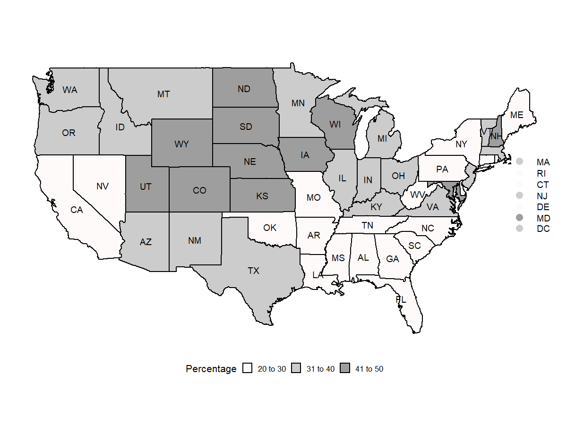
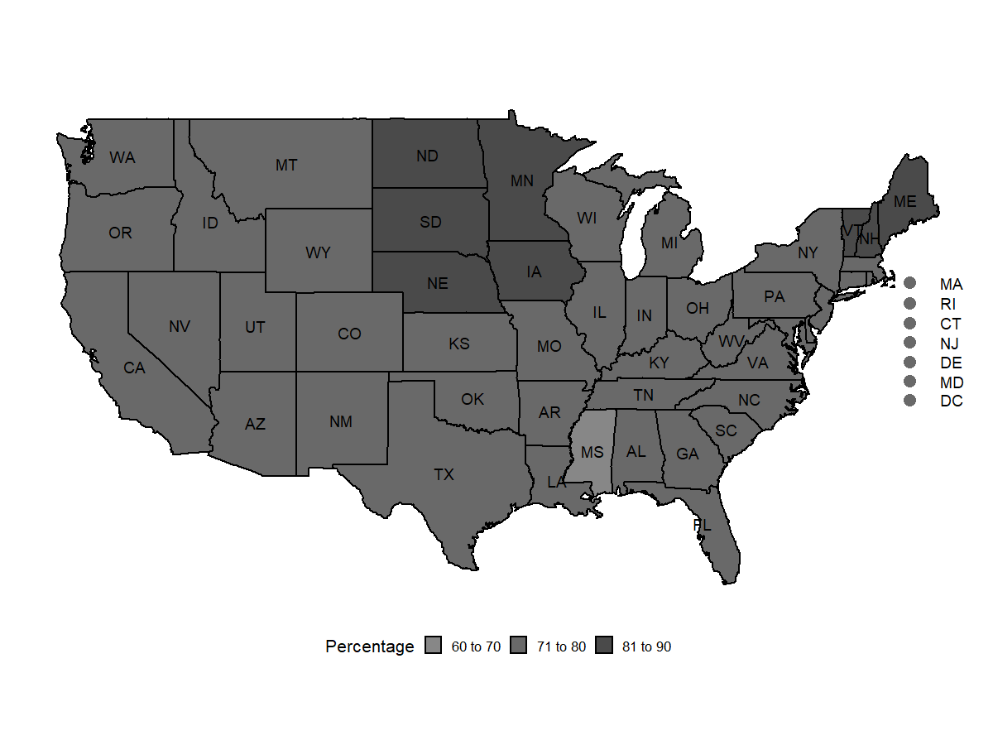
Employment: April 2019 – December 2019
With Disabilities
Without Disabilities
Source : Current Population Survey

Slide 29
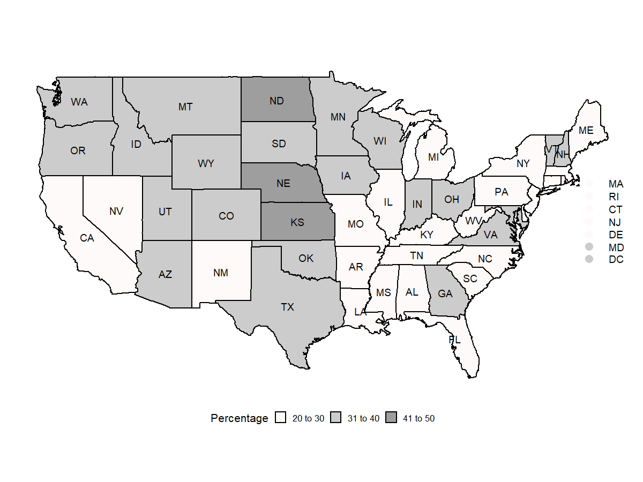
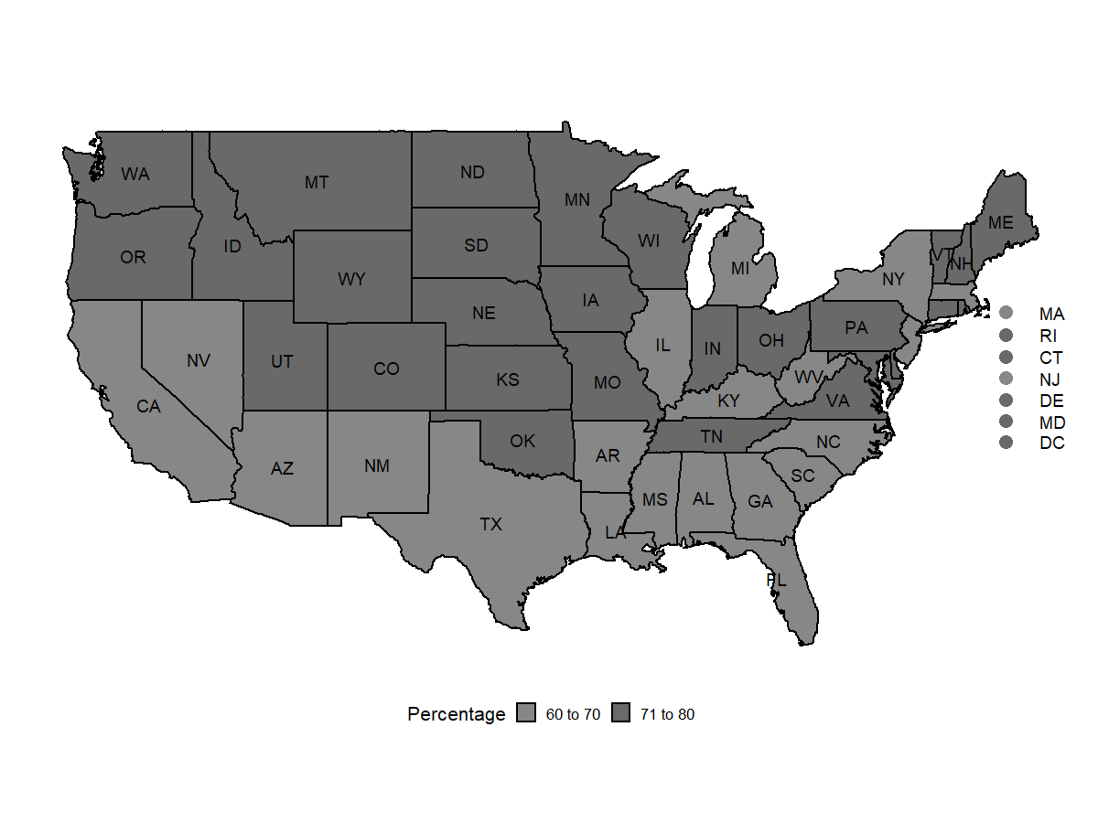
Employment: April 2020 – December 2020
With Disabilities
Without Disabilities
Source : Current Population Survey

Slide 30
April 2019 – December 2019
April 2020 – December 2020
With Disabilities
Without Disabilities
Source : Current Population Survey

