Slide 1
Disability Statistics at NCHS:
An Update
Julie D. Weeks, Ph.D.
National Center for Health Statistics
Annual Compendium of Disability Statistics Release
Capitol Visitor Center, Washington, DC
November 2, 2011

Slide 2
A number of ongoing disability-related activities…
ACA Section 4302 meetings
Health, U.S. content
Healthy People 2020 work groups
Washington Group on Disability Statistics
National Health Interview Survey content
Future directions for measurement and research

Slide 3
ACA Section 4302
2010 Patient Protection and Affordable Care Act:
  Mandates the collection of data on disability status
  Requires a standard disability measure
  Acknowledges disability as a demographic
ACA Disability Subcommittee:
  NCHS member
  Recommended the 6-question ACS measure as the minimum standard
Current status:
  DHHS solicited public comments on draft standards
  10/31/2011: Secretary announced final standards
Notes:
The Affordable Care Act requires new standards for the collection and reporting:
- of health and health care information
- on race, ethnicity, sex, primary language, and of course disability status
- mandates the collection of data on “disability status for applicants, recipients, or participants”
- by “any federally conducted or supported health care or public health program, activity or survey.
Perhaps the most important impact of the ACA will be the expectation that disability be used as a demographic in reporting.
Subcommittees were formed to address each of the reporting areas:
- the disability subcommittee recommended the 6-question ACS measure, however
- important to note that the message was clear from the subcommittee that this measure is a MINIMAL measure.
- acknowledged within committee that while the ACS measure should be used as a starting point,
- additional measures are needed to better identify:
- mental health, speech, learning or developmental limitations
- as well as some neurological limitations, for example traumatic brain injury.
June 30, 2011 – August 1, 2011:
- Federal Register notice published at the end of June 2011,
- with a deadline for comments on the recommended draft standards by August 1, 2011.
Just two days ago:
-the secretary made final those recommended standards.
Other Federal Surveys with ACS:
- Aside from the ACS, the ACS disability measure has now been added to a number of other Federal data collections efforts:
- CPS, NHIS, Crime Victimization Survey
- Also being considered for inclusion in surveys administered by Ded, HUD and DOT.

Slide 4
Health, U.S. and Healthy People
Health, U.S.:
  Historically, used “limitation of activity due to a chronic condition”
  In 2009, moved to Basic Actions Difficulties and Complex Activity Limitation (disability measures consistent with current disability models and legislation)
  Disability used as a demographic in 20+ tables (pain, SRH, alcohol use, no usual source of care, health care visits, insurance, etc.)
HP Change in Operational Definition:
Include in the core of all applicable Healthy People 2020 population data systems a standardized set of questions that identify “people with disabilities.”
  Adopted ACS as the standard measure of disability for 2020 work
  HP Objectives tables have disability as a demographic
  Where possible ACS set used
Notes:
Health, U.S. is NCHS’ annual report to the Secretary on trends in:
- health, health care utilization and financing and many other health statistics.
Those statistics are presented in numerous tables, and where disability has been included in the past:
- the measure has historically been “limitation of activity due to a chronic condition”
In 2009, the move away from this measure occurred:
- to keep up with a changing conceptualization of what we should be measuring wrt disability
- Basic Actions Disability and Complex Activity Limitations measures are now being used instead.
[more on BAD and CAL later]
- as of the 2011 edition, now we have over 20 tables in Health, U.S.
Also occurring at the same time, HealthyPeople (the Department’s 10-year national objectives for improving health)
- was re-vamping it’s measures for disability.
In December 2010, HealthyPeople 2020 was launched with one important change in operational definition:
- to include disability as a demographic in all objectives, and
- to used the ACS measure as that standard.
HP2020 has approximately 95 tables where disability is reported as a demographic.
- where the data collection instrument allows, the ACS set is the measure used.

Slide 5
Washington Group: Purpose
Purpose: The promotion and coordination of international cooperation in the area of health statistics by focusing on disability measures suitable for censuses and national surveys which will provide basic necessary disability information throughout the world.
Measures must be developed within the framework of a model, culturally comparable, and accepted for use across many countries.
Short Set Measure (6 questions):
Adopted in 2006 (Uganda meeting)
Approx 20 countries planning to/using the SS in census
Extended Set Measure (additional functional domains):
Adopted in 2010 (Luxembourg meeting)
Added to 2010 NHIS
Notes:
The fourth major disability-related activity occurring at NCHS is the Washington Group on Disability Statistics.
The Washington Group is a United Nation’s City Group mandated to develop comparable measures for disability.
Participation includes:
- representatives from over 60 countries, National Statistical Offices,
- international organizations and NGOs, as well as some DPOs.
NCHS acts as the secretariat of this international group.
The WG first developed a short set of disability questions – there are 6 –
- that have been tested, adopted by the UN and now are being included in plans for Censuses around the world.
Note similarities to ACS requirements: short, broad measure capturing as many persons at risk for participation restrictions.
Note differences: to follow.
Once the short set was adopted, work commenced on creating a much longer set of questions that countries could use on their health surveys where space and time was less an issue.
This longer set also expanded the measure to include:
a) increasingly complex activities and
b) more domains of functioning.

Slide 6
Possible Domains and Activities
Mobility
  Walking
  Climbing stairs
  Bending or stooping
  Reaching or lifting
  Using hands
Sensory
  Seeing
  Hearing
Communicating
  Understanding
  Speaking
Cognitive functions
  Learning
  Remembering
  Making decisions
  Concentrating
Emotional functioning
  Interpersonal interactions
  Psychological well-being
Other
  Affect
  Pain
  Fatigue
  Self care

Slide 7
WG Disability Short Set
1-5. How much difficulty do you have:
seeing even if wearing glasses?
hearing even if using a hearing aid?
remembering or concentrating?
walking or climbing stairs?
with self-care, such as washing all over or dressing?
6. Because of a physical, mental or health condition, how much difficulty do you have communicating, for example understanding or being understood by others?
a) No, no difficulty c) Yes – a lot of difficulty
b) Yes – some difficulty d) Cannot do at all
Notes:
Here are the questions in the short set.
They are intended to cast a wide net and to be very simple questions– like “how much difficulty do you have seeing even if wearing glasses--- and there are 6 questions for 6 disability domains: vision, hearing, cognition, mobility, self-care and communication.
Note similarities to ACS requirements:
- short, broad measure
- capturing as many persons at risk for participation restrictions.
- domains of functioning:
- same: vision, hearing, cognition, movement, self-care
- diff: WG has communication, ACS has independent living or an IADL measure
“doing errands alone such as doctor office or shopping”
Note differences:
- rather than “do you have serious difficulty”, “how much difficulty”
- rather than “yes/no”, a response set which allows for a range of functional difficulty.

Slide 8
National Health Interview Survey Disability Content
Basic Actions Difficulties
  Movement
  Sensory
  Emotional
  Cognitive
Complex Activity Limitations
  Social and leisure activities
  Perceived ability to work
  Maintaining independence, including self care and HH chores
American Community Survey Set
Washington Group Short Set
Washington Group Extended Set
  Upper body movement
  Learning
  Affect (anxiety & depression)
  Pain
  Fatigue
  Participation & QOL Measures
Notes:
The National Health Interview Survey is, of course, the Department’s longest ongoing, national survey of health.
It also has one of the richest disability-related measures content.
Basic Actions Difficulties represent the primary building blocks of functioning
that are necessary for maintaining independence and
participating in social role activities.
1. Movement difficulties:
Walking
Standing
Bending or kneeling
Reaching overhead
Using hands & fingers
2. Sensory difficulties:
Vision and hearing
3. Emotional difficulties:
In particular, feelings that interfere with accomplishing daily activities
4. Cognitive difficulties:
Specifically, remembering or experiencing confusion
Complex Activity Limitations describe limitations or restrictions in the ability
to participate fully in social role activities such as working or maintaining a household.
1. Social Activity Limitation:
Attending movies or sporting events
Visiting with friends
Pursuing hobbies or engaging in leisure time activities
2. Work Limitation:
Limitation in the kind or amount of work
Inability to work at a job or business
3. Self-Care Limitation:
ADLs (self-care activities)
IADLs (shopping, cooking and taking care of bills)
ACS
Washington Group Short Set
Washington Group Extended Set – which expands the functional domains to include:
1. Upper body
2. Learning
3. Affect
4. Pain
5. Fatigue
The latest experimental content includes measures of participation and quality of life.

Slide 9
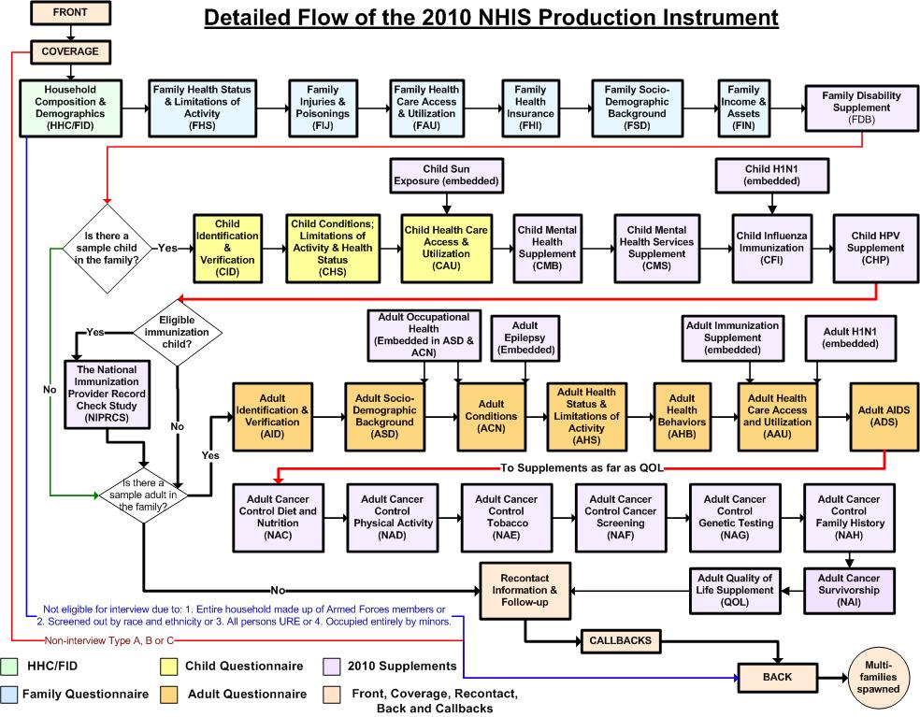

Slide 10
Location of NHIS Disability Questions: ACS and WG
2008 (4th quarter) -2009
  FDB: ACS questions – ½ sample “person” and ½ “family” style
2010
  FDB: ACS questions – “person” style
  QOL: WG questions, plus some quality of life / participation measures
2011
  FDB: ACS questions – “person” style
  CDB: ACS questions
  ADB: ACS questions
  AFD: WG questions, plus some quality of life / participation measures
Notes:
Many of the NHIS disability measures have been part of the survey for quite some time:
Activity and Work Limitation
ADLs
IADLs
Basic Actions Difficulties
Complex Activity Limitations
The ACS and Washington Group content are relatively new.
More importantly, these measures have been added
a) as quickly as possible
b) in a carefully orchestrated manner to allow for specific methodological analysis.

Slide 11
What Are We Learning About
Disability Questions from the NHIS?
2008 (4th quarter) -2009
  FDB: ACS questions – ½ sample “person” and ½ “family” style
  Do disability estimates vary by administration style? How?
  Do NHIS estimates vary from the ACS and CPS? How?
2010
  FDB: ACS questions – “person” style
  QOL: WG questions, plus some quality of life / participation measures
  Do different question sets yield varying estimates of disability? How?
  How does participation vary by disability status?
2011
  FDB: ACS questions – “person” style
  CDB and ADB: ACS questions
  AFD: WG questions , plus some quality of life / participation measures
  How do disability estimates vary when asked in the family section vs. the sample adult/child sections?
  How do extended questions on disability operate in a national survey?

Slide 12
Prevalence of Disability by Survey: 2009
Disability Item | Ages |  | NHIS
 |  | CPS ASEC† (%) | Family- Style (%) | Person-Style (%) | ACS (%)
Vision difficulty | 1+ | 1.7 | 2.1 | 2.4 | 2.2
Hearing difficulty | 1+ | 3.1 | 3.9 | 4.1 | 3.4
Mobility difficulty | 5+ | 6.9 | 6.6 | 7.2 | 6.9
Cognitive difficulty | 5+ | 3.5 | 3.9 | 4.7 | 4.8
Self-care difficulty | 5+ | 2.0 | 1.8 | 2.2 | 2.6
Independent living diff | 15+ | 4.0 | 4.7 | 5.1 | 5.4
Any disability | 1+ | 11.6 | 12.0 | 13.1 | 12.1
†NOTE: CPS data are for population 16 years and over.
Notes:
The first research from the NHIS using the ACS content focused on several questions:
Do disability estimates vary by administration style? How?
Do NHIS estimates vary from the ACS and CPS? How?
Orientation to table:
A. Components of disability corresponding to the 6 questions, and “any” disability (any “yes” across the 6).
B. Surveys across the top -
1. CPS Annual Social and Economic Supplement
2. CPS data are for the 16+ population
Results
A. Any disability
1. NHIS person > ACS / NHIS family > CPS
2. effect of 16+
would increase prevalence in the NHIS and ACS – a greater difference
B. Mode
1. person > family
2. similarity between ACS (person) and NHIS (family)
C. Component parts – mobility and independence higher

Slide 13
* CPS and ACS cover persons 16-64; NHIS covers persons 18-64.
Notes:
From this same paper:

Slide 14
Where Does the ACS Fit In?
Basic Action Measures
31.7%
Source: NCHS, 2010 NHIS, ages 18+
Notes:
Another example of ongoing analyses:
Do different question sets yield varying estimates of disability? How?
In particular, how does the ACS measure compare to the Basic Actions and Complex Activity Limitation measures?
For example,
the BAD measure identifies 31.7% of the population.

Slide 15
Where Does the ACS Fit In?
Basic Action Measures
31.7%
Complex Activity
Limitation
15.3%
10.8% Non-Overlap
Source: NCHS, 2010 NHIS, ages 18+
Notes:
Whereas, CAL identifies 15.3% of the population.
One would expect this given that CAL are a much more severe measure of disability.
Yet, almost 11% of the population has a CAL and is not identified by the BAD measure.
Finding out who these people are is part of the ongoing research agenda.
Measurement error, of course, may be part of the answer.
However, we expect that the difference is due to functional difficulties people have
that ARE NOT captured by the basic Actions measures
such as learning, communications and some of the very domains of functioning that the WG extended set captures.

Slide 16
Where Does the ACS Fit In?
ACS Questions
19.7%
Basic Action Measures
31.7%
Complex Activity Limitation
15.3%
9.0% Non-Overlap
10.8% Non-Overlap
Source: NCHS, 2010 NHIS, ages 18+
Notes:
How do the ACS questions fit in with BAD and CAL?
The measure captures fewer people than Basic Actions (as expected)
but more people than the CAL measure (also as one would expect)
An additional 9% of the population has at least one ACS difficulty, but does not report a BAD or CAL.

Slide 17
Relationship of ACS to Basic Action and Complex Activity Measures
Source: NCHS, 2010 NHIS Sample Adult File, Ages 18+
Notes:
Of course, there is a great deal of interest in the kinds of functioning problems picked up by the ACS measure.
Moreover, who is not identified by the measure is equally important.

Slide 18
Next Steps in Disability Measurement
Incorporating disability measures in more national surveys.
Which standard should be adopted – ACS or WG?
Adding other functioning domains that are not currently included, for example learning and mental health.
Development of measures of participation (other than work).
Development of measures of the environment.
Conduct longitudinal surveys.
Conduct disability supplements on single-policy issues.

Slide 20
Thank you!
Questions?

Slide 21
The ACS Disability Measures
For sample persons 1 year of age and older:
1. Is this person deaf or does he/she have serious difficulty hearing?
2. Is this person blind or does he/she have serious difficulty seeing?
For sample persons 5 years of age and older:
3. Because of a physical, mental, or emotional condition, does this person have serious difficulty concentrating, remembering or making decisions?
4. Does this person have serious difficulty walking or climbing stairs?
5. Does this person have difficulty dressing or bathing?
For sample persons 15 years of age and older:
6. Because of a physical, mental, or emotional condition, does this person have difficulty doing errands alone such as visiting a doctor’s office or shopping?
Response Categories: 1. Yes 2. No

Slide 22
Equalization of Opportunities
Seeks to identify all those at greater risk than the general population for limitations in participation.
Disability used as a demographic.
Employed (%)

