Slide 1
2017 Annual Disability Statistics Compendium
Eric A. Lauer
University of New Hampshire
February 13, 2018

Slide 2
2017 Annual Disability Statistics Compendium
Eric A. Lauer
University of New Hampshire
February 13, 2018
2

Slide 3
Purpose of Today’s Presentations
Describe the purpose of the Compendium
Introduce new accessible html version of the Compendium
Discuss our upcoming State-Specific Reports that include county-level data
How to access the Compendium and technical assistance
3

Slide 4
Background
What is the Compendium?
Compilation of statistics on the people with disabilities
Why do we care?
Disability statistics are often difficult to find and scattered across multiple agencies and websites
Compendium Design
Comprehensive, accessible, and a guide to what’s readily available
4

Slide 5
Data Sources
American Community Survey (ACS)
Current Population Survey (CPS)
Basic Monthly Survey
Annual Social and Economic Supplement (ASEC)
Behavioral Risk Factor Surveillance Survey (BRFSS)
Social Security Administration (SSA) reports
Office of Special Education Programs (OSEP) sponsored reports
Rehabilitation Services Administration (RSA) reports
And more …
5

Slide 6
Topics Covered
Population Size, Prevalence, and Disability Type
Demographic Characteristics
Health, Health Insurance, Risky Behavior
Employment, Earnings, and Poverty
Social Security Disability Insurance (SSDI) and Supplemental Security Income (SSI)
Medicaid and Medicare
Special Education Services and Outcomes
And more …
6

Slide 7
What’s New This Year?
Improved accessibility: HTML
Compendium and Compendium Supplement on website
Available for download
State-Specific Reports
County-level statistics
Tables similar to the Compendium
County-level maps
Interpretive text
Mean, median, and range of estimates across counties
Accessible HTML version available
7
Notes:
Reference Sue Fox and Aging projects coming next.

Slide 8
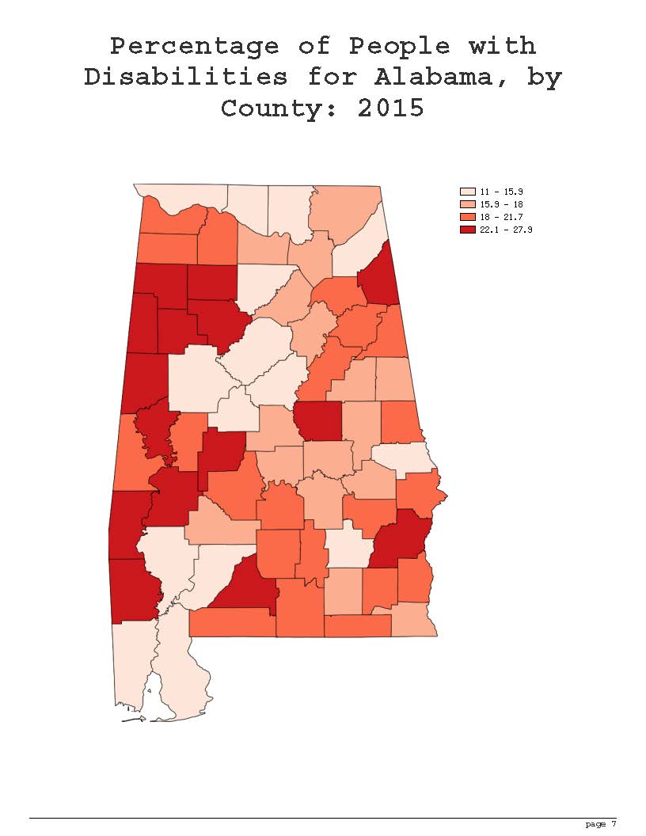
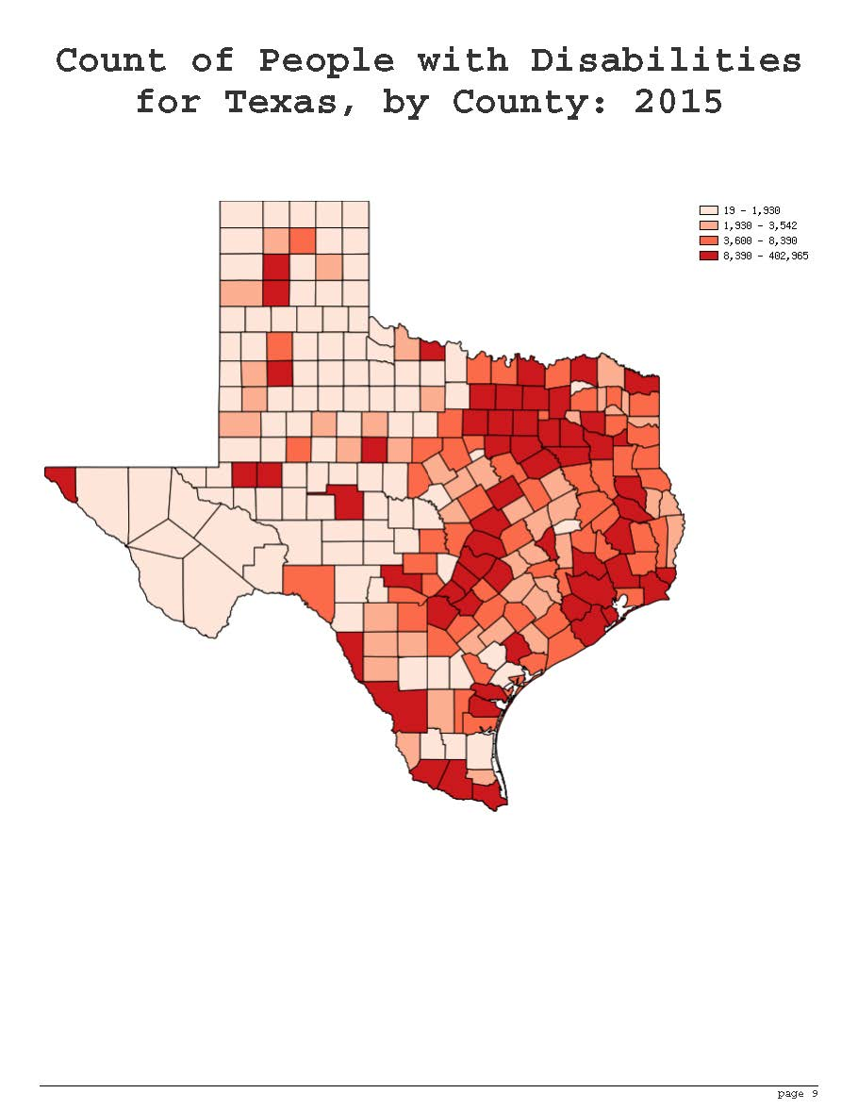
What’s New This Year?
8
Notes:
Reference Sue Fox and Aging projects coming next.

Slide 9
Future Plans
Expand State-Specific Report, by topics
Produce
Produce zzz zzzz
Such as
[Sorry, redacted text will appear in our forthcoming grant proposal.]
9
Notes:
Reference Sue Fox and Aging projects coming next.

Slide 10
Contact Information
Institute on Disability
University of New Hampshire
10 West Edge Drive, Suite 101
Durham, NH 03824
Eric A. Lauer
(603) 862-4829
Eric.Lauer@unh.edu
10

